Slide 1

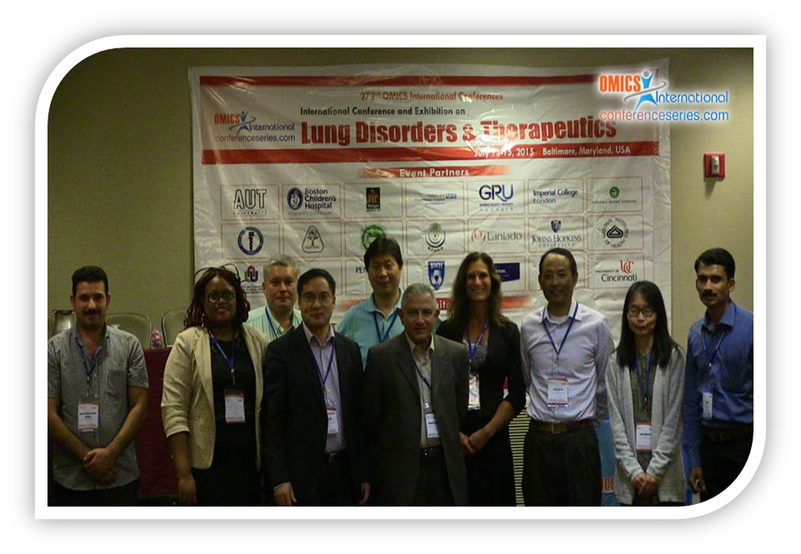
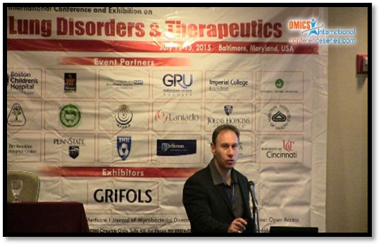
Lung-2015
Baltimore, USA
July 13 - 15, 2015
Du Toit Loots

Slide 2
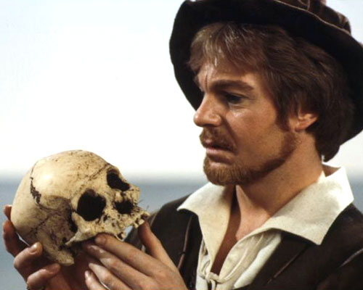
William Shakespeare – Hamlet (1623)
"To be, or not to be, that is the question—
Whether 'tis Nobler in the mind to suffer
The Slings and Arrows of outrageous Fortune,
Or to take Arms against a Sea of troubles,
And by opposing end them? To die, to sleep—
No more; and by a sleep, to say we end…."
In the speech, a despondent or feigning Prince Hamlet contemplates death and suicide. He bemoans the pains and unfairness of life but acknowledges the alternative might be still worse.

Slide 3
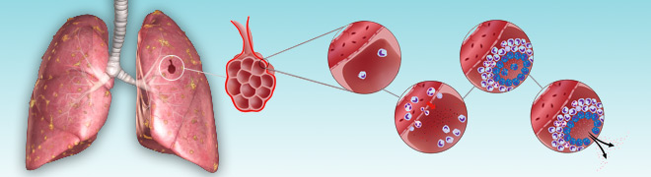
"TB or not TB"
That is the question -
Understanding and Diagnosing
TB using Metabolomics
Prof Du Toit Loots
Infectious Disease Metabolomics Laboratory, North-West University - Human Metabolomics, Potchefstroom, 2520, South Africa.
Email: dutoit.loots@nwu.ac.za

Slide 4
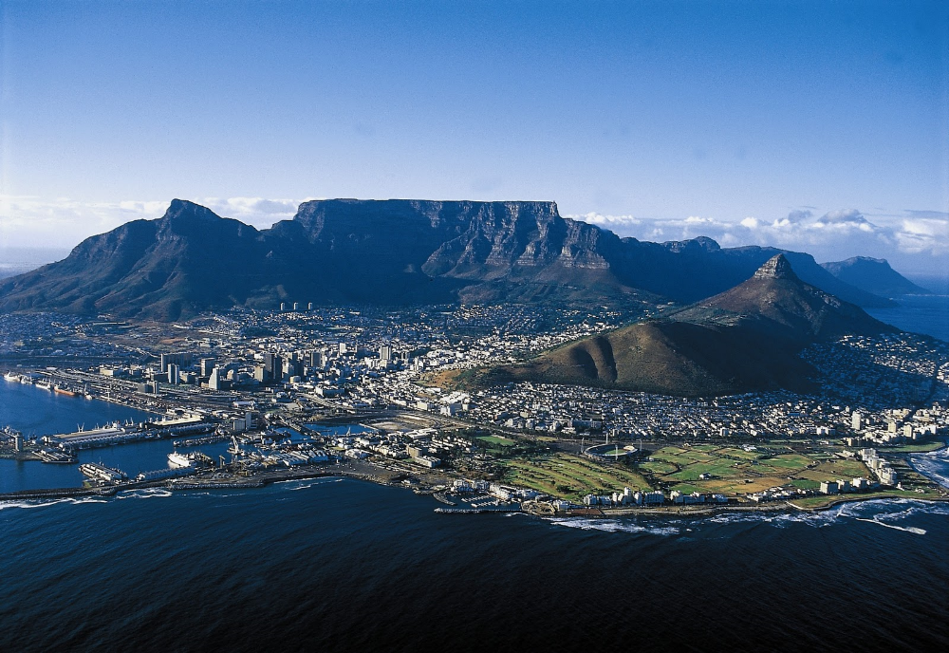


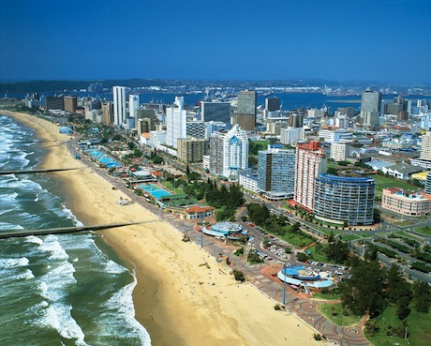
South Africa

Slide 5
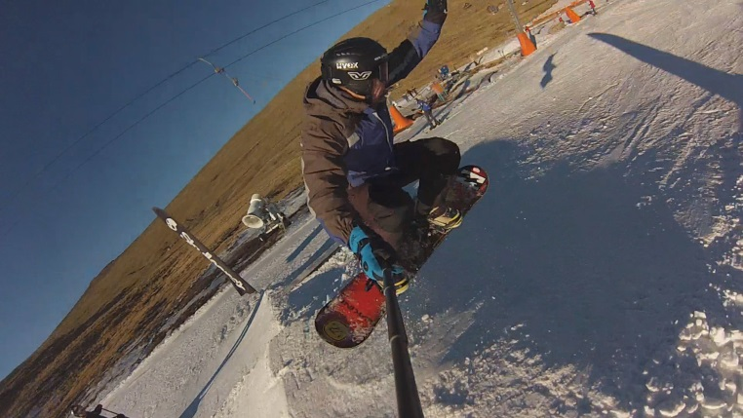

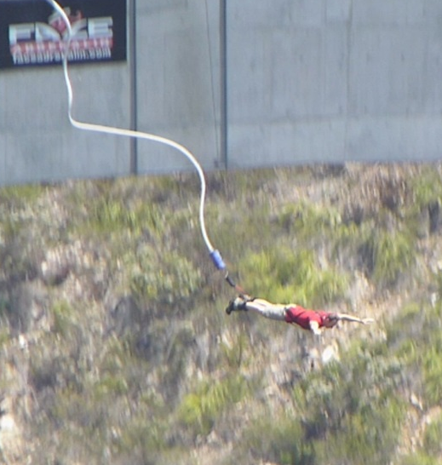

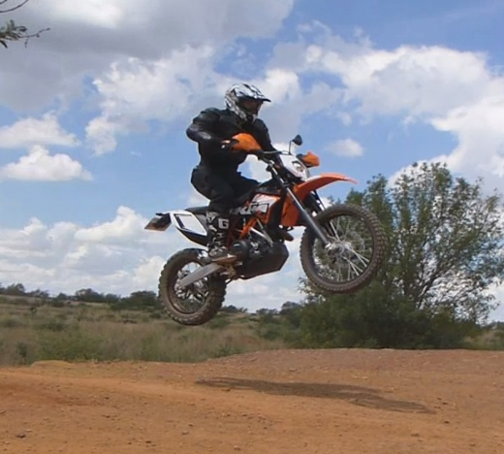
South Africa

Slide 6
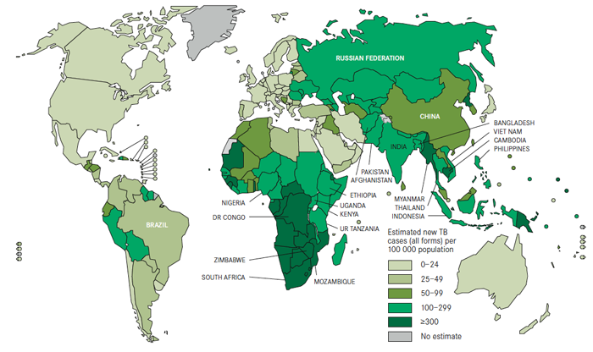
Global TB prevalence

Slide 7
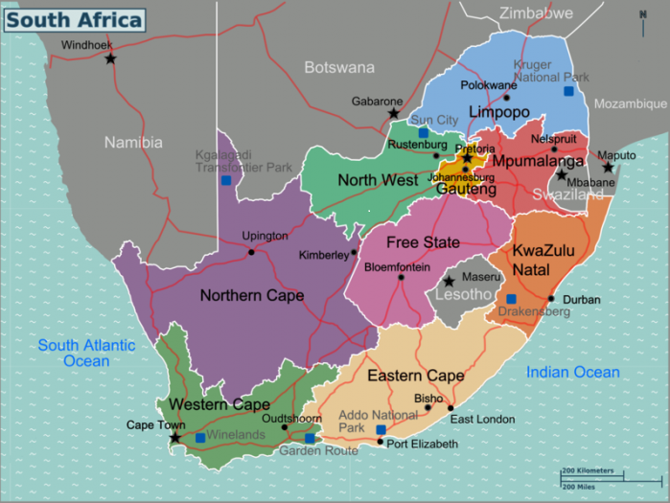
NWU-Human Metabolomics
Potchefstroom

Slide 8
Tuberculosis: Shocking Statistics
Infectious disease of primarily lungs – M. tuberculosis
2nd most deadliest infectious disease (after HIV)
⅓ of global population infected
9 million new cases per year
1,4 million deaths per year of which 25% are HIV co-infected
MDR-TB, XDR-TB is on the rise in many countries
Despite fervent research efforts since it's discovery in 1882 – TB is still considered a global epidemic
Major reasons – insufficient diagnostic methods
New approaches for biomarker ID = Metabolomics?

Slide 9


Metabo-WHAT-ics????
?
?
?
?
?
?
?

Slide 10
Metabolomics
Unbiased, identification and quantification of ALL intra- and extra-cellular metabolites (small molecule intermediates and products of metabolism) present in a biological system/sample (cell, body fluid, tissue, organism), using highly selective and sensitive analytical methods (such as liquid/gas chromatography and mass spectrometry), in conjunction with bioinformatics for identifying new metabolite markers, at a specific point in time and under certain conditions.
Uses: Identifying compounds / markers of a perturbation

Slide 11
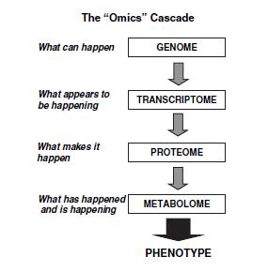
Systems Biology
DNA
RNA
Systems / Integrative
Biology
Proteins
Metabolites

Slide 12
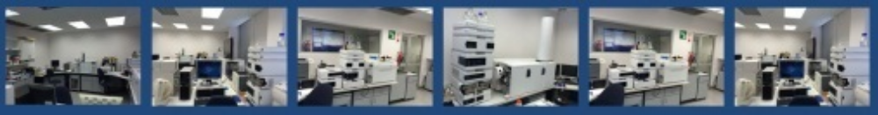
NWU-Human Metabolomics
GC-MS:
Agilent GC-MSD
Agilent GC-QQQ
Leco Pegasus 4D GCxGC-TOFMS
Leco GC-TOFMS
CE:
Agilent CE
NMR:
Bruker 500Mhz
LC-MS:
Agilent 6410 LC-QQQ
Agilent 6460 LC-QQQ
Agilent 6220 LC-TOF
Agilent 6510 LC-QTOF
Agilent LC-MSD XCT Plus IonTrap
Agilent LC-UV(DAD)
Synapt G2 SI UPLC QTOF Plus Ion Mobility

Slide 13
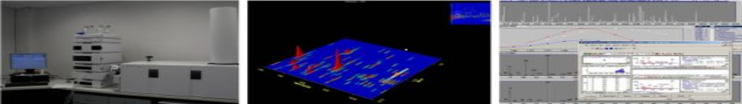
Untargeted and Semi-targeted metabolomics
Untargeted:
GCxGC-TOFMS
UPLC-TOFMS Ion Mobility
NMR
Samples
Blood
Urine
Tissue
Sputum
Cell Cultures
Plant
Skin Secretions (Frogs)
CSF
Etc…
Semi-Targeted GC-MS/LC-MS:
Free Fatty Acids
Long Chain Fatty Acids
Organic Acids
Acylcarnitines
Amino Acids

Slide 14
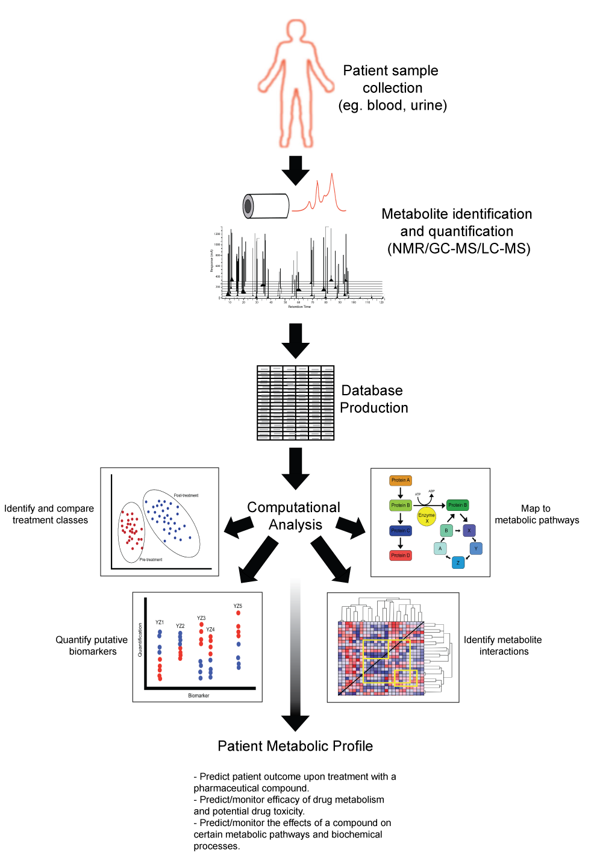
Metabolomics workflow
Metabolite Markers

Slide 15
Our Journey
1) TB Characterization:
  J.C. Schoeman & Du T. Loots. (2011). Improved disease characterization and diagnostics using metabolomics: A review. J Cell Tissue Research, 11(1): 2673-2683.
2) TB Diagnostics:
  I. Olivier & Du T. Loots. (2011). An overview of tuberculosis treatments and diagnostics. What role could metabolomics play? J Cell Tissue Research, 11(1): 2655-2671.

Slide 16
Metabolomics Methodology:
Total Lipid Extraction Method
"Total Metabolome Extraction Method"
Olivier & Loots. (2012). African Journal of Microbiology Research
Du Preez & Loots. (2013). African Journal of Microbiology Research

Slide 17
Applications of Methodologies
Cell Cultures
1) Total Lipid Extraction Method
2) Total Metabolome Extraction Method
Applications?
a) Diagnostics
Olivier & Loots. (2012). Journal of Microbiological Methods
Patent: PCT/IB2012051995
b) Drug Resistance
Rif: Olivier & Loots. (2012). Omics.
a) Virulence
Meissner-Roloff et al. (2012). Metabolomics (hyper vs hypo)
Swanepoel et al. (2013). Metabolomics (ESX-1)
b) Growth
Loots et al. (2013). Metabolomics (ESX-3)
Loots et al., submitted, Metabolomics (Iron)
c) Drug Resistance
INH: Loots 2014. Antimicrobial Agents and Chemotherapy
b) Diagnostics
Patient sputum samples

Slide 18
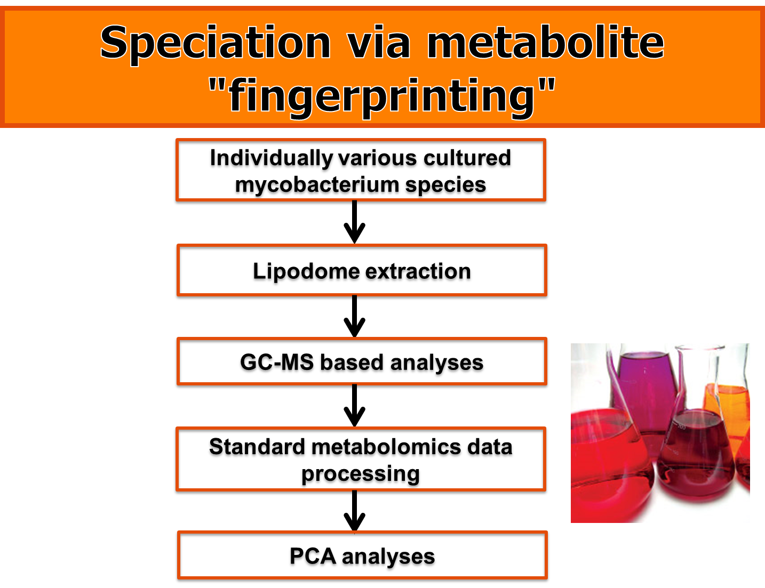
Metabolomics for TB Diagnostics

Slide 19
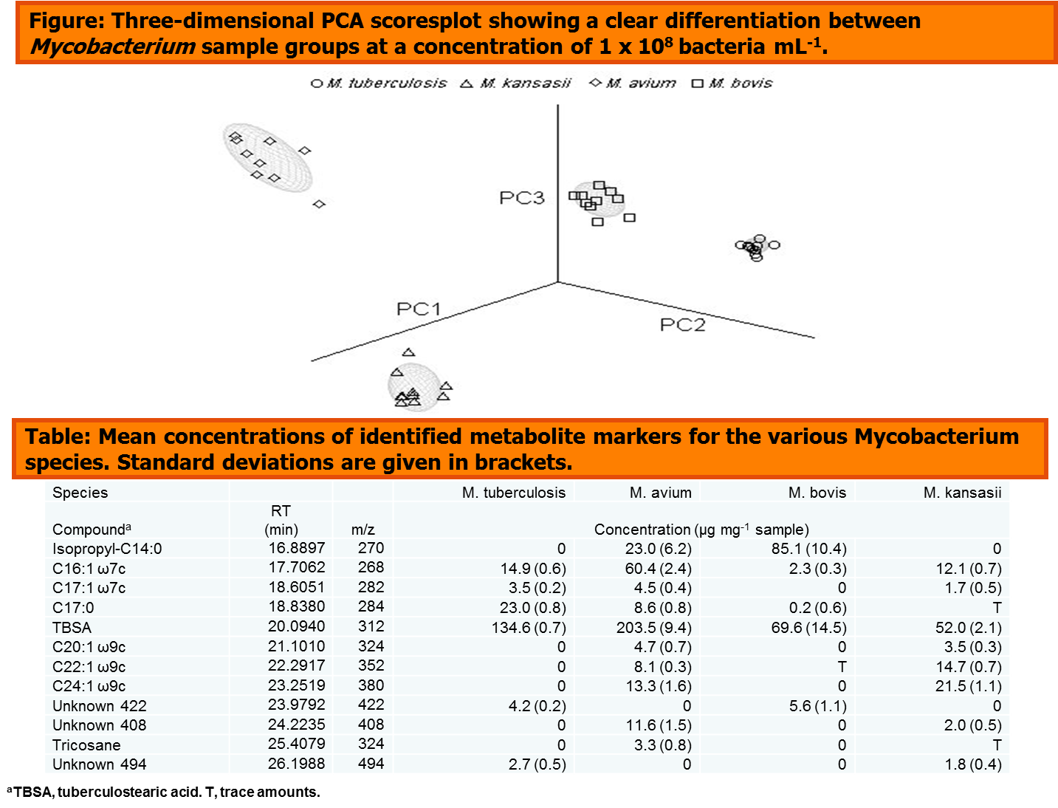
Speciation

Slide 20
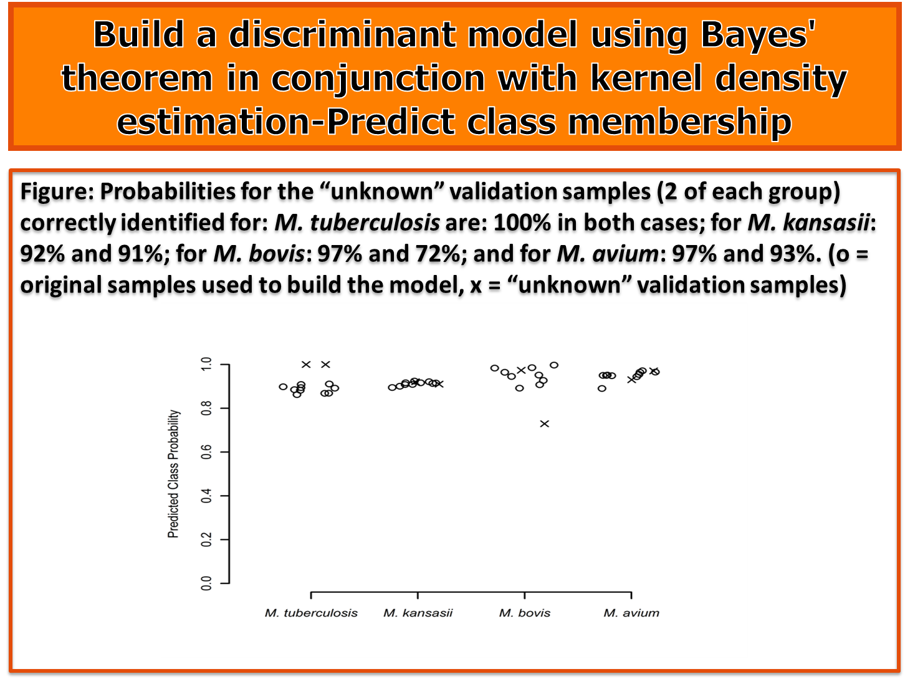
Diagnostics - Speciation

Slide 21
TB or not TB - Sputum
Characteristics of Sputum:
Mucus in lower airways of individuals suffering from pulmonary diseases
Populated by M. tuberculosis in pulmonary TB patients
High viscosity and uneven consistency
Problematic regarding repeatability esp. when chromatographic MS methods are used
4 sputum preparation methods were investigated:
Pooled TB-negative sample: 50% used as is (TB negative)
50% spiked with M. tuberculosis (TB positive)
Sputolysin - 1:1 v/v
N-Acetyl-L-cysteine + NaOH (0.5N NALC + 20% NaOH) - 1:1 v/v
1M NaOH - 2:1 v/v
Ethanol homogenization (40% EtOH) - 2:1 v/v

Slide 22
Homogenization
Total Metabolome Extraction Procedure
(Olivier & Loots. 2012)
GCxGC-TOFMS Analysis
Standard Metabolomics Data Processing
ChromaTOF Statistical Compare
50% filter, QC Correction, QC-CV filter

Slide 23
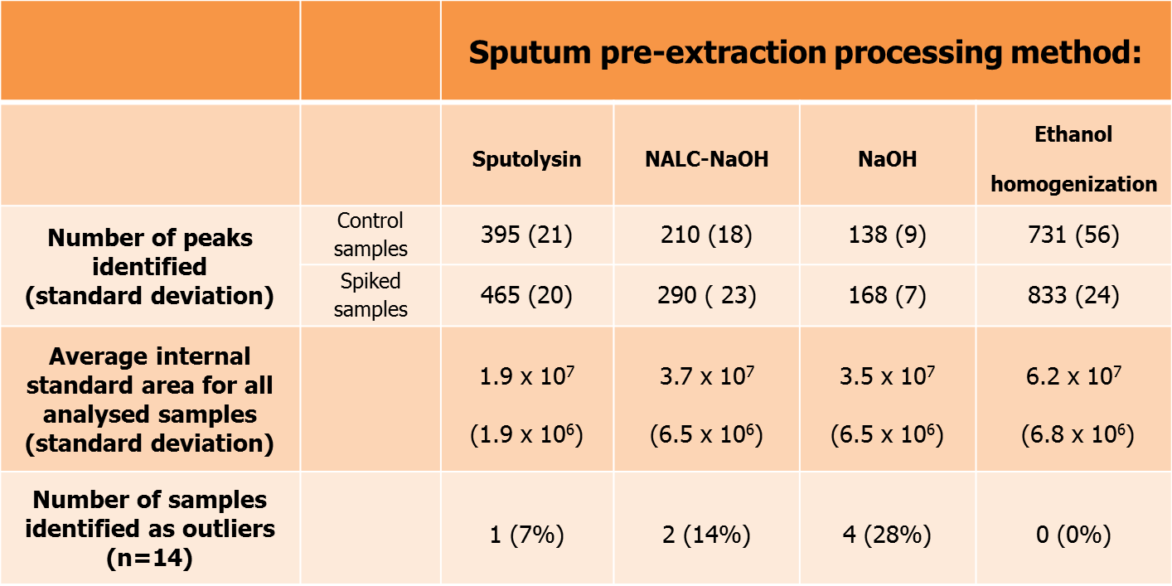
Extraction Efficiency

Slide 24


Slide 26


Slide 27
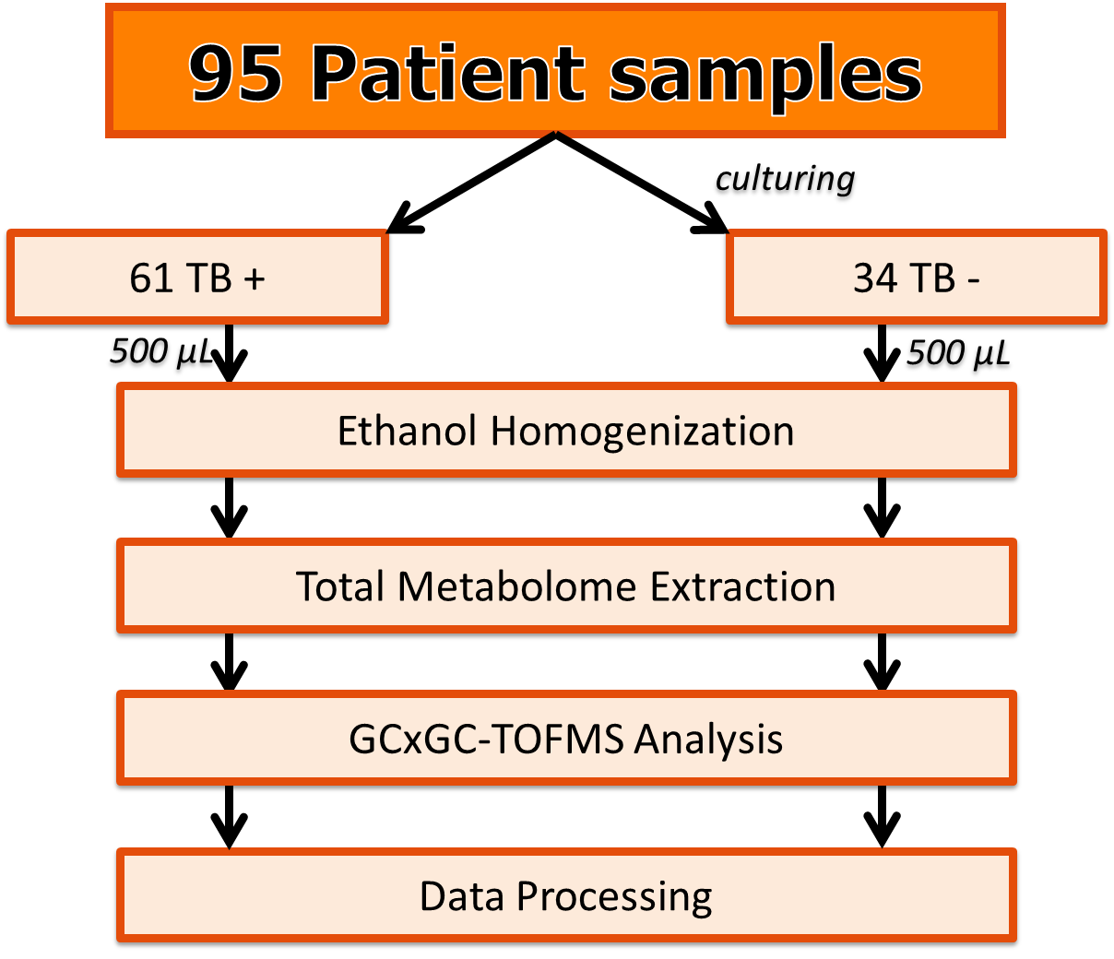
Applied to Patient Sputum

Slide 28
Data Processing
Deconvolution (ChromaTOF)
Peak Alignment (Statistical Compare)
2037 compound peaks identified
Standard Metabolomics Data Clean-up
50% filter, QC Correction, QC-CV filter
498 Compounds after Data Clean-up
PCA Analysis

Slide 29

PCA Analysis
Venn-diagram
PLS-DA > 1.0
80
ES
>0.3
PCA
>0.1
41
22
53
38
t-test < 0.05
Data set comprising of only the 498 selected compounds after data clean-up
3 Unique markers:
98% Specificity and 100% Sensitivity compared to culture (Gold Standard)

Slide 30
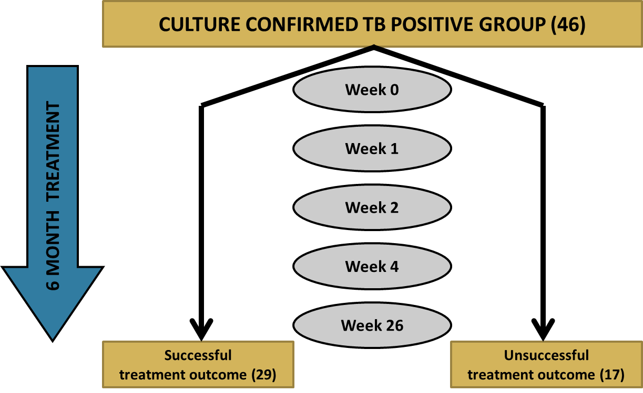
Urine:
Predicting Treatment Outcome

Slide 31
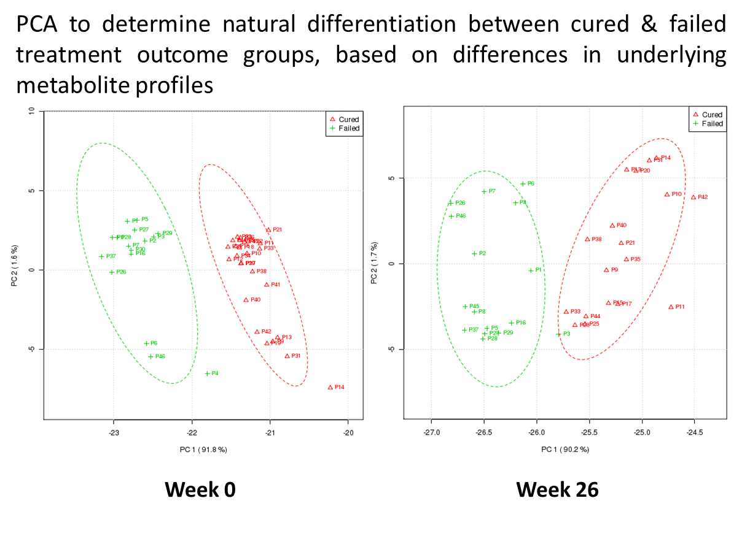
Urine:
Predicting Treatment Outcome

Slide 32

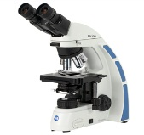

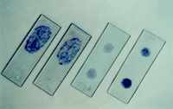
TB Diagnostics
Future with metabolomics
Current
Symptomatic Patient
TB or not TB?
3 Markers sputum
-98% sensitivity
-100% specificity
-1 Hour turnaround time
-Inexpensive after infrastructure purchased
Culturing (2-8 weeks)
Smear microscopy
-Poor detection limit-10 000 cells/ml
Gene amplification
-Poor sensitivity, false positives, expensive
Point of care
Nanotechnology
Drug Resistance
Metabolomics Drug Resistance Markers?
Culturing (8-16 weeks)
Gene amplification
Speciation
Patent: PCI/IB 2012051995
Gene amplification
Predicting Treatment Outcome /Treatment Monitoring
Differentiate Cured vs Failed at time of Diagnosis – Predict Response to Frist Line Medication
Culturing (2-16 weeks)
Gene amplification
Smear microscopy
PCA plot: Treatment response-Cured vs Failed

Slide 33
Metabolomics Contact:
Email: dutoit.loots@nwu.ac.za

Slide 34

Meet the eminent gathering once again at
Lung & Respiratory Care -2016
Manchester, UK
August 01 - 03, 2016
Lung & Respiratory Care – 2016 Website: lung.conferenceseries.com

