Slide 1
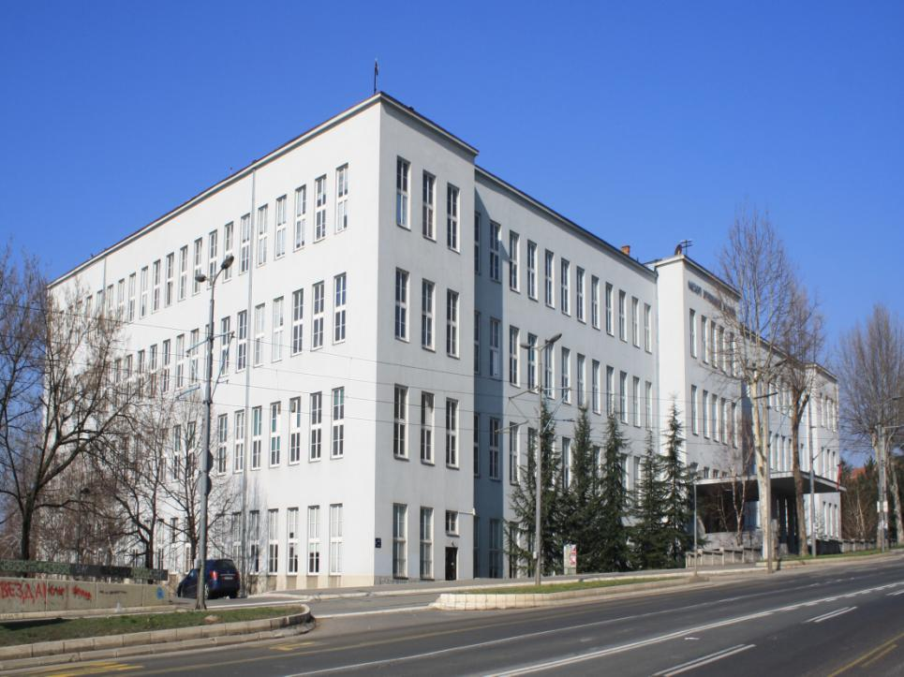
THE EFFECTS OF PROBIOTIC SUPPLEMENTATION IN WEANED PIGS DIET
FACULTY OF VETERINARY MEDICINE, BELGRADE UNIVERSITY
Dragan Šefer, Stamen Radulović, Radmila Marković, Dobrila Jakić-Dimić

Slide 2
affect gut microflora by altering metabolism of the microrganisms
subtherapeutic levels of antibiotics have been in use for
over fifty years!!
ANTIBIOTICS
suppress microbial growth in the gut
better growth production results
However...

Slide 3

negative effects on animals health and production
residua in tissues and long withdrawal period
ANTIBIOTICS
development of resistance in miocroorganisms
allergies and genotoxicity

Slide 4


European Parliament and Council Regulation
(EC, No 1831/2003)
from 22. septembar 2003
Antibiotics can be used as a feed addittives only before 31. december of 2005
Great interest for development of new alternatives that would help in manipulation of gastrointestinal microflora in livestock

Slide 5

EUBIOSIS
PROBIOTICS
living microorganmisms which induce beneficial effects in animal organism
Aggregation to pathogenic bacteria
Competation at adherence site
Nutritive competition between microorganisms
Bactericide effects
Prevention of Coliform bacteria and other bacteria from attaching to the intestinal wall

Slide 6
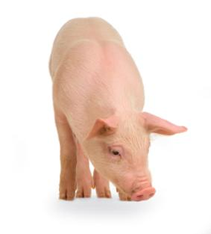
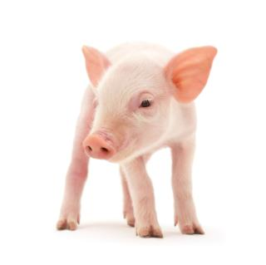
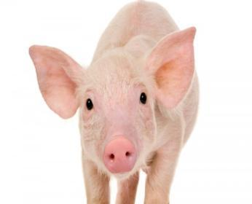
FEEDING TRIAL
The experiment included 24 pigs (Landrace x Yorkshire)
Commercial conditions of rearing
Weaned at age of 35 days
Distributed randomly in two feeding treatments
The experiment lasted 40 days

Slide 7
Animals were fed with identical commercial complete corn - soybean based diets with a standard chemical composition
 | C | E-I
Corn | 53 | 53
Soybean meal | 18 | 18
Soybean grit | 19 | 19
Premix | 10 | 10
Growth stimulator | - | +
Raw composition of diets up to BW 15 kg (%)

Slide 8
 | C | E-I
Corn | 60 | 60
Soybean meal | 15 | 15
Soybean grit | 15 | 15
Premix | 10 | 10
Growth stimulator | - | +
Raw composition of diets for BW 15 – 25 kg (%)

Slide 9
GROWTH STIMULATOR | GROUP
 | C | E-I
PROBIOTIC | - | 0,4 kg/t
Probiotic is comercial product comprised of a mixture of spray-dried spore-forming B. subtilis and B. licheniformis (3.2 × 10⁹ viable spores/g)

Slide 10
The chemical composition of the diet for pigs up to 15 kg, [%]
 | C | E-I
Water | 11,21 | 11,20
Ash | 3,24 | 3,30
Protein | 20,94 | 20,90
Fat | 6,20 | 6,15
Cellulose | 3,58 | 3,55
Starch | 54,83 | 54,90
Ca | 0,95 | 0,94
P | 0,68 | 0,66
ME, MJ/kg | 14,35 | 14,32
Lysine | 1,44 | 1,44
Methionine+cystine | 0,72 | 0,72
Tryptophan | 0,31 | 0,31

Slide 11
The chemical composition of the diet for pigs 15 - 25 kg, [%]
 | C | E-I
Water | 11,50 | 11,42
Ash | 2,92 | 2,94
Protein | 18,66 | 18,60
Fat | 5,73 | 5,70
Celullose | 3,43 | 3,40
Starch | 57,76 | 57,94
Ca | 0,90 | 0,89
P | 0,66 | 0,64
ME, MJ/kg | 14,21 | 14,18
Lysine | 1,27 | 1,27
Methionine+cystine | 0,64 | 0,64
Tryptophan | 0,28 | 0,28

Slide 12

GROWTH PRODUCTION RESULTS
Body weight* of pigs during the experiment, [kg]
Days of the experiment | C | E-I
1. | 8,53±2,20 | 8,54±1,51
20. | 13,20±4,04 | 13,94±2,93
40. | 25,32±6,31 | 27,98±4,76
*The value is expressed as ±Sd

Slide 13
10,51% more
The average body weight of pigs during experiment, (kg)

Slide 14
GROWTH PRODUCTION RESULTS
Average daily gain of pigs during experiment, [kg]
Period of experiment | C | E-I
1-20. | 0,23±0,15 | 0,27±0,10
20-40. | 0,61±0,13 | 0,70±0,13
1-40. | 0,42±0,12 | 0,49±0,09
*The value is expressed as ±Sd

Slide 15
16,67% more
The average daily body weight gain during the experiment, kg

Slide 16
GROWTH PRODUCTION RESULTS
Average daily feed consumption, [kg]
Period of experiment | C | E-I
1-20. | 0,49 | 0,53
20-40. | 1,29 | 1,38
1-40. | 0,89 | 0,96

Slide 17
7,86% more
Average daily feed consumption during experiment, (kg)

Slide 18
GROWTH PRODUCTION RESULTS
Feed to gain ratio during experiment
Period of experiment | C | E-I
1-20. | 2,130 | 1,963
20-40. | 2,115 | 1,971
1-40. | 2,119 | 1,959

Slide 19
7,55 % lower
Feed to gain ratio during experiment

Slide 20
MORPHOMETRIC ANALYZES
Morphometric characteristics * of jejunum (µm)
OBSERVED PARAMETER | C | E-I
Villi length | 498,1±112,5 ^{C} | 732,7±117,3 ^{C}
Villi width | 66,5±18,70 ^{C} | 84,23±17,76 ^{C}
Crypt depth | 166,8±55,26 | 159,9±60,04
*The value is expressed as ±Sd
^{C} p<0,001

Slide 21
Length of the villi in the tested segment of jejunum

Slide 22
The width of the villi in the tested segment of jejunum

Slide 23
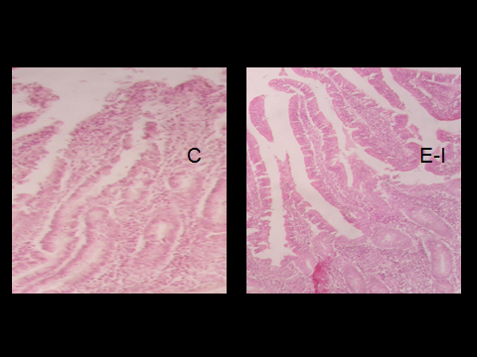

Slide 24
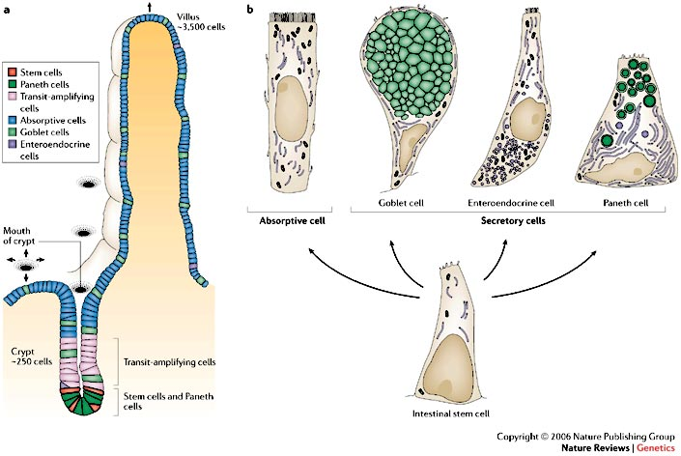

Slide 25

Obtained results indicate that the use of probiotic as alternative growth promoter has nutritive, medical and economic advantages

Slide 26

THANK YOU
FOR YOUR ATTENTION

Slide 27


DEPARTMANT OF
NUTRITION
AND BOTANY
FACULTY OF
VETERINARY MEDICINE
BELGRADE UNIVERSITY

