Slide 1
Stress Testing in Women
Todd D. Miller, M.D.
Mayo Clinic
Rochester, MN
E-mail: miller.todd@mayo.edu
Disclosures: None

Slide 2
Purposes of Stress Testing
Diagnosis (probability) CAD
Prognosis (risk stratification)
Other

Slide 3
Factors Affecting Diagnostic Accuracy Exercise ECG
TN
Prevalence CAD in population (Sp = )
Exercise performance
Resting ECG
Medications
Gender specific
  Hormone status (digoxin)
  Abnormal coronary tone
  Microvascular disease
TN + FP

Slide 4
MI/CD By Age and Sex
ARIC and CHS
New and Recurrent MI or Fatal CHD per 1,000
Age (Years)
Mozaffarian D. Circulation 2015;131:e29-e322

Slide 5
Effect Hormone Therapy Exercise ECG
Percentage
*
Bokhari S. JACC 2002;40:1092

Slide 6
Meta-Analysis Exercise ECG
%
Gianrossi R. Circ 1989;80:87
Kwok Y. AJC 1999;83:660

Slide 7
Verification Bias
No cath
735
(–) Test
750
1,000 pt
Cath
15
Cath
125
(+) Test
250
No
cath
125
TP
TP
TN
Se =
TN
Se =
Sp =
TP
Sp =
FP
TP + FN
TN + FP
+ FN
TN +
Begg CB and Greenes RA: Biometrics 39:207, 1983
Diamond GA: AJC 5:1175, 1986
Notes:
DV Revised 8-29-2005

Slide 8
Exercise ECG
MPI Reference Standard
%
Miller TD. AJC 2001;87:868

Slide 9
Impact of Verification Bias – Women
Apparent
Sensitivity
Specificity
Adjusted
100
80
60
%
40
20
0
Roger VL. Circ 1997;95:405
Miller TD. AJM 2002;112:290

Slide 10
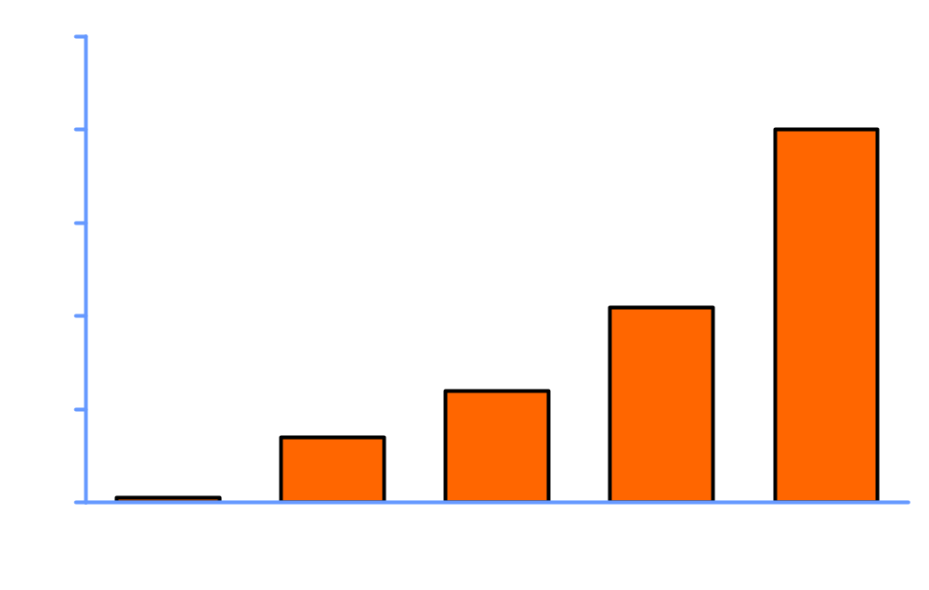
CAD Prognostic Index
Annual
mortality
(%)
Califf RM: JACC 27:964, 1996

Slide 11
Prognostic Value Exercise Capacity
St. James WTH Project
Hazards Ratio of Death
3.1
(2.1-4.8)
1.9
(1.3-2.9)
2.0
(1.3-3.2)
1.0
1.0
Exercise Capacity Categories
Gulati M. Circulation 2003;108;1554

Slide 12
Duke Treadmill Score
Score =
Duration (min Bruce protocol) –
(5x ST-seg deviation)(mm) –
(4x angina index)(0, 1, 2)
Annual
CV
mortality
(%)
(≥5)
(-10 to +4)
(<-10)
Mark DB: NEJM 325:849, 1991
CP1197053-2

Slide 13
Duke Treadmill Score
Women
Men
Probability of survival
Probability of survival
Low
Moderate
High
Low
Moderate
High
Years
Years

Slide 14

WOMEN Trial n = 824
p=0.19
13.1%
Costs
ETT $338
MPI $643
% MACE
p<0.001
MACE 17
CD 1
MI 3
Hosp 13
5.1%
p=0.40
1.2%
0.4%
Test Results
Shaw LJ. Circ 2011;124:1239

Slide 15
Risk Stratification in the Elderly (Age ≥75)
Cardiac Survival
Duke Score
SPECT
Duke Score
SPECT
95%
High
5%
86%
93%
85%
Low
25%
69%
60%
High
35%
%
Low
Intermediate
High
Low
49%
Intermediate
70%
Intermediate
16%
P=0.4519
P<0.001
Annual cardiac mortality (%)
Years
Years
 | Duke score | SPECT
Low | 2.0 | 0.8
Intermediate | 2.0 | 1.0
High | 4.8 | 5.8
59 52 46 39
164 117 104 79
12 7 6 3
112 97 89 75
37 30 25 17
83 46 39 26
Valeti US. Circ 2005;111:1771
Kwok JMF. JACC 2002;39:1475
Valeti US. Circ 2005;111:1771

Slide 16
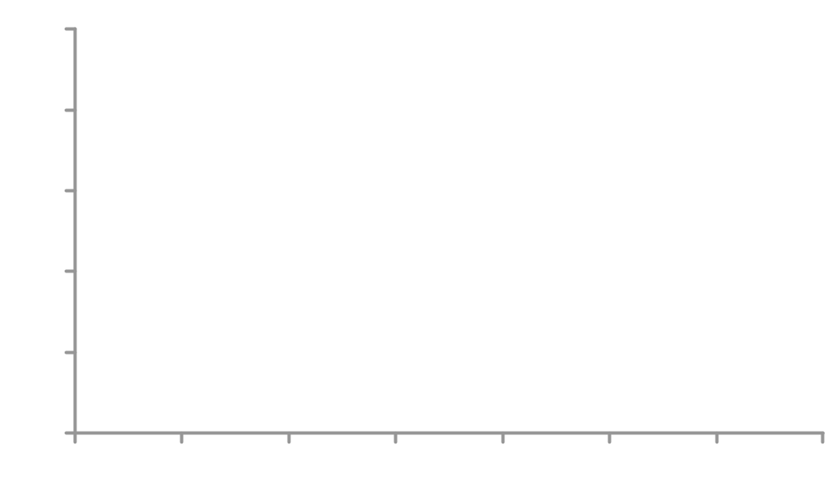
Survival Free of CD
SSS Women
Low
97%
92%
Intermediate
High
69%
%
P=0.012
Years
At risk (no.)
Low 69 64 60 60 60 57 48 22
Intermediate 15 14 12 12 11 11 8 4
High 19 10 10 10 9 8 7 3
Notes:
DV Revised 5-27-2004

Slide 17
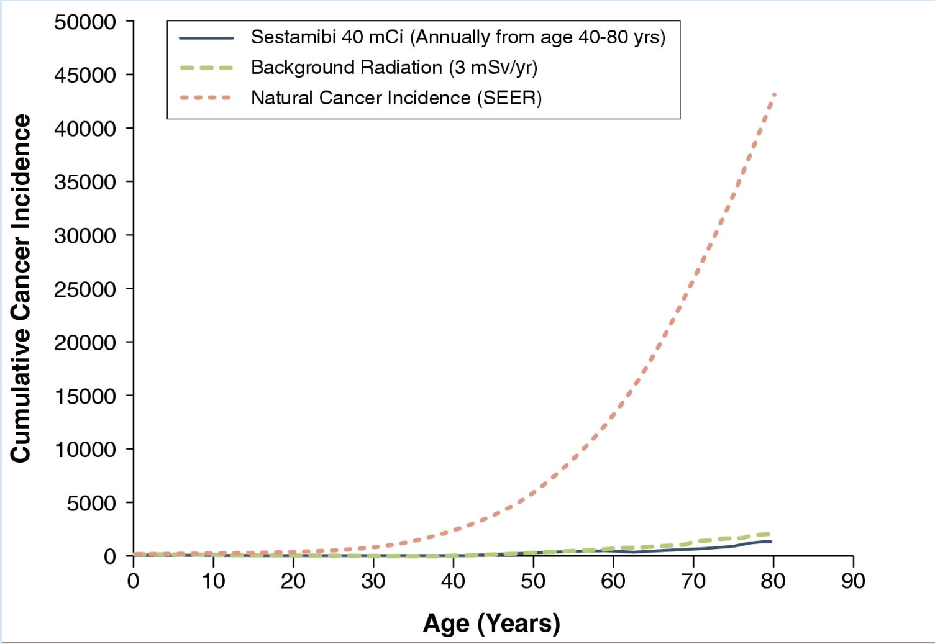
Cancer Incidence in Women
Gerber TC. JACC Cardiovasc Imaging 2010;3:528

Slide 18
Conclusions
Standard ETT and stress imaging modest value diagnosis CAD
Most important role of stress testing risk stratification CAD
Apply all available information to patient management and not just ischemia
Approach standard ETT when appropriate as initial test most cost effective

Slide 19
Recommendations
Individual Stress Modalities
Variable | ETT | Imaging*
Pre-test prob CAD | Intermediate | High**
Able to exercise*** | Yes | No
Interpretable ECG**** | Yes | No
Prior false (+), indeterminate ETT | No | Yes
* Pre-menopausal ⎯ no radiation
** Includes elderly (> age 75 yrs)
*** 5 METs
**** Paced, LBBB, WPW, ≥ 0.5 mm ST ↓
Mieres JH. Circ 2014;130:350

