Slide 1
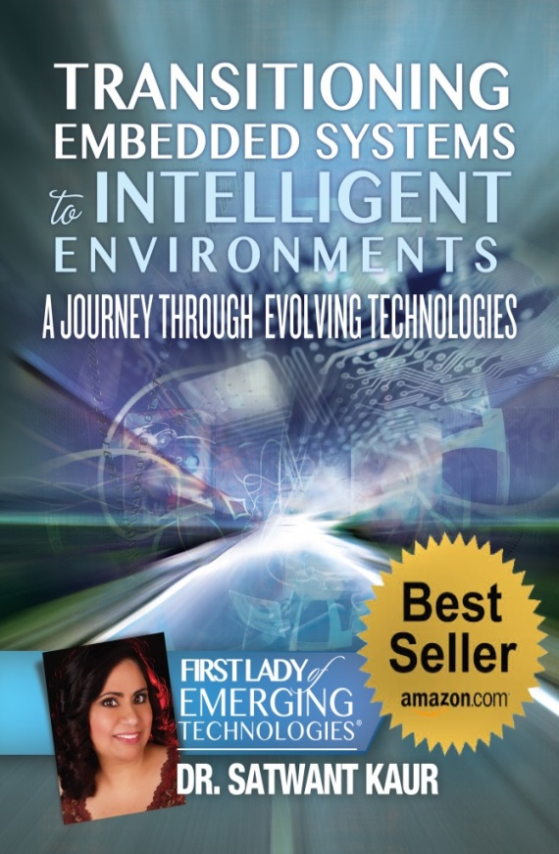
Emerging Nanotechnology Trends by the First Lady of Emerging Technologies
Satwant Kaur, PhD.
Nanotek 2014 Keynote
Dec 1, 2014
Website: www.satwantkaur.com
Email: Satwant.Kaur@gmail.com
Disclaimer: I am not endorsed by any third-party affiliation, organization, or employer. All opinions are solely mine, and do not reflect the opinions and/or views of any third-party affiliation, organization, or employer.

Slide 2

Speaker’s Bio
Current Position:
  Chief Technologist (CT) -Innovation (HLS), Hewlett Packard Company
  HP Distinguished Technologist
Previous Positions:
  Platform strategist, Intel Architecture Group, Intel.
  CTO, Emerging Technologies Group, TIBCO Software.
  Director of Development, Symantec.
  Faculty, EE, Idaho State University
Author:
  Author, “Transitioning Embedded Systems to Intelligent Environments”
Inventor of:
  Intel’s Reduced Interoperability Technologies
  CA Technologies’ Event Correlation Engine
  Dozens of cutting edge inventions at HP.
Education:
  B.Tech. in EE, IIT, Delhi.
  M.S. in CS, Oakland University
  Ph.D. in Mobile Internet Protocols, Oakland University
Nanotek 2014 Keynote
Dr. Satwant Kaur, First Lady of Emerging Technologies

Slide 3
Emerging Nano Technologies:
Nano Materials that Detect Explosives
3D Printed Graphene Nano Wires
Reducing Infection in Surgical Implants
Stem Cell Therapy Without Donor Cells
Nano Heart Muscle on Spider Web Silk
Treatment of Amputee’s Pain with Nano Sensors
3D Scanning and 3D Printing of Nano Electronics
Making Nano Circuits with Human DNA
Nanotek 2014 Keynote
Dr. Satwant Kaur, First Lady of Emerging Technologies

Slide 4
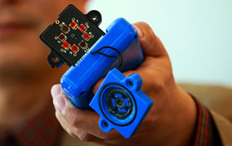
Nano Materials that Detect Explosives
Handheld explosives detector made with Carbon Nanotubes
A layer of microscopic deposit of nano electrodes that detects explosives
The deposit contains bundles of carbon nanotubes that have been broken down with a polymer
Explosives are detected when voltage between the electrodes results in a change of current through the nanotube
By University of Utah
Nanotek 2014 Keynote
Dr. Satwant Kaur, First Lady of Emerging Technologies

Slide 5
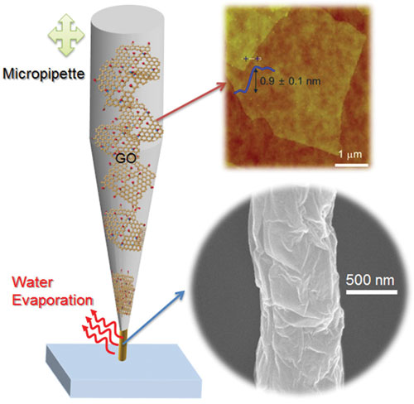
3D Printed Graphene Nano Wires
Graphene is a honeycomb of one atom thick carbon.
So to make graphene based IC’s, we need precise patterning of graphene sheets at nano scale
This is done by 3D printing uses stretched liquid ink through nozzle aperture
Used to fabricate graphene nanowires
By Korea Electrotechnology Research Institute (KERI)
Nanotek 2014 Keynote
Dr. Satwant Kaur, First Lady of Emerging Technologies

Slide 6
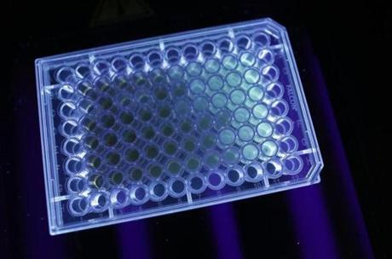
Reducing Infection in Surgical Implants
Currently, implants are screwed in place during surgery and can get infected
Nano sized materials in implant reduces infection by mimics the nano size of natural bone and muscles
Bacterial cells bounce off the tiny spikes on the surfaces of nanomaterials.
96 well plate shown here have different concentrations of nanoparticle for treatment of bacteria. Stronger glow show stronger bacteria.
By Northeastern University
Nanotek 2014 Keynote
Dr. Satwant Kaur, First Lady of Emerging Technologies

Slide 7
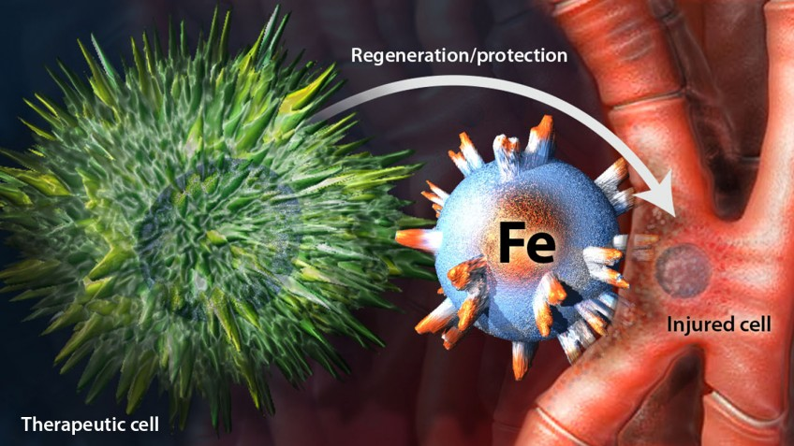
Stem Cell Therapy Without Donor Cells
Stem cell therapy works by bringing healing cells to the cells needing repair
Magnetic nano cells act as matchmaker between them.
MagBICE (magnetic bi-functional cell engager) has Fe platform with two antibodies.
First locates patient’s own stem cells after a heart attack
Second targets injured tissue
This brings patients own stem cell to the cells needing repair
By North Carolina State Univ. & Cedars-Sinai Heart Institute
Nanotek 2014 Keynote
Dr. Satwant Kaur, First Lady of Emerging Technologies

Slide 8

Nano Heart Muscle on Spider Web Silk
Spider silk is coated with carbon nanotubes to make it contract like a heart muscle
Coating making it 3 times stronger than untreated spider silk, which weight-for-weight is one of strongest substances. It also makes it conducts electricity.
When used with heartbeat monitor and a piston it can raise 35 mg; and electrical current can make thread contract like a muscle.
By National High Magnetic Field Lab, Florida
Nanotek 2014 Keynote
Dr. Satwant Kaur, First Lady of Emerging Technologies

Slide 9
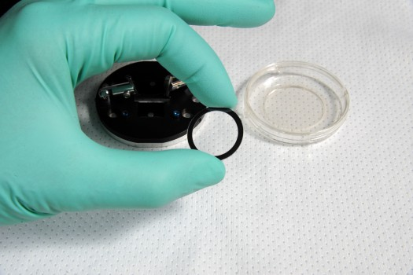
Treatment of Amputees with Nano Sensors
Amputees due to improvised explosive device (IED) have painful bone growths
The root cause of pain can be determined by Nanosensors.
Protein specific gold Nanosensor arrays on microscope coverslips are used to image proteins secretion in real time.
Brightness of sensors change as the cell secretes proteins
Unusual secretions can be detected and cured
By U.S. Naval Research Lab
Nanotek 2014 Keynote
Dr. Satwant Kaur, First Lady of Emerging Technologies

Slide 10
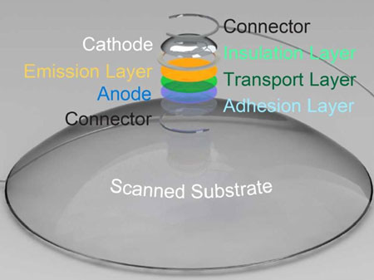
3D Scanning and Printing of Nano Electronics
Semiconducting nanoparticles can be used to create active 3D Nanoelectronics
5 materials are 3D printed
1) emissive semiconducting inorganic nanoparticles
2) an elastomeric matrix
3) organic polymers: transport
4) solid and liquid metal leads
5) Transparent substrate layer
Curved substrate can also be 3D scanned & 3D printed
Quantum dot LED on curved substrate can be printed
By Princeton University
Nanotek 2014 Keynote
Dr. Satwant Kaur, First Lady of Emerging Technologies

Slide 11
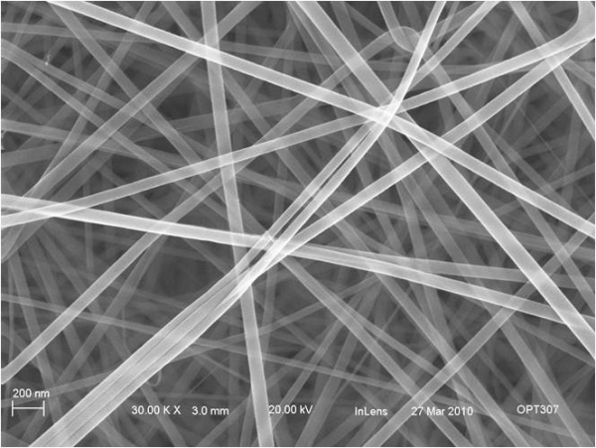
Making Nano Circuits with Human DNA
DNA can carry electricity
So, Nano Wires can be made from DNA
Significant current can move through DNA over 100 picoamperes traveling distances exceeding 100 nanometers
This can enable DNA-based programmable circuits for molecular electronics and nano circuits
By Hebrew University of Jerusalem
Nanotek 2014 Keynote
Dr. Satwant Kaur, First Lady of Emerging Technologies

Slide 12
Thank You
Nanotek 2014 Keynote
Dr. Satwant Kaur, First Lady of Emerging Technologies

