Slide 1
The Long and Wireless Road
Norman E. Shaw
Director, IEEE-Standards Association

Slide 2
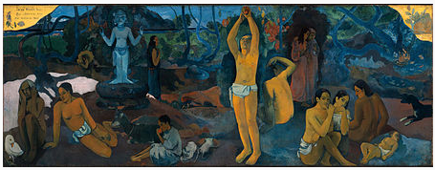
Paul Gaugin - 1897
D'où Venons Nous / Que Sommes Nous / Où Allons Nous
Where Do We Come From? What Are We? Where Are We Going?

Slide 3
D’ou Venons Nous?
Where do we come from?
…or, a short walk down wireless memory lane.

Slide 4
Where Do We Come From?
Architecture
Data
Applications
0G – Radio Telephones
1G – AMPS IS-91 (also DataTAC, Mobitex, NMT, etc.)
2G – GSM (also D-AMPS, TDMA, iDEN, etc.)
3G – UMTS (also CDMA2000, WiDEN, etc.)
4G – EUTRA (also WiMAX, etc.)

Slide 5
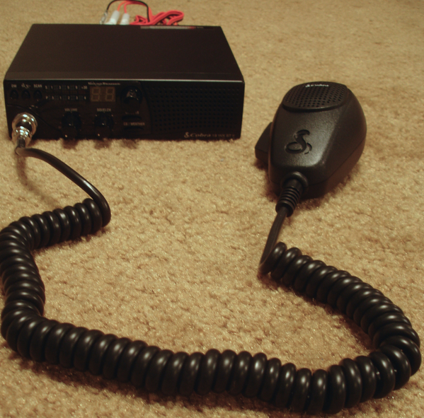
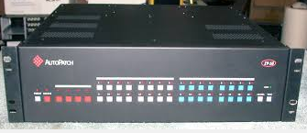
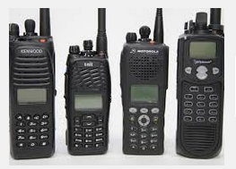
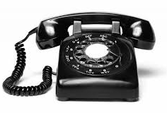
0G – Radio Telephones (1980’s)
OMG – I can call home with my radio!!!

Slide 6

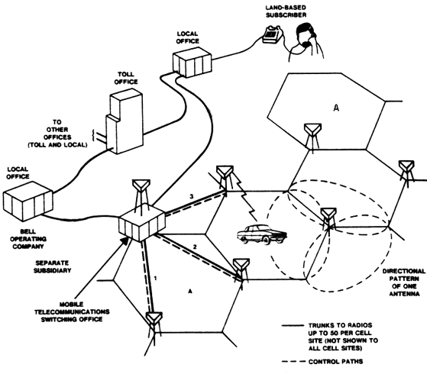
1G - Advanced Mobile Phone Service “AMPS” Network Diagram (1980’s)
Analog
Killer App = Voice
Data Service over CDPD
  1 DS0/Sector
  Through DACCS
  Lost 1 voice channel
Usually a T1/Sector
  1 control channel
  23 voice channels
Does anyone remember what a “T-Coder” is?

Slide 7
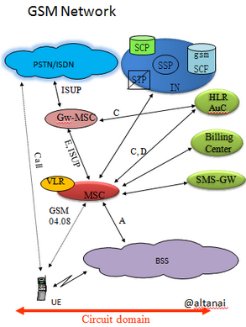
2G – Global System for Mobile (GSM)
(also D-AMPS, TDMA, iDEN, etc.) (1990’s)
Digital Voice
Killer App = SMS
Data Service over WAP
  Walled Garden
  GPRS - SGSN, GGSN
Still a data-over-voice Network…voice-centric
SS7…SS7…SS7
Still T1 sector backhaul
WAP is crap and WOS is worse…
Notes:
EU in early 90’s, (1992) US by late 90’s
GPRS – General Packet Radio Service

Slide 8
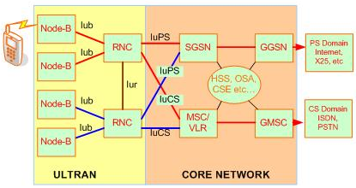
3G – Universal Mobile (2000’s)
Telecommunications System (UMTS)
Digital Voice
Killer App = “www” and “CrackBerry”
Wideband-CDMA (W-CDMA)
Heterogeneous data/voice network
Still T1 sector backhaul
Gateways and Nodes…

Slide 9
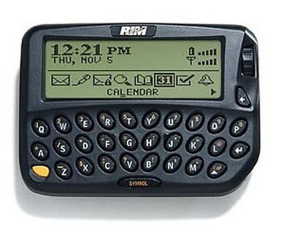
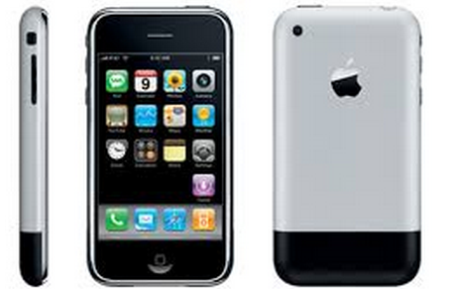
…and then something BIG happened!
1999 - Blackberry
The introduction of the “Smartphone” fundamentally changed the direction and motivation behind wireless communications.
2007 - iPhone

Slide 10
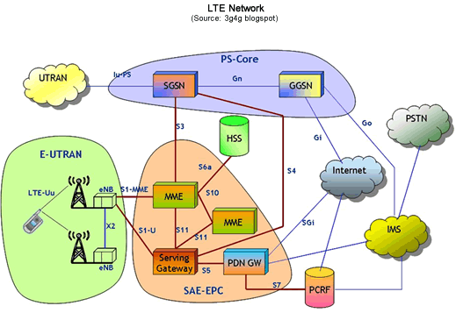
4G – Long Term Evolution (LTE) (2010’s)
Data-centric Network
Killer App = Facebook
Where is the clear voice path???
Broadband backhaul
WAP is crap and WOS is worse…

Slide 11
Que Sommes Nous?
What are we?
…how does our work fit in the big picture?

Slide 12
What Are We?
Cellular telephony began as an alternative access for mobile voice communications
  Based on Radio Communication Fundamentals (and frequency reuse)
Currently, this technology is a primary access technology to “content”

Slide 13
Ou Allons Nous?
Where are we going?
…What is 5G and what do they mean by IoT?
…Just how “Connected” are the vehicles going to be?
…Are we going down the “dumb-pipe” path?
Notes:
I Don’t Know?
- but here’s what I can tell you
5G
there will need to be a major shift in the paradigm here
Services will need to be seamless
Session handoff to equate to voice handoff
Daddy don’t wanna be a “Dumb Pipe”
What’s your “differentiator”

Slide 14
5G – …and so it goes
Multiple Radio Access Technologies (RATs)
  5G (OFDM)
  802.11ax
Seamless “Session” handoff
Numbers may drive bandwidth requirements
3GPP is considering GERAN for service to IoT

Slide 15
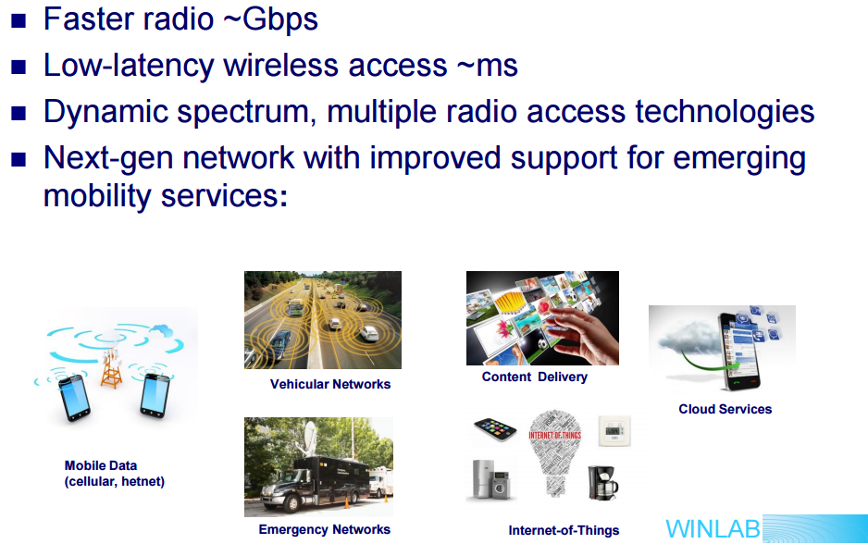
5G – The Vision

Slide 16
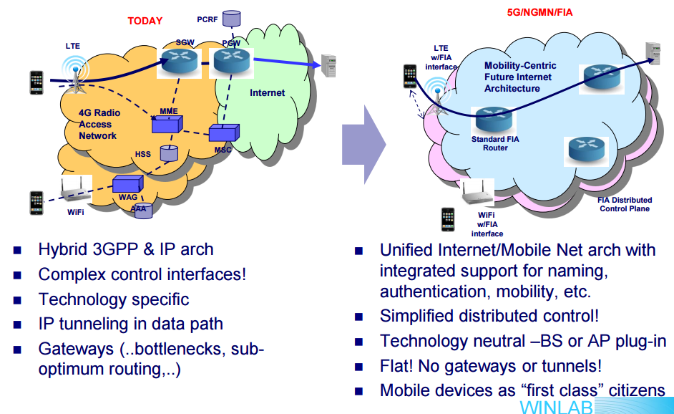
5G Network Architecture?

Slide 17
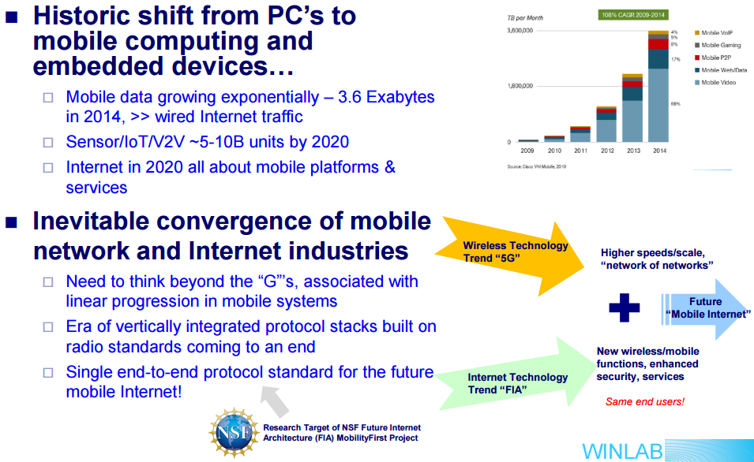
Mobility-centric Internet Protocol Architecture

Slide 18
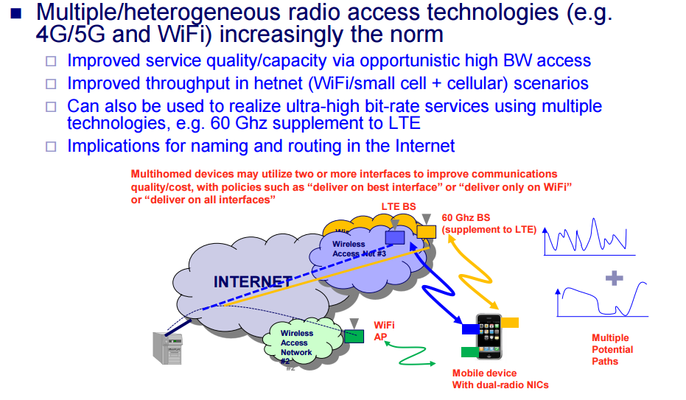
Multi-homing for Service Continuity

Slide 19
The Internet of Things (IoT)
Sensors and Actuators
Virtual Objects
People
Services
Platforms
Networks
Low Bandwidth
Possible high-volume
3GPP is considering GERAN
  IoT over 2G technology
But what about Telematics?

Slide 20
IoT Application Domains
Healthcare
Media
Home & Building
IoT architecture frame work
Logistics
Retail
Mobility/
Transpor-tation
Energy
Manufactur-ing
* due to the diversity of IoT application areas only selected domains and stakeholders are shown

Slide 21
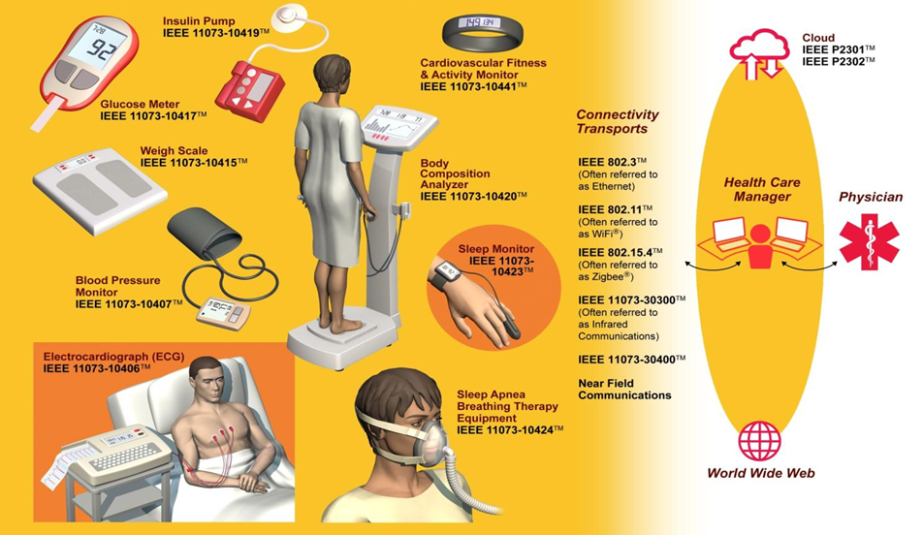
eHealth and Wireless Monitoring
ISO/IEEE 11073 series Health Informatics - Medical / Health Device Communication Standards

Slide 22
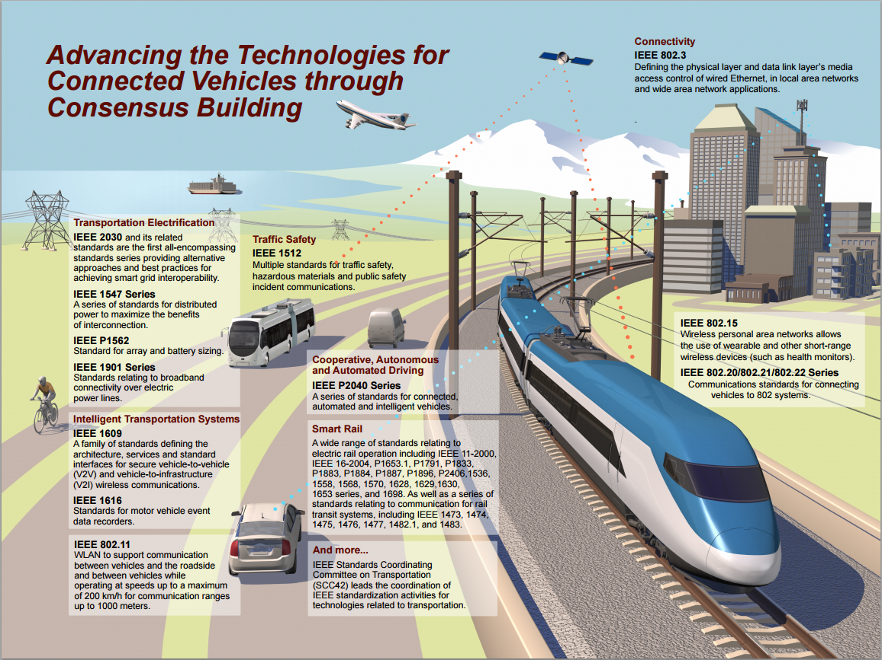
The Connected Vehicle

Slide 23
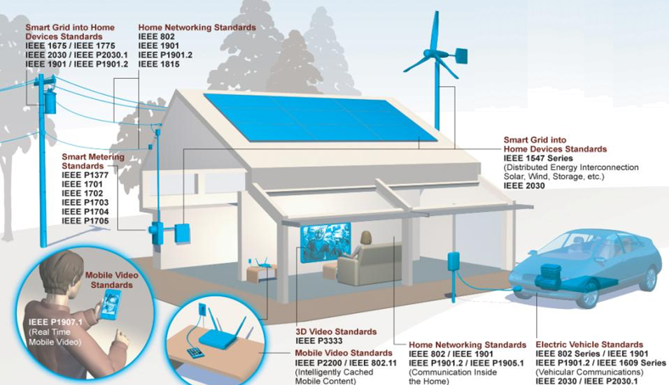
The Smart Home Initiative

Slide 24

A few comments from your sponsor…

Slide 25







Institute of Electrical and Electronics Engineers (IEEE):
World’s Largest Professional Association
Our Global Reach
430,000+
Members
45
Technical Societies
160
Countries
Our Technical Breadth
1,400
Annual Conferences
3,700,000+
Technical Documents
160+
Top-cited Periodicals

Slide 26

IEEE-SA Presence
Globally recognized standards
Clear IPR policy
Approximately 1300 active standards
More than 500 standards
under development
Over 7,000 individual members and 20,000 standards developers from every continent
200+ corporate members
Leverages the breath of
40+ technical areas
Smart Grid standards
quoted in NIST
Flagship transport layer standards in communications (IEEE 802)
Independent global community
Open standards process…
IEEE-SA Strengths
Notes:
IEEE-SA drives the functionality, capabilities and interoperability of a wide range of products and services that transform the way people live, work and communicate. We promote innovation, enable the creation and expansion of international markets and help protect health and public safety.
- IEEE-SA is a a globally recognized standards-development organization with over 900 active standards.
- At any point in time we have more than 500 standards projects under development.
- We have an individual membership of 7,000, more than 200 corporate members and, overall, more than 20,000 developers of standards worldwide.

Slide 27

Different Paths: Standards Development
Individual Method
Participants are individual technical experts
Each individual participant has 1 vote
Entity (Corporate) Method
Participants are “entities,” i.e., companies, universities, government bodies, etc.
Each entity has one vote
Requires 3 entities
Ballot groups are made up of a minimum of 10 individuals
Ballot group participants must be IEEE-SA individual members
Individuals represent themselves
Designated representative and alternate represent the entity
Entity sends representatives to meetings
Open membership, participation, and governance
No restrictions
Any individual or organization
Includes academia
Any industry or size of company

Slide 28
Standards,
Finally, a few thoughts on Standards…
Specifications,
and OpenSource =
Collaboration

Slide 29
The Market Challenge of Standards
Benefits
Establishes Developer Community
Eliminates Customer Concerns with Sole-Sourcing
Broadens Market Reach
  Sole-source sales restricted to “must have”
Reduces Production Costs
Reduces R&D Costs
Improves Interoperability
  Affiliated Market Potential
Challenges
IP Protection Issues
  What do you protect/what do you expose?
Competition
  Must compete on:
    Efficiency
    Differentiation
Cost/Resources
  R&D Support
  Standards delegate(s)

Slide 30


Tools for Collaboration
ISTO
IEEE Standards
Association
Industry Connections
ICAP

Slide 31

Thank You!

