Slide 1

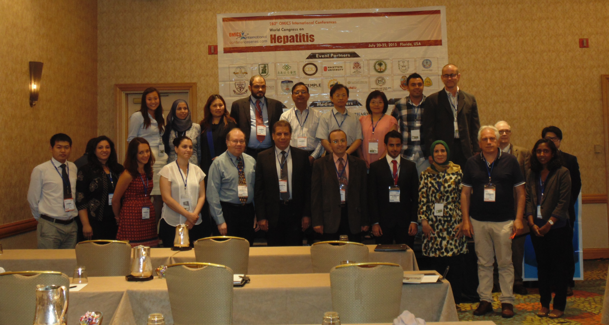
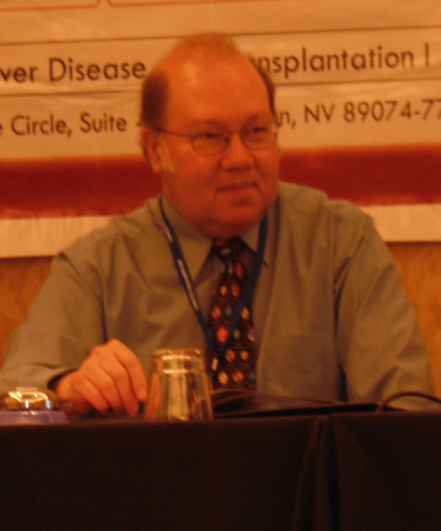
Hepatitis-2015
Orlando, USA
July 20 - 22 2015
Mark A Feitelson

Slide 2
Does HBx promote the appearance of liver cancer stem cells?
Mark A. Feitelson, Ph.D.
Department of Biology
College of Science and Technology
Temple University
Philadelphia, PA

Slide 3
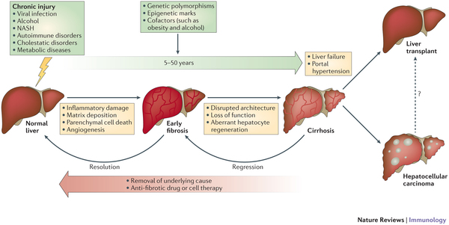
Natural history of HBV infection
Nature Reviews Immunology 14, 181–194 (2014)

Slide 4
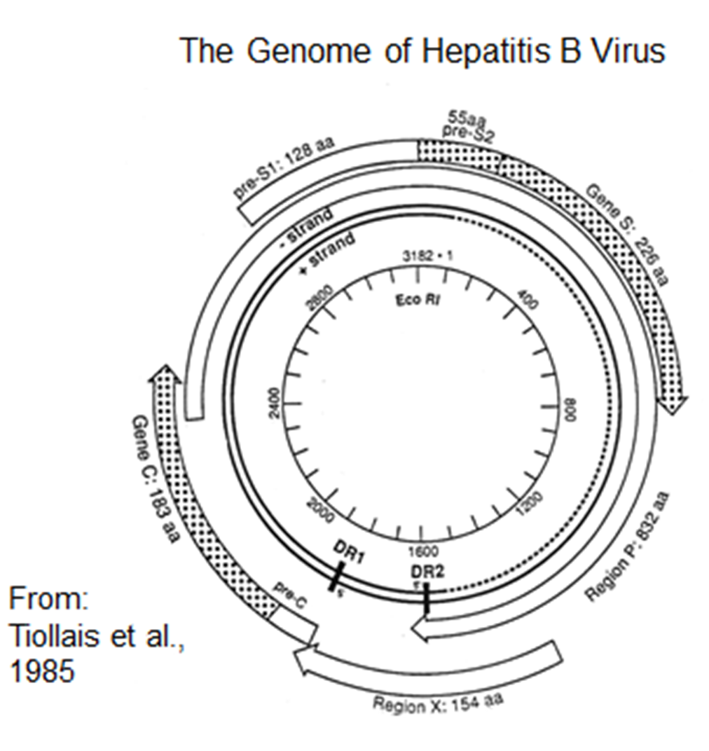
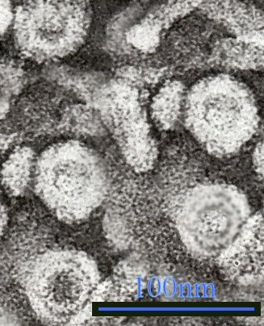

Slide 5
HBx is a viral “oncoprotein” that has three main functions
HBx stimulates virus gene expression and replication, which promotes chronic infection.
HBx promotes the development and progression of chronic liver disease by blocking immune mediated clearance of virus infected cells.
HBx contributes to the development of HCC by multiple mechanisms:
  inhibits proteasomal degradation
  is a transcriptional regulator
  stimulates cellular signaling pathways
  partially blocks DNA repair
  utilizes epigenetic machinery (HDACs and DNMTs)
  binds to and inhibits selected tumor suppressor gene
  products

Slide 6
What is epigenetics?
global hypomethylation and localized hypermethylation of DNA
alterations in histone and nonhistone protein acetylation, deacetylation and methylation
which alter the compactness of chromatin and its accessibility to complexes that activate transcription.
Histone deacetylases (HDACs) promote carcinogenesis by targeting specific chromosomal regions also targeted by transcription factors.
DNA methyltransferasess (DNMTs) promote DNA methylation in CpG islands within promoter regions of about half the genes of the genome. Progressive DNA methylation is associated with cancer.
Altered miRNA and RNAi expression also contribute to carcinogenesis.

Slide 7
Interaction of HBx with epigenetic machinery
HBx, as a trans-activating, protein binding protein, up-regulates expression of DNMTs. DMNTs down-regulate tumor suppressors by promoter methylation.
HBx binds to DMNT1, DNMT3A, HDAC and to other protein complexes, but not directly to DNA. HBx binds to the CBP/P300 complex (scaffold) having HAT activity, and to mSin3A, which has HDAC activity. Binding of HBx to DNMTs may also promote their redistribution, thereby activating gene expression.
Further, HBx alters the expression of miRNAs that impact cell viability and growth (e.g., by targeting p53 and β-catenin).
HBx activates signal transduction pathways (e.g., NF-κB, AP-1, AP-2, PI3K/Akt, Jak/STAT, ras, src, Wnt, etc) that mediate epigenetic changes in the infected cell.
These HBx activities may all contribute to “stemness.”

Slide 8
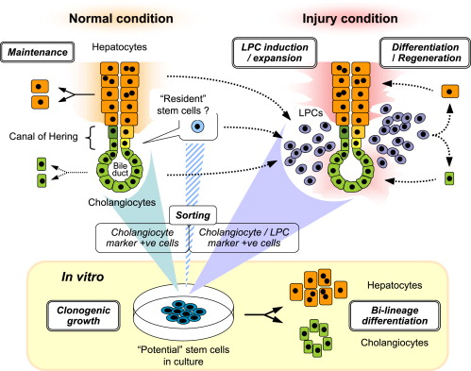
Cell Stem Cell 14(5):561-74, 2014

Slide 9
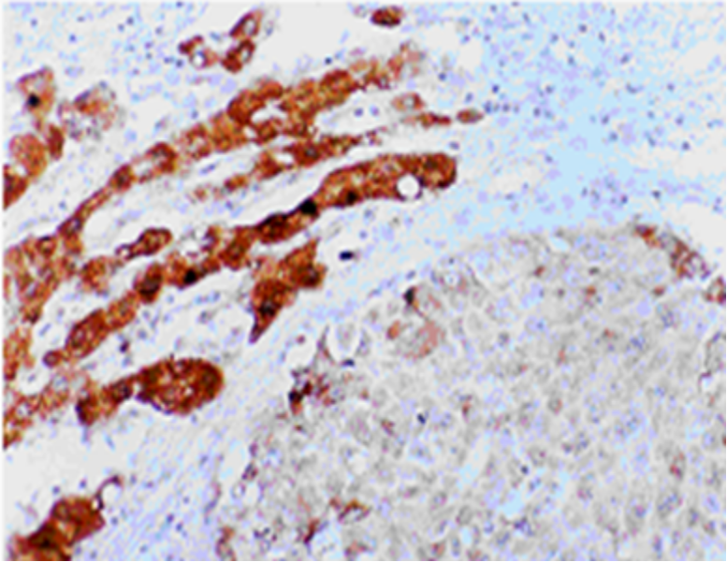
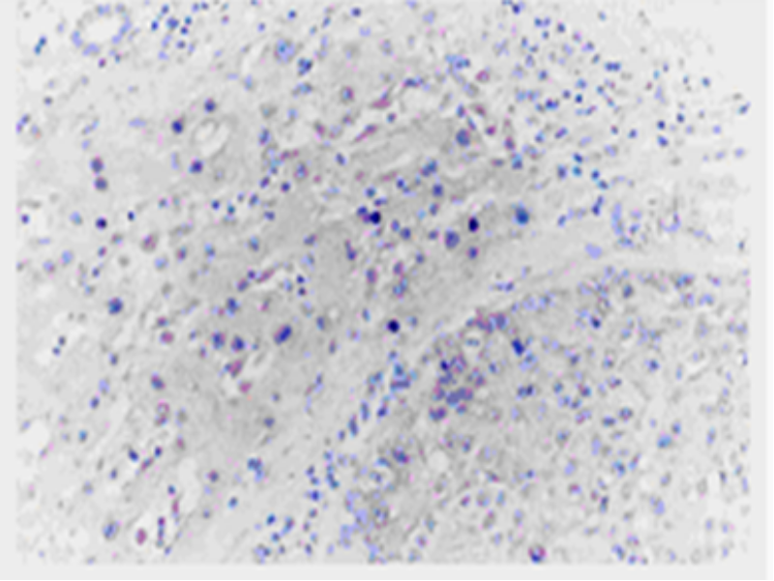
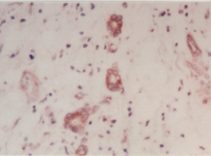
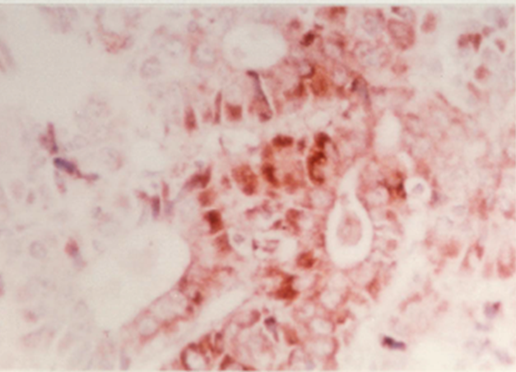
HBx staining in hepatocytes (A), HCC (B), bile ducts (C) and cholangiocarcinoma (D)
A
C
B
D

Slide 10
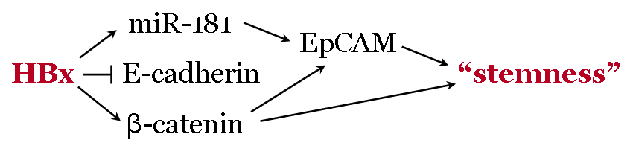
Model of the putative relationship between HBx and “stemness” in the pathogenesis of HBV associated HCC
Pathways implicated in the self-renewal of stem cells are similar to those seen in tumor initiating or cancer stem cells (CSCs).
HBx may stimulate “stemness” by
⇨ src mediated tyr phosphorylation (activation) of β-catenin
⇨ β-catenin released from E-cadherin and/or GSK3β complexes activates EpCAM
⇨ up-regulation of miR-181 which stimulates expression of EpCAM
Munz M, et al. Cancer Res, 2009. Gonzalez B, et al. Stem Cells, 2009.

Slide 11
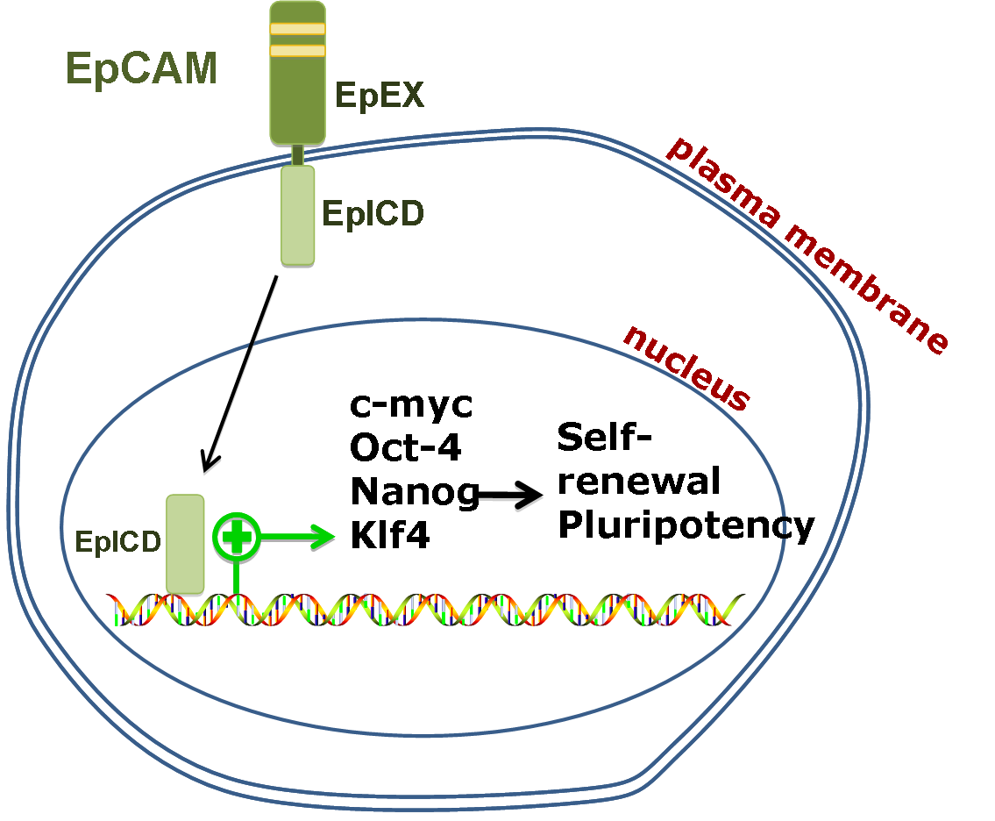
How does EpCAM promote “stemness?”
EpCAM is a marker of HCC and hepatic stem cells (HSCs), but not normal hepatocytes.
Yamashita T, et al, Gastroenterology, 2009.
*
Modified from Lu TY, et al, J Biol Chem, 2010

Slide 12
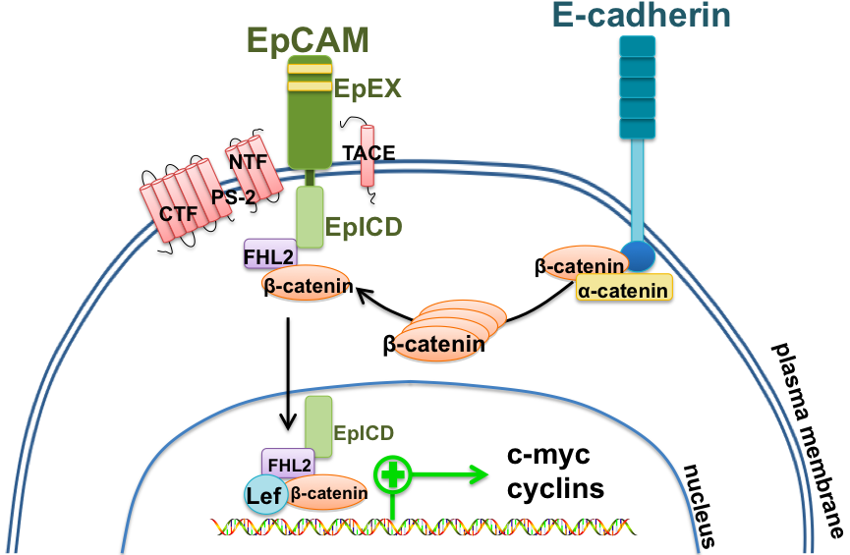
Signaling pathways of EpCAM
*
EpCAM is transcriptionally up-regulated by β-catenin.
Yamashita T, et al, Cancer Res 2007.
*
detachment, migration and metastases
src
HBx
Modified from Munz M, et al. Cancer Res, 2009.
HBx also up-regulates/stabilizes β-catenin through inactivation of GSK3β.

Slide 13
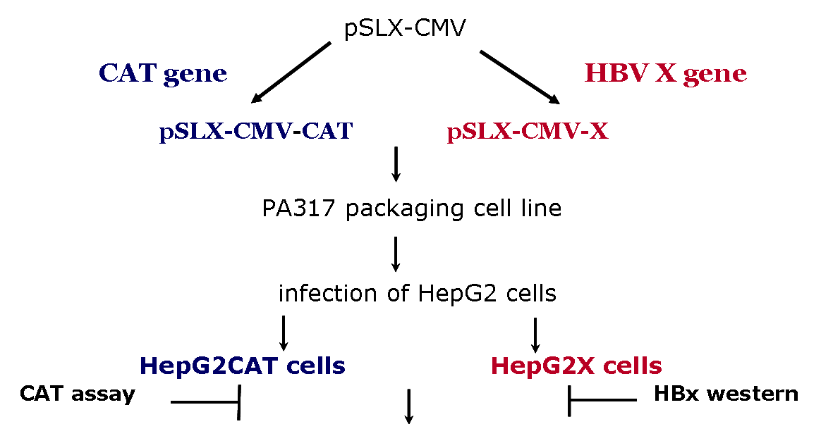
Test the hypothesis that HBx triggered “stemness” in the development of HCC.
further characterization

Slide 14
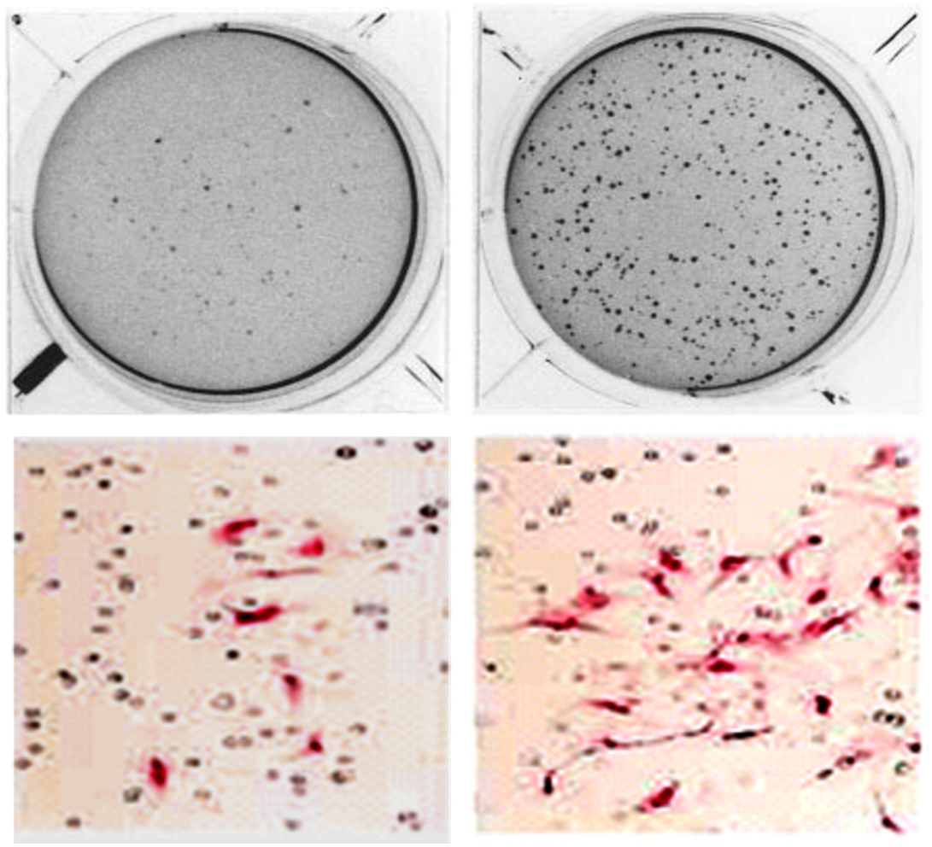
Phenotypic Characteristics of HBx Associated “Stemness”
a b
Colony formation in soft agar and cell migration in a Matrigel chamber. 2.5x10⁶ HepG2CAT (a) or HepG2X (b) cells were seeded into the 6 well plates or chambers. Colony formation was assessed after 21 days. HepG2X cells yielded ~10 fold more colonies than HepG2CAT cells.
Cell migration was observed after 24h by H&E staining. About 5-fold more HepG2X (d) than HepG2CAT cells (c) migrated.
c d

Slide 15
Phenotypic Characteristics of HBx Associated “Stemness”
Cell line onset of Student’s t test average size Student’s t test
tumor (day) (tumor onset) of tumor (cm³) (tumor size)
HepG2CAT 44 + 3 0.85 + 0.3
HepG2X 31 + 3 P < 0.005 1.6 + 0.5 P < 0.02
Tumor growth in HBx positive compared to negative cells. For tumorigenicity assays, 12 nude mice were injected subcutaneously with 2-3 x 10⁶ HepG2CAT (n=12) or HepG2X (n=12) cells.

Slide 16
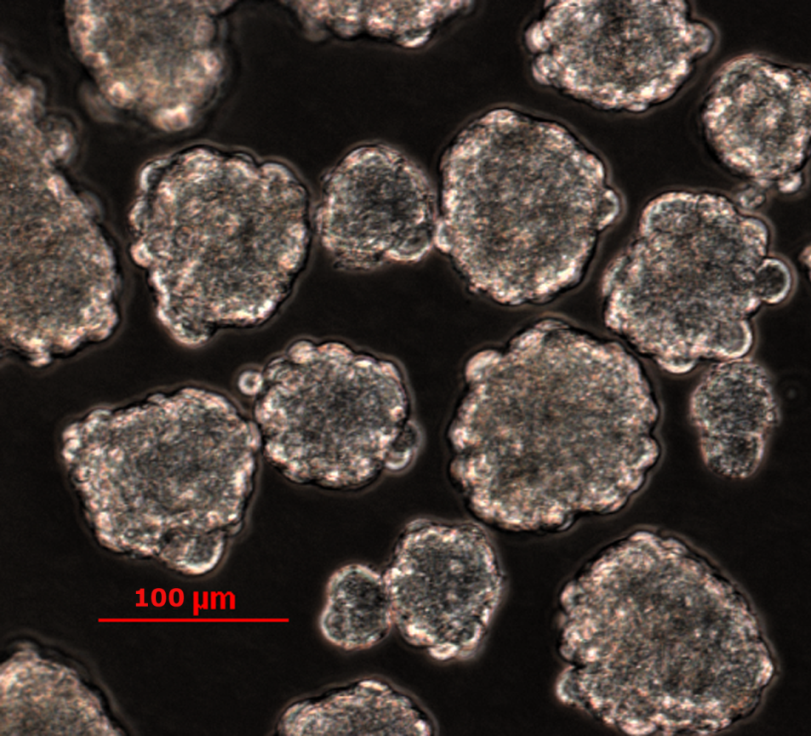
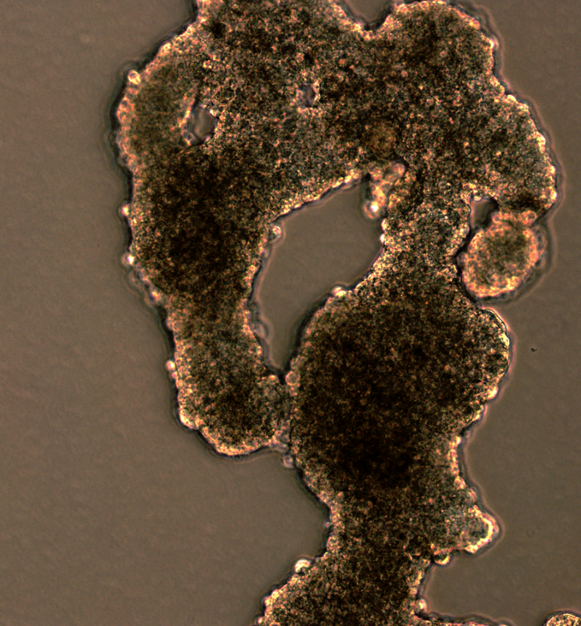
Phenotypic Characteristics of HBx Associated “Stemness”
a
b
MCTS (multicellular tumor spheroid) formation assay. HepG2X cells formed spheroids by day 3 after inoculation and expanded upon cultivation up to 7 days (a), while 70 to 90% of the HepG2CAT cells (b) formed disorganized cell clusters and became adherent, with very few floating spheres.

Slide 17
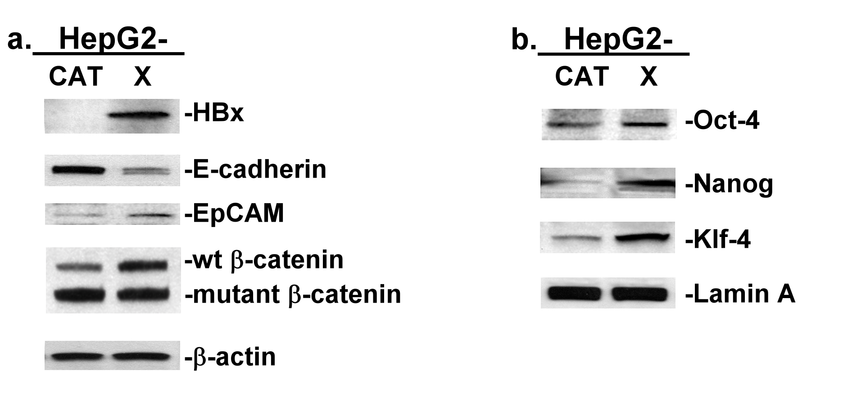
Relationship between HBx and markers associated with “stemness” in HepG2X and HepG2CAT cells
Western blot of HepG2X and HepG2CAT total (a) or nuclear (b) extracts. HBx was associated with a downregulation of E-cadherin (3.8-fold), upregulation of EpCAM (3-fold) and β-catenin (2.5-fold). HBx promoted upregulation of Oct-4 (1.6-fold), Nanog (3.4-fold), and (Klf-4) 3.5-fold. β-actin and Lamin A were loading controls.

Slide 18
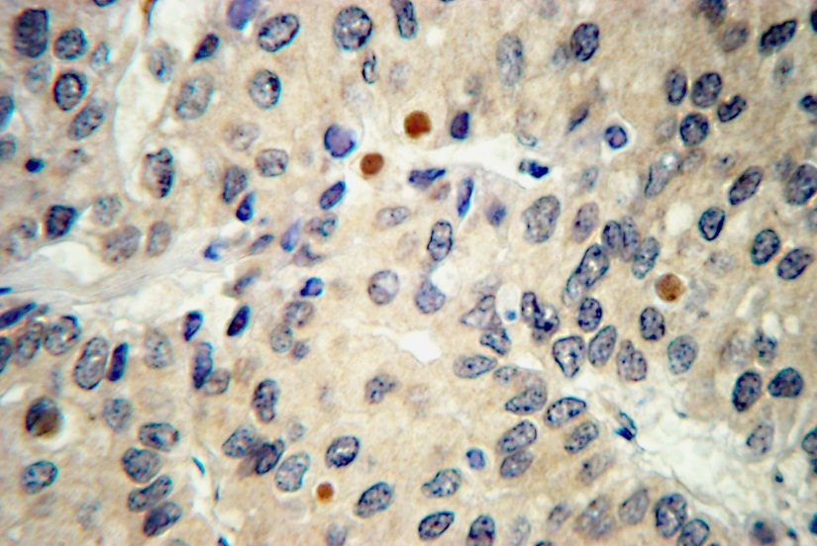
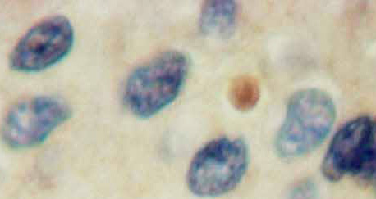
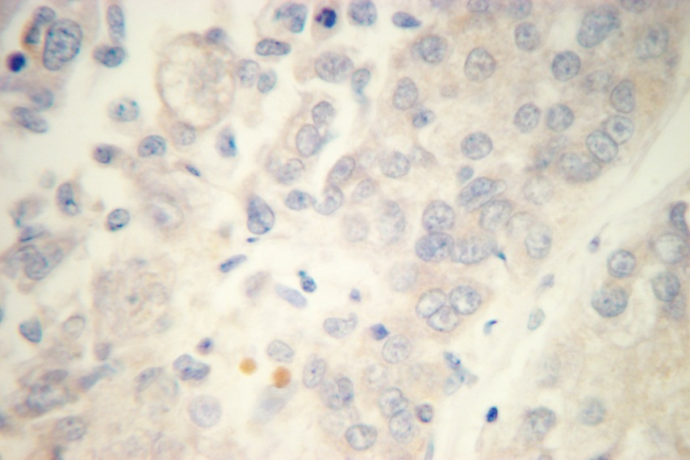
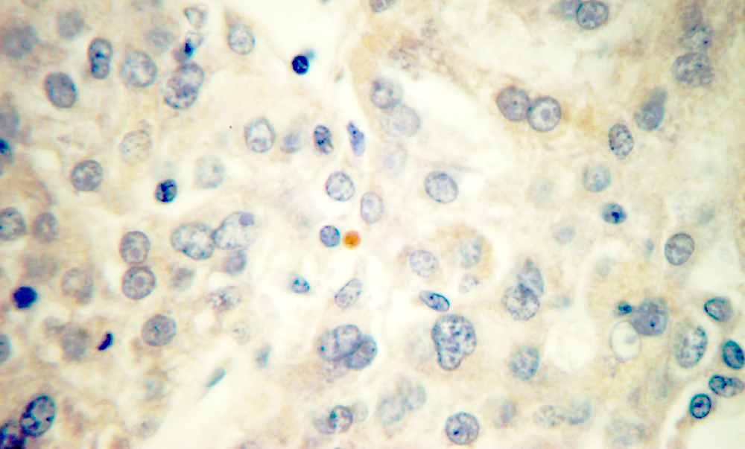
Staining of HCC tissues from an HBV infected carrier for Oct-4 and Nanog
Oct-4
Nanog

Slide 19
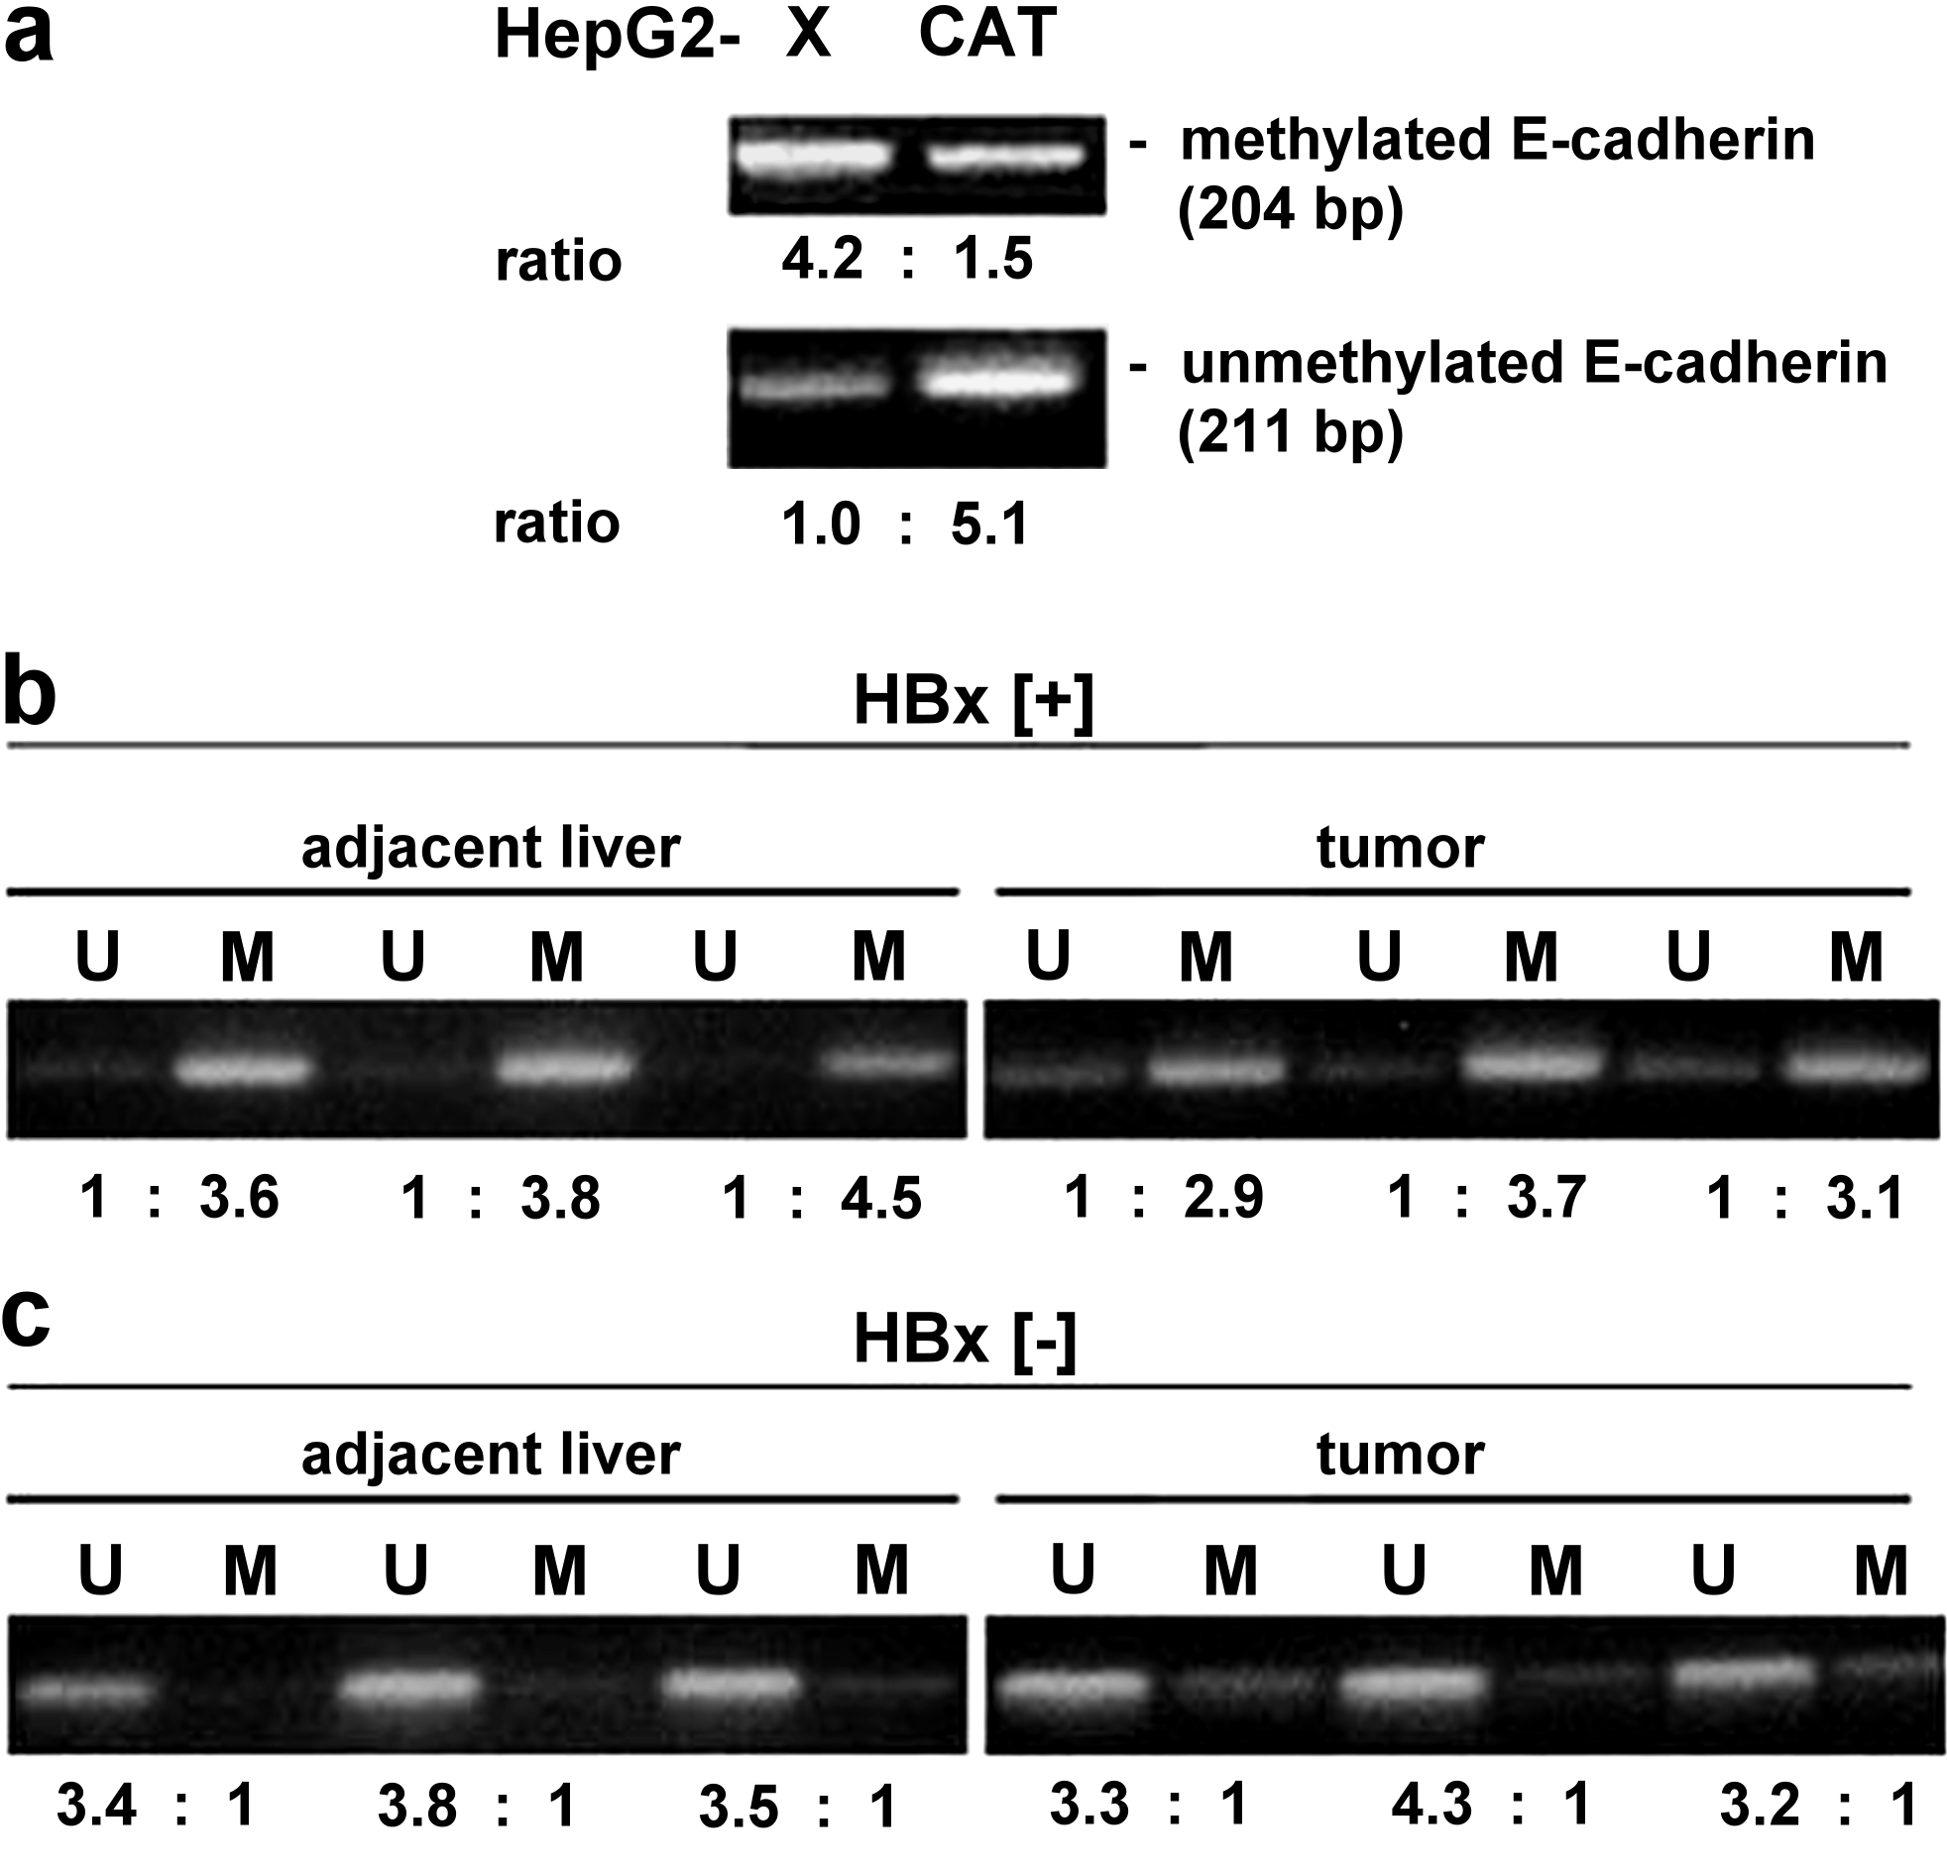
HBx transcriptionally represses the E-cadherin by CpG-island hypermethylation of the E-cadherin gene promoter
State of DNA methylation of the E-cadherin promoter in (a) HepG2X and HepG2CAT cells, and (b and c) clinical samples from HBV infected patients.
Detection of unmethylated (U) or methylated (M) E-cadherin promoter by methylation specific PCR.
E-cadherin expression is also down-regulated by HBx via (1) histone deacetylation and by (2) down-regulation of miR-373.

Slide 20
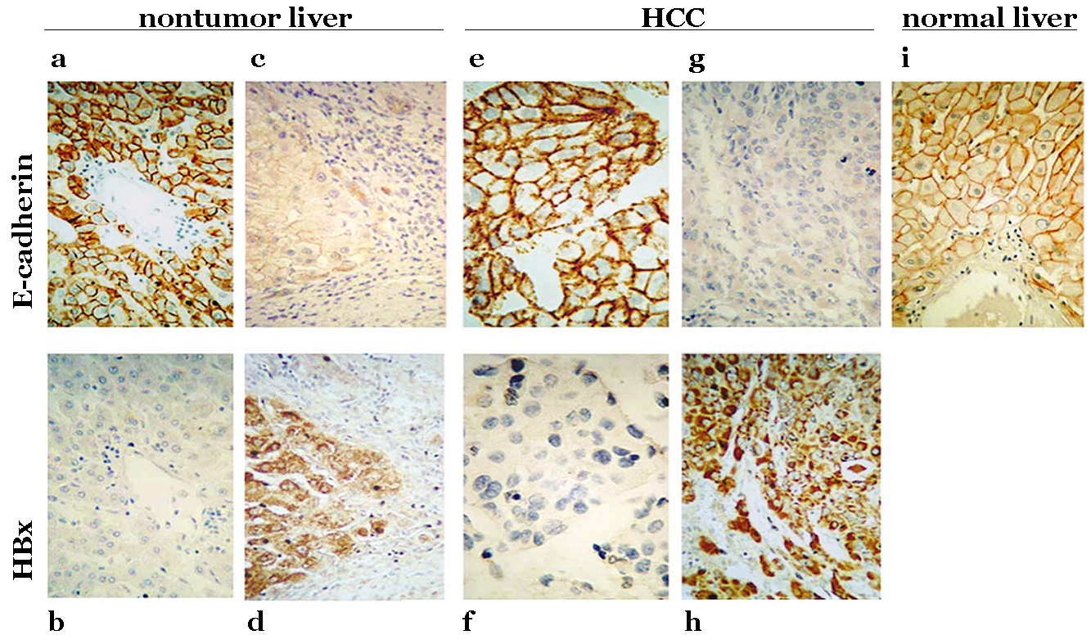
Expression of E-cadherin and HBx in nontumor liver (a-d), HCC (e-h) tissues and in uninfected (normal) liver (i)
There is an inverse correlation between HBx and E-cadherin expression. These observations are representative of those seen in a panel consisting of 22 patients.

Slide 21
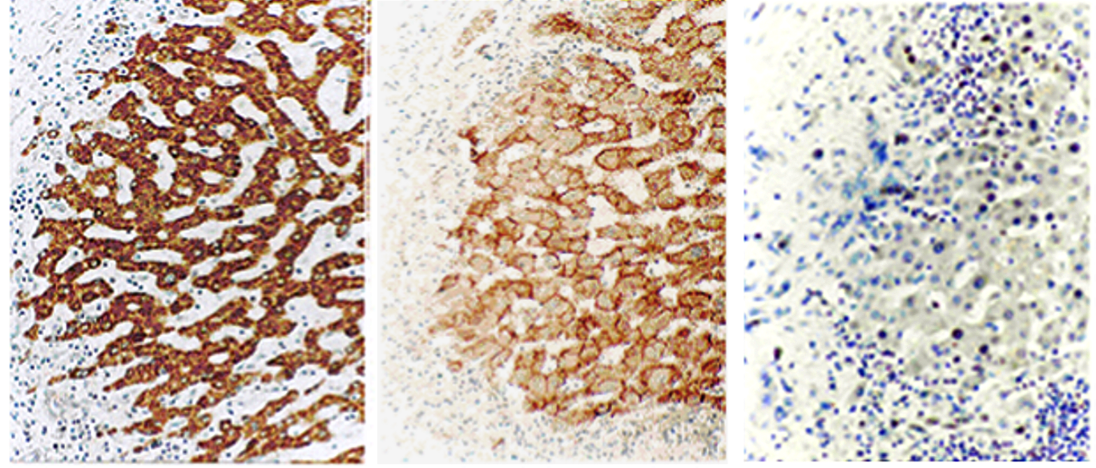
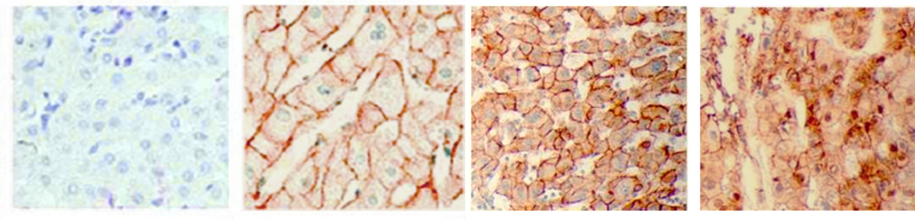
Co-staining of HBx and β-catenin in consecutive sections of liver or HCC from HBV infected patients.
HBx β-catenin IgG
IgG normal liver infected liver HCC
β-catenin staining in normal uninfected liver (mostly membranous), in chronically infected liver (mostly cytoplasmic), and in HCC (mostly nuclear). These data are representative of a panel of 214 patients showing co-staining in 75% of cases.

Slide 22
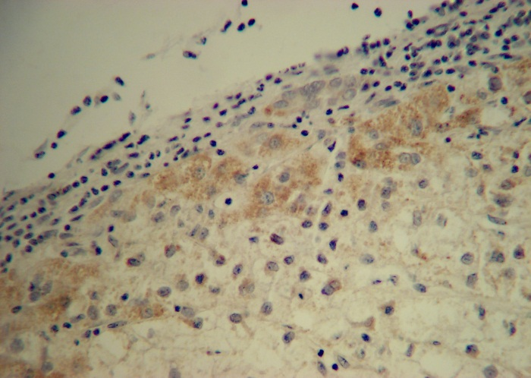
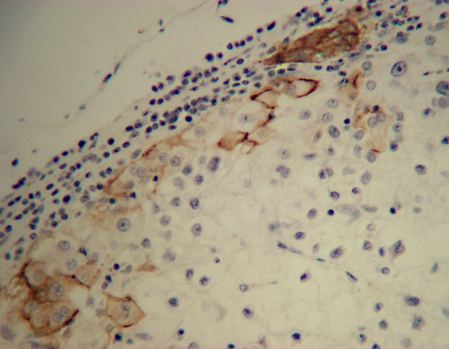
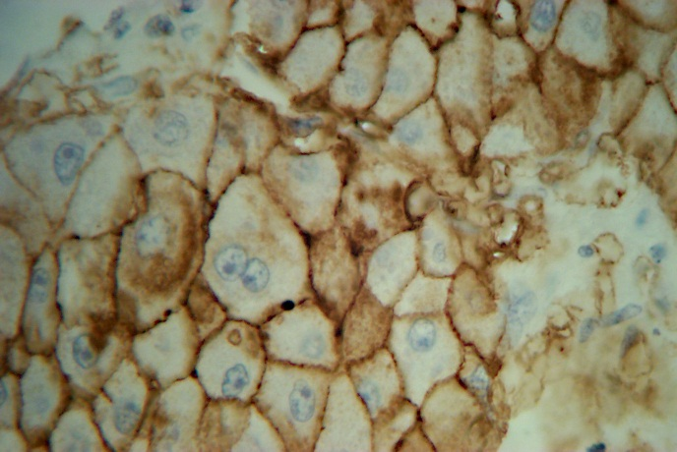
Co-staining of HBx and EpCAM in consecutive sections of HCC from HBV infected patients.
a b c
Staining of HCC nodule for (a) HBx or (b) EpCAM (x200). (c) High power view of EpCAM (x400). Co-staining was seen in 87% cases (47 patients from 49).

Slide 23
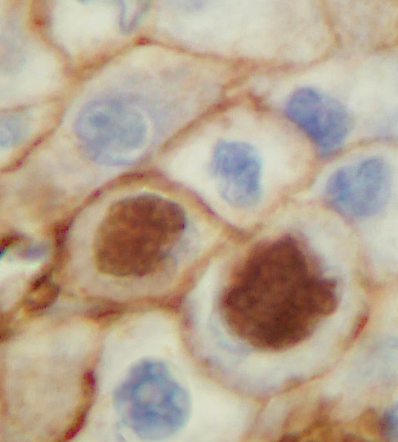
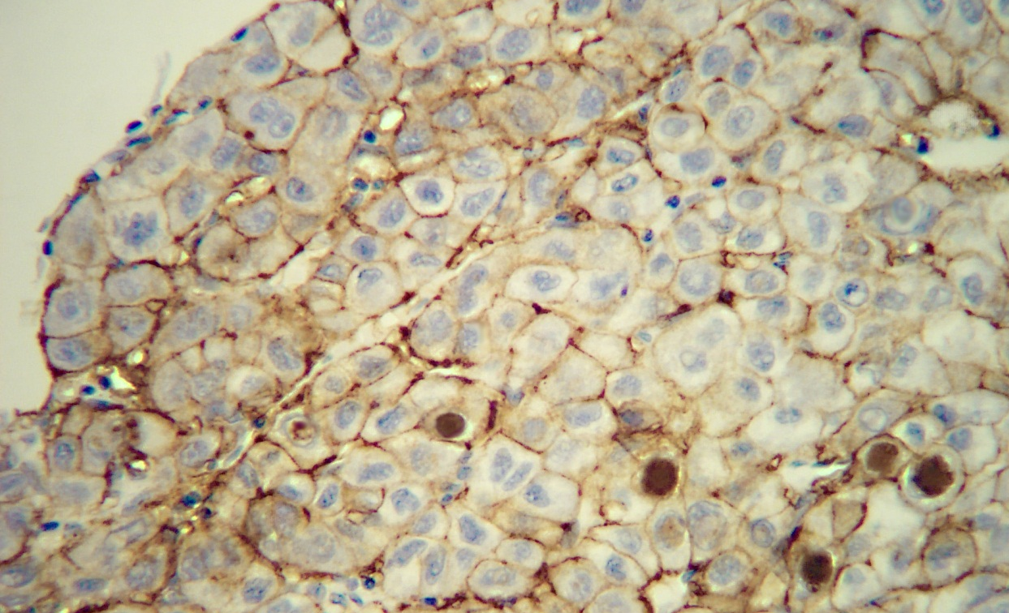
EpCAM in the nuclei of HCC cells

Slide 24
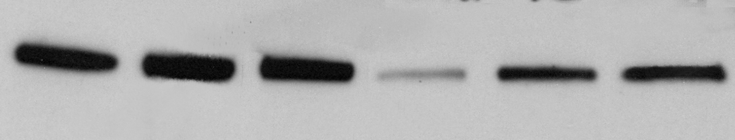
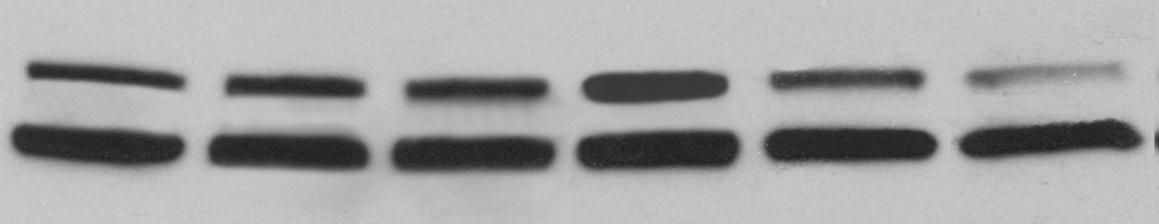
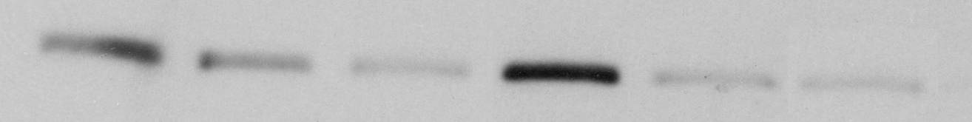
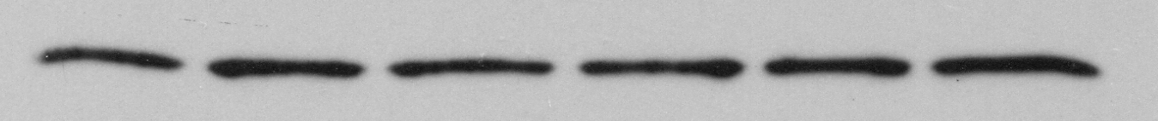
Suppression of E-cadherin expression by histone deacetylation
HepG2CAT HepG2X
c 12h 24h c 12h 24h
TSA (350 nM Trichostatin A) [HDACi]
E-cadherin
wt-β-catenin
mutant-β-catenin
EpCAM These findings suggest
that HBx promotes
β-actin carcinogenesis by
epigenetic mechanisms

Slide 25
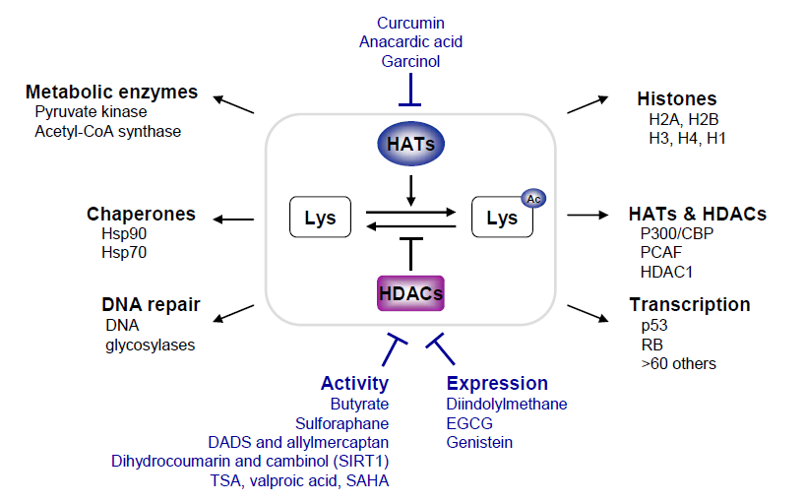

Slide 26
miR-181
miR-181 family members are expressed in HSCs and CSCs.
Forced expression of miR-181 endowed EpCAM+ HCC cells with stem cell properties, whereas miR-181 suppression induced differentiation (Ji J et al, Hepatology, 2009).
miRNA microarray data from HBx+ compared to negative HepG2 cells showed that HBx was associated with up-regulated miR-181a (2-fold) and miR-181b (1.5-fold), suggesting an epigenetic pathway that induces EpCAM expression.

Slide 27
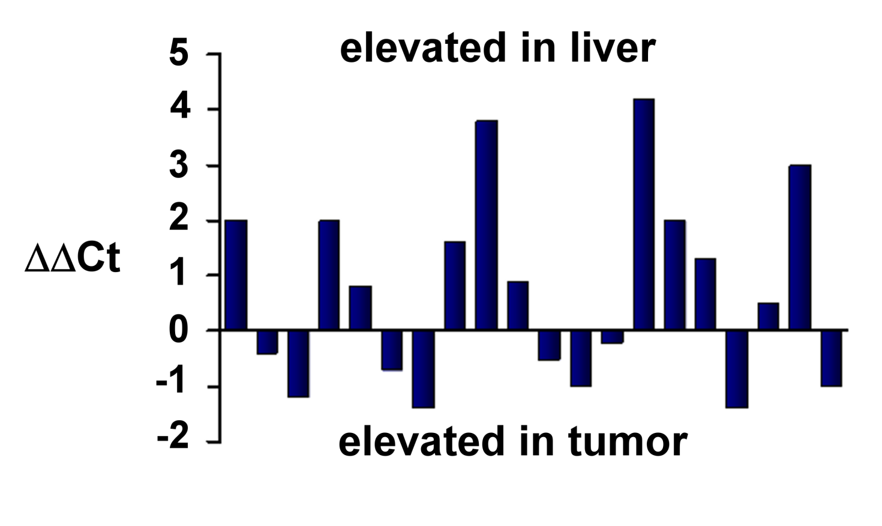
Expression of miR-181a in tumor (HCC) and nontumor liver
20 tumor/nontumor liver pairs from HBV carriers were evaluated for HBx by staining and miR-181a by real-time RT/PCR; 11 of 15 HBx+ nontumor liver samples had elevated miR-181a (73%) (p < 0.01).

Slide 28
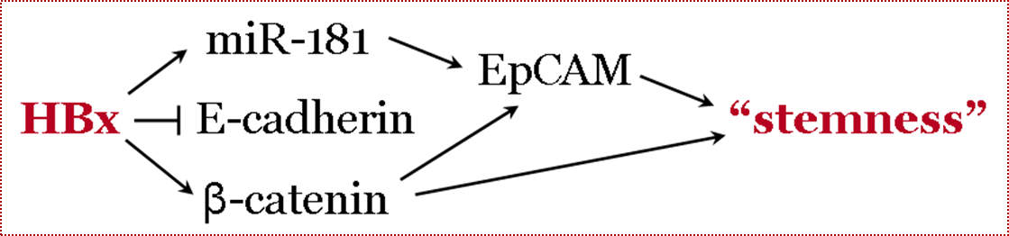

Slide 29
HBx
mSin3A/HDAC
miR-373
TGF-β
Snail-1
Mir-181
E-cadherin
β-catenin
EpCAM
EMT
NF-κB
STEMNESS

Slide 30
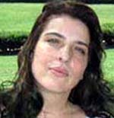
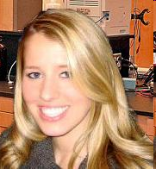
Acknowledgements
Chengzheng Hospital
Second Military Medical College
Mark Feitelson’s lab:
Alla
Arzumanyan
Tiffany
Friedman
Enoch Kotei, Melissa Vitolo,
Ke Yuan, Zoe Ozment,
Marcy Clayton, Angela Ahiekpor, Jingbo Pan, Chelsa Corradetti,
Jie Liu, Sarah Wallett, Zhaorui Lian, Yuliya Anikanova,
N. Lale Tufan, Wuoyi Wu,
Eva Ping Lu, Jung-min Lee, Eugeney Bichenkov
Li Li Xianxing Li
Minghua Zhu
Hong-Yang Wang
Meng-Chao Wu
Hong Kong University
University of the Witwatersrand
Irene O. L. Ng
Patrick Arbuthnot Michael Kew

Slide 31

Meet the eminent gathering once again at
Hepatitis-2016
Dubai, UAE
October 17 - 19, 2016
Hepatitis– 2016 Website:
hepatitis.omicsgroup.com

