Slide 1
About Omics Group
OMICS Group International through its Open Access Initiative is committed to make genuine and reliable contributions to the scientific community. OMICS Group hosts over 400 leading-edge peer reviewed Open Access Journals and organize over 300 International Conferences annually all over the world. OMICS Publishing Group journals have over 3 million readers and the fame and success of the same can be attributed to the strong editorial board which contains over 30000 eminent personalities that ensure a rapid, quality and quick review process.

Slide 2
About Omics Group conferences
OMICS Group signed an agreement with more than 1000 International Societies to make healthcare information Open Access. OMICS Group Conferences make the perfect platform for global networking as it brings together renowned speakers and scientists across the globe to a most exciting and memorable scientific event filled with much enlightening interactive sessions, world class exhibitions and poster presentations
Omics group has organised 500 conferences, workshops and national symposium across the major cities including SanFrancisco,Omaha,Orlado,Rayleigh,SantaClara,Chicago,Philadelphia,Unitedkingdom,Baltimore,SanAntanio,Dubai,Hyderabad,Bangaluru and Mumbai.

Slide 3
SPACE INVADER ASTEROIDS
Detect and Deter
Geoscience meets Astroscience
Douglas R. McCarter
McCarter Machine Inc. dba, McCarter Technology Inc.
Lasers, Optics & Photonics Philadelphia Sept 08-10, 2014
Notes:
As you discovered this past Sunday, with only a weeks notice a large asteroid came close to the earth. Insufficient warning is due to inefficient materials used to build asteroid detector telescopes. There is a Global Problem requiring a Global Solution, the Earth is sitting Blind to small and medium size Asteroids and……. Helpless if a Large Asteroid is in our Path. I have a plan as a Optical Material Scientist but my I need my Brothers and Sisters in Geoscience to help. I am going to show today how Single Crystal Silicon can provide precision positioning for precision prediction. As a bonus the same silicon technology can increase data resolution accuracy for YOUR Geoscience nMissions as well,

Slide 4
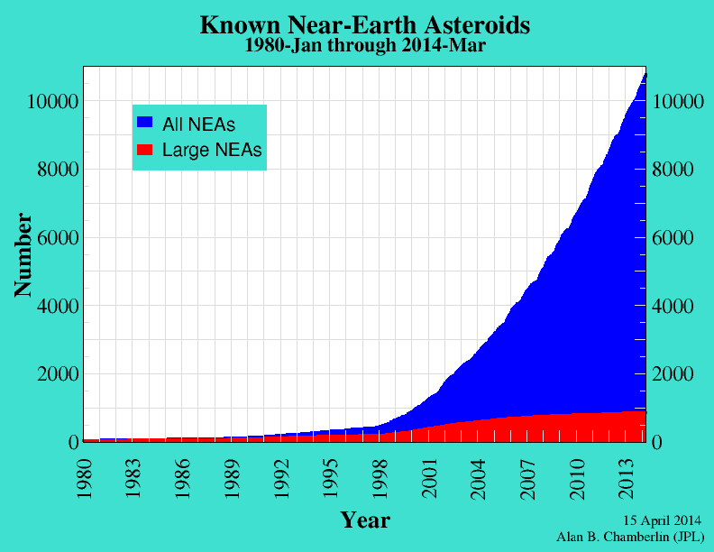
The Problem -
Many dangerous NEOs
  We see many, < 1.0%
  Since 2001 Unseen
    28 NEOs struck earth
    With nuclear force
We can’t see unless:
  Sufficiently large
  Not traveling in a path hidden by the sun
If impending earth collision, no good options
Urgent minimum action: Early warning system
Notes:
I use NEO because it doesn’t take up as much room on the slides.
Discovered by:
Ground based Catalina, Pan-STARRS, LINEAR, Spacewatch & spacebased NEOWISE
UN nuclear blast detectors
Current options: each would take months of prep
crash a spacecraft into it - only works for small to medium asteroids
hit it with a nuclear bomb – unknown unintended consequences for earth

Slide 5
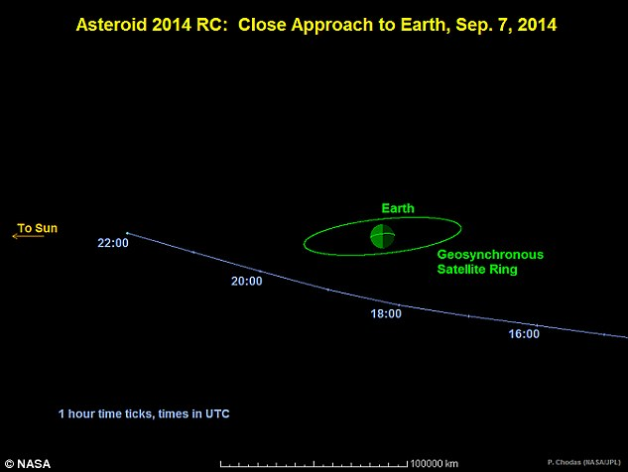
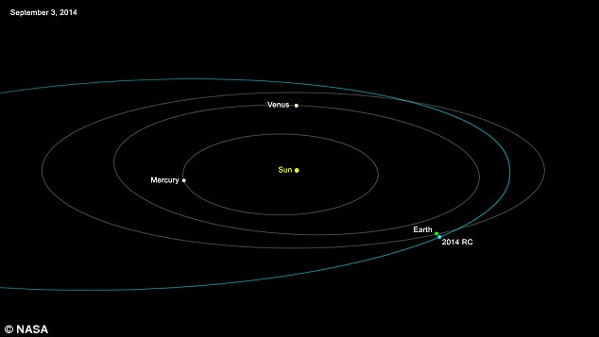
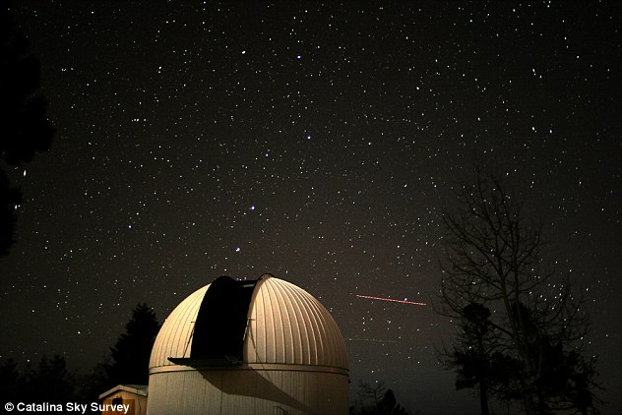
Elliptical Orbital Pattern
Notes:
Look at what happened this last Sunday 25,000 miles over South Wales. The 60 foot asteroid almost entered the Geosynchronous orbit of the Worlds Satellites, and could have caused hundreds of millions of dollars loss and unknown schedule for replacements. The news said it missed us and all asteroids are seen and No asteroid is coming to hurt us. The next sentence they said the one last year that hit Russia just “slipped” through their watch. As I mentioned before 28 nuclear explosions have been created by medium asteroids and we SAW NONE of THEM! The ones that miss will be back and we need to be ready.

Slide 6
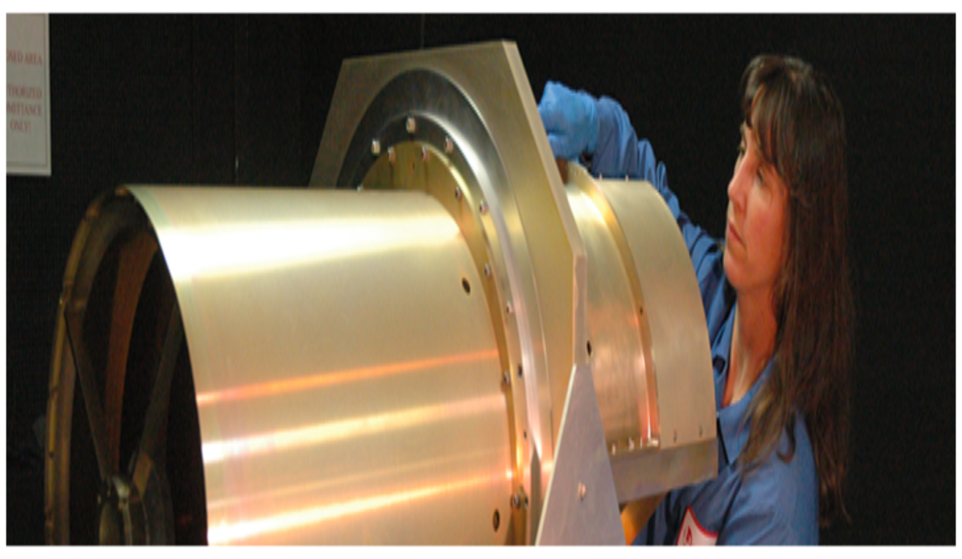
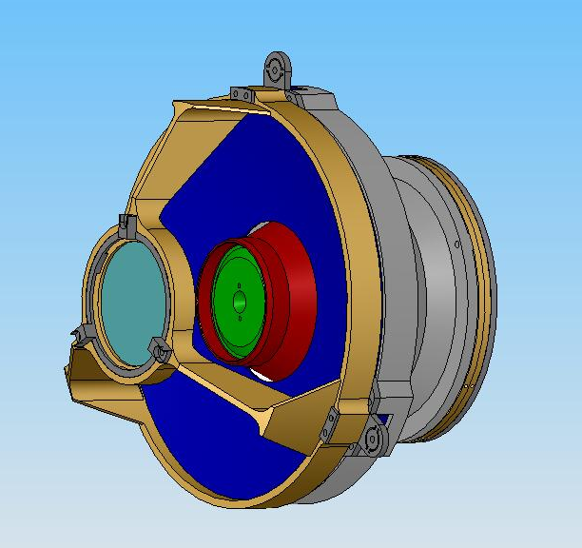
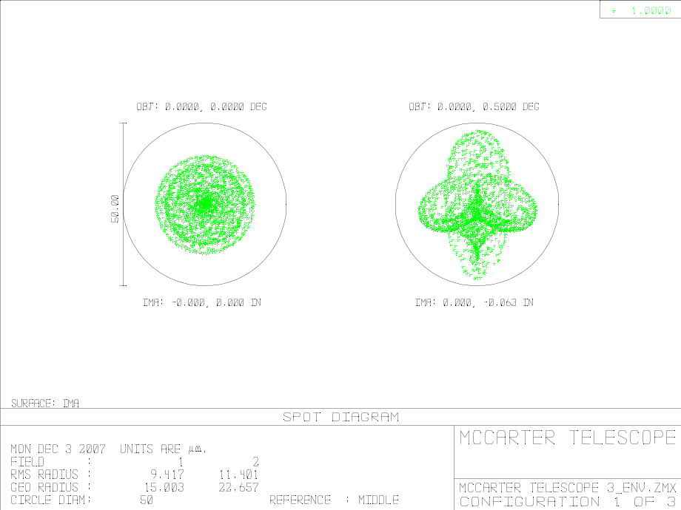
JPL Aluminum WISE
Axial Displacement Error
20 degrees Celsius
Temperature change
-170k to 500 C
McCarter CAIT
Notes:
Single Crystal Silicon

Slide 7
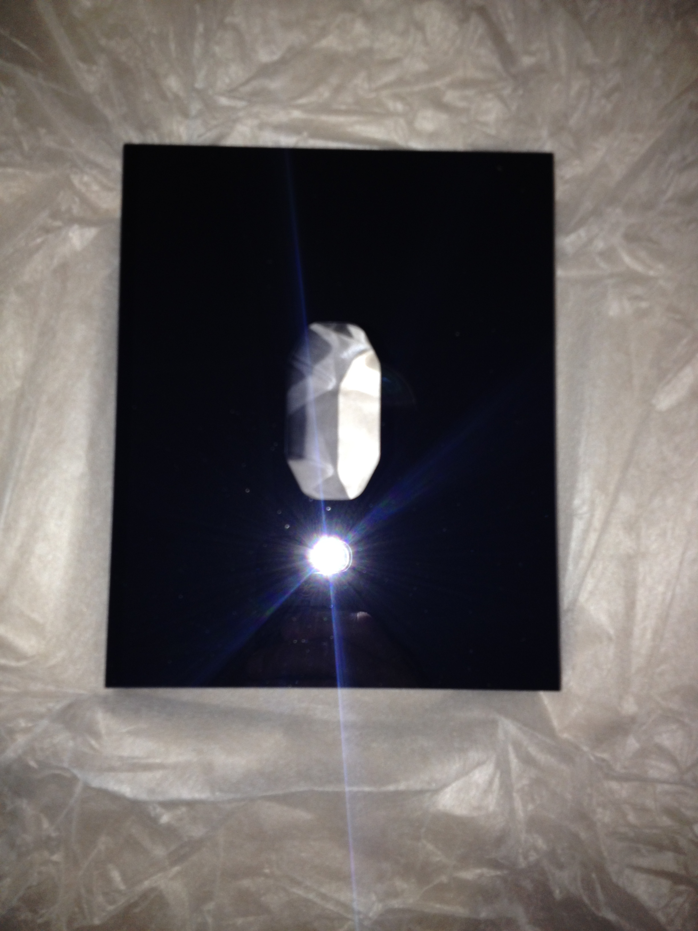
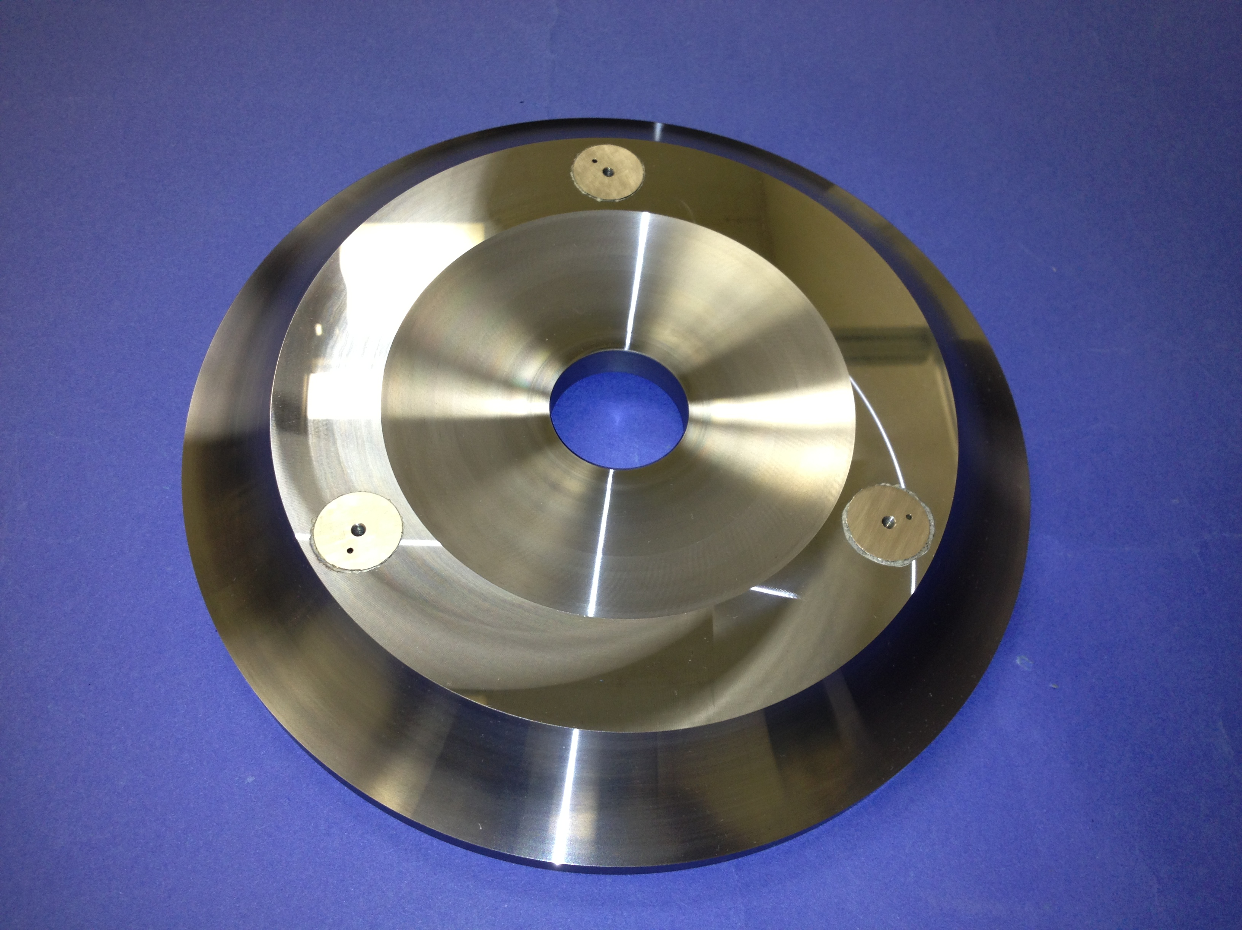
Why SC-Si?
Combination of properties superior for space based high energy applications:
  Lightweight, stiff and strong
  THE BEST combination of thermal properties:
    Even better at lower temperatures
Lowest floor-to-floor cost and schedule of all competing materials
  Readily available material
  McCarter proprietary/patented processes:
    CAD/CAM with conventional tools
    Glass Frit Bonding
    McCarter Super Finishing
Notes:
Complex Geometries achieved without any residual Subsurface Damage
Compact Modularity using GFB metal inserts with low stress/strain
SuperFinishing on conventional machines saves cost and schedule for optical finishing
Meter Class Silicon Optics size only restricted by oven capacity

Slide 8
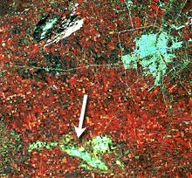
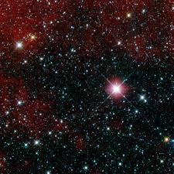
Silicon Infrared Synergy for Earth or Space to Provide Accurate Position for Accurate Prediction
Notes:
The Geoscience Study of Shadows provide for discovery of downwind deforestation, insect and pestilence removal, crop disease as shown, weather monitoring and even illegal crops in the middle of a jungle. This can improved by a factor of an order of a magnitude by using SCSi. As I learned last year in San Antonio Texas at the 1st annual conference on Lasers-Optics and …….that there is a need for Increased Data Resolution and in fact, Accurate Positioning provides Accurrate Prediction. We can not predict at this time because the materials that are used are inefficient.

Slide 9
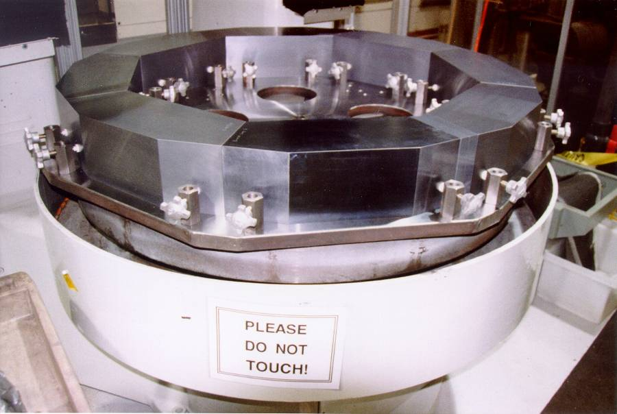
Where Can SC-Si Be Used?
For infra-red systems
  Mirrors, lenses, prisms, windows, structures
Size matters:
  SC-Si can be as big as you need
  McCarter’s glass frit bonding makes it possible
Attachments
  SC-Si to SC-S
  SC-Si to metal

Slide 10
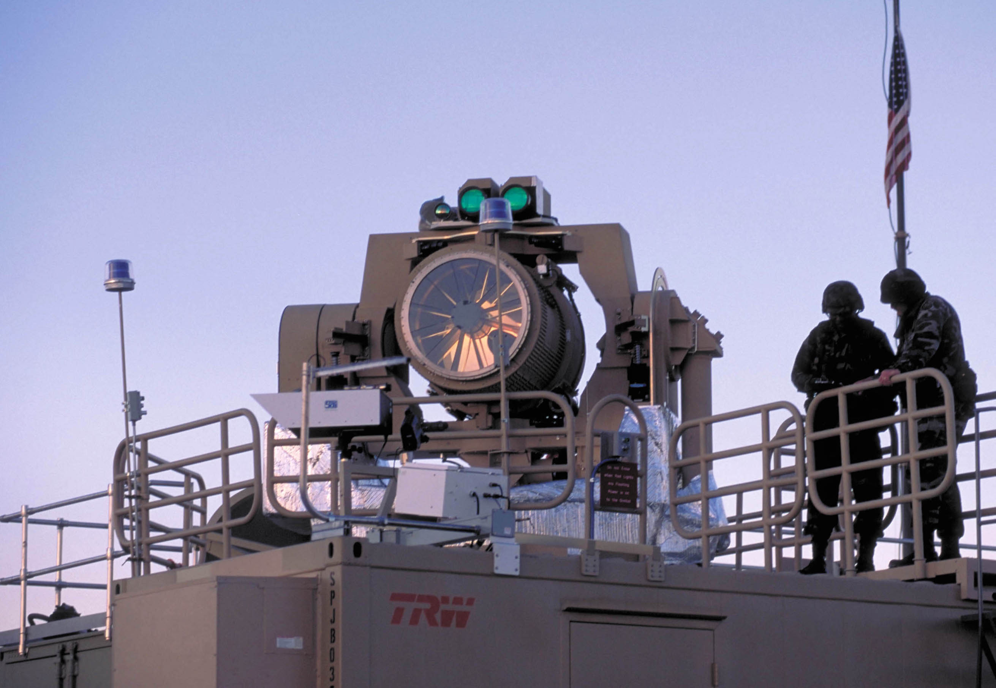
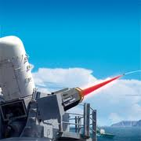
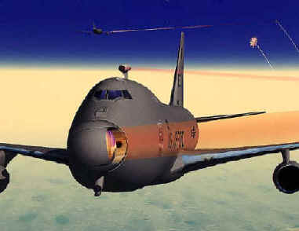
Must Deflect Or Destroy
Many scenarios to capture, deflect or destroy
Space borne high energy lasers with SC-Si mirrors:
  Only reliable solution to deflect/destroy asteroids
Mirror material is critical
  Can not blur or creep in operation
  “Accurate Positioning = Accurate Prediction”
SC-Si is the solution because:
  History of high energy laser mirror successes
  Space qualified
Notes:
Works for both organic and inorganic asteroid management. Thermal Cycling breaks apart asteroids as discovered this year in and reports published in Nature Advance Online Publication and Marco Delbo of the Côte d'Azur Observatory in Nice, France, .
Al NEOWISE loses image with sudden temp change
successes - Zenith Star; THEL; ABL; MTHEL; CRAM; Spaced Based Laser IFX
in 2001 thru 2005 on MISSE 1 & 2 and at NASA Goddard in 2000-2005 & 2013

Slide 11
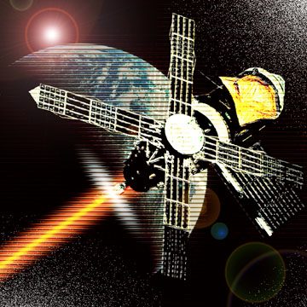
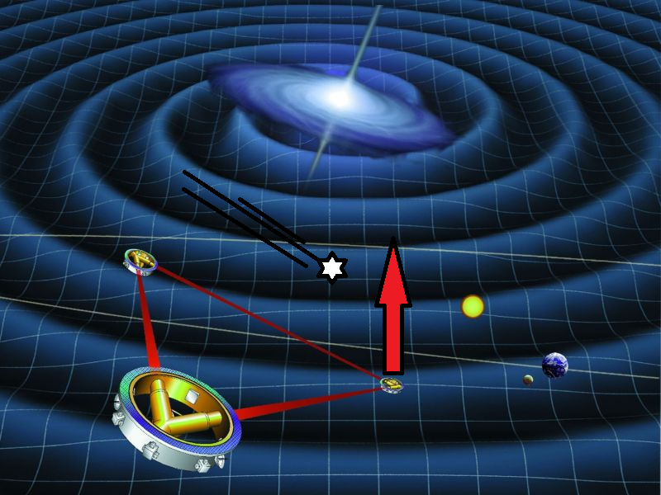
Proposed Scenario
Detection:
  Array of wide angle cryostable
  all silicon imaging telescopes
  telescopes CAIT tm
Deflect or destroy:
  Array of space-borne silicon commercial high energy lasers
  Destroy small ones
  Deflect larger one’s orbit
    Ablation of selected area(s)
    Capture for study if possible
McCarter CAIT
McCarter SBL
McCarter FCF
Notes:
They can build on one another and back up a human error malfunction if necessary
Once detected and orbit defined:
Begin by clearing earth orbit of space trash
Perfect targeting and power control early
Force offsets force
PROTECT ALL Satellites ‘Geosyncrencenious Orbit with HEL Relay Systems. Attack asteroids with Space Drone HEL battalion.
Relying on gravity tug satellites is optimistic at the most

Slide 12
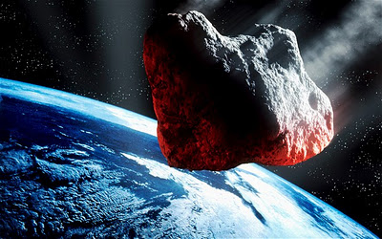
Make It Happen
Funding required now
  International effort required
SC-Si available now up to 460mm (18”) in diameter
Facilities in place to make it happen now
But mature designs are needed
  Sentinel?
  DE-STAR?
  NEOWISE replacement?
  New SC-Si D/D (Detect/Deter)
  All are needed
    Lessons learned combine to build the best/most reliable systems
    Unlimited resource potential and learning from captured asteroids
Notes:
Even if a city is not hit in USA there will be Economic collateral damage

Slide 13

All It Takes Is Money
Early Warning System 7 years not 7 days with SCSi Telescopes
Maintain Communication with all Efforts
Build FCF Solar Powered HEL Systems Adjacent to Protect Geosynchronous Satellite Orbit
Build Space Fence for Moon Orbit Collection
Build Solar powered Space HEL Drones for Attack
Notes:
Sentinel funds from everyone, all can help
Have to have a captured asteroid with active mining operation before any money available – many years away

Slide 14
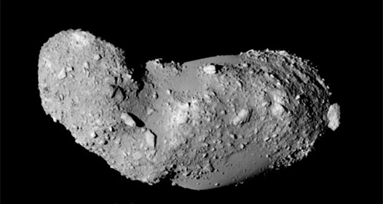
The “Beast is only a Rock”

Slide 15
Let Us Meet Again
We welcome all to our future group conferences of Omics group international
Please visit:
www.omicsgroup.com
www.Conferenceseries.com
http://optics.conferenceseries.com/

