Slide 1

Correlating Qualitative with Quantitative Measurement of Sea Level Rise in Florida Bay
Douglas J. Leaffer, MSCE, PG, EIT

Slide 2
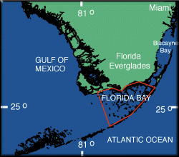
Area of Study
NOAA Gauging Station at Lat 24º 42.7’ N, Long 81º 6.3’ W

Slide 3
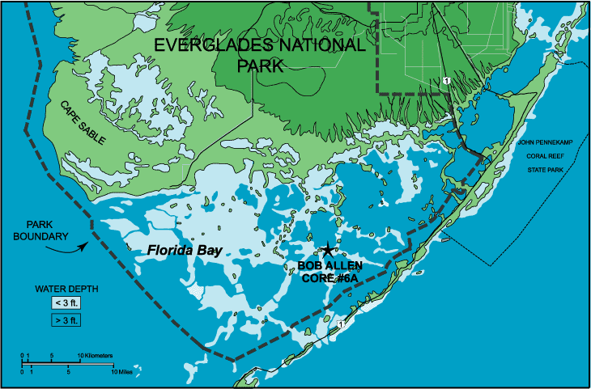
Florida Bay
Flamingo, FL
Vaca Key

Slide 4
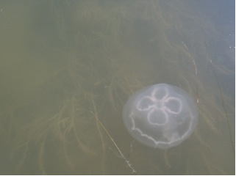
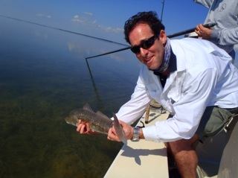
Shallow Water, Sensitive Environment

Slide 5
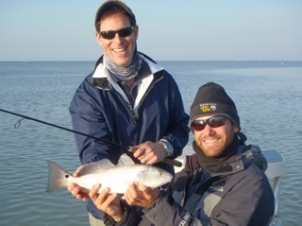
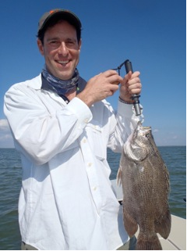
Florida Bay with Fishing Guide

Slide 6
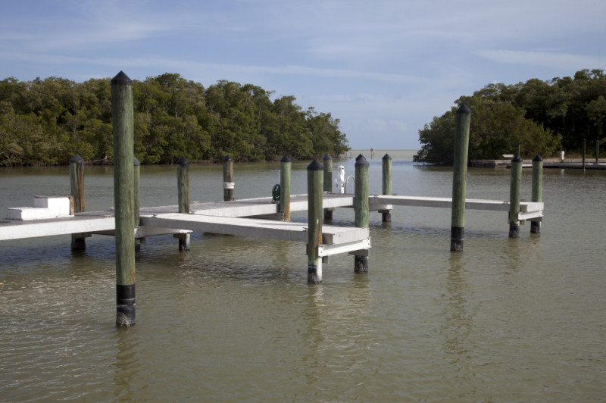
Boat Docks at Flamingo, Florida

Slide 7
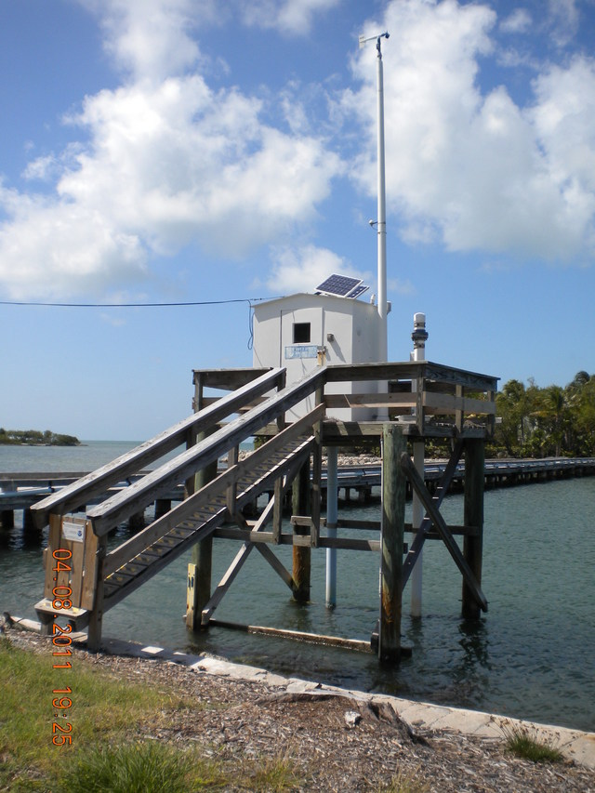
Vaca Key, FL – NOAA Station 8723970

Slide 8
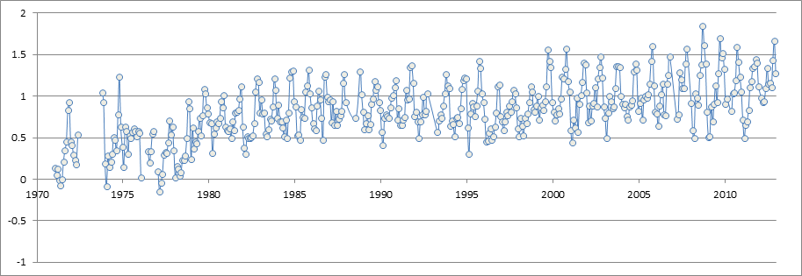
Monthly Mean Sea Level (MSL) Trend
Normalized change in feet
Annual Fall Flood Heights in the 1980’s are now Average Heights (2010’s)

Slide 9
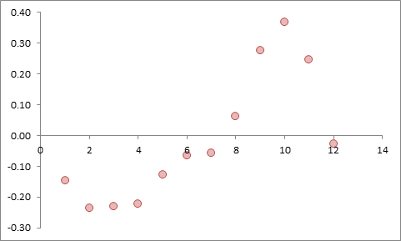
Avg. Water Height Variations by Month
Flamingo Docks Submerged
Peak in October
NOAA Station # 8723970 - Data Shown are Heights in Feet +/- MSL (2012)

Slide 10
Qualitative Observations Today
Dock submergence (Flamingo, FL) for 2 months / year compare to 2 -3 weeks (1980’s) – per fishing guide
Prolonged flooding a frequent event after strong storms (Miami Beach)
Non-storm event seawater flooding during lunar high tides
Significant beach erosion (Central FL southward to Miami-Dade County)
Salt water intrusion into Biscayne Aquifer (since 1950’s)
Source: Sea Level Rise and its Impact on Miami-Dade County, WRI Fact Sheet, 2014

Slide 11
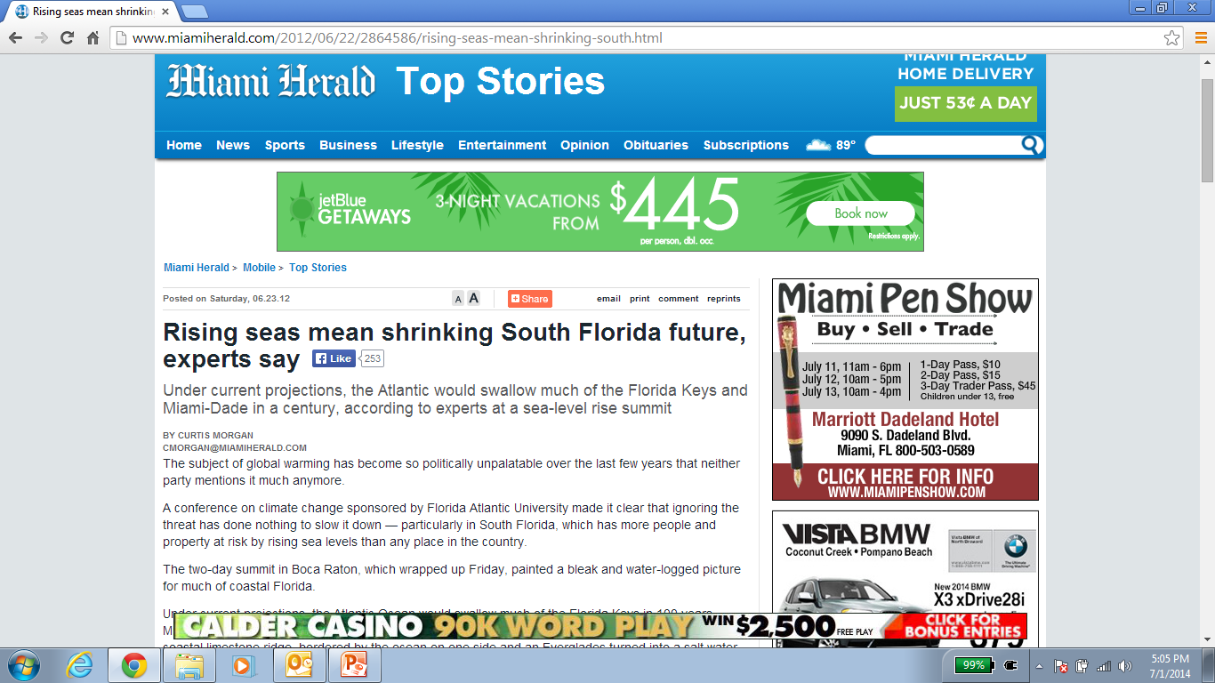
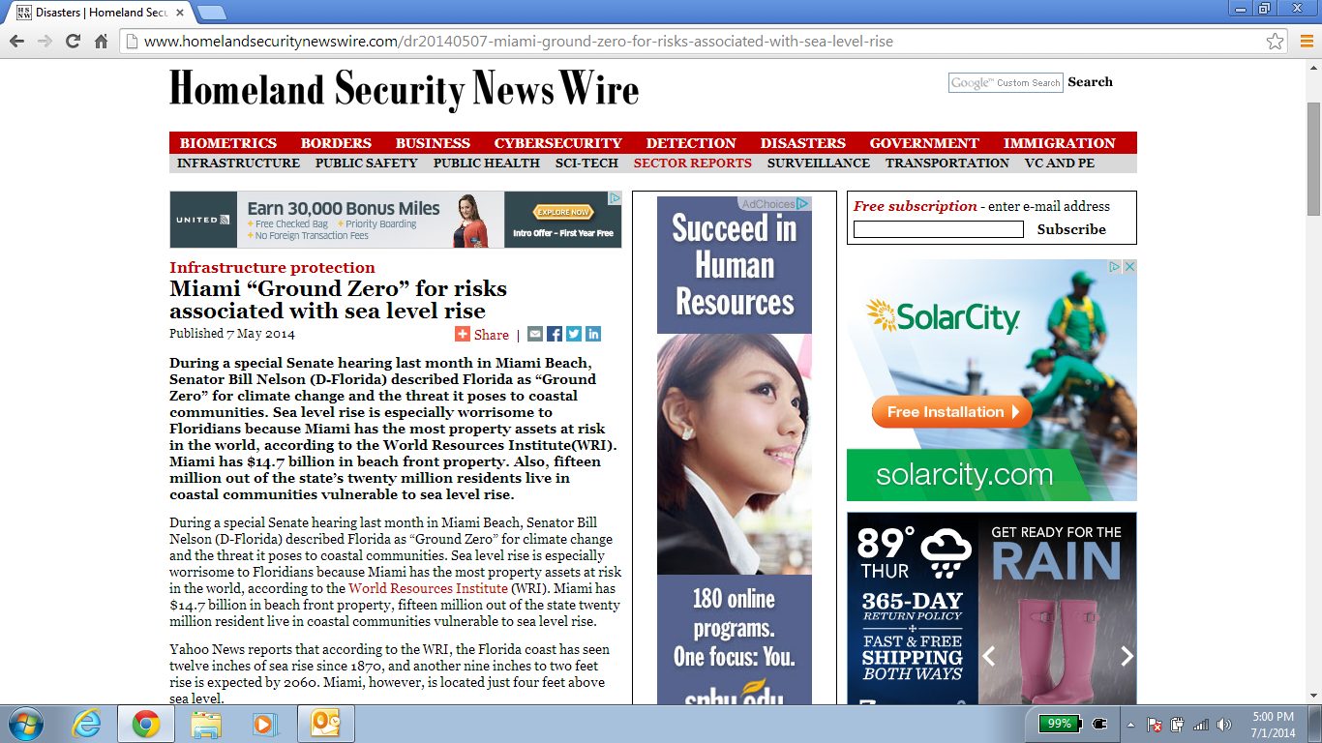


Slide 12

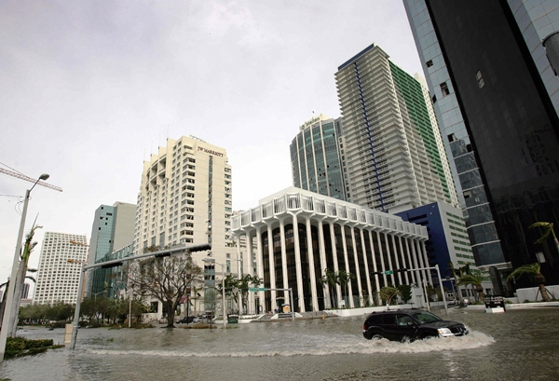
"Miami, as we know it today, is doomed," says Dr. Harold Wanless, Chairman of the Department of Geological Sciences at the University of Miami (RollingStone: 6/20/13)

Slide 13
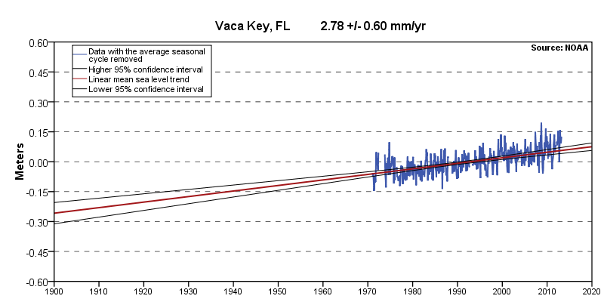
Statistical Monthly MSL Trend
Equivalent to a Sea Level Rise of 0.91 feet in 100 years

Slide 14
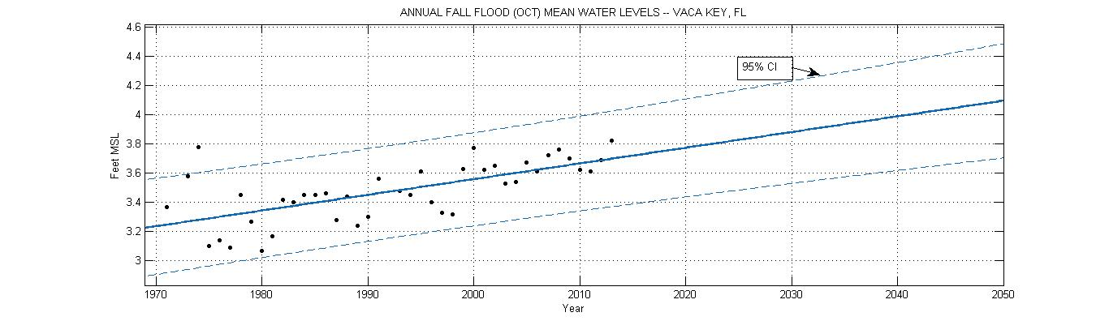
Annual Fall Flood Mean WL Forecast 2015-2050
Source: NOAA
Note: Dampening Amplitude of Annual Fall Flood Oscillations

Slide 15
Existing Flood Risks - South Florida
Every coastal flood today is already wider, deeper and more damaging, due to
roughly 8 inches of warming-driven global sea level rise recorded since 1900 (IPCC 2013)
This rise has already increased the annual chance of extreme coastal floods threefold at Key West, a proxy for Southeast Florida
Source: Florida & the Surging Sea, A Vulnerability Assessment. Climate Central, 2013

Slide 16
Climate Central Projections
Eight water level stations around coastal Florida
Projections across the locations varied only slightly
Analysis projects a range of local sea level rise
  0.6-1.3 feet by 2050, and
  1.7-4.7 feet by 2100, at Key West (MSL 2012 baseline)
End-of-century projections at the seven other water level stations range from:
  3 inches lower (Apalachicola) to about
  2 inches higher (Vaca Key)
Source: Florida & the Surging Sea, A Vulnerability Assessment. Climate Central, 2013

Slide 17
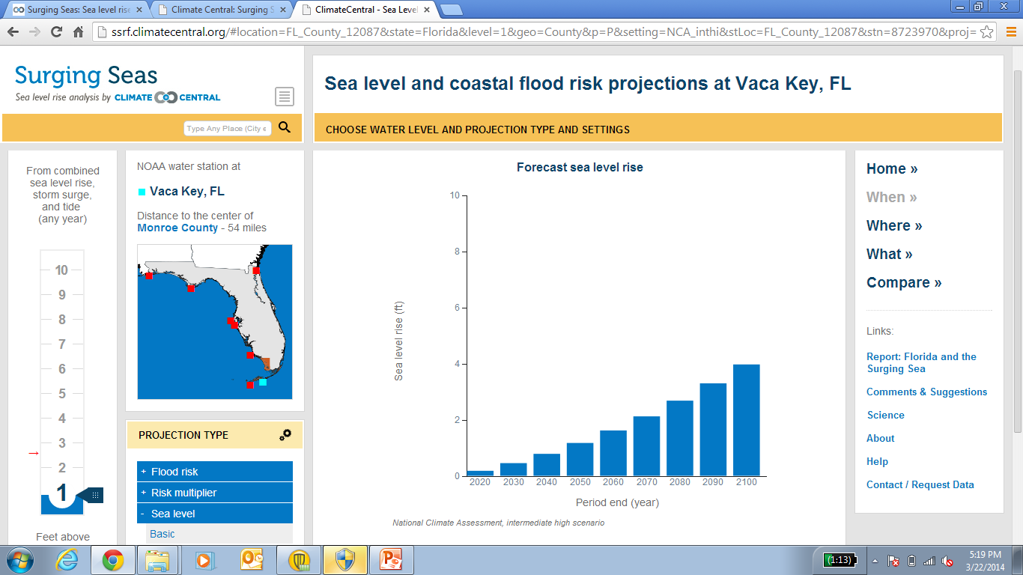
Source: Florida & the Surging Sea, A Vulnerability Assessment. Climate Central, 2013

Slide 18
Populations and Receptors at Risk
Miami-Dade alone has more people living less than 4 feet above sea level than any state in the nation except Louisiana
More than 10 percent of land in Miami-Dade sits at less than 1 foot above current sea level,
  nearly 20 percent at less than 2 feet, and
  one-fourth at less than three feet.
Homes, businesses, roads, infrastructure, wastewater treatment facilities, hazardous waste sites

Slide 19
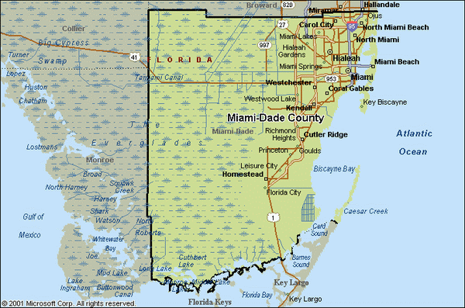
Map of Miami-Dade County

Slide 20
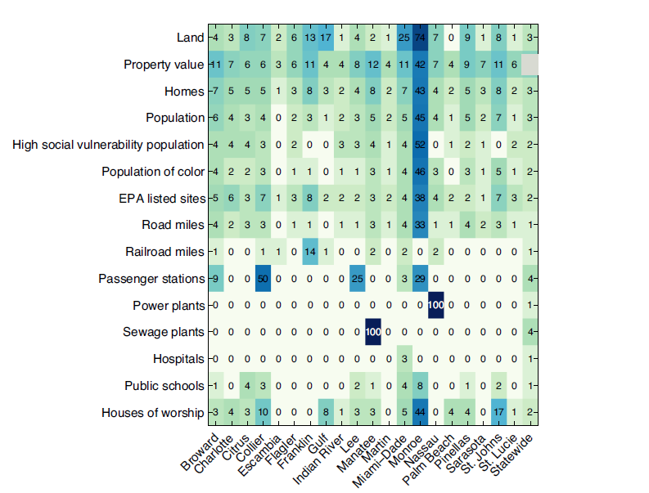
People, Property and Infrastructure on Land < 3 ft. (% pop.)
Source: Florida & the Surging Sea, A Vulnerability Assessment. Climate Central, 2013

Slide 21
Adaptation and Mitigation
Current pattern of development and housing density may reflect attempts to steer clear of historic flood risk
Roughly 23 million cubic yards of beach renourishment needed over the next 50 years to sustain aesthetic and tourism viability of South Florida beaches
Addition of high-capacity pumping stations costing approximately $70M each (plus necessary land acquisitions) to augment existing flood/salinity control structures
Stormwater management, recapture and storage
Construction of higher seawalls

Slide 22
Conclusions
Since 1870, average global sea level rise of 8 inches
In Southeast Florida, sea level has risen 12 inches
Qualitative observations today demonstrate SLR is occurring in “real-time”
By the year 2060, it is estimated that sea levels along Florida’s coastline could rise between another 9 inches to 2 feet
Major impacts to population, property, infrastructure
Mitigative measures and adaptation in progress
Source: Sea Level Rise and its Impact on Miami-Dade County, WRI Fact Sheet, 2014

Slide 23
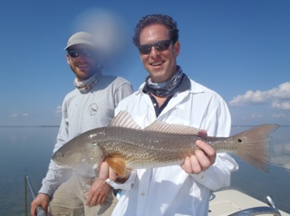
Florida Bay - an Environment at Risk

Slide 24
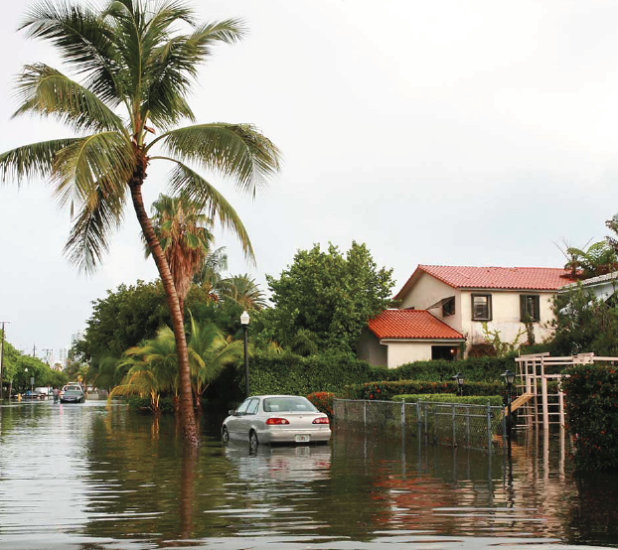
Douglas J. Leaffer, MSCE, PG, EIT
Framingham State University
dleaffer@framingham.edu

