Slide 1

About Dr. Spiel
Dr. Spiel has specialized in pain treatment for 15 years. He is well-known and has significant expertise in all new and effective approaches for treating pain. As a result, Dr. Spiel is able to offer the most relevant and appropriate treatment options to patients who have not been treated successfully to date. This knowledge and experience, in conjunction with his broad and unique background, including certifications in interventional pain and radiology, has resulted in highly successful outcomes for his patients.

Slide 2
Patent Pending Statement
The materials in this presentation include explanations and descriptions of developments that are the intellectual property of Douglas Spiel, MD and patents for these developments have been applied for and are pending.

Slide 3
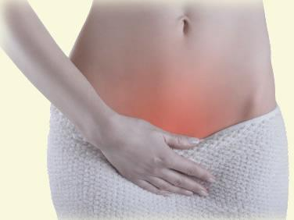
Towards a New Understanding of
Chronic Pelvic Pain

Slide 4
Definition: Non menstrual pelvic pain of greater than 3 months or pelvic pain greater than 2 weeks per month for 6 months causing functional disability requiring medical or surgical treatment.
Prevalence:
15% of the female population age 18 to 50
Most common indication for referral to health services
10% of all GYN referrals
Higher prevalence in patients with depression and sexual abuse history
Costs:
Medical 2.8 B/yr
Loss of productivity 15 B/yr

Slide 5
Prognosis
Poor -
In a study of 72 women followed for 3.4 years only 25% had recovered substantially.

Slide 6
Why is this so difficult to treat?
Lets look at the etiologies:
Level A evidence

Slide 7
Gynecology
Endometriosis
Gynecologic Malignancies*
Ovarian Retention Syndrome
Ovarian Remnant Syndrome
Pelvic Congestion Syndrome
Pelvic Inflammatory Disease
Tuberculous salpingitis

Slide 8
Urologic
Bladder Neoplasm*
Interstitial Cystitis/ Painful bladder syndrome (IC/PBS)
Radiation Cystitis

Slide 9
Gastrointestinal
Carcinoma of the colon*
Constipation
Inflammatory bowel disease
Irritable bowel disease

Slide 10
Musculoskeletal
Abdominal wall myofascial pain
Chronic coccygeal or back pain
Faulty posture
Fibromyalgia
Neuralgia of Iliohypogastric, Ilioguinal, Pudendal or genitofemoral nerves
Pelvic Floor tension myalgia
Peripartum pelvic pain syndrome

Slide 11
Other
    Abdominal cutaneous nerve entrapment in a surgical scar
    Somatization disorder
    Prior Pelvic Surgery

Slide 12
Important Facts:
Many patients have no documentable abnormal anatomy
80% have endometriosis
40-60% have concomitant IBS
80-90% have depression
45% have dyspareunia(seen in 75% of patients with IC)
38-85% have IC (urinary urgency, frequency, bladder or pelvic pain in absence of infection)
30% Pelvic varicose veins
Dysmenorrhea, the most common feature of recurrent pelvic pain is seen in approximately 75% of woman
30% of patients with PID develop CPP
65% of patients with endometriosis have IC
Frequent complaints of vulvodynia
72% of patients from tertiary care center specializing in CPP had more than one diagnosis
The hallmark of IC, Hunner’s ulcers, are seen in only 10% of patients with IC

Slide 13
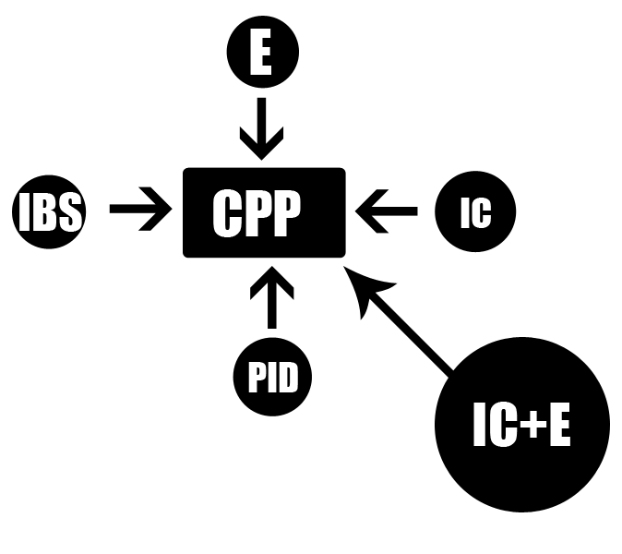
What does this mean?

Slide 14
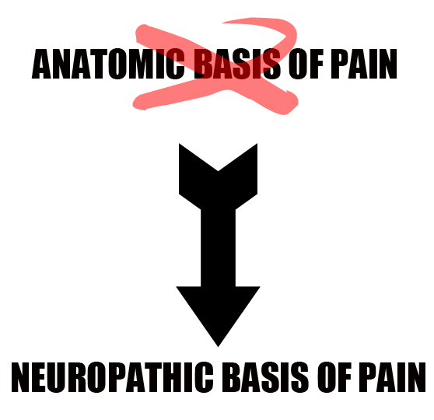
A new hypothesis to CPP

Slide 15
Pelvic Insults
Surgery
Radiation
Pelvic Inflammatory Disease
Endometriosis
Interstitial Cystitis
Inflammatory Bowel Disease
Irritable Bowel Disease
Chemically Induced Ovulation
Cancer

Slide 16
The insult is irrelevant!
Treat the end result!

Slide 17
Neurobiology
Nociception and pain
Sensory afferents are either C-fibers or A-delta fibers. Afferents synapse on 2nd order neurons of the spinothalamic tract in dorsal horn.
3 types of second order neurons
1) Low threshold mechanoreceptors
2) High threshold nociceptors
3) Wide dynamic range neurons(WDRs)
WDRs are multireceptive:
1) A– Delta
2) C- Fibers
3) A- Beta
4) Visceral Afferents
This convergence of afferents on one neuron helps explain loss of specificity and referred pain.

Slide 18
Neurobiology Continued
2nd order neurons cross over to the contralateral spinal cord and ascend to the brain.
In the thalamus they synapse on 3rd order neurons which carry signals to the somatosensory cortex.
Somatics have cortical representation, visceral afferents don't.
Descending pathways (inhibitory pathways) are triggered in CNS-Cortex, thalamus, PAG, nucleus raphe magnus, locus coeruleus which stimulate inhibitory neurons in the dorsal horn.
These inhibitory neurons synapse on the primary afferents and 2nd order dorsal horn neurons. Inhibitory neurons release endogenous opioids and inhibitory neurotransmitters like GABA which have an antinociceptive effect.

Slide 19
Mechanism of Chronic Pain
When peripheral nociceptors receive noxious stimuli of sufficient intensity, NMDA receptors in the dorsal horn are stimulated which increase the excitability of other 2nd order neurons- this is known as wind up.

Slide 20
Peripheral Sensitization
A heightened response of primary afferents to nociceptive inputs
  Inflammatory neurotransmitters may sensitize these afferents (IE, endometriosis, IC, vulvodynia)
  Abnormal or excessive sprouting of nerve terminals at a site of injury
  After initial peripheral nerve injury there is a greater loss of C-fibers compared to larger A–Beta fibers, so A-Beta fibers sprout new branches in the dorsal horn synapsing with 2nd order neurons in positions previously vacated by the C-fibers. As a result, A–Beta fibers can take on a nociceptive role, ie cutaneous allodynia after viscerosomatic pain referral

Slide 21
Sympathetically Mediated Pain
Sympathetic nociceptors may become up regulated and sensitized by injury or ongoing neurogenic inflammation
Abnormal sprouting may occur in neuromas or in the dorsal root ganglion
The proliferation of sympathetic neurons in the lower reproductive tract of animals is under estrogen control
Estrogen may effect vulnerability to SMP

Slide 22
Central Sensitization
Changes in CNS that facilitate, enhance or distort pain.
Largely mediated by WDR neurons
WDRs are excited by activation of NMDA receptors and by decreased inhibitory neurotransmitters (from descending pathways)
Visceral afferents produce more dorsal horn excitability than somatics
Neuroinflammation in the spinal cord which facilitates central sensitization is a key mechanism behind the multiorgan involvement of chronic pelvic pain = neural cross sensitization.
Intimate close connections in the dorsal horn of the spinal cord allow neuroinflammation to spread from involved to uninvolved neurons.
Once the end terminal of the previously uninvolved afferent is stimulated in the dorsal horn, substance P travels retrograde down C- fibers and A- Delta fibers leading to sensitization at terminal nociceptors.

Slide 23
Central Sensitization Example
Rats with surgically induced endometriosis demonstrate reduced bladder capacity, vaginal hyperalgesia and increased visceral pain.
- “Neural Crosstalk”

Slide 24
Other Systemic Factors
Concomitant inflammatory and autoimmune syndromes are significantly more common in patients with IC.
IC patients are:
    100 times more likely to have inflammatory bowel disease
    30 times more likely to have SLE
    50 times more likely to have Sjögren's syndrome

Slide 25
Anatomy of the Pelvic Nervous System
The superior hypogastric plexus receives post ganglionic post sympathetic contributions from the inferior mesenteric ganglion and from the hypogastric nerves.
These post ganglionic sympathetic fibers continue down through the inferior hypogastric plexus to innervate the lower pelvic structures as well as the vulva.
Parasympathetic innervation arises from the second, third, and forth sacral segments and contribute to the plexus via the pelvic nerve.

Slide 26
Visceral Afferents:
Anatomy of the pelvic nervous system continued
Pelvic structures within the peritoneum have their afferents pass through the super hypogastric plexus and enter the spinal cord via T11, T12, L1, or L2 spinal nerve roots.
Extra peritoneal structures have their afferents pass through the inferior hypogastric plexus and pelvic splanchnic nerves and enter the spinal cord via S2, S3, and S4 spinal nerve roots, except the lower vagina and vulva whose visceral afferents pass through the pudendal nerve.

Slide 27
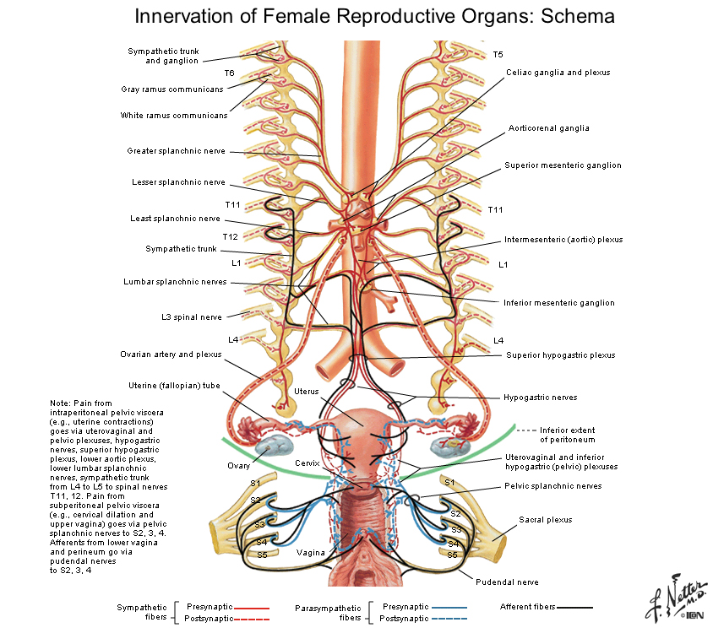

Slide 28
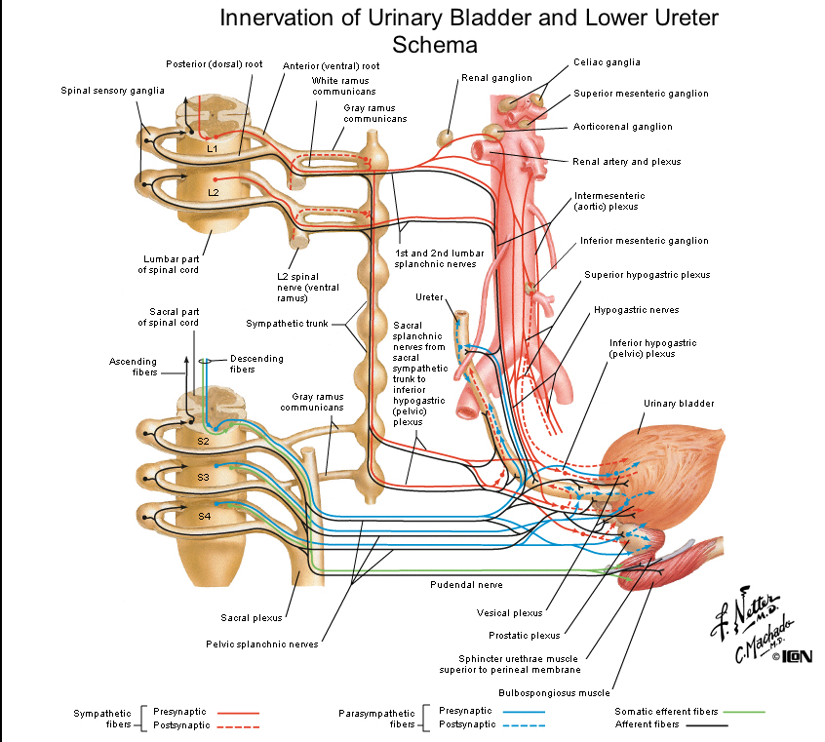

Slide 29
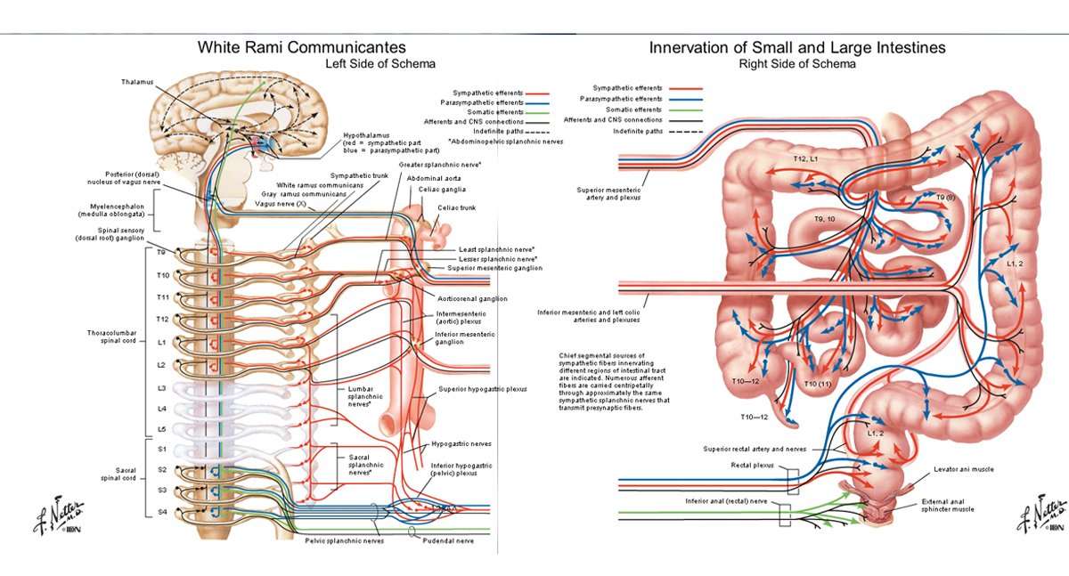

Slide 30
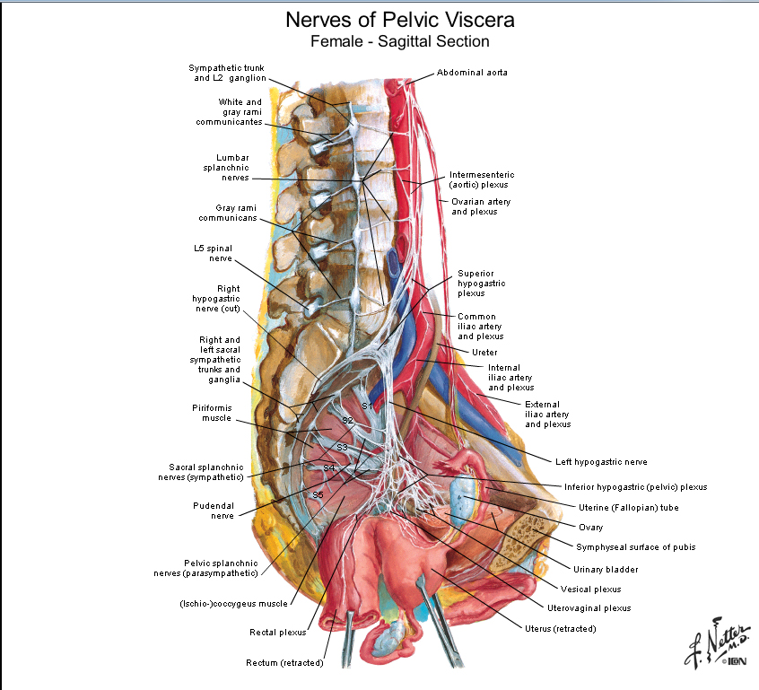

Slide 31
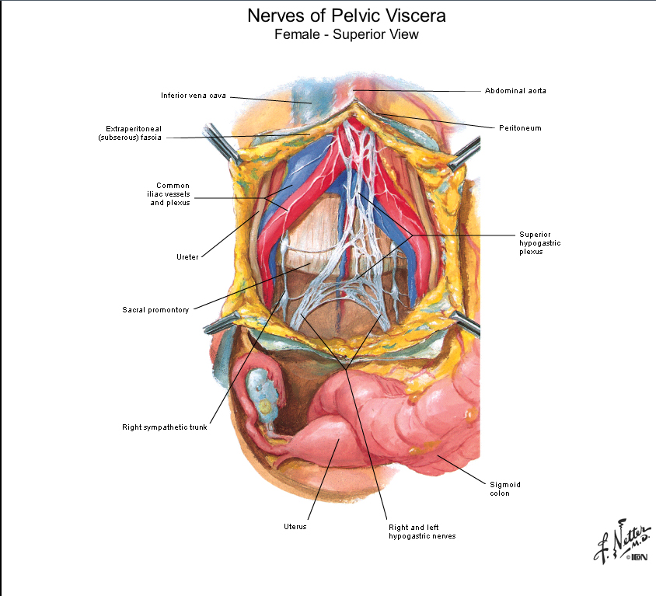

Slide 32
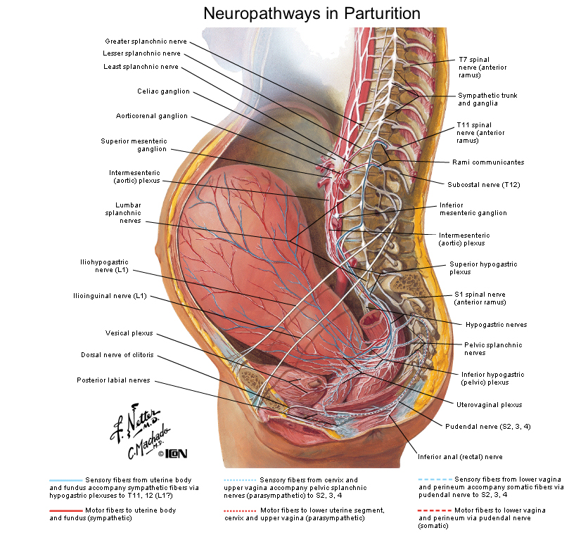

Slide 33
What other medical condition begins with an insult and leads to severe chronic regional pain?
CRPS
Complex Regional Pain Syndrome

Slide 34
CRPS Signs and Symptoms
Sensory
  Hyperesthesia
  Allodynia
Vasomotor
  Temperature
  Skin Color
Sudomotor/ Edema
  edema
  sweating
Motor/Trophic
  decreased range of motion
  weakness, tremor, dystonia
  hair, skin, nail changes
Allodynia
Pelvic Varicosities in 30% of CPP
Pelvic floor muscle dysfunction
Prevalence is 85% in IC

Slide 35
CRPS comes in two flavors
SMP (sympathetically mediated pain)
SIP (sympathetically independent pain)

Slide 36
Anesthetic blockade of acute vs chronic pain
Acute Pain
Hours (halflife)
Chronic Pain
Days, Weeks, Months, ? Years
Why?
Neuroplasticity

Slide 37
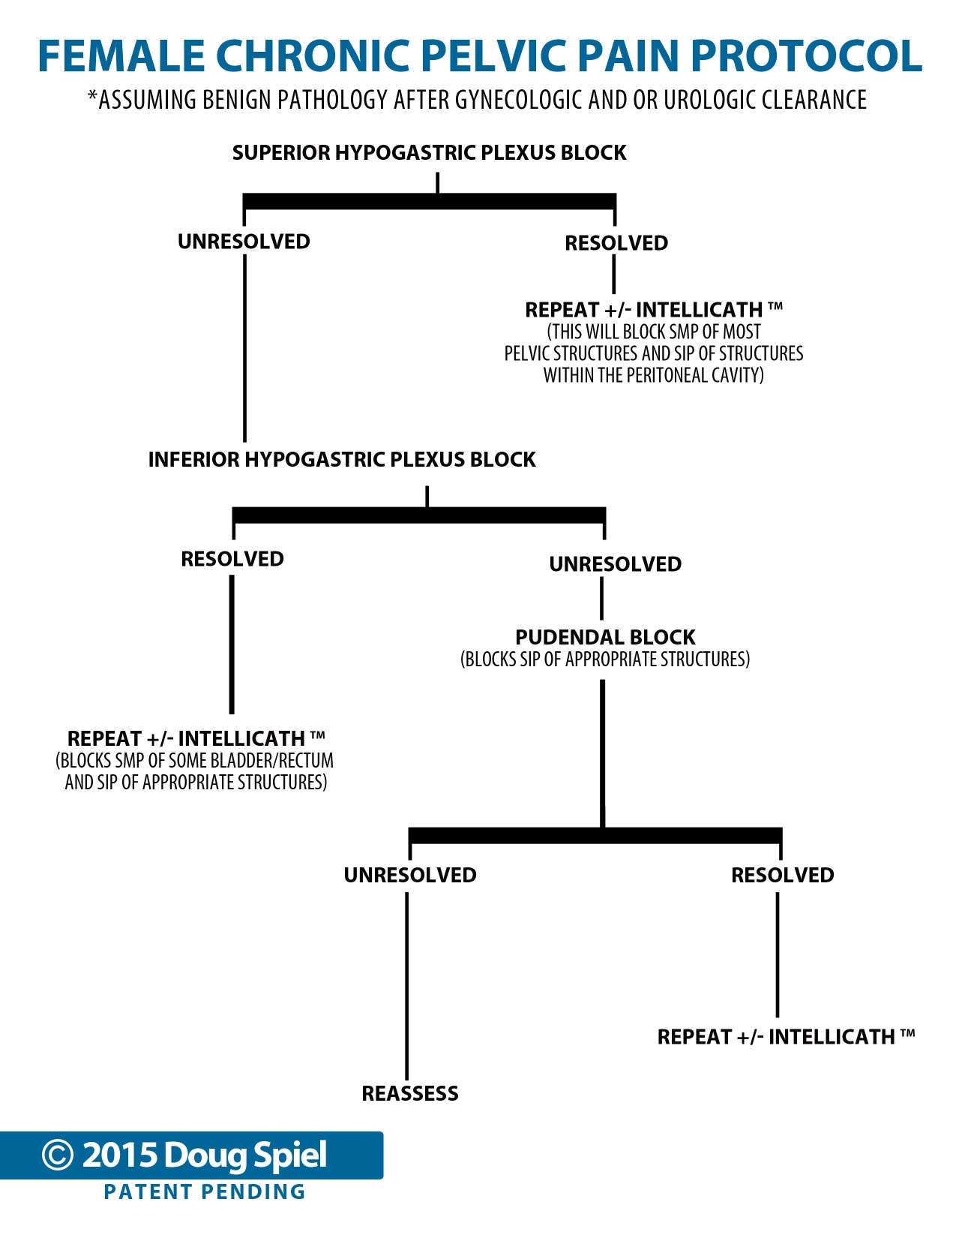

Slide 38
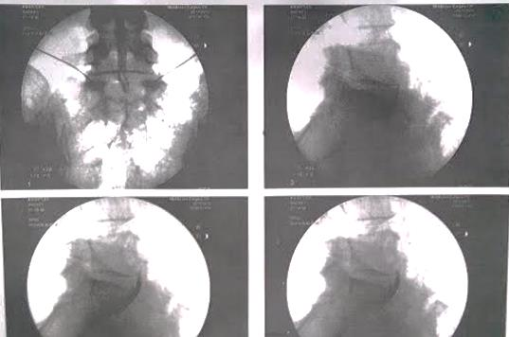

Slide 39

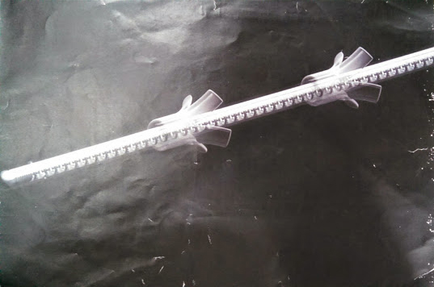
Allows for prolonged anesthetic blockade without repeated trips to the OR
Deployable through a 12 gauge needle
Internal spring coil design resists kinking
Patent protected tines resist migration
Works in concert with external pump and infusion reservoir
Made from the same polymers that are used in devices approved for long term use

Slide 40
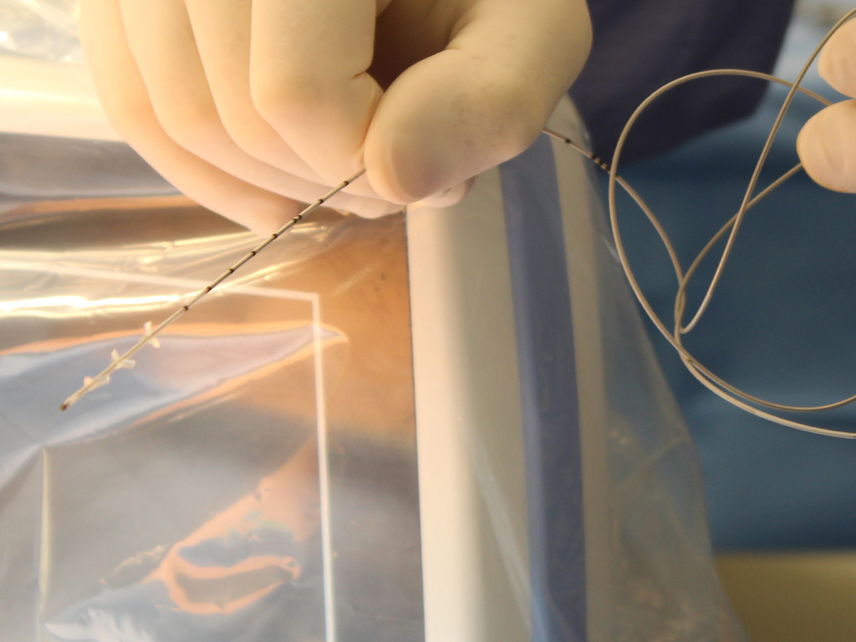

Slide 41
Patient Case Studies

Slide 42
Case Presentation
Patient: A.K.
28 year old female
Endometriosis x 15 years
3 Laparoscopic surgeries
3 Laparotomies
Bladder biopsy with perforation/septic shock
2008 MVA with low back pain 2° facet and discogenic
Symptoms of CPP
Burning Pelvic Pain
Dysuria
Vulvodynia
Dyspareunia
Dysmenorrhea
Frequency
Urgency

Slide 43

Prior Treatments
Suboxone
Oxycodone
OCP
Lupron
Klonopin
Tramadol
Tylenol 3
Mobic
Nortriptyline
Dilaudid

Slide 44
Current Treatment
3-6-14 SHPB
100% initial response x 48°
50% x 1 week
pain with menses
3-20-14 SHPB
3-27-14 SHPB
100% initial relief x 4 days
4-16-14 Follow up
Pain remains improved
Limited pelvic pain, abdominal pain and dysuria despite menses
4-24-14 SHPB
90% dyspareunia
90% dysuria pain
X 2 weeks

Slide 45
Current Treatment Continued
5-22-14 SHPB
5-27-14 Follow up
Patient having menses every 10 days!
+ Severe bleeding x 7-8 days
Severe Dysuria
5-30-14 Follow up
Menses stopped
‘d pain significantly near 100%!
6-17-14 Follow up
Return of pain x 1 week with menses
+ dysuria, pelvic pain, vulvodynia
7-9-14 Follow up
Severe menses = severe pain = dysmenorrhea
menorrhagia x 3 weeks
Still on OCP

Slide 46
Current Treatment Continued
8-7-14 GYN procedure (D+C)
directed at metorrhagia / menorrhagia
8-14-14 SHPB
100% pain relief except some abdominal cramps.
8-21-14 SHPB
8-25-14 Follow up
100% pain relief persists
8-26-14 Moves to Florida
10-28-14 Follow up
Persistent pain relief of dysuria, vulvodynia, dyspareunia, some abdominal cramping during ovulation +menses
11-19-14 Calls office
Informed of impending GYN surgery next week for ruptured ovarian cyst + AP
11-26-14 GYN Surgury
Some persistent pelvic pain

Slide 47
Current Treatment Continued
12-18-14 SHPB
12-22-14 Phone Call
Patient returning to Florida doing well!
3-18-15 Phone Call
Dysuria 80% improved
Burning Pelvic Pain 80% improved
Frequency 80% improved
Urgency 80% improved
Vulvodynia 30% improved
Dyspareunia 30% improved
80 – 90%
1 Month ago

Slide 48
Take Home Points
Treat ongoing anatomic pathology (acute pain)
Address hormonal dysregulation

Slide 49
Case Presentation
Patient: S.F
49 year old female
5-6 IVF Treatments with Medically Induced Ovarian Stimulation (2009-2010)
CPP symptoms x 5 years (began 2010)
Bladder pain
Pelvic cramps
Urethral burning
Dysuria
Urgency
Frequency
Difficulty ambulating
Difficulty sitting
Vulvodynia
Dyspareunia
Pelvic floor spasms
Constipation
Depression

Slide 50
Prior Treatments:
Continued S.K.
OCPs
TCAs
Percocet
Pyridium
Uribel
Vesicare
Refused cystoscopy
Refused bladder distension
Refused progesterone

Slide 51
Continued S.K.
Current Treatments:
1st SHPB
1 week
65% improved symptoms
2nd SHPB
4 weeks
80 - 85% improved symptoms
Mild exacerbation during menses
3rd SHPB
1 week
70% improved symptoms
4th SHPB

Slide 52


Slide 53
Prostatodynia, or chronic pelvic pain syndrome (CPPS) designates unexplained chronic pelvic pain in men.
- National Institute of Health

Slide 54
Etiologies of Male Chronic Pelvic Pain

Slide 55
Associated with Male Chronic
Pelvic Pain – Causes?
Urinary Tract Infection
Urinary Obstruction
Interstitial cystitis
Irritable bowel disease
Inflammatory bowel disease
Constipation
Prior pelvic surgery
Chronic Back Pain
Fibromyalgia
Bladder Cancer
Radiation Cystitis
Colon Cancer
Abdominal wall myofascial pain
Chronic coccygeal pain
Faulty Posture
Iliohypogastric, Ilioinguinal,
Pudendal or Genitofemoral neuralgia
Pelvic Floor tension Myalgia
Abdominal cutaneous nerve entrapment
Somatization disorder
Epididymis
Vasectomy
Genitourinary Malignancy

Slide 56
Prior Treatment
Digital rectal exam
Ultrasound
Urinalysis
Lengthy course of antibiotics
Oral muscle relaxants
Alpha adrenergic blockers
Prostatic massage
Modified Diet
Heat therapy
Cystoscopy
Hydrodistenion
Videourodynamics
Therapeutic Ejaculation
Transurethral resection of the prostate
Myofascial Release Therapy

Slide 57
Chronic Prostatitis Facts
Most common urologic diagnosis in men > 50
3rd most common urologic diagnosis in men < 50
2 M office visits / yr
Average Urologist sees 10 pts / month
Urinary pathogens are rare (Less than 10% of cases show a bacterial cause.)
1/3 show histologic signs of inflammation after prostate biopsy
*Men with CP/CPPs show evidence of having a
“pan-pelvic hypersensitivity syndrome”

Slide 58
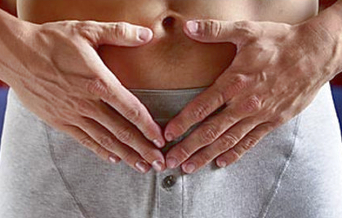
Symptom Checklist
Irritative Voiding
Obstructive Voiding
Pain in Pelvis
Pain in lower back
Pain in genitalia
Erectile dysfunction
Urgency
Dysuria
Difficultly starting stream
Uneven stream
Feeling of fullness in the bladder after voiding
Pain in lower back lower abdomen, pubis, testes and anus
Painful ejaculation

Slide 59
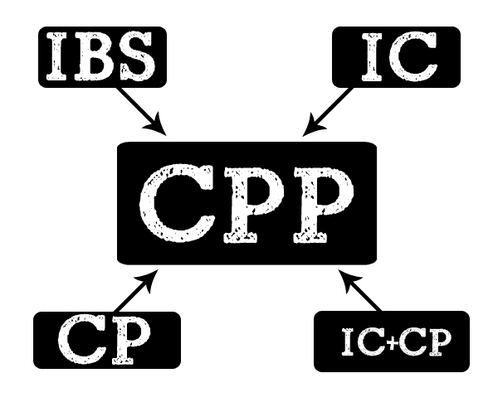

Slide 60
NIH describes four categories of prostatitis
Type I – Acute bacterial
Type II – Chronic bacterial
Type III – Chronic nonbacterial
Type IV – Asymptomatic Inflammatory Prostatitis

Slide 61
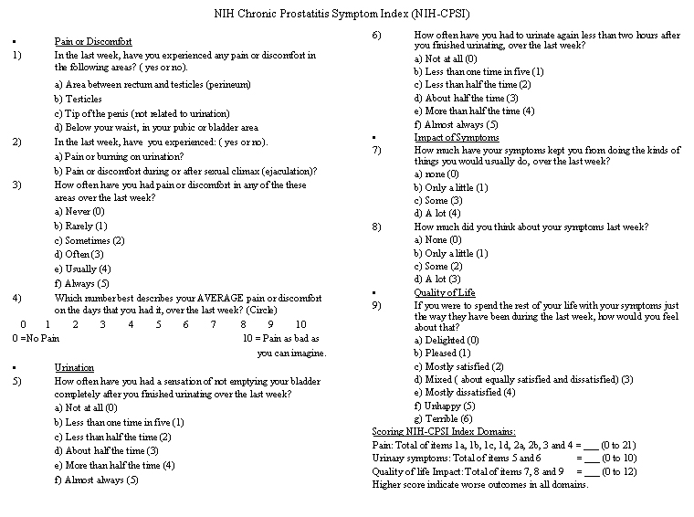

Slide 62
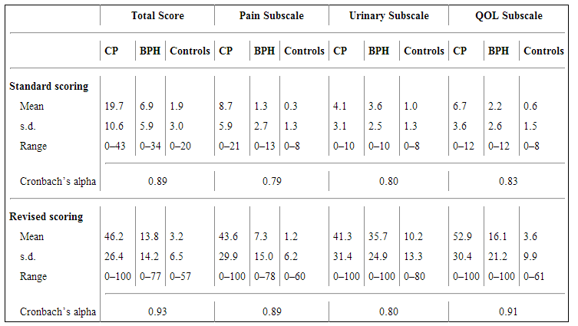
Scoring the NIH CPSI

Slide 63
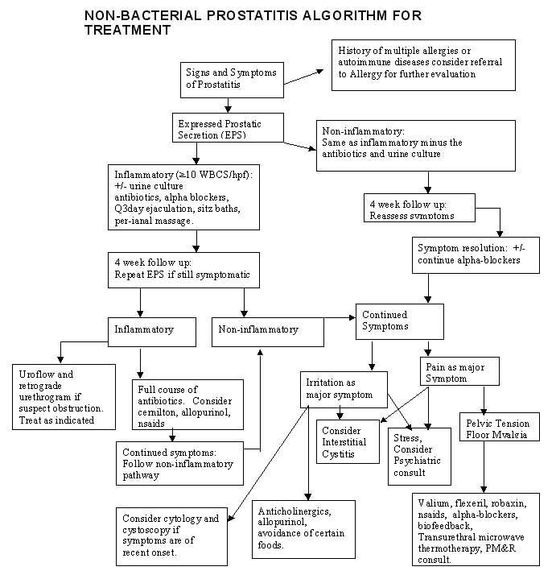

Slide 64
Innervation

Slide 65
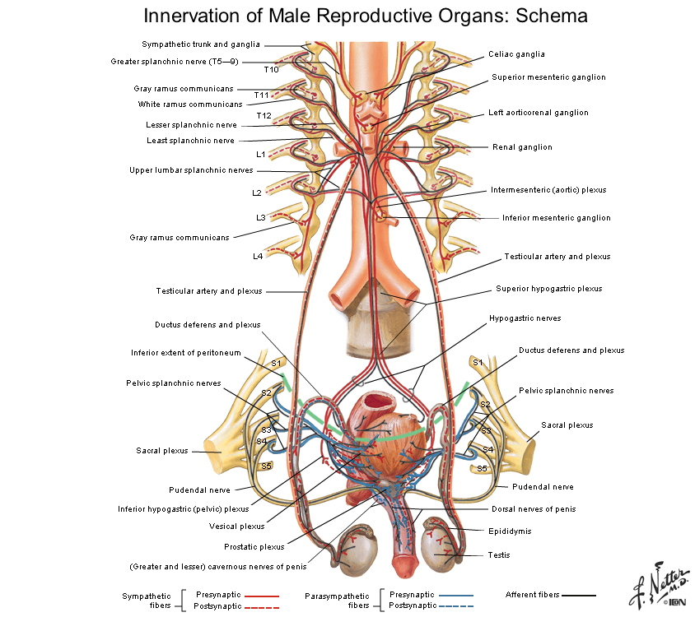

Slide 67
Testis/Epididymis
Nerves travel with testicular vessels to T10 + T11 via renal and aortic autonomic plexus through to lesser splanchnics

Slide 68
Penis
  Symp: SHP IHP Penis
  P/S: IHP
  Afferents: Pudendal

Slide 69
Bladder
SYMP : SHP IHP Bladder
Sacral Splanch IHP Bladder
P/S: Pelvic Splanch IHP Bladder
Afferents: Dome SHP
Body IHP

Slide 70
Prostate
SYMP: SHP IHP
Sacral splanchnics IHP
P/S: IHP
Afferents: IHP

Slide 71
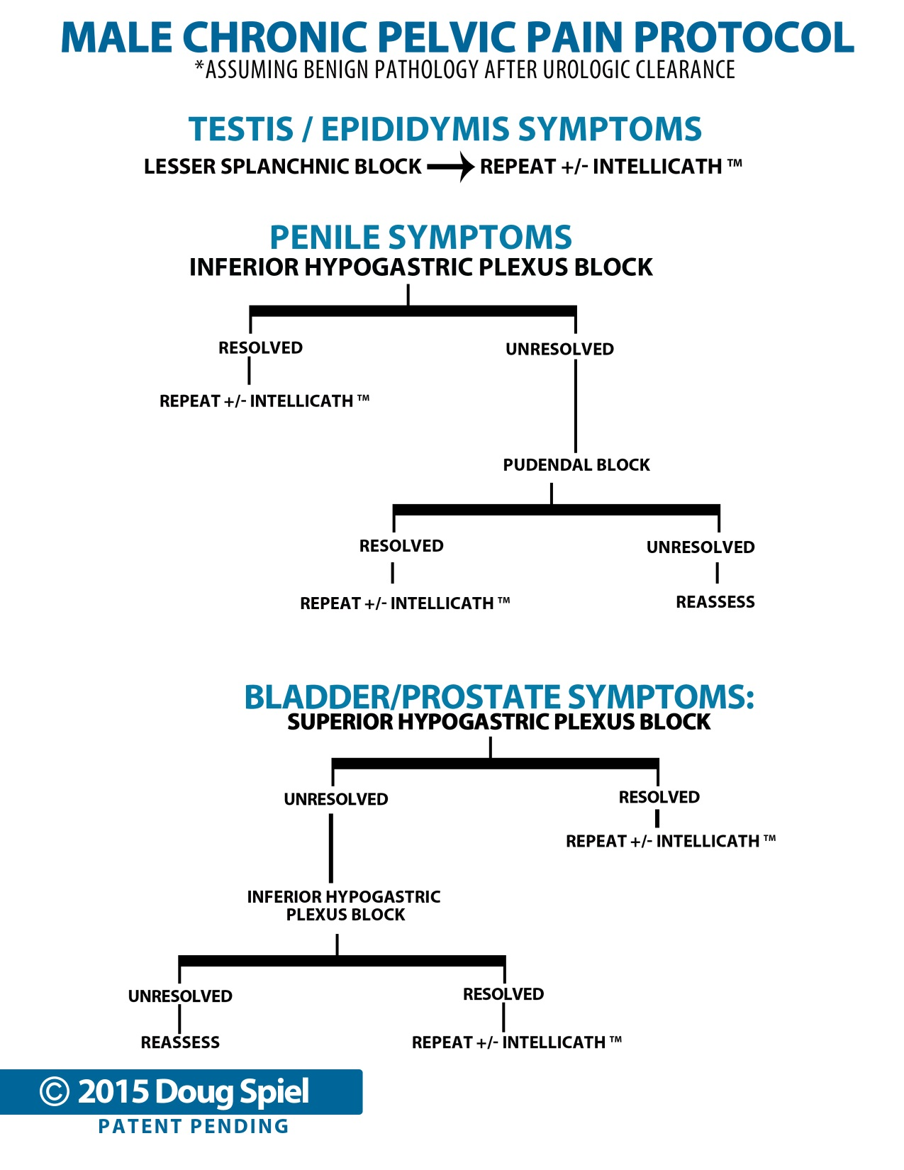

Slide 72

Thank You!
Q&A

