Slide 1
About OMICS Group
OMICS Group is an amalgamation of Open Access Publications and worldwide international science conferences and events. Established in the year 2007 with the sole aim of making the information on Sciences and technology ‘Open Access’, OMICS Group publishes 500 online open access scholarly journals in all aspects of Science, Engineering, Management and Technology journals. OMICS Group has been instrumental in taking the knowledge on Science & technology to the doorsteps of ordinary men and women. Research Scholars, Students, Libraries, Educational Institutions, Research centers and the industry are main stakeholders that benefitted greatly from this knowledge dissemination. OMICS Group also organizes 500 International conferences annually across the globe, where knowledge transfer takes place through debates, round table discussions, poster presentations, workshops, symposia and exhibitions.

Slide 2
OMICS International Conferences
OMICS International is a pioneer and leading science event organizer, which publishes around 500 open access journals and conducts over 500 Medical, Clinical, Engineering, Life Sciences, Pharma scientific conferences all over the globe annually with the support of more than 1000 scientific associations and 30,000 editorial board members and 3.5 million followers to its credit.
OMICS Group has organized 500 conferences, workshops and national symposiums across the major cities including San Francisco, Las Vegas, San Antonio, Omaha, Orlando, Raleigh, Santa Clara, Chicago, Philadelphia, Baltimore, United Kingdom, Valencia, Dubai, Beijing, Hyderabad, Bengaluru and Mumbai.

Slide 3
From Remedy to nanoparticles for AD treatment
Doaa A. Ghareeb, Ph.D
Pharmacovigilance-2015
8/18/2015

Slide 4
Outlines
Introduction about AD
Introduction about Berberis vulgaris and Berberine
Disease induction by different mechanism
Disease treatment with extract, active compound and NP
Conclusion

Slide 5
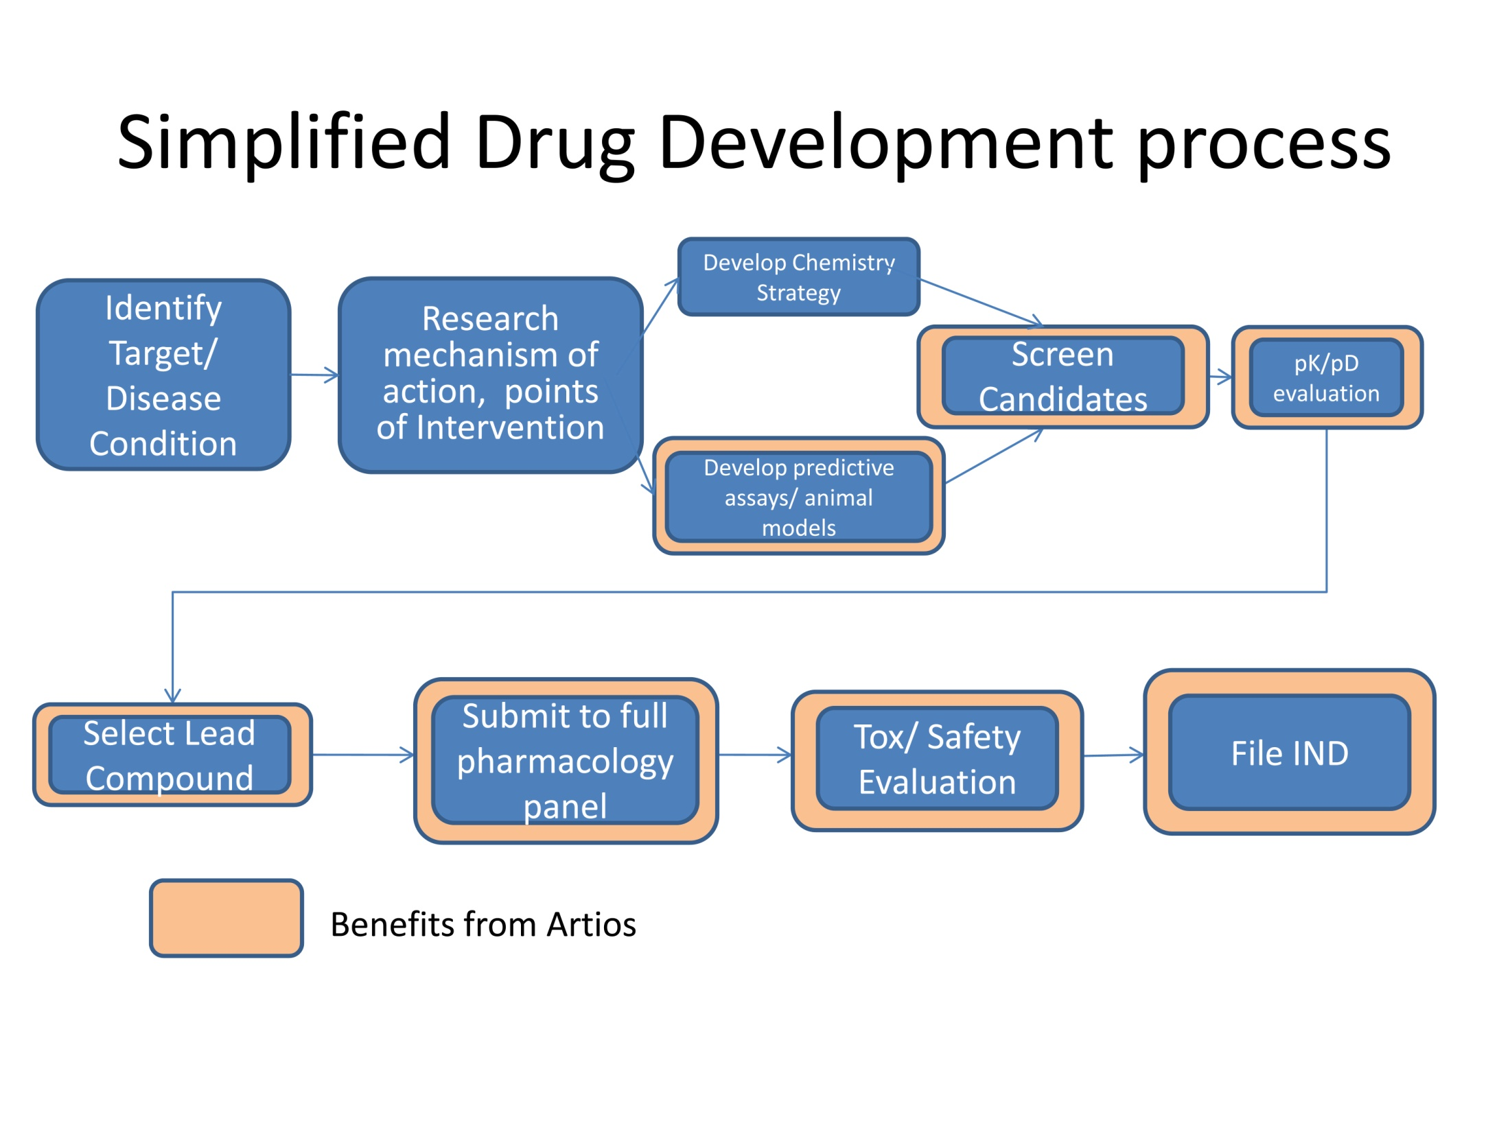
At animal model

Slide 6
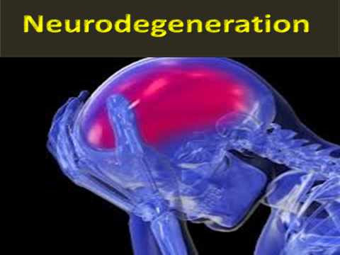
The target
Alzheimer Disease
Alzheimer’s disease (AD) is a complex neurodegenerative condition which has become a major public health problem because of its increasing prevalence, long duration and high cost of care.
AD is the fourth leading cause of death among 10% of 70 years aged people after myocardial infraction, stroke and cancer.
It affects the middle-to old-aged individuals, approximately one in four individuals over the age of 85 and it is estimated that more than 25 million people worldwide are affected to some degree by AD.

Slide 7
Research Mechanism of action
Alzheimer’s disease hallmarks
AD is characterized by loss of short term memory, disorientation, and impairment of judgment and reasoning.
Neuropathologically, the AD brain is characterized by two hallmark
Proteinaceous aggregates
amyloid plaques, mainly composed of the amyloid-β peptide (Aβ); and
Neurofibrillary tangles
comprised of hyperphosphorylated aggregates of the tau protein.

Slide 8
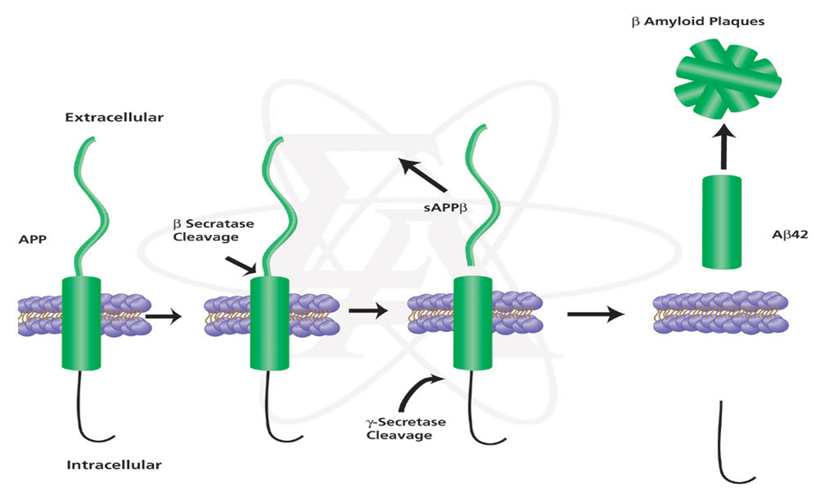
β- amyloid accumulation:
Aβ is produced from amyloid precursor protein (APP) by serial proteolytic reactions catalyzed by β-site of APP cleaving enzymes β-secretase and γ-secretase.

Slide 9
Risk factors for amyloid aggregation
In Egypt, we have several factor lead to AD progression such as;
  Water Pollution
  Liver disease
  Insulin resistance syndrome
  Aging and oxidative stress related disorder.
Therefore,
We target different causes and/or mechanisms

Slide 10

Inflammation
Insulin resistance
Liver Disease
Muscarinic receptor antagonist
Water pollution; heavy metal

Slide 11
brain insulin signaling has faced a novel and increased interest in neuroscience research, either in its signaling pathways and/or as a promising therapy against diabetes and age-relate neurodegenerative disorders.

Slide 12
Fatty acid accumulation
Insulin resistance
Mitochondria lipid bilayer
Lipid peroxidation
B-oxidation
PGC1α
UCP1
ROS
Alter the activity of Complex IV and V
ATP production through ETC
Alter the NADPH oxidase, and NADH dehydrogenase (Complex I) expression
mt DNA mutation
PPAR γ, p53, NOS expression increased
Pancreas and brain damage
Notes:
peroxisome proliferator-activated receptor gamma, coactivator

Slide 13
Oxidative stress and brain tissue
Hyperinsulinemia
ROS
Brain tissue is rich in mitochondria
AChE hyperactivity
ATP metabolism alteration
Chaperon down regulation
Brain energy disruption
ACh decreased
ADAM 15 overexpression
Glucose stimulates insulin secretion
Β-amyloid precursor
TNFα
Insulin
and
IGF 1
IDE
glucose
Β-amyloid clearance
Albumin and Transthyretin transport
Β-amyloid precipitation

Slide 14
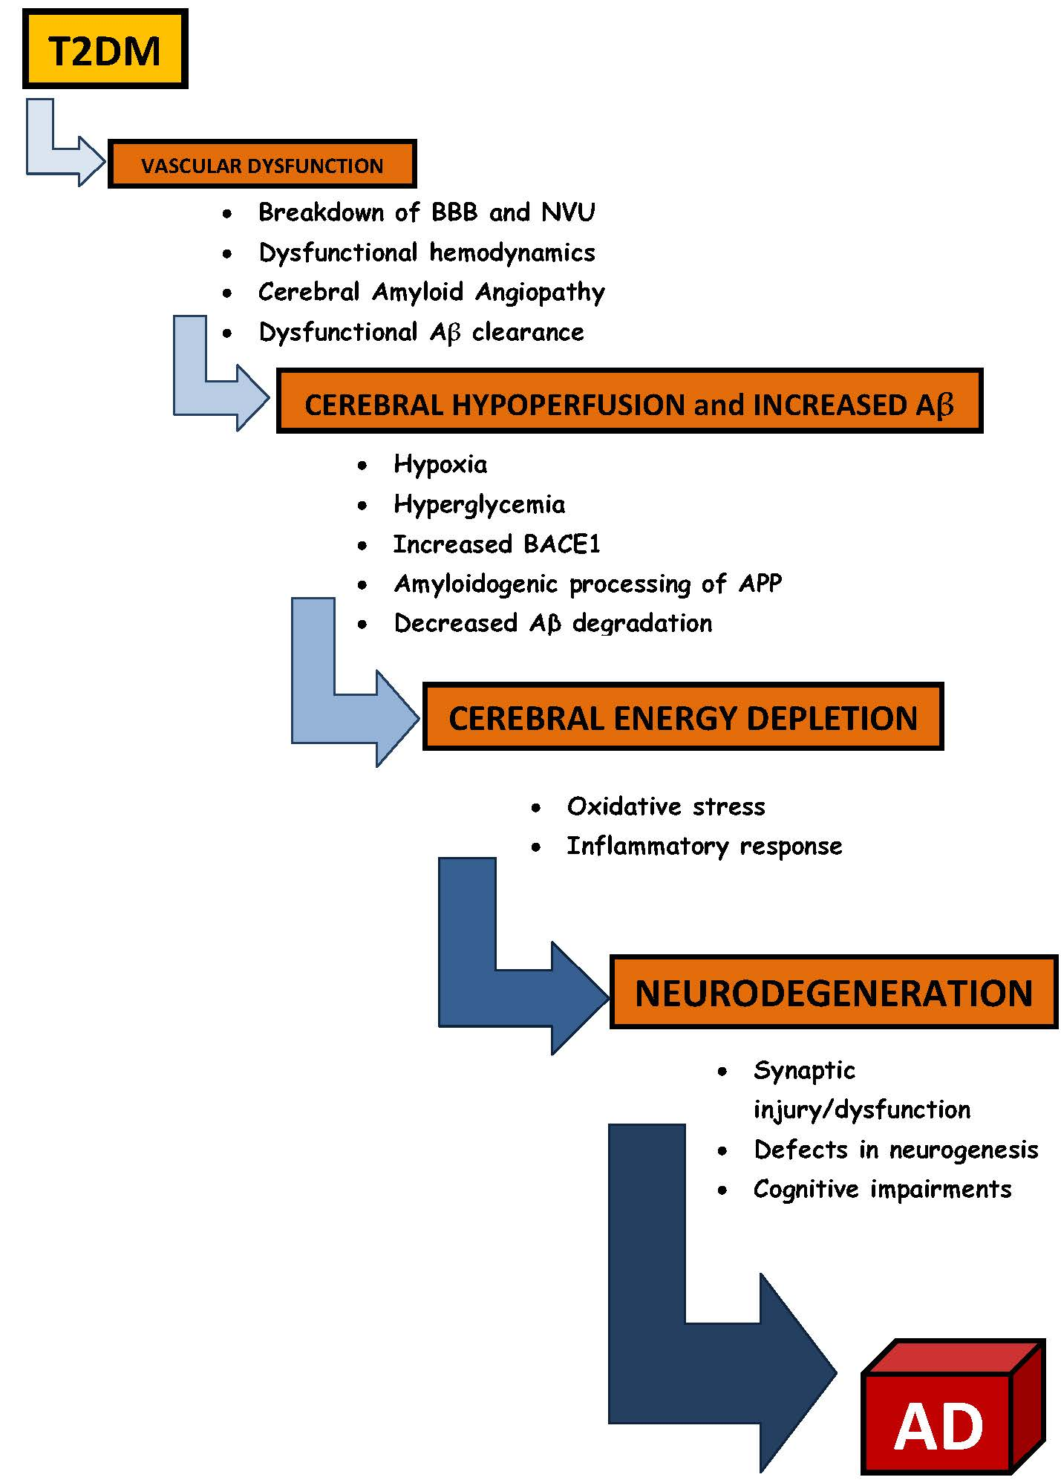

Slide 15
Muscarinic receptor antagonist
Insulin resistance

Slide 16
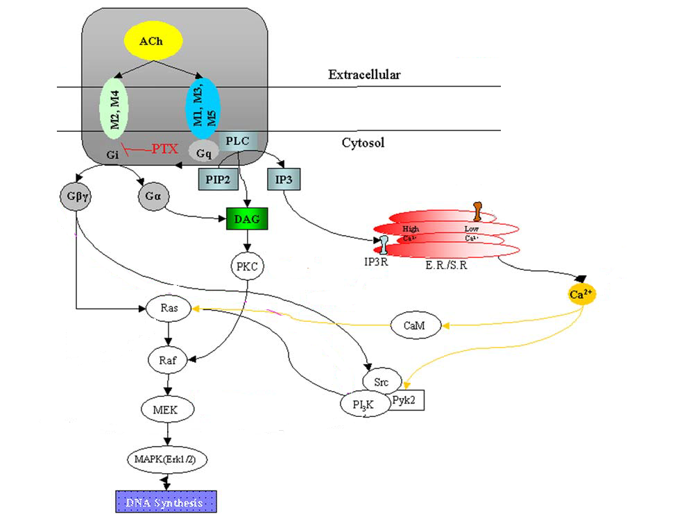
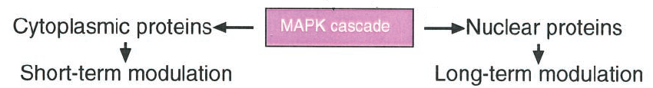
Muscarinic receptor-coupled signal transduction pathways
Ca²⁺ mobilization

Slide 17
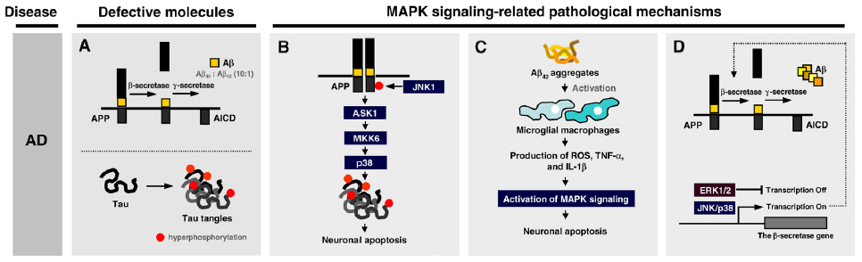
Roles of MAPK pathways in the pathogenesis of Alzheimer's disease

Slide 18
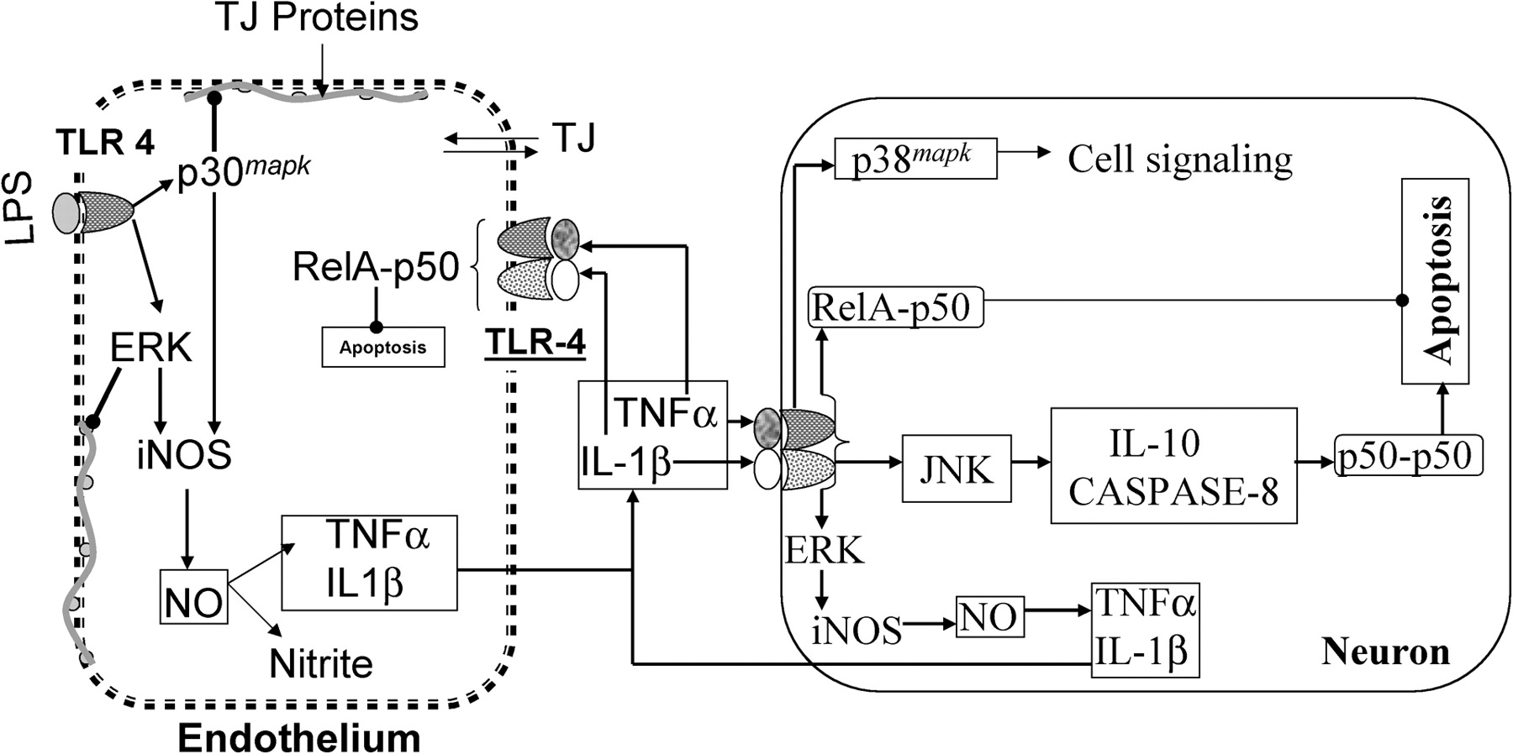
Neuroinflammation

Slide 19
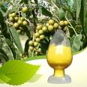
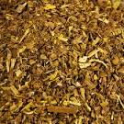


Identify lead
Berberise vulgaris L.
B.V. extract
Antiinflammatory
Antimicrobail
Potent antioxidant
Hypolipidemic
Antitumor
Liver support
Anti-diabetic
Berberine, dervatives and extract
Immuno-modulatory agent
Enhance Th1 production, which in turn stimulate the CTL by inducing MHC I.
Potent antioxidant
Hypolipidemic and Antidiabetic
Antitumor agent as iup-regulate sP53 and ICAM genes
Treat NASH
Cheap (cost /per year for each patient= 270 EP)

Slide 20
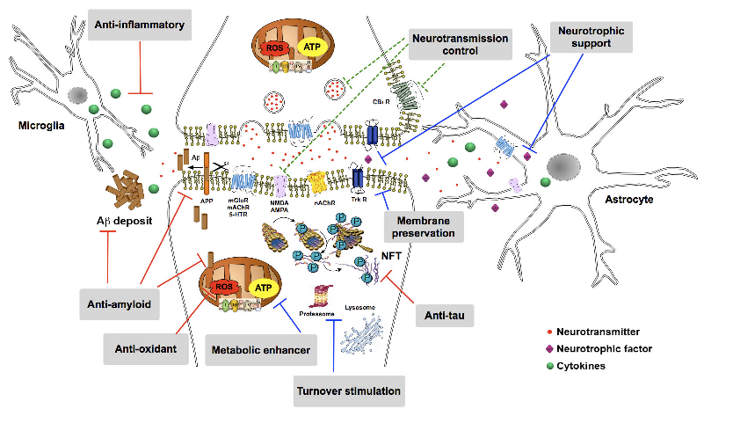
Main cellular targets that are currently under development to prevent or retard the progression of Alzheimer to disease states
Neurotransmitter: ACh, DOPA. Neurotrophic factor: the neurotrophin BDNF (brain-derived neurotrophic factor). Membrane preservation and neuron plasticity: CREB (cAMP response element-binding protein). Metabolic enhancer: ATP, NADP. Glucose. Anti-inflammatory: TNF-alpha. Antioxidants: ROS, XO, ALD, TBARS

Slide 21


Assays and results

Slide 22
Assays
Phytochemical screening
Solvent crude extraction
Larger scale analysis
Solvent partition
Small scale analysis
LD 50
Toxicity study
Animal treatment
Chemical structure elucidation

Slide 23
In vitro Inhibitory effect percentage of Berberine chloride and Berberis vulgaris toward
AChE.

Slide 24
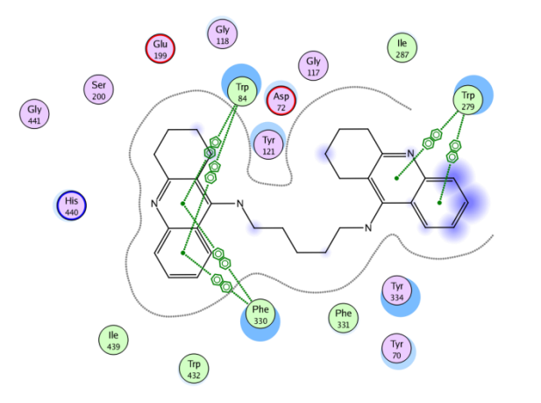
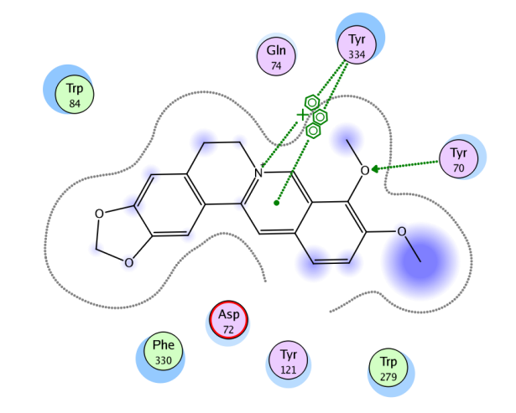
Molecular modeling analysis of berberine activity
Docking models of the compound-enzyme acetylcholinesterase (AChE) complex

Slide 25
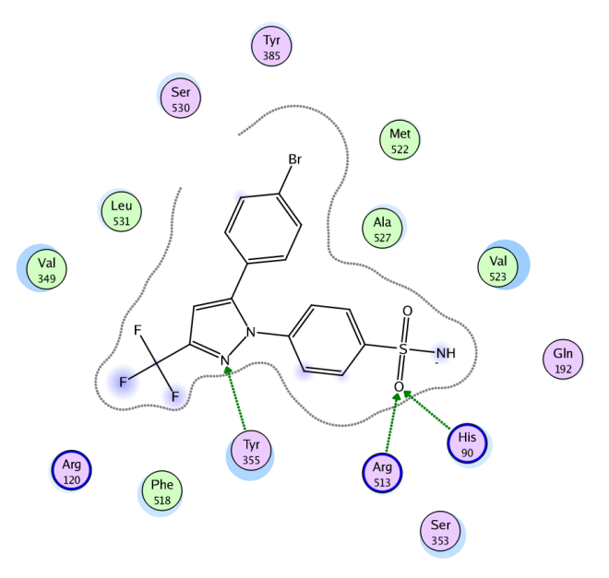
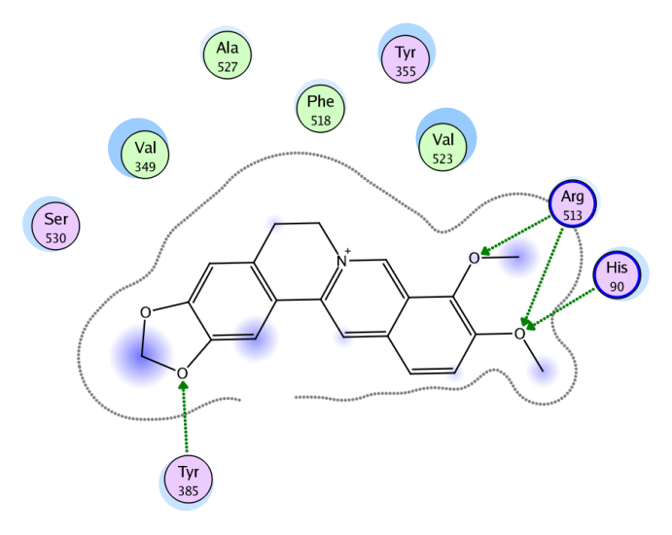
Molecular modeling analysis of berberine activity
Docking models of the compound-enzyme Cyclooxygenase-2 (COX-II) complex.

Slide 26
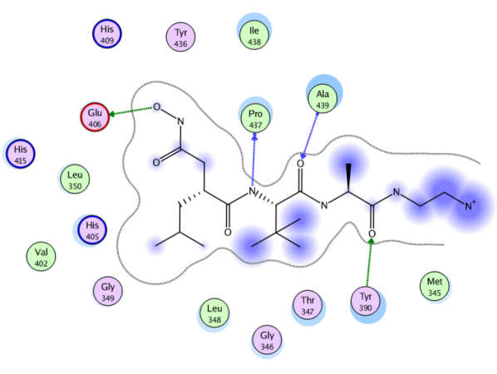
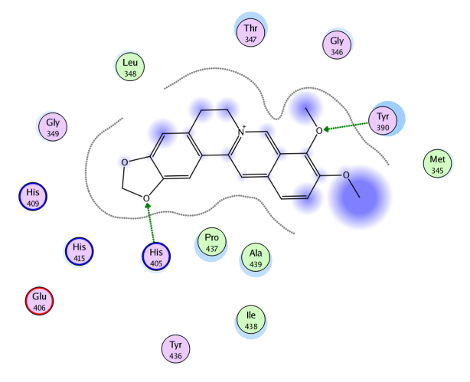
Molecular modeling analysis of berberine activity
Docking model for berberine (right image) and reference ligand (left one) 2D interactions to the binding pocket of Tumor Necrosis Factor-Alpha Converting Enzyme (TACE).

Slide 27
Animal model for brain damage related to liver disease and IR syndrome
Figure: Blood Insulin resistance markers

Slide 28
Animal model for brain damage related to liver disease and IR syndrome
Figure: Brain damage markers

Slide 29
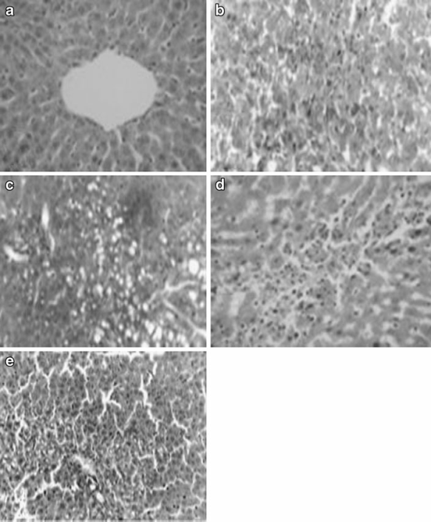
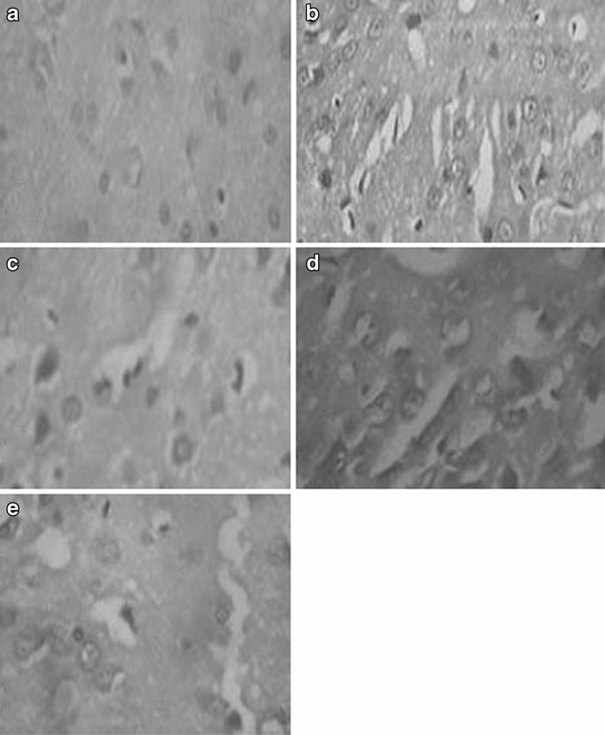
Fig. 4 showed that normal cellular architecture in the control group (Fig. 4a). During the first week of NAFLD induction, severe neurodegenerative changes with pyknosis and vacuolations was observed (Fig. 4b) that associated with cavitations in the second week of induction period (Fig. 4c). Furthermore, during the third week (NAFLD progression, neurodegeneration with eosinophilic cells, pyknosis and vacuolations were shown in Fig. 4d. Finally, severe neurodegeneration, pyknosis acuolations and
cavitations was observed during the fourth week (Fig. 4e).
Fig. Effect of the NAFLD induction and progression on liver histology. Hematoxylineosin staining showed the cells in a longitudinal section at magnification 400× of light microscope: (a) Control (b) first week (c) second week (d) third week (e) Fourth week. Solid arrow shows steatosis, dashed arrow shows necrosis and dotted arrow shows inflammation

Slide 30

NASH
IR
Glucose, Lipid profile
ATPase hyperactivity
Lipid peroxidation
CYP 2E1
ROS and NO
AChE and MAO hyperactivation
IL6 and TNF α
Β-amyloid plaque

Slide 31
Effect of Extract and Berberine on AD related to IR
Effect of treatment on blood parameters

Slide 32
Effect of Extract and Berberine on AD related to IR
Effect of treatment on Brain parameters

Slide 33
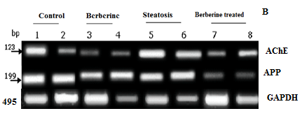
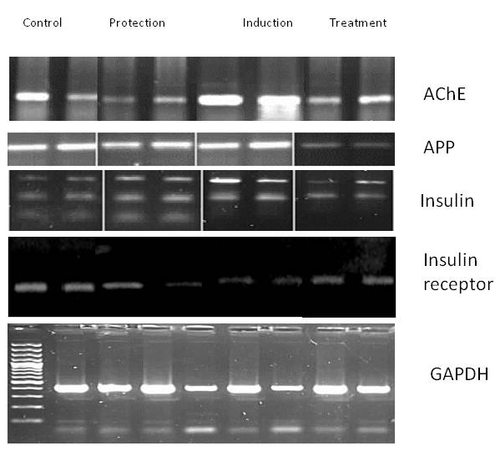
Effect of Extract and Berberine on AD related to IR

Slide 34
Effect of Berberine on AD related to Heavy metals intake

Slide 35
Effect of Berberine on AD related to Heavy metals intake

Slide 36
Effect of barberry extract on AD-like disease related to neuroinflammation

Slide 37



Slide 38
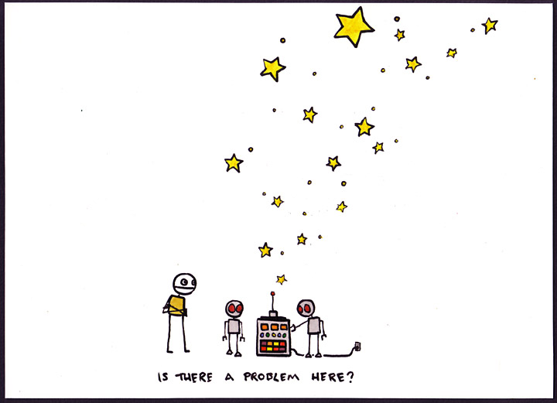

U want to say berberise is good candidate

Slide 39
The problem and solution
problem
Berberine has low bioavailability,
because the intestinal absorption of berberine is very low due to its solubility
solution
nanoparticles
why?
Administration by parental, oral, nasal and ocular routes.
By attaching specific ligands on to their surfaces, nano particles can be used for directing the drugs to specific target cells.
Improve stability and therapeutics index and reduce toxic affect.

Slide 40
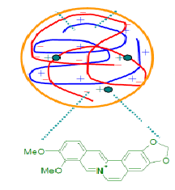
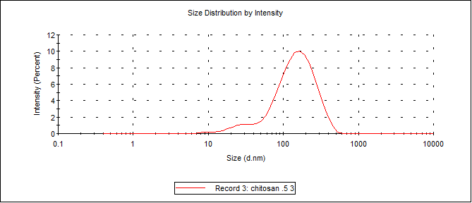
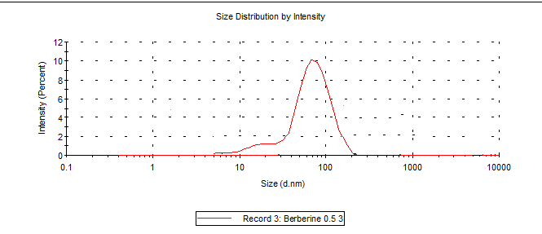
Chitosan/Ber NP

Slide 41
In vitro effect of Berberine nanoparticle

Slide 42
Effect of Berberine nanoparticles on AD treatment

Slide 43




Slide 44
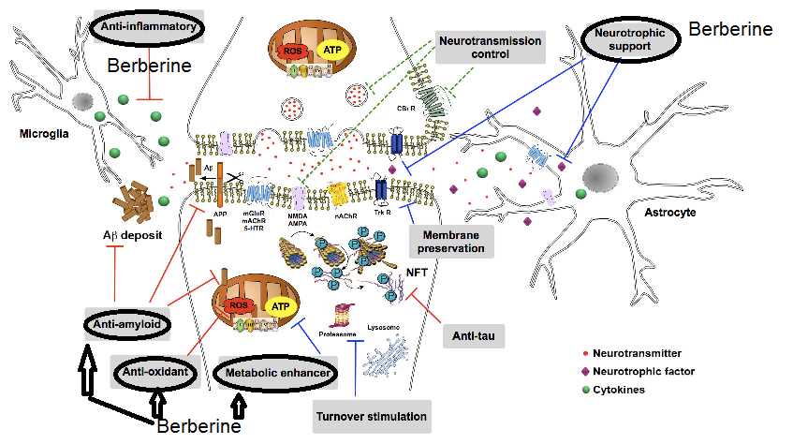
Neurotransmitter control
Inhibits AChE
Neurotrophic factor
Increases BDNF
Antioxidants
Reduces ROS
Increases antioxidants
Anti-inflammatory
Metabolic enhancer
Neuron Plasticity
    Inhibits the production of TNF, ADAM, IL 1B, iNOS and COX
Increases ATP, NADP
increases CREB

Slide 45
Interrelation between fields
Crude extract
Botany
Marine science
Bioscreening
Biochemistry
Chemistry
In vivo investigation
Biochemistry
Microbiology
immunology
Molecular biology
prototype
Clinical trial
Active ingredient isolation
Biochemistry
Chemistry
Biochemistry
Chemistry
pharmacy
Biochemistry
Pharmacy
medicine
Product development
Industry
product
prototype
patents
publications
price
promotion
place
product

Slide 46
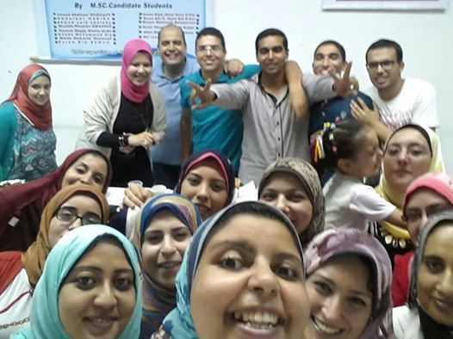
Acknowladge
I would thank everybody taught and help me here In Egypt and worldwide.
My professor:
  Prof. M. ElSadani
  Prof. M.ElSayed
  Dr. Essam Emad
  Dr. Fatama ElRashidy
  Dr. M. Elkarsh
My Teamwork
My students
With them I will be continue my track

Slide 47






My colleague in this work
Prof. Maha El-Demellawy
Dr . Hend Hussien
Dr. Hani Hafez
Dr. Sofia Amin
Dr. Hany Emery
M.Sc. Amal AbdEl-Mageed
M.SC. Samer Saleh
M.Sc. Enas Seif
M.Sc. Eman Sarhan
M.Sc. Shimaa Mohamed
B.Sc. Marium Abady
B.Sc. Mohamed Nofel
M.Sc. Shimaa Abd Elkhafar
M.Sc. Marwa El-Zeftaoy
Part of this work is funded from STDF

Slide 48

doaa.ahmed@alex-sci.edu.eg; d.ghareeb@yahoo.com

Slide 49
Let us meet again..
We welcome you all to our future conferences of OMICS International
5th International Conference & Exhibition on Pharmacovigilance & Clinical Trials
On
September 19 - 21, 2016 at Vienna, Austria http://pharmacovigilance.pharmaceuticalconferences.com/

