Slide 1



Influence of Impact Speed on Water Droplet Erosion (WDE)
Performance of Ti-6Al-4V and Mechanism of Material Removal During the Incubation and Advanced Stages
4th International Conference and Exhibition on Materials Science & Engineering
Florida, Orlando, USA, September 14-16, 2015
A. K. Gujba, L. Hackel, D. Kevorkov* and M. Medraj

Slide 2
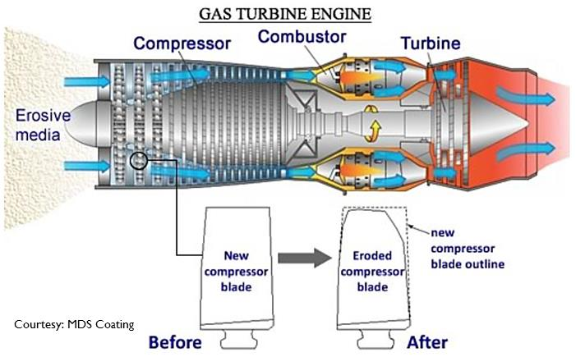
INTRODUCTION
Gas turbine efficiency in power generation industry is paramount but its adversely affected by ambient temperature.
Fog cooling is employed in order to reduce the temperature by spraying small droplets.

Slide 3
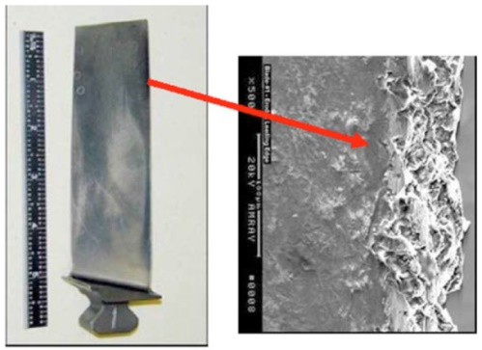
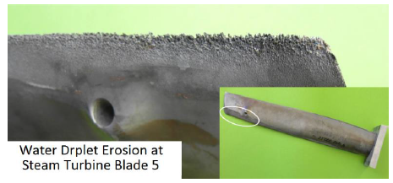
INTRODUCTION
Gas turbine efficiency in power generation industry is paramount but its adversely affected by ambient temperature.
Fog cooling is employed in order to reduce the temperature by spraying small droplets.
Alstom
General Electric

Slide 4
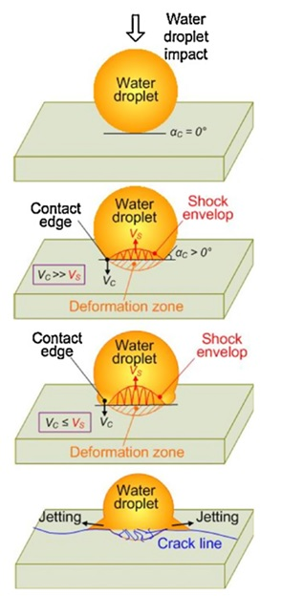


WATER DROPLET EROSION
Main Erosion Mechanisms
Water hammer
Deformation
Shock waves
Sub-surface cracks
Side jetting
Surface cracks
and asperities
Hydraulic penetration
Deep cracks
Kong et al. 2010

Slide 5
WATER DROPLET EROSION
Factors Influencing Water Erosion
Droplet properties
Velocity, size, flow rate
Material properties
Hardness, toughness, ultimate resilience
Other parameters
Impact angle,
surface roughness…
Kong et al. 2010

Slide 6
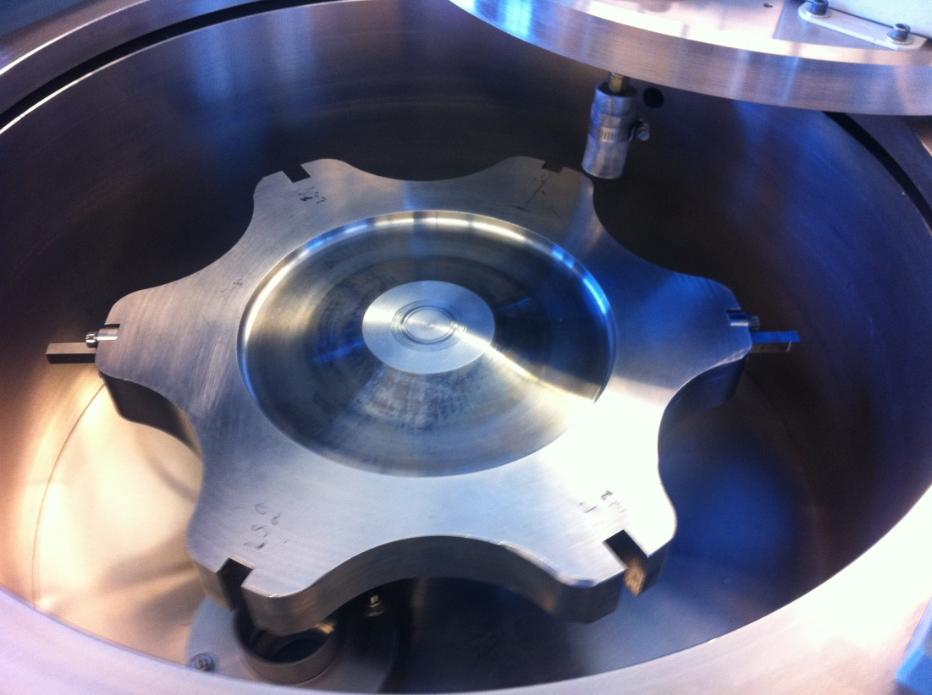
WATER DROPLET EROSION TESTING
The state of the art rig for liquid impingement erosion testing
at Concordia University, Montreal, Canada.
Rig parameters
Impact speed (m/s) = 150-500
Droplet size (µm) = 200-600
Test impact angle (⁰) = 1-90
Flow rate (liter/min) = 0.02-0.30
http://users.encs.concordia.ca/~tmg/index.php?title=Main_Page

Slide 7
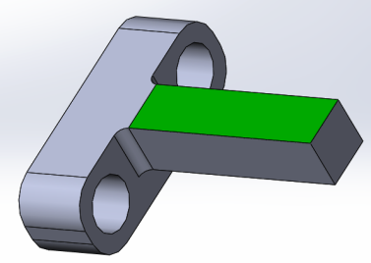
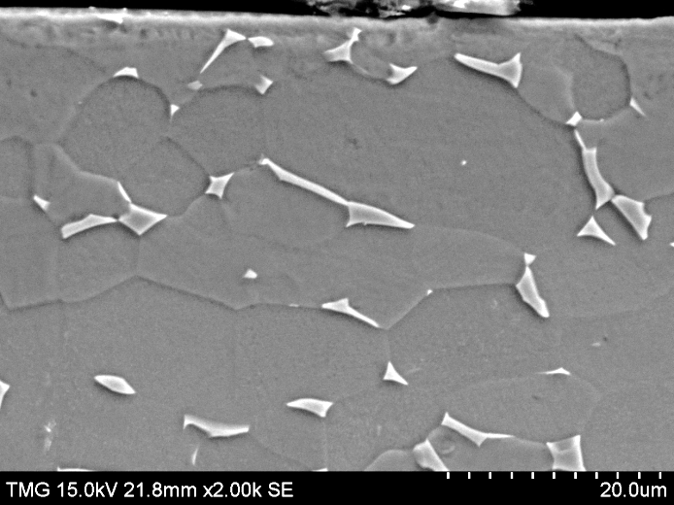
MATERIAL
Ti-6Al-4V (ASTM B265, Grade 5) alloy, used for compressor blades in gas turbine, was investigated.
T-shaped coupons, as shown, were machined using a CNC
The microstructure of the Ti-6Al-4V alloy contains α and β phases.
Sample geometry
Top surface
Cross section
α-phase
β-phase

Slide 8
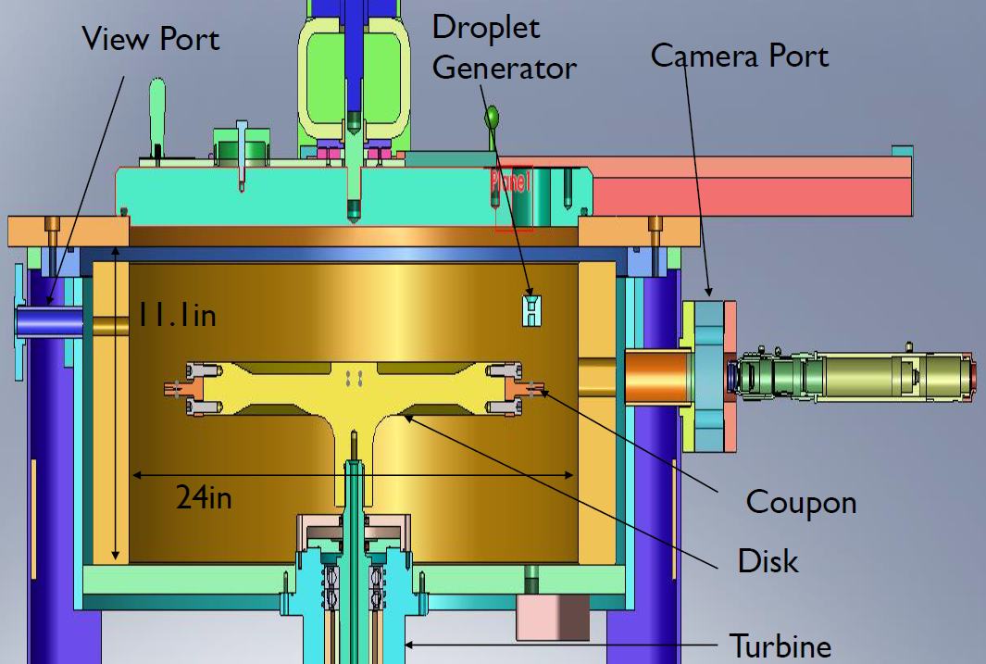
WATER DROPLET EROSION TESTING
The test was done in accordance with ASTM G73 standard
for liquid impingement erosion testing.
Test parameters
Impact speed (m/s) = 150-350
Av. droplet size (µm) = 460
Test impact angle (⁰) = 90
Flow rate (liter/min) = 0.05
Nozzle-sample distance (mm) = 5
http://users.encs.concordia.ca/~tmg/index.php?title=Main_Page

Slide 9
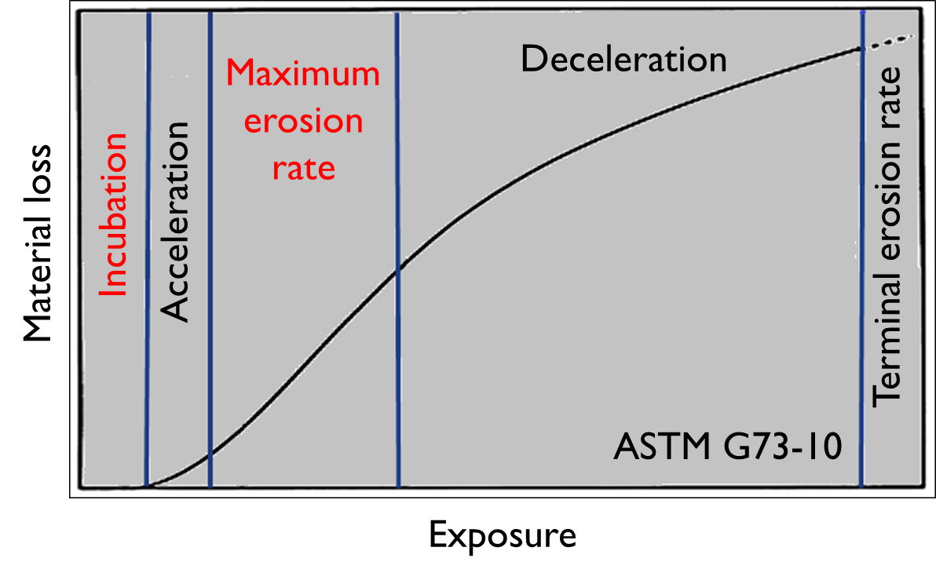
CHARACTERIZATION OF ERODED COUPONS
Weigh coupon at certain interval
Optical images
SEM Micrographs - Mechanisms
Only incubation period and maximum erosion rate will be presented in this work

Slide 10
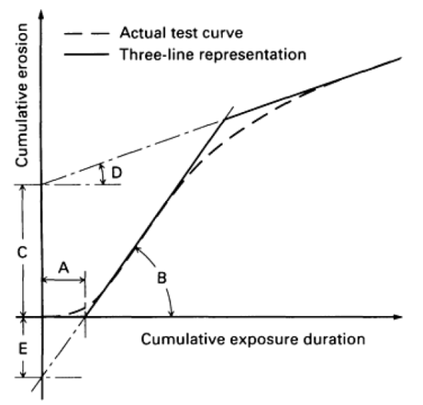
RESULTS – WDE CURVES
F. Heymann
350m/s
325m/s
300m/s
Incubation period

Slide 11
ANALYSIS OF WDE CURVES
Incubation period
F. Heymann
Maximum erosion rate

Slide 12
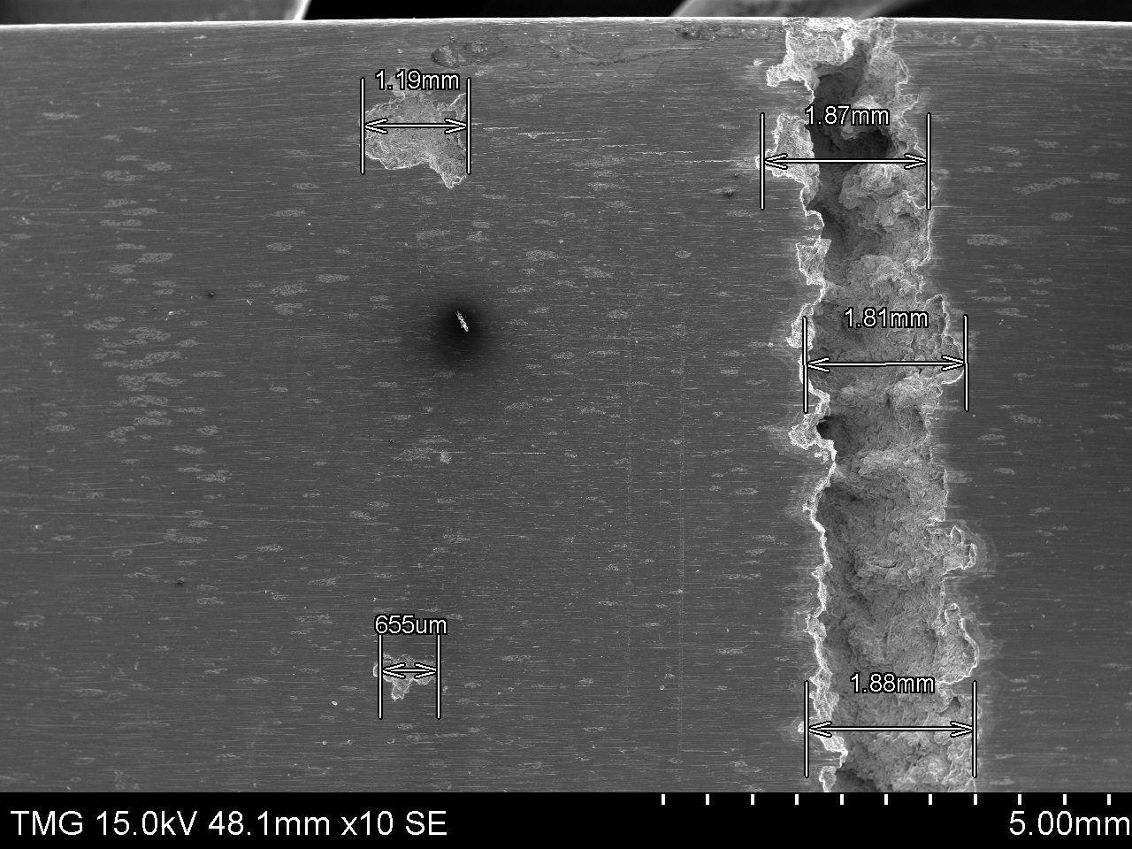
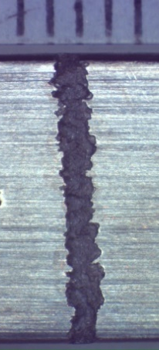
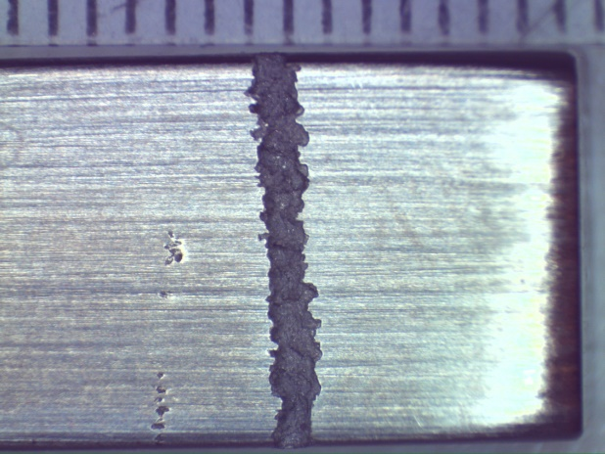
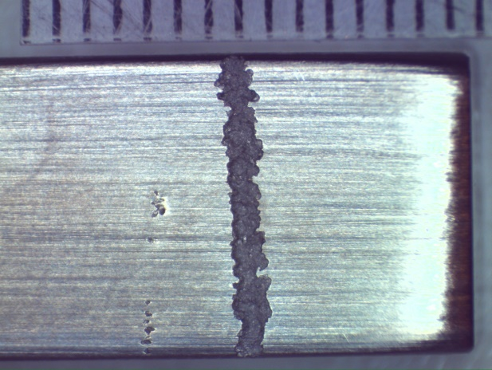
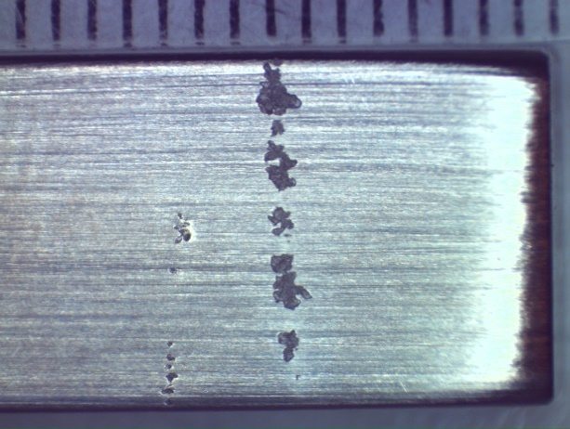
WDE MECHANISM – INITIATION STAGE
A
B
Incubation stage
Advanced stage
0min 6mins
32mins 56mins

Slide 13
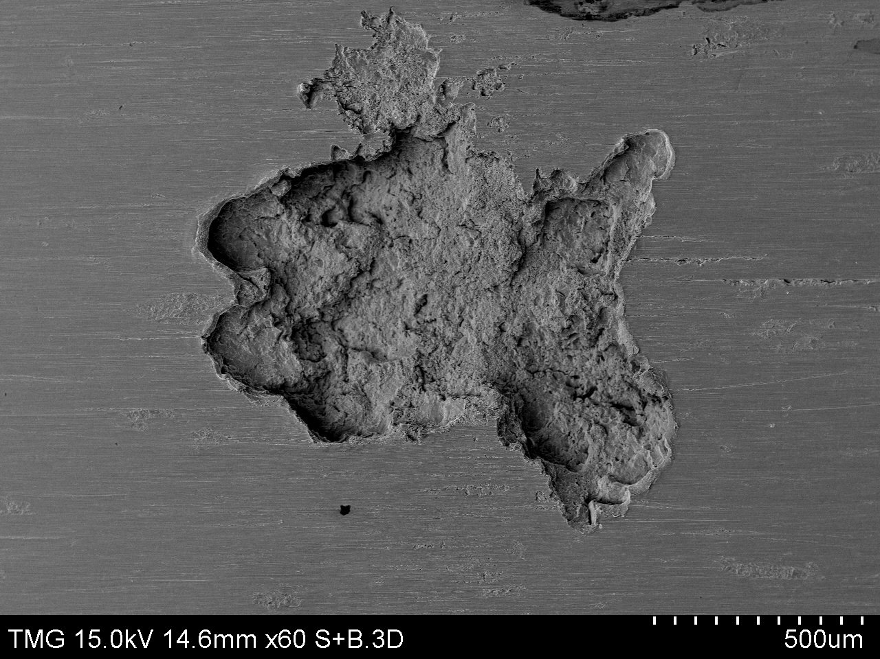
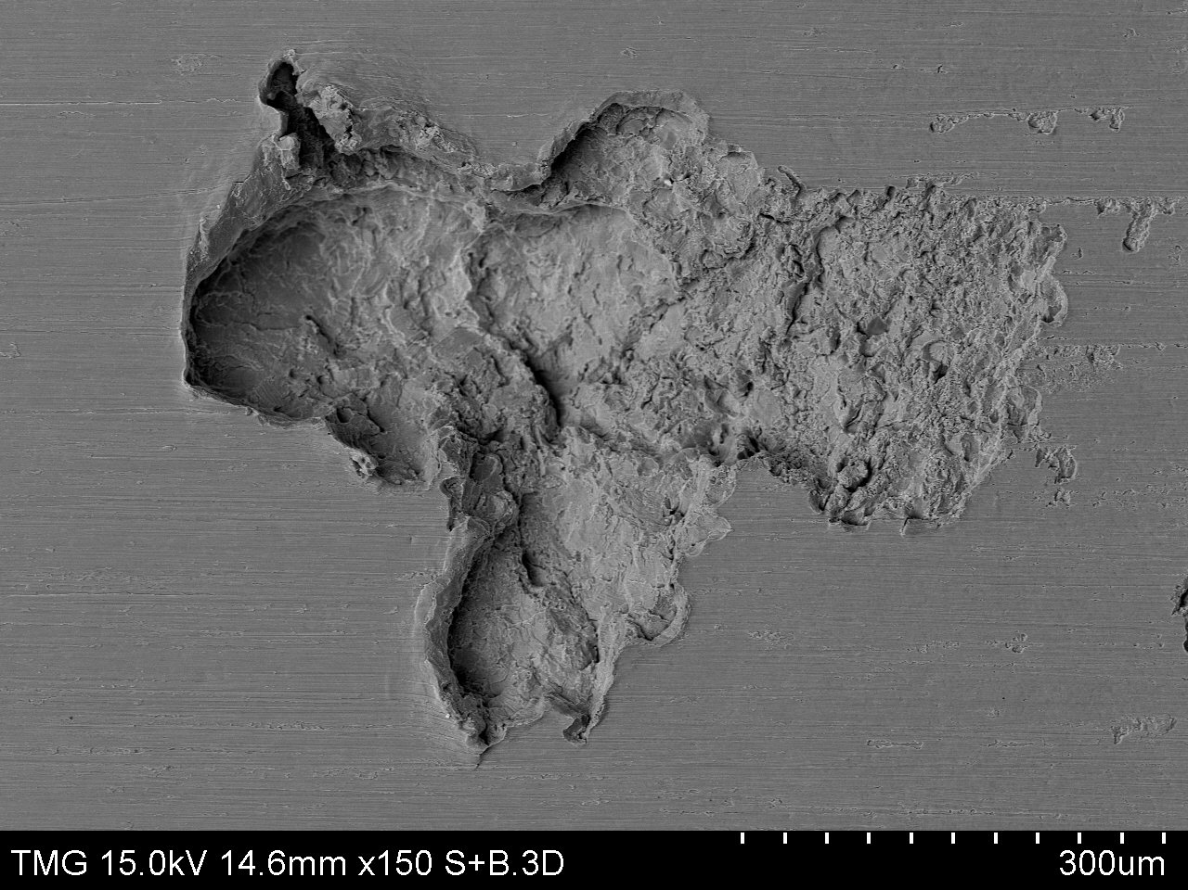
WDE MECHANISM – INITIATION STAGE
A
B
Incubation stage
Advanced stage

Slide 14
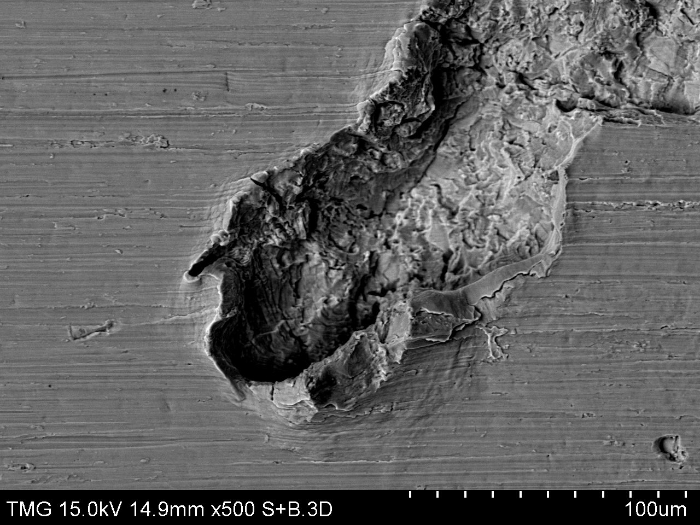
WDE MECHANISM – INITIATION STAGE
Network of microcracks
Potential sites for pit growth and crack propagation
Formation of asperities due to impact and side jetting

Slide 15
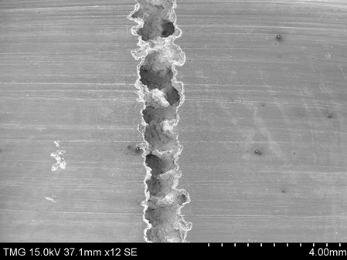
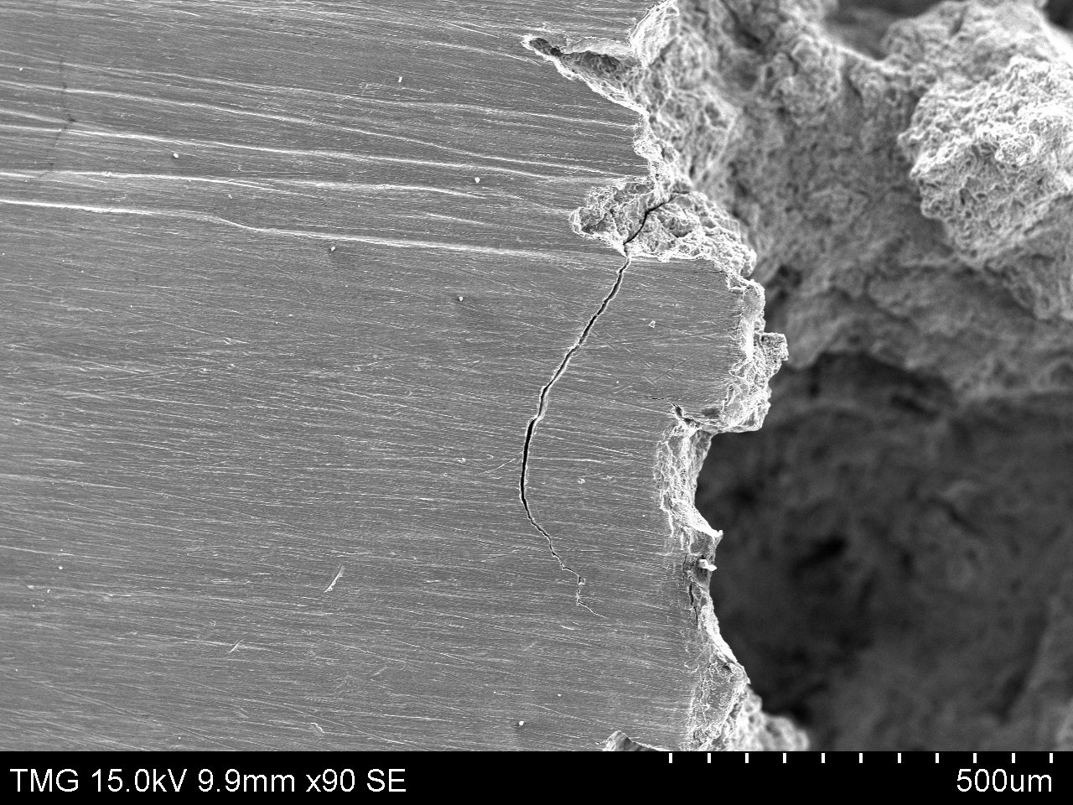
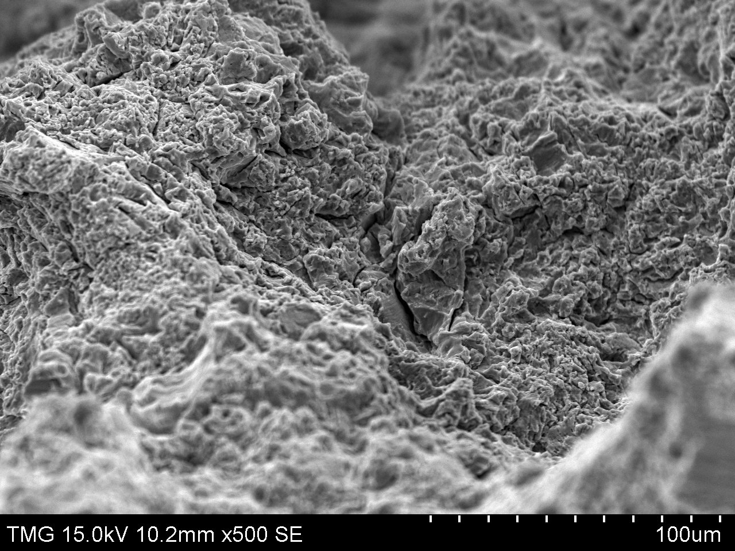
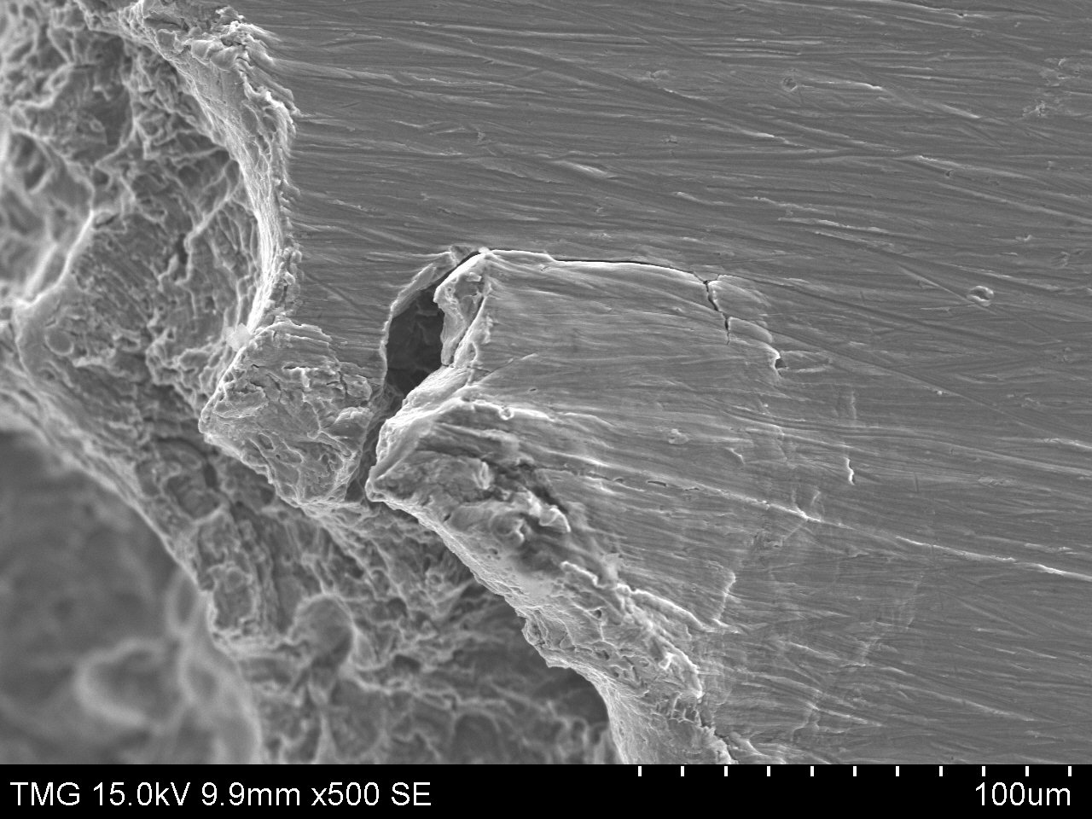
WDE MECHANISM – ADVANCED STAGE
Sub-surface crack from beneath the crater
Deep tunnel due to hydraulic penetration
Material upheaval due to stress wave
Fatigue surface cracks
Stress wave direction

Slide 16
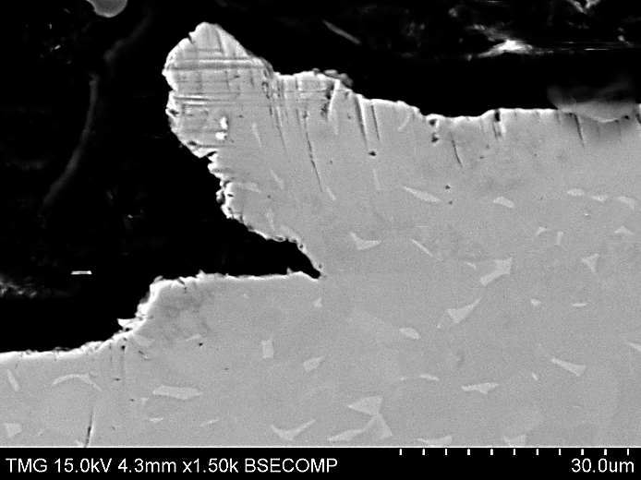
WDE MECHANISM – ADVANCED STAGE
Crack propagation due to lateral flow
Micro jetting effect forming due to hydraulic penetration
Sub-surface cracks
Coupon top surface
Sub-surface cracking
Material folding (upheaving)

Slide 17
Conclusions
Higher the impact speed accelerates the erosion initiation and increases erosion rates.
Main causes of the erosion damage at early stages are the high impact pressure and the lateral jetting.
Formation of microcracks, isolated pits and shallow depressions were typical features associated with the incubation stage.
The hydraulic penetration and stress waves are the main causes of erosion in advanced stages.
Deep cracks, sub-surface cracks, material folding and upheaving are main features observed at the advanced stage.

Slide 18



