Slide 1
About OMICS Group
OMICS Group is an amalgamation of Open Access Publications and worldwide international science conferences and events. Established in the year 2007 with the sole aim of making the information on Sciences and technology ‘Open Access’, OMICS Group publishes 500 online open access scholarly journals in all aspects of Science, Engineering, Management and Technology journals. OMICS Group has been instrumental in taking the knowledge on Science & technology to the doorsteps of ordinary men and women. Research Scholars, Students, Libraries, Educational Institutions, Research centers and the industry are main stakeholders that benefitted greatly from this knowledge dissemination. OMICS Group also organizes 500 International conferences annually across the globe, where knowledge transfer takes place through debates, round table discussions, poster presentations, workshops, symposia and exhibitions.

Slide 2
OMICS International Conferences
OMICS International is a pioneer and leading science event organizer, which publishes around 500 open access journals and conducts over 500 Medical, Clinical, Engineering, Life Sciences, Pharma scientific conferences all over the globe annually with the support of more than 1000 scientific associations and 30,000 editorial board members and 3.5 million followers to its credit.
OMICS Group has organized 500 conferences, workshops and national symposiums across the major cities including San Francisco, Las Vegas, San Antonio, Omaha, Orlando, Raleigh, Santa Clara, Chicago, Philadelphia, Baltimore, United Kingdom, Valencia, Dubai, Beijing, Hyderabad, Bengaluru and Mumbai.

Slide 3
Effect of Fraxinus angustifolia (Oleacea) leaf and bark extracts on acute and chronic inflammation: enhanced activity of nanovesicle-trapped extracts
Djebbar Atmani ¹*, Kenza Moulaoui¹, Maria Manconi² and Dina Atmani-Kilani ¹
¹Laboratory of Applied Biochemistry, Faculty of Nature and Life Sciences, University of Bejaia, 06000 Algeria
²Dpt. Scienze della Vita e dell’Embiente, University of Cagliari, Italy
*E-mail: djatmani@yahoo.com

Slide 4
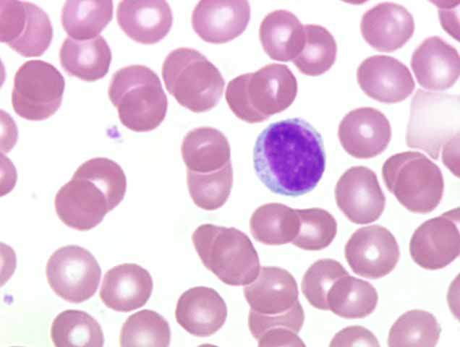
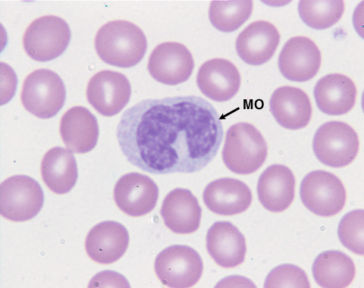
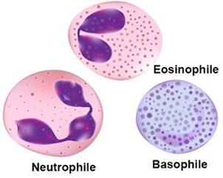
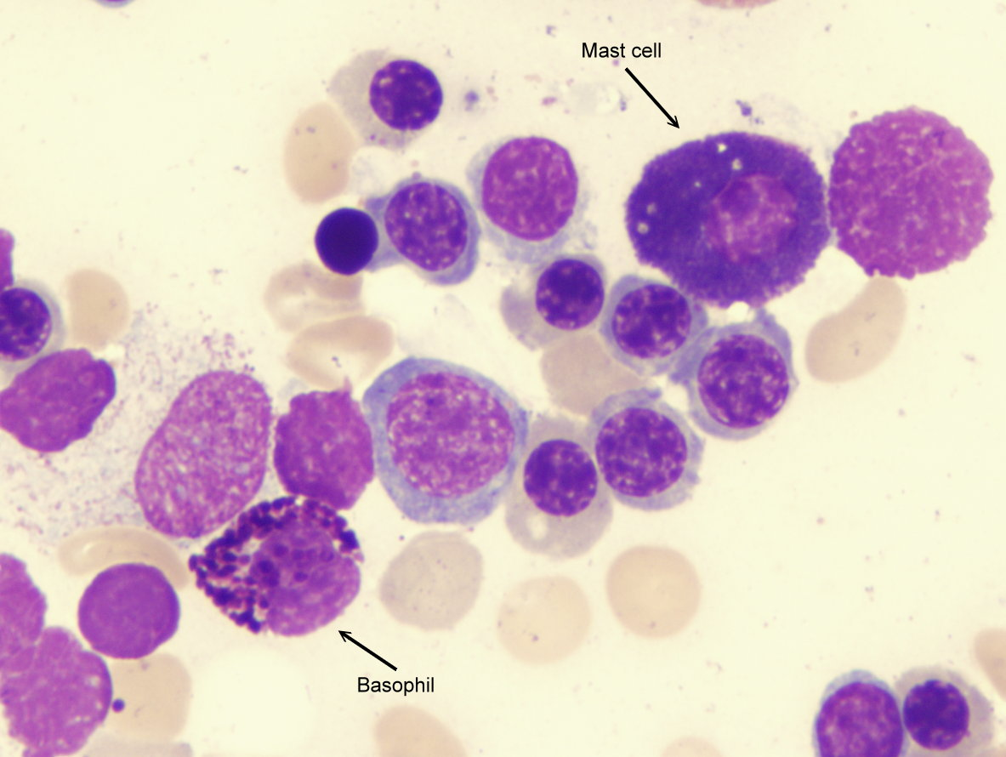
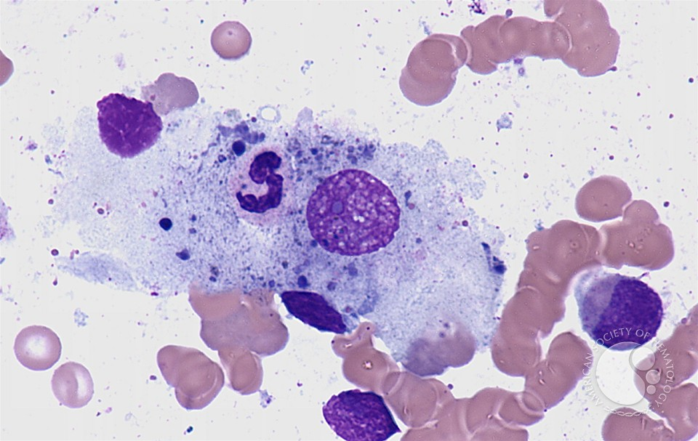
Introduction
Inflammation is a defense reaction of the organism to various aggressions which can be physical, chemical, biological (immune response) or infectious.
It is characterized by:
the recruitment of a variety of immune cells in the inflamed site:
Lymphocyte
Monocyte
Macrophage
Polymorphonuclear
Mast cell
the release of various pro-inflammatory cytokines
and
reactive oxygen species / nitrogen (ROS / RNS)

Slide 5
Background
Current treatment of inflammation involves NSAIDs and other drugs such as aspirin. Although effective, these drugs have many adverse effects that may hinder their use in the long-term.
Recently, much of the attention has been focused on medicinal plants that have beneficial effects against various diseases; however, more scientific evidence is needed to verify a key role of bioactive components derived from the medicinal plants. In view of these potential health benefits, there has been intensive research on natural phenolic compounds (phenolic acids, flavonoids, and tannins) which are considered to be a major contributor to various biological activities, such as anti-oxidative, anti-inflammatory, anti-cancer and anti-atherosclerotic activities. Recently, we reported anti-oxidative (Atmani et al., 2009) and anti-enzymatic (Berboucha et al., 2010) activities of Fraxinus angustifolia.
Fraxinus angustifolia (ash tree) is widely used in traditional folk medicine; hence, the present investigation was carried out to evaluate the anti-inflammatory and antioxidant potential of extracts and vesicles loaded of Fraxinus angustifolia in vitro and in experimental animal models.

Slide 6
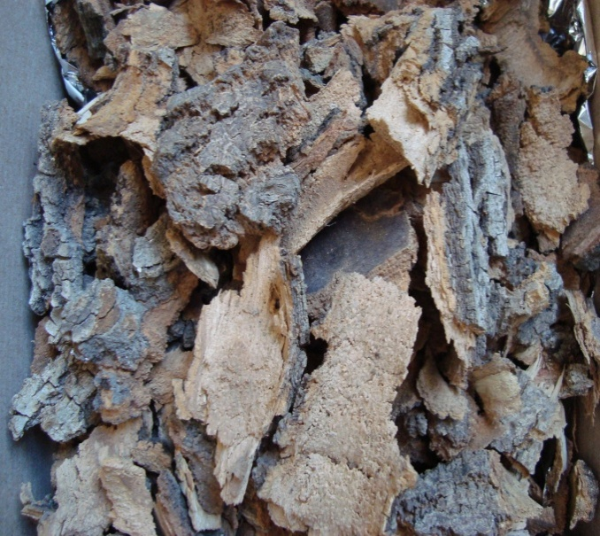
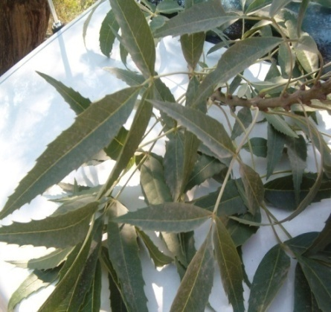
This study was focused on a medicinal plant (Fraxinus angustifolia)
(family of Oleaceae), widely used in traditional medicine in the treatment of asthma, gout, inflammation, rheumatism and as a diuretic.
Classification
Kingdom: Plantae
Phylum: Spermaphytes
Sub branch: Angiosperms
Class: Dicotyledonous
Subclass: Asteridae
Order: Lamiales
Family: Oleaceae
Genus: Fraxinus
Species: F. angustifolia
Barks
Leaves

Slide 7
Extraction of phenolic compounds
Powder of Leaves and Bark of Fraxinus angustifolia
Ethanol (95%) maceration
After 24h
Decantation
After 24h
Evaporation
Hydro-alcoholic extract leaves
Hydro-alcoholic extract bark

Slide 8
Carrageenan-induced mouse hind paw oedema
According to the method of Winter et al., 1972
Oral Administration of FAB and FAL (150 mg/kg) and indomethacin (10 mg/kg)
Induction of Oedema by subcutaneous injection of carrageenan (0.05 mL of 3% carrageenan suspended in saline) into the right hind paw of mice
After 60 min
Paw volume measurement using a plethysmometer
At 0h, after 1h, 3h and 5h

Slide 9
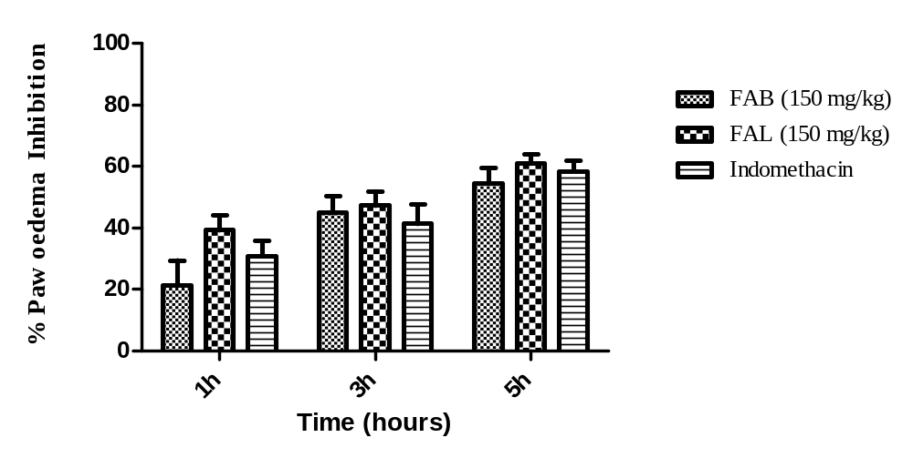
Figure 1: Percentage of oedema inhibition of Fraxinus angustifolia leaf (FAL) and bark (FAB) ethanol extracts (150 mg/kg) on carrageenan-induced mice paw edema, compared to indomethacin (10 mg/kg).

Slide 10
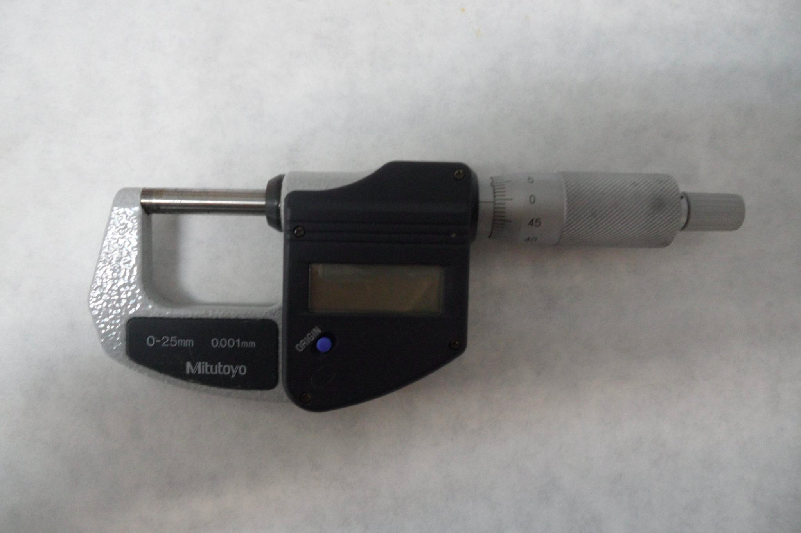
TPA-induced mouse ear oedema
According to the method of Young and De Young, 1989
Induction of ear oedema by topical application of TPA on the outer and inner surfaces
Application of FAB and FAL extracts (1mg/ear) and indomethacin (0.5 mg/ ear)
Before and After 4h
Measure the thickness of each ear
micrometer

Slide 11
Mouse ear edema induced by multiple topical application of TPA
According to the method of Stanley et al., 1991
Chronic inflammation induced by topical application of TPA on both ears of mice on alternate days (1, 3, 5, 8 and 10 days).
After 6h
Administration of extracts twice daily for four consecutive days (8, 9, 10 and 11)
The percentage of swelling inhibition was expressed as the weight difference between ear weight relative to sample and to control group

Slide 12
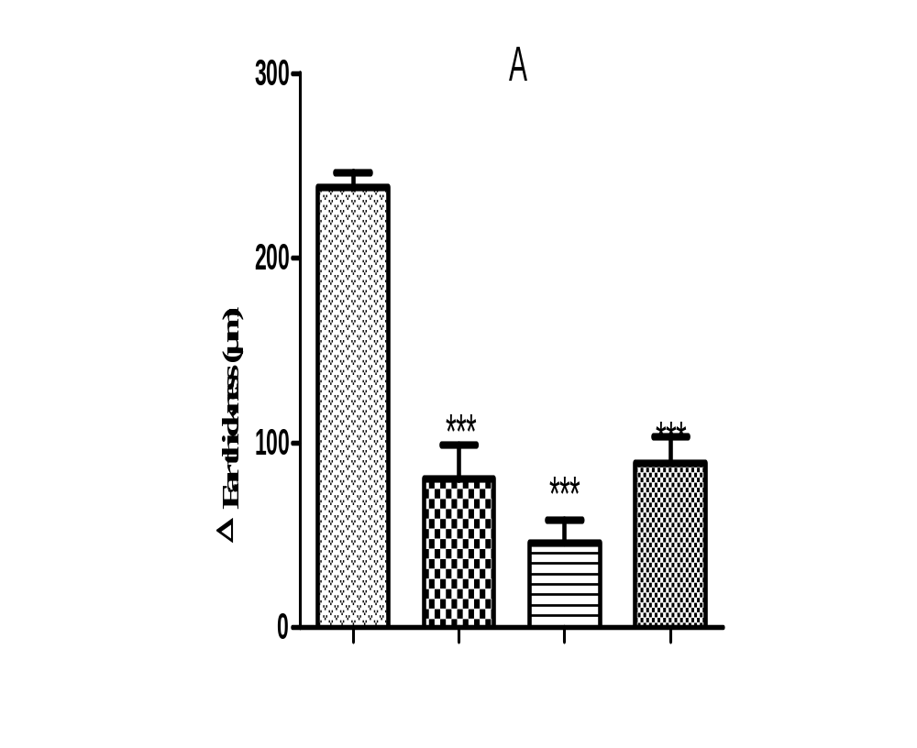
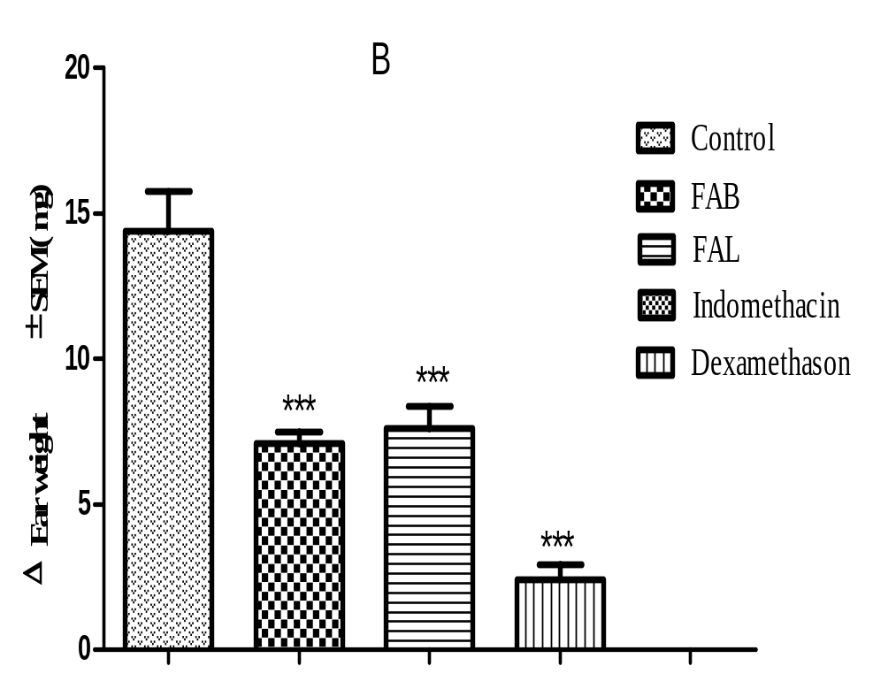
Figure 2: Anti-inflammatory effect of the ethanol extract from Fraxinus angustifolia leaves (FAL) and bark (FAB) on acute TPA-induced ear edema (A), ear subchronic inflammation induced by repeated applications of TPA (B) in mice. Statistically significant difference from the control is expressed by * P<0.001. by Dunnett’s multiple comparison test.

Slide 13
Myeloperoxidase assay
According to the method of De Young et al., 1989
Mice ear samples homogenized in cold PBS (80mM, 0.5% HTMB)
Centrifugation for 20 min at 4 °C
30 µl of supernatant add : 100 µL of 80 mM PBS
85 µL of 0.22 M PBS
15 µL of H₂O₂
20 µl of TMB/8%DMF + 30 µl NaOAc
Measure the absorbance at 630 nm

Slide 14
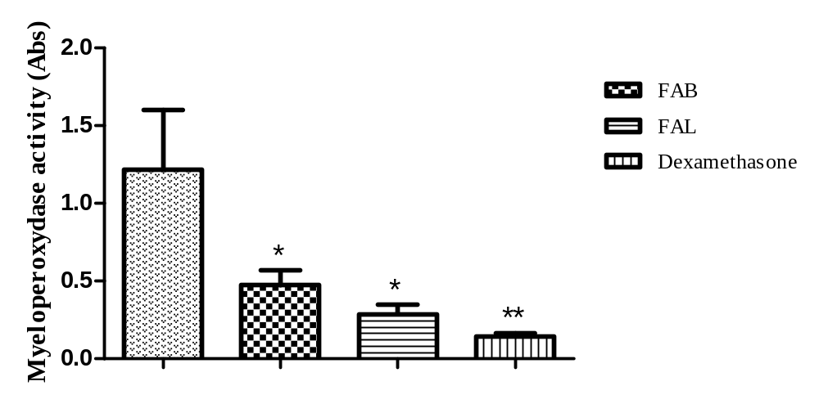
Figure 3: Effect of FAB and FAL on myeloperoxydase activity *P<0.05 and **P<0.01. by Dunnett’s multiple comparison test.

Slide 15
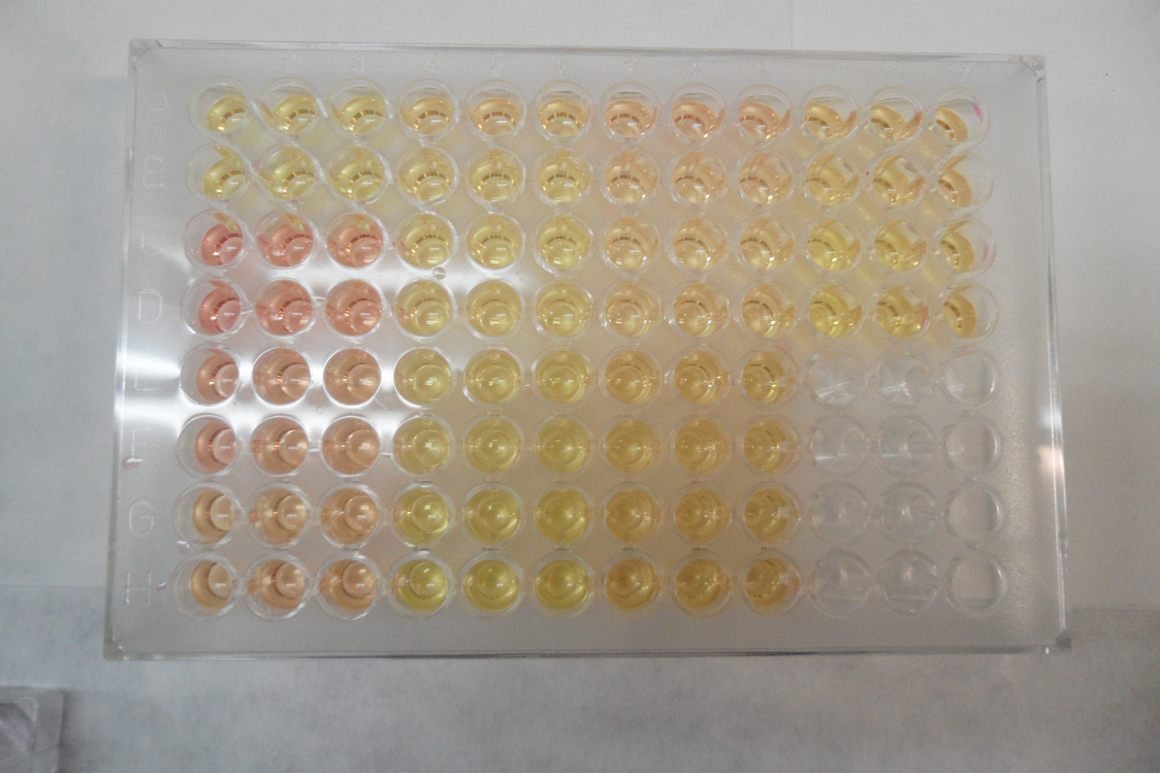
Nitric oxide production in RAW 264.7 macrophage
According to the method of Aquila et al., 2009
Incubate Macrophages (RAW 264.7)
in 96 well plates (200 µl/well)
Incubation at 37°C/24h
Microplate of nitric oxyde
1µg/µL LPS
Add the extracts dilutions (25,50,75,100µg/ml)
Add 100 µL of the Griess reagent
Measure the absorbance at 540 nm

Slide 16
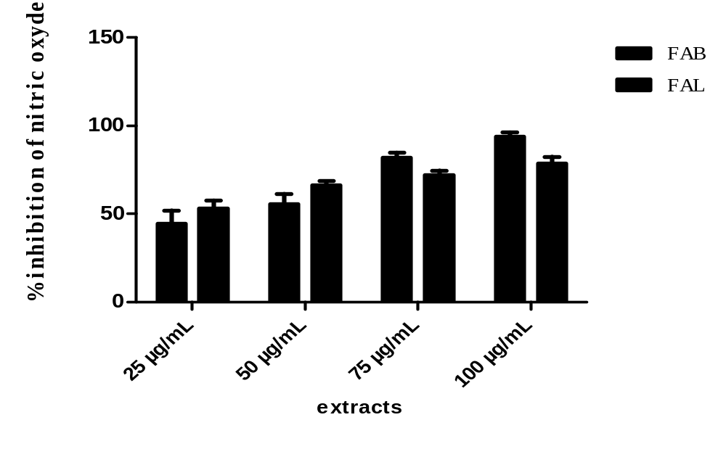
Figure 4: Effect of FAB and FAL on NO production in LPS-stimulated macrophages

Slide 17
Vesicle preparation
leaf and bark of F. angustifolia were incorporated in ethosomes and PEVs containing a high amount of water cosolvent (50%,v/v)
Leaf and Bark
-Ethanol/Water
-Ethylene glycol/Water
-Transcutol/Water
60 mg/mL Phospholipon®50
-L ethosomes
-L Trc-PEVs
-L EG-PEVs
-B ethosomes,
-B Trc-PEVs
-B EG-PEVs

Slide 18
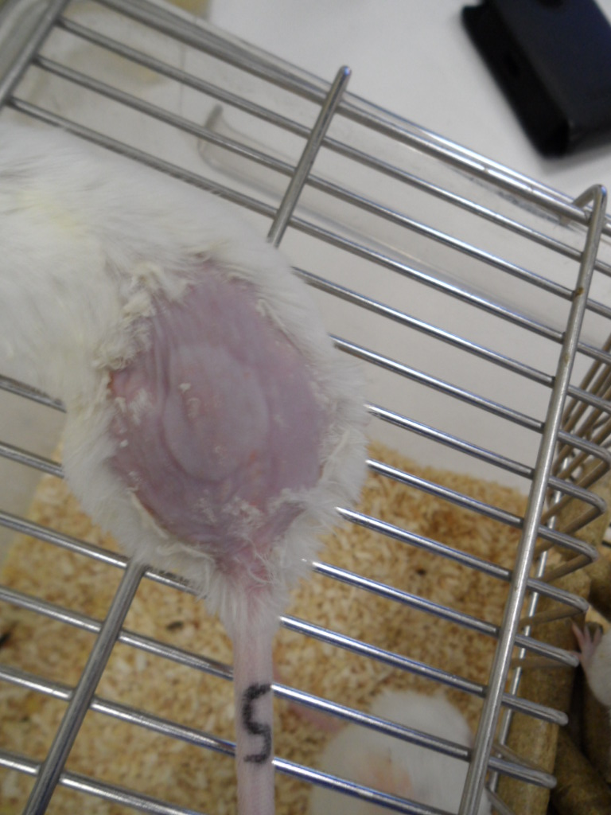
TPA-induced skin inflammation assay
According to the method of Stanley et al., 1991
Shave the back skin of mice one day before the experiment.
Apply TPA to the shaved dorsal area to induce cutaneous inflammation (day 1)
The leaf and bark extract solution or vesicles charged with extracts (ethosomes, Trc-PEVs and EG-PEVs) were topically smeared over the same dorsal site 3 and 6 h after TPA application.
repeat this procedure on days 2 and 3.
The treated dorsal skin area of mice , weighed to assess any increase indicative of oedema formation.

Slide 19
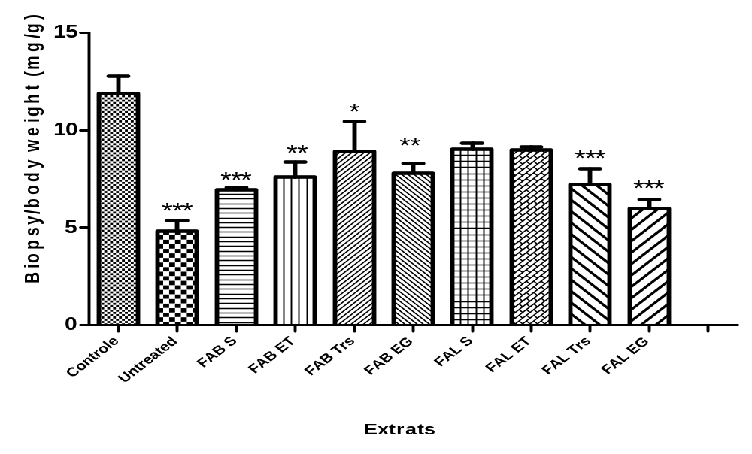
Figure 5: Mouse oedema obtained after TPA treatment followed by application of leaf and bark extract solutions, ethosomes and PEVs. *P<0.05 and **P<0.01. *** P<0.001 by Dunnett’s multiple comparison test.

Slide 20
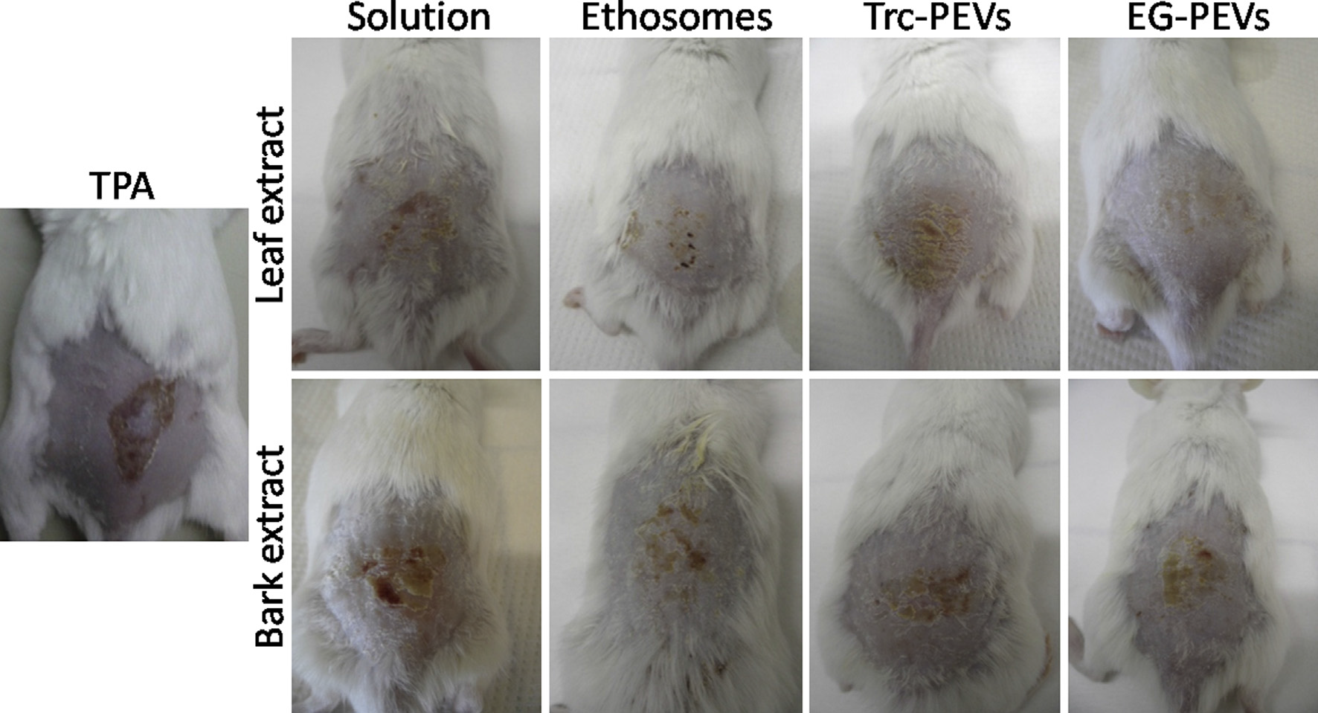
Figure 6: Photographs of dorsal skin of mice treated with TPA to induce inflammation, and treated with TPA followed by the administration of leaf and bark extract solutions,
ethosomes and PEVs (Moulaoui et al., Eur. J. Med. Chem (2015).

Slide 21
Myeloperoxidase assay
According to the method of De Young et al., 1989
Mice ear samples homogenized in cold PBS (80mM, 0.5% HTMB)
Centrifugation for 20 min at 4 °C
30 µl of supernatant add : 100 µL of 80 mM PBS
85 µL of 0.22 M PBS
15 µL of H₂O₂
20 µl of TMB/8%DMF + 30 µl NaOAc
Measure the absorbance at 630 nm

Slide 22
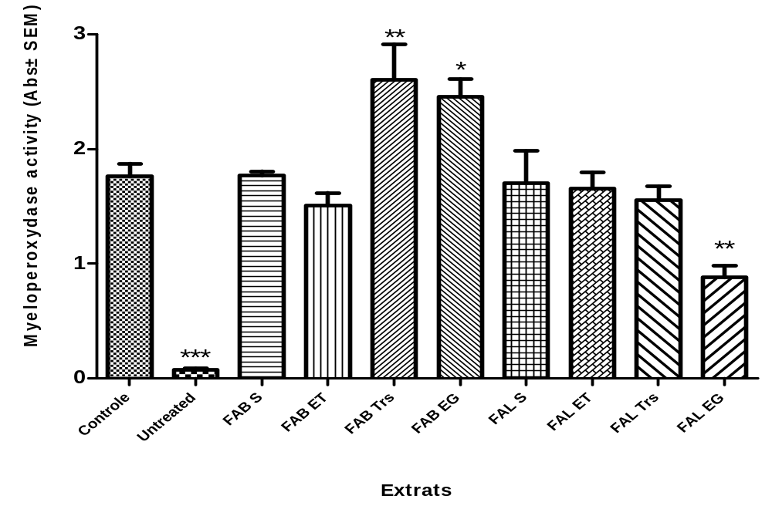
Figure 7 : Absorbance of myeloperoxydase activity after TPA treatment followed by application of leaf and bark extract solutions, ethosomes and PEVs. *P<0.05 and **P<0.01. by Dunnett’s multiple comparison test.

Slide 23
Free radical-scavenging ability by the use of stable ABTS radical
According to the method of Oyedemi et al., 2011
ABTS (7 mM)
Potassium persulfate (2.45 mM)
Solution ABTS^{˙+} (Abs= 0.7 nm)
10µl (100 µg/mL solution of extracts of leaf and bark or the three types of the vesicles charged with extracts) + 1ml ABTS^{•+} (7mM, Abs = 0.7nm)
Measure the absorbance at 734 nm

Slide 24
Free radical-scavenging ability by the use of stable DPPH radical
According to the method of Caddeo et al., 2013
20 µL (100 µg/mL solution of extracts of leaf and bark or the three types of the vesicles charged with extracts)
980 µL DPPH methanolic solution (25 mM).
Conservation in the dark for 30 mn
Measure the absorbance at 517 nm

Slide 25
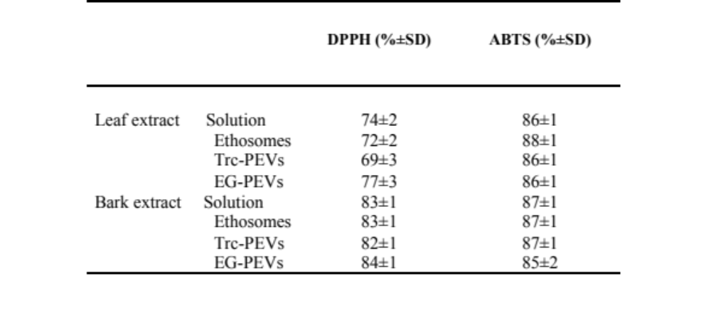
Table 2. Antioxidant activity (%) measured by DPPH, ABTS radical scavenging by leaf and bark extract in ethanolic solutions and vesicles.

Slide 26
Antioxydant activity against oxydative stress in human keratinocytes
According to the method of Phan et al., 2001
Seed keratinocytes in 24 well plates (5x10⁴ cells/well)
After 24h of incubation at 37 °C
Add hydrogen peroxide + solution of extracts of leaf and bark or the three types of the vesicles charged with extracts (100µg/mL)
After 4h of incubation at 37 °C
Wash three times with PBS
Add 500 µl MTT
Measure the absorbance at 530nm after 2H

Slide 27
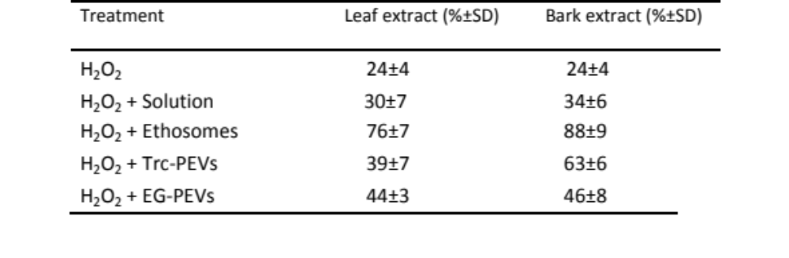
Table 3. Protective effect of leaf and bark extract ethanolic solutions and vesicles against H₂O₂-induced oxidative stress in human keratinocytes.

Slide 28
HPLC –photodiode array detection system
Extracts
FAL
FAB
Standards
Rutin
Quercetin
Cathenin
Acid tannic
Mobile phase : Mixture of methanol, water, acetonitrile and acetic acid (40:41, 94:18:0,06 v/v)
Deliver at a flow rate of 0.3 mL/min.
Identification of major compounds

Slide 29
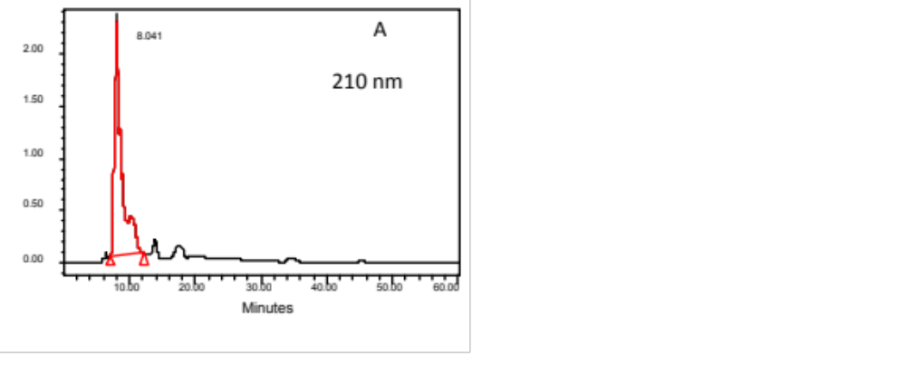
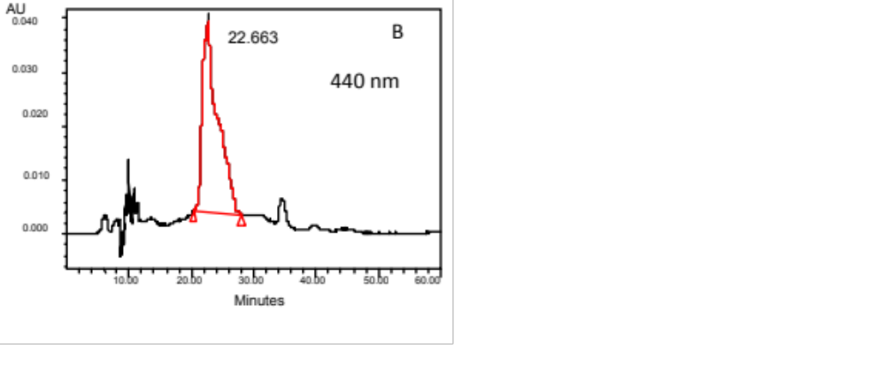
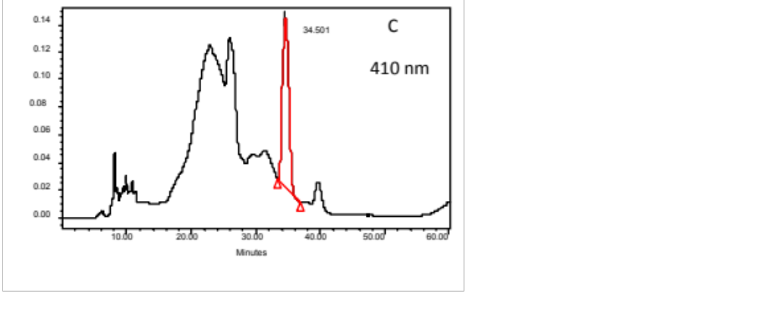
Major phenolic compounds of FAL
Rutin
Quercetin
Tannic acid
Figure 8: Chromatograms at different wavelengths of identified components of leaf extract: rutin (A), quercetin (B) and tannic acid (C)

Slide 30
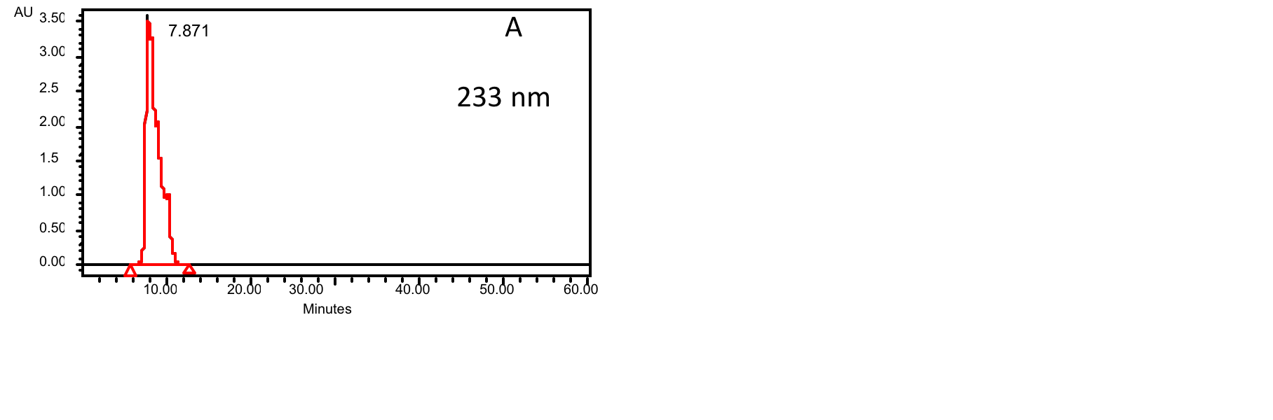
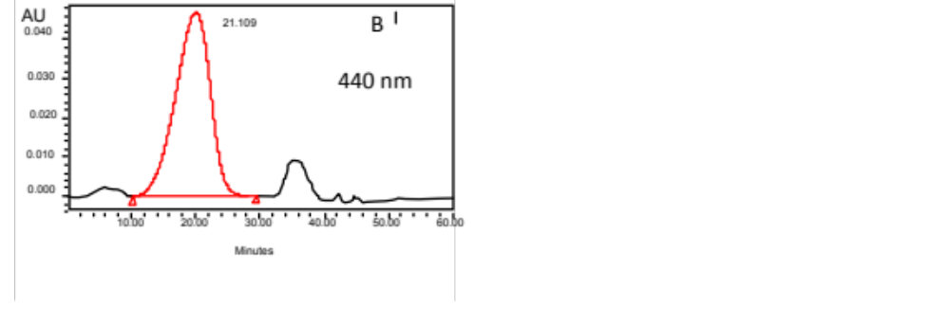
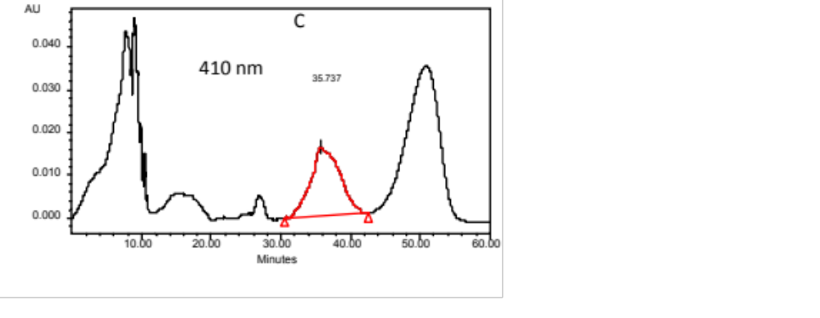
Major phenolic compounds of FAB
Catechin
Tannic acid
Quercetin
Figure 9: Chromatograms at different wavelengths of identified components of bark extract: catechin (A), tannic acid (B) and quercetin (C).

Slide 31
Conclusion
Obtained results suggest that the ethanol extract from the leaves and bark of Fraxinus angustifolia exhibited interesting anti-inflammatory activity against acute and subchronic oedema, both when orally administered and topically applied.
Fraxinus angustifolia extracts showed a significant radical scavenging activity in different in vitro assays.
Hydro-alcoholic extracts of bark and leaves incorporated in nano-vesicles showed significant anti-inflammatory activity, inhibiting the onset of skin wound after TPA treatment. This protective effect was more important in EG-PEVs of leaves formulation, thanks to the excellent ability of the vesicle carrier to increase drug bioavailability in the target tissue.

Slide 32
Fraxinus angustifolia may be considered as an important source of polyphenols: rutin, quecetin and tannic acid in the leaves and catechin, quecetin and tannic acid in barks. These compounds are known to be strong free radical scavengers, hydrogen donors and/or metal ion chelators.
Obtained results may justify the use of this plant in folk medicine, although further pharmacological investigations are being carried out in order to fully understand the involvement of phenolic compounds in the anti-inflammatory action.

Slide 33
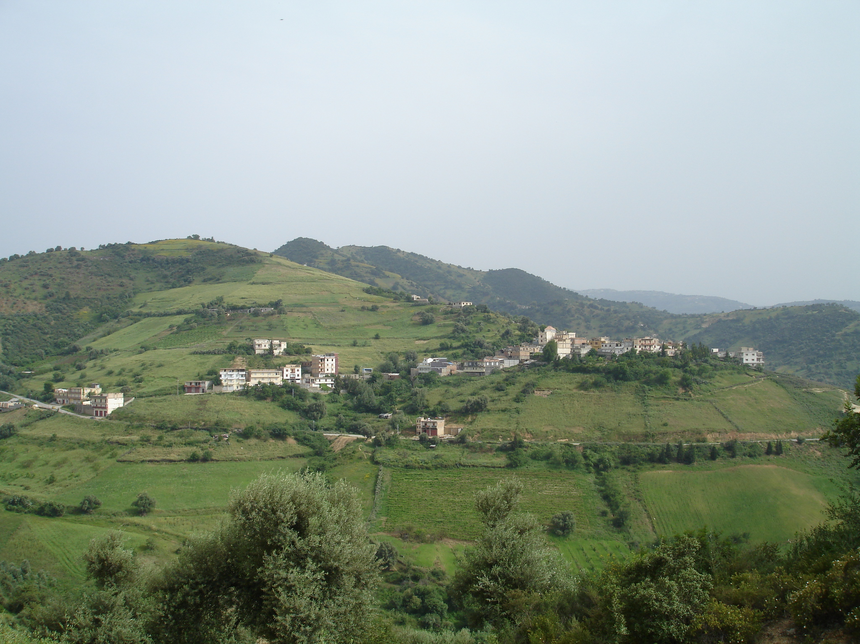
Thank you

Slide 34
Let us meet again..
We welcome you all to our future conferences of OMICS International
4th Annual Conference on European Pharma Congress
June 18-20,2016, Berlin, Germany.
http://europe.pharmaceuticalconferences.com/

