Slide 1
Conference Series LLC Conferences
Conference Series LLC is a pioneer and leading science event organizer, which publishes around 500 open access journals and conducts over 500 Medical, Clinical, Engineering, Life Sciences, Pharma scientific conferences all over the globe annually with the support of more than 1000 scientific associations and 30,000 editorial board members and 3.5 million followers to its credit.
Conference Series LLC has organized 500 conferences, workshops and national symposiums across the major cities including San Francisco, Las Vegas, San Antonio, Omaha, Orlando, Raleigh, Santa Clara, Chicago, Philadelphia, Baltimore, United Kingdom, Valencia, Dubai, Beijing, Hyderabad, Bengaluru and Mumbai.

Slide 2

Biosimilar Development Cost : Role of Analytics
DiptI Gulati
PJI Biotech

Slide 3
Agenda
Biosimilar
Development Process
Regulatory Requirements
Role of Analytics
Analytics and Development Cost
Conclusions

Slide 4
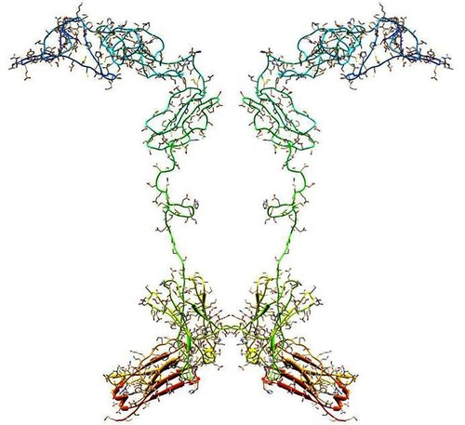
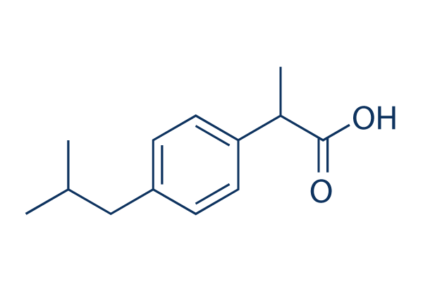
Biosimilars
Biosimilars are a less expensive copy of Biological Products.
Biosimilars are complex heterogeneous molecules manufactured using living cells.

Slide 5
Approved Biosimilar
EMA has approved 22 Biosimilar, 2 approvals have been withdrawn leaving 20 Biosimilar in Europe.
On March 06, 2015, US FDA approved Zarxio, the first Biosimilar product in US. On April 2016, FDA approved Inflectra (infliximab-dyyb), administered as an intravenous infusion, for multiple indications. This is biosimilar to Janssen Biotech’s Remicade (infliximab).
Several approved in ROW (Japan, Korea, India, Canada, Australia Etc.).

Slide 6
Development Process
There are four stages in the Biosimilar development
Product Development and Comparative Analysis.
Process Development Scale-up and Validation.
Clinical Trials.
Regulatory Review and Approval.
Average Time: 8-10 Years
Average Cost: $ 100-300 Million

Slide 7
Product Development and Comparative Analysis
Characterize Licensed Reference Product.
Define Target product profile.
Define critical Quality Attributes.
Reverse Engineer the Biosimilar.
Perform Analytical Comparability between proposed biosimilar and Reference product.
Average Time: 1-2 Years
Average Cost: 3.0 % of Total Cost

Slide 8
Process Development Scale-up and Validation
Optimize the process until high analytical similarity between reference and biosimilar is achieved.
Scale-up the manufacturing process.
GMP are established.
Process is Validated.
Average Time: 1-2 Years
Average Cost: 20% of Total Cost

Slide 9
Clinical Trials
Non-clinical and Clinical studies are performed to demonstrate the Biosimilarity.
Address the residual uncertainties with Analytical, non-clinical and clinical studies.
Average Time: 2-4 Years
Average Cost: 77% of total cost

Slide 10
Regulatory Review and Approval
Average Time: 1-2 Years.
Average Cost: Regulatory Fee as applicable.

Slide 11
Regulatory Requirements
  Biosimilar has the same mechanism of action, conditions of use, route of administration, dosage form and strength as reference product.
  Comprehensive characterization and comparison at quality level should provide a basis for reduction in the non-clinical and clinical data.
  A final determination of Biosimilarity is based on totality of the evidence: combination of quality, non-clinical & clinical evaluation.

Slide 12
Dossier Requirements
New Biologics
Full Quality Data
Full Non-clinical Data
Full Clinical Data
Biosimilar
Full Quality Data + Comparability
Reduced Non-Clinical Data + Comparability
Reduced Clinical Data + Comparability

Slide 13
Development Process of Biosimilar vs Biologics
Biological
Additional Clinical Studies(Immunogenicity)
Comparative Human PK/PD
Innovator Biologic
Clinical Pharmacology, safety and efficacy
Comparative Nonclinical
Biosimilar
Nonclinical Studies
Analytical: Physicochemical and Functional Comparative characterization
Analytical

Slide 14
Analytical data is the foundation of Biosimilar Approval.

Slide 15
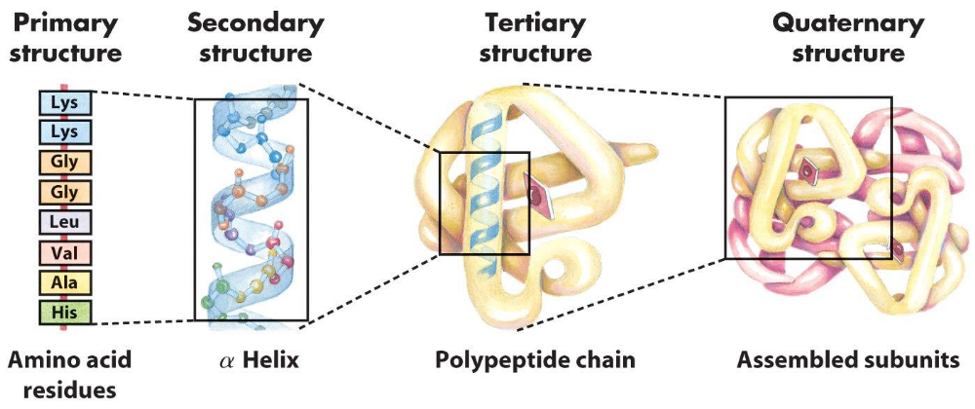
Role of Analytics

Slide 16
Role of Analytics
A deep understanding of primary and 3-D molecular structure, biological function & critical quality attributes (CQA) of Reference and Biosimilar is critical step for establishing the Analytical Similarity.
Biosimilar may not be exact match but if Molecular structure/biological function and CQA of Reference and Biosimilar are highly similar, there is a great possibility that clinical performance (efficacy & safety) will be highly similar to reference product.
It is also important to understand how CQA link to the manufacturing process (Material Quality Attributes and Critical Process Parameters), so that process can be adequately controlled to obtained desired CQA.
Notes:
Read slide 1

Slide 17
Role of Analytics
Understanding the relationship between CQA and Clinical Performance (safety, PK/PD, activity and immunogenicity) of the product is critical.
Helps to predict clinical similarity from quality data.
CQA can be controlled to obtain desired/similar clinical performance.
All CQA Need to match.

Slide 18
Thanks to power of Analytics
Deep and Comprehensive evaluation of Biosimilar and Reference Product structure & function can be obtained by using modern analytical methods.
Complexity of the protein products can be addressed using large array of powerful tests.
Relationship between CQA, CPP and Clinical performance can be understood with advanced analytical technologies.

Slide 19
Sensitive and State of the Art Analytical Tools
Molecule can be analyzed and characterized using State of the art analytical technology.
Sensitive biological tests can be used to understand the relationship between functional CQA (potency, activity etc.) and clinical performance.
Higher Analytical Capability and State of the Art Analytical techniques are key to demonstrating analytical similarity between reference and biosimilar product.

Slide 20
Role of Analytics
Analytical technology/Tools can be classified into 3 major categories:
Biochemical/Chemical Tools: To study the structure of protein.
Biological/ functional Tools: To study the activity/immunogenicity of protein.
Biophysical tools: To study the 3-Dimentinal structure/folding of proteins.

Slide 21
Role of Analytics: Chemical Analysis
How to tell if Reference and Biosimilar product are similar
Thorough understanding of CQA of molecule can be achieved by Analytical Characterization and increased Testing.
Powerful analytical tools can detect the smaller differences in primary structure or carbohydrate structure of molecule due to change in process.
Analytical methods can even detect minor differences on Glyco-protein structure, which may impact clinical performance of the product.
Analytical tools can also detect minor non-product related residual impurities which may impact clinical performance.

Slide 22
Role of Analytics: Chemical Analysis
Examples of Chemical Analytical Tools to evaluate Biosimilar
Amino acid analysis
Mass Spectroscopy
Size exclusion chromatography
HPLC (Reverse Phase)
Ion-Exchange Chromatography
Capillary electrophoresis and SDS-PAGE
Analytical Ultracentrifugation

Slide 23
Role of Analytics: Biophysical Analysis
How to tell if Reference and Biosimilar product fold similarly and has similar 3-dimentional structure
X-Ray Crystallography can be used to understand the molecule, how it folds and what is the 3-dimentional structure of the molecule.
Crystallography can demonstrate if reference and biosimilar are similar in 3-dimentional structure.
Two molecules with similar amino acid sequence/glycosylation structure and three dimensional structure will probably have similar functional PK/PD profile and clinical performance.

Slide 24
Role of Analytics: Biophysical Analysis
Examples of Biophysical analytical tools
X-Ray Crystallography
Micro-Calorimetry
Circular Dichroism
Fluorescence Spectroscopy
NMR
Raman Spectroscopy
Mass Spectroscopy
Size Exclusion Chromatography

Slide 25
Role of Analytics: Biological Analysis
How to tell if reference and biosimilar molecule is functionally equivalent?
There are a whole array of biological assays available, which can detect:
Differences in functional attributes of the Reference and Biosimilar product.
Help in determination if differences will be clinically meaning full or not.
To demonstrate the Clinical Comparability of the product.

Slide 26
Role of Analytics: Biological Analysis
Examples of Bioactivity or Bioassay for Biological Analysis
Cellular Bioassay
Animal Bioassay
Ligand and Receptor Binding assay (ELISA, surface Plasmon resonance)
Signal transduction
Immunoassay
Flow Cytometry

Slide 27
Analytical data makes foundation for Biosimilar Approval.
Modern analytical technology/tools can help to generate extensive analytical characterization and functional data.

Slide 28


Development Cost
How Powerful Analytics can help to reduce cost of Biosimilar Development??
O’Man, That is too big of Pill for
me to swallow. Biosimilars of
Biosimilar is the way to go.

Slide 29
Analytics and Development Cost
  Prices of Biosimilar are only 30% lower than innovator drugs as compared to Generics which are about 80-90% lower than innovator drugs.
  Biosimilar manufacturing is more time consuming and costlier than the generic drug development due to complex manufacturing process and higher Pre-clinical/ Clinical Cost.
  Generic Development Cost: 1-2 years and $ 5-10 million.
  Biosimilar Development Cost: 8-10 years and $ 100-300 million.
Notes:
Read Slide.

Slide 30
Analytics and Development Cost
Cost of Analytical characterization: 2-3% of total cost.
Cost of Process optimization: 20% of total cost.
Cost of Clinical Trials: 77% of total cost.
Demonstrating that Biosimilar is highly similar to reference product using extensive analytics data can reduce Clinical Trials requirements and high Clinical Trial cost because analytical data serves as surrogate for large clinical data.

Slide 31
Analytics and Development Cost
Extensive analytical characterization and analytical similarity demonstration not only reduces cost of clinical trials but also reduces approval time, thus resulting in total cost of development.
Understanding potential impact of CQA on activity, PK/PD, safety and immunogenicity at early development stage can also result in reduction of pre-clinical and Clinical study cost.

Slide 32
Conclusions
State of the Art Analytics are key to reducing Biosimilar development time and Cost of development because analytical data develops the basis of reduced clinical testing.
Analytics can be used to demonstrate high level of structural similarity.
Analytics can used to understanding the relationship between CQA and Clinical Performance.
Performing extensive Analytical Characterization using State of the Art Techniques may increase the cost of product comparative analysis from 3% to 6% but it creates an opportunity for reduction in high percentage of clinical trial cost.
Notes:
READ Slide.

Slide 33
Let us meet again..
We welcome you to our future conferences of Conference Series LLC
through
6th International Conference and Exhibition on Biologics and Biosimilars
October 19-21, 2016 Houston, TX, USA
http://biosimilars-biologics.pharmaceuticalconferences.com/europe

