Slide 1


Slide 2
Title of Paper | Quality of life among leprosy affected persons- A cross sectional study in a rural block, Tamil Nadu, India
Presenting Author | Dr. G. Dinesh Kumar M.D
Designation | Assistant Professor, Dept. of. Community Medicine, SRM MCH & RC, SRM UNIVERSITY, CHENNAI,INDIA
Co- authors | Dr. K.R John , Dr. M. Logaraj
Date | 16.05.2016
Venue | Hotel Hilton San Antonio Airport, San Antonio, Texas, USA

Slide 3
CONTENTS
INTRODUCTION
OBJECTIVES
MATERIALS & METHODS
RESULTS
DISCUSSION
CONCLUSION
RECOMMENDATIONS
REFERENCES

Slide 4


INTRODUCTION
Leprosy is a chronic granulomatous infection, principally affecting the skin and peripheral nerves, caused by Mycobacterium leprae(1) remains a leading cause of peripheral neuropathy and disability in the world, despite extensive efforts to reduce the disease burden (2).
Impairments may give rise to disabilities, such as limitations of activities involving the use of hands, feet and eyes, and restrictions in social participation.

Slide 5
CURRENT SCENARIO
According to official reports received from 121 countries from all WHO regions except for Europe, the global registered prevalence of leprosy at the end of 2014 was 174 554 cases (0.24 cases per 10 000 people).
The number of new cases reported globally in 2014 was 213 899 (0.3 new cases per 10 000 people).

Slide 6
INTRODUCTION
India achieved the goal of elimination (i.e point prevalence rate of less than 1case per 10,000 population) of leprosy as a public health problem at National level in Dec 2005 (3)
Care after cure is an important aspect and which needs more concentration as most of the patients situation worsen after being released from treatment. (3).

Slide 7
INTRODUCTION
WHO defines Quality of Life as “Individual’s perception of their position in life in the context of the culture and value systems in which they live and in relation to their goals, expectations, standards and concerns”.
It is a broad ranging concept affected in a complex way by the person's physical health, psychological state, level of independence, social relationships, personal beliefs and their relationship to salient features of their environment

Slide 8
INTRODUCTION
There should be a clear focus on managing disability, especially after treatment completion, as it can have a huge influence on quality of life of the people
“Global Leprosy Strategy 2016‒2020”, which is structured around the following 3 core pillars:
  Pillar I: Strengthen government ownership, coordination and partnership
  Pillar II: Stop leprosy and its complications.
  Pillar III: Stop discrimination and promote inclusion

Slide 9
OBJECTIVES
To determine the Quality of Life (QoL) among leprosy affected persons ( LAP) using the WHOQOL-BREF
To find out the factors associated with Quality of Life (QoL) among leprosy affected persons ( LAP)

Slide 10
MATERIALS & METHODS
STUDY DESIGN
  Cross sectional study
  STUDY AREA
      Leprosy settlements in Kattankulathur block
        Bharathapuram, Alapakkam
        Solomon Nagar, Alapakkam
        Calvary Nagar, Vallam
        Bethel Nagar, Alapakkam
        Annai Indra Memorial Nagar,Chettipuniyam
        Gnanodaya trust,Vengadapuram

Slide 11
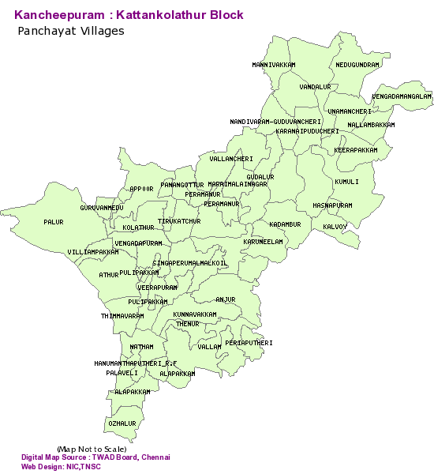

Slide 12
MATERIALS & METHODS
  STUDY POPULATION
  Inclusion criteria;
    Treatment completed persons
  Exclusion criteria;
    Age less than 18
    Not willing to participate in the study

Slide 13
MATERIALS & METHODS
SAMPLE SIZE -247
  using the formula n = (1.96)² Pq / d², and on the basis of deformities prevalence as 20 % from a study in South India ⁶
SAMPLING TECHNIQUE - SIMPLE RANDOM SAMPLING
  STUDY PERIOD September 2013 – August 2014

Slide 15
DATA COLLECTION
After getting clearance from the Institutional Ethical Committee A pilot study was conducted.
For the each of the villages, a visit was done to the meet with the local leaders, they were explained the details of the study.
After getting permission, House to house interview was conducted using a predesigned, pretested questionnaire

Slide 16
DATA COLLECTION
Questionnaire elicited information on socio demographic variables and information on leprosy like type of leprosy, duration since diagnosis etc
Subjects were also graded for any deformities in the body using the WHO disability grading. Informed Consent was also obtained for the same.
Female subjects were examined in the presence of female members

Slide 17
W.H.O DISABILITY GRADING SCALE

Slide 18
Quality of life (QOL) information was collected using the instrument WHOQOL-BREF. This questionnaire composes of 26 questions, two general questions and the remaining 24 encompass four domains: physical, psychological, social relations and environment.
The sum of the responses provides a score for the overall QOL⁸. Higher score indicates a better quality of life

Slide 19
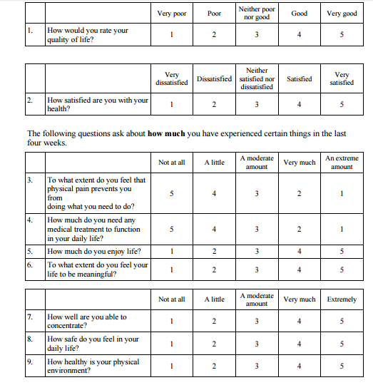

Slide 20
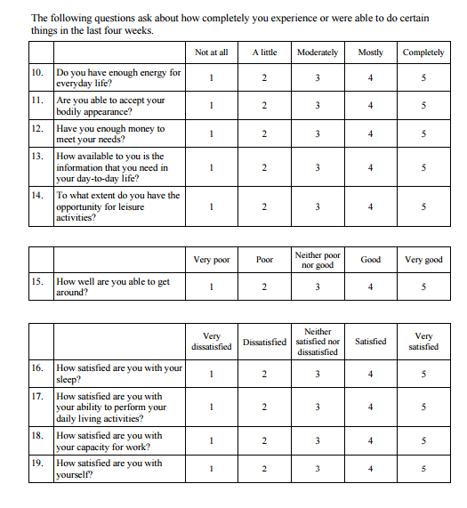

Slide 21
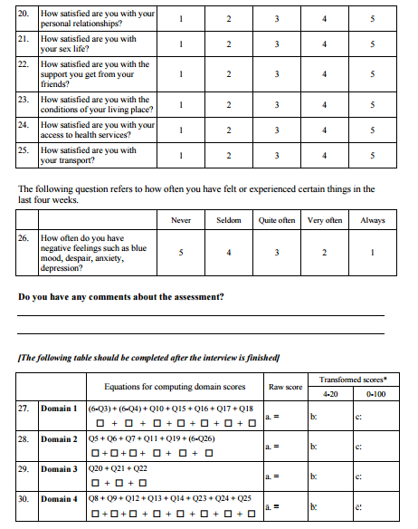

Slide 22
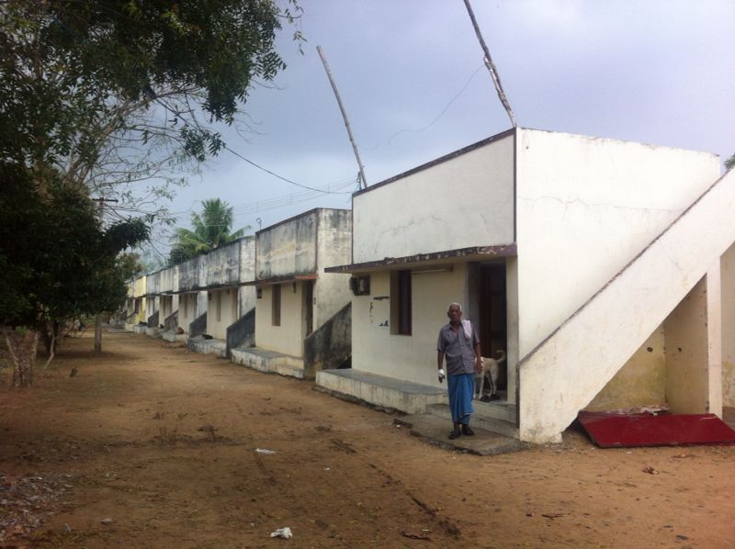
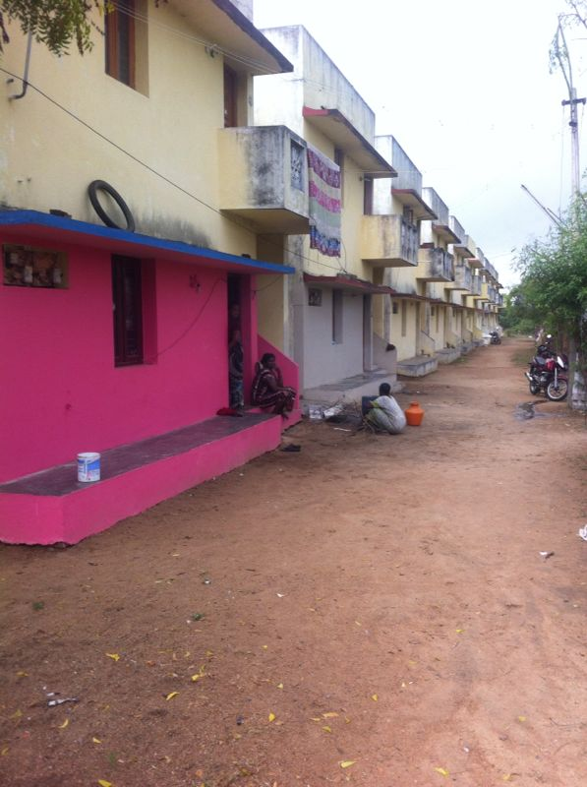
Vengadapuram Colony

Slide 23
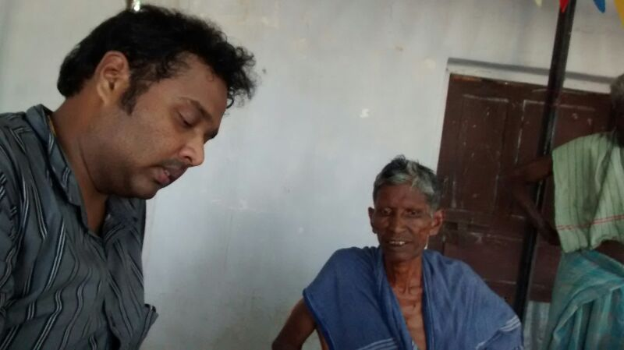
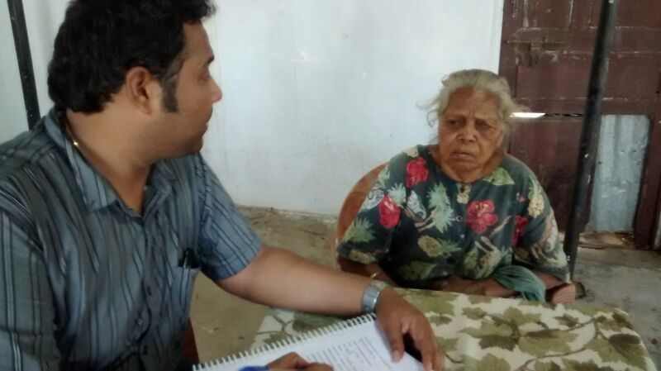

Slide 24
ANALYSIS
Data was entered in MS-Excel sheet spread sheet.(2007) . Data was analyzed using statistical package for social sciences version 20 (trial version).
Univariate analysis of the variables was done followed by unpaired ‘t’ test for comparison of means
Linear regression analysis was done with overall Quality of life as the dependent variable and baseline variables as the independent variables.
‘p’ value of less than 0.05 was considered to be statistically significant

Slide 25
RESULTS

Slide 26
TABLE 1 : SOCIO-DEMOGRAPHIC DISTRIBUTION OF STUDY PARTICIPANTS
Mean Age 60.19±12.8
Mean income
19 USD

Slide 27
Fig 1: W.H.O Disability grading of Study Participants

Slide 28
Fig 2: QoL scores based on the different domains

Slide 29
TABLE 2: COMPARISON OF BASELINE VARIABLES WITH OVERALL QoL SCORES
* - Statistically significant

Slide 30
TABLE 3 : LINEAR REGRESSION ANALYSIS

Slide 31
DISCUSSION
Among the 247 subjects in our study, mean domain scores for the various domains were; Physical (20.55 ± 3.9), Psychological domain (16.16 ± 2.9), Social relationship domain (8.16 ± 2.08) and Environment domain (24.34 ± 3.9).
On Comparison with other studies, our study had better scores in the all the domains except the social relationship domain.^{9, 10}
In spite of the high prevalence of deformities, the physical domain score in our study was found to be high

Slide 32
DISCUSSION
Lower age groups had a better quality of life scores across all the domains.
Males had a better score compared to females in all the domains of QOL. But there was no statistical significance seen in any of the domains.
The type of leprosy (i.e. paucibacillary or multibacillary) at the time of diagnosis did not have any significance on any domains of the quality of life

Slide 33
DISCUSSION
On assessing the overall quality of life it was found that age, education income, occupation, marital status, disease duration and the disability had influence on the quality of life.
Linear regression model after controlling the effects of other variables showed that occupation, marital status and disability had significant effect on the overall quality of life.

Slide 34
LIMITATIONS
Cross sectional study – True temporal relationship cannot be established.
Covered a very selective area due to resource constraints and hence limits the generalisability of the results
WHO disability grading system that does not account for any disability or deformity of the face

Slide 35
RECOMMENDATIONS
More studies to assess those being released from treatment.
‘CARE AFTER CURE’ – SHOULD NOT BE NEGLECTED
“The road to life of the affected does not end with cure of the disease, but continues way forward till they attain the best of their abilities”

Slide 36
REFERENCES
[1] Britton WJ, Lockwood DN. Leprosy. Lancet 2004 Apr 10; 363(9416):1209-19
[2].Madhavan K, Vijayakumaran P, Ramachandran.L, Manickam C, Rajmohan R, Mathew J et al. Sustainable leprosy related disability care within integrated general health services: findings from Salem District, India. Lepr Rev.2007; 78:353–361.
[3].VanBrakel WH, Sihombing B, Djarir H, Beise K, Kusumawardhani L, Yulihane R et al. Disability in people affected by leprosy: the role of impairment, activity, social participation, stigma and discrimination. Global Health Action. 2012; 5
[4].Sarkar J, Dasgupta A, Dutt D. Disability among new leprosy patients, an issue of concern: An institution based study in an endemic district for leprosy in the state of West Bengal, India Indian J Dermatol Venereol Leprol 2012; 78:328-34.
[5].Jain P, Tripathi D, Singh CM, Srivastava DK, Sharma A , Bansal M. A study of high disability rate among leprosy affected persons in Gwalior district .Indian Journal Of Community Health.2011; 23(2): 90-92.
[6].Chavan LB, Patel P. Epidemiology of disability in incident leprosy patients at supervisory urban leprosy unit of Nagpur city. Natl J Community Med 2011; 2(1):119-122.
[7].Brandsma JW, VanBrakel WH. WHO disability grading: operational definitions. Lepr Rev 2003; 74: 366-373.
[8].Rad F, Ghaderi E , Moradi G , Salimzadeh H. The Study Of Disability Status Of Live Leprosy Patients In Kurdistan Province Of Iran. Pak J Med Sci 2007 Oct-Dec; 23(6):857-61
[9].Nardi SM, Paschoal Vdel A. Chiaravalloti-Neto F, Zanetta DM. Leprosy-related disabilities after release from multidrug treatment: prevalence and spatial distribution. Rev. Saúde Pública 2012 Dec; 46(6):969-977.
[10].Ishida Y. Prevalence of disability among leprosy patients and effectiveness of leprosy reaction services with standard prednisolone treatment at field level in an endemic country--some data from joint leprosy research collaboration in Myanmar. Nihon Hansenbyo Gakkai Zasshi.2009 Sep; 78(3):277-82

Slide 37
REFERENCES
[11].Gautham HYPERLINK "http://www.ncbi.nlm.nih.gov/pubmed?term=Gautham MS[Author]&cauthor=true&cauthor_uid=22125937"MS, Dayananda M, Gopinath D, Shivraj NS, Riyaz B, Pruthvish S.Community-based needs assessment of Leprosy patients in Chamrajanagar District, Karnataka, India. Lepr Rev 2011Sep; 82(3): 286–295
[12].Raposo MT, Caminha AV, Heukelbach J, Sánchez-González MÁ, de Medeiros JL, Nemes MI. Assessment of physical impairments in leprosy patients: a comparison between the world health organization (who) disability grade and the Eye-Hand-Foot score. Rev Inst Med Trop Sao Paulo. 2011 Mar-Apr; 53(2):77-81
[13].Kumar AA, Naidu AA, Mahapatra BR, Porichha D. Trend in decline in leprosy disabilities of a LEPRA project in Malkangiri district, Odisha, India. Indian J Lepr.2013 Jul-Sep;85(3):101-8.
[14].Shen J, Liu M, Zhou M. Current situation of leprosy colonies/leprosaria and their future in P.R. China. Lepr Rev 2007 Sep; 78(3): 281–89
[15].De Araujo E Araujo AE, De Aquino DM, Goulart IM, Pereira SR, Figueiredo IA, Serra HO et al. Factors associated with neural alterations and physical disabilities in patients with leprosy in São Luis, State of Maranhão, Brazil. Rev Soc Bras Med Trop 2014 Jul; 47(4):490-7
[16].Guerrero MI, Muvdi S, Leon CI. Delay in leprosy diagnosis as a predictor of disability in a cohort of patients in Colombia, 2000 - 2010. Rev Panam Salud Pública. 2013 Feb; 33(2):137-143.
[17].El-Dawela RE, Mohamed AS, Yousef F Analysis of newly detected leprosy in Sohag Governorate, Upper Egypt, 2004-2008.Lepr Rev.2012 Mar; 83(1):71-9.
[18].SinghL, Malhotra R, Bundela RK, Garg P, Dhillon KS, Chawla S, Lal BB. Ocular disability--WHO grade 2 in persons affected with leprosy. Indian J Lepr. 2014 Jan-Mar; 86(1):1-6.
[19].Waziri-Erameh MJ, Omoti AE. Ocular leprosy in Nigeria: a survey of an Eku leprosorium. Trop Doct. 2006 Jan; 36(1):27-8.

Slide 38
Thank you !!!!

