Slide 1

THE ASSOCIATION BETWEEN LIFESTYLE OF WOMEN WITH POLYMORPHISM OF VITAMIN D RECEPTOR (TaqI AND BsmI) IN RURAL AND URBAN AREAS AND THE OCCURRENCE OF VITAMIN D DEFICIENCY IN TROPICAL REGIONS
Dina Keumala Sari¹, Zaimah Zulkarnaini Tala¹, Sri Lestari², Sunna Vyatra Hutagalung³, Ratna Akbari Ganie⁴, Delina Sekar Harum⁵
^{University of Sumatera Utara}

Slide 2
Background
Tropical regions→ North Sumatera → Indonesia
Women → varied occupation
25(OH)D serum level
POLYMORPHISM VITAMIN D RECEPTOR GENE
URBAN and RURAL

Slide 3
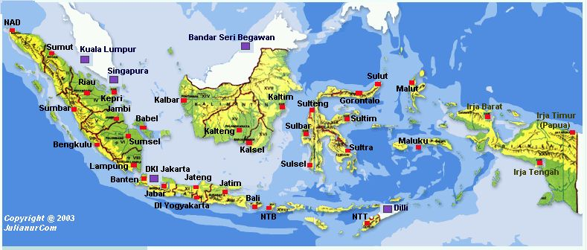
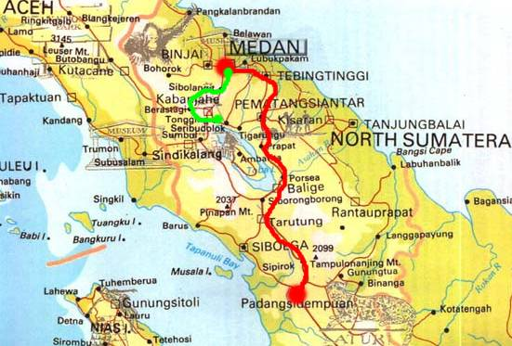
Indonesia
North Sumatera

Slide 4
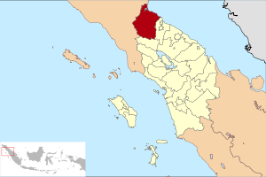
Location
Rural
Urban
Rural:
Kecamatan Sirapit
Kabupaten langkat
North Sumatera
Indonesia
Urban:
Kota Medan
The city of North Sumatera Provence
Indonesia
3.57ºN latitude and 98.65ºE longitude
Average temperature was ±32ºC (90ºF)

Slide 5
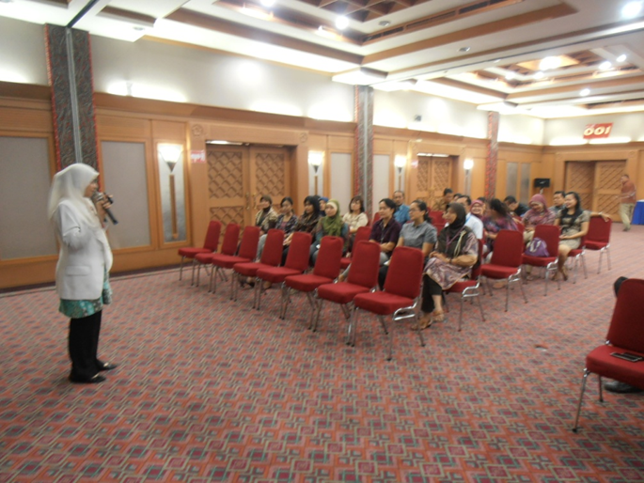
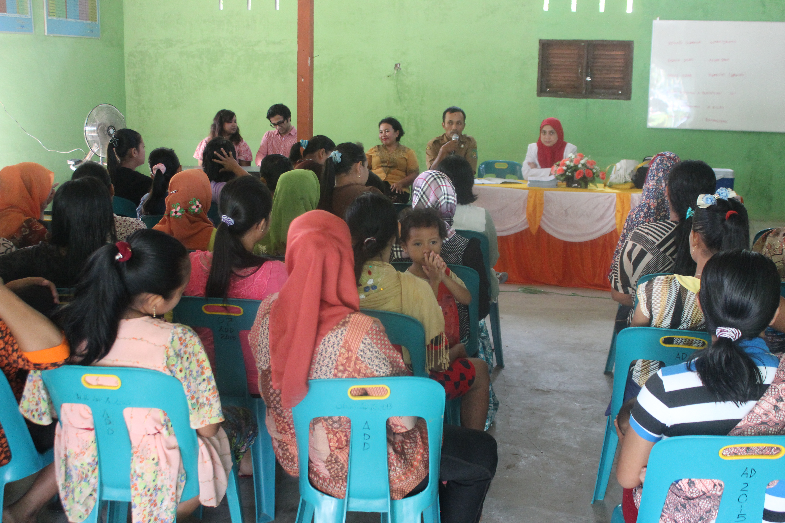
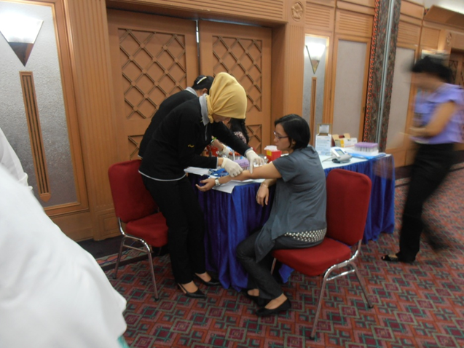
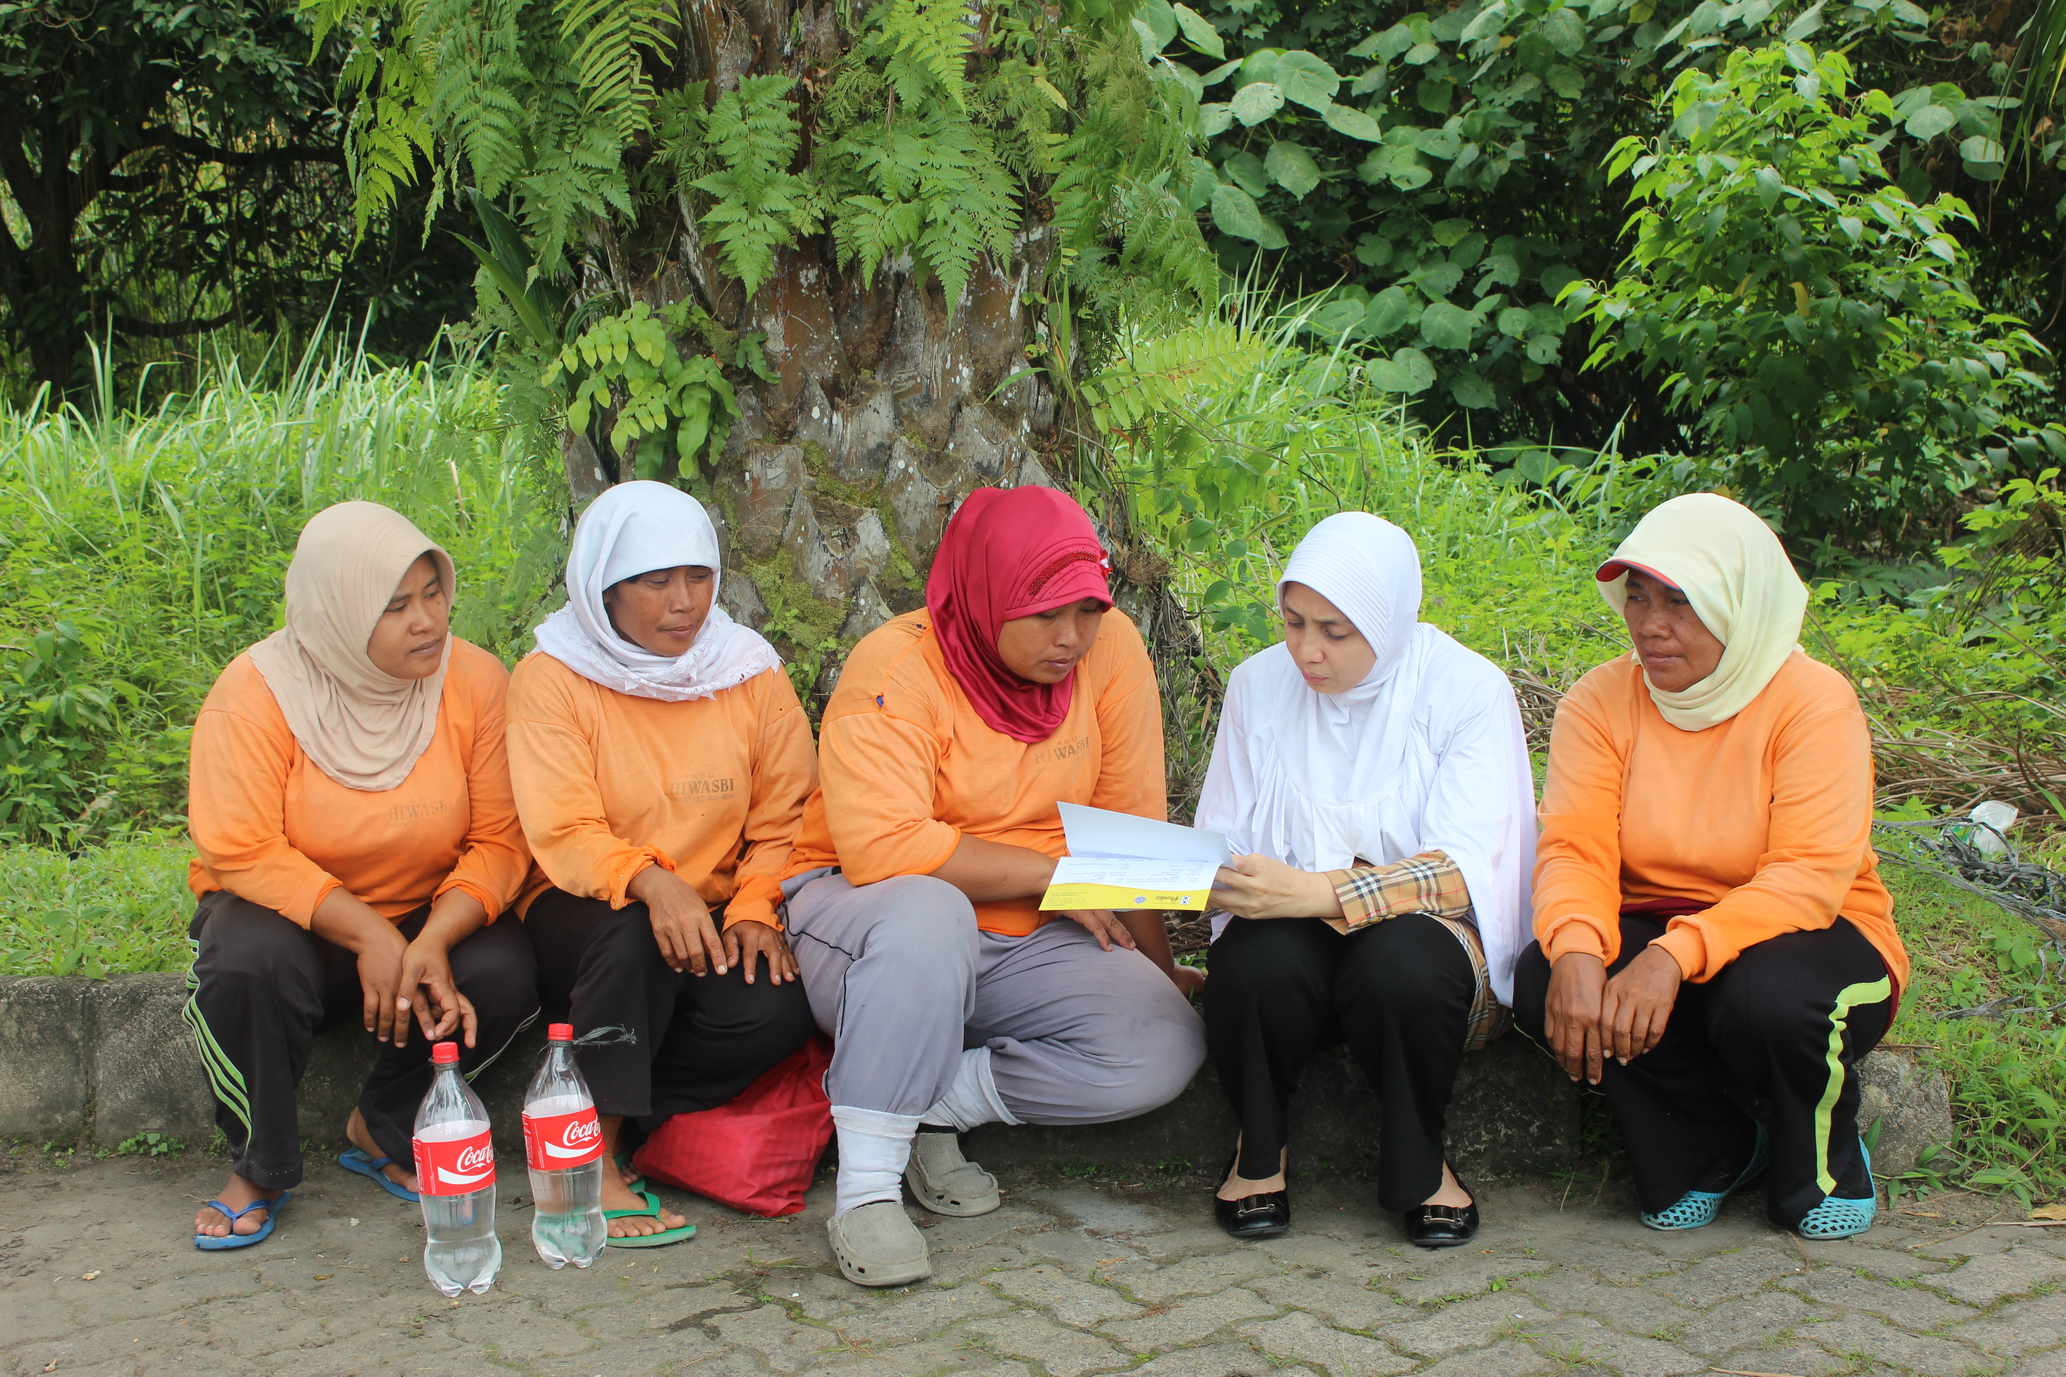
Rural and urban women

Slide 6
OBJECTIVE
This study aims to investigate the difference in the lifestyles of women living in rural and urban areas, as well as to identify the presence of Vitamin D receptor gene polymorphism and whether it can lead to a decrease in serum 25-hydroxyvitamin D or 25(OH)D levels.

Slide 7
METODH
This is a cross-sectional study
Living in rural and urban areas
Vitamin D receptor gene polymorphism, serum 25-hydroxyvitamin D level, body mass index, and lifestyle, which includes type of work, duration of exposure to sunlight, sunscreen use, Vitamin D intake, and physical activity.
100 healthy women

Slide 8
Research Scheme
Study idea
Research concept
Evaluation
DESCRIPTIVE
PARAMETER
COMMUNITY
Women
20-30 years old
25(OH)D
Evaluation
Obese
100 subjects
Kalsium
Laboratory
Monitoring
No complilcation
CTx
Study
Vit D
Methods analytiy
Screening
Observation
Goal 1
Analysis
Goal 2
Publication
1
2
3
4
5
6
Desain
Metode
Occupation
Cross sectional
Vitamin D intake
Interview
Calciium
Book
Location
BONE DENSITY
Article
DEMOGRAPHY
OSTEOPOROSIS RISK
Poster/leaflet
METODOLOGY
PUBLICATION

Slide 9
Tabel 1. Characteristic of the study population living in rural and urban areas
Parameters | All | Rural group (n=50) | Urban group (n=50) | p-value
Age (years) | 37.7±9.9 | 44.1±7.5 | 31.4±7.9 | 0.001*
Age group [(n(%)] 20-29 years 30-39 years 40-50 years | - 33(33) 67(67) | - 3(6) 47(94) | - 30(60) 20(40) | 0.001*
Body mass index/BMI (kg/m²) | 24.2±3.9 | 25.8±3.9 | 22.7±3.5 | 0.001*
BMI category [(n(%)] Underweight Normal Overweight Obese I Obese II | - 12(12) 83(83) 5(5) - | - 2(4) 44(88) 4(8) - | - 10(20) 39(78) 1(2) - | 0.001*
*significant: p-value <0.05

Slide 10
Table 2. Lifestyle of the study population living in rural and urban areas
Characteristics | Rural group (n=50) | Urban group (n=50) | p-value
Occupation: Non-government employee Nurse Doctor Farmer | - - - 50 (100) | 39(78) 10(20) 1(2) - | 0.001*
Sunscreens application Yes No | 39(78) 11(22) | 48(96) 2(4) | 0.007*
Physical activity Low Moderate High | 22(44) 28(56) - | 42(84) 8(16) - | 0.001*
Vitamin D intake Less Sufficient | 37(74) 10(26) | 46(92) 7(8) | 0.001*
*significant: p-value <0.05

Slide 11
Table 3. Distribution of the study population based on frequency of allele and genotype single nucleotide polymorphism of vitamin D receptor gene
Allele/single nucleotide polymorphism | Rural (%) | Urban (%)
rs1544410 (BsmI) A G AA (homozygote wild type) GG (homozygote mutant) AG (heterozygote) | 6 94 - 44 6 | 16 84 - 34 16
rs731236 (TaqI) C T CC (homozygote wild type) TT (homozygote mutant) CT (heterozygote) | 13 87 1 38 11 | 50 50 - - 50

Slide 12

Tabel 4. Average value and categories of serum 25(OH)D serum levels of the study population living in rural and urban areas
Parameters | All | Rural group (n=50) | Urban group (n=50) | p-value
25(OH)D serum level (ng/dL) | 17.6±4.8 | 20.2±4.4 | 14.9±3.6 | 0.001*
25(OH)D category [(n(%)] Deficiency Insufficiency Sufficiency Normal in sunny countries | 70(70) 29(29) 1(1) - | 25 (50) 24(48) 1(2) - | 45(90) 5(10) - - | 0.001*

Slide 13
Conclusions
Lifestyle factors such as lack of sunlight exposure, use of sunscreens, lack of Vitamin D intake, and low levels of physical activity may lead to low levels of serum 25(OH)D
Lifestyle changes can be one of the strategies to increase serum 25(OH)D levels in women with vitamin D receptor gene polymorphism

Slide 14
Thank you

