Slide 1


Epidermal growth factor (EGF) promotes ovarian steroidogenesis and epidermal growth factor receptor (EGFR) signaling is required for gonadotropin-induced steroid production in common carp Cyprinus carpio
Prof. Dilip Mukherjee
Endocrinology laboratory
Department of Zoology
Kalyani University
Kalyani, West Bengal
India

Slide 2
BACKGROUD
The vertebrate ovary is an extremely dynamic organ, development and function of which are primarily regulated by pituitary gonadotropins-FSH and LH
However, various locally produced growth factors, particularly, IGFs, insulin and EGF are reported to play important role either independently or synergistically with gonadotropins in modulating gonadal steroidogenesis
Understanding the independent role of EGF in modulating gonadal steroidogenesis and the signaling pathways induced by gonadotropins is essential to know how EGF takes part in these processes
Studies on role of EGF in mammalian ovary is extensive

Slide 3
Mature EGF (55 amino acids) is released from large precursor anchored to the plasma membrane and EGF act by binding to a specific EGFR on the cell surface with high affinity
EGFR is a glycosylated transmembrane protein (170 kDa), which represents the prototypes of RTKs and binding of EGFR by EGF activates its intrinsic receptor tyrosine kinase and rapidly elicits the downstream signaling
EGF production has been demonstrated in the ovarian follicles of mammal and birds
It modulates ovarian steroidogenesis and granulosa cell differentiation by increasing progesterone production and inhibit FSH-induced 17β-estradiol production
EGF triggers steroidogenesis in gonadal cells, including Leydig cells and granulosa cells
Whereas, EGF promotes steroidogenesis in these models, an essential role of EGF and EGFR in regulating the gonadotropin-induced steroidogenesis in mammals have recently been described

Slide 4
In non-mammalian vertebrates studies on EGF and its roles in the ovary are rather limited
This was because EGF has not been cloned until 2004 in any non-mammalian species. It was Wang and Ge (2004) first cloned EGF and EGFR from zebrafish ovary
Reports are available that in fish ovary, EGF plays role in controlling follicle survival and steroidogenesis as well as DNA synthesis in the vitellogenic follicles

Slide 5
Taking fish as a model we, tried to explore the regulatory role of EGF on ovarian follicular steroidogenesis and how EGFR signaling is required for gonadotropin-induced steroid production
For our study, we considered isolated theca-granulosa cells of late vitellogenic ovarian follicles
Theca–granulosa cells were isolated by enzymatic (collagenase) digestion
After isolation, theca and granulosa cells were mixed and pre-incubated for 6 h in 24 well culture plate in DMEM supplemented with 2% BCS-DMEM, streptomycin (100 µg/ml) and penicillin (100 IU/ml)
Initial density of theca-granulosa cell in the incubation was 0.9 x 10⁵ and 2.1 x 10⁵ cell per well respectively
After 6 h, BCS-DMEM was replaced by serum-free DMEM in each well containing effectors and inhibitors and incubated for different time in a metabolic shaker bath at 23 ±1⁰C

Slide 6
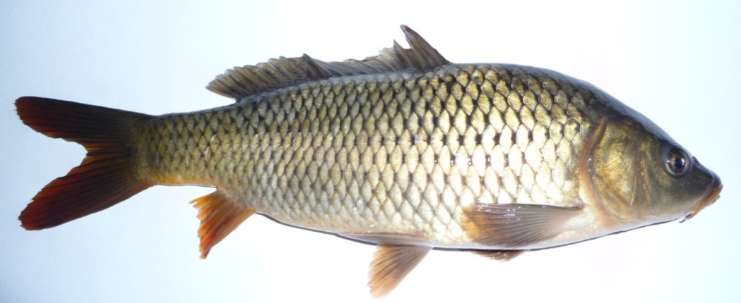
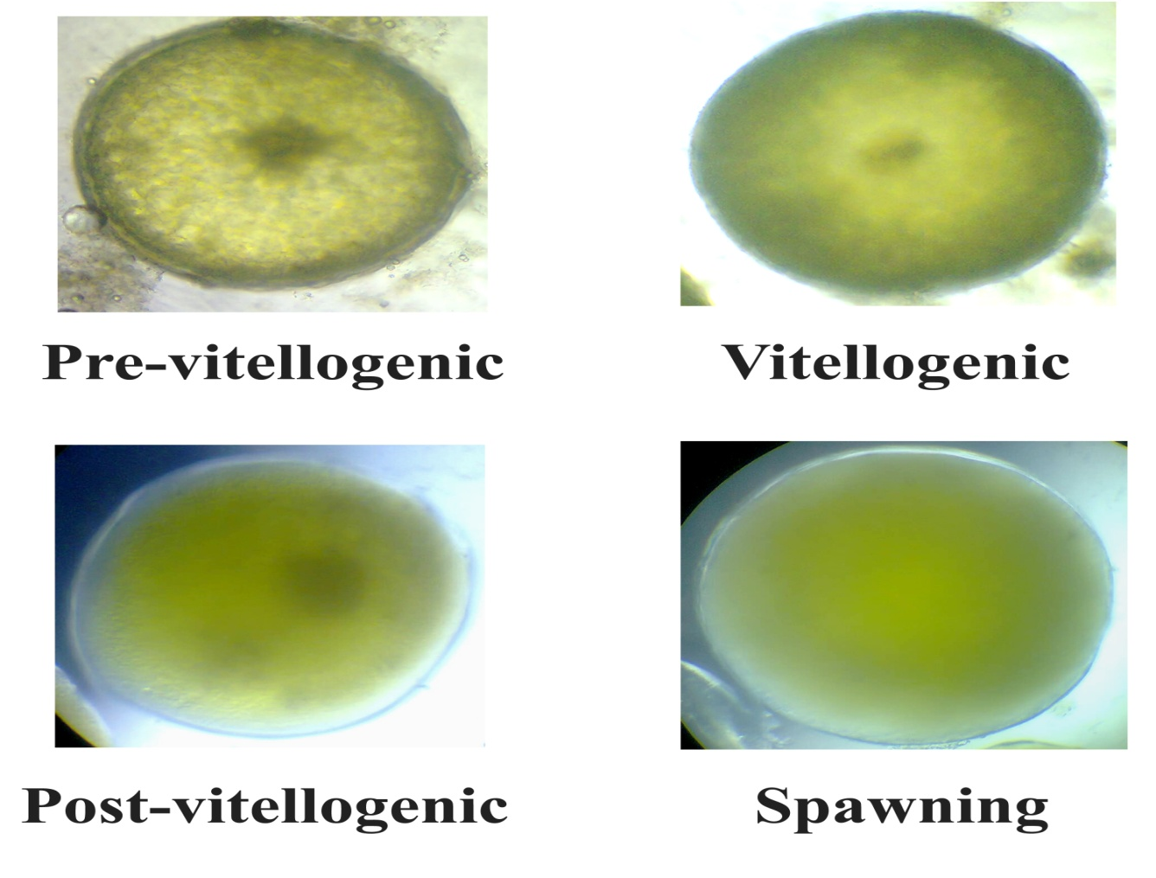
Cyprinus carpio

Slide 7
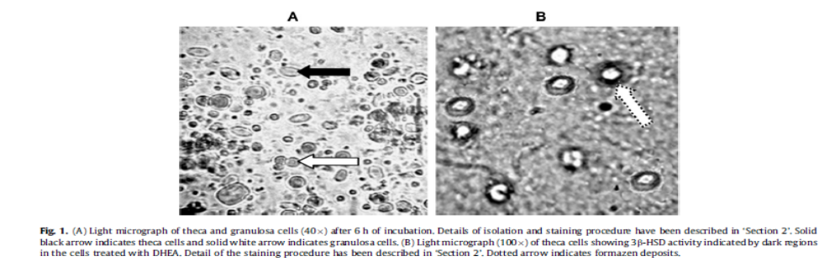
Granulosa cells stained with P-nitroblue- tetrazolium
Theca- granulosa cells
PI
DAPI

Slide 8
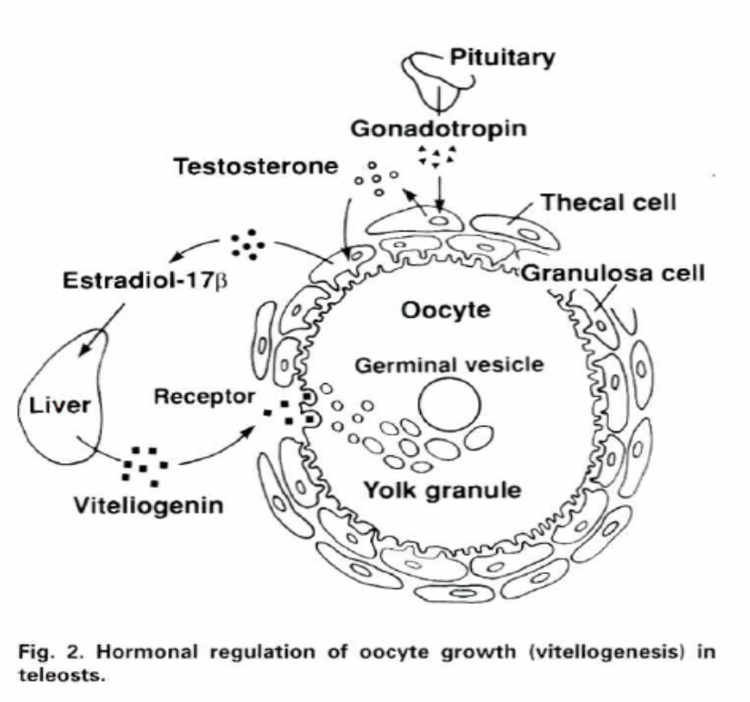
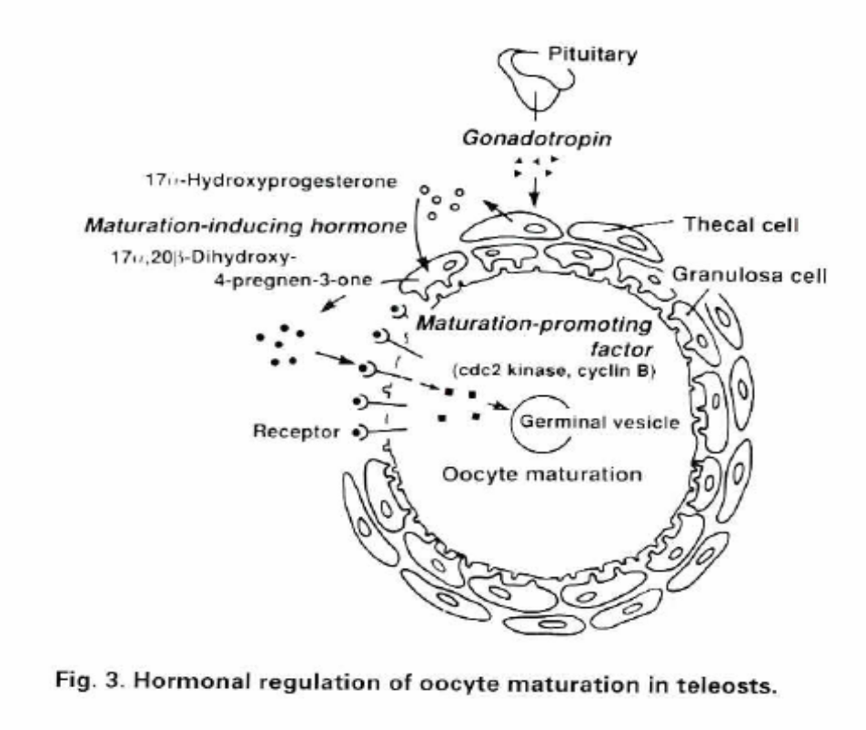
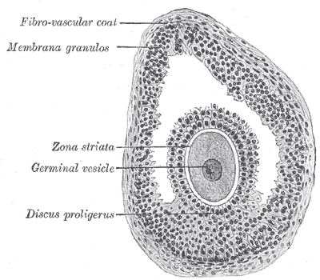
Late- Vitellogenic
Post- Vitellogenic
Gravid follicle of human

Slide 9
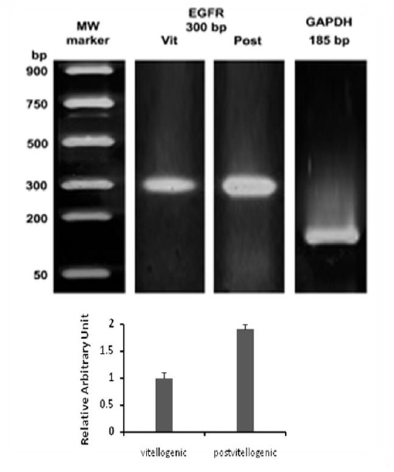
RT-PCR expression of EGFR in carp follicle

Slide 10
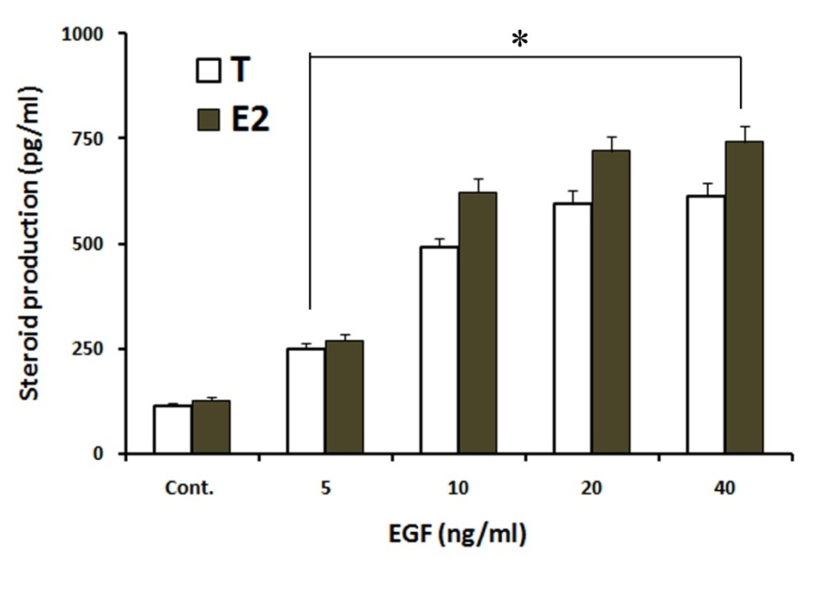
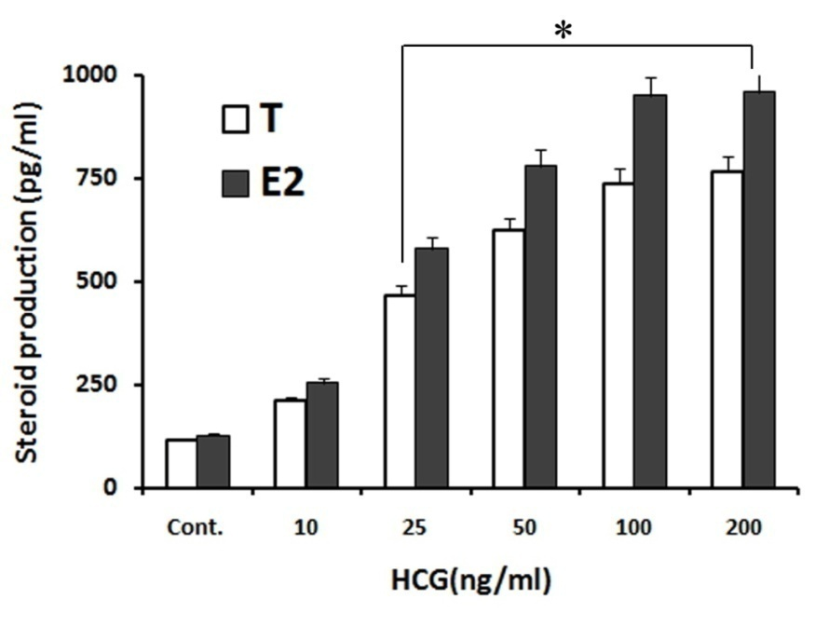
Effect of EGF and HCG on Testosterone (T) and 17β-estradiol (E2) production in carp ovarian follicles

Slide 11
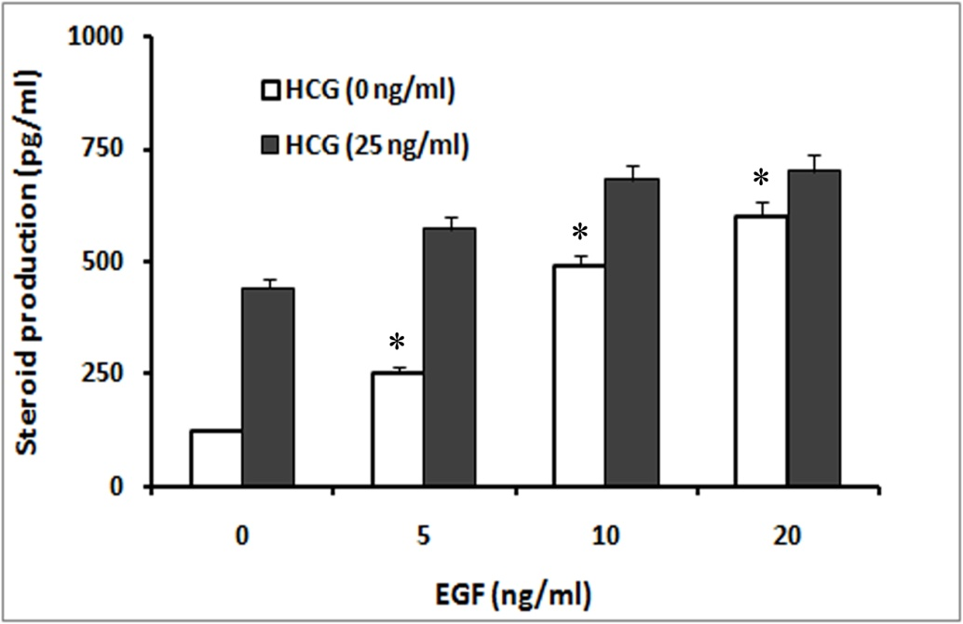
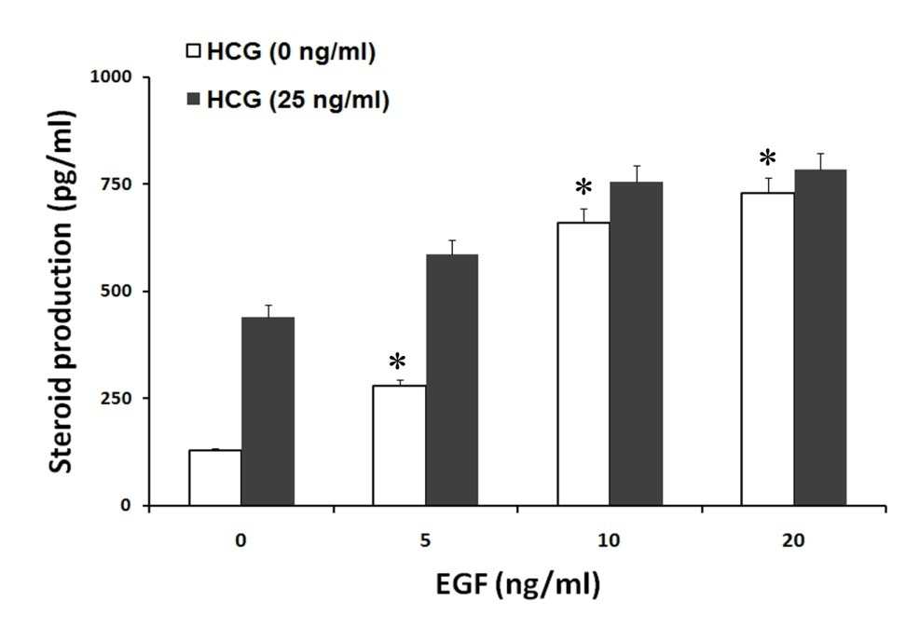
Dose response effect of EGF on basal (hollow bar) and HCG-stimulated (solid bar) in vitro release of steroids
T
E2

Slide 12
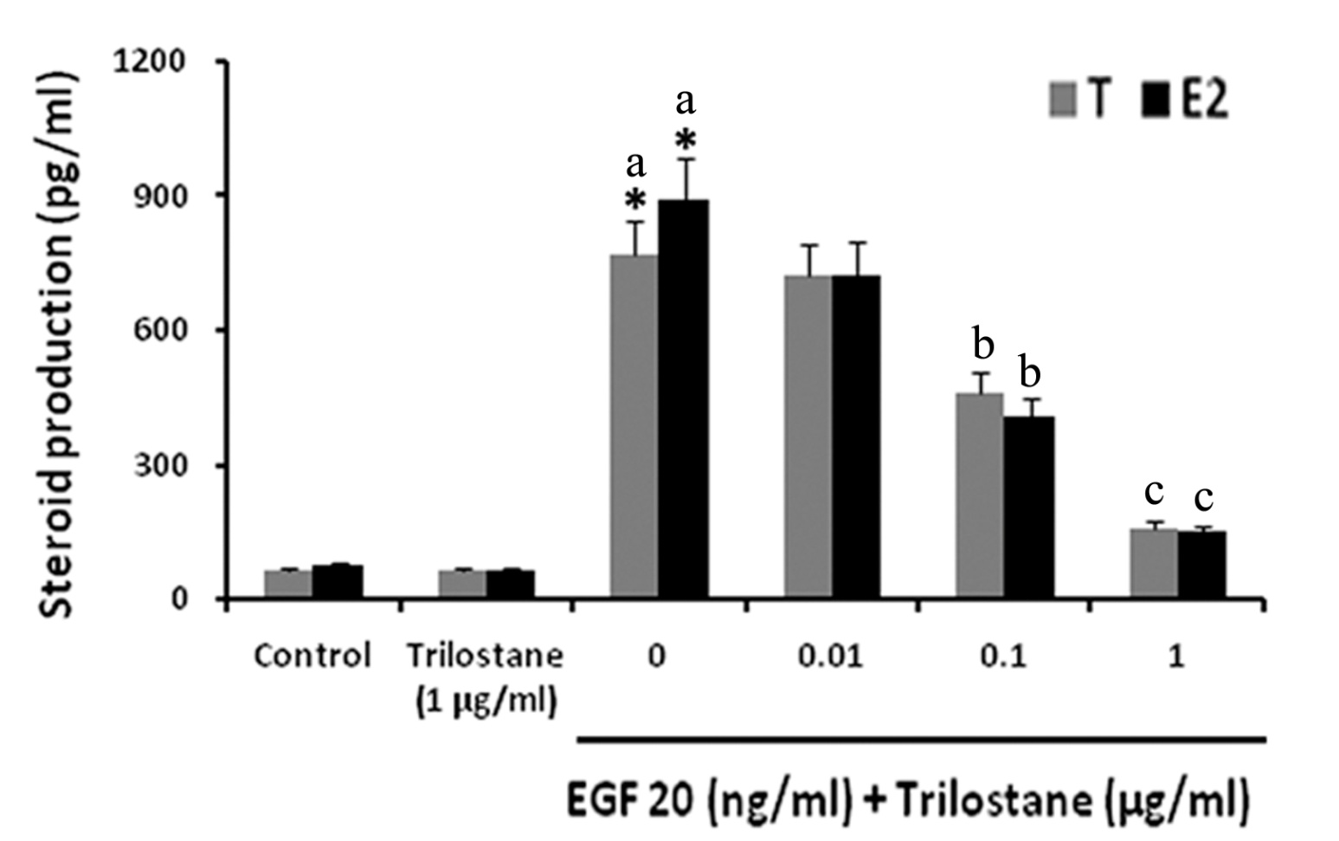
Effect of 3β-HSD inhibitor (Trilostane) on EGF- induced steroid production

Slide 13
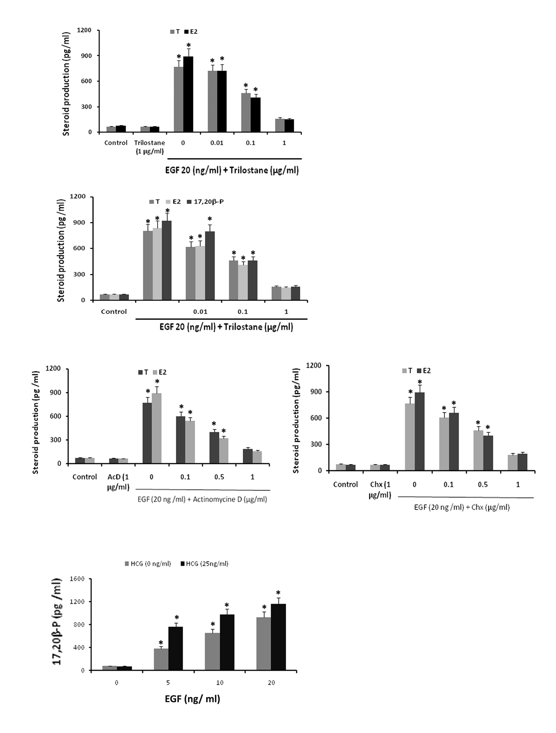
Effect of protein synthesis inhibitor on EGF-induced steroid production

Slide 14
Inference
EGFR mRNA was expressed in vitelligenic and post-vitellogenic carp ovarian follicle cells
EGF independently can stimulate T and E2 production by the follicle cells and the extent of production was little less than that of HCG
EGF could stimulate both basal and HCG stimulated T and E2 release.
3b-HSD inhibitor could effectively attenuate steroidogenesis
Both transcription and translation inhibitor could block the steroidogenesis

Slide 15
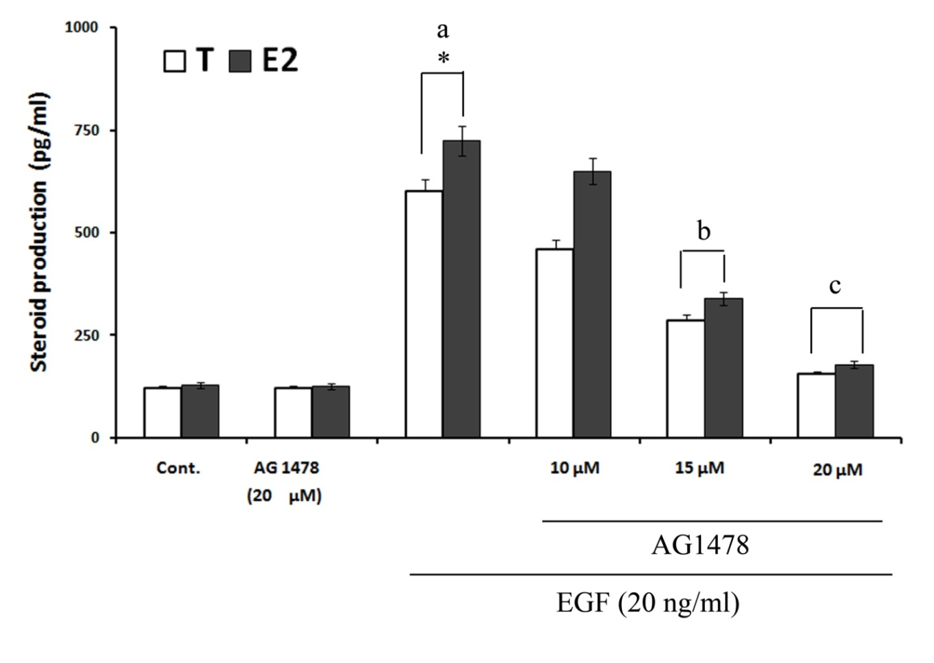
Effects of EGFRI inhibitor-AG1478 on EGF-induced steroid production

Slide 16
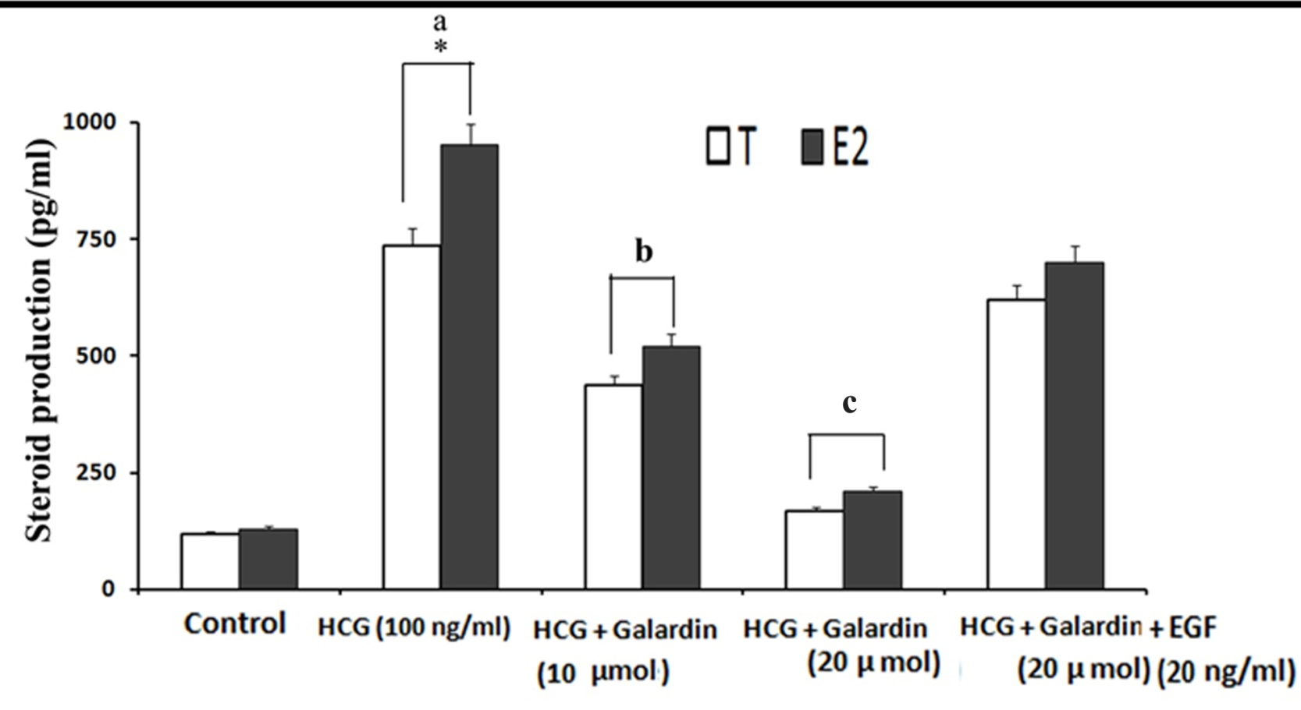
Effect of MMP inhibitor, Galardin on HCG-stimulated steroid production and rescue by EGF

Slide 17
Inference
EGFR signaling is necessary for EGF-stimulated steroidogenesis
EGFR signaling is also necessary for HCG-induced follicular steroidogenesis
HCG-mediated steroidogenesis in ovarian follicles requires cleavage of membrane-bound EGF family members and activation of the EGFR
We proposed that,
HCG activates its receptor located on the follicle cells resulting in to activation of MMPs and cleavage of the membrane-bound EGFs
Soluble EGF molecule then bind to EGFR of the follicle cells to enhance steroid production

Slide 18
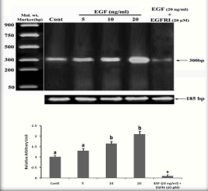
RT-PCR expression of EGFR mRNA and effects of EGF and EGFRI

Slide 19
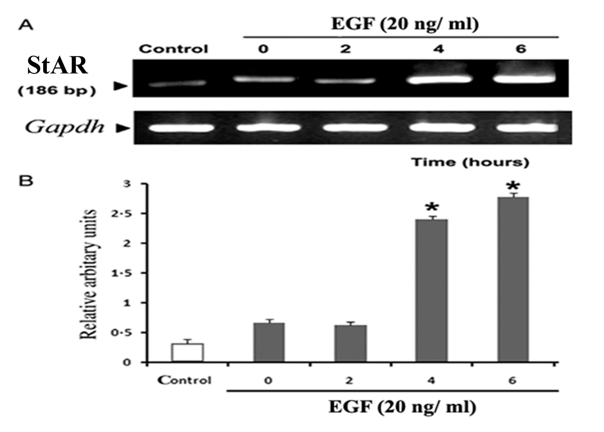
EGF-induced StAR mRNA expression

Slide 20
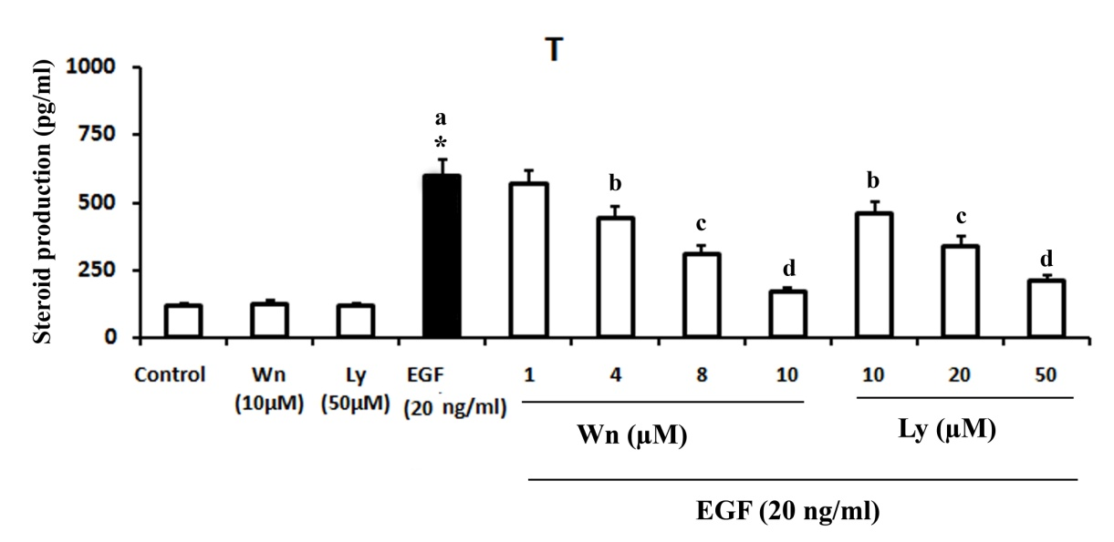
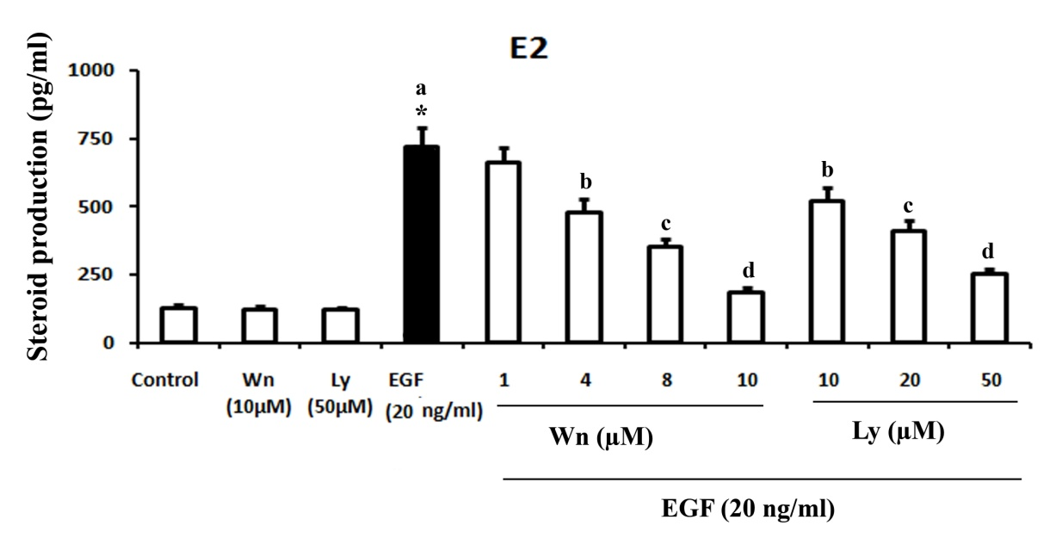
Effect of Wortmannin (Wn) and Ly294002 (Ly) on EGF-induced steroid production

Slide 21
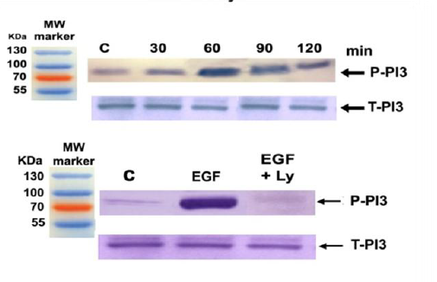
EGF-stimulated P⁸⁵ associated PI3 kinase activation and effect of PI3 kinase inhibitor

Slide 22
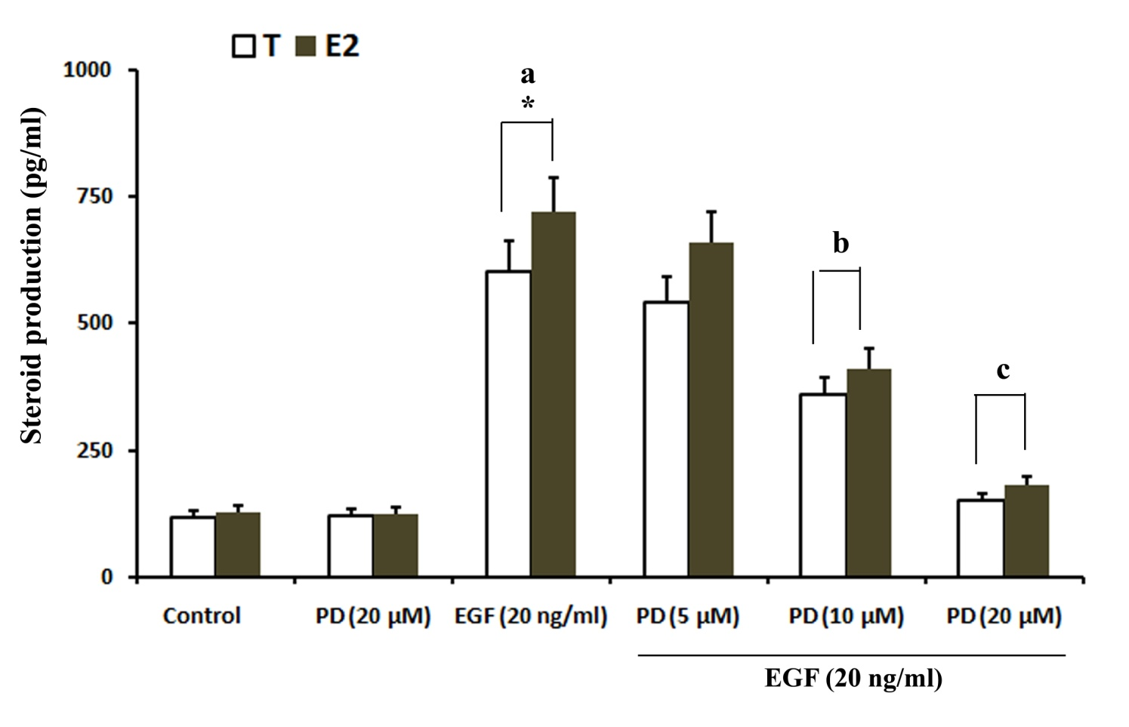
Effect of MEK inhibitor PD98049 on EGF-stimulated steroid production

Slide 23
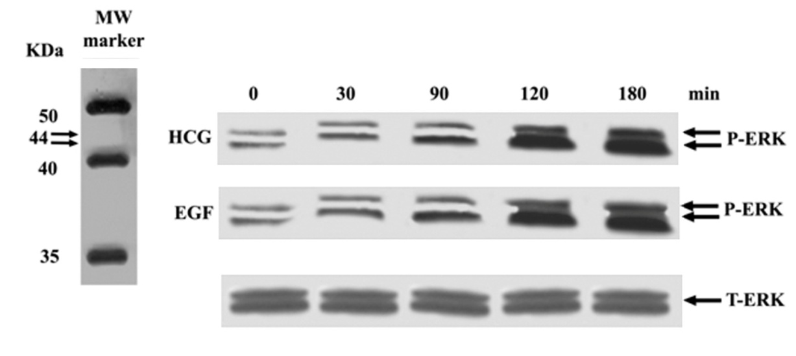
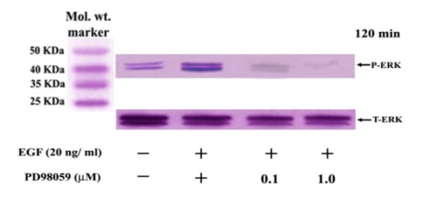
Time- and MEK1/2-dependent activation of ERK1/2 by EGF

Slide 24
Inference
EGF stimulates the EGFR expression in carp ovarian follicular cells
EGF can induce StAR gene expression
EGF effects on steroid production is mediated through activation of PI3 kinase and MAP kinase

Slide 25
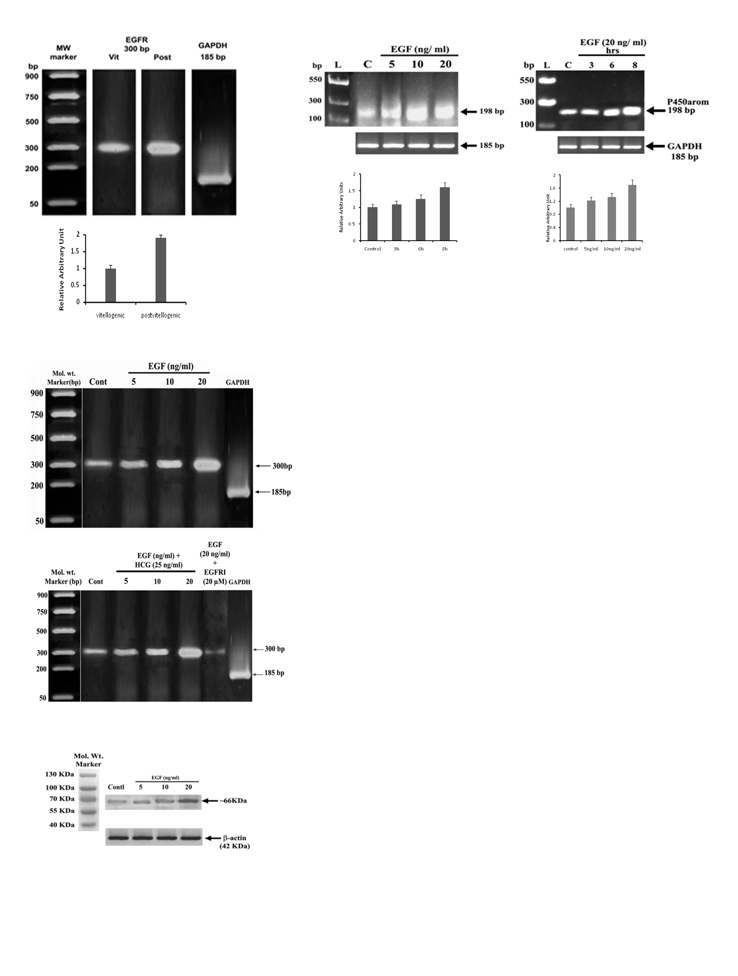
P450 mRNA and its expression in follicular cells and effects of EGF

Slide 26
Summary
Like mammal, EGF is a potent regulator of fish ovarian steroidogenesis
EGF induces steroidogenesis both independently and synergistically with gonadotropins
EGF-mediated steroid production requires an active EGFR and EGFR-mediated signaling is critical for normal gonadotropin-induced steroidogenesis in fish ovarian follicles
EGF signaling is mediated through PI3 kinase and MAP kinase activation
EGF-mediated steroid production in fish ovarian follicle is dependent on StAR gene expression

Slide 27

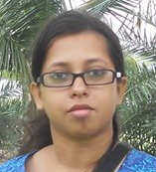









Co-workers
Suravi
Sumana
Buddhadev
Puja
Sujata
Koushik
Shreyasi
Arindam
Payel
Piyali

Slide 28

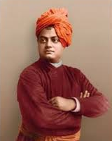
THANK YOU
Sisters and Brothers of America,
It fills my heart with joy unspeakable to rise in response to the warm and cordial welcome which you have given us. I thank you in the name of the most ancient order of monks in the world; I thank you in the name of the mother of religions; and I thank you in the name of millions and millions of Hindu people of all classes and sects. My thanks, also, to some of the speakers on this platform who, referring to the delegates from the Orient, have told you that these men from far-off nations may well claim the honour of bearing to different lands the idea of toleration. I am proud to belong to a religion which has taught the world both tolerance and universal acceptance.................

