Slide 1
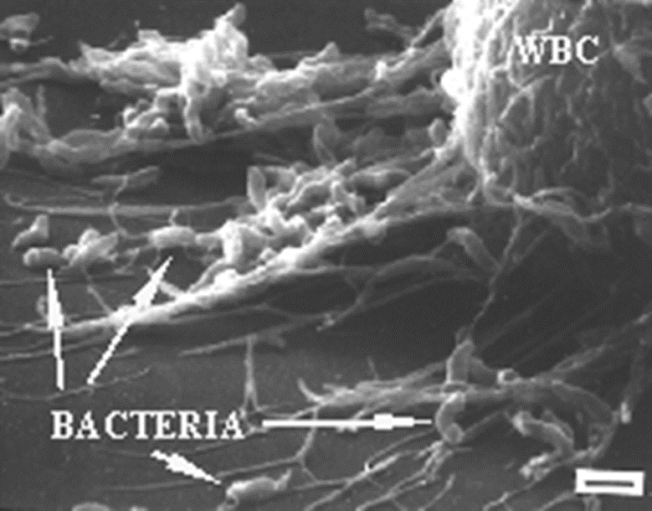
Antimicrobial activity of lactic acid bacteria on pathogens in foods
Why succesful?
How succesful?
Prof.Dr. Dilek Heperkan
Istanbul Technical University,
Faculty of Chemical and Metallurgical Engineering, Dept. of Food Engineering

Slide 2
Microorganisms especially bacteria can be used for a number of beneficial purposes. Among them some are more prominent like Lactic acid bacteria (LAB) and bifidobacteria.
Lactic acid bacteria have been used as natural food-grade preservatives against a variety of undesirable microorganisms.
LAB has been used for production of fermented foods for many years. As a matter of fact fermented foods existed long before mankind discovered microorganisms.
During their activity in production of fermented foods their inhibitory potential on pathogenic bacteria have been recognised and they gained increasing interest in the scientific community.
Thus LAB has been used as a tool to produce antimicrobial compounds and to control undesirable microorganisms.

Slide 3
Antibiotics;
On the other hand, acute diarrhea due to the loss of normal intestinal microbiota, drug-resistant strains and chronic toxicity due to widespread use of antibiotics are well known negative effects of antibiotics.
Pesticides;
The risks of toxic residues in foods, as well as contamination of soil and water due to the use of xenobiotics in food production chain are considered negatively by the public.
Lab producing a wide range of antimicrobial metabolites thus, the last two decades have seen pronounced advancements in using LAB and their metabolites for natural food preservation, as well as crop protection, and health protection.

Slide 4
Content:
The role of lactic acid bacteria
  Bio preservative agent
  Probiotic potential
  Antimicrobial agent Why succesful
  Biopestiside
  Chemotherapeutic agent / infection control agent
Case studies; Antimicrobial activities against
  Listeria monocytogenes (the method we used and the
  Staphylococcus aures results we obtained)
  Salmonella typhimurium
Industrial applications of LAB How succesful

Slide 5
LACTIC ACID BACTERIA
The term lactic acid bacteria (LAB) has no strict taxonomic significance, although the LAB have been shown by serological techniques and 16S ribosomal RNA cataloguing to be phylogenetically related.
They share a number of common features:
they are Gram-positive
non-sporeforming rods or cocci
non-motile
resistant to acid and
high fermentative ability
The most are aerotolerant anaerobes which lack cytochromes and porphyrins and are therefore catalase- and oxidase-negative.
Some do take up oxygen through the mediation of flavoprotein oxidases and this is used to produce hydrogen peroxide and/or to re-oxidize NADH produced during the dehydrogenation of sugars.

Slide 6
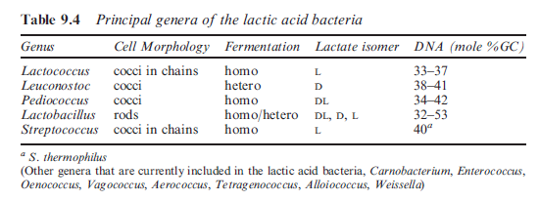
LAB compose a heterogeneous bacterial group, their common characteristic is the ability to ferment sugars.

Slide 7
Lactic acid bacteria, which convert fermentable sugars to lactic acid and other organic acids depending on their metabolic pathways.
They are the most important group of bacteria in fermented foods. Thus, due to the acid production the pH of the environment reduces to a pH 3.5.
However, Lactobacillus spp. plays a major role in the process and Leuconostoc and Pediococcus to a lesser extent.

Slide 8
Heterofermenters produce roughly equimolar amounts of lactate, ethanol/acetate, and carbon dioxide from glucose.
Some authors also include Bifidobacterium among the lactic acid bacteria although this has less justification as they are quite distinct both phylogenetically and biochemically.
For example, hexose fermentation by bifidobacteria follows neither the EMP glycolytic pathway nor the phosphoketolase pathway but produces a mixture of acetic and lactic acids.

Slide 9
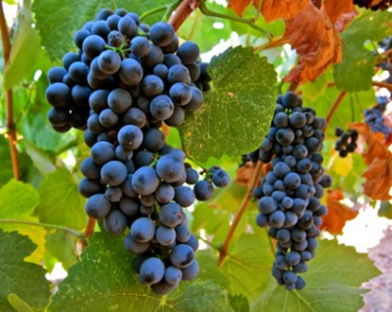
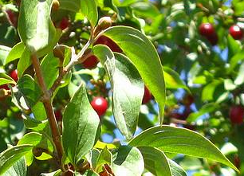
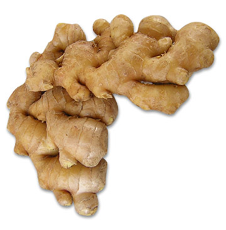
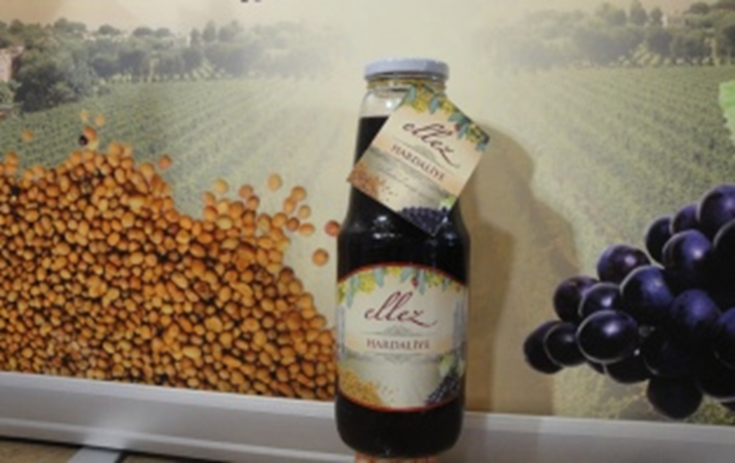
The role of lactic acid bacteria
Biopreservative agent
LAB are well known for their activity as starter cultures in the manufacture of fermented foods for a number of industries.
Lactic fermentation is one of the oldest forms of preparation and preservation of foods (Charlier et al.,2009). LAB are essential to the production of fermented products.
Raw materials for HARDALIYE

Slide 10
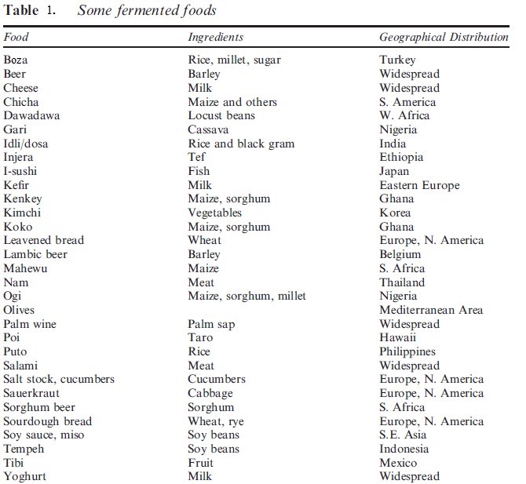
Cereal based
Milk based
Fish based
Fruit based
Meat based
(Adams and Moss, 2008)

Slide 11
Health benefits
Since the trends towards
natural (minimally processed or without additives)
high nutritional value
health-promoting
flavor rich products
Fermented food play an important role in human diet around the world due to their health benefits.

Slide 12
Role of LAB Biopreservative Agent
(Food preservation and safety)
Food preservation
Their ability to promote food preservation is summerized below;
they cause a decrease in pH as a result of lactic acid production, and additionally,
they produce a number of antimicrobial agents and thus play a role in the inhibition of pathogenic / spoilage microorganisms during fermentation process in foods.
A combination of these factors limits the proliferation of undesirable microorganisms.
LAB therefore undoubtedly play a role in promoting food safety.

Slide 13
2) Probiotic characteristics of lactic acid bacteria
Probiotic potential is another significant character of a LAB. The most commonly used species, in probiotic preparations are Lactobacillus ssp., Bifidobacterium ssp. and Streptococcus ssp. Probiotic strains have several beneficial properties such as
Improving intestinal tract health
producing antimicrobial substances
enhancing the immune response
reducing symptoms of lactose intolerance
enhancing the bioavailability of nutrients, and
decreasing the prevalence of allergy in susceptible individuals (Parvez et al., 2006; De Bellis et al., 2010: Mena and Aryana, 2012).

Slide 14
Probiotic characteristics of lactic acid bacteria Beneficial role of LAB (Charlier et al.,2009)
The current definition of a probiotic is a “live micro-organism which when administered in adequate amounts confers a health benefit on the host” (FAO/WHO report, October, 2001), which does not imply that microorganisms have to be orally ingested.
The well known species of probiotics are lactobacilli and bifidobacteria (Lb. casei, Lb. rhamnosus, Lb. acidophilus, Bf. bifidum).

Slide 15
3. Antimicrobial metabolites
LAB have antimicrobial effects against undesirable microorganisms through producing various metabolites or through inhibiting the cell adhesion of pathogenic organisms in vitro.

Slide 16
Antimicrobials produced by lactic acid bacteria
Organic acid | Lactic acid | Major metabolite of LAB fermentation. Active against spoilage and Gram-negative bacteria, some fungi
 | Acetic and propionic acids | More antimicrobially effective than lactic acid. Active against spoilage bacteria, clostridia, some yeasts and fungi
Other | Hydrogen peroxide | Active against pathogens and psychotropic spoilage organisms e.g. Staphylococcus aureus, Pseudomonas sp.
 | Carbon dioxide | Active against Gram positive and specially Gram-negative psychrotrophic bacteria e.g. Enterobacteriaceae and Listeria

Slide 17
Bacteriocins and bacteriocin- like peptides | Active against broad spectrum of Gram-positive and Gram-negative bacteria, yeast, fungi and protozoa e.g. species of Salmonella, Shigella, Clostridium, Staphylococcus, Listeria, Candida, and Trypanosoma
Reuterin | Active against broad spectrum of Gram-positive and Gram-negative bacteria, yeast, fungi and protozoa e.g. species of Salmonella, Shigella, Clostridium, Staphylococcus, Listeria, Candida, and Trypanosoma
Diacetyl | Active against Gram positive and Gram-negative bacteria e.g. Listeria, Salmonella, Yersinia, E. coli, and Aeromonas
Fatty acids, Fenil lactic acids | Active against Gram-positive bacteria and some fungi

Slide 18
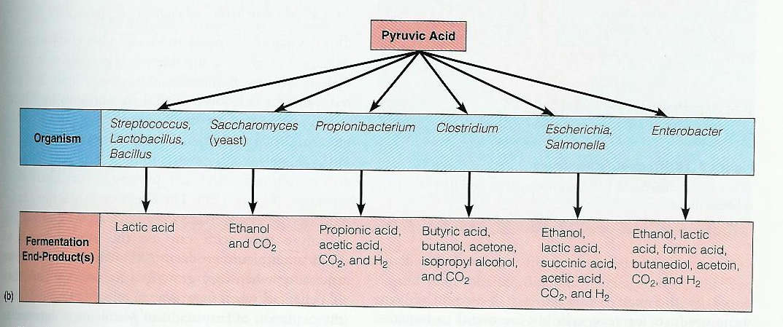
Organic acids
Organic acids have been used as food additives and preservatives in food industry. It is used for preventing food spoilage and extending the shelf life of foods.
The type of organic acid depends on the type of producer species.
Homofermenters produce lactic acid as a single product from the fermentation of glucose. Whereas heterofermenters produce acetic acid as well.

Slide 19
depending on the physiological status of the organism and the physicochemical characteristics of the environment (Ricke, 2003).
Organic acids are capable of exhibiting bacteriostatic and bactericidal properties
There are a number of research conducted to investigate the effect of different organic acids on inhibiting the growth of pathogens in laboratory media and liquid foods.
Propionic acid and acetic acid showed the strongest inhibitory effect against E. sakazakii in laboratory broth media (Back et al., 2009).

Slide 20
How can we test antimicrobial efect of LAB against pathogens?
(Agar overlay, disc diffusion, well diffusion)
Upload the supernatant containing metabolites
Incubation
(37 C for 24 h)
Measure the inhibited zone around the sterile disc (diameter, mm or cm)
Sterile disk
Inoculate pathogenic bacteria

Slide 21
Hydrogen peroxide (H₂O₂)
Lactic acid bacteria produce H₂O₂ as a low molecular weight antimicrobial compound. Hydrogen peroxide showes bacterostatic effect against gram positive bacteria (including LAB) and bactericidal effect against a number of gram negative bacteria in general (Yang, 2000).
Mechanism
Hydrogen peroxide oxidizes the sulphidril groups in a molecule and thus cause denaturation of a variety of enzymes.
increases the permeability of the membrane by peroxidizing the lipids in the plasma membrane.
has a role on production of superokside (O²⁻) and hydroxil (OH*) free radicals and causing damage in DNA (bactericidal effect) (Ammor ve diğ., 2006).

Slide 22
However, the actual role of hydrogen peroxide produced by LAB in the inhibition of pathogens has been difficult to demonstrate and thus is still controversial.

Slide 23
Bacteriocins and bacteriocin-like inhibitory substances
Many species of LAB produce bacteriocins with fairly large spectra of inhibition thus they considered as promising agents for use in food preservation.
There is an increasing interest in the literature which mainly focused on
The isolation and identification of bacteriocin producing LAB
Their antimicrobial / antagonistic effects to different pathogens
Characterisation of the active metabolite and finally
Possibility to use them as a biopreservative in foods as well as other area of interest.

Slide 24
Bacteriocins and bacteriocin-like inhibitory substances
Numerous strains of LAB associated with foods produce bacteriocins, defined as proteinaceous compounds with activity against related species.
Bacteriocins are ribosomally-synthesized peptides or proteins secreted by certain strains of bacteria.
Mechanisms
The antagonistic activity of LAB to pathogens may affect the growth rate and/or survival depending on the type and the concentration of bacteriocin.
Most bacteriocins kill target cells by permeabilization of the cell membrane, and the activity is often very speciﬁc, since they employ speciﬁc receptors on the target cell surfaces (Kjos et al., 2011).

Slide 25
Nisin (L. lactis) and pediocin (Pediococcus acidilactici) are among the most well characterised bacteriocins and the most frequently used in fermented products.

Slide 26
4. Biopestisides environmentally friendly biocontrol systems
Several species of lactic acid bacteria have been recognised as producers of bioactive metabolites which are functional against a broad spectrum of undesirable microorganisms.
They are effective to fungi, oomycetes and other bacteria.
Consumers in developed countries have become
more critical and more fragmented in their food
choices, leading to situations where quality
differentiation of food products, has become necessary in order to satisfy consumers.

Slide 27

Consumer pressure against chemicals in food production and the risks of toxic residues
General public have
become interested and
often critical with regard to
certain ways of producing
food- both at the farm level
and at the processing
level.
As a result, discussions on
organic production,
reduce the application of
pesticides on crops,
animal welfare, and the use of
genetically modified
organisms (GMOs) in food
production.

Slide 28
Consumer pressure
Public fear of using chemicals in food production, the perceived risks of toxic residues in treated products, as well as contamination of soil and water, pesticides are looked upon negatively by the public.
The necessity to move away from traditional chemical treatments, many studies have focused on finding alternative biocontrol systems.
In general, due to the different modes of actions (i.e. antagonistic effects or induction of plant defence mechanisms),the use of LAB as preservatives has a definite potential (Axel et al., 2012).
Thus, they may represent an interesting tool for the development of novel concepts in pest management.

Slide 29
5)Antimicrobial chemotherapeutic agents
Antimicrobial chemotherapeutic agents have been widely used to control gastrointestinal infections. However, the widespread use of antibiotics is now being discouraged due to problems including the emergence of drug-resistant strains and chronic toxicity (Mody et al., 2003).
In addition, antibiotics are often responsible for acute diarrhea due to the loss of normal intestinal microbiota as well as pathogenic organisms (Van der Waaij et al., 1982).
As alternatives, lactic acid bacteria or their derivates have been administered. LAB have been used or planning to use against pathogens not only in food and plant protection industry but also in medical industry as well.
Bacteriocin producer LAB strains which are active against S. aureus and other pathogenic bacteria are also screened in order to develop probiotic for the human body (Voravuthikunchai et al., 2006).

Slide 30
Why succesful ?
LAB have been widely studied for their antimicrobial activity, and several antibacterial and fungicidal compounds have been isolated and characterised to date.
Amongst the antibacterial compounds, nisin (Lactococcus lactis) has been used successfully as an effective biopreservative in some dairy products for decades. Nisin is currently used commercially as a food preservative in around 50 countries.
ıt is registered as a food preservative E234 (No 95/2/EC 1995).
Among other pthogenic bacteria the growth of S. enteritidis was also effectively inhibited by the presence of the (lactic acid bacteria culture condensate mixture) LCCM.
In vitro and in vivo experiments showed that the LCCM has antimicrobial effect against S. enteritidis. Ingestion of the LCCM after a meal will be helpful for preventing S. enteritidis infection (Park et al., 2005) .

Slide 31
Why succesful
LAB play a crucial role in every part of nutrition safety such as
food preservation
food safety and quality
to a lesser extent in nutrition
Majority of fermented foods is produced by the activity of lactic acid bacteria
environmentally friendly biocontrol systems (biopestiside)
Antimicrobial chemoterapeutic agent/disease control on skin infections

Slide 32
S.aureus
Staphylococcus aureus is one of opportunistic pathogen, involved in food poisoning, toxic shock syndrome (TSS) and a wide range of infections.
The natural habitat of this species are the nasal cavity and the skin of warm-blooded animals. Because of its importance, S. aureus is one of the most studied pathogen.
S.aureus is the causative agent of skin-releated infections and superficial lesions to life-threatening septicaemia (Charlier et al.,2009).

Slide 33
Case studies
Material and Methods
A total of 47 strains were isolated from 30 tulum cheese samples obtained from east Anatolia. This cheese is a traditional semi- soft cheese.
Species were identified by 16S rRNA using PCR.
Antimicrobial activities of strains were tested using well diffusion assay
The antimicrobial activity of each strain were confirmed by classical microbiological analyses using selective media for each pathogen.

Slide 34
LAB have antimicrobial effects against pathogens such as (Park et al., 2005)
Escherichia coli O157:H7
Vibrio cholerae
Salmonella enteritidis
  Salmonella typhimuriumATCC 14028
Listeria monocytogenes
  Staphylococcus aureus ATCC25923
E. sakazakii
Aspergillus niger
Yeasts

Slide 35
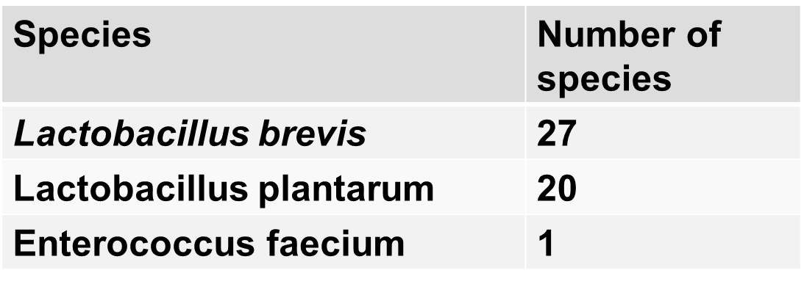
Table 1. The number of species isolated from cheese
Supernatants obtained from LAB tested for their total antimicrobial capasities after 24 and 48hrs.

Slide 36
Bacterial metabolite production
Supernatant
Neutralized (NaOH)
Neutralized (NaOH)
Catalase added

Slide 37
Table 2. pH of supernatants after incubation
Species | Number of strains | pH of supernatants
Lactobacillus brevis | 27 | 3,81-4,37
Lactobacillus plantarum | 20 | 3,77-5,55
Enterococcus faecium | 1 | 4,33

Slide 38
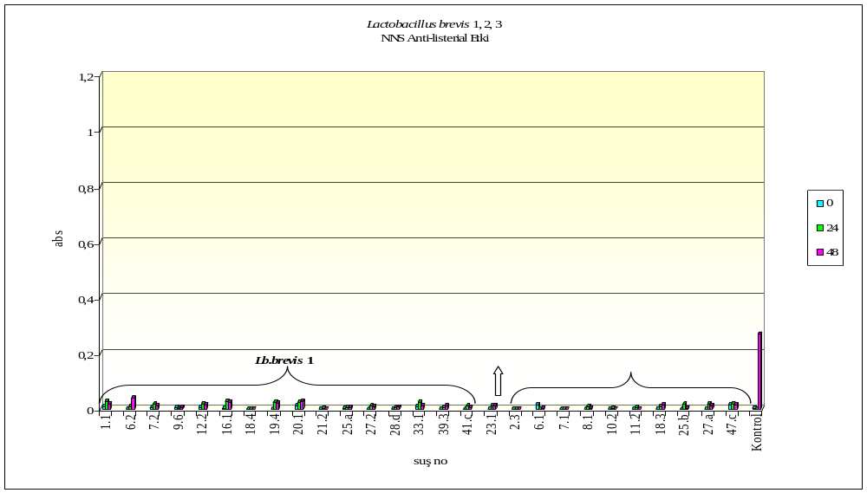
Figure1. Antagonistic effects of organic acids (non-neutralized supernatant) of Lactobacillus brevis against Listeria monocytogenes
0,27
23.1: Enterococcus faecium

Slide 39
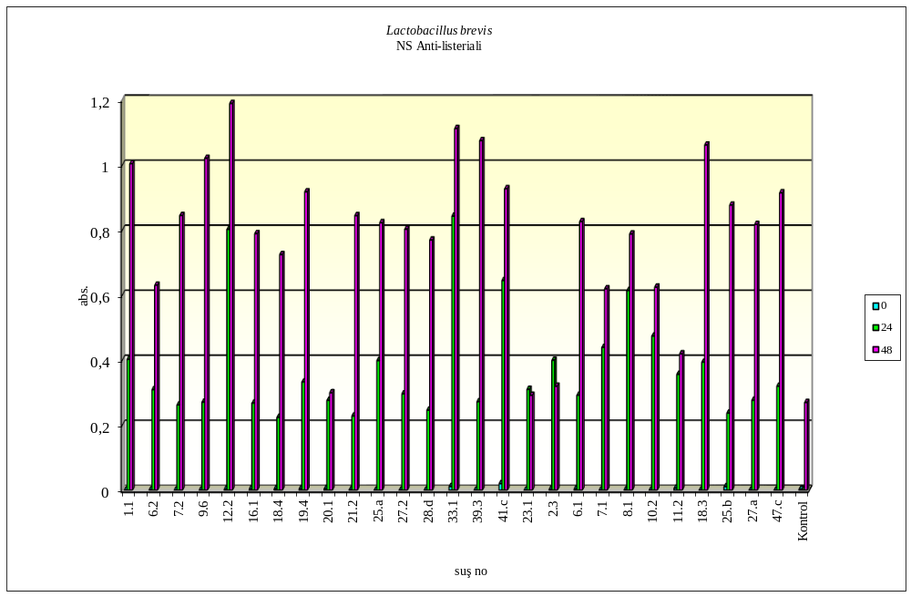
Figure 2. Antagonistic effects of neutralized supernatant of Lactobacillus brevis against Listeria monocytogenes
Lb. brevis 1
Lb. brevis 2
Lb. brevis 3

Slide 40
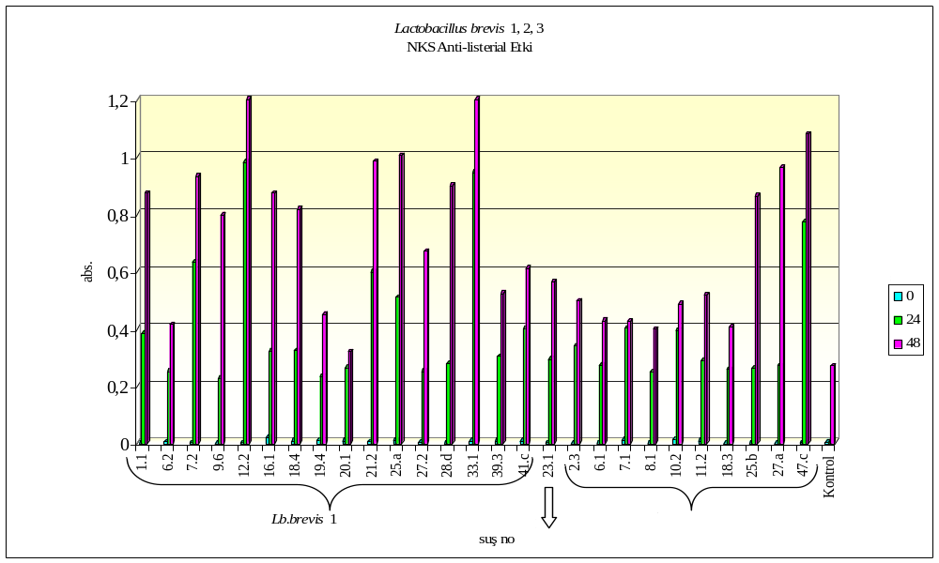
Figure 3. Antagonistic effects of neutralized supernatant containing catalase of Lactobacillus brevis antimicrobials against Listeria monocytogenes

Slide 41

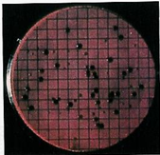
Confirmation by inoculating supernatant with pathogen on PALCAM agar showed complete inhibiton by organic acids but not neutralized and neutralized supernatant with catalase.
Thus the inhibitory effect of
L. brevis associated with the
organic acid.

Slide 42
The results of this study were in agreement with the literature
the antagonistic effects of Lb. brevis against;
    S. aureus (Aslim B. 2005; Banerji 2011)
    E. coli (Aslim B. 2005; Banerji 2011)
    Y. enterocolitica (Aslim B. 2005)
Aslim B. (2005) organic acid
Banerji (2011) ise bacteriyocin-like compounds

Slide 43
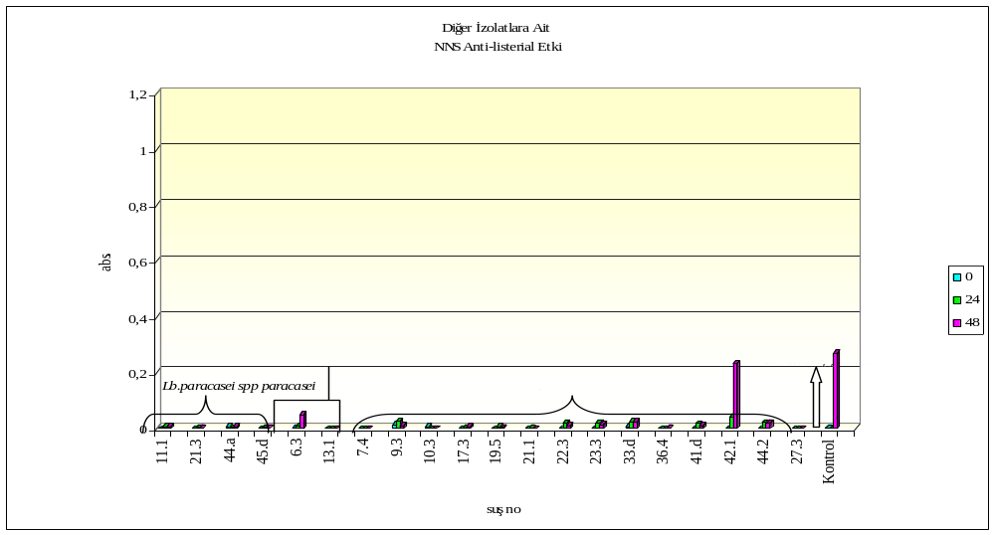
Figure 4. Antagonistic effects of organic acids (non-neutralized supernatant) of Lactobacillus plantarum against L. monocytogenes

Slide 44
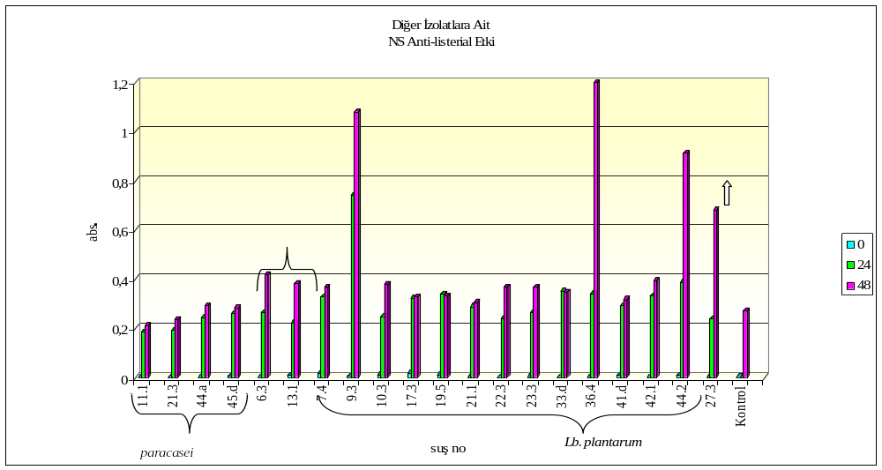
Figure 5. Antagonistic effects of neutralized supernatant of Lactobacillus plantarum against L. monocytogenes

Slide 45
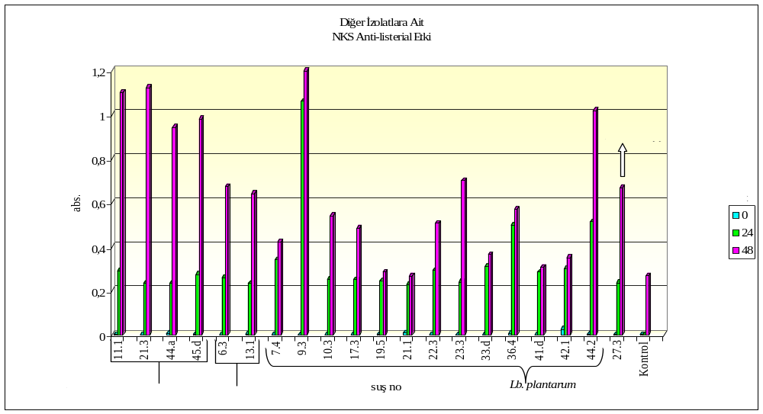
Figure 6. Antagonistic effects of neutralized supernatant containing catalase of Lactobacillus plantarum against L. monocytogenes

Slide 46
The results of this study were not inagreement with the literature
The antagonistic effects of Lb. plantarum Gonzalez et al., (2007) organic acids only
Neutralized and neutralized containing catalase 3 supernatants were effective against L. monocytogenes

Slide 47
  Staphylococcus aureus
  Salmonella typhimurium
Well diffusion
  0, 6, 24 and 48hrs
  640nm
confirmed
  After 24 and 48hrs
  Staphylococcus aureus - BP agar
  Salmonella typhimurium – XLD agar

Slide 48
Figure 7. Antagonistic effects of organic acids (non-neutralized supernatant) of Lactobacillus brevis against Staphylococcus aureus
*23.1: Enterococcus faecium

Slide 49
Figure 8. Antagonistic effects of neutralized supernatant of Lactobacillus brevis against Staphylococcus aureus
*23.1: Enterococcus faecium

Slide 50
Figure 9. Antagonistic effects of neutralized supernatant containing catalase of Lactobacillus brevis antimicrobials against S. aureus
*23.1:Enterococcus faecium

Slide 51
Lactobacillus brevis against Staphylococcus aureus
Organic acids
  The absorbans of supernatants were below the the control
  Thus
  Organic acids were effective against S. aureus.
  H₂O₂ were effective against S. aureus.
  Bactericin and bacteriosin like metabolites
  were effective against S. aureus

Slide 52
Figure 10. Antagonistic effects of organic acids (non-neutralized supernatant) of Lactobacillus plantarum against S. aureus

Slide 53
Figure 11. Antagonistic effects of neutralized supernatant of Lactobacillus plantarum against S. aureus

Slide 54
Figure 12. Antagonistic effects of neutralized supernatant containing catalase of Lactobacillus plantarum antimicrobials against S. aureus

Slide 55
Lactobacillus plantarum against Staphylococcus aureus
Organic acids
  The absorbans of supernatants were below the the control
  Thus
  Organic acids
  H₂O₂
  Bactericins and bacteriosin like metabolites
  were all effective against S. aureus.

Slide 56
Figure 13. Antagonistic effects of organic acids (non-neutralized supernatant) of Lactobacillus brevis against Salmonella typhimurium
*23.1: Enterococcus faecium

Slide 57
Figure 14. Antagonistic effects of neutralized supernatant of Lactobacillus brevis against Salmonella typhimurium
*23.1: Enterococcus faecium

Slide 58
Figure 15. Antagonistic effects of neutralized supernatant containing catalase of Lactobacillus brevis antimicrobials againstSalmonella typhimurium
*23.1: Enterococus faecium

Slide 59
Lactobacillus brevis against Salmonella typhimurium
Organic acids
  The absorbans of supernatants were below the the control
  The absorbans of supernatants were higher than the control for H₂O₂ and bactericin and bacteriosin like metabolites
  Thus
  Organic acids were effective except 6.2
  H₂O₂ and were bactericin and bacteriosin like metabolites were ineffective

Slide 60
Figure 16. Antagonistic effects of organic acids (non-neutralized supernatant) of Lactobacillus plantarum against Salmonella typhimurium

Slide 61
Figure 17. Antagonistic effects of neutralized supernatant of Lactobacillus plantarum against Salmonella typhimurium

Slide 62
Figure 18. Antagonistic effects of neutralized supernatant containing catalase of Lactobacillus plantarum antimicrobials against Salmonella typhimurium

Slide 63
  The results of this study were in agreement with the literature for Staphylococcus aureus and for Salmonella typhimurium (Todorov ve diğ., 2010; Zago ve diğ.,2011)
  We also almost completed the characterization of metabolite that were effective against tested pathogens bu using spectroscopic methods and SDS-PAGE and.

Slide 64
How succesful ?
Many studies have focused on the investigation of growth parameters on the production of antimicrobials.
Optimisation of antimicrobial production by manipulating growth parameters such as growth media composition, temperature or pH.
Investigation of alternative carbon, nitrogen and mineral sources to increase antimicrobial and/or bacteriocin yields or more cost effective production.
the inclusion of adjunct cultures to induce bacteriocin-production.

Slide 65
Another strategies have been (O’ Shea et al., 2013)
Use of conjugation to transfer a bacteriocin producing phenotype
Subcloning and expression of bacteriocin genes or gene clusters
Bioengineering of bacteriocin peptides
While genetic manipulation by recombinant and bioengineering-based approaches offer great promise, only strains which have been modified through non-recombinant approaches can be directly added to food.

Slide 66
How succesful in crop protection ?
There are a number of studies in the literature that shows the potential of LAB against pathogen in crops.
One of them is
The control of Phytophthora infestans by biocontrol agents. It has been reviewed by Axel et al ( 2012) recently.
There are two LAB-containing commercial products currently available which have been tested against potato blight.

Slide 67
How succesful as biopesticide?
Effective microorganism (EM), applied as a liquid microbial inoculant to soil expecting to become dominant in the soil and improve the soil quality and enhancing crop production (Higa and Parr 1994).
Although these applications improved the soil and crop quality and higher crop yields obtained the final evaluation was generally ineffective / insufficient in the field (Becktell et al. (2005); Dorn et al. (2007)
Similar reduction rate was obtained by (oregano) plant extract too (20 to 38 %)

Slide 68
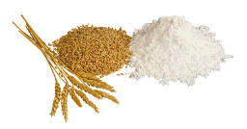
Cereal-based products
However, the news from many other sectors are more promising. For example, LAB bioprotection retards the development of fungal diseases in the field and inhibit pathogens and spoilage fungi in cereal-base products (Oliveira et al.i 2013).
In addition to the health safety improvement, LAB metabolites also enhance shelf-life, organoleptic and texture qualities of cereal-base foods.
The application of antimicrobial LAB during malting and brewing can be successfully applied as a hurdle to spoilage microorganism growth (Rouse and van Sinderen, 2008; Wolf-Hall, 2007).

Slide 69
how succesful
It is estimated that the agricultural chemical industry produces over 45,000 different artificial pesticides/ fertilizers worldwide (Oliveira et al.i 2013).
Current late blight control systems are primarily based on the application of pesticides (Cooke et al. 2011).
Environmentally friendly products for plant protection, still represent an insignificant portion of the overall pesticide market, (Glare et al. 2012).
More research is needed in this area.
Amongst the many trials conducted so far, biological control agents were mostly screened for their activity in vitro and in vivo, with assays generally being performed under very simplified conditions (Axel et al 2012).
Effective application measures in field still need further optimization (Leblanc et al., 2005).

Slide 70
How succesful as food biopreservation?
When using live microbial antagonists in food biopreservation, there are a number of criteria and requirements, which must be taken into account;
Criteria and requirements:
Consumer protection is the most important aspect, in particular in terms of ready-to-eat food as well as other food products,

Slide 71
Requirements of biopreservative agents
SAFETY: Consumer protection
Environmental friendly
EFFECTIVITY
Antimicrobial / Antagonistic
APPLICIBILITY
COMPATIBILITY: protective cultures should not cause any detrimental effects
STABILITY / SURVIVAL
Should meet REGULATORY CRITERIA

Slide 72
How succesful as seafood biopreservation?
Biopreservation of fish and seafood products is an alternative to meet safety standards and to control microbial deterioration without negative impact on the sensory quality of the product
Thus, LAB is effective and usually meets most of the necessary requirements for biopreservation of seafood products. there is again some problems in their applicibility. However, since they may be efficient only in a narrow range of food environment (pH, fat content, etc.) and this limits their application in many seafood products.

Slide 73
LAB-prosess combinations
The weakness of LAB / antimicrobials observed in particular foods overwhelmed by combining biopreservative and food processes and more promising results obtained by these combinations.
Some of the examples of these combinations in different foods.
LAB-high hydrostatic pressure
LAB-pulsed electrical field
LAB-mild heat treatment
LAB-ultrasound etc.
promising results were obtained like

Slide 74
In conclusion
Lactic acid bacteria (LAB) possess a major potential for use in biopreservation because most LAB are generally recognized as safe, and they naturally dominate the microflora of many foods.
LAB bioprotection retards the development of fungal diseases like Fusarium head blight (FHB) in the field and inhibit pathogens and spoilage fungi in food products.
FHB is of growing international importance in recent years leading to significant economic losses across the value chain by reducing grain yield and quality of barley and wheat in cultivation sites worldwide (Gilbert and Tekauz, 2000).

Slide 75
In conclusion
However, to date, all biopesticides tested against Phytophthora infestans showed inconsistent field performance, although some could inhibit the pathogen in vitro (Axel et al 2012).
Continued screening of bacteria and their metabolites is necessary to select potential candidates for further specific evaluation as P. infestans control agents.

Slide 76
In conclusion
The application of LAB starter cultures in food systems provides an excellent control system regarding the growth of typical food-associated pathogenic/spoilage microorganisms.
The application of bacteriocin producing LAB, alone or in combination with processes, could be more widely applied by the food industry.
Thus, lactic acid bacteria have been used as natural food-grade preservatives against a variety of undesirable microorganisms.

Slide 77
