Slide 1

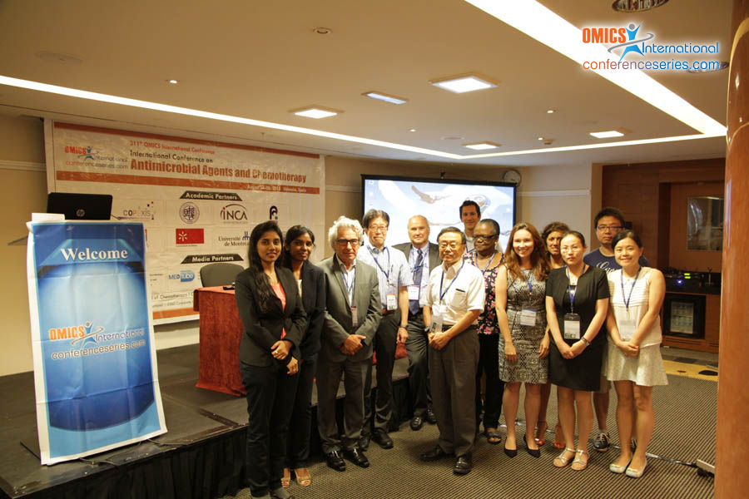
Chemotherapy-2015
Valencia, Spain
August 04- 06, 2015
Didier Coquoz

Slide 2
International Conference on
Antimicrobial Agents and Chemotherapy
August 04-06, 2015 Valencia, Spain
Evolution of cancer drug development and registration paradigms in light of the successes of immunotherapy
Dr. Didier Coquoz, Copexis, Switzerland dc@copexis.com

Slide 3
Some trial considerations
Usual situation for many FDA drug approvals
  Multiple studies
  Studies are large 1,000 – 5,000 patients
  Placebo control group
  Double blinded or a blinded independent assessment
  Highly significant p values (0.001)
Oncology drug data submitted for approval
  One study, 100 – 800 patients
  No blinding, no placebo control
  Heterogeneous patient group
  Statistical evidence ~ 0.03 – 0.05

Slide 4
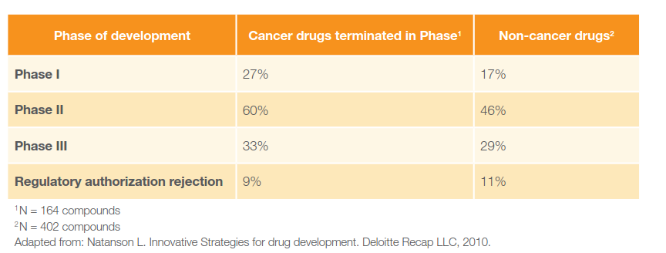
Failure rates

Slide 5
LIVE LONGER – Measure Survival- PFS/DFS/OS
  Efficacy, reassures for safety, unbiased endpoint but – subsequent therapy, long time required
  PFS/DFS often viewed as surrogate for OS:
    Colorectal cancer: 3 year DFS (p ≤ 0.03) => 5 year OS
LIVE BETTER – Measure QOL – PRO
  Important: control group + blinding needed (bias) hard to measure, scale problems, missing data Drug Tox. symptoms versus tumor symptoms
SAFETY (Benefit / Risk assessment)=> COMPARISONS ARE NECESSARY
  HOW? controlled clinical trials

Slide 6
Successes of immunotherapy
  Early 90’s
  Immunomodulators: Interleukin 2
    Considered as a “failure” mainly due to SAE
  Early 90’s - current
  Immunomodulators: none
  Monoclonal antibodies, bi-specific antibodies (however not immunomodulators)
  Therapeutic vaccines: essentially one: Sipuleucel-T
  From 2013
    Anti-CTLA4 (Yervoy®), anti-PD1 (Opdivo®), anti-PDL1…
    Check point inhibitors
    cytokines, immunocytokines

Slide 7
Challenges of immunotherapy
  Immunomodulators, vaccines:
  Goal: increase the immune response
  Cancer develops immunosuppressive strategies
  vaccines: reduction of efficacy
  Immunodulators
    Anti-CTLA4, -PD1, -PDL1, check point inhibitors:
      inhibit the immuno downregulation mechanisms. Risk: over-immuninity
    Cytokines, immunocytokines:
      inhibit the immuno downregulation mechanisms. Risk: over-immuninity, or
      bypass the cancer induced immunosuppressive mechanisms
  Cancer develops immunosuppressive strategies
  vaccines: reduction of efficacy
  Immunodulators
    Anti-CTLA4, -PD1, -PDL1, check point inhibitors:
      inhibit the immuno downregulation mechanisms. Risk: over-immuninity
    Cytokines, immunocytokines:
      inhibit the immuno downregulation mechanisms. Risk: over-immuninity, or
      bypass the cancer induced immunosuppressive mechanisms

Slide 8
Challenges of immunotherapy
  Immunomodulators, vaccines: Different MoA and response pattern relative to cytotoxics, TKIs etc..:
  MoA: stimulation of the immune cells
  MoA consequences:
    Invasion of the tumor by immune cells and immune reaction
    Probably less efficacious on bulk tumor
    Probably more efficacious on cancer initiating cells, residual disease and metastases
  Clinical potential:
    Probably most efficacious in combination with other anti-cancer treatments (costs!)
    Potential of cure ! (total eradication of the cancer including residual disease and metastatses)

Slide 9
Challenges of immunotherapy
results from T-cell immune response assays as biomarkers for clinical surrogacy are highly variable and often non reproducible
  harmonisation of assays
immunotherapy induces novel patterns of the antitumour responses not captured by WHIO criteria or Response Evaluation Criteria in Solid Tumours (RECIST)
  new immune-related response criteria
immunotherapy induced survival curves can show a delayed separation
  modified statistical models are needed to describe the hazard ratios as a function of time, and differentiate them before and after separation of curves to improve planning of phase III trials
Hoos. A. Ann Oncol 2012; 23

Slide 10
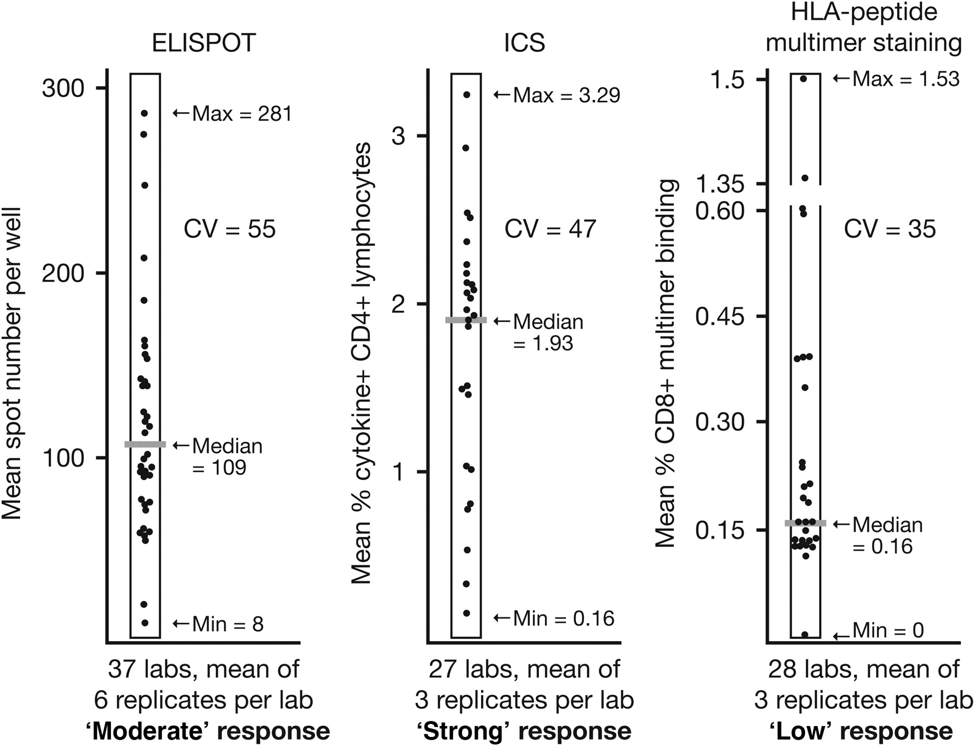
inter-laboratory variability in
immune response measurements
Hoos. A. Ann Oncol 2012; 23

Slide 11
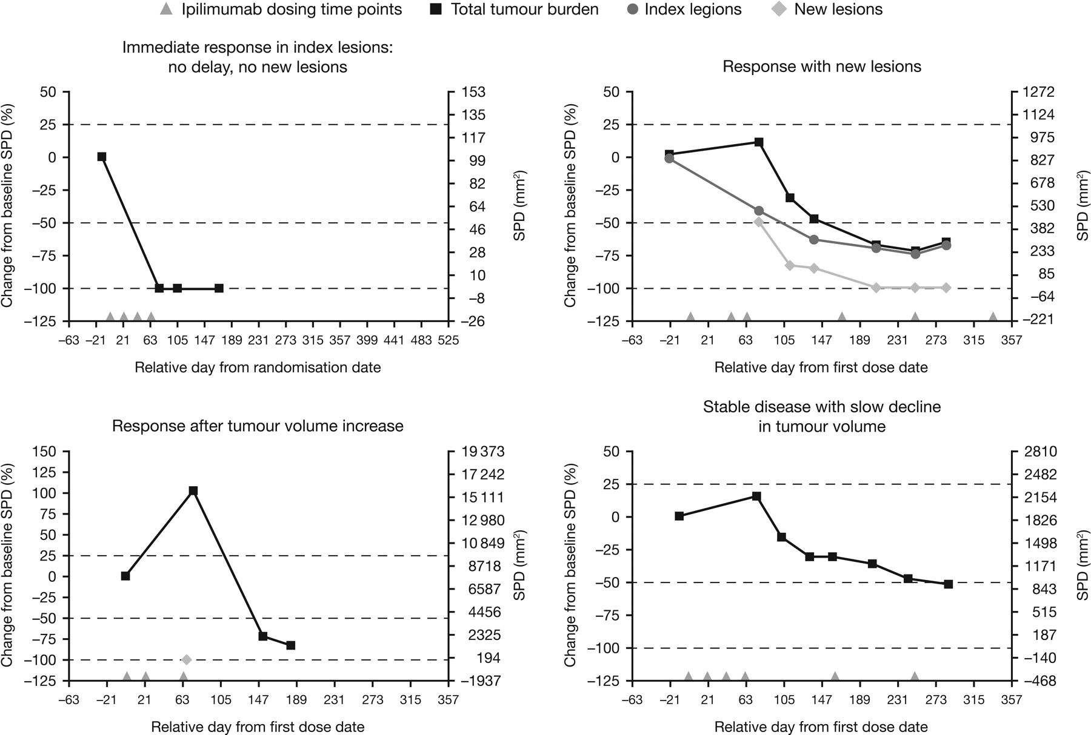
Novel response patterns observed with immunotherapies
Hoos. A. Ann Oncol 2012; 23

Slide 12
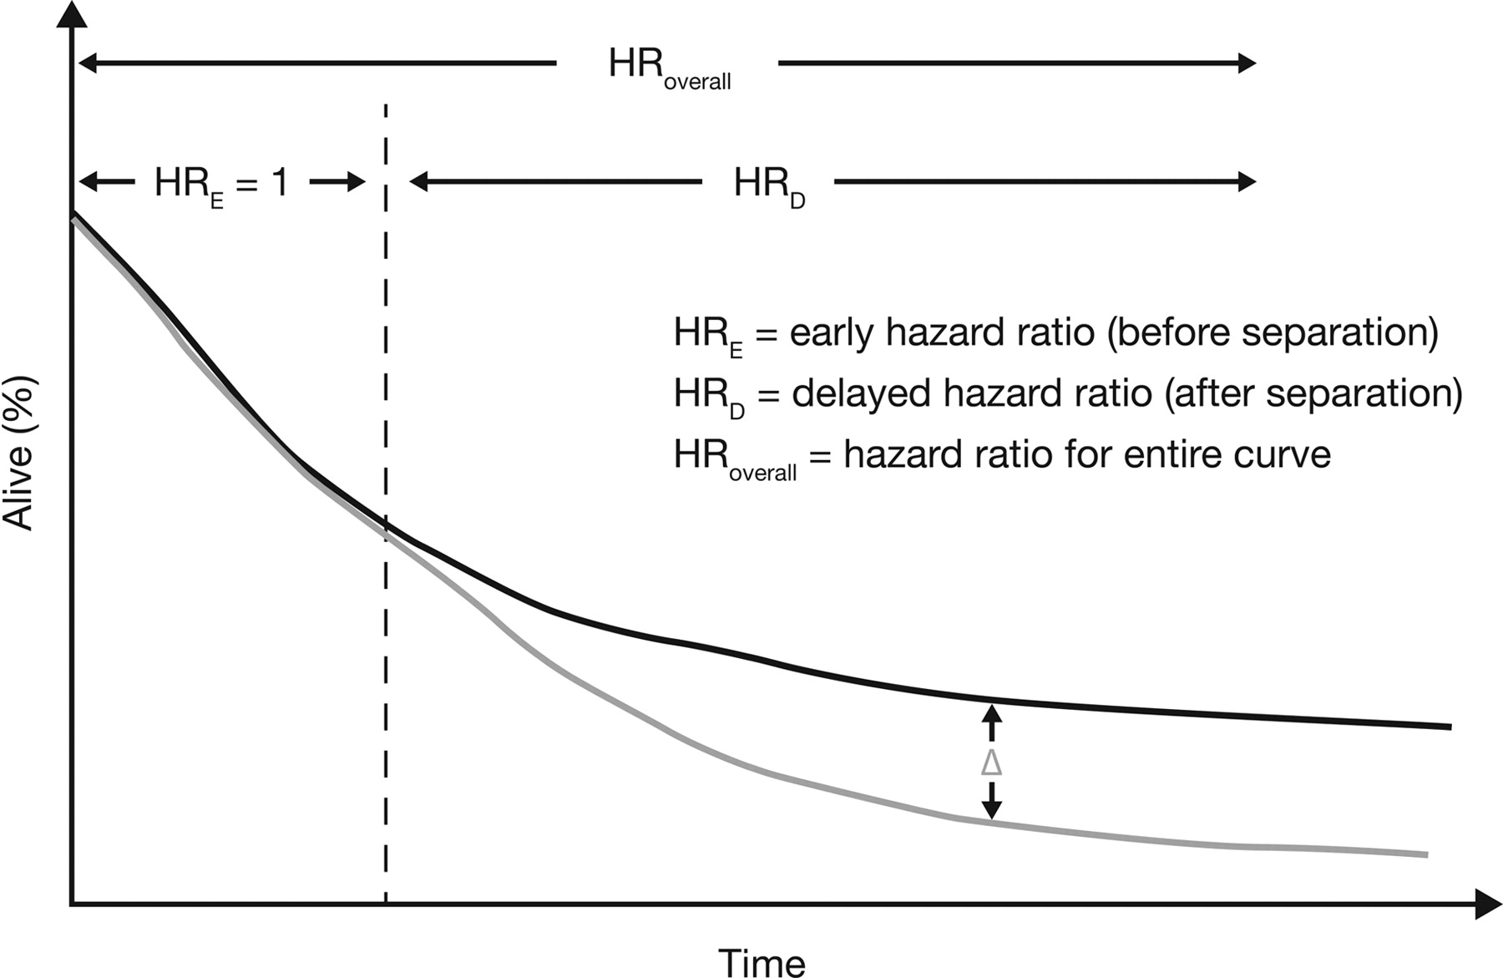
model scenario demonstrating implications
of delayed separation of survival curves.
Hoos. A. Ann Oncol 2012; 23

Slide 13
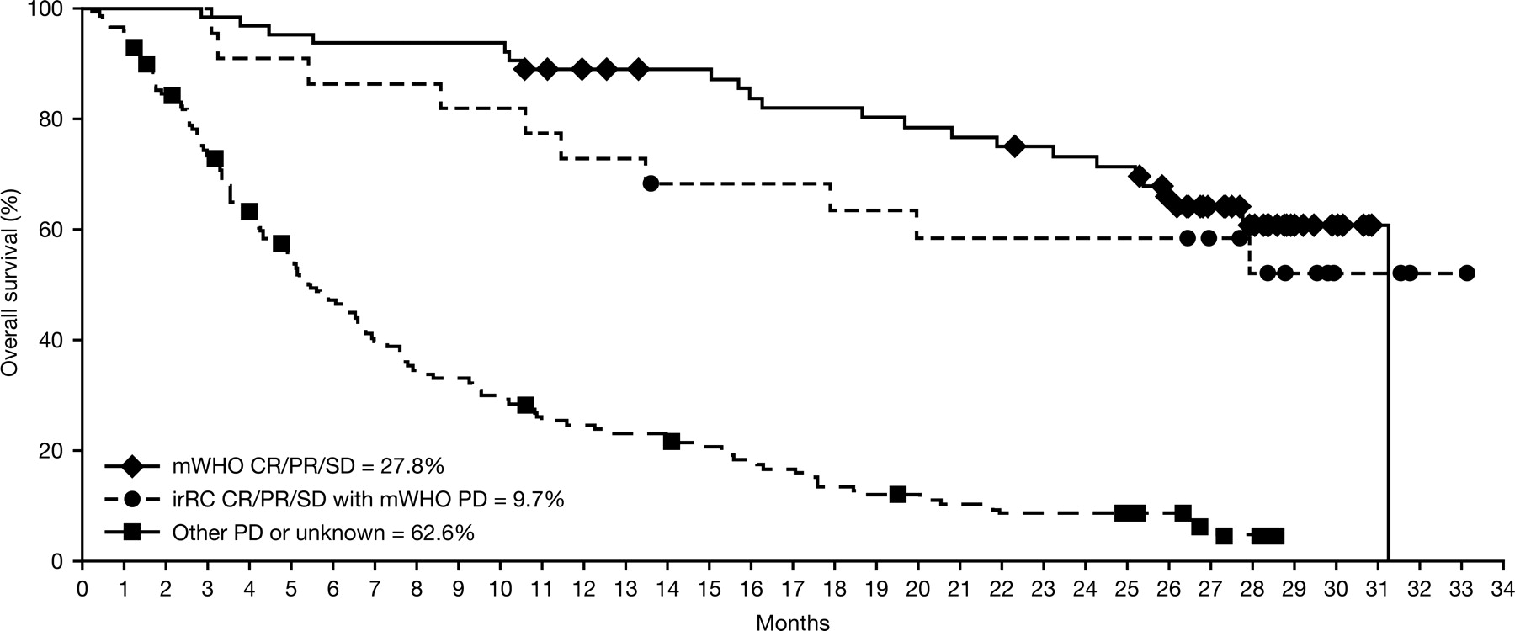
Immune-related response criteria identify survivors among 227 patients enrolled in phase II studies of ipilimumab 10 mg/kg monotherapy that would have had progressive disease according to modified World Health Organisation criteria
Wolchock, JD et al., Clin Cancer Res 2009; 15(23)

Slide 14
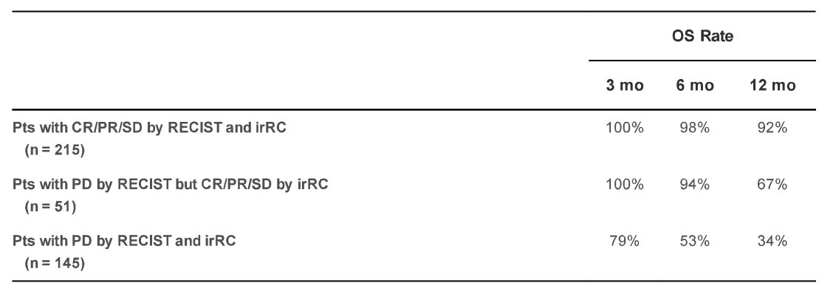

immune-related response criteria patients
from 3 melanoma cohorts treated with pembrolizumab (n=411)
  Hodi et al. J. Clin. Oncol. 2014, 32:5s (suppl: abstr. 3006)
© The Author 2012. Published by Oxford University Press on behalf of the European Society for Medical Oncology. All rights reserved. For permissions, please email: journals.permissions@oup.com.

Slide 15
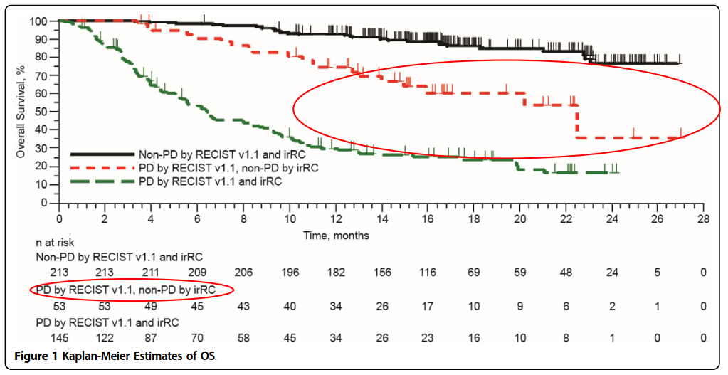
immune-related response criteria patients
from 3 melanoma cohorts treated with pembrolizumab (n=411)
  Hodi et al. Jo. Immuno Ther. Cancer 2014, 2(Suppl3): P103
© The Author 2012. Published by Oxford University Press on behalf of the European Society for Medical Oncology. All rights reserved. For permissions, please email: journals.permissions@oup.com.

Slide 16
challenges and recommendations for immunotherapy
 | Cellular immune response | Antitumour response | Survival
Challenges | Complex assays exist | Conventional and novel response patterns are observed | Translation of immune and antitumour response into a survival effect takes time
 | Results are highly variable and not reproducible across trials | Translation of the immune response into an antitumour response takes time | Proportional hazards assumptions are not applicable
 | Assay procedures are not harmonised | No systematic criteria exist to capture new response patterns | Conventional statistical models do not account for nonproportional hazards and delayed separation of curves
Recommendations | Harmonise assay use through standard operating procedures that accompany individual assay protocols | Identify relevant response patterns | Employ statistical models that account for the delayed effect
 |  | Use systematic immune-related response criteria to reproducibly capture new patterns | Consider use of early interim and futility analyses
Hoos. A. Ann Oncol 2012; 23

Slide 17
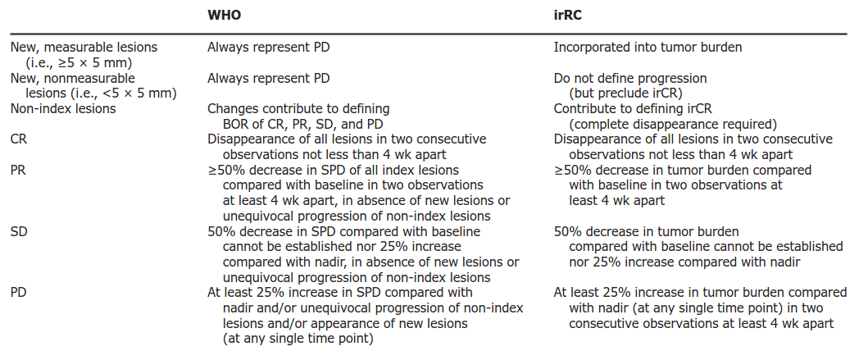
challenges and recommendations for immunotherapy
Wolchock, JD et al., Clin Cancer Res 2009; 15(23)

Slide 18
Main references
  Hoos A., Ann Oncol 2012; 23: viii47-viii52
  Naidoo J. et al., Br. J. of Cancer 2014; 111: 2214–2219
  Wolchok et al., Clin Cancer Res 2009; 15(23): 7412-7420
  Hodi et al. J. Immuno Ther. Cancer 2014, 2(Suppl3): P103
  Hodi et al. J. Clin. Oncol. 2014, 32:5s (suppl: abstr. 3006)

Slide 19
Meet the eminent gathering once again at
Chemotherapy-2016
Dallas, USA
June 06-07, 2016
Chemotherapy-2016
Website: chemotherapy.conferenceseries.com

