Slide 1

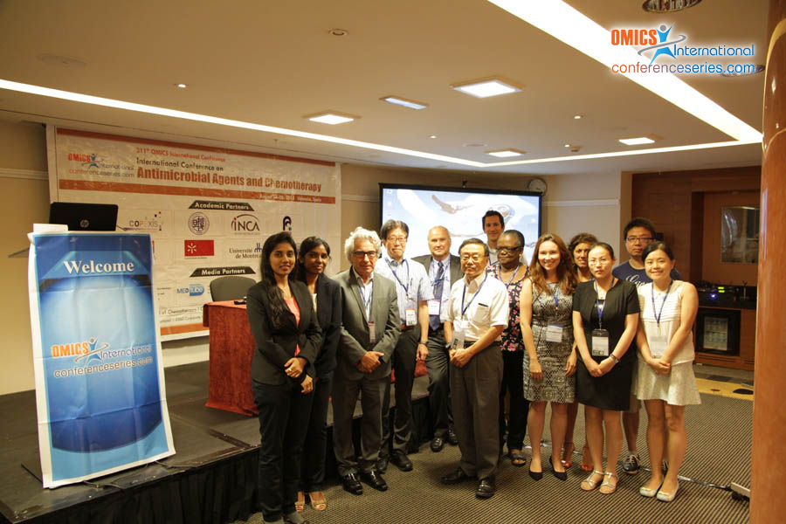
Chemotherapy-2015
Valencia, Spain
August 04- 06, 2015
Didier Coquoz

Slide 2
International Conference on
Antimicrobial Agents and Chemotherapy
August 04-06, 2015 Valencia, Spain
Keynote
Are we at the start of a new era for
anti-microbial and anti-cancers therapies?
Dr. Didier Coquoz, Copexis, Switzerland dc@copexis.com

Slide 3
anti-cancer and anti-microbial agents differences
Anti cancer agents
Advances
  Limited 70’s early 90’s
  Boom 90’s: Mabs
  Boom 2000’: TKIs
  Boom since 2013: immunomodulators
Incentives
  Developed countries
  High prices
  Major players
Anti microbial agents
Advances
  Limited since 70-80’s
Incentives
  Mainly developing countries
  Low prices
  Major players exited

Slide 4
anti-cancer and anti-microbial agents
potential synergies
Anti-cancer or anti-microbial treatments:
  early: -statics and -toxics
  more recently: anti-physiologic/metabolic drugs discovered through the advances in intracellular mechanisms understanding (exemple: TKIs), mainly anti-cancer, future in anti-microbials?
  recently: immunomodulation, mainly anti-cancer, future in anti-microbials?
Cancer or microbial infection:
  abnormal invasion of cells
  difference relative to host cells in structure/physiology/metabolism/growth
  natural mechanism of defense: immune system

Slide 5
Approaches for anticancer treatments
Diagnostics/theragnostics
New drugs
Cancer specific
Statics-toxics
early detection
adapted treatment
reduced resistance risk
limited implementation
largely investigated
new areas based on intracellular physiology, KIs
Treatment specific
Immunomodulation
early detection
adapted treatment:
  increased efficacy
  reduced drug developemnt costs
reduced resistance risk
implementation mandatory?
more investigated recently
therapeutic vaccines
immunomodulating Abs, cytokines

Slide 6
Approaches for antimicrobial treatments
Diagnostics/theragnostics
New drugs
Disease/strain specific
Statics-toxics
early detection
adapted treatment
reduced resistance risk
limited implementation
largely investigated
new areas based on intracellular physiology, KIs?
limited costs?
Treatment specific
Immunomodulation
early detection
adapted treatment:
  increased efficacy
  reduced drug developemnt costs
reduced resistance risk
implementation mandatory?
less investigated
therapeutic vaccines
immunomodulating Abs, cytokines
high costs

Slide 7
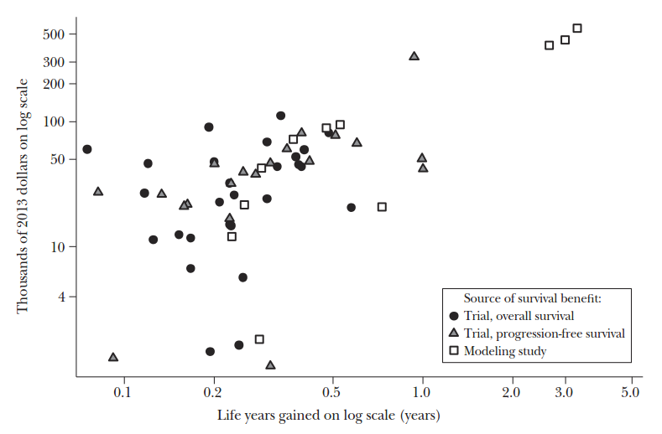
market incentives for anti cancer treatments
Drug Prices versus Life Years Gained
average drug treatment price is $65,900 (2013), average survival benefit 0.46 years
Howard H. et al., Journal of Economic Perspectives, 2015

Slide 8
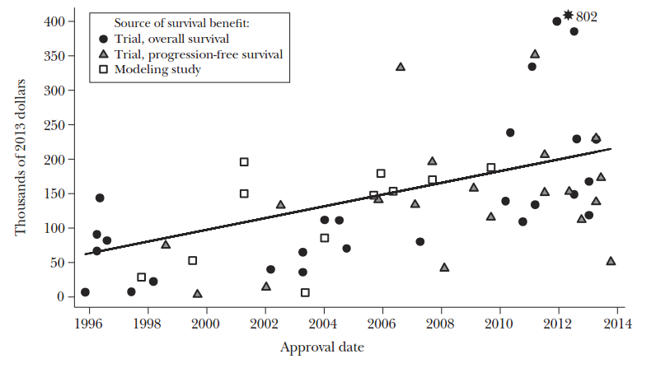
market incentives for anti cancer treatments
Drug Price per Life Year Gained versus Drug Approval Date
Howard H. et al., Journal of Economic Perspectives, 2015

Slide 9
anti cancer and anti-microbial treatments
FDA approvals 2014
  Anti-cancer agents: all new drugs, some breakthroughs
    belinostat; HDAC inhibitor, relapsed or refractory peripheral T-cell lymphoma, Approved July 2014
    blinatumomab; bispecific Ab CD19-directed CD3 T-cell engager, Philadelphia chromosome-negative relapsed /refractory B cell precursor ALL
    ramucirumab; anti-VEGFR2 Ab, gastric cancer
    ibrutinib; Bruton's tyrosine kinase (BTK) inhibitor, chronic lymphocytic leukemia
    pembrolizumab; anti-PDL-1, unresectable or metastatic melanoma
    olaparib; poly ADP ribose polymerase (PARP), previously treated BRCA mutated advanced ovarian cancer
    nivolumab; anti-PD1, unresectable or metastatic melanoma, Approved December 2014
    idelalisib; phosphoinositide 3-kinase inhibitor, relapsed CLL, follicular B-cell NHL and small lymphocytic lymphoma
    ceritinib; ALK inhibitor (mainly), ALK+ metastatic non-small cell lung cancer, Approved April 2014

Slide 10
anti cancer and anti-microbial treatments
FDA approvals 2014
  Anti-microbial agents (excludes antivirals): no breakthrough
    dalbavancin; second-generation lipoglycopeptide antibiotic, same class as vancomycin, acute bacterial skin and skin structure infections
    oritavancin; second-generation glycopeptide antibiotic, acute bacterial skin and skin structure infections
    tedizolid phosphate; oxazolidinone-class antibiotic, acute bacterial skin and skin structure infections
    miltefosine; leshmanias, derivative of alkylphosphocholine compounds (early 1980s), initially as an anticancer drug by German scientists Hansjörg Eibl and Clemens Unger
    tavaborole; antifungal for toenails
    ceftolozane + tazobactam; combination of cephalosporin-class antibacterial drug and a beta-lactamase inhibitor; intra-abdominal and urinary tract infections
    finafloxacin otic suspension; acute otitis externa
    metronidazole 1.3% Vaginal Gel; bacterial vaginosis
    efinaconazole 10% topical gel; onychomycosis of the toenails

Slide 11
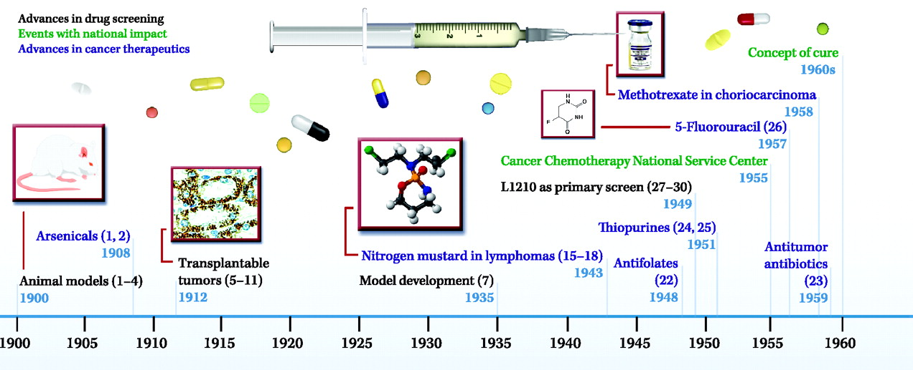
History of anti cancer treatments
AACR

Slide 12
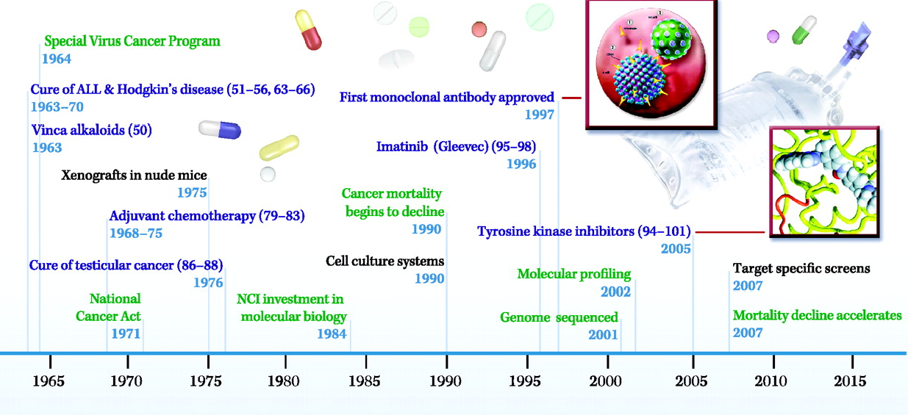
History of anti cancer treatments
Immunomodulators
breakthroughs
AACR

Slide 13
anti cancer treatments future
Potential “cure” (eradication) of cancers ?

Slide 14
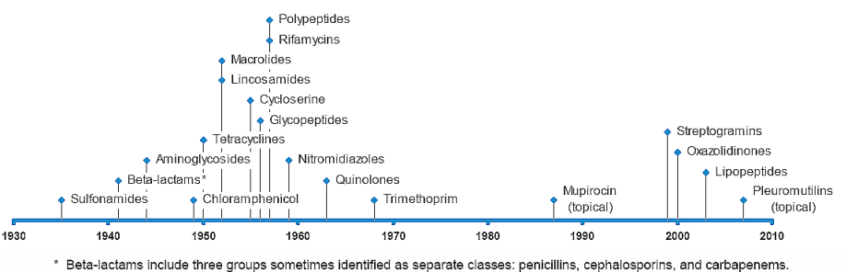
challenges of antimicrobial treatments
antibiotics has been one of the neglected areas in drug development in the last decades
  14 classes of antibiotics were introduced for human use between 1935 and 1968
  since then, 5 classes have been introduced
  only two first-in-class between 2000 and 2014: fidaxomicin (new class of narrow spectrum macrocyclic antibiotic) and bedaquiline (diarylquinoline anti-tuberculosis drug)
From “Extending The Cure” Responses To The Growing Threat Of Antibiotic Resistance. 2008 .

Slide 15
challenges of antimicrobial treatments
In comparison, during the same period, the FDA approved:
  90 novel compounds for the treatment of malignancies.
  51% of the approved drugs were first-in-class

Slide 16
challenges of antimicrobial treatments
Main reasons of anti-microbial agents development stall
  Low prices of existing treatments
  Mainly developing countries
  Major players exited

Slide 17
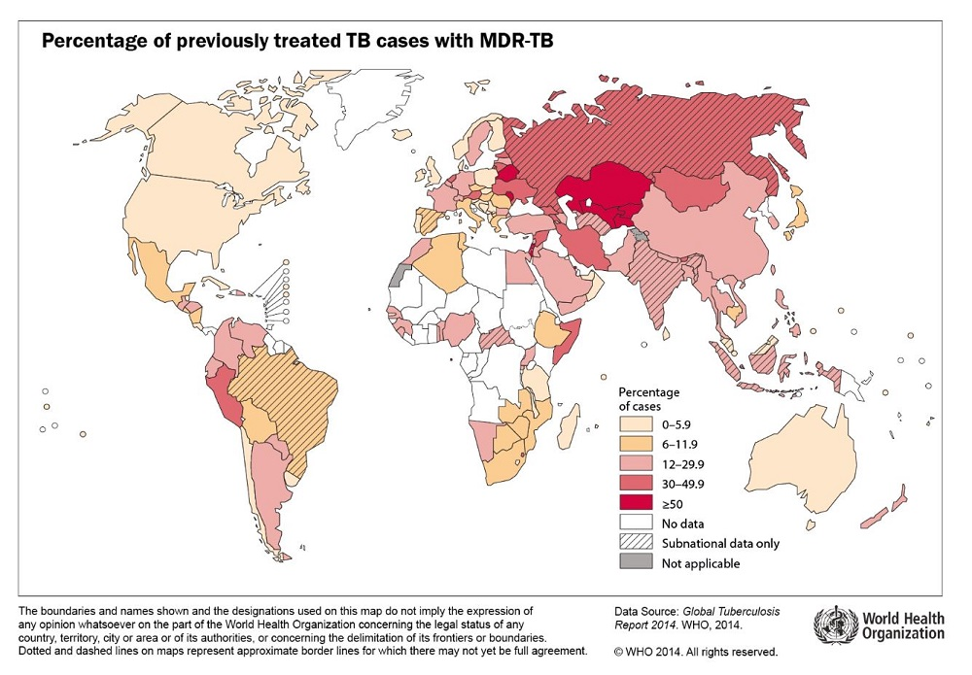
challenges of antimicrobial treatments
However, the seemingly unstoppable rise of MDR (Multi Drug Resistant) and XDR (Cross Drug Resistant) pathogens has placed antibiotic drug development back in the spotlight.

Slide 18
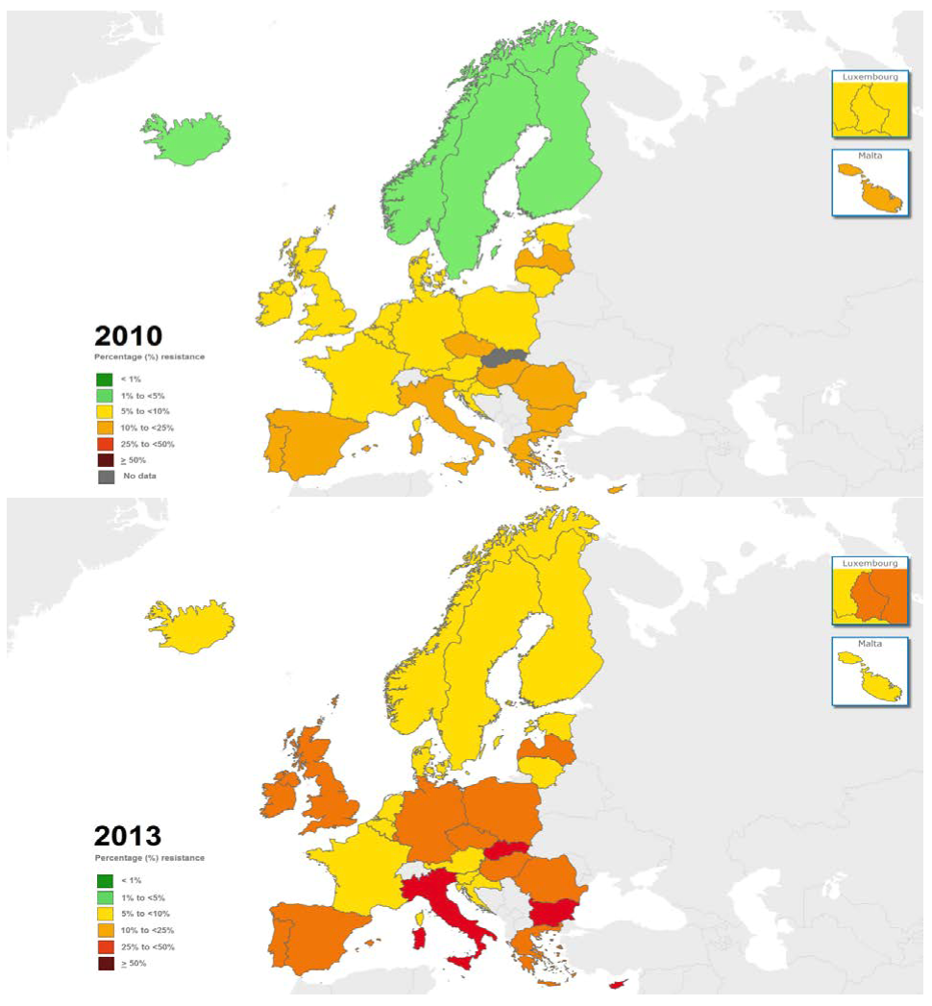
challenges of antimicrobial treatments
Not only a developing countries problem:
Escherichia coli: percentage of invasive isolates with resistance to third-generation
cephalosporins, EU/EEA, 2010 (top), 2013 (bottom)
ECDC, Summary of the latest data on antibiotic resistance in the European Union

Slide 19
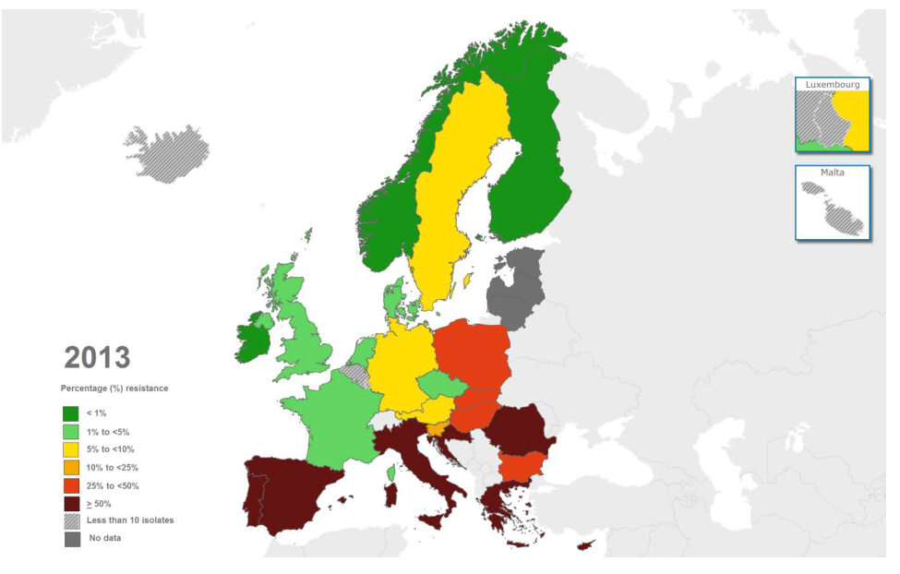
challenges of antimicrobial treatments
Not only a developing countries problem:
Acinetobacter species: percentage of invasive isolates with combined resistance to
fluoroquinolones, aminoglycosides and carbapenems, EU/EEA, 2013
ECDC, Summary of the latest data on antibiotic resistance in the European Union

Slide 20
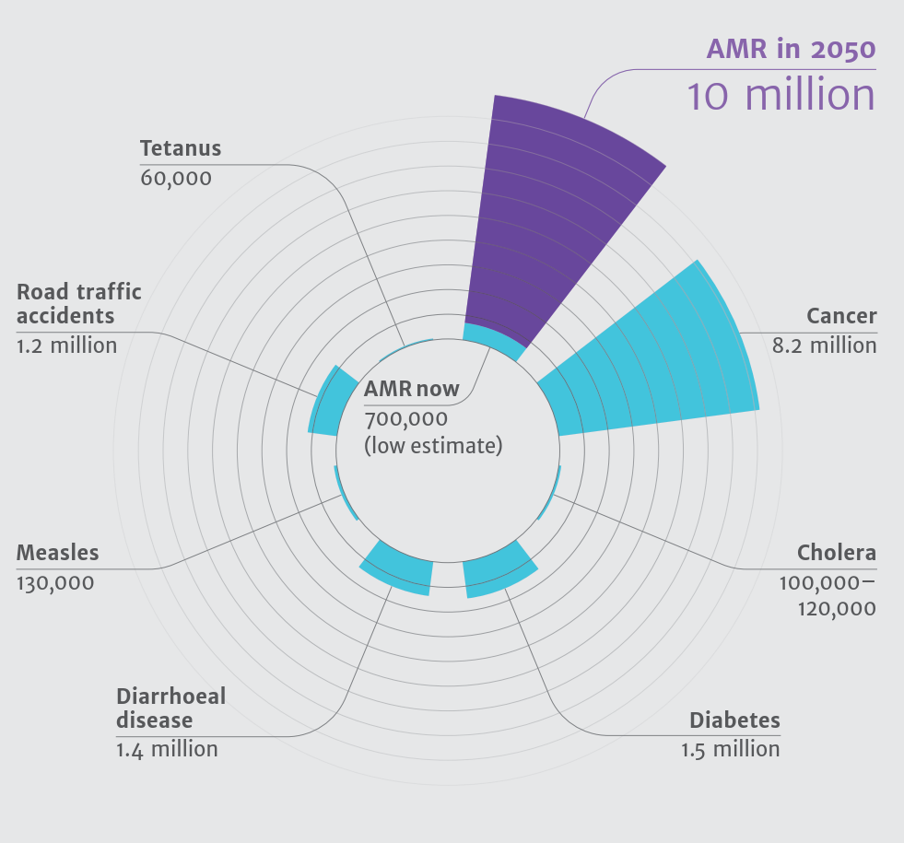
challenges of antimicrobial treatments
Deaths attributable to AMR every year compared to other major causes of death
The Review on Antimicrobial Resistance, 2014

Slide 21
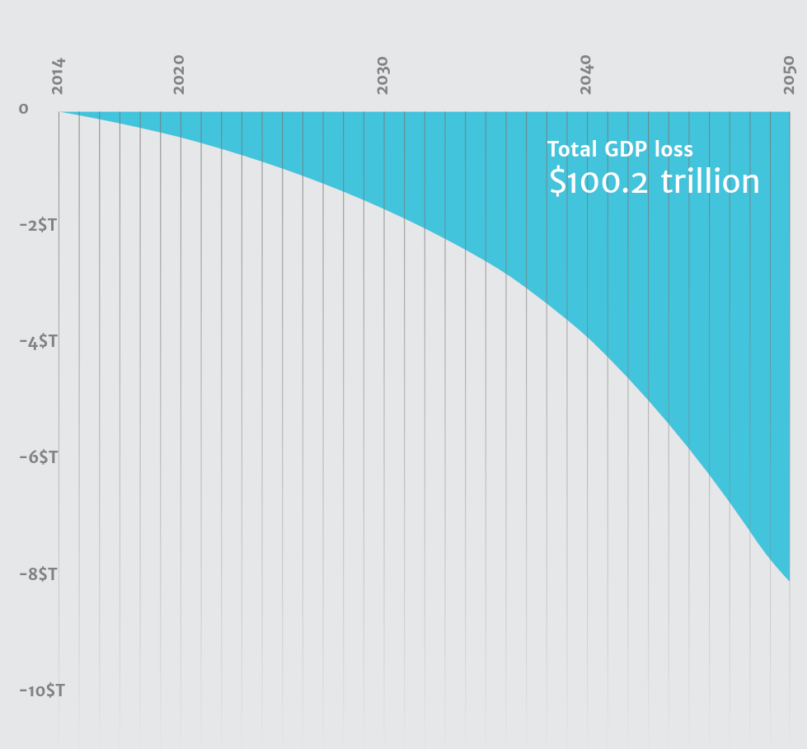
challenges of antimicrobial treatments
AMR’s impact on World GDP in trillions of USD
The Review on Antimicrobial Resistance, 2014

Slide 22
challenges of antimicrobial treatments
the most urgent need is to develop new medicines that address the threat posed by drug-resistant strains of Gram-negative bacteria.

Slide 23
challenges of antimicrobial treatments
Challenges for developing new antimicrobial treatments:
  market failure (low potential prices, absence of appropriate incentives to develop medicines for which use will be restricted)
  regulatory requirements (ex: early development requirements (IMPD, tox. etc..), phase III trials (currently 2 requested, phase 3 clinical trial average cost: $70 million per trial),etc..)
  scientific challenges

Slide 24
Market challenges of antimicrobial treatments
Market challenge and recent incentives
  net present value of an antibiotic: minus $50 million, new musculoskeletal drug: $1 billion
  Incentives, examples (1, US):
    Generating Antibiotic Incentives Now (GAIN) Act (US)
      prolonged exclusivity and other provisions that could increase the value of antibiotics to companies

Slide 25
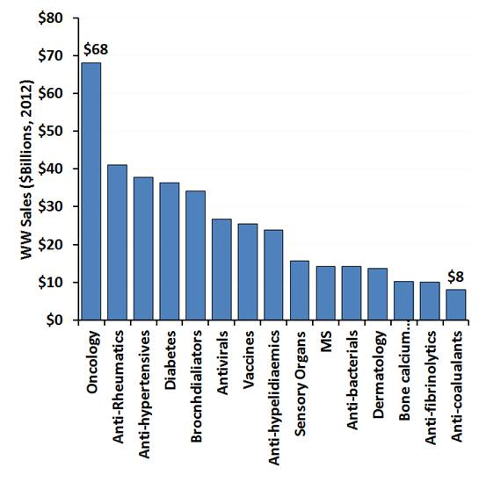
market incentives: anti cancer vs anti microbial treatments
EvaluatePharma

Slide 26
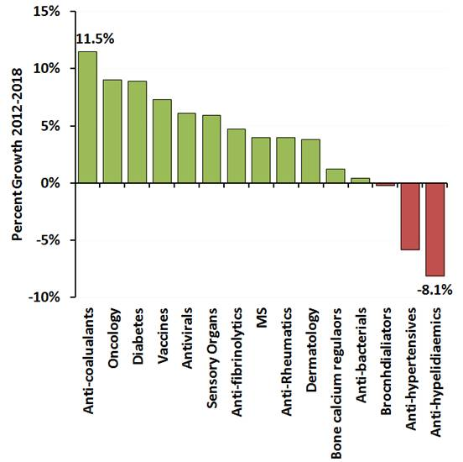
market incentives: anti cancer vs anti microbial treatments
EvaluatePharma

Slide 27
challenges of antimicrobial treatments
  Results of GAIN as of December 2014:
    37 antibiotics in development, 10 in Phase 1, 18 in Phase 2, eight in Phase 3, and one NDA.
    At least 24 designated as "qualified infectious disease products," (QIDPs) meaning they were being studied for serious or life-threatening infections and receiving benefits provided under the Generating Antibiotic Incentives Now, or GAIN, Act of 2012.
    At least two antibiotics in early development attack bacteria in an entirely new way by sidestepping the resistance of some bacteria to available antibiotics.
    Of the 32 or so companies with antibiotics in clinical development today, only five rank among the top 50 pharmaceutical companies by sales.
    Nearly 80 percent of the products currently in development are being studied by small companies

Slide 28
Market challenges of antimicrobial treatments
  Incentives, examples (2, Europe):
    Innovative Medicine Initiative (IMI)/fp7 (2013)
      COMBACTE (2013) new ways of designing and implementing efficient clinical trials for novel antibiotics
      TRANSLOCATION (2013) increase the overall understanding of how to get antibiotics into multi-resistant Gram-negative bacteria
      ENABLE24 antibiotic drug development platform. The project aims to advance the most promising early discovery stage of novel antibiotic molecules from the academic and SME sector to early clinical development.
      DRIVE-AB25 (2014) recommendations for new commercial models that provide industry with an incentive to invest in antibiotic development while ensuring that new antibiotics are used wisely.
    Global Action Plan Against the rising threats from Antimicrobial Resistance (2015)
    1 million € price for new diagnostic (2015)

Slide 29
Regulatory incentives for antimicrobial treatments
    Recent regulatory incentives, FDA example
  ADAPT Act (Antibiotic Development to Advance Patient Treatment Act) 2013
    expedite novel antibiotic approval by the FDA
    Qualified Infectious Disease Products (QIDPs):
      priority review
      fast-­track designation
      eligible for an additional five years of marketing exclusivity, exclusive marketing rights without
      competing with a generic drug product.
      up to 2015: 52 QIDP designations to 35 different unique molecules

Slide 30
Regulatory incentives for antimicrobial treatments
Recent regulatory incentives, EMA example
  relaxed its guidelines for clinical antibiotic trials in four ways:
    patients can be enrolled in trials after receipt of a dose of previous antibiotic treatment, making enrolment possible
    organism-specific rather than disease-specific studies;
    small studies can be used to support approval of antibiotics that treat resistant, critical infections
    clinical response endpoints can be assessed at test-of-cure visits

Slide 31
New era for anti-cancer and anti-microbial treatments?
Strong incentives for new antimicrobials
Potential “cure” of cancer
Bridges?
Ex:
KI
immunotherapy

Slide 32
New era for anti-cancer and anti-microbial treatments?
Thank you for your attention

Slide 33
Meet the eminent gathering once again at
Chemotherapy-2016
Dallas, USA
June 06-07, 2016
Chemotherapy-2016
Website: chemotherapy.conferenceseries.com

