Slide 1
About OMICS Group
OMICS Group International is an amalgamation of Open Access publications and worldwide international science conferences and events. Established in the year 2007 with the sole aim of making the information on Sciences and technology ‘Open Access’, OMICS Group publishes 400 online open access scholarly journals in all aspects of Science, Engineering, Management and Technology journals. OMICS Group has been instrumental in taking the knowledge on Science & technology to the doorsteps of ordinary men and women. Research Scholars, Students, Libraries, Educational Institutions, Research centers and the industry are main stakeholders that benefitted greatly from this knowledge dissemination. OMICS Group also organizes 300 International conferences annually across the globe, where knowledge transfer takes place through debates, round table discussions, poster presentations, workshops, symposia and exhibitions.

Slide 2
About OMICS Group Conferences
OMICS Group International is a pioneer and leading science event organizer, which publishes around 400 open access journals and conducts over 300 Medical, Clinical, Engineering, Life Sciences, Phrama scientific conferences all over the globe annually with the support of more than 1000 scientific associations and 30,000 editorial board members and 3.5 million followers to its credit.
OMICS Group has organized 500 conferences, workshops and national symposiums across the major cities including San Francisco, Las Vegas, San Antonio, Omaha, Orlando, Raleigh, Santa Clara, Chicago, Philadelphia, Baltimore, United Kingdom, Valencia, Dubai, Beijing, Hyderabad, Bengaluru and Mumbai.

Slide 3
PREMATURE AGING INDUCED BY SUNLIGHT
Dhelya Widasmara

Slide 4
INTRODUCTION

Slide 5
AGING
A “biological reality” → its own dynamic beyond human control
Complex process → progressive functional decline due to the accumulation of molecular damage over time
Human skin like all other organs → chronological aging and aging as a consequence of environmental damage (photoaging)
Aging skin has a marked susceptibility to dermatologic disorders → structural and physiologic changes → consequence of intrinsic and extrinsic aging

Slide 6
PHOTOAGING
damage to the skin
caused by intense and chronic exposure to sunlight
types of aging:
intrinsic aging
extrinsic aging
characterized by
dryness,
wrinkling,
elastosis,
telangiectasia,
anomalous pigmentation

Slide 7
Genes
Aging
Pollutants
Environment
Sunlight Exposure
Premature Aging
Ultraviolet

Slide 8
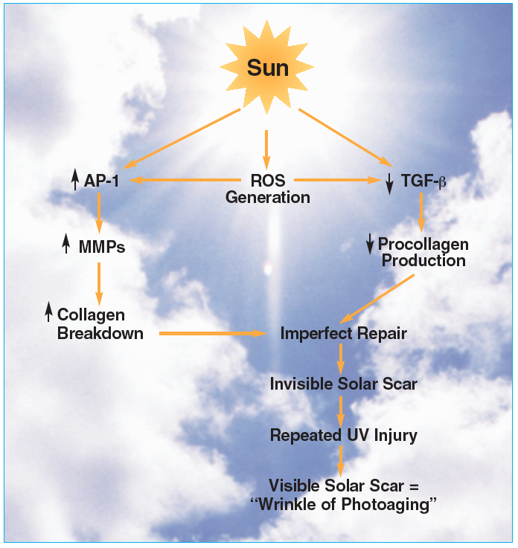
Mechanism of extrinsic skin photoageing

Slide 9
Sunlight and photoaging
Sunlight
Ultraviolet B (UVB, 280-315 nm) → cause DNA damage
Ultraviolet A (UVA, 315-400 nm) → most effective in penetrating skin
Visible light (400-760 nm)
Infrared (760-106 nm)
Ultraviolet
ROS Production → DNA damage, MMP, MAPK, PKC
Induction various cytokines
Inhibit skin cell renewal processes

Slide 10
UV radiation
Beneficial effect
Stimulate psychophysical energies, biochemical process, hypophysis & supra adrenal gland
Negative effect
Premature photo aging & cutaneous cancer
Favor vitamin D syntesis
Production of melanin
Regulation of sebaceous secretion

Slide 11
Duration
Time
Gradual character of sun exposure
Human prototype
Type of protection used
SUNLIGHT EXPOSURES
UV RADIATION
SKIN PHOTO AGING
Loss of skin level
Wrinkles
Uneven hyperpigmentation
Skin thickenings
Skin becomes rough

Slide 12
UV RADIATION
Inflammatory process occurs at skin level
Involvement of dermis layer (monocytes & netrophils)
Free radicals leading to tissues destruction

Slide 13
FREE RADICALS
Accumulation → DNA Damage
Modified protein & molecules → destruction skin collagens network (dermis)
Collagen destruction → Skin becomes fragile
Fine/deep wringkles, irregular pigmentation, rough, inflamed, telangiectases

Slide 14
METHODS OF AGING ANALYSIS
Glogau Classification of Photoaging
FSIA (Face Skin Image Analysis)
Fitzpatrick-Goldman Classification Wrinkle Scale
Daniell’skin Wrinkle Grading Methods
The Wrinkle Severity Rating Scale (WSRS)

Slide 15
GLOGAU CLASSIFICATION
The Glogau classification system was developed to objectively measure the severity of photoaging and especially wrinkles
It helps practitioners pick the best procedures to treat photoaging.

Slide 16
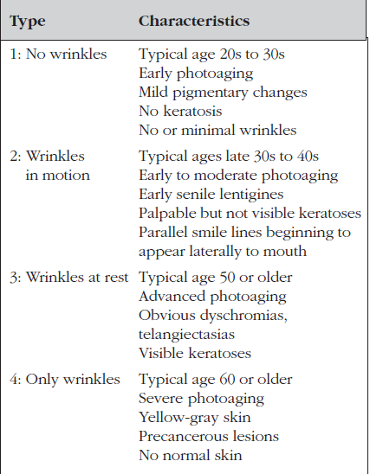
GLOGAU CLASSIFICATION

Slide 17
FSIA (FACE SKIN IMAGE ANALYSIS)
Gajah Mada University, Indonesia, has developed DCT (Discrete Cosinus Transformation) digital image analysis
This program is for measuring surface roughness of skin including wrinkles that can be captured by digital camera and named FSIA (Face Skin Image Analysis)

Slide 18
FSIA (FACE SKIN IMAGE ANALYSIS)…
Classification of variable roughness wrinkles assessed by hue on the color spectrum LUX (Logarithmic hUe eXtension)
The result images are taken from the consideration that the skin element consist of red spectrum

Slide 19
IMMUNOHISTOCHEMISTRY ANALYSIS
Immunhistochemistry has emerged ad a powerfull investigative tool → provide supplemental information to the routine morphological assessment of tissue
Study cellular markers → define specific phenotypes → provided important diagnostic, prognostic and predictive information relative to disease status and biology
The application of antibodies to the molecular study of tissue pathology → adaptation and refinement of immunohistochemical techniques (use in fixed tissues)

Slide 20
CASE

Slide 21
PATIENT A
Name : Mr. A
Age : 19 y.o
Working status : Hospital employer
Smoking history : yes (sometimes)
Alcohol history : no
Using cosmetical : no
Using hormonal contraception : no
Rejuvenation therapy : no
Sistemic diseases : no
Glogau scale : type I

Slide 22



PATIENT A

Slide 23
PATIENT B
Name : Ms. B
Age : 19 y.o
Working status : Student
Smoking history : no
Alcohol history : no
Using cosmetical : yes
Using hormonal contraception : no
Rejuvenation therapy : no
Sistemic diseases : no
Glogau scale : type I

Slide 24
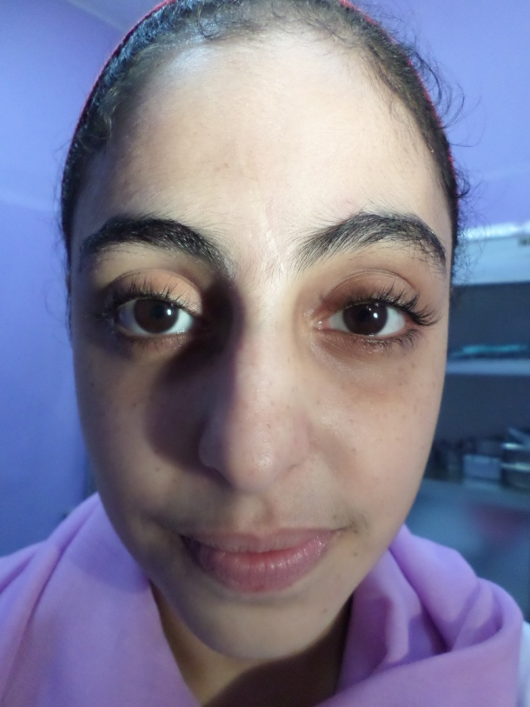
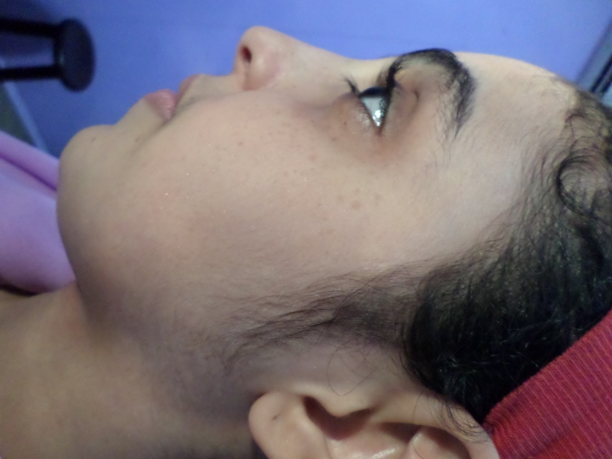

PATIENT B

Slide 25
FSIA (FACE SKIN IMAGE ANALYSIS)
FSIA result | Patient A | Patient B
Forehead | 8,882 | 2,438
Left Cheek | 6,835 | 1,535
Right Cheek | 8,594 | 7,931

Slide 26
FSIA (FACE SKIN IMAGE ANALYSIS)
FSIA result | Patient A | Patient B
Forehead | 8,882 | 2,438
Left Cheek | 6,835 | 1,535
Right Cheek | 8,594 | 7,931
From the FSIA result, compare patient A with patient B, we could see that there are significant different results from both patients. The premature aging can be caused by manyfactors such as sunlight exposure (patient A).

Slide 27
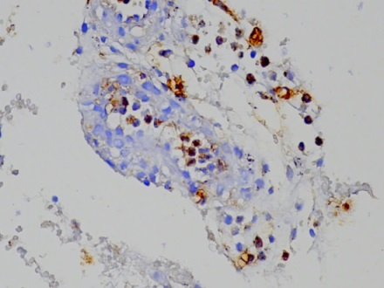
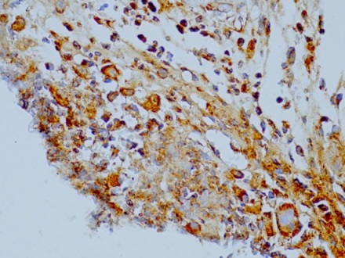
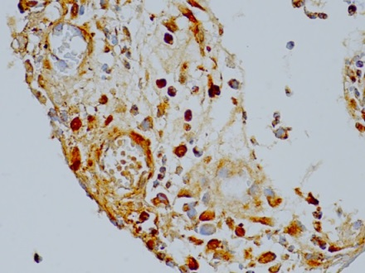
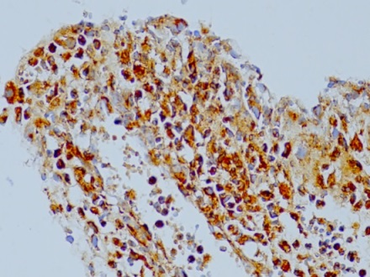
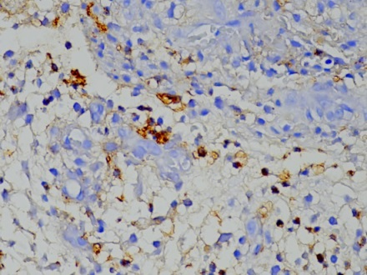
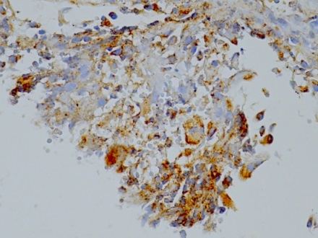
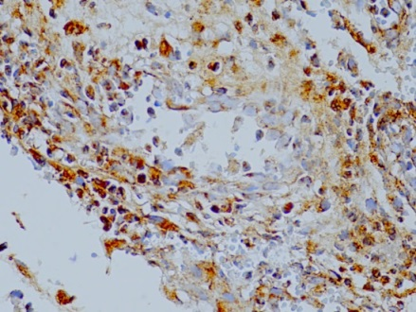
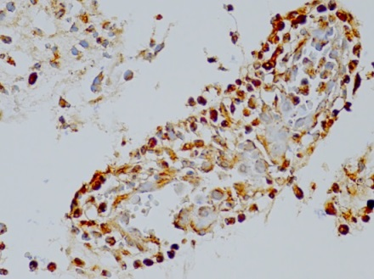
Immuno-histochemistry analysis
Apoptotic cells
MMP expression
PKC-α expression
MAPK p38 activation
PATIENT A
PATIENT B
Representation of immunohistochemistry analysis of MMP1, PKC-α and MAPK-p38 cutaneous biopsy. Relative expression of MMP1, PKC-α and MAPK-p38 patient A increases against patient B. However, apoptotic cells - analysis with Terminal deoxynucleotidyl transferase dUTP nick end labeling assay (TUNEL assay) – it appears that the number of apoptotic cells showed a tendency to increase patient A to compared with patient B.

Slide 28
Summary
It is important to distinguish between natural skin aging and photoaging.
Knowledge about the mechanisms underlying these processes can be utilized for developing future therapies
Educating patients is essential, as sunscreens and sun protection can prevent many of the changes associated with photoaging
Many treatments are available to treat photoaged skin; however, the best treatment is prevention.

Slide 29


Slide 30
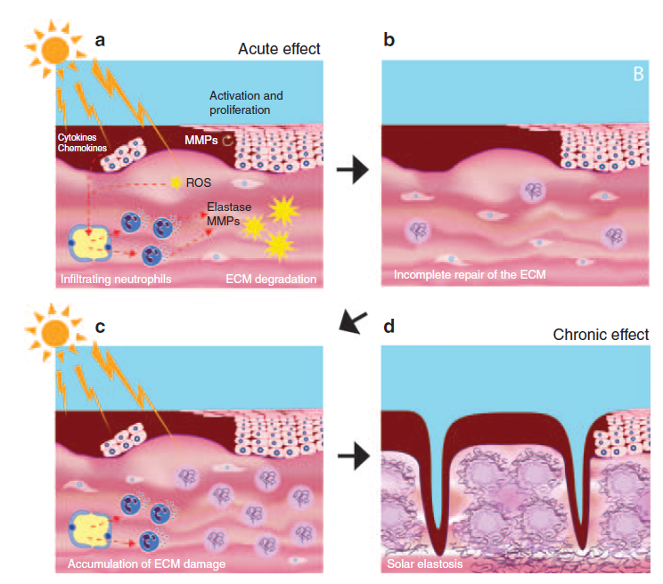
The pathogenesis of photoaging

Slide 31
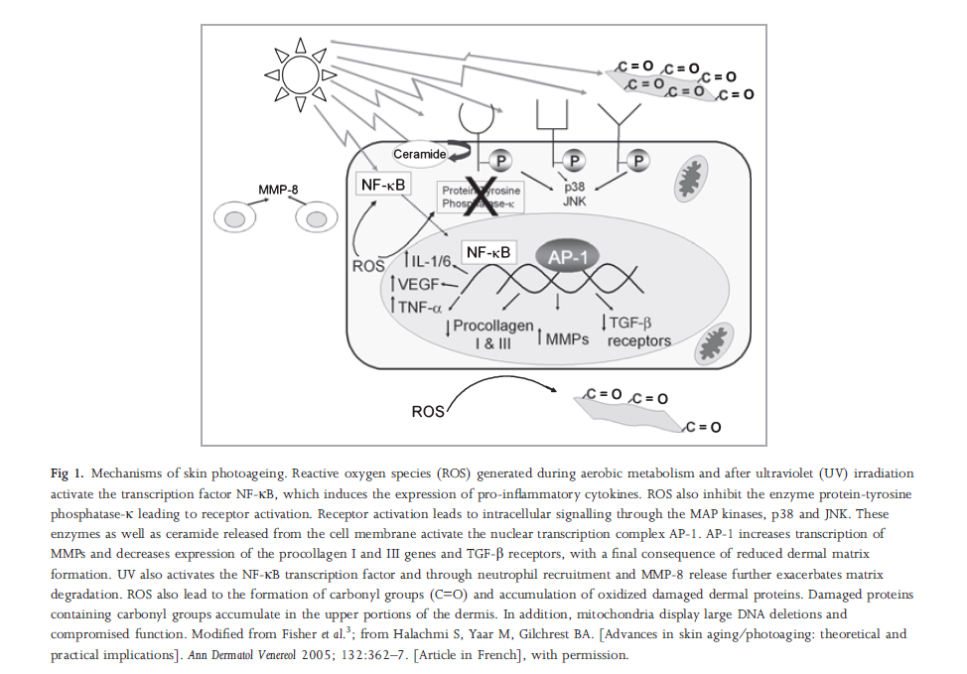
Mechanism of skin photoageing

Slide 32
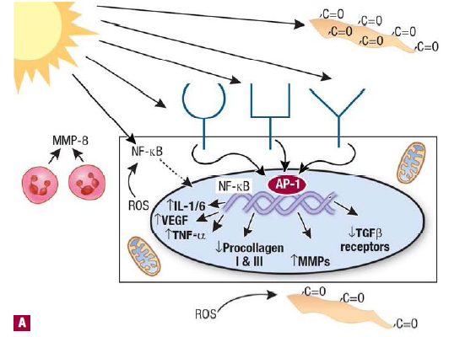
Mechanism of intrinsic skin photoageing

Slide 33
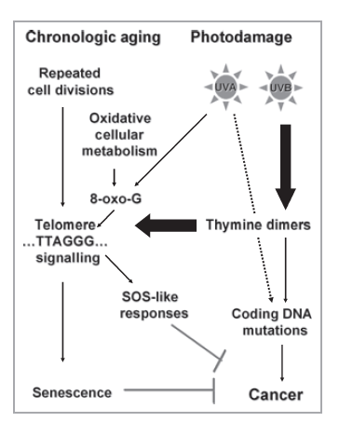

Hypothetical common mechanism
for intrinsic ageing & photoageing

Slide 34
Lets Meet again at Cosmetology-2015
4th International Conference and Expo
On
Cosmetology & Trichology
June 22-24, 2015 Philadelphia, USA
Theme: Cosmetology and Trichology: Tracking and Tackling its Consequences
Website: http://cosmetology-trichology.conferenceseries.com/

