Slide 1
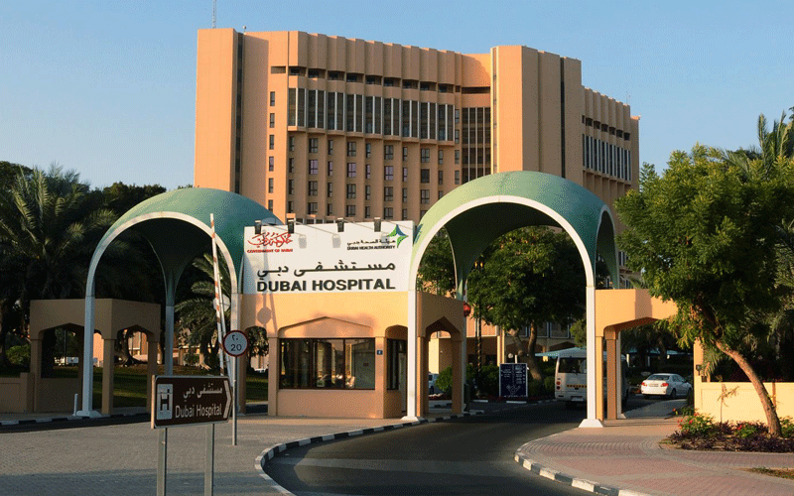




Slide 2
Anemia in a renal transplant recipient
Dr. Dhanya Mohan
MD DNB MRCP (UK)
Department of Nephrology
Dubai Hospital

Slide 3
History
34 year old Arab male
Type 1 DM for 13 years
Hypertension for 3 years
Diabetic retinopathy and nephropathy
CKD Stage 5, Dialysis dependent since Aug 2010
Feb 2011: Travelled to China, underwent LURD renal transplantation
    Received ATG as the induction agent
    Maintained on Pred 5mg od
    Tacrolimus 2mg bd
    MMF 750mg bd

Slide 4
History
Received Valganciclovir and Septrin prophylaxis
Continued follow up in our Nephrology Clinic, with baseline S. creatinine: 1.1-1.3 mg/ dl
October 2012: detected to have anemia, Hb: 8 gm/ dl
  Previous Hb: 13.3 gm/ dl July 2012
  Admitted for further evaluation
  No history of blood loss
  No jaundice, skin bleeds
  No fever or skin rash

Slide 5
On examination
Pallor present
No lymphadenopathy
CVS: S1 S2 normal
RS: Clear
P/A: Soft, allograft in RIF.
Liver, spleen: Not palpable

Slide 6
Anemia in a renal transplant recipient, normal renal function
Iron deficiency
Drug induced: Myelosuppressive effect of MMF
Tacrolimus toxicity
Blood loss
Viral infections

Slide 7
Investigations
Hb: 8gm/ dl →7.3gm/ dl
MCV: 80 fl
WBC: 3,500/ cc
Plts: 2,12,000/ cc
Retics: 0.4 % (Normal: 0.2 -2 %)
Blood film: Normocyctic normochromic anemia. Mild leucopenia consistent with bicytopenia.
Creatinine: 1mg/ dl
Urea: 52 mg/ dl
LFT: normal Tacrolimus level: 7ng/ ml

Slide 8
Evaluation of differentials
Iron studies: Normal
Vitamin B 12, folate: Normal
CMV DNA PCR: negative
Stool Occult Blood: Positive

Slide 9
UGI Scopy:
Erosive pre-pyloric gastritis
Angiodysplasia of stomach
H. pylori: negative
Colonoscopy: Normal
Patient was discharged on Pantoprazole and Inj. Darbepoetin 60mcg once per week

Slide 10
Further course
Recurrent anemia: received five units of Packed RBC during the next four months, recurrent anemia
Advised bone marrow examination multiple times, but unwilling
March 2013: evaluated elsewhere
BM examination report:
Myeloid : erythroid ratio: 4: 1
Complete myeloid maturation, no increase in blasts
Decreased erythroid cells with giant pronormoblasts?

Slide 11
Further course..
Retics: 0.17%
Keeping in mind persistent reticulocytopenia with refractory anemia, diagnosed to have Pure red cell aplasia
Parvovirus B 19 infection suspected
Parvovirus serology and DNA PCR requested
Parvovirus Ig M: positive
Parvovirus Ig G: positive
Parvovirus DNA PCR: positive

Slide 12
Diagnosis
Pure Red Cell Aplasia secondary to Parvovirus B 19 infection

Slide 13
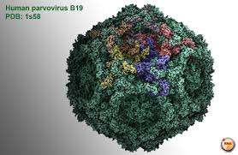
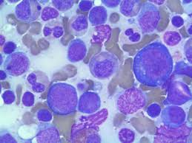
Parvovirus B 19
Small, non enveloped, single stranded DNA
virus
Parvovirus family, erythrovirus genus
1975
Pronounced tropism for erythroid precursor
cells

Slide 14
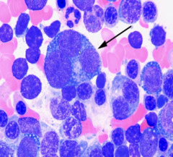
Parvovirus B 19
Infection very common
70-85% serologic evidence of past infection
Transmission occurs by inhalation of virus in aerosol droplets
Vertical transmission, transfusion of blood and blood products
Targets the erythroid progenitor cells in BM by binding to the glycosphingolipid globoside
Clearance: humoral immune response

Slide 15
Complications – Well established syndromes
Fifth disease / erythema infectiosum
Arthropathy
Hydrops fetalis, IUD, Miscarriage
Transient aplastic crises
Chronic pure red cell aplasia – in immunocompromised patient

Slide 16
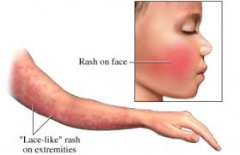
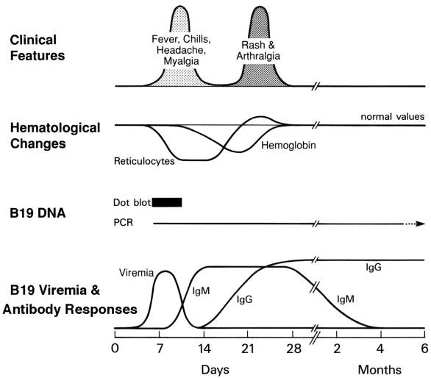
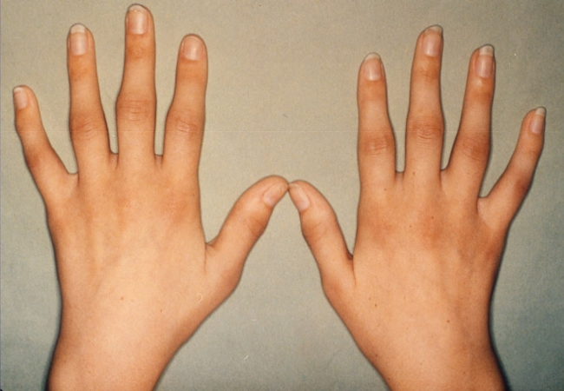

Slide 17
Manifestations in renal transplant patients
System | Manifestation
Hematologic | Acute anemia Chronic pure red cell aplasia Leukopenia, thrombocytopenia, pancytopenia
Renal | Transient allograft dysfunction Acute allograft rejection Collapsing glomerulopathy Thrombotic microangiopathy
Hepatobiliary | Acute hepatitis Fibrosing cholestatic hepatitis
Neurologic | Encephalitis Cerebral angitis

Slide 18
Co-infection with herpes viruses
CMV infection/ HHV 6
Co infection can enhance the pathogenicity and complications related to each individual virus

Slide 19
Diagnosis
Serology: Ig M/ Ig G
DNA PCR:
BM examination: giant pronormoblasts

Slide 20
Treatment
Reduction or discontinuation of immunosuppression
Change of immunosuppression (tacrolimus to cyclosporine)
IV immunoglobulin alone
Combination of IV immunoglobulin and reduced immunosuppression
Conservative therapy, with transfusion and /or erythropoetin

Slide 21
IV Immunoglobulin
Important source of anti B 19 antibodies
400mg/ kg/ day for 5-10 consecutive days
Mean time to hemoglobin recovery: 3.9 weeks
ADR:
  Fever, chills, headache, myalgia, hypertension, chest pain
  AKI: Sucrose for IV Ig stabilisation

Slide 22
How did we treat him?
Reduced Mycophenolate to 250mg bd
Tacrolimus to 2mg -0- 1mg
IV Ig 400mg/ kg for 5 days
Wt: 80 Kg
30gm IV Ig over 4 hours

Slide 23
Treatment
3rd day: Fever, chills, malaise…IV Ig withheld for one day, and then the course completed
On discharge, Hb: 8.4 gm/ dl. WBC: 4200/cc, Plts: 225000/cc
May 2013: Clinic visit: Hb: 13.2 gm/ dl, Parvovirus DNA PCR: Neg
3 year follow up: Hb: stable, Parvovirus DNA PCR: Positive, 375 copies/ ml

Slide 24
Take home message
Renal transplant patients can develop symptomatic B 19 infections as a result of primary infection or because of reactivation of latent or persistent viral infection
Pure red cell aplasia manifesting as chronic anemia is the most common presentation of B 19 infection in immunocompromised patients
Other cytopenias & collapsing glomerulopathy and thrombotic microangiopathy are associated with B 19 infection in renal transplant recipients
In KTRs, serologic tests should be supplemented by a PCR to detect viral DNA
Treatment with IV Ig and/ or minimization of immunosuppression can effectively combat B 19 infection

Slide 25
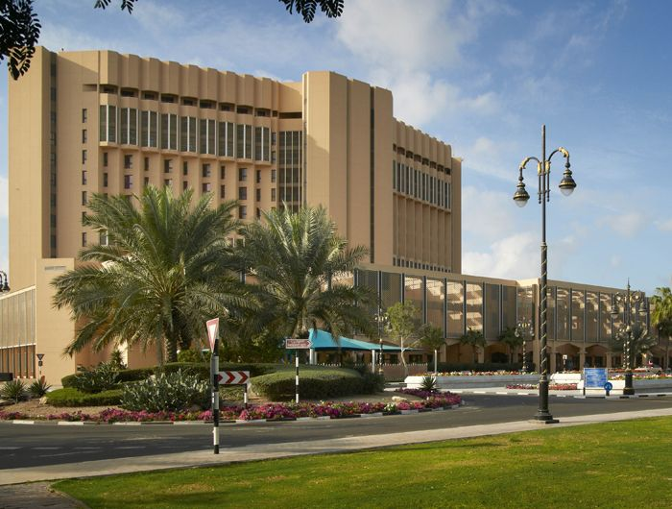
Thank you for your attention!

