Slide 1

Artificial Neural Network Based Data Mining Approaches to Identify Key Molecular Drivers of Proliferation in Breast Cancer
Devika Agarwal¹, Tarek M.A.Abdel Fatah², Robert C. Rees¹, Stephen. Y. T.Chan², Graham R.Ball ¹
¹ John van Geest Cancer Research Centre, School of Science and Technology, Nottingham Trent University, Clifton campus, Nottingham NG11 8NS, UK
²Clinical Oncology Department, Nottingham University Hospitals, NHS Trust, Nottingham NG5 1PB, UK

Slide 2
Outline
Introduction
    Breast Cancer
    Proliferation
    Array Technology
    Challenges in biomarker identification
Research aims
Artificial Neural Networks (ANNs)
Microarray cohorts
Integrative ANN data mining approach
Molecular drivers of proliferation – ANN network inference
SPAG5 validation
Summary

Slide 3
Breast Cancer
Statistics
Disease Characteristics
Current Treatment Pathways
Research
Interest
Most common diagnosed cancer, women under 35
Complex with great heterogeneity
Surgery – mastectomy
Molecular pathways
Sentinel lymph node biopsy followed by surgery
Radiation Therapy
30% treated cancer will metastasise
Different distinct biological and molecular features
Precision medicine
Chemotherapy
Hormone Therapy
90% deaths occur due to metastasis
Diverse clinical outcomes
Targeted therapy- Monoclonal antibodies
Focus on proliferation pathways
Immunotherapeutic approaches

Slide 4
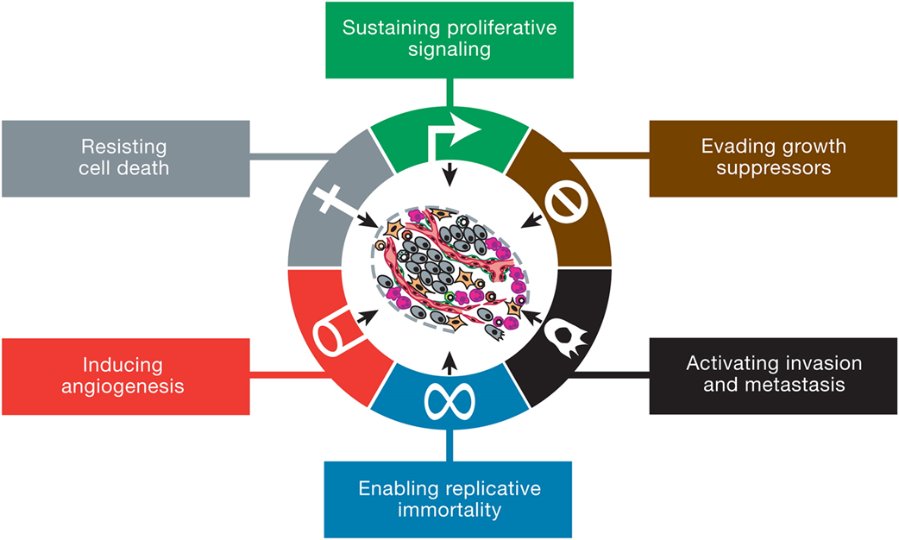
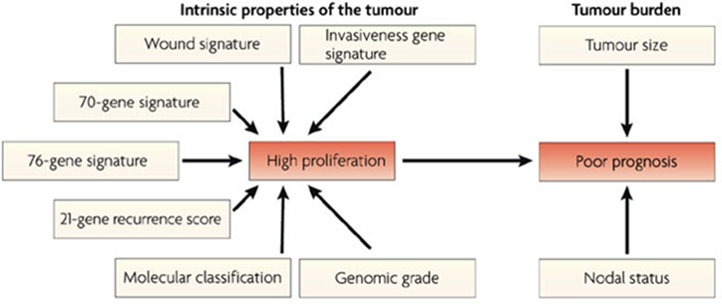
Proliferation
One of six hallmarks of cancer – sustained chronic proliferation
Increased cell proliferation is strongly associated with poor clinical outcome
Previously published gene signatures – overlapping genes are associated with proliferation
Chemotherapy drugs often target the mitotic system and induce apoptosis in tumours cells
Hanahan & Weinberg, Cell 7=144-5, 646-674 (March 2011)
Nature Reviews Cancer 7, 545-553 (July 2007)

Slide 5
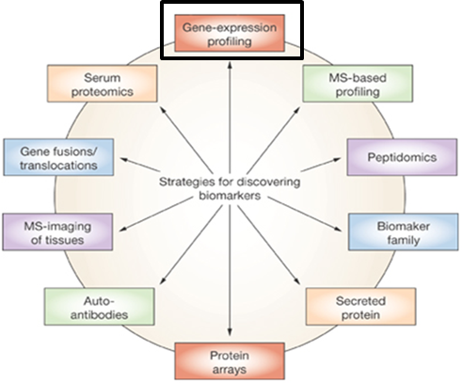
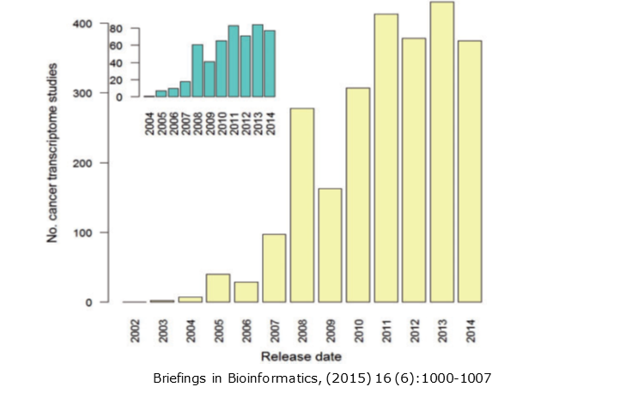
Expression array technologies
Powerful technology in elucidating the heterogeneous nature of cancer
Exponential increase in the availability of transcriptome profiling studies & data
high- throughput analyses data can be multi-dimensional, noisy and non-linear
Dependant on highly robust computational methodologies to produce any biologically relevant results
Nature Clinical Practice Oncology (2008) 5, 588-599

Slide 6
Challenges in biomarker identification
Post genomic era (-omics technologies) offers a great potential for molecular characterization of many diseases.
Diseases are diverse and heterogeneous.
One has to search through potentially hundreds of thousands of pieces of information for consistent features that address a clinical question in the population.
Curse of dimensionality – large number of non -linear dimensions (variables) compared to samples.
Solutions should ideally identify a small set of genes that can generalize well for a large proportion of patients.
Even then one marker may no fit all so a panel of markers is needed.
Many data mining approaches fail to find consistent elements/markers /predictors between datasets for a particular clinical question in the population.
Not sufficient statistical power /low sample size /risk of false discovery .
Notes:
The dimensionality of the data means any given parameter will appear to have a very minute influence even if in reality it has a strong influence
The dimensionality of the data masks the importance of given markers
A straw coloured needle in a haystack
This lack of consistency suggests that the approaches are not finding the real features of the data.
One possibility is that the individual data sets do not have sufficient statistical power to provide an accurate representation of the global solution.
And the features discovered are false discoveries.

Slide 7
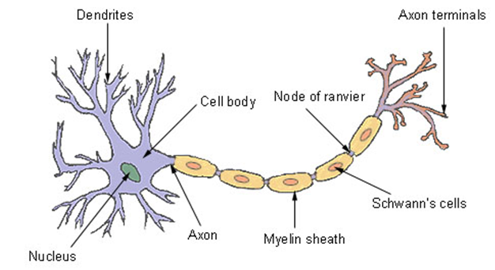
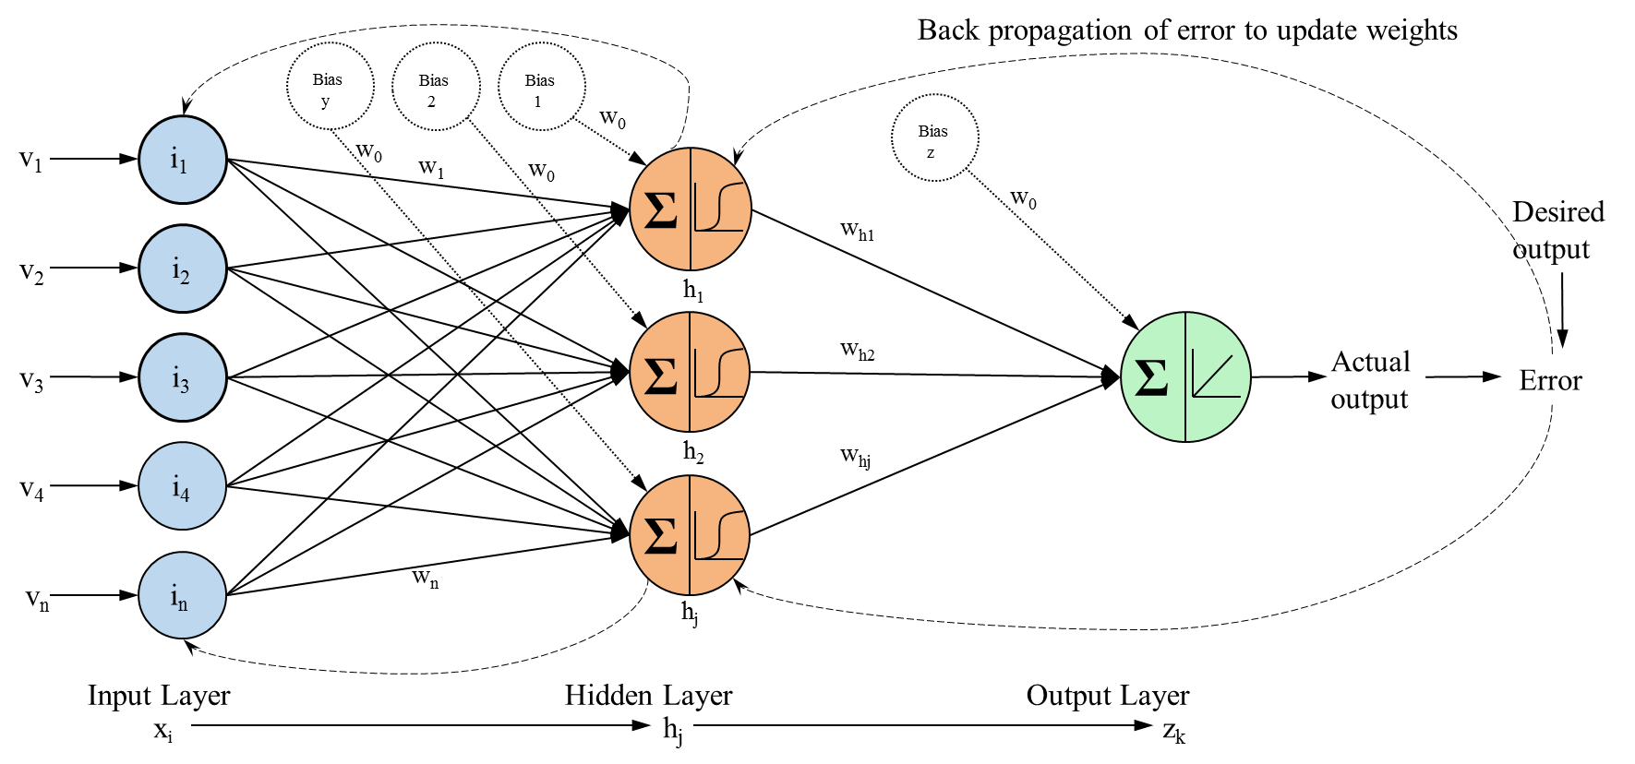
Artificial Neural Networks – Potential Solution
Simplified version of biological neural networks
Transform input values to output values
Applications:
Classification – pattern recognition, identify indicative biomarkers
Noise Reduction – recognise pattern in inputs and reduce noise in outputs
Prediction – based on previous data
Importance:
Ability to learn
Ability to generalize
Cope with non – linear and complex data
NCI, SEER - http://training.seer.cancer.gov/brain/tumors/anatomy/neurons.html
Notes:
Learn by an iterative approach to model development based on feedback from predictive error.
Quick due to parsimonious nature

Slide 8
Research Aims
To identify biomarkers that relate to cancer disease characteristics by data mining of select transcriptomic arrays and conventional biological techniques.
To identify core markers regulating the proliferation system in breast cancer by using an artificial neural networks (ANN) integrative data mining approach.
To study the potential biological associations between these markers and thus identify driver markers for proliferation by using an ANN based network inference algorithm.
Investigating the biological and therapeutic relevance of key markers by immunohistochemistry (IHC), literature and other data sources.

Slide 9
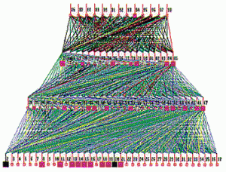
ANN architecture – Our Approach
Approach commonly used
for transcriptomic data
In house approach – constrained architecture
Σ
Σ
Σ

Slide 10
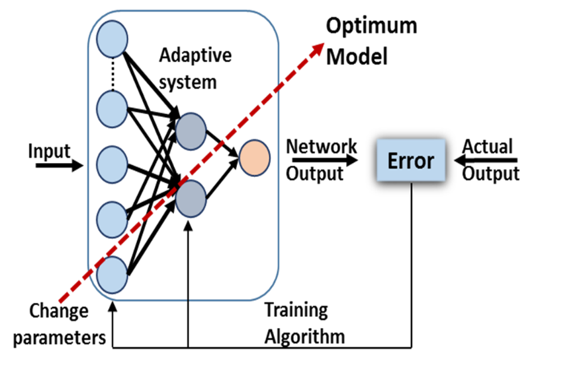
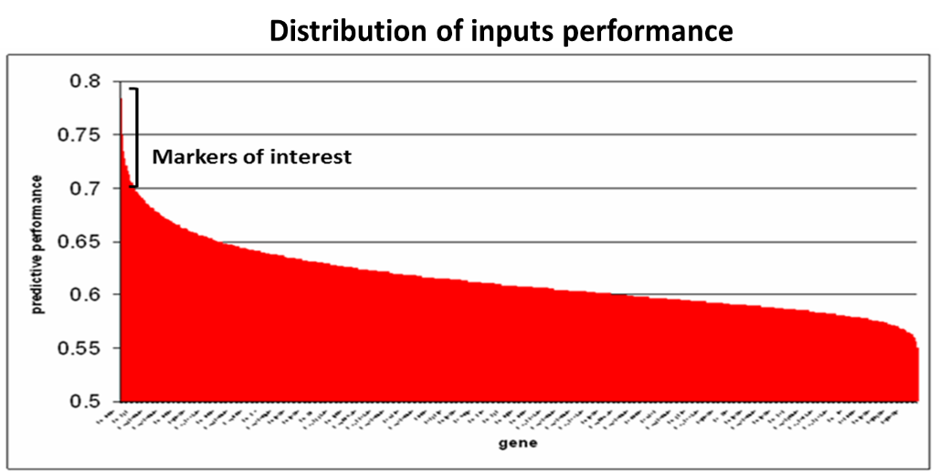
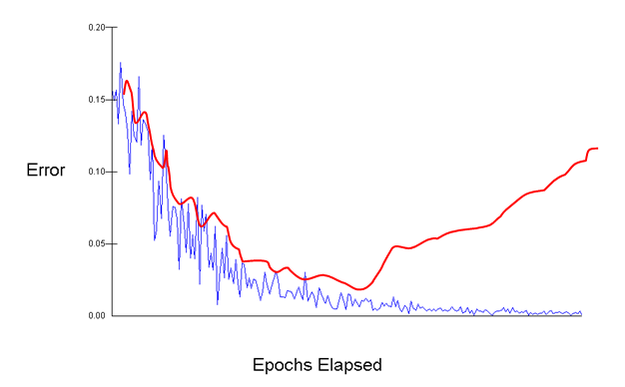
ANN Model Development – Our Approach
ANN is trained to compute at output which is compared to desired output and network modified to reduce error
Training is stopped when ANN performance fails to improve on the test subset
Learn by an iterative approach to model development based on feedback from predictive error.

Slide 11
Identification of common proliferation markers across datasets

Slide 12
Microarray Cohorts
Nottingham Cohort (E-TABM-576, n=128) – Illumina Human-6 Expression Array log normalized data. Part of the Nottingham Tenovus Primary Breast Carcinoma Series. Clinico-pathological data for the patients obtained from Nottingham University Hospital Trust.
Uppsala Cohort (E-GEOD-4922, n=249)- Affymetrix HG-U133A & B chip MAS5 & log transformed data. Patient samples of primary invasive breast tumours collected from 1987-1989.
Molecular Taxonomy of Breast Cancer International Consortium Cohort (METABRIC) (EGAS00000000083 , n=1980) – Illumina HT12 v3 Expression array log transformed data. Clinically annotated primary invasive breast cancer and a subset of normal samples.

Slide 13
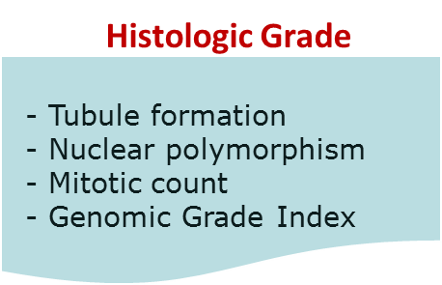
Proliferation System- Questions for ANN Modeling
Ki-67
TOP2A
- Assess proliferation by IHC
- Nuclear antigen- all phases of cell cycle except resting phase
- Potential treatment endpoint marker
-DNA replication
-Levels vary with cell cycle and with Ki-67 in tumours
-Prognostic marker & therapy target
KIF2C
BIRC5/Survivin
- Motor protein, spindle disassembly in mitosis
- Previous work showed as influential marker for mitotic index
- Anti-apoptotic and regulation of cell cycle
- Synthesis and degradation cell cycle dependent
Survival
- Prognosis of the disease
- Routinely used as an indicator of clinical utility for biomarkers

Slide 14
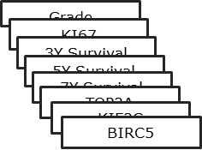
Research Approach– ANN Integrative Data Mining Approach
Nottingham cohort
47,289 probes
N=128
Grade
ANN classification
Mitotic Index
ANN classification
Ki67
ANN classification
5y Survival
ANN classification
TOP2A
ANN classification
ANN classification
KIF2C
ANN classification
BIRC5
Uppsala cohort
22,283 probes
N=249
Common Genes in the top 200 genes associated with each question identified by ANN Root Mean Squared Error
ANNs classification
Grade
KI67
METABRIC cohort
44,803 probes
N=1980
3Y Survival
5Y Survival
7Y Survival
ANNs classification
TOP2A
KIF2C
BIRC5
Notes:
Cross comparison of data sets allows identification of common features between data sets which have much greater statistical power.

Slide 15
ANN class data split – METABRIC Data
METABRIC Cohort (n=1980) | Binary Class
ANN Targets | Low/0 (%) | High/1 (%) | Total Samples
MKI67 | 990 (50) | 990 (50) | 1980
TOP2A | 990 (50) | 990 (50) | 1980
KIF2C | 990 (50) | 990 (50) | 1980
BIRC5/Survivin | 990 (50) | 990 (50) | 1980
Grade I vs III | 169 (47.1) | 190 (52.9) | 359
Survival 3 years or above (5 runs) | 165 (50) | 165 (50) | 330
Survival 5 years or above (runs 1-4 ) | 301 (50) | 301 (50) | 602
Survival 5 years or above (run 5) | 301 (46.2) | 350 (53.8) | 651
Survival 7 years or above (run1) | 370 (50) | 370 (50) | 740
Survival 7 years or above (run2) | 370 (53.2) | 325 (46.8) | 695
Survival 7 years or above (run 3) | 370 (54) | 320 (46) | 690

Slide 16
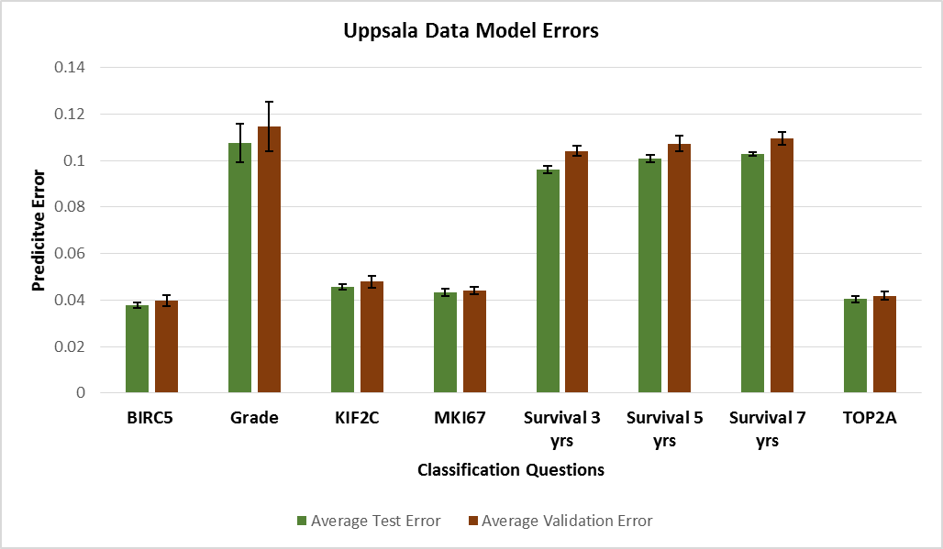
Stepwise ANN model performance consistency – Uppsala Data
The averaged Mean Square Error (MSE) across 10 independent models ranged from 0.038 -0.107 ( test subset ) and 0.039 -0.115 (validation subset) for the questions in the Uppsala data.

Slide 17
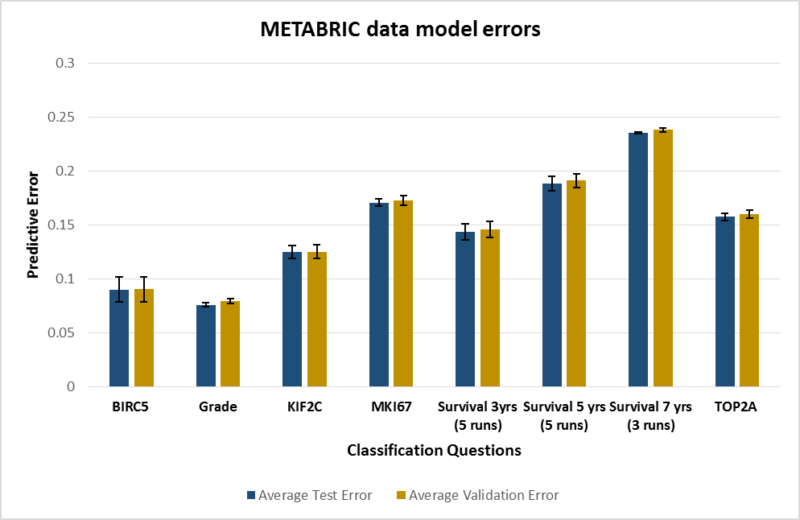
Stepwise ANN performance consistency – METABRIC Data
The averaged Mean Square Error (MSE) across 10 independent models ranged from 0.076 -0.230 ( test subset ) and 0.08 -0.238 (validation subset) for the questions in the METABRIC data.

Slide 18
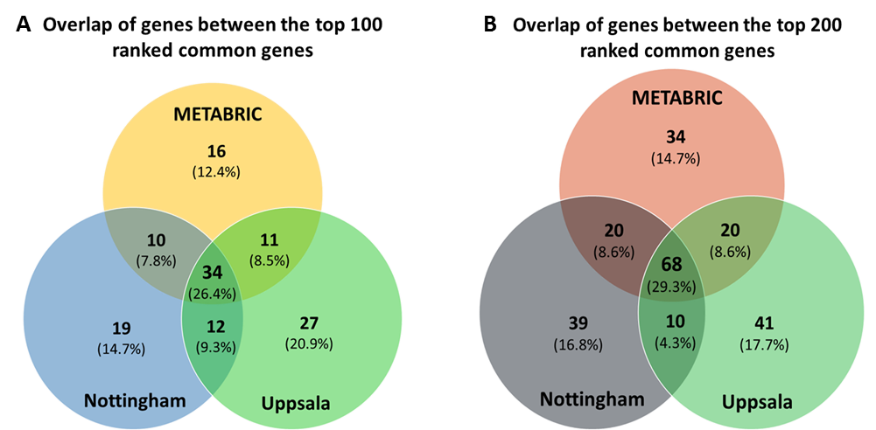
Common Genes across 5 or more questions – 3 Cohorts

Slide 19
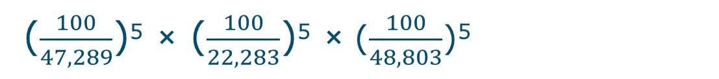
The probability of finding these common genes in the top100 of a minimum of 5 questions in three datasets by chance
= 2.78034 ×10⁻³⁹
calculated by

Slide 20
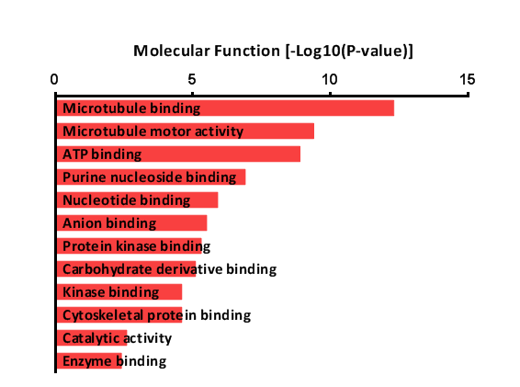
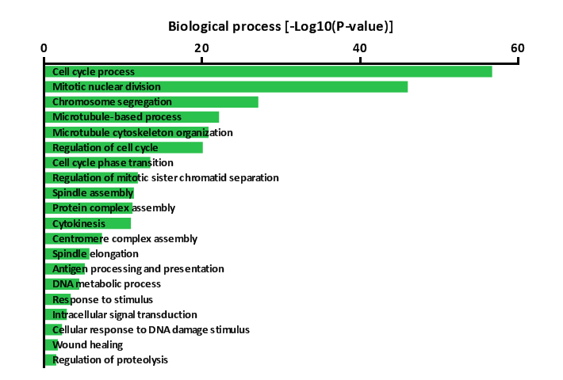
Top 200 common genes - Functional analysis using GO

Slide 21
Comparison of the common genes with published gene signatures
Signature | Type of Signature | No Genes | No of genes common with our signature
Mitotic CIN Attractor | Chromosomal instability | 100 | 53
CIN70 | Chromosomal instability | 70 | 27
Genomic Grade index | Molecular Grade | 97 | 52
Genomic Grade index (PAM) | Molecular Grade | 264 | 51
MammaPrint | Metastatic Risk | 70 | 6
Meta-PCNA | Proliferation | 131 | 37
Oncotype Dx | Recurrence risk | 21 | 4
PAM50 Subtype | molecular subtype | 50 | 12
Proliferation Signature | Proliferation | 104 | 26
Survival CI Index | Prognostic model | 100 | 31

Slide 22
Summary Integrative Data Mining Approach
The integrative ANN based datamining approach identified 68 common genes between the top 100 & 200 of a minimum of 5 different proliferation associated questions across 3 cohorts.
These genes were found to be involved or associated with the cell cycle , the kinetochore , chromosome segregation and transcription factors.
Good concordance with previously published cell cycle/proliferation signatures but also have novel findings.
The gene signature identified is significantly associated with cell cycle and chromosomal instability (CIN) in breast cancer.

Slide 23
Identification of key molecular drivers of proliferation with network inference

Slide 24
Marker Interaction Studies- Towards systems biology
Biological Processes are defined by more than just a list of genes.
The ANN based interaction algorithm predicts relationships between various markers in a defined subset.
Multiple markers are used to predict the expression of one.
Provides insight into how markers may regulated each other (uni- or bi-directional or inhibitory or stimulatory ).
Implemented in this to identify key molecular drivers regulating the proliferation system.

Slide 25
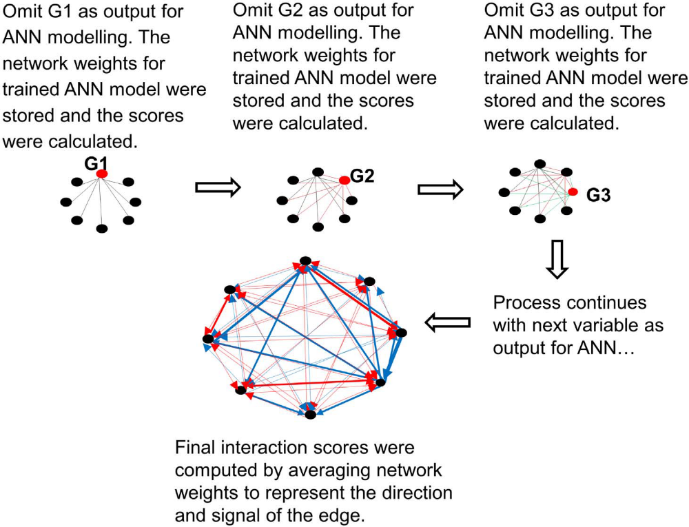
Tong, D et al, 2014. PlOS One

Slide 26
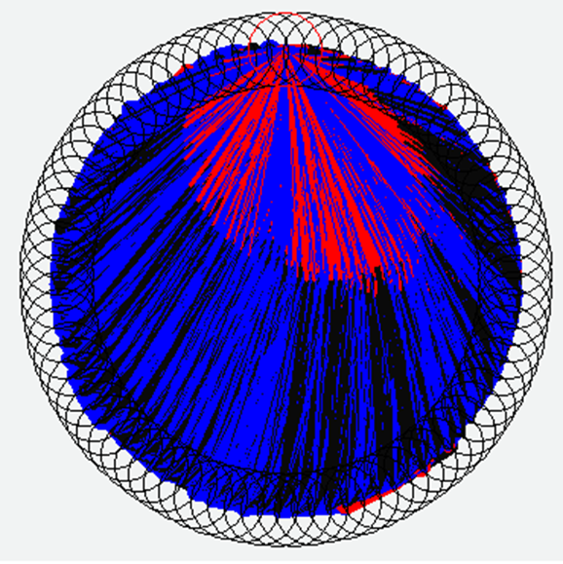
Example of interaction results 100 factors – All interactions (9900 interactions)

Slide 27
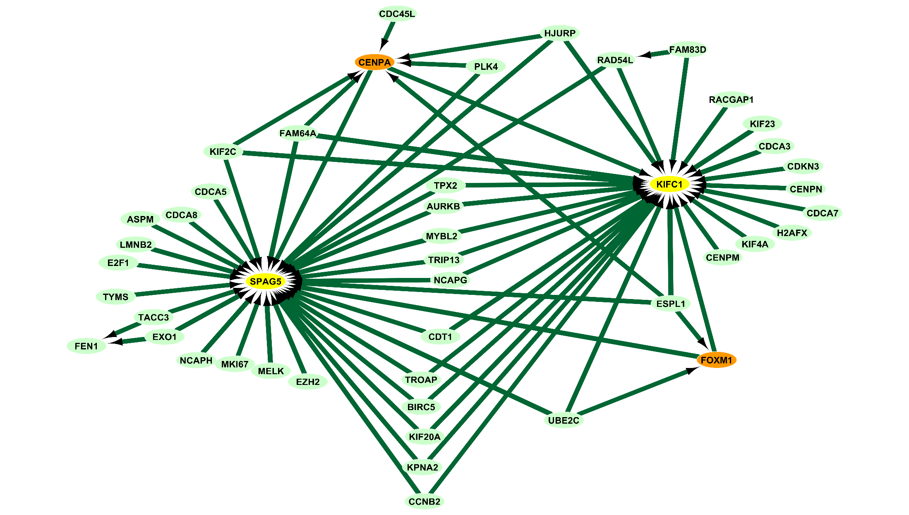
KIF2C Interactome (Nottingham Cohort) – SPAG5 as hub

Slide 28
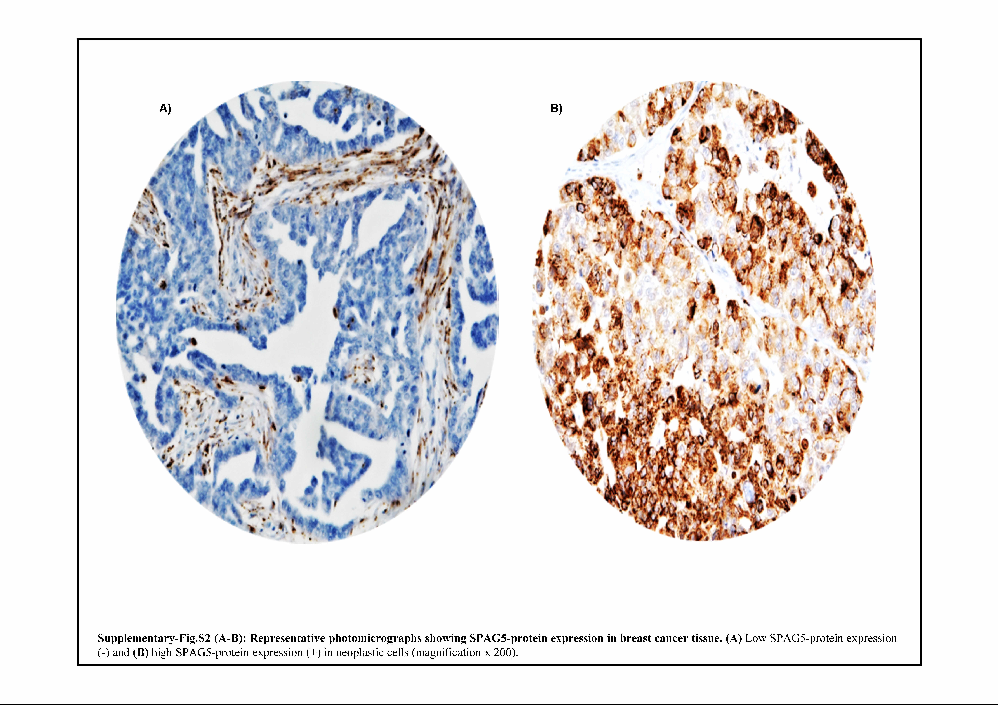
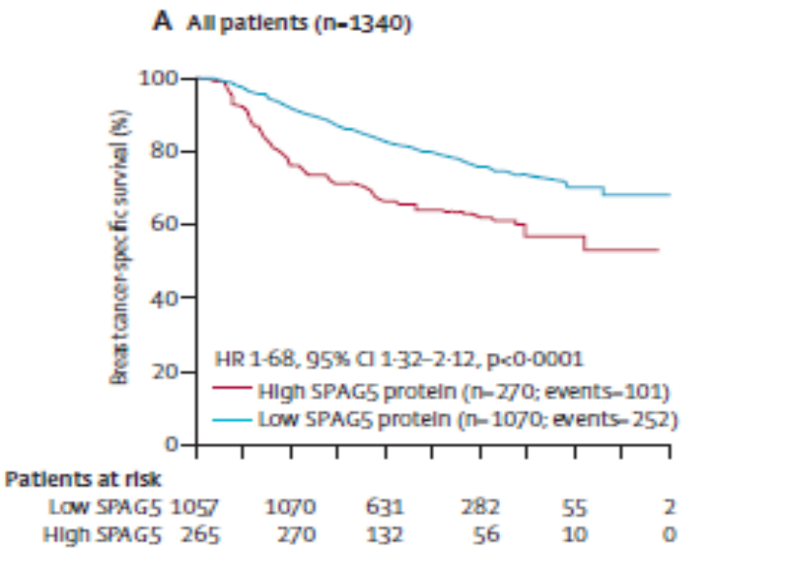
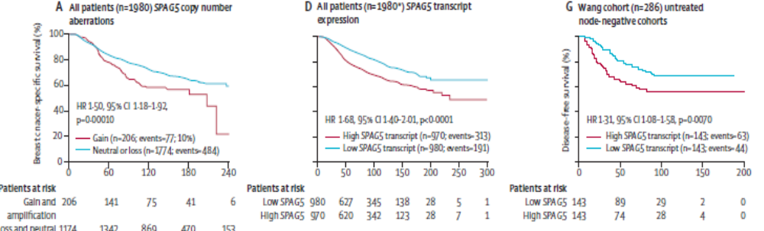
Protein Expression and Clinical Outcome – SPAG5

Slide 29
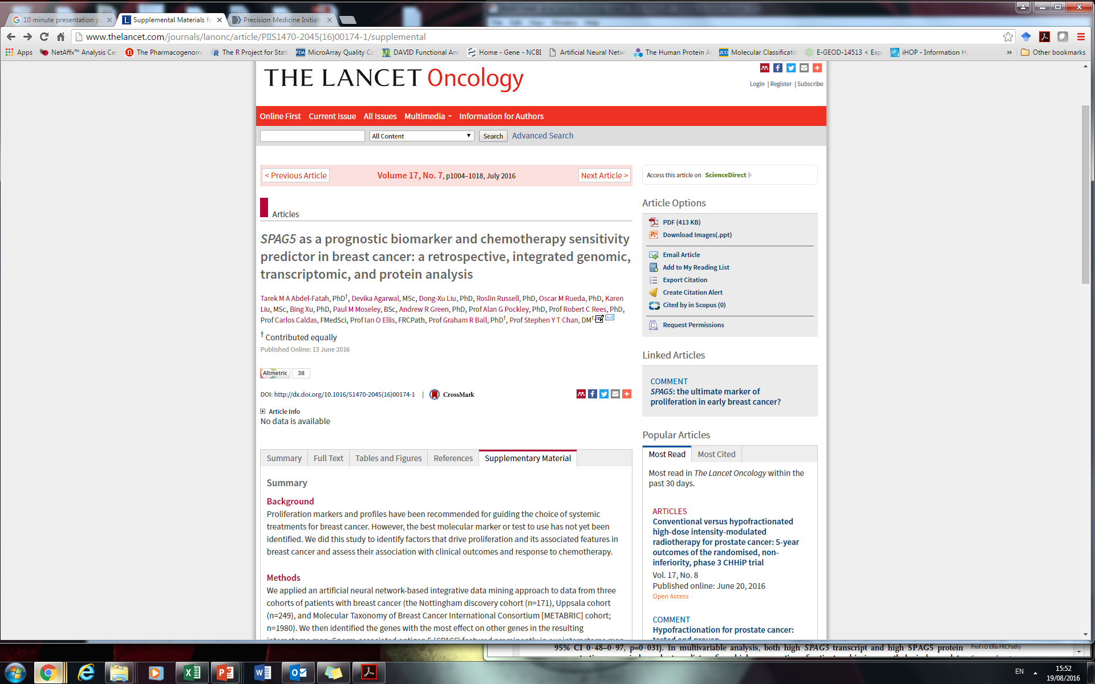
Publication – The Lancet Oncology, June 2016

Slide 30
Conclusions
Identification of 68 core proliferation system associated genes across in excess of 2300 cases across 3 datasets and SPAG5 as key hub by a novel ANN based data mining approaches.
These genes were found to be involved or associated with the cell cycle , the kinetochore , chromosome segregation and cell cycle transcription factors.
Good concordance with previously published cell cycle/proliferation/CIN gene signatures but also have novel findings.
In patients with ER-negative breast cancer with high SPAG5 protein expression, anthracycline-based adjuvant chemotherapy increased breast cancer-specific survival overall compared with that for patients who did not receive chemotherapy.
Copy number analysis – amplification in 19% of HER2 Enriched subtype and 18% of Luminal B subtype patients.
The transcript and protein products of SPAG5 are independent prognostic and predictive biomarkers that might have clinical utility as biomarkers for combination cytotoxic chemotherapy sensitivity.
Other markers were also found to be interesting hubs and are being pursued

Slide 31
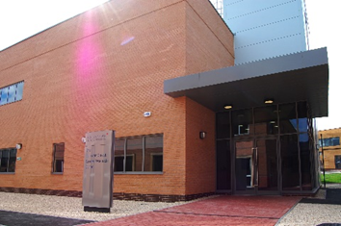


Acknowledgements
Professor Graham Ball
Professor Robert Rees
Professor A.Graham Pockley
JvGCRC Students and Staff
Nottingham University Hospitals
Prof Ian Ellis
Prof Stephen Chan
Dr Tarek Abdel-Fatah
Paul Moseley
Dr Andrew Green
Funding
Nottingham Trent University Vice –Chancellors Bursary
The John and Lucille van Geest Foundation

Slide 32
Future Work
Application and integration across multiple cancer types (common cancer signature).
Integration of multiple types of data (miRNA, transcription factors, copy number data).
More computational modelling approaches to identify driver genes.
Concordance modelling in other selected biological pathway

