Slide 1
Development of
Whey Protein Based Edible Films with pH-controlled Release
for Active Packaging
Derya Boyacı
İzmir Institute of Technology
Turkey

Slide 2
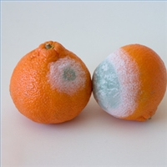
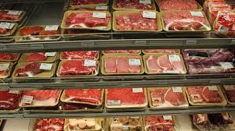
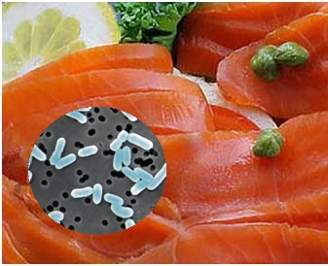
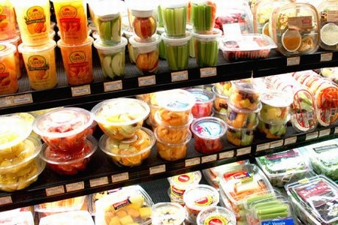
Food Safety and Packaging
Microorganisms
Chemicals
O2
Moisture
Light
Functional Properties of Packaging Materials
Better shelf-life
and quality

Slide 3
Active and Antimicrobial Packaging
A packaging system releases active/antimicrobial compounds on the food surface to delay microbial growth.
Environment
Food
Packaging
Inhibit pathogenic bacteria
Control spoilage
Use minimum amounts of
active compounds
Extend shelf life
Safe and High quality foods

Slide 4
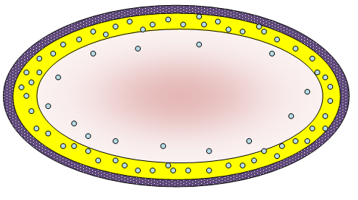
Controlled Release Packaging (CRP) System
Innovative form of active packaging where antimicrobial and antioxidant compounds incorporated into a polymer and relase in a controlled manner.
Non-active barrier film
Food
Active CRP film
Active agent
Figure 1. CRP System

Slide 5

Controlled Release
Direct addition of antimicrobials
Excessive use !
Neutralization !
Antimicrobial sprays or dips
Diffusion into center of food !
Controlled release antimicrobial packaging
Prevent too high / too low concentration of active substances at food surface
Prevent sensorial or toxicological problems ( use lower amounts of active agent)

Slide 6
Diffusion into Food !
FASTER
Release Rate
Growth Rate
SLOWER
Microbial Spoilage!

Slide 7
pH-Controlled Release in WPI films
pH-triggering mechanism for controlled release of lysozyme from WPI films
Can be triggered by adjusting the pH of food when antimicrobial activity is needed
Before cold storage
After freezing-thawing
Before transportation and market display

Slide 8
Edible Films and Antimicrobials
Whey Protein Isolate
20% of milk proteins
pI ≈ 5.4
One of the most commonly
used biodegradable film material
Forms transparent brittle films
Good O2, CO2, lipid and aroma barrier properties
Lysozyme
Hydrolases
pI ≈ 9,2
Molecular weight ≈ 14.7 kDa
Found in tears, mucus, egg white
One of the most frequently used biopreservative
Antimicrobial activity mainly on gram-positive bacteria

Slide 9
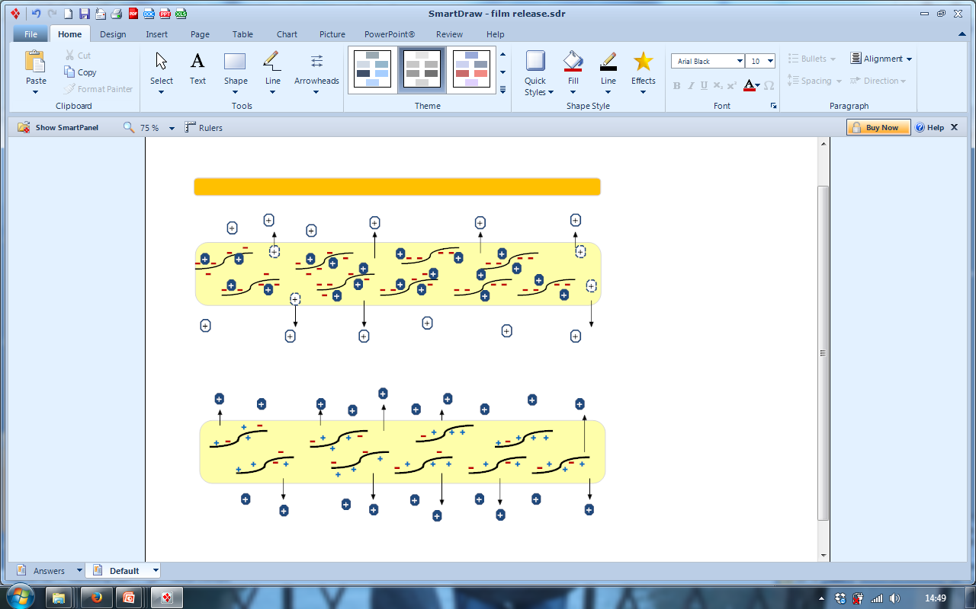
WPI films
Whey protein film (WPI)
WPI – Oleic acid blend film ( 9% oleic acid)
WPI – Beeswax composite film (30% beeswax)
: Free lysozyme
: Bound lysozyme
Negatively charged WPI
Neutral pH
pH
Below pI (pH 5.4)

Slide 10
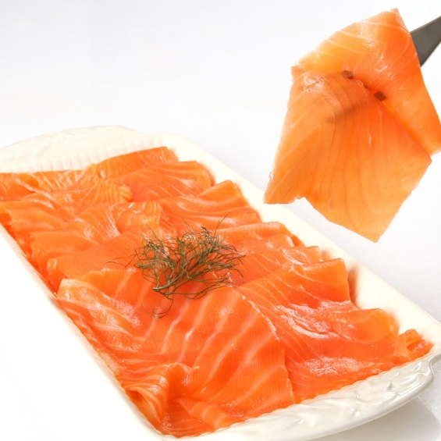
Potential Application
Activation of Lyz based antilisterial activity
Listeria monocytogenes - Smoked fish processing (Smoked salmon)
  MAP → lost after opening the pack
  Vacuum packaging has no absolute effect on L. Monocytogenes
  pH-triggered release system can be employed as a hurdle to reduce the risk, especially during the storage of remaining food after the first consumption.
Cold smoked salmon

Slide 11
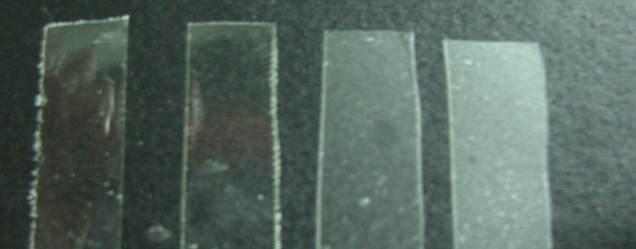
Produced WPI Films
Control
LYS
LYS +
Oleic acid (9%)
LYS +
Beeswax (30%)
Released LYS activity into buffer
Released LYS activity on smoked salmon
In-vitro antimicrobial activity of films
Antimicrobial activiy of the films coated on smoked salmon
Morphological properties

Slide 12
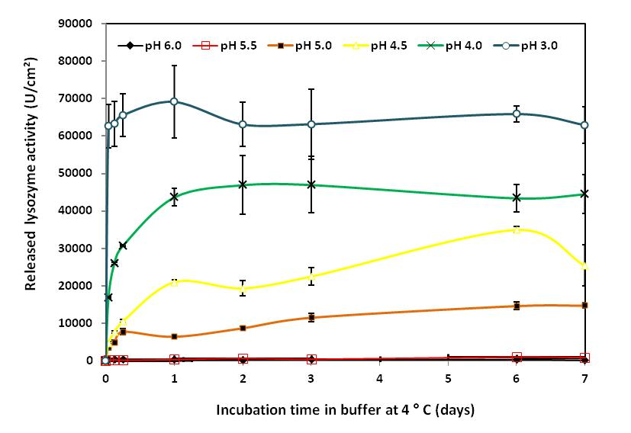
LYS Activity of the Films
LYS release at different pHs

Slide 13
LYS Activity of the
Composite and Blend Films
pH 4.5
pH 4.0
pH 5.0
pH 5.5

Slide 14
Film Morphology
Control WPI film
WPI + LYS
WPI + Oleic acid
WPI + bees wax

Slide 15
Release on Smoked Salmon
OLE & BW

Slide 16
Antimicrobial Activity against L. innocua
Film composition |  |  |  | Average zone area (mm²) at 4ºC
LYZ (mg/cm²) | OLE (%)ª | BW (%)ª | Acidification (5% citric acid) | 24 h | 48 h
- | - | - | - | Partial zones | Partial zones
- | - | - | + | Partial zones | Partial zones
0.7 | - | - | - | 51.7 ± 8.5^{d} | 63.5 ±13.9^{c}
0.7 | - | - | + | 101.1 ± 15.3^{c} | 84.6 ± 22.5^{b}
0.7 | 9 | - | - | 121.5 ± 14.9^{b} | 93.9 ± 17.4^{b}
0.7 | 9 | - | + | 141.6 ± 26.6ª | 124.3 ± 32.7ª
0.7 | - | 30 | - | 54.5 ± 7.4^{d} | 55.6 ± 11.04^{c}
0.7 | - | 30 | + | 58.5 ± 21.2^{d} | 88.11 ± 55.6^{c}

Slide 17
Antimicrobial Activity against L. innocua
L.innocua counts during storage at 4°C (log CFU/g)ª
Day 0 | Day 1 | Day 3 | Day 5 | Day 7
Uncoated 4.98 ± 0.08^{a,A} | 4.82 ± 0.10^{ab,B} | 4.82 ± 0.10^{a,B} | 4.80 ± 0.11^{a,B} | 4.83 ± 0.13^{a,B}
WPI/OLE (control)^{b} 4.92 ± 0.10^{a,A} | 4.72 ± 0.10^{bc,C} | 4.73 ± 0.08^{b,C} | 4.78 ± 0.09^{a,BC} | 4.84 ± 0.11^{a,B}
WPI/OLE+LYS 4.92 ± 0.08^{a,A} | 4.68 ± 0.07^{c,B} | 4.69 ± 0.15^{b,B} | 4.74 ± 0.12^{a,B} | 4.49 ± 0.12^{b,C}
WPI/OLE (acidified) 4.97 ± 0.04^{a,A} | 4.84 ± 0.11^{a,B} | 4.77 ± 0.13^{ab,B} | 4.80 ± 0.12^{a,B} | 4.57 ± 0.09^{b,C}
WPI/OLE+LYS (acidified) 4.97 ± 0.07^{a,A} | 4.49 ± 0.13^{d,B} | 4.45 ± 0.13^{c,BC} | 4.27 ± 0.19^{b,BC} | 4.24 ± 0.15^{c,C}

Slide 18
Conclusion
LYS release mechanism based on acidification of the film was tested
The films were successfully applied on smoked salmon slices
Activation of edible films by consumer before consumption or after for the remaining part of the food is possible
To optimize the concentration of LYS and increase the efficieny of film activity, further food applications are needed.

Slide 19


