Slide 1
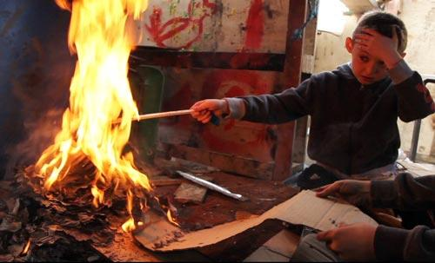
Ethical and Clinical Considerations for Mental Health Professionals Working with JFSB
Dr. Ronn Johnson, Ph.D.,ABPP
Dr. Kori Ryan, Psy.D.
Jessica Mueller, Psy.D Candidate
Shelby Moreira, Psy.D Candidate
Susan Szakonyi, MA Candidate
Mallory Schuckert, MA Candidate
Derrick Young, MA Candidate

Slide 2
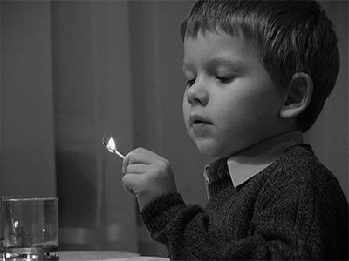
JFSB Overview
Ethical Importance
Background and History
Portrait of JFSB
Family/Community Interactions
Treating JFSB Clients
Ethical Codes
DSM 5 Quadrant
Conclusion
Notes:
***** this needs to be chang

Slide 3
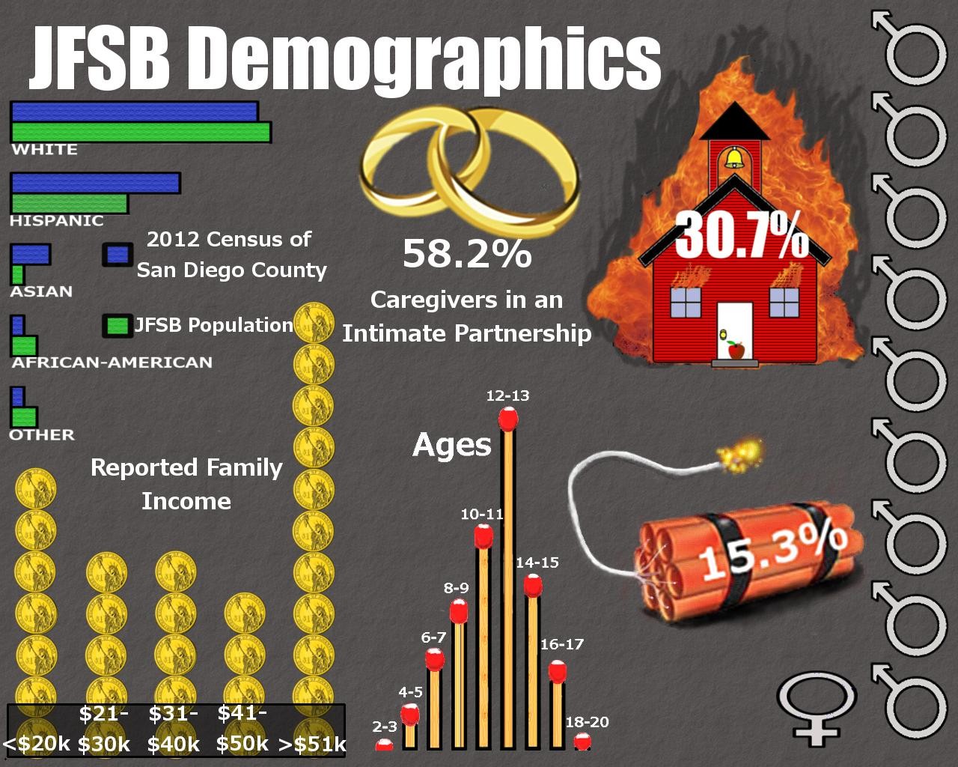

Slide 4
Why is this ethically important?
Research shows:
Juveniles who played with matches
10 or more times
Juveniles who had set 10 or more fires
Non-offenders | Offenders
34.6% | 55.1%
Non-offenders | Offenders
18.4% | 23.2%
Watt et al., 2015
Notes:
Regardless of whether you work in a forensic setting, you are likely to encounter a juvenile firesetter.
Watt et al evaluated 274 youth and found these staistics. Showing the seriousness and prevalence of this problem.
Because many of the youth stated that they have played with matches regardless of offender status, you’re likely to come across these kids. As a clinician, one must be aware of this issue so that risk can be assessed for.

Slide 5
Background and History of JFSB Treatment
18th/19th Century:
Arson viewed as 1979:
irrepressible mental urge FEMA Develops 1st JFS Model 2015
First JFS Risk Assessment 2014 DSM-V Quadrant Model
FEMA publishes 3rd Currently being validated
1937-1938: JFS model
Yarnell Studies
Early 20th Century: 2002 2014
Either/Or mentality on crime FEMA Publishes FEMA identifies
2nd Generation JFS Model JFS Typologies
1960-1980’s
JFS viewed as
intentional act
Meant to do harm (Macdonald Triad Hypothesis, 1966)
Notes:
Patricia’s Dissertation Pages 6-36 Have all info necessary to present on this timeline, below are some notes from these pages:
Historic literatures references arson as a crime caused by mental illness, with a slow evolution from belief in supernatural of demonic possession, to an organic disease of the mind.
UNITED STATES EARLY 20th CENTURY: The political climate of the era was rife with a forced choice mentality of either/or concerning almost every facet of criminal behavior (Baker, 1938) and firesetting or arson was no different. A juvenile who set fires was either a victim of their situation/mental illness, or a deliberately malicious delinquent (Davis, 1942).
YARNELL STUDIES: 238 juvenile fire setters, discussed firesetting as an expression of homosexuality when male’s engaged in the act of firesetting together as pairs (Patricia’s dissertation page 28)
These early United States beliefs that arson was driven by mental defect or illness carried into the 19th and early 20th centuries. During that time, the term pyromania gained popularity in both public and professional fields (Wooden, 1984). Other terms included “impulsive incendiarism” by Meckel in 1820, “monomaniac incendiarac” in 1833, and “reasoning monomania” or “mani avec conscience” by Jensen in 1845 (Mehregany & Donna, 2011).
FEMA published the first generation of the FEMA model design for lowering the future risk of juvenile firesetting in 1979. The model is “a formal process for firesetting behavior that includes intake, interview, education, referral, and evaluation… [and]…a comprehensive strategy that addresses safety issues via educational means” (NFPA, 2010). The goal of the program is “early identification and intervention to prevent and control firesetting and arson” (Gaynor, 2002). The second version of the first generation program was published in 2002.

Slide 6
Myths-Demographics of a Juvenile Fire Setter
Age ranges from middle childhood to adolescence
Primarily reported with males?
  Females referred for treatment just as much as males
Low SES to suburban communities
From curiosity and mental illness to criminal behaviors
Ethically important for providers to be aware of own biases related to “typical juvenile firesetter”
Notes:
Be aware of own biases regarding treatment of juvenile fire setters

Slide 7
Family and Community Involvement
Importance of parental involvement
  Working with juveniles requires consent from parents or legal guardians
  Involving parents or caregivers in assessment and treatment process
Community Cooperation
  Involvement and cooperation of schools, authorities, and emergency response teams
  Release of information
Confidentiality issues related to working with juveniles and wards of the state
Notes:
Confidentiality issues related to working with juveniles and wards of the state

Slide 8
Ethics In Treatment of JSFB Clients
Impacts of culturally responsive treatment-
  Alliance between treatment team and client
  Relationship between JSFB client and their guardians
  Understanding between client and members of the community
Notes:
Identification of the salient cultural factors involved affect the client's receptivity to treatment, and the involvement of their support system. The juveniles environment can greatly impact the efficacy of treatment, as well as the accuracy of information collected regarding the client. The clinician should carefully consider the parents impact on their client, their client’s treatment and how they apply parent reported data to treatment.
Understanding the intersectional cultural issues will help the treatment team appropriately address the client's fire setting behaviors through their world view.

Slide 9
Ethics In Treatment of JSFB clients
Risk factors and public safety:
  Potential treatment prognosis
  Firesetting risk level
  Access to resources
  Supervision in environment
  Emotional support
Kennedy et al., 2006
Notes:
An ethical treatment team continually assesses for all kinds of risk. Constant risk assessment is all the more imperative considering the imminent risk fire setting can pose to public safety. Though the motives and psychopathology varies between cases, specific risk factors stand out that impact the potential likelihood of firesetting behavior. Some of these risk factors include: potential treatment prognosis, firesetting risk level, ongoing access to resources and support, supervision in the environment and emotional support.

Slide 10
Ethics In Treatment of JSFB clients
Why trauma informed care?
Statistical link between fire setting behavior and trauma
JSFB population more likely to be in residential treatment, group homes, etc
Trauma presents differently in children than adults
Root et. al, 2015 and Hodgdon, H. et. al 2013
Notes:
Research points to a statistical link between firesetting behavior and childhood maltreatment
- A 2005 study by the Ontario Fire Public Safety Office showed that of a sample of 205 youth ages 4-17 in the Arson Prevention Program for Children, 48% of the sample had a history of maltreatment documented by social services and caregivers.
Compared to the children who had not experienced maltreatment within this sample- the children who had experienced maltreatment demonstrated increased frequency of firesetting behaviors (p=.07) and a wider range of accelerants and targets.
Trauma informed care is the practice of mental health treatment that calls for equal sensitivity to all clients regarding universal potentiality to have experienced trauma. Regardless of their diagnosis or documented history, trauma Informed care is considered best practice, and is all the more relevant with at risk populations like JSFB clients. It is critical to consider the likelihood that a juvenile with existing psychopathology is likely to experience trauma in the juvenile justice system, or as a result of their firesetting behavior.
As always, more research with larger more diverse samples could further explore the relationship between non normative events in childhood and fire setting behavior. However, appropriate application of culturally considerate assessment used in concurrence with trauma informed care will increase the likelihood of appropriate diagnosis and effective treatment.

Slide 11
DSM 5 Quadrant
Autism Spectrum Disorder
Posttraumatic Stress Disorder
Conduct Disorder/ Oppositional Defiant Disorder
Attention Deficit Hyperactivity Disorder
Notes:
●The term was coined by Dr. Johnson after he noticed that Conduct Disorder/Oppositional defiant disorder, PTSD, Autism, Spectrum, and ADHD were commonly seen in juvenile firesetters and bomb makers.
Conduct disorder- Conduct disorder is classified by inappropriate aggressive behavior and disregard for the rights of others which results in delinquent behavior, including fire setting (APA, 2013, Lexcen, 2000). JFSB are more likely to meet criteria for CD than any other mental health disorder (Dolan et al., 2011, Kolk & Kazdin, 1988; Sakeim & Osborn, 1994) which is likely because fire setting is part of the criteria for conduct disorder.
PTSD- PTSD occurs after witnessing, experiencing, learning of, or being exposed to details of a traumatic event (APA,2013).
ADHD- Characterized by deficits in social interaction and communication and the presence of unusual behaviors or interests (APA, 2013)
ASD- ASD is characterized by deficits in social interaction and communication and the presence of unusual behaviors or interests (APA,2013)
This is important in terms of

Slide 12
Ethics Codes
Specialty Guidelines for Forensic Psychology
Gaining and maintaining competence
Therapeutic-forensic role
Communication with forensic examinees
Communication with those seeking to retain a forensic practitioner
American Psychological Association
Informed consent
Competence
Limits of Confidentiality
Notes:
Informed consent: Working with juveniles it is important to make sure consent and assent are given prior to starting treatment. Assent of the juvenile means that the juvenile has an understanding of the treatment being provided and understands his or her rights
Competence: Therapist should be practicing within their realm of competence or area of expertise. Appropriate supervisor should be sought prior to working with juvenile, juvenile fire setters or individuals with specific diagnoses you’re not familiar with.
Limits of confidentiality: Limits of confidentiality should always be explained to a client. It’s important to note limits of confidentiality when working with a forensic population, because the client is whoever the referral agent is.
Specialty guidelines for forensic psychology
*Gaining and maintaining comptence: This is important because juvenile firesetters a specific population that needs specialized training. Forensic practitioners needadequte training, education, and supervised experienced
*Therapeutic forensic role- providing therapy in a forensic role is tricky because of the issue of multiple relationships. This may impair objectivity and or cause harm to the client. The therapist shoud
*communication with forensic examinees: forensic practitioners must inform the client about the nature and purpose of the exam or interview. This is especially important
*commun. to retain: this includes information that may be disclosed to retaining party.

Slide 13
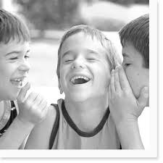
Questions?

Slide 14
Future Directions: Prevention
Best practices
  Ethical use of statistics and research
  Ethical responsibility to work with community agencies and authorities
  Knowledge regarding criminal justice prevention methods
    Common prevention methods:
      Geo-mapping
      Geo-profiling
      Pulling Levers
Notes:
Moved to end of presentation - Best practices Ethical responsibility to use statistics appropriately, ethical responsibility to work with individuals from different community agencies and officials
GeoMapping: The use of geo-mapping software is useful in discerning where certain and specific phenomena occur and helps lend insight into why certain phenomena may be occurring in certain regions or areas. Geo-mapping is a useful way to present data and provides visuals of where this data is coming from, or where there is a lack of data indicating a minimal occurrence of certain phenomena or lack of reporting of such phenomena. Geo-mapping can be a particularly helpful tool for law enforcement and the field of criminology as it provides insight into where specific crimes are being committed.
Geo-mapping has been successfully utilized to document specific crimes over time. For example, if there are a higher number of robberies in a certain neighborhood, law enforcement can warn local business owners and better assist them in preparing for and possibly preventing a robbery in their own business. Law enforcement can also examine this data and better determine how to utilize their resources, if robberies are being committed often in a particular neighborhood, local law enforcement may consider dispatching extra officers to that particular neighborhood for a six month time frame in order to intervene and hopefully prevent more robberies from occurring. Geo-mapping can thus be immensely helpful in guiding the allocation of law enforcement resources as well as other local resources that could be of help in the intervention and prevention of crimes and in the promotion of public safety.
In instances when geo-mapping data indicates that few or no juvenile fire setting incidents occur, this could be an indication that fires are being underreported. Additional resources may be allocated to this region in order to improve public awareness and encourage reporting. Alternatively, this particular region may provide fire safety education in schools, churches, and at community events or has community service providers dedicated to educating the public about fire safety and treating juvenile fire setters, serving as a model for other communities.
Geo Profiling:
Geo-profiling takes the concept of geo-mapping and integrates it into a particular context. For example, in the field of criminology and criminal justice, geo-profiling is used to research crime. If law enforcement personnel and researchers can pinpoint not only where certain crimes are being committed, but also the motivation for frequently used by the offenders in this crime, they may be able to better understand why these crimes are being committed. This understanding could lead to more effective intervention and prevention strategies. For example, geo-profiling has been used by law enforcement to document criminal gang activity in urban regions and has helped law enforcement gain a better understanding of where certain gang territories begin and end, thus if a gang related crime is committed in a certain territory, law enforcement can reference geo-profiling data to determine which gang or gangs might be involved based on the gang territory where the crime was committed, or to predict violence in a certain neighborhood following a thus-far isolated incident. This information provides law enforcement a place to start when investigating crimes committed in communities with strong gang presences.
The above examples illustrate how geo-profiling can help facilitate the research and handling of juvenile gang related fire setting. In terms of juvenile fire setting, geo-profiling provides data regarding regions where intentionally set fires occur more frequently. Not only does juvenile fire setting geo-profiling data provide information about where fires are occurring, it also provides information about where fires are not occurring, and this is also helpful and relevant forensic information.
Pulling Levers: The focused deterrence strategy identified as pulling levers is an example of a successful pairing of crime analysis and policing strategies put into action. At its most elementary, this specific problem-oriented policing technique involves the identification of a specific criminal problem, and the identification of individuals responsible for the majority of the calls related to that problem in a community, followed by structured approach to sanctioning those individuals for those behaviors. This results in a reduction of the rate and impact of that criminal behavior in the community. The reduction of GR-JFSB at the community level may be well served via the use of the pulling levers model by community and regional task force groups.

Slide 15
References
American Psychiatric Association (2013). Diagnostic statistical manual of mental disorder (5th Ed.). Arlington, VA: American Psychiatric Publishing.
Dolan, M., McEwan, T.E., Doley, R., & Fritzon, K. (2011). Risk factors and risk assessment in juvenile fire-setting. Psychiatry, Psychology and Law, 18(3), 378-394. DOI: 10.1080/13218719.2011.559154
Federal Emergency Management Agency (1983). Juvenile firesetter handbook: Dealing with children ages 7 to 13. Washington, DC: U.S. Government Printing Office.
Gannon, Theresa A., and Afroditi Pina. "Firesetting: Psychopathology, Theory and Treatment." Aggression and Violent Behavior 15 (2010): 224-38. Edselp. Web. 1 Sept. 2015.
Hodgdon, H., Kinniburgh, K., Gabowitz, D., Blaustein, M., & Spinazzola, J. (2013, October). Development and Implementation of Trauma-Informed Programming in Youth Residential Treatment Centers Using the ARC Framework. Journal of Family Violence, 28(7), 679-692. doi:10.1007/s10896-013-9531-z
Insurance Information Institute (2015). Arson. Retrieved from http://www.iii.org/issue-update/arson
Johnson, Ronn. "Forensic and Culturally Responsive Approach for the DSM-5: Just the FACTS." Journal of Theory Construction & Testing 17.1 (2013): 18-22. Academic Search Premier. Web. 1 Sept. 2015.
Johnson, Ronn. "Towards a Forensic Psychological Evaluation of Juvenile Fire Setters: Parent Power." Journal of Forensic Research J Forensic Res 05.01 (2014): n. pag. Web
Johnson, R., Jones, P. (2014). Identification of parental endorsement patterns : An example of the importance of professional attunement to the clinical- forensic risk markers in juvenile firesetting and bombmaking. American Journal of Forensic Psychology, 32 (2)

Slide 16
References
Kennedy, Patrick J., Ellen L. E. Vale, Sarah J. Khan, and Andrea Mcananey. "Factors Predicting Recidivism in Childand Adolescent Fire-setters: A Systematic Review of the Literature." Journal of Forensic Psychiatry & Psychology 17.1 (2006): 151-64. Academic Search Premier. Web. 1 Sept. 2015. Root, C., S. Mackay, J. Henderson, G. Del Bove, and D. Warling. "The Link between Maltreatment and Juvenile Firesetting: Correlates and Underlying Mechanisms." Child Abuse & Neglect 32 (2008): 161-76. Edselp. Web. 1 Sept. 2015.
Sharf, R. S. (2004) Theories of Psychotherapy and Counseling. Pacific Grove, CA: Brooks/Cole.
van der Put, C. E., & Stams, G. M. (2013). Youth Offender Care Needs Assessment Tool (YO-CNAT): An actuarial risk assessment tool for predicting problematic child-rearing situations in juvenile offenders on the basis of police records.Psychological Assessment, 25(4), 1167-1178. doi:10.1037/a0033453
Zara, G., & Farrington, D. P. (2009). Childhood and adolescent predictors of late onset criminal careers. Journal Of Youth And Adolescence, 38(3), 287-300. doi:10.1007/s10964-008-9350-3
Theresa A. Gannon, Emma Alleyne, Helen Butler, Harriet Danby, Aparna Kapoor, Tamsin Lovell, Katarina Mozova, Elizabeth Spruin, Tracey Tostevin, Nichola Tyler, Caoilte Ó Ciardha, Specialist group therapy for psychological factors associated with firesetting: Evidence of a treatment effect from a non-randomized trial with male prisoners, Behaviour Research and Therapy, 2015, 73, 42
National Gang Crime Research Center. Bomb and arson crimes among american gang members: A behavioral science profile. Journal of Gang Research, 9(1), 1-38.
Federal Emergency Management Agency: Understanding Youth Fire setting Behaviors, 2012.

