Slide 1
Powerful and Novel Multivariate Statistical Approaches in Big Data Sets and in Data Mining With Applications to Bio-, Medical-, and Material-Informatics
Derrick K. Rollins, Sr.
Department of Chemical and Biological Engineering
Department of Statistics
Iowa State University

Slide 2
Outline
Objective
Methods
  PCA
  Cluster Analysis
  Combine PCA and Cluster Analysis
Case Results
  Bioinformatics
  Medical-Informatics
  Material-Informatics – Nondestructive Testing
  Other Applications
Conclusions
Future Work
Acknowledgements

Slide 3
Objective
To Discuss and Illustrate the Powerful Role That Multivariate Statistical Methodologies Can Have in Big Data Inference and Modeling Using Methodologies That I Have Developed

Slide 4
PCA Methodology in the Microarray Context
Developed in the Context of Microarray (i.e., gene expression) data mining where the number of genes is very large compared to the number of experimental conditions called “assays.”
  The objective is to identify the set of genes that contributed the most to differences between groups of assays
PCA finds inherent relationships between the variables
For the relationships that group in meaningful ways, the proposed method finds and ranks the largest contributors

Slide 5
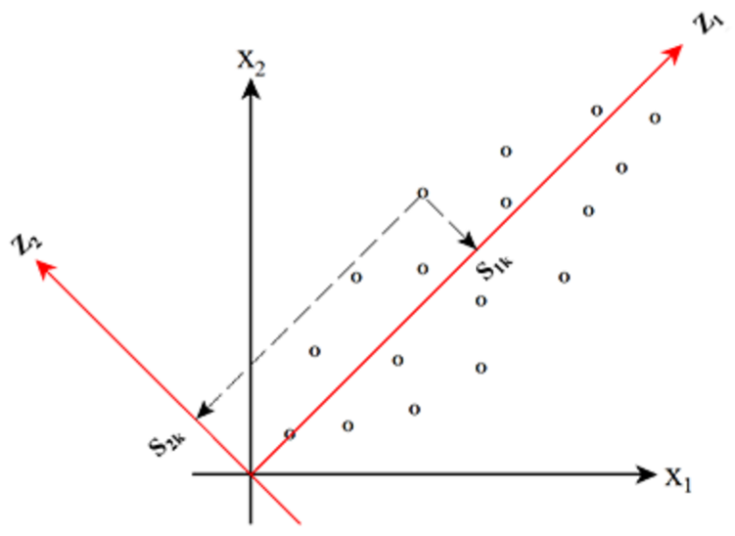
PCA in the Context of Gene Expression Data
A multivariate method that is able to quantitatively determine variables that maximize variation in a reduced dimension
Defined data set as X (m by n matrix)
  m (genes) expressed along rows (measurements)
  n (assays) expressed along columns (variables)
Orthogonally transform original data system (X)
to a new coordinate system (W) using principal
components (PCs)
PC is a linear combination of
variables (assays)
W₁
W₂
Notes:
System = space

Slide 6
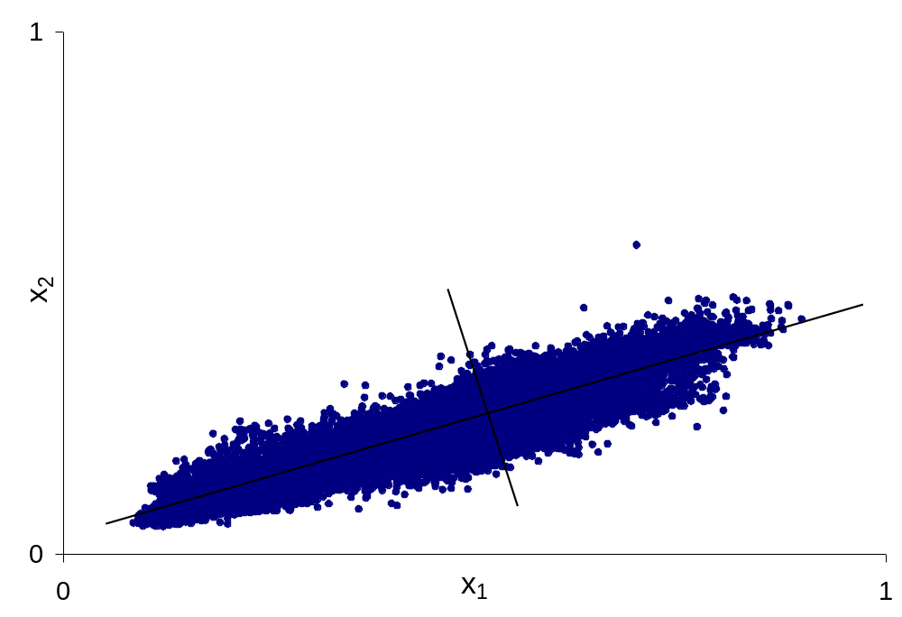
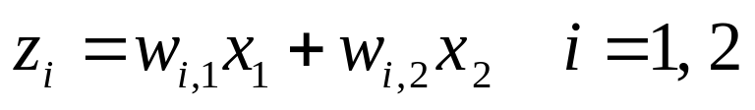
PCA – Basic Idea

Slide 7
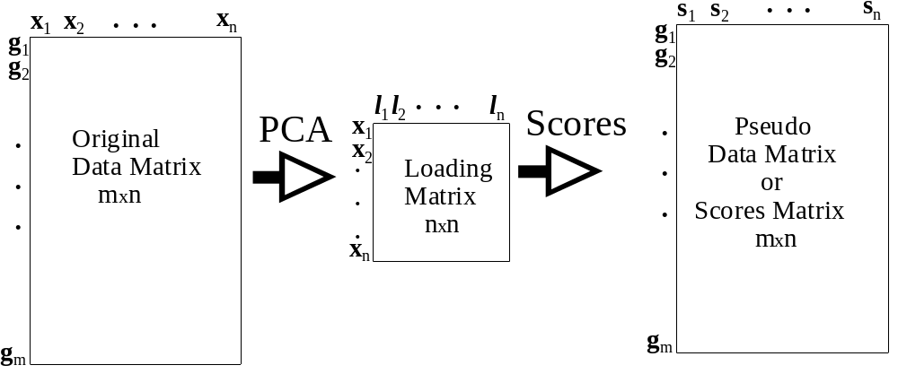
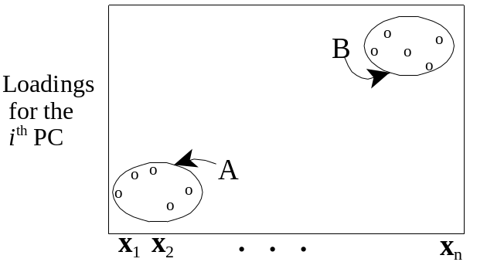
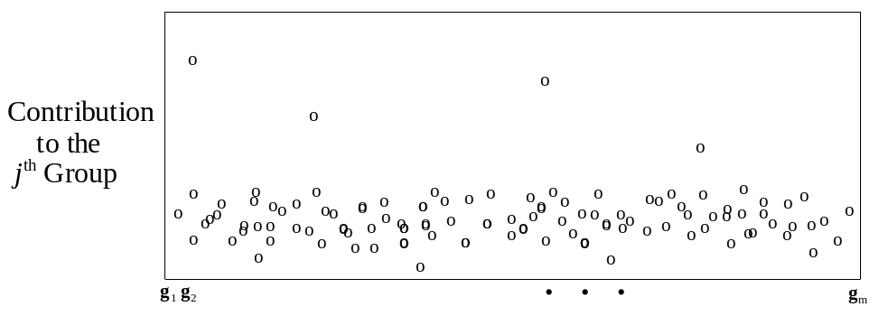
Eigengenes (EG) Pseudo Variables
Assay Groups
The Meaning of Contribution
Group A
Group B
s
. . .
s
s
. . .
s
g
1
p
p+1
n
g
1
Contribution Plot
2
. . .
. . .
.
.
.
.
.
.
.
.
.
. . .
. . .
g
m
Notes:
PC derived from X is EG - elements of S is pseudo values of gene expression
EA – elements of score matrix pseudo assay

Slide 8
Ethanol Response in E. coli
(Gonzalez et al., 2003)
12 Assays and 4290 Genes

Slide 9
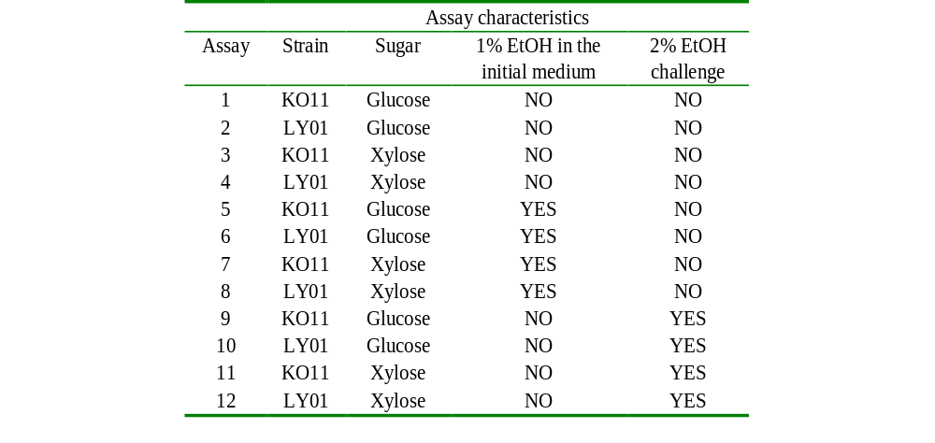
Ethanol Response in E. coli
12 Assays and 4290 Genes
(Gonzalez et al., 2003)
9
Notes:
2% ETOH

Slide 10
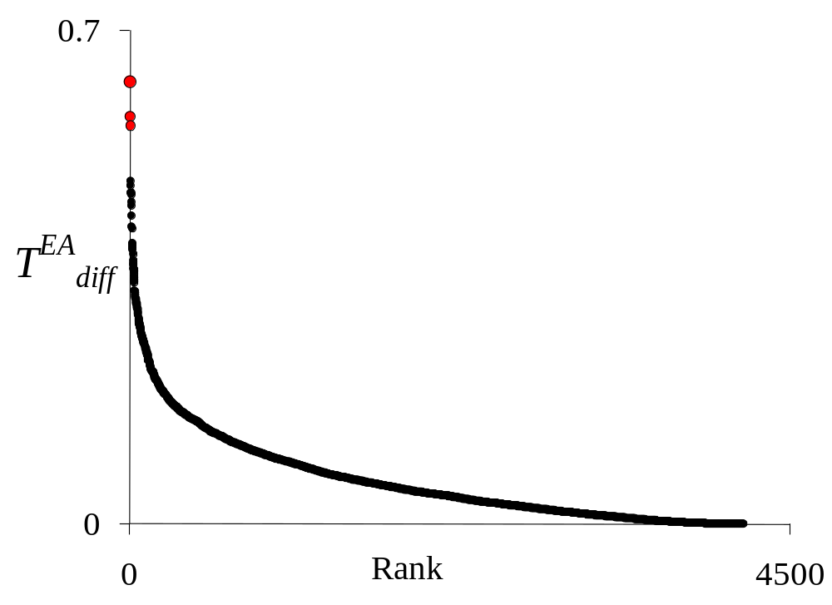
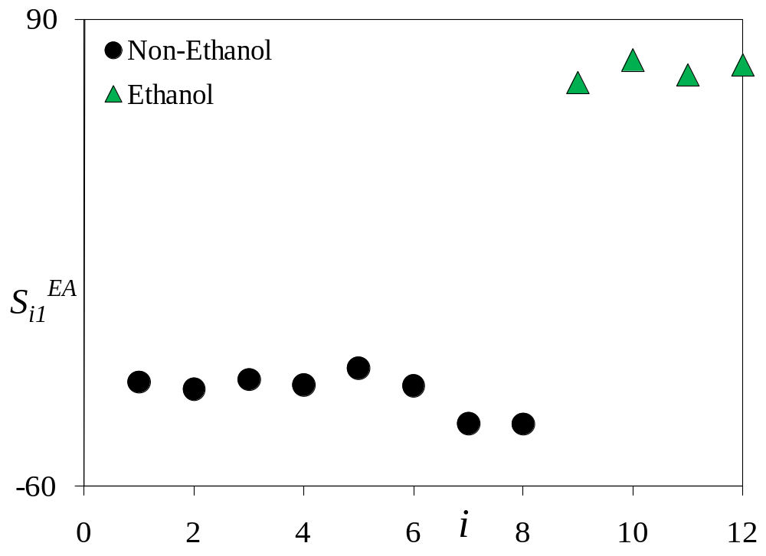
PCA Score Plot and Gene Signature Plot
10
Notes:
rank decreases as the number increases. The top ranking genes seen on the upper left in plot (b) show excellent ranking as evidenced by the vertical line and clear separation of the most highly ranked genes.

Slide 11
Differential Expression Gene Signature
Rank | Gene Name | EtOH Rank* | Non-EtOH Rank* | Rank | Gene Name | EtOH Rank* | Non-EtOH Rank*
1 | b2387 | 729 | 2001 | 11 | argT | 925 | 2330
2 | ybdO | 558 | 2182 | 12 | argH | 2 | 4286
3 | b1455 | 959 | 2120 | 13 | ycbE | 317 | 3626
4 | gltD | 2884 | 151 | 14 | b0538 | 328 | 2658
5 | appY | 360 | 2457 | 15 | citB | 372 | 2642
6 | caiA | 5 | 3810 | 16 | wbbH | 2952 | 408
7 | b0960 | 2664 | 787 | 17 | ccmD | 2605 | 1083
8 | yaiD | 1 | 4284 | 18 | agaA | 885 | 2483
9 | b1815 | 3178 | 43 | 19 | ymcC | 568 | 2587
10 | ydaK | 375 | 2548 | 20 | abc | 389 | 2705
* Assay specific gene rank identified in Rollins et. al. (2006)
11
Notes:
* Assay specific rank in Rollins et. al. (2006)

Slide 12
Medical Diagnosis Exploiting Medical Data Bases
The accurate classification, i.e., diagnosis, of a medical condition using multiple-input, historical data of large quantities.
Using PCA, a pseudo-variable (i.e., a linear combination of all the variables, i.e., x₀) is obtained that distinguishes the condition.
  This reduces the variable space to one dimension.
  Methods are created using this pseudo-variable and historical data to improve classification accuracy of the medical condition.
  PCA was also used to reduce the number of variables for a particular type (i.e., number of genes) to help improve classification.
12

Slide 13
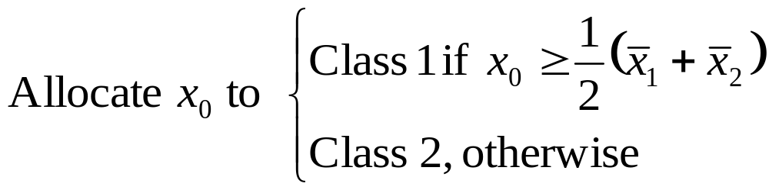
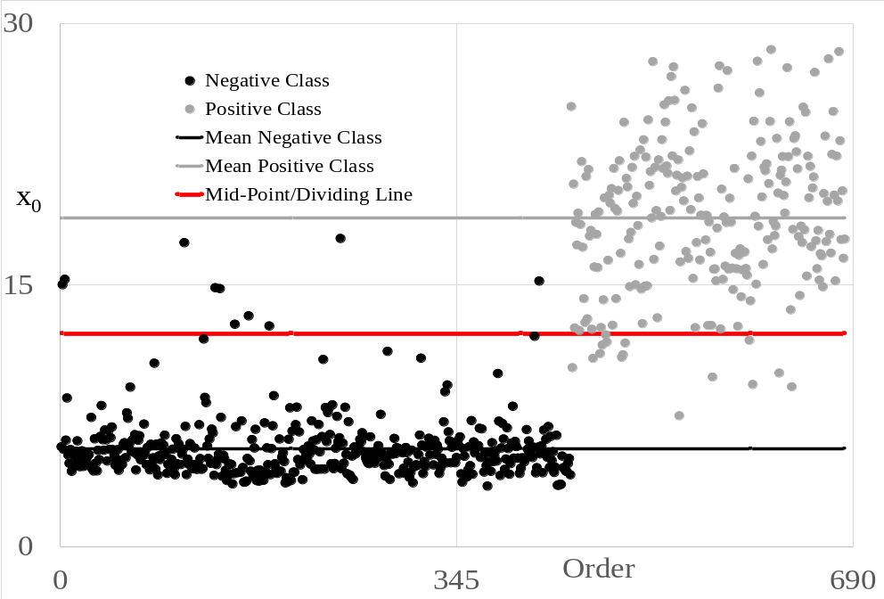
MM Allocation Rule
13

Slide 14
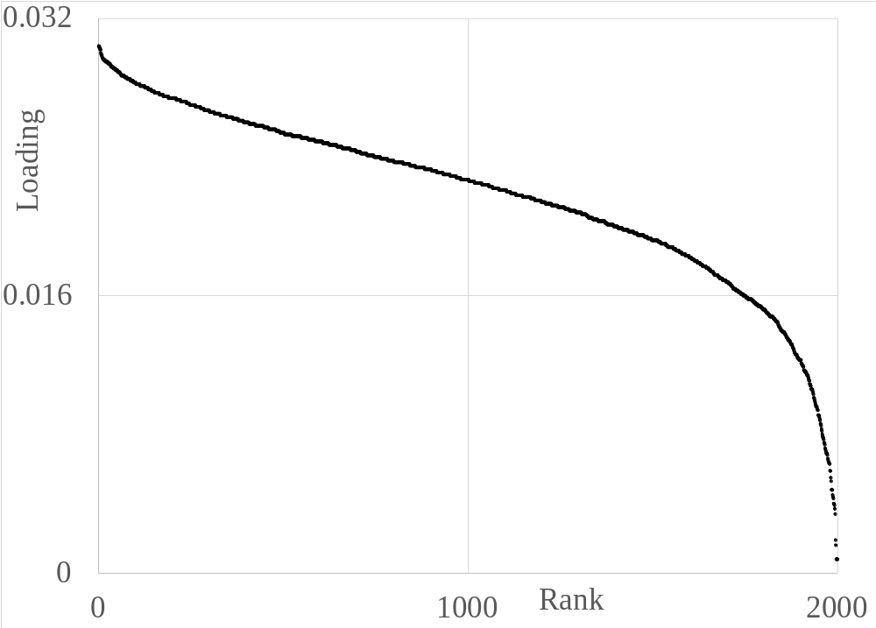
Feature Reduction Method (FRM)

Slide 15
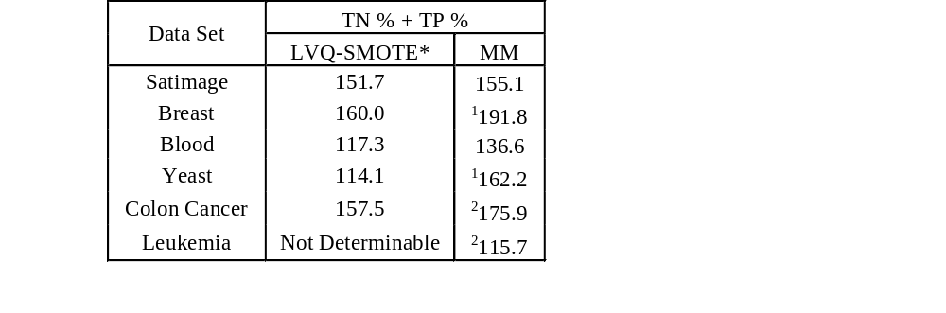
True Negative (TN) % + True Positive (TP) %
* Nakamura M., Kajiwara Y., Otsuka A., Kimura H. LVQ-SMOTE – Learning Vector Quantization based Syn- thetic Minority Over–sampling Technique for biomedical data. BioData Minining 2013, 6(16).

Slide 16
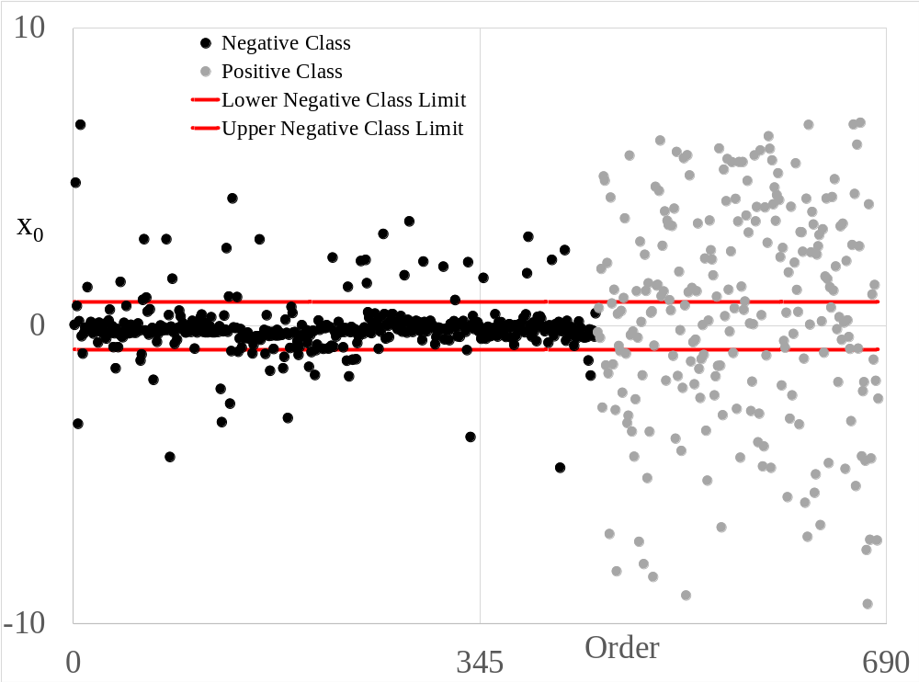
Visual Illustration of the SM

Slide 17
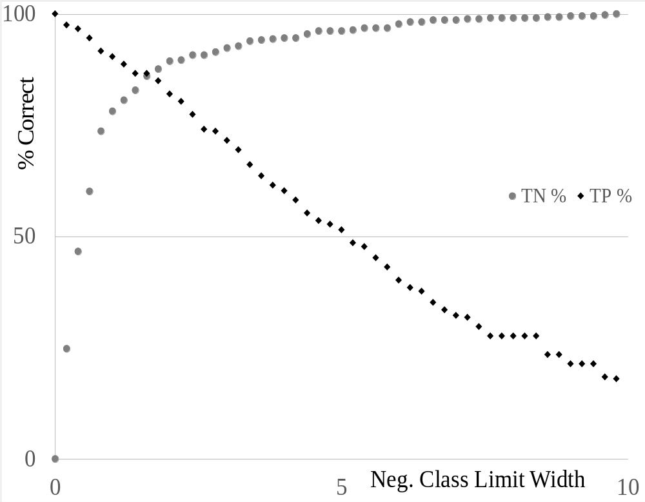
Accuracy With Increasing Class Width for SM

Slide 18
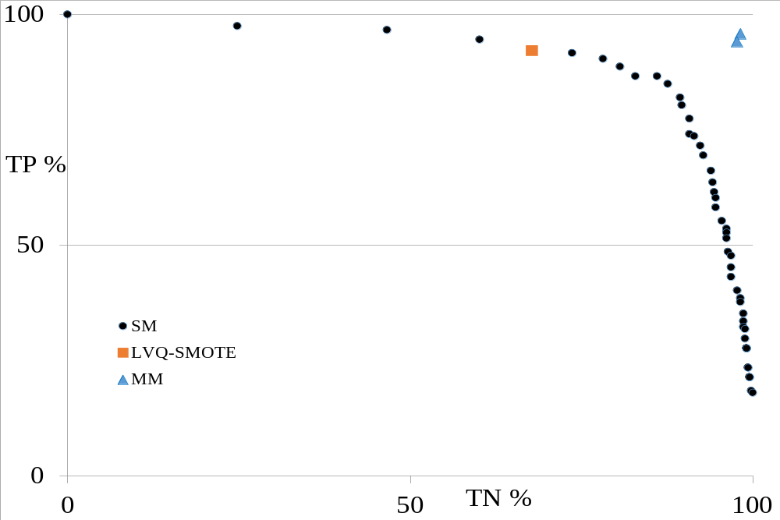
LVQ-SMOTE vs SM Breast Case

Slide 19
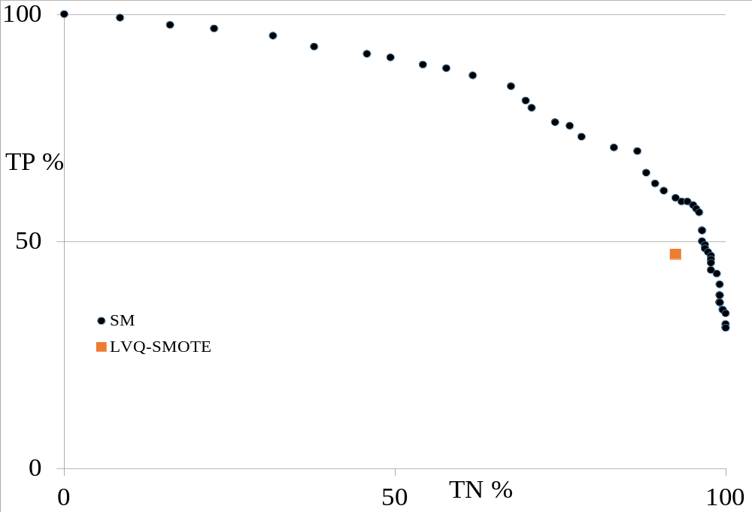
LVQ-SMOTE vs SM Ionosphere Case

Slide 20
Using PCA to Enhance NDE

Slide 21
Background
A non-destructive test needs to be developed for a physical property on panels of several composite layers
The destructive test consists of cutting a panel into six equal parts and using each part to obtain the value for the panel as a whole.
Several panels, cut into six parts, were sent to ISU CNDE lab and tested

Slide 22
The Objective
  To develop a procedure using a novel Principal Component Analysis (PCA) method where the non-destructive tests on the six panels for each panel group correlates with the one destructive test result for each panel
Notes:
22

Slide 23
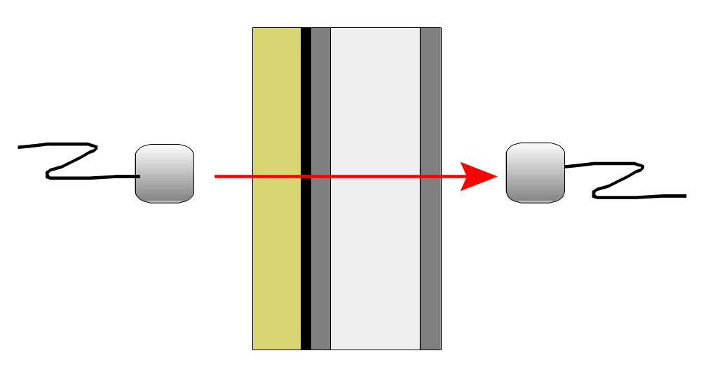
Side view of Composite Panel Showing Through Transmission of the Signal of the Non-Destructive Test
T
R

Slide 24
The Panel Problem
Notes:
* Assay specific rank in Rollins et. al. (2006)

Slide 25
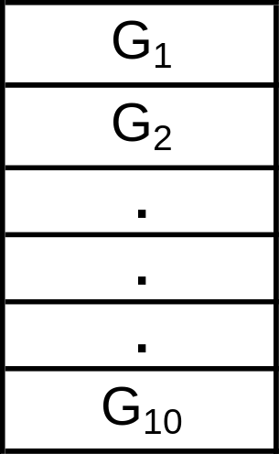
Location Matrix for Panel Surface
Gates for Panel Depth
1 | 251 | . | . | . | 62,251
. | . | . |  |  | .
. | . |  | . |  | .
. | . |  |  | . | .
250 | 500 | . | . | . | 62,500
G_{j} gives the statistical measurement of the signal in a certain depth range of the panel called “Gates.”

Slide 26
Electronic Signal Data Matrix
Location | G₁ | G₂ | . | . | . | G₁₀
1 | x_{1,1} | x_{1,2} | . | . | . | x_{1,10}
. | . | . | . |  |  | .
. | . | . |  | . |  | .
. | . | . |  |  | . | .
62,500 | x_{62500,1} | x_{62500,2} | . | . | . | x_{62500,10}
x_{ij} is the statistical measurement of the signal at location i corresponding to
G_{j}.

Slide 27
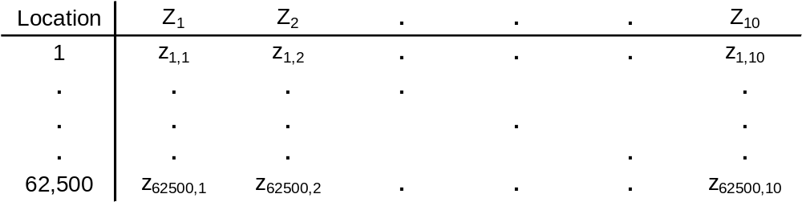
Pseudo Electronic Signal Data Matrix
Thus, PCA creates pseudo variables that are linear combinations of the gates at a particular location on the panel

Slide 28
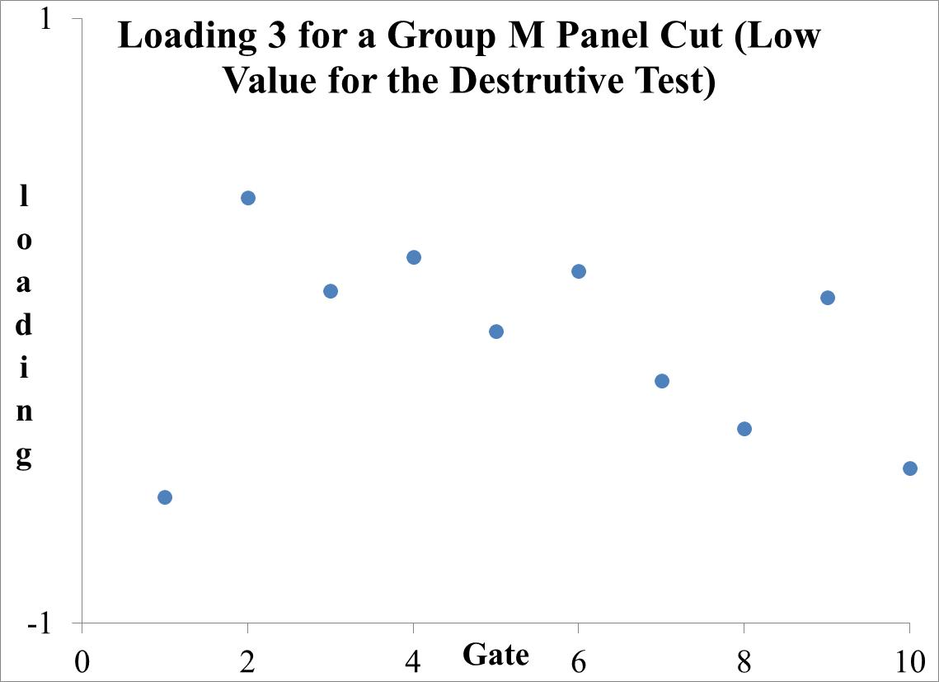
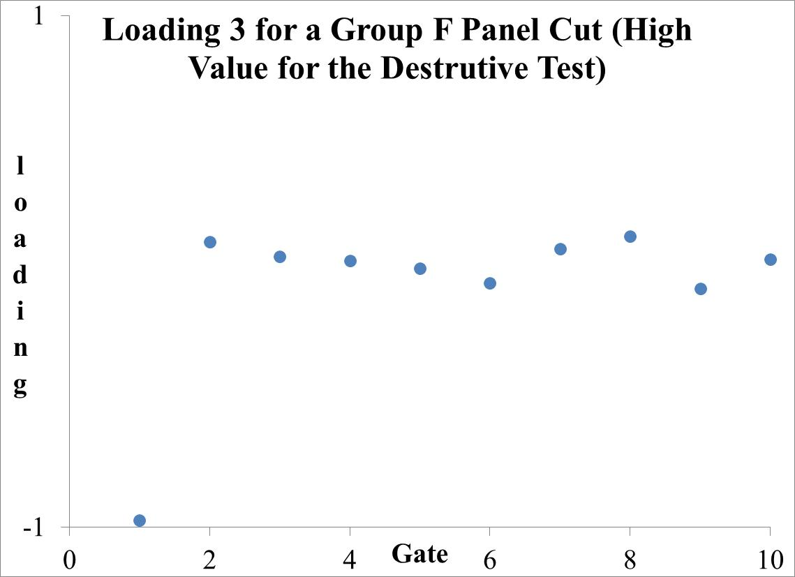
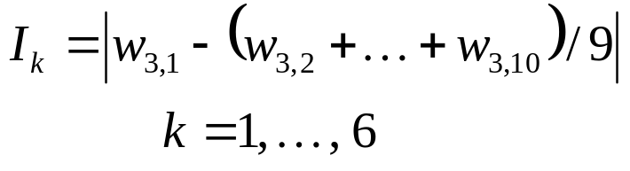
Finding and Defining the Index
where k is the panel number

Slide 29
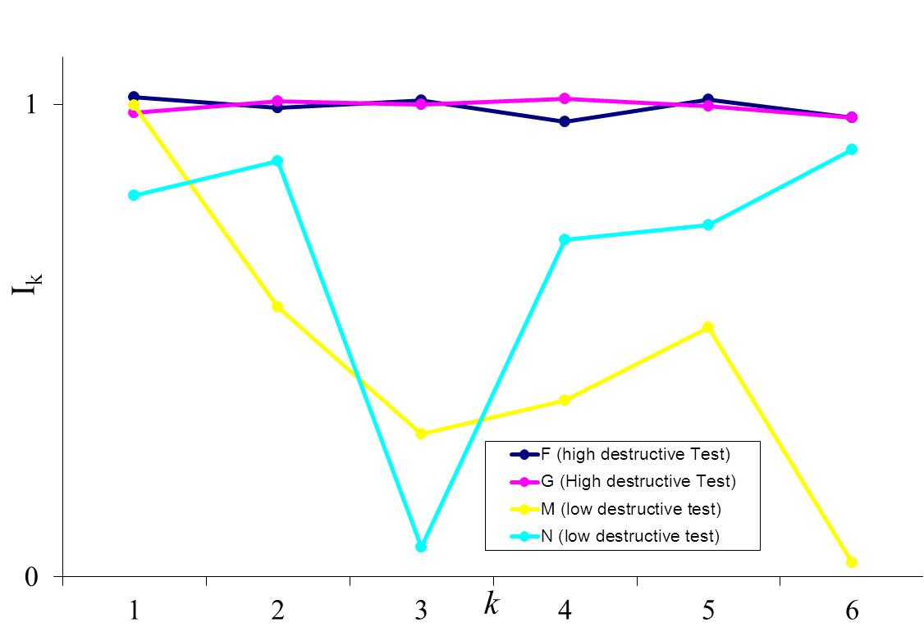
The Consistency and Strength of This Index Across All Panel Sections For Four Groups
Thus, I_{k} is a performance measure created from principle component (PC) 3
that contrast the weight for Gate 1 with the average of the other gates. This measure correlates well with the destructive test results as shown by the figure.
Notes:
29

Slide 30
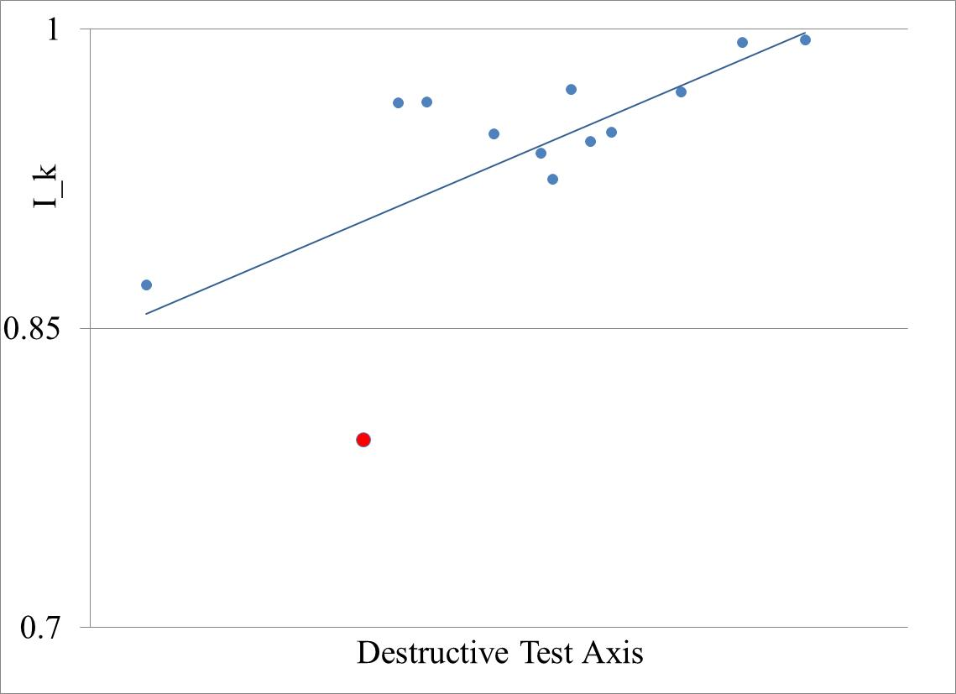
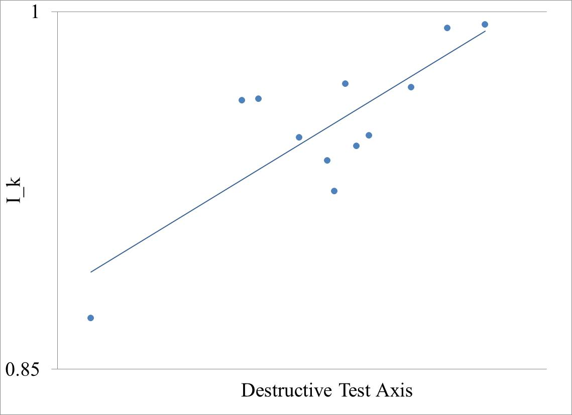
The Correlation of I_{k} With the Destructive Test
All Panel Groups -- r = 0.7
Group N Removed -- r = 0.8

Slide 31
Other Applications and Methodologies
Hald, E. S., R. J. Stoner and D. K Rollins, “Determining Juvenile Cancer Types From Gene Expression Using Gene Contribution and Differential Analysis,” Journal of MedicalStatistics and Informatics 2014 2: 2 (2 April 2014).
Teh, A., D. Layton, D. R. Hyduke, L. R. Jarboe and D. K. Rollins, “Data Mining Based on Principal Component Analysis: Application to the Nitric Oxide Response in Escherichia coli (No. JSSA-E20131006-01),” Journal of Statistical Science and Application, 2(1), 1-18(2014).
Ghasemi, P., M. Aslani, D. K. Rollins, R. C. Williams, and V. R. Schaefer, “Modeling Rutting Susceptibility of Asphalt Pavement Using Principal Component Pseudo Inputs in Regression and Neural Networks,” submitted to Transportation Research Record: Journal of the Transportation Research Board, in review.
Mathematical modeling in free-living or archived data studies with large data sets but low signal-to-noise ratio

Slide 32
Summary and Conclusions
Statistical Approaches and Methodologies Can Aid in Analysis and Modeling of Large Data Sets by:
  Creating Orthogonal Pseudo-Variables (PCA) to Exploit Correlation Among Variables
  Reducing dimensionality of the input space
  Creating a Smaller Set of Orthogonal Pseudo-Input Variables (PCA) for Modeling Outputs
  For Extracting Information When the Signal-to-Noise Ratio is Small
  ………

Slide 33
Questions

