Slide 1
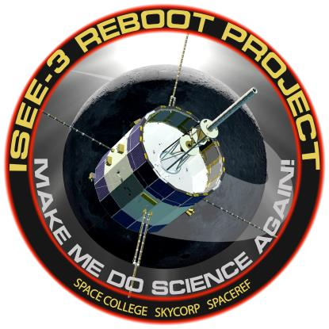




ISEE-3 Reboot Project
www.spacecollege.org
Dennis Ray Wingo
CEO
Skycorp Incorporated

Slide 2
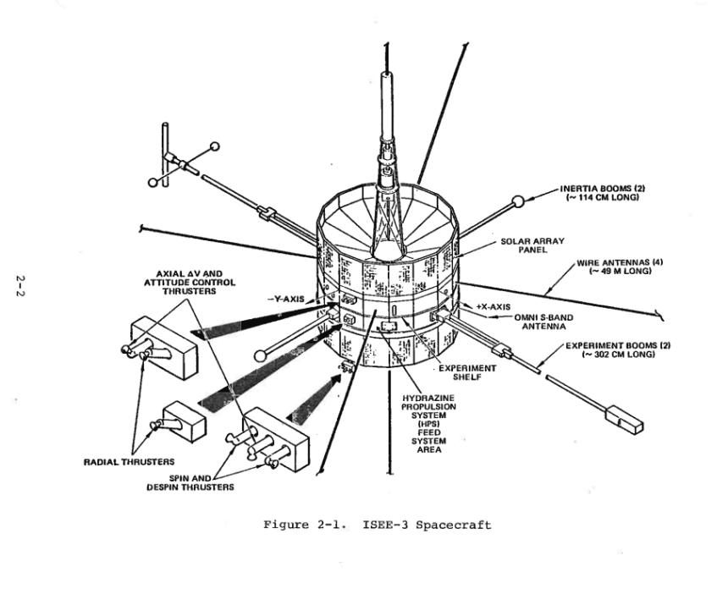
ISEE-3

Slide 3
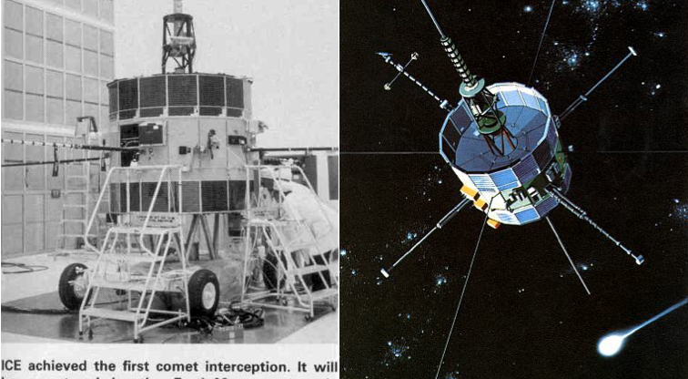
Spacecraft

Slide 4
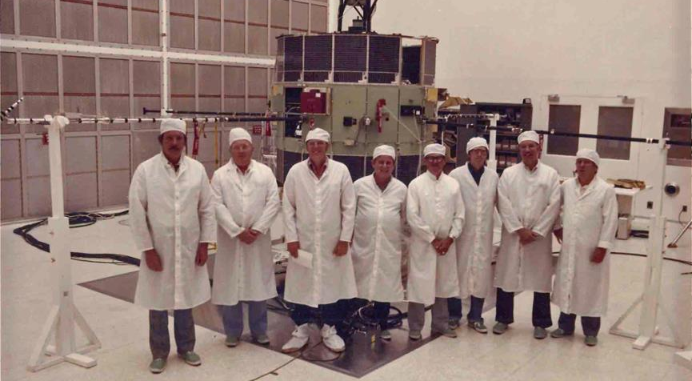
Spacecraft Prior to Launch

Slide 5
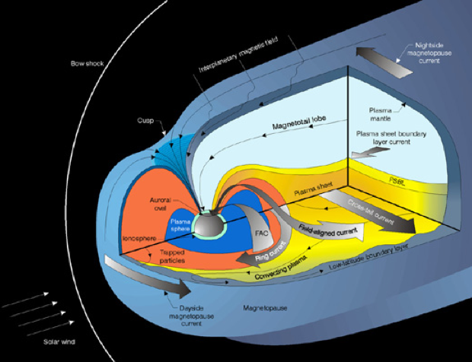
Original Mission

Slide 6
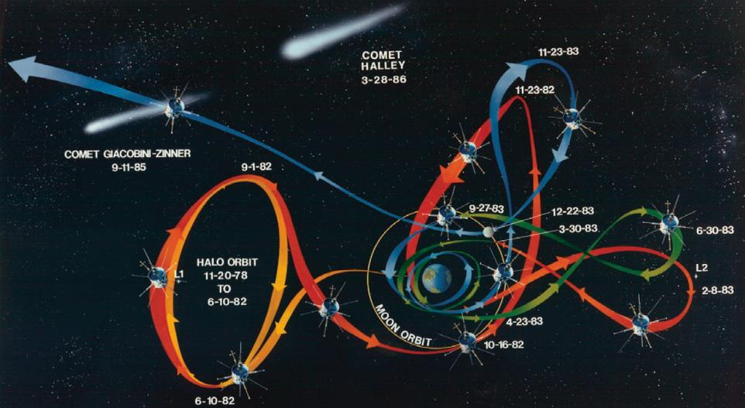
ISEE-3 Mission

Slide 7
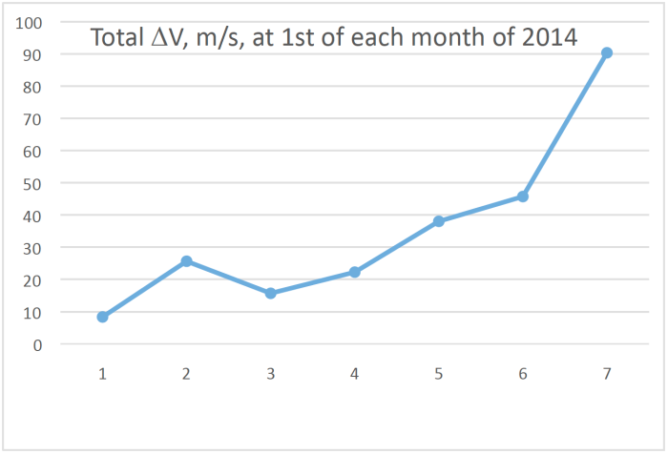
Newton Hates Us, The Time Crunch

Slide 8
Project Milestones
Project
  Began 4-12-14
  Crowd Funding Goal Met 5-18-14
  Space Act Agreement Signed 5-21-14
  ATP-E4.1 Completed and Approved 5-29-14
  ATP E4.2 In Progress
Technical
  Document Acquisition 4-12-5-21
  Software Radio Delivered 5-05-14
  Arecibo Trip 5-17-30
  S Band Power Amp Delivered Arecibo 5-21-14
  First Commanding Successful 5-29-14
  Preliminary Telemetry Evaluation Complete
  Maneuver Plan Development In Progress

Slide 9
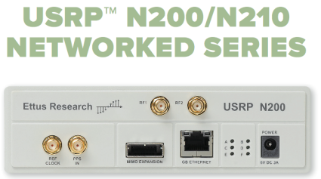
Technical Approach I Software Radio
Software Defined Radio (SDR) Used For Modulation and Demodulation of ISEE-3 Signals
GNU Radio Software Used to Turn Bits into Signal
Reduced Mod/Demod Development Time to Weeks

Slide 10
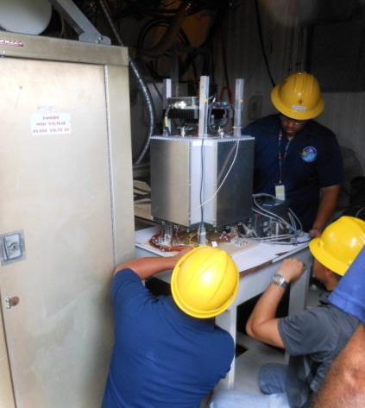
Technical Approach II Arecibo
Limited Availability of Ground Stations to Transmit S Band to Interplanetary Space
No Time to Acquire High Power Amps
Arecibo not back to full schedule after earthquake.
Arecibo ideal for Project

Slide 11
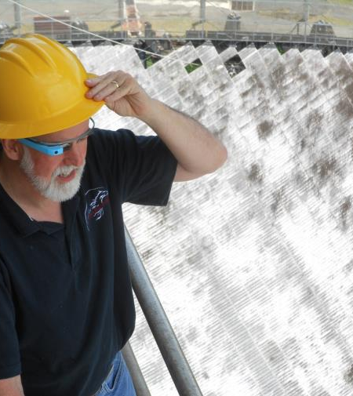
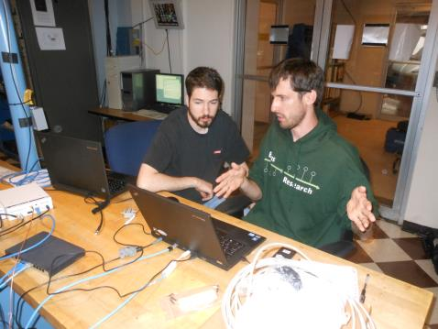
At Arecibo

Slide 12
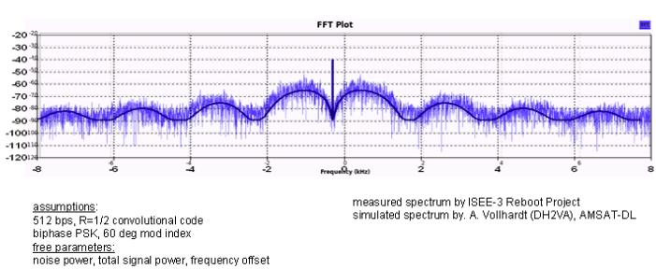
Success!

Slide 13
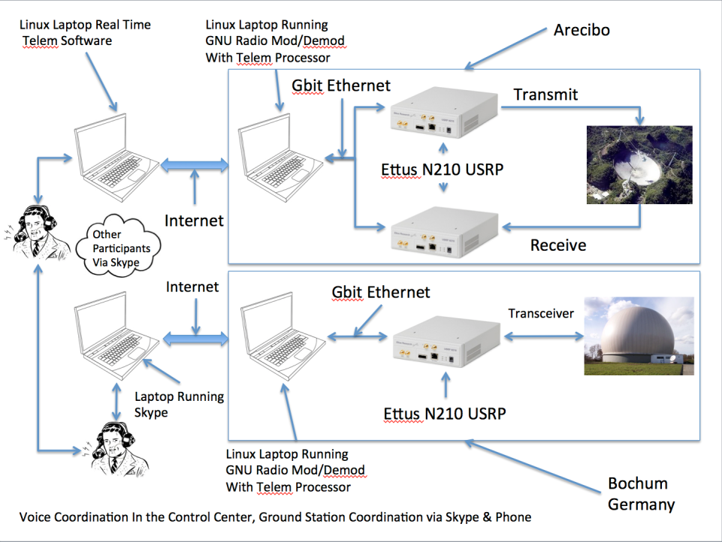

Slide 14
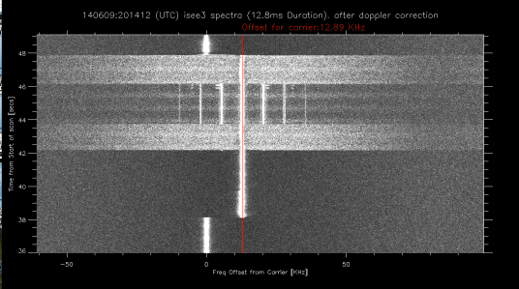
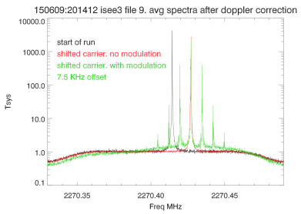
Operational Communications Status
6-9-14
  Testing Spacecraft Telecom, Commanding Different Data Rates (64, 512, 2048 bits/sec). Test Backup ROM Successful. Commanding ~50% Successful. Frequency Offset Between +-5-15 kHz. 9.4 and 7.5 kHz Successful. Test Coherent Ranging, First Thought Unsuccessful, Then.
Waveform Similar to 1978-02_compatibility_test_report_isee-c_flight_model (page 162)

Slide 15
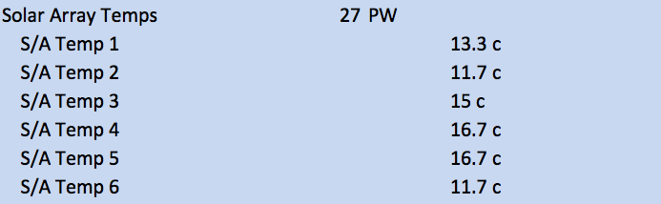
Solar Array Temperatures (2014)
Solar Array is Thermally Isolated from the Spacecraft
Solar Array Thermal Design Nominal Value is 10-15c (conflicting sources)
Solar Cell Test Nominal Temperature is 15 c.
AIAA 80-9207 “Design and Performance of the International Sun-Earth Explorer
Power Systems” Obenschain, A.F, Ruitberg, A.P, NASA GSFC

Slide 16
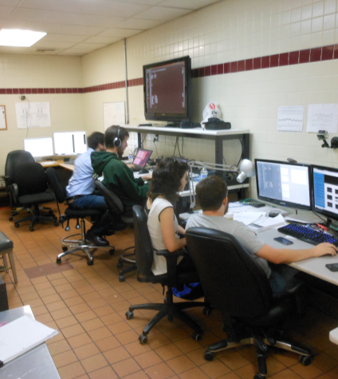
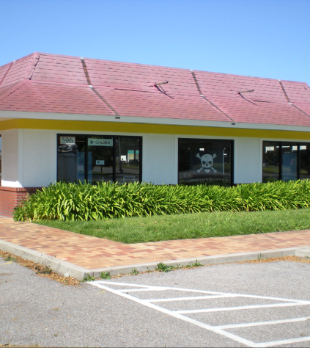
Operations at McMoons

Slide 17
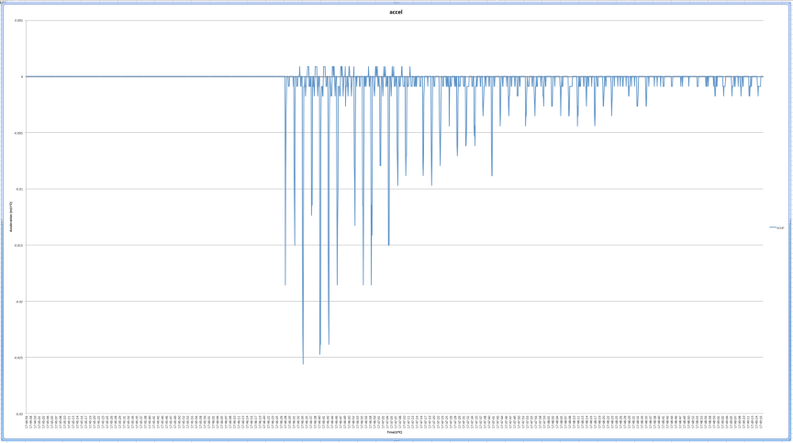
The Agony of Defeat (temporary)

Slide 18
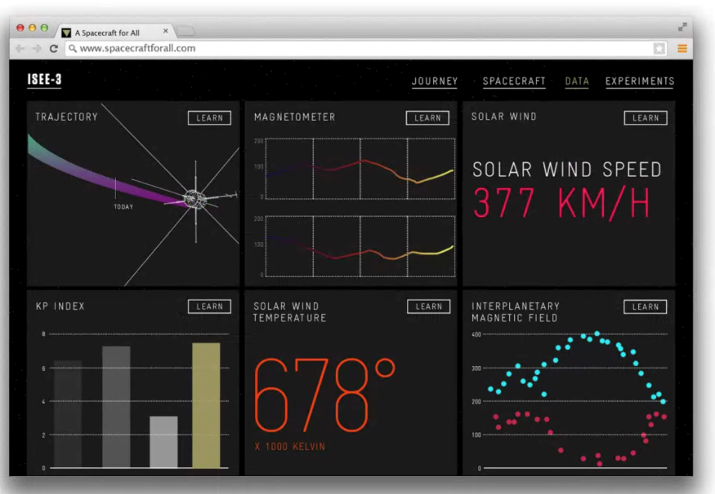
ISEE-3 Science

Slide 19
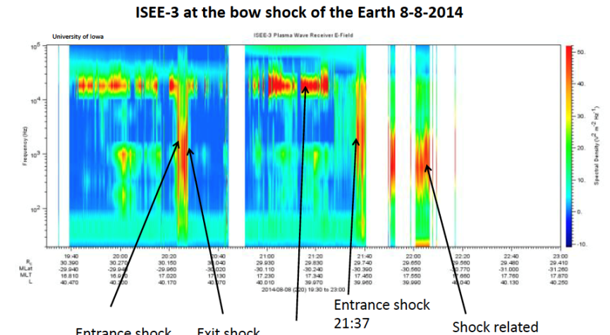
Data….

Slide 20
ISEE-3 Project Firsts
First Private Entity to Recover and Successfully Command an Abandoned Spacecraft in Interplanetary Space
First Use of Software Defined Radio in Real Time Spacecraft Command and Control
First NASA Space Act Agreement To Utilize Abandoned NASA Assets

Slide 21
Where Next?

