Slide 1
Cytotoxicity of Silver Sulfide Quantum Dots evaluated by the MTT cell culture assay in heLa Cells
Deniz Özkan Vardar¹, Ibrahim Hocaoğlu², Havva Funda Yağcı Acar³, Nurşen Başaran⁴
¹Hitit University, Sungurlu Vocational High School, Health Programs, Sungurlu, Çorum, Turkey
²Koc University, Materials Science and Engineering, Istanbul, Turkey
³Koc University, Department of Chemistry, Istanbul, Turkey
⁴Hacettepe University, Faculty of Pharmacy, Department of Toxicology, Ankara, Turkey

Slide 2
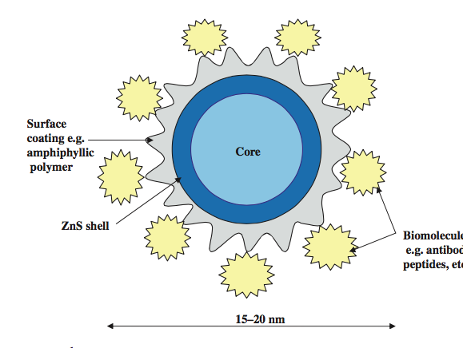
Quantum dots (QDs) are nanometer-scale semiconductor crystals composed of groups II–VI or III–V elements, and are defined as particles with physical dimensions smaller than the exciton Bohr radius.
Metal and semiconductor nanoparticles in the size range of 2–6 nm are of considerable interest, due to their dimensional similarities with biological macromolecules (e.g. nucleic acids and proteins)
Quantum dots are size ranges between 2 to 10 nm and can carry 10 to 50 atoms.
The general structure of a QD comprises an inorganic core semiconductor material, e.g. CdTe or CdSe, and an inorganic shell of a different band gap semiconductor material, e.g. ZnS. This is further coated by an aqueous organic coating to which biomolecules can be conjugated.
Sarwat B. et al. Semiconductor quantum dots as fluorescent probes for in vitro and in vivo bio-molecular and cellular imaging

Slide 3
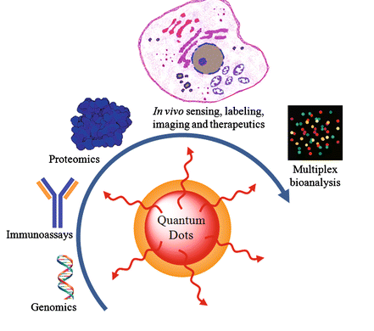
Quantum dots are optical and electrical properties currently applied in biomedical imaging and electronics industries.
Applications of QDs have been mostly studied on mammalian cells, such as biomedical applications that include sentinel lymph node mapping, multifunctional drug delivery, and photodynamic therapy.

Slide 4
Deep understanding of their effects in the cellular environment and their cytotoxic effects are still lacking.
So, the aim of this study was to assess and compare the in vitro cytotoxicity of silver sulfide quantum dots coated with 2-mercaptopropionic acid (2MPA) and meso-2,3-dimercapto succinic acid (DMSA).
For this purpose cell lines (Hela) were treated with Ag₂S-2MPA and Ag₂S-DMSA quantum dots in the concentration range of 5-2000 μg/mL for 24 h.
Cellular responses and their effects were determined.

Slide 5
MTT Assay used as the basis for colorimetric assays is the metabolic activity of viable cells.
Tetrazolium salts are reduced only by metabolically active cells.
Thus, 3-(4,5-dimethylthiazol-2-yl)-2,5-diphenyltetrazolium bromide (MTT) can be reduced to a blue colored formazan and the amount of formazan can be correlated to the amount of viable cells.

Slide 6
The objective of this study was to evaluate the cytotoxicity and identify the underlying mechanisms of toxicity of Silver Sulfide quantum dots coated with 2-mercaptopropionic acid and meso-2,3-dimercaptosuccinic acid using a HeLa cell line.
The acquired results will provide valuable information for the QDs application in biomedical field.

Slide 7
Materials
ID CODE: IH78
Composition (Core/Shell/Coating):
Ag₂S-(2-mercaptopropionic acid)
Hydrodynamic Size :
In water: 3.0nm

Slide 8
ID CODE: IH113
Composition (Core/Shell/Coating):
Ag₂S-(Meso-2,3-Dimercapto Succinic acid)
Hydrodynamic Size :
In water: 2.9 nm

Slide 9
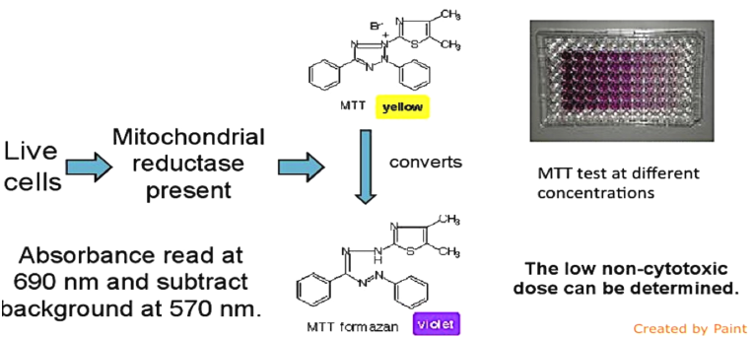
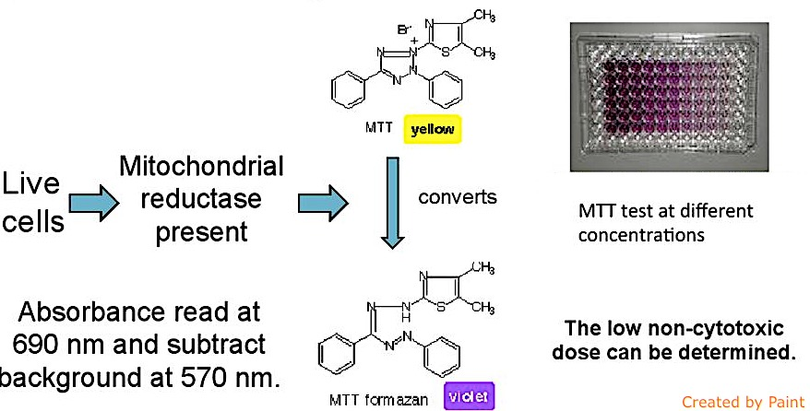
Methods
The cytotoxicity of QDs was quantitatively evaluated by thiazoyl blue colorimetric (MTT) assay.
Cells seeded in 96-well plates were separately treated with different concentrations (5-20002 μg/mL) of quantum dots Ag₂S-(2-mercaptopropionic acid) and Ag₂S-(Meso-2,3-Dimercapto Succinic acid) for 24 h.
Ten microliters of MTT (5 mg/mL) was added to each well and incubated for another 4 h at 37°C.
Next, 100 μL DMSO was added to each well, and the optical density at 540 nm was recorded on a microplate reader.

Slide 10
Cytotoxic effects of Ag₂S-(2-mercaptopropionic acid) QD in HeLa cells
Cell viability determined by MTT after 24 h treatment with different concentrations.
Data are expressed as a percentage of the non-treated control cells, and represent three independent experiments.
No cytotoxic effects of 2-MPA coated Ag₂S-QD were observed below 200 μg/ml concentration,
However at the higher concentrations (400-2000 μg/ml) the cell viabilitiy slightly began to decline.

Slide 11
Cytotoxic effects of Ag₂S-(2-meso-2,3-dimercaptosuccinic acid) in HeLa cells
Cell viability determined by MTT and NRU assay after 24 h treatment with different concentrations.
Data are expressed as a percentage of the non-treated control cells, and represent three independent experiments.
No cytotoxic effects of DMSA coated Ag₂S-QD were observed below 25 μg/ml concentration,
However at the higher concentrations (50-2000 μg/ml) the cell viabilitiy slightly began to decline.

Slide 12
Conclusion
The present study was aimed to in vitro assess the cytotoxic potential of these two kinds of QDs was also evaluated in the HelA cell line.
In summary, the results manifested that when modified with different QDs still possessed excellent biocompatibility and low cytotoxicity to cells, which may make them more promising in bioimaging and other biomedical applications.

Slide 13
References
W.C.W. Chan, D.J. Maxwell, X.H. Gao, R.E. Bailey, M.Y. Han, S.M. NieLuminescent quantum dots for multiplexed biological detection and imagingCurr Opin Biotechnol, 13 (2002), pp. 40–4
Sarwat B. et al. Semiconductor quantum dots as fluorescent probes for in vitro and in vivo bio-molecular and cellular imaging. Nano Reviews, [S.l.], aug. 2010.

Slide 14
Thank You for Attention…

