Slide 1



Comparison of the Cytotoxic Effects of Silver Sulfide Quantum Dots Coated with 2-mercaptopropionic acid and meso-2,3-dimercaptosuccinic acid in V79 Cells.
Deniz Özkan Vardar¹, Ibrahim Hocaoğlu², Havva Funda Yağcı Acar³, Nurşen Başaran⁴
¹Hitit University, Sungurlu Vocational High School, Health Programs, Sungurlu, Çorum, Turkey
²Koc University, Materials Science and Engineering, Istanbul, Turkey
³Koc University, Department of Chemistry, Istanbul, Turkey
⁴Hacettepe University, Faculty of Pharmacy, Department of Toxicology, Ankara, Turkey
Toxicology & Applied Pharmacology
Deniz ÖZKAN VARDAR
20-22 October2012

Slide 2
1
Over the past twenty years, the nanotechnology industry is rapidly growing.
With this dramatic expansion the safety evaluation and the risk management of nanomaterials are the important requirements.
Toxicology & Applied Pharmacology
Deniz ÖZKAN VARDAR
20-22 October 2012

Slide 3
2
Due to the distinct physico-chemical proterties of many nanomaterials, their possible toxicity may differ from the bulk material of similar chemical nature.
Toxicology & Applied Pharmacology
Deniz ÖZKAN VARDAR
20-22 October 2012

Slide 4
3
Nanomaterials may have unpredictable genotoxic properties
Because of their small size and high surface area and other physico-chemical features such as charged surfaces.
Toxicology & Applied Pharmacology
Deniz ÖZKAN VARDAR
20-22 October 2012

Slide 5
3
Nanomaterials may have unpredictable genotoxic properties
Because of their small size and high surface area and other physico-chemical features such as charged surfaces.
Toxicology & Applied Pharmacology
Deniz ÖZKAN VARDAR
20-22 October 2012

Slide 6
4
These materials can entry into the body via inhalation, dermal or oral routes.
So nanomaterials can promote cell damage with direct and indirect mechanisms
Toxicology & Applied Pharmacology
Deniz ÖZKAN VARDAR
20-22 October 2012

Slide 7
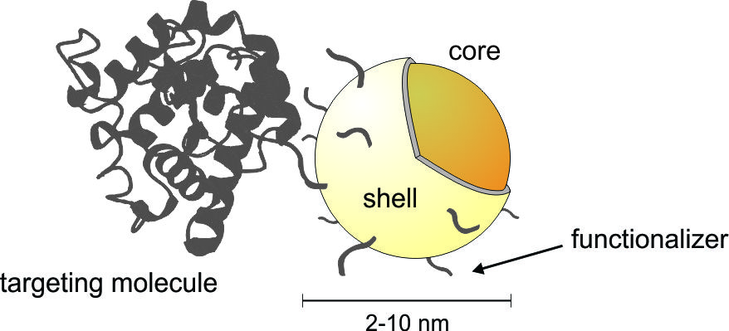
5
Quantum dots have semiconductor nanocrystals (size ranges between 2 to 6 nm) that have unique spectral properties.
The semiconductor particle (named “core”) is usually coated by a layer of another semiconductor material (named “shell”) which in general has a greater band gap than the band gap of the core rendering excellent optical properties.
Toxicology & Applied Pharmacology
Deniz ÖZKAN VARDAR
20-22 October 2012

Slide 8
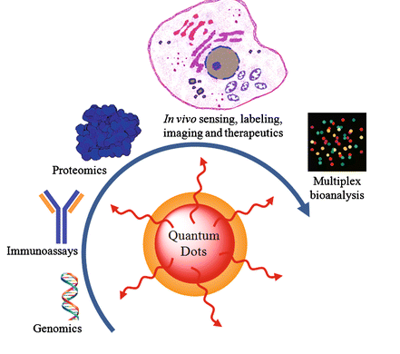
6
Quantum dots have optical and electrical properties currently applied in biomedical imaging and electronics industries.
Applications of QDs have been mostly studied on mammalian cells, such as biomedical applications that multifunctional drug delivery, and photodynamic therapy.
Toxicology & Applied Pharmacology
Deniz ÖZKAN VARDAR
20-22 October 2012

Slide 9
  Deep understanding of their effects in the cellular environment and their cytotoxic effects are still lacking.
7
Toxicology & Applied Pharmacology
Deniz ÖZKAN VARDAR
20-22 October 2012

Slide 10
8
Cellular responses and their effects were determined by the cytotoxicity assays are based on different modes of detection like neutral red uptake and MTT assays.
Neutral red assay has been used for the identification of vital cells in cultures.
This assay quantifies the number of viable, uninjured cells after their exposure to toxicants;
It is based on the uptake and subsequent lysosomal accumulation of the supravital dye, neutral red.
Toxicology & Applied Pharmacology
Deniz ÖZKAN VARDAR
20-22 October 2012

Slide 11
9
Another assay as a colorimetric assays is the metabolic activity of viable cells.
Tetrazolium salts are reduced only by metabolically active cells.
Thus, 3-(4,5-dimethylthiazol-2-yl)-2,5-diphenyltetrazolium bromide (MTT) can be reduced to a blue colored formazan and the amount of formazan can be correlated to the amount of viable cells.
Toxicology & Applied Pharmacology
Deniz ÖZKAN VARDAR
20-22 October 2012

Slide 12
10
In this study; the aim was to evaluate the cytotoxic potential of
  Silver sulfide quantum dots coated with 2-mercaptopropionic acid (2MPA)and meso-2,3-dimercapto succinic acid (DMSA).
  For this purpose Chinese Hamster Lung Fibroblast cell lines (V79) were treated with quantum dots in the concentration range of 5-2000 μg/mL for 24 h.
Toxicology & Applied Pharmacology
Deniz ÖZKAN VARDAR
20-22 October 2012

Slide 13
11
Materials and Methods
Materials
Silver sulfide quantum dots coated with 2-mercaptopropionic acid (2MPA)and meso-2,3-dimercapto succinic acid (DMSA) were synthesized at the Department of Chemistry, Faculty of Science, Koç University.
QDs were characterized in terms of size and size distribution.
Toxicology & Applied Pharmacology
Deniz ÖZKAN VARDAR
20-22 October 2012

Slide 14
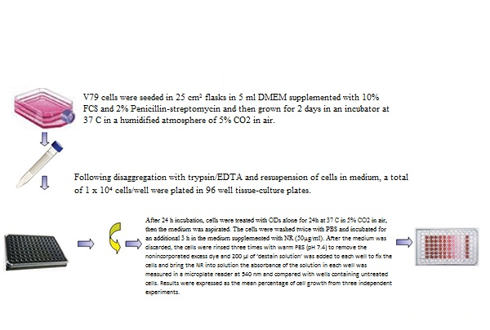
Methods
12
Neutral Red Assay;
V79 cells were seeded in flasks in Dulbecco’s modified Eagle’s medium (DMEM).
After 24 h incubation, cells were treated with quantum dots in the concentration range of 5-2000 μg/mL for 24 h
The cells were washed twice with PBS and incubated for an additional 3 h in the medium supplemented with NR
After the medium was discarded, the cells were rinsed three times with warm PBS to remove the nonincorporated excess dye and 200 µl of ‘destain solution’ was added to each well to fix the cells and bring the NR into solution.
The plates were shaken for 20 min, and the absorbance of the solution in each well was measured in a microplate reader at 540 nm and compared with wells containing untreated cells.
Toxicology & Applied Pharmacology
Deniz ÖZKAN VARDAR
20-22 October 2012

Slide 15
Methods
12
The cytotoxicity of QDs was quantitatively evaluated by MTT assay.
Cells seeded in 96-well plates were separately treated with different concentrations of quantum dots for 24 h.
10 microliters of MTT (5 mg/mL) was added to each well and incubated for another 4 h at 37°C.
Next, 100 μL DMSO was added to each well, and the optical density at 540 nm was recorded on a microplate reader.
Toxicology & Applied Pharmacology
Deniz ÖZKAN VARDAR
20-22 October 2012

Slide 16
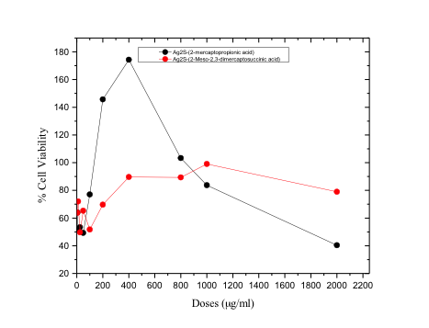
13
Results
The effects of the Ag2S-(2-mercaptopropionic acid) and Ag2S-(2-meso-2,3-dimercaptosuccinic acid) on cell viability at different concentrations were determined by NRU assay after 24 h treatment.
Data were expressed as the percentage of the viable cells to non-treated control cells, and represent three independent experiments.
Toxicology & Applied Pharmacology
Deniz ÖZKAN VARDAR
20-22 October 2012

Slide 17
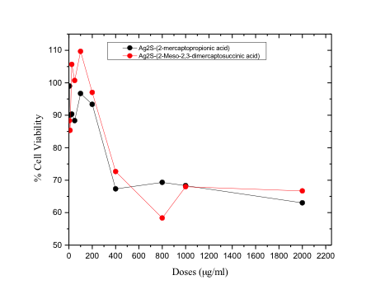
14
Results
The effects of the Ag2S-(2-mercaptopropionic acid) and Ag2S-(2-meso-2,3-dimercaptosuccinic acid) on cell viability at different concentrations were determined by MTT assay after 24 h treatment.
Data were expressed as the percentage of the viable cells to non-treated control cells, and represent three independent experiments.

Slide 18
15
Conclusion
The present study was aimed in vitro assessment of the cytotoxic potential of these two kinds of QDs on V79 cell line.
In summary, the results manifested that when modified with different QDs still possessed excellent biocompatibility and low cytotoxicity to cells, which may make them more promising in bioimaging and other biomedical applications.
Toxicology & Applied Pharmacology
Deniz ÖZKAN VARDAR
20-22 October 2012

Slide 19


Prof. Dr. Nurşen Başaran
Hacettepe University
Department of Toxicology
Assoc. Prof. Funda Yağcı Acar
Koç University,
Department of Chemistry
Dr. İbrahim Hacıoğlu
Koc University,
Materials Science and Engineering
Toxicology & Applied Pharmacology
Deniz ÖZKAN VARDAR
20-22 October 2012

Slide 20
THANK YOU FOR
YOUR ATTENTION
Toxicology & Applied Pharmacology
Deniz ÖZKAN VARDAR
20-22 October 2012

