Slide 1
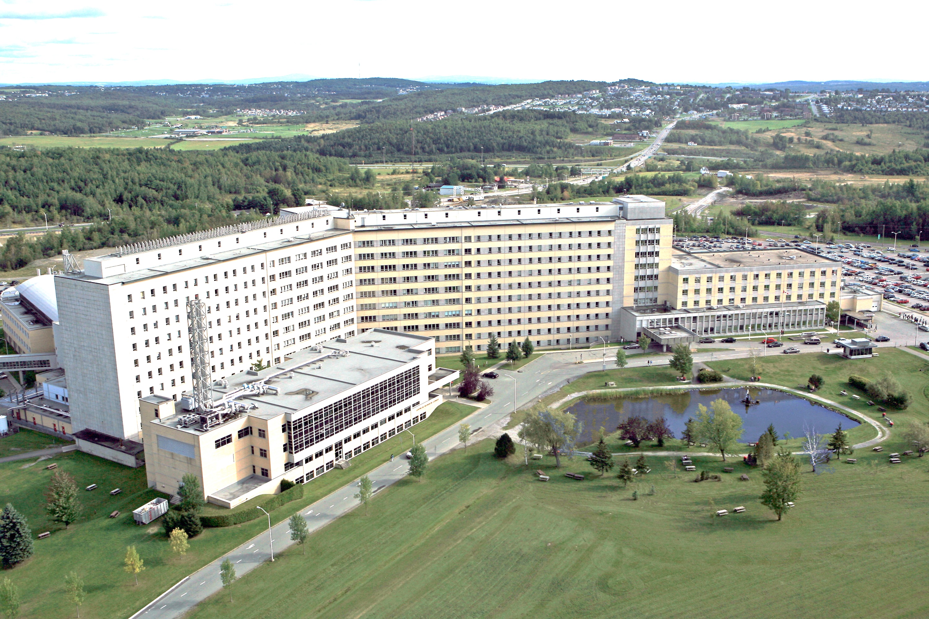

Role of Nlrs in Multiple sclerosis
Denis Gris
University of Sherbrooke QC Canada
3rd International Conference on Neurology & Therapeutics
www.neuroimmunology.ca

Slide 2
Multiple sclerosis is a devastating disease
The first description of the disease was mentioned in 14th century
In 1838 Dr. Charcot connected the symptoms to the pathology of the central nervous system (CNS)
MS is characterized by appearance of demyelinating plaques throughout the brain and spinal cord
Approximately 400,000 North Americans acknowledge having MS, and every week about 200 people are diagnosed. Worldwide, MS may affect 2.5 million
MS follows geographical gradient with the risk increasing further from equator. Canada and northern Europe have the highest risk of acquiring MS
Genetic predisposition among twins is 30%
Sex ration is 2 to 1, females to males
MS is an autoimmune disorder
MS is a progressive disease

Slide 3
Mechanism of MS
Antigen presenting cell
MHC II, CD80, CD86
IL-18, IL-12, IL-1β,
CD8
FasL ,TNF-α,
Granzymes
B cells auto antibody
Macrophages, Microglia,
Astrocytes
MMPs, FasL, IL-18, IL-1β,
TNFa, NO, ROS, Complement
Autoreactive CD4 T Cells
Th1- IFN-γ, Th17- IL-17
Myelin degradation,
Oligodendrocyte, and neuronal loss
Neurological symptoms

Slide 4
NLRS
Nucleotide-binding Leucine-rich repeat -containing proteins NOD-like receptors
Card
N-terminal
Nucleotide-binding
Leucine-rich repeat
Pyrin
Nlrs
Inflammasome
Caspase-1, IL-1β, IL-18
Nlrp1
Nlrp3
Nlrc4
Nlrc5
Non-inflammasome
NF-κB regulators
Transcription factors
CIITA, Nlrc5
Positive
NOD-1
NOD-2
Negative
Nlrp12
Nlrx1
TNFα, IL-1, IL-6, iNOS
NLRs are sensing and redirecting multiple molecular pathways

Slide 5
Inflammasome in MS
Stimulation
ATP
Poreforming toxins
Nigiricine
MSU
Asbestos
Silica
Bacterial RNA
ASC
Pro-IL-1β
IL-1β
NLRP3
PyD
CARD
NBD
PyD
CARD
Caspase1
Caspase1
NBD
PyD
CARD
Caspase1
NLRP3
PyD
CARD
ASC
Pro-IL-18
IL-18
Inflammasome
Hypothesis
Inflammasome exacerbates MS

Slide 6
EAE model of MS
Experimental Autoimmune Encephalomyelitis
Myelin oligodendrocyte glycoprotein (MOG₃₅₋₅₅)
5
T cell infiltration
3
T cell infiltration
Clinical scores
Ptx
0
Immunization
2 days
2 wks
3-4 wks
4-6 wks
0 healthy animal
tail dragging on ground constantly
tail dragging and locomotor disturbance of at least one hind leg
severe hind body paralysis
severe locomotor deficiency of front limbs
5 conditions to terminate experiment

Slide 7
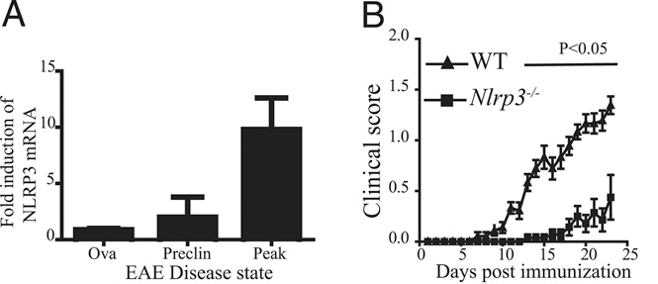
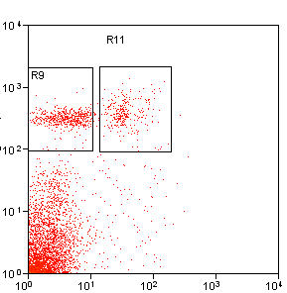
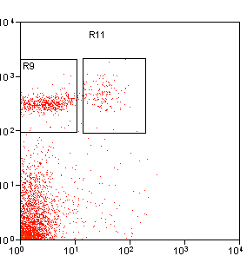
Progression of EAE in Nlrp3^{-/-} mice
WT
Nlrp3 ^{-/-}
Mg
Mφ
Mg
Mφ
0.68%±0.1
0.35%±0.13
0.6%±0.14
0.13%±0.05*
CD11b
CD45
Expression of Nlrp3 drives inflammation within the spinal cord

Slide 8
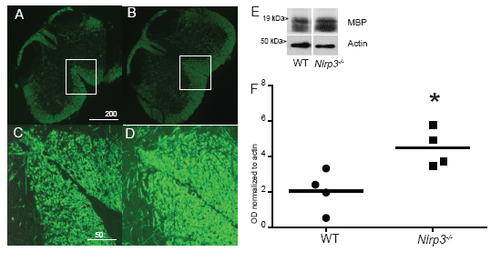
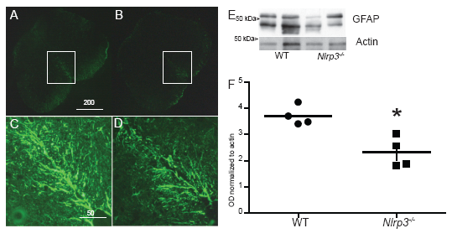
Demyelination and gliosis are
reduced in Nlrp3-/- mice
Three weeks after immunization spinal cords were prepared
for immunohistochemistry
Myelin
Astrocytes
WT Nlrp3^{-/-}
WT Nlrp3^{-/-}
Spinal cords from Nlrp3^{-/-} mice had significantly more
myelin and reduced gliosis

Slide 9
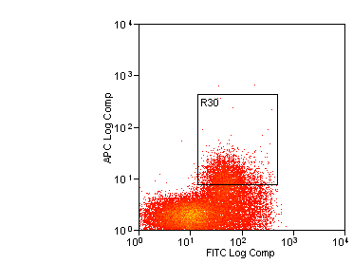
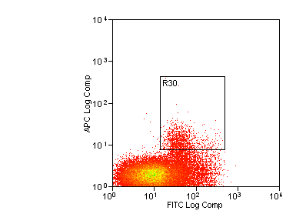
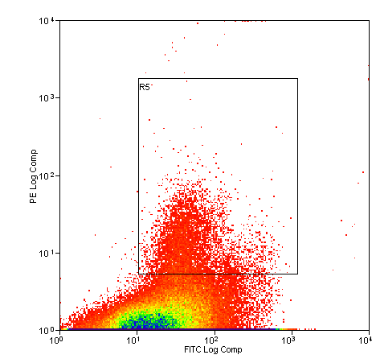
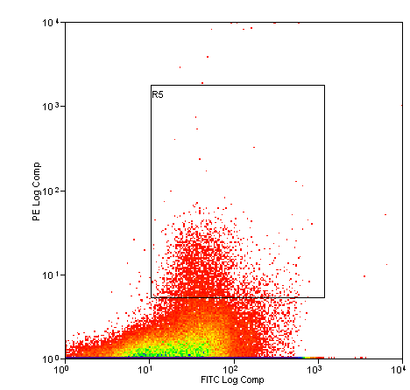
Th1 and Th17 responses after ex vivo recall
WT
Nlrp3^{-/-}
9.2 ± 4.2
2.9 ± 1.2*
IFN-γ
3.5 ± 0.9
1.84 ± 1.1*
IL-17
CD44
Th1 and Th17 responses are reduced in Nlrp3^{-/-} mice

Slide 10
NLRP3 plays detrimental role in MS
Gris et al J Immunology 2011
Inoue and Shinohara Autoimmune Dis. 2013
Cuprizone model
The inflammasome sensor, NLRP3, regulates CNS inflammation and demyelination via caspse-1 and IL-18. Jha et al J Neurosci. 2010 Nov
Caspase 1 KO has improved course of EAE
ASC KO Shaw et al J Immunol. 2010 May
NOD1 and NOD 2 enhance pro-infammatory role of dendritic cells and augment CNS inflammation in mice. Immunity 2011 Jan 28

Slide 11
Nlrx1 and Nlrp12
Negative regulators of NFkB
Nlrx1
X
Nucleotide-binding
Leucine-rich repeat
Localized to mitochondria
Inhibits NFkB and Type I interferon signaling during viral infections
Plays role in cell death (autophagy and apoptosis)
Augments ROS production
Nlrp12
Pyrin
Nucleotide-binding
Leucine-rich repeat
Inhibits NFkB pathway
Plays role in intestinal tumorogenesis
Forms an inflammasome
Associates with human diseases

Slide 12
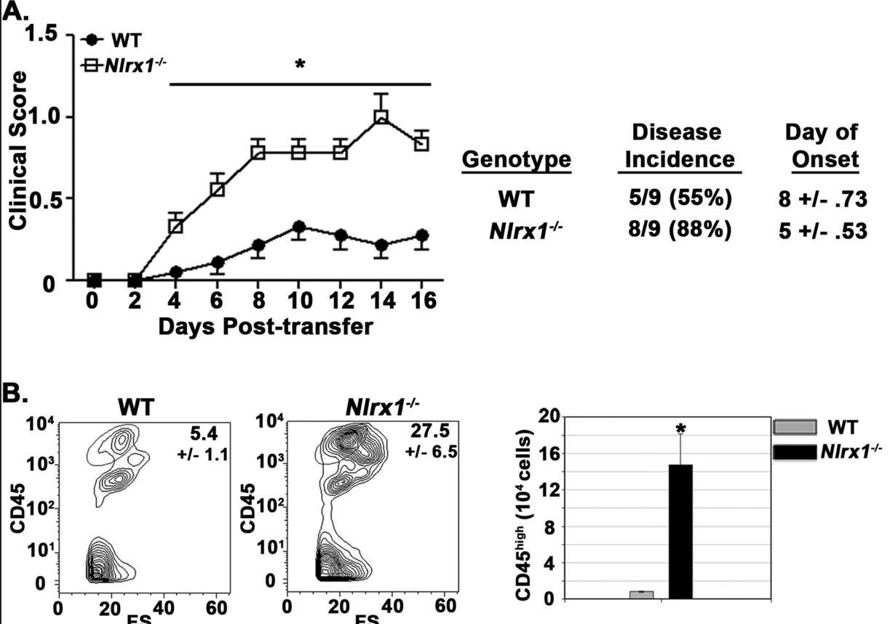
Nlrx1 controls inflammation within the CNS
Adoptive transfer of encephalitogenic T cells from 2D2 mice

Slide 13
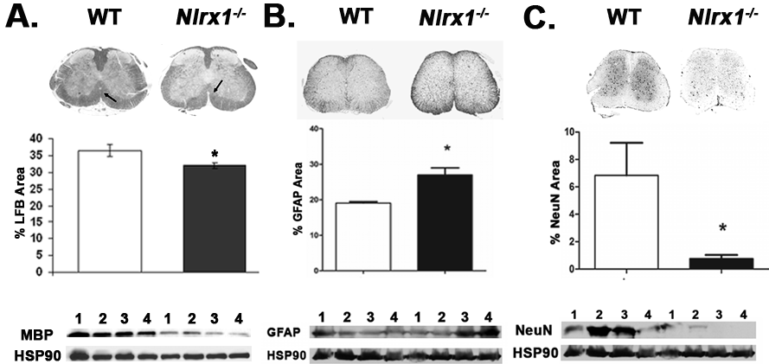
Nlrx1^{-/-} mice have exacerbated EAE
Myelin Astrocytes Neurons

Slide 14
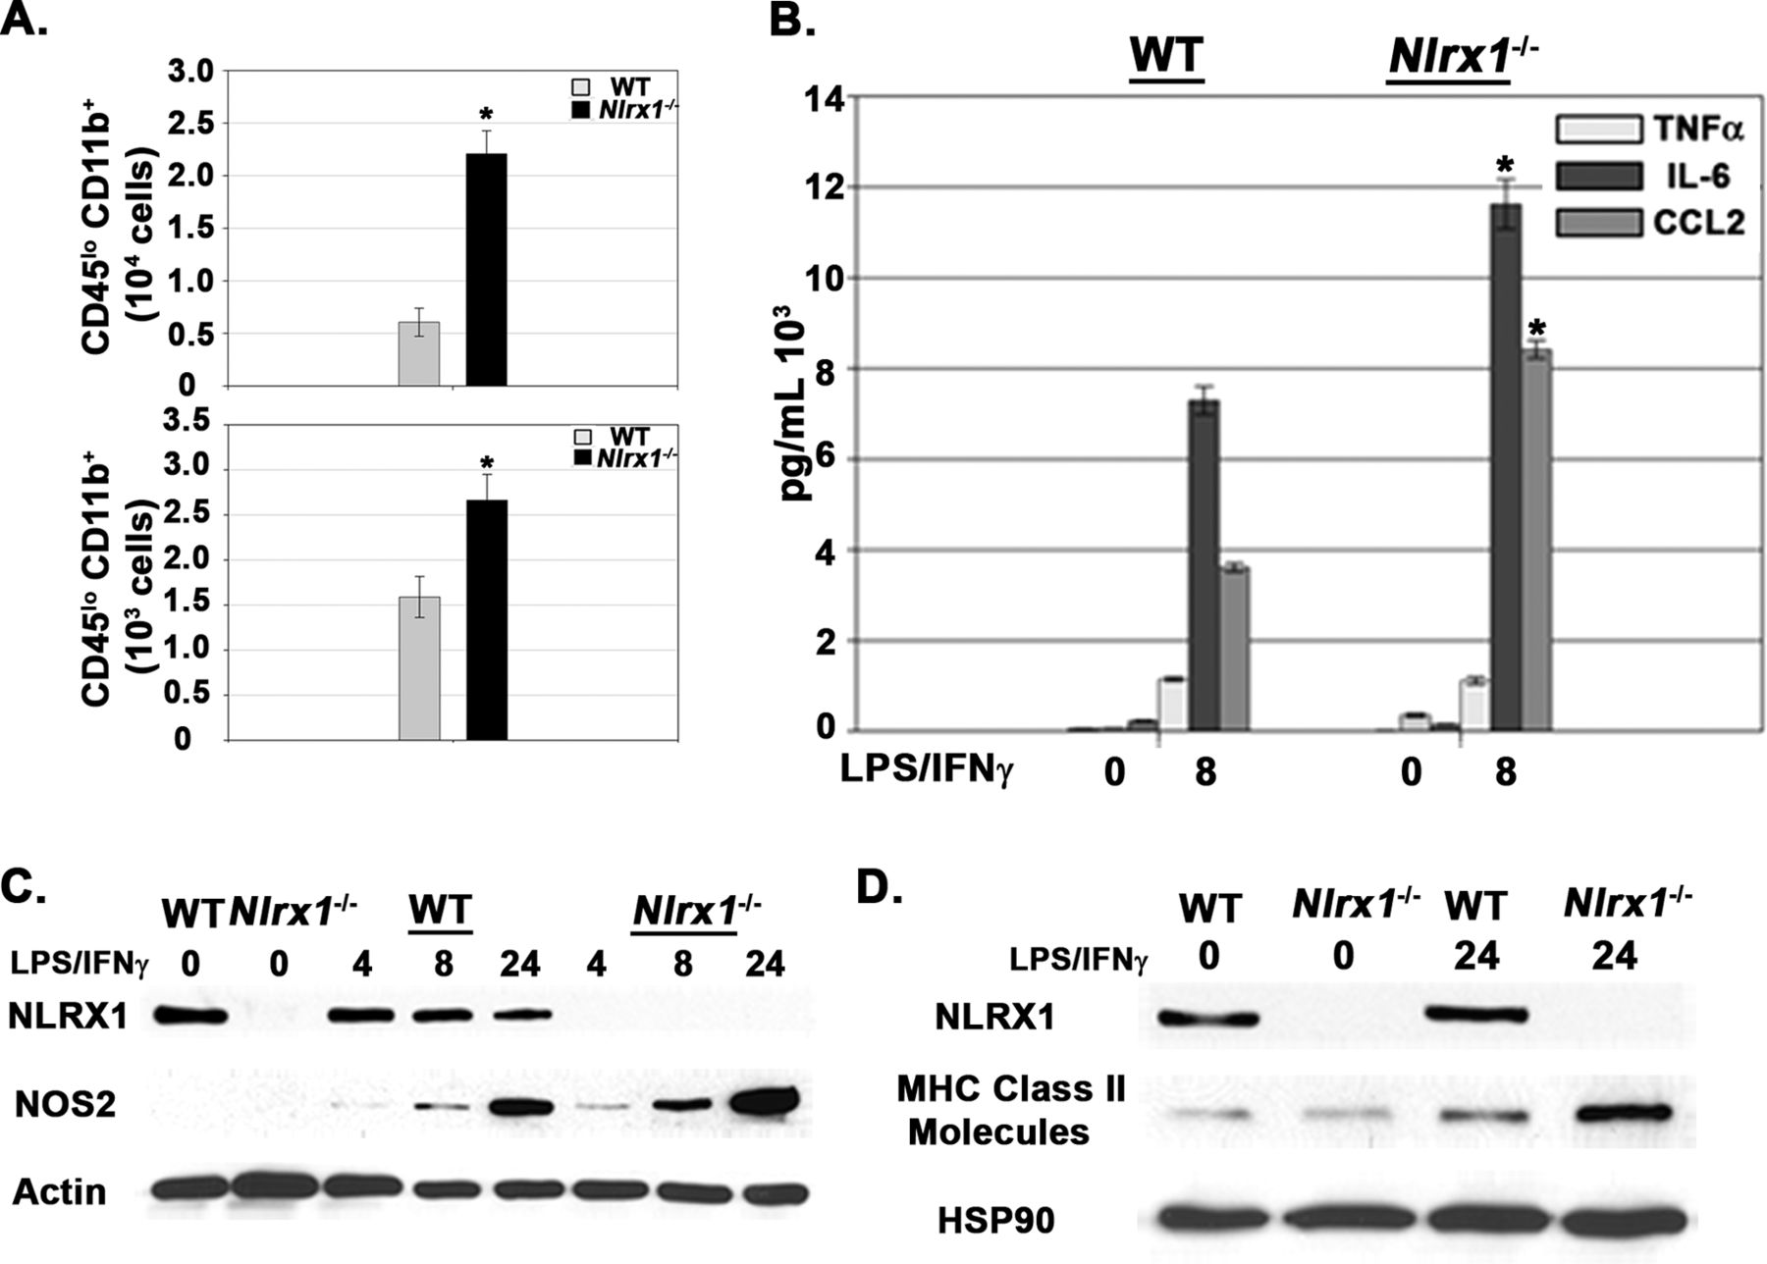
Nlrx1^{−/−} microglia have enhanced inflammatory responses.
Eitas T K et al. J. Biol. Chem. 2014;289:4173-4179
Notes:
Nlrx1^{−/−} microglia have enhanced inflammatory responses.A, top panel, total numbers of CD45^{lo} CD11b⁺ populations in spinal cord tissue 18 dpi during active EAE. n = 6 mice/group. Bottom panel, total numbers of CD45^{lo} CD11b⁺ populations in spinal cord tissue 16 dpi during passive EAE. n = 5 mice/group. B, ELISA analysis of cytokines and chemokines produced by primary WT and Nlrx1^{−/−} microglia after stimulation with LPS/IFNγ. C, immunoblot analyses of NOS2 in primary WT and Nlrx1^{−/−} microglia after stimulation with LPS/IFNγ. Actin was used as a total protein loading control. D, Immunoblot analyses of MHC class II molecule expression in primary WT and Nlrx1^{−/−} microglia after stimulation with LPS/IFNγ. HSP90 was used as a total protein loading control. Error bars represent mean ± S.E. *, p < 0.05.

Slide 15
Conclusions
NLRs play detrimental role in development of EAE by augmenting pro-inflammatory effect of T cells, dendritic cells, macrophages, and microglia.
Inflammasome, Nlrp3, NOD1, and NOD2
NLRS can play protective role by acting at the level of microglia and macrophages to control excessive inflammation.
NLRX1 and NLRP12

Slide 16





Acknowledgements
UNC at Chapel Hill
Dr. Ting
Dr. Eitas
Dr. Wen
McGill University
Dr. Gris
Dr. Antel
University of Florida
Dr. Jobin
University of Bayreuth
Dr. Braun
University of Sherbrooke
Autism group
Dr. Takser
University of Klien
Dr. Rosenstiel

Slide 17
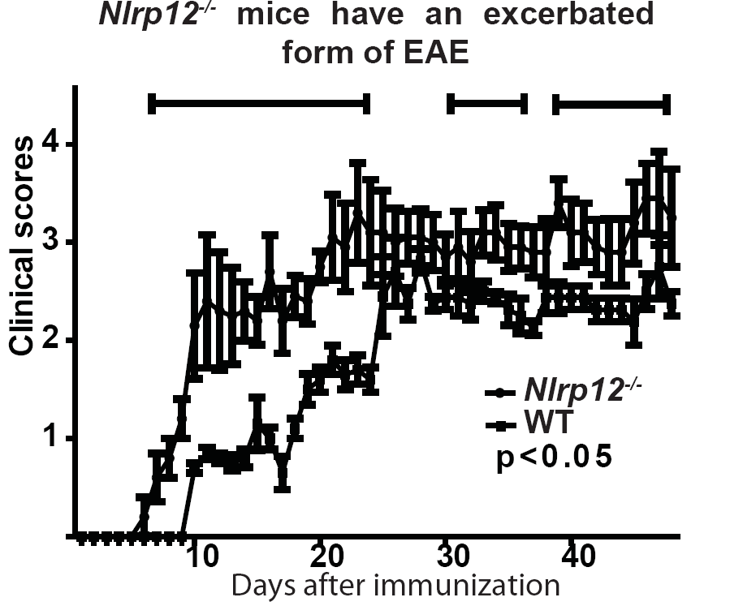
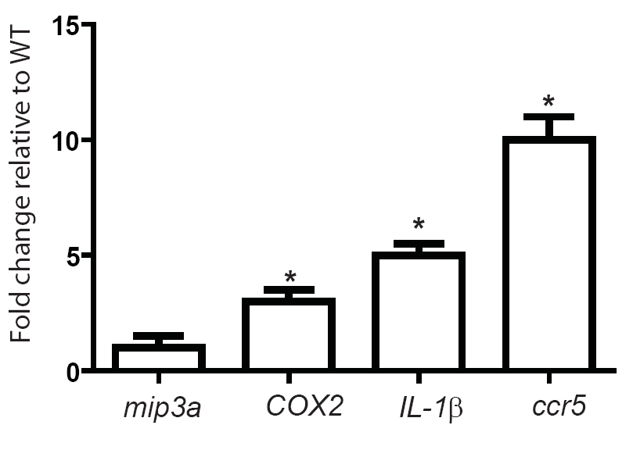
Nlrp12
Nlrp12^{-/-} mice have exacerbated form of EAE
and elevated inflammatory response

Slide 18
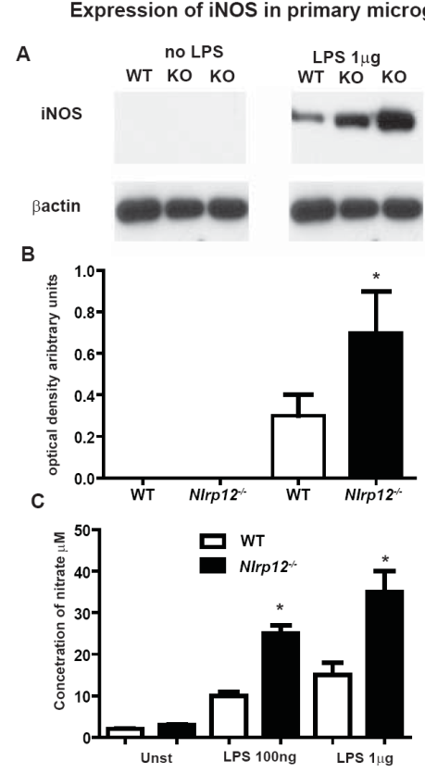
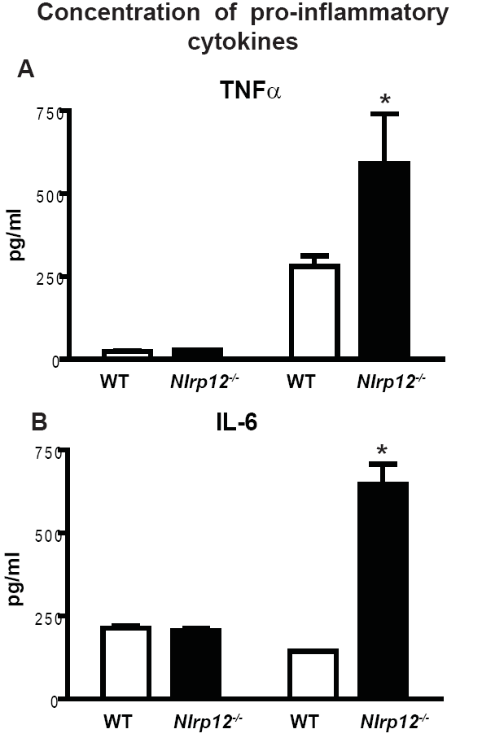
Nlrp12 inhibitor of iNOS and cytokines expression
Significant increase in iNOS expression and
TNFα and IL-6 production by Nlrp12^{-/-} microglia

Slide 19
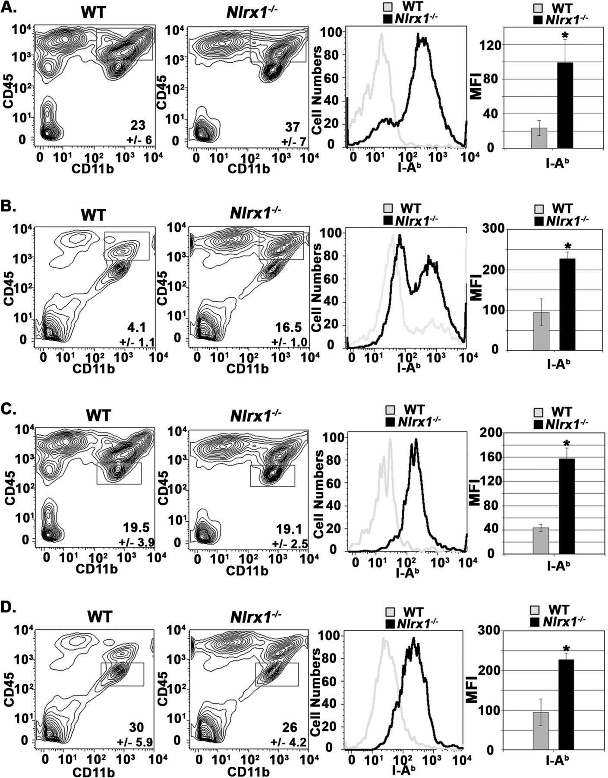
Microglia and macrophages are hyperactivated in Nlrx1^{−/−} mice during EAE
Macrophages
Microglia
Eitas T K et al. J. Biol. Chem. 2014;289:4173-4179
Notes:
Peripheral innate immune cells and resident microglial populations are hyperactivated in Nlrx1^{−/−} mice during EAE.A, flow cytometry analysis of CD45^{high} CD11b⁺ cell populations in spinal cord tissue at 18 dpi during active EAE. Left panels, contour maps depicting the selection of CD45^{high} CD11b⁺ cell populations. Center panel, I-A^{b} expression on CD45^{high} CD11b⁺ WT and Nlrx1^{−/−} cells. Right panel, mean fluorescence intensity (MFI) was used to quantify surface expression of I-A^{b}. n = 6 mice/group. B, flow cytometry analysis of CD45^{high} CD11b⁺ cell populations at 16 dpi during passive EAE. The panels are the same as in A. n = 5 mice/group. C, flow cytometry analysis of microglia at 16 dpi during active EAE. Left panels, contour maps depicting selection of CD45^{lo} CD11b⁺ cell populations. Center panel, I-A^{b} expression on CD45^{lo}, CD11b⁺ WT, and Nlrx1^{−/−} cells. Right panel, mean fluorescence intensity was used to quantify the surface expression of I-A^{b}. n = 5 mice/group. D, flow cytometry analysis of microglia at 16 dpi during passive EAE. The panels are the same as in C. n = 5 mice/group. Error bars represent mean ± S.E. *, p < 0.05.

Slide 20
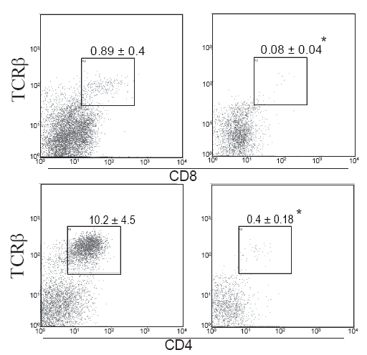
T cell infiltration 3 weeks after immunization
WT Nlrp3^{-/-}
Spinal cords from Nlrp3^{-/-} animals had fewer
CD4 and CD8 T cells

