Slide 1
Understanding temporal relationships between depression, falls and physical activity in a cohort of post-hospitalised older adults—A breakthrough or a conundrum?
Den-Ching Angel Lee
Aislinn F Lalor, Grant Russell, Rene Stolwyk, Ted Brown, Fiona McDermott, Terry P Haines
July 2017

Slide 2
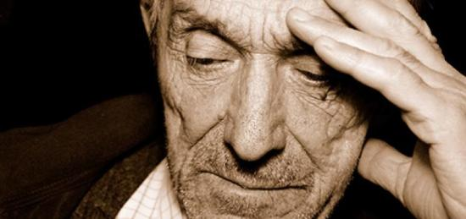
Background
Clinical depression in older adults: late-age onset depression
Affects 15% community –dwelling older adults
½ present as a new depressive episode
Diagnosed in people aged 60 years or older
(Brodaty et al.,2001)

Slide 3

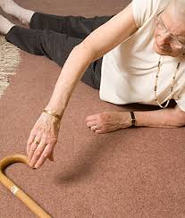
Background
Strawbridge et al.,2002
Turcu et al.,2004

Slide 4


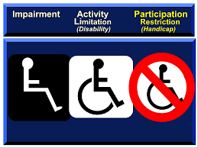
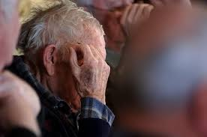
Background
Low rates of positive outcome
Self-critical cognition
Fiske’s behavioural model (Fiske et al., 2009)
-
-ve
-ve

Slide 5
Background-What is the directional relationship?
Falls
Depressive symptoms
Physical activity
Potential explanation
of late-age onset depression

Slide 6
Aim
To investigate the temporal relationships between depressive symptoms, falls and participation in physical activities amongst older adults

Slide 7
Research questions
Are falls associated with depression?
Do falls precede a worsening of depressive symptoms?
Does having symptoms of depression precede subsequent falls?
Same pattern of questioning
  Falls and physical activity
  Physical activity and depression

Slide 8
Methods-Design
A prospective cohort study (broader mixed methods investigation)
Participants
  Older adults aged ≥65 years
  Admitted to subacute or inpatient rehabilitation wards
  Length of hospital stay ≥ two weeks duration
  Exclusion:
    significant cognitive impairment,
    significant hearing or speech impairment
    discharge destination following hospitalisation that was another hospital or a nursing home
Notes:
Reasons for choice of participants: These people have been shown to experience poor health outcomes following their discharge to the community. Previous studies have identified that there is a high risk of falls, functional decline and psychological morbidity in this period which can frequently lead to hospital readmission.
A minimum of two weeks was selected as it was reasoned that the surgery or illness that precipitated this hospitalisation would have been a significant health event likely to have ongoing ramifications for the patient’s health and function during the six-month follow-up period post-discharge.

Slide 9
Methods-survey instruments
Fiske’s behavioural model guided the selection of survey items and questionnaires

Slide 10
Methods-Measurement tools
  Geriatric Depression Scale-Short Form (GDS-SF) (Sheikh & Yesavage, 1986)
  The Phone-FITT household and recreational subscales (Gill et al., 2008)
  Self-reported falls in the last month
  Self-report physical capacity using a Likert scale
    1.“can do without difficulty”, 2. “can do but with difficulty”, 3. “cannot do without someone else”
    Getting on and off public transport
    walking up and down stairs without a handrail
    bending and picking up an object from the floor
    moving about their usual place of residence

Slide 11
Methods-Procedure
Questions of the surveys were loaded onto an online survey program (www.surveymonkey.com)
7 assessment time points:
  face-to-face in the hospital within 48 hours prior to their planned discharge at baseline t_{n=0}
  face-to-face at their residence at three months t_{n=3} and six months t_{n=6} post-discharge
  A telephone survey was conducted at one, two, four and five months t_{n=1},₂,₄,₅ post-discharge.
Notes:
A range of other demographic details were collected from participants at baseline including pre-existing history of depression.
The follow up assessments measured self-reported falls in the last month, self-reported physical capacity, depressive symptoms, and participation in recreational and household physical activities.

Slide 12
Methods-Statistical analyses
Logistic regression
  Differences in the baseline data were compared between all participants at t_{n=0} and those who completed the survey at t_{n=6}
Notes:
Testing difference: to determine if a particular characteristic measured at baseline predicted completion of the six month follow-up assessment.

Slide 13
Methods-Statistical analyses
Example: Falls and depression
Are falls associated with depression?
  Logistic regression with cluster analysis using data from same time point tn (excluding t0)
Do falls precede a worsening of depressive symptoms?
  Linear regression with cluster analysis using falls data from tn and depression change score at tn-tn+1 (excluding t0)
Does having symptoms of depression precede subsequent falls?
  Logistic regression with cluster analysis using depression score from tn and falls data from tn+1 (excluding t0)

Slide 14
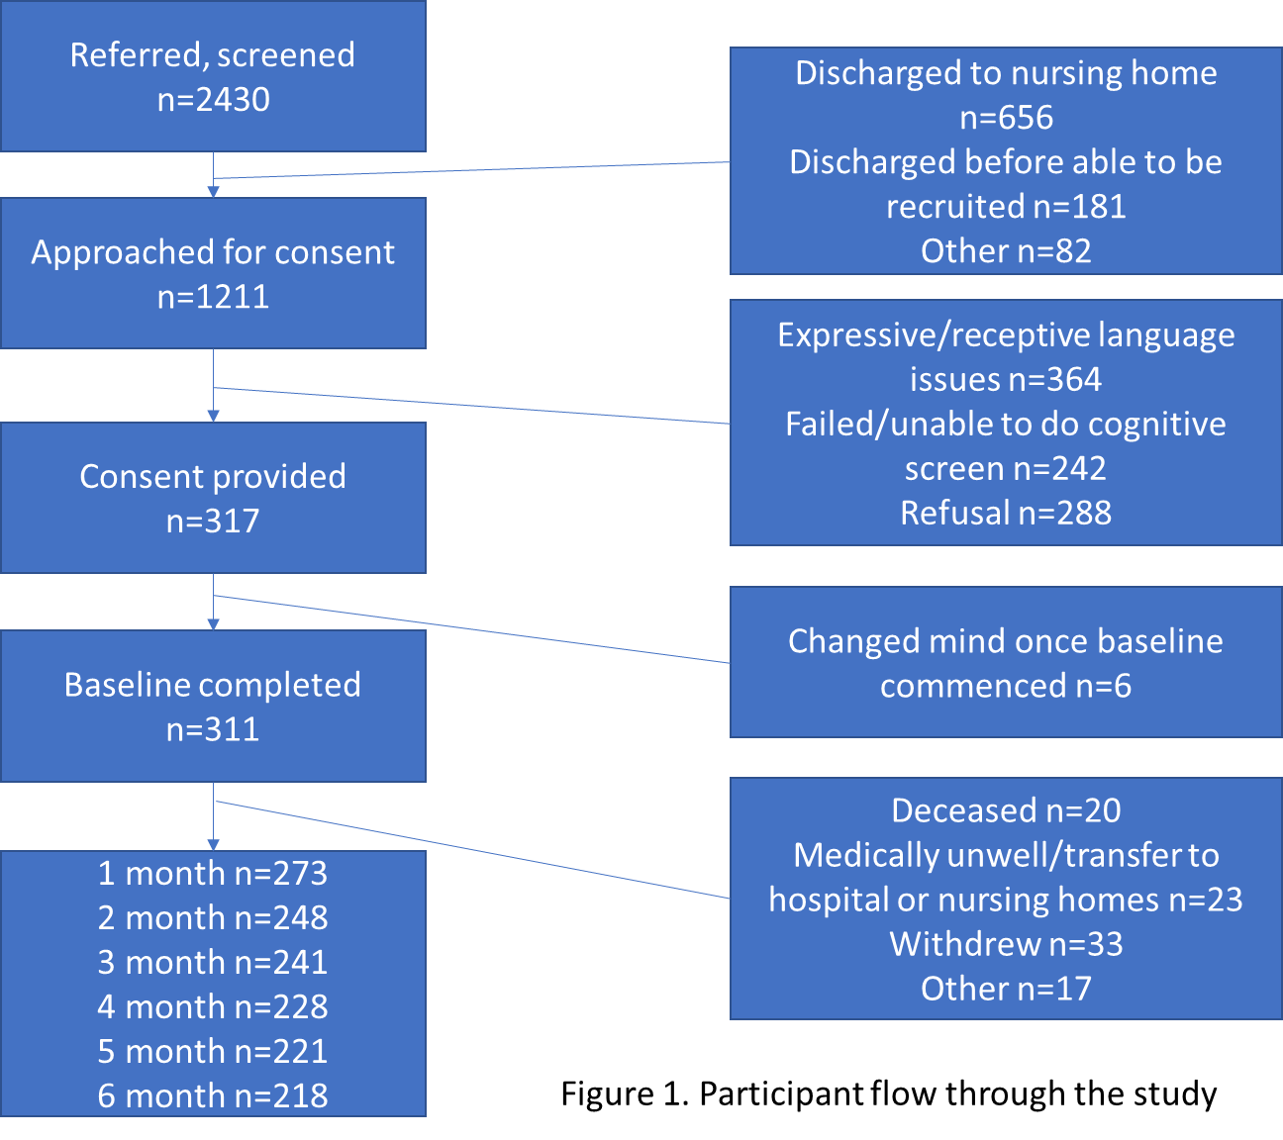
Results

Slide 15
Results
Participants who had a higher mean depression score at baseline were more likely to drop out before the six month follow-up
No significant differences in other baseline characteristics between those who did and did not complete the six-month follow-up survey

Slide 16
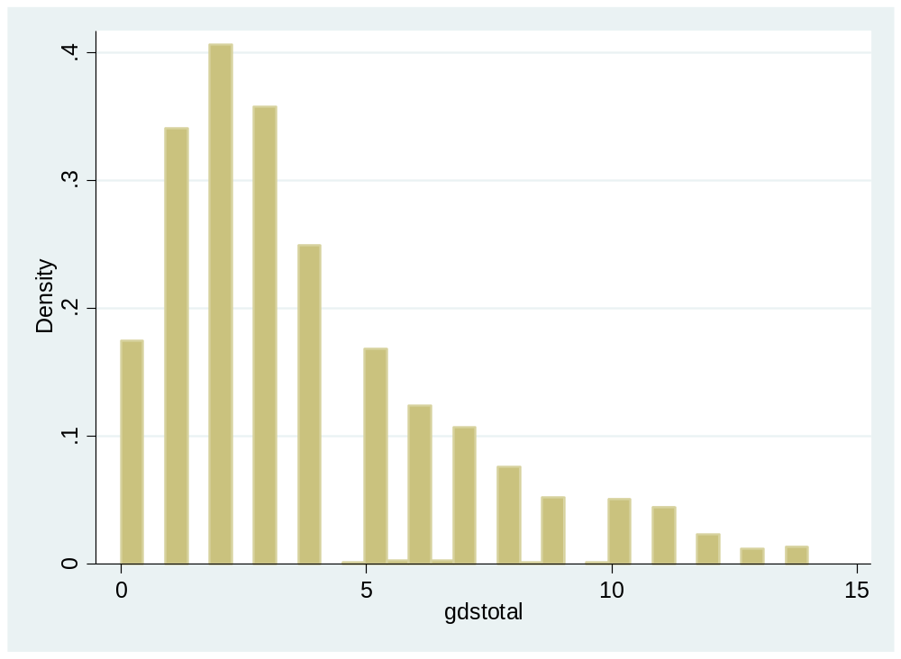
Results
GDS-SF score >5
is suggestive of depression
Geriatric Depression Scale-Short Form scores from month 1 to 6

Slide 17
Results
Lower score means
less activity
Physical activity household score from month 1 to 6

Slide 18
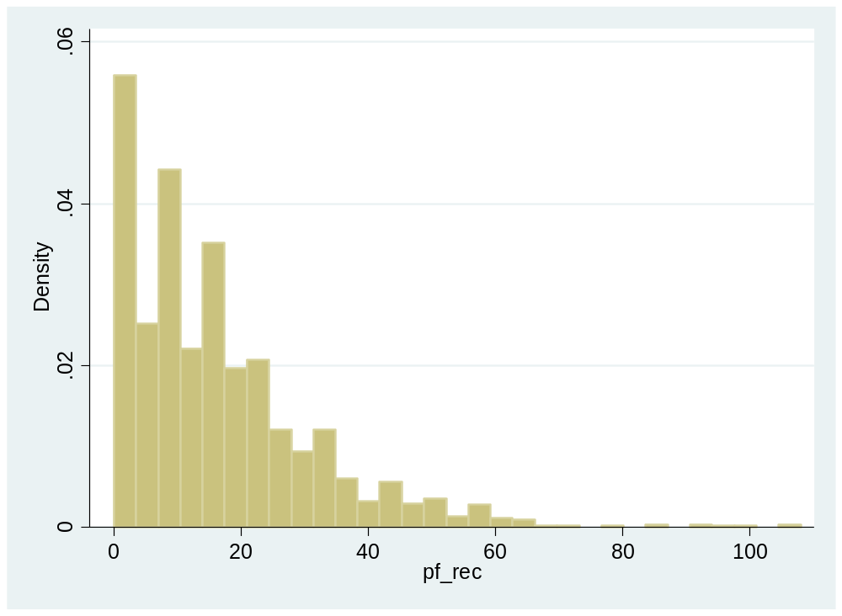
Results
Lower score means
less activity
Physical activity recreation score from month 1 to 6

Slide 19
Results
Proportion of participants who reported falling in the last month by month of follow-up

Slide 20
Results: Falls and depression
tn
tn
odds ratio OR: 1.23 (1.15, 1.30)

Slide 21
Results: Falls and depression
tn
tn+1
OR: 1.20 (1.12,1.28)

Slide 22

Results: Falls and depression
tn
tn-tn+1

Slide 23


Results: Falls and physical activity
tn
tn
tn
OR: 0.97 (0.95, 0.99
OR: 0.96 (0.95, 0.98)

Slide 24
Results: Falls and physical activity
tn
tn
tn+1
OR: 0.97 (0.96, 0.99)
OR:0.97 (0.96, 0.99)

Slide 25
Results: Falls and physical activity
tn
tn-tn+1
tn-tn+1

Slide 26
Results: Depression and physical activity
tn
tn
tn
coef: -0.07 (-0.09, -0.05),
p<0.001
coef: -0.04 (-0.05, -0.02) ,
p<0.001

Slide 27
Results: Depression and physical activity
tn
tn-tn+1
tn-tn+1

Slide 28
Results: Depression and physical activity
tn
tn
tn-tn+1

Slide 29
Discussion-summary of results
Falls
Depression
Physical activity
tn
tn+1
tn
tn+1
tn
Falls
Falls

Slide 30
Discussion-clinical implications
Clinical implications of the results are somewhat unclear
  Use of antidepressants to address depressive symptoms has been found to be associated with increased risk of falls in a recent review (Park et al., 2015)
  Physical activity program delivered to older adults following hospitalisation actually increased the rate of falls (Sherrington et al., 2014)

Slide 31
Discussion
Our findings are consistent with other research
Depressed mood ↔ ↑physical impairment→↑ risk of fall
However, some findings are inconsistent with other research
  ↑Physical activity did not ↓depressive symptoms (? Effect is too small to detect or that the six month follow-up period is too short).
  Depressive symptoms do not appear to inhibit physical activity post-discharge (? changes in physical health or the enablement to participate in activity programs through social supports).

Slide 32
Discussion-limitations
It is possible that falls did cause a reduction in physical activity levels and an increase in depressive symptoms, but they had already taken place prior to the monthly assessment undertaken in this study.
It is likely that we have underestimated the proportion of participants who have clinically significant depressive symptoms each month due to the systematic drop-outs of participants who had a higher mean depression score at baseline.

Slide 33
Discussion-confounding variables
Re-run analyses controlling for possible confounding variables:
  Pre-existing history of depression at baseline
  Self-reported physical capacity over the follow-up period
  Age
  Gender
  Length of hospital stay
  Culturally and linguistics diverse background
  Hospital falls
Re-run analyses using the square-root transformation of depression scores and physical activity scores
→Little effect on the results attained

Slide 34
Conclusion
Physical activity programs in the older post-discharge population may increase falls and have an unknown effect on mood
Non-pharmacological approaches such as cognitive behavioural therapy may offer an effective approach to management of depression and carry lesser risk of increasing falls
Research is required to understand the best approaches to dealing with these interconnected problems in older adults who have recently had an extended period of hospitalisation

Slide 35
Acknowledgement
This work was supported by Beyond Blue: The National Depression Initiative, Victoria, Australia (project ID 12182B)

Slide 36
Publication
Lee, D.-C. A., Lalor A. F., Russell G., Stolwyk R., Brown T., McDermott F., & Haines T.P. (In press). Understanding temporal relationships between depression, falls and physical activity in a cohort of post-hospitalised older adults—A breakthrough or a conundrum? International Psychogeriatrics

Slide 37
Questions?

