Slide 1

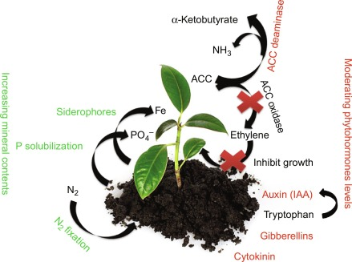

PLANT GROWTH PROMOTING RHIZOBACTERIA: A BOON FOR SUSTAINABLE AGRICULTURE
Dr. Deepmala Katiyar
Post Doctoral Fellow
Banaras Hindu University, India
Notes:
NOTE:
To change the image on this slide, select the picture and delete it. Then click the Pictures icon in the placeholder to insert your own image.

Slide 2
Flow of Presentation
Step 1 Title
Introduction
History
Classification
Type of PGPR
Step 2 Title
Mechanism of PGPR
Task description
Task description
Step 3 Title
Research findings
Growth promotion
Step 4 Title
Bio-control activity
Conclusion

Slide 3
INTRODUCTION
Plant growth-promoting rhizobacteria (PGPR) are naturally occurring soil bacteria that aggressively colonize plant roots.
PGPR are known to induce plant defenses that confer beneficial effects such as increased plant growth via low susceptibility to diseases caused by pathogens (Katiyar et al., 2016).
The term PGPR was first used by Joseph W. Kloepper and Schroth in the late 1970s.
Rhizosphere was coined by German agronomist Hiltner in 1904. Rhizosphere is the region around roots having high microbial activity (Katiyar et al., 2017).
2-5% of rhizobacteria are PGPR (Singh et al., 2017)

Slide 4
CLASSIFICATION OF PGPR
Extracelluar PGPR (ePGPR): Exist in the rhizosphere, on the rhizoplane or in the spaces between the cells of root cortex.
Agrobacterium, Arthrobacter, Azotobacter, Azospirillum, Bacillus, Burkholderia, Caulobacter, Chromobacterium, Erwinia, Flavobacterium, Micrococcous, Pseudomonas and Serratia.
Intracellular PGPR(iPGPR) : Locate generally inside the specialized nodular structures of root cells.
Family of Rhizobiaceae includes Allorhizobium, Bradyrhizobium, Mesorhizobium and Rhizobium, endophytes and Frankia species.

Slide 5

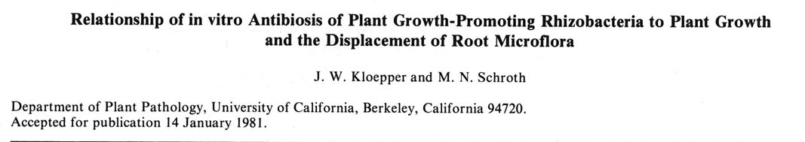
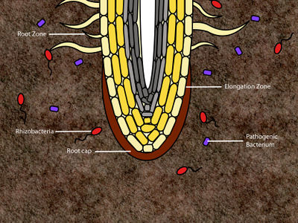
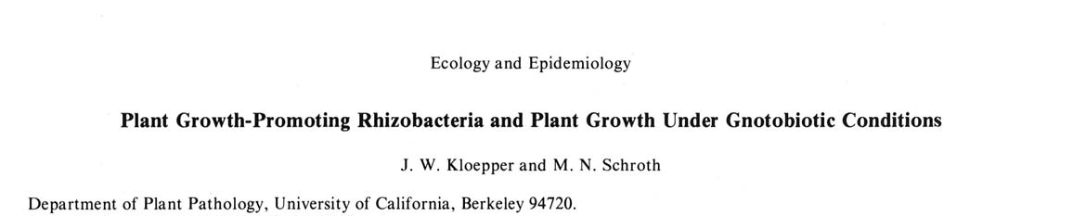
KLOEPPER
Plant Growth Promoting Rhizobacteria on Radishes
PGPR: Plant growth promoting bacteria refers to bacteria that colonize the roots of plants (rhizosphere) that enhance plant growth (Kloepper and Schroth , 1981).

Slide 6
SCENARIOS OF PGPR ACROSS THE WORLD
International Status
National Status
New approaches and practices are being developed and use for sustainable agriculture for various crops & vegetables. Therefore, various works is going on PGPR association for different plants in various laboratories and reported by Kloepper et al., 1981; Bar-Ness et al.,1992; Glick,1997; Vazquez et al., 2000 Bashan and Holguin 2002; Ryu et al., 2003; Burd et al., 1998; Bashan et al., 1998; Belimov et al., 2005; Rodriguez et al., 2007; Grandlic et al., 2008; Compant et al., 2005; Zaidi et al., 2009.
PGPR work is going on different laboratories of India. Krishna et al., 2003; Pal et al., 2003; Devananda, 2000; Vidhyasekaran and Muthamilan, 1995 reported that the plant growth promoting rhizobacteria promoted growth and increased yield in various crops.
Indirect mechanism like ISR by PGPR has been achieved in large number of crops by Viswanathan and Samiyappan, 1999; Ramamoorthy and Samiyappan, 2001; Bharathi et al., 2004; Vidhyasekaran et al., 1997; Nandakumar et al., 2001; Vivekananthan et al., 2004; Paul and Kumar, 2003; Kandan et al., 2005; Bhattacharyya and Jha, 2012.

Slide 7
CRITERIA FOR RHIZOBACTERIA AS PGPR
PGPR must fulfil at least 2 of 3 criteria (Weller et al. 2002; Vessey 2003).
Aggressive colonization
Plant growth stimulation
Bio-control

Slide 8
PGPR
DIRECT PLANT GROWTH PROMOTIOM
(Bio-fertilizer activity)
Phosphate solubilization
Potassium solubilization
IN-DIRECT PLANT GROWTH PROMOTIOM
(Bio-control activity)
Antibiotic production
Hydrolytic enzyme
Nitrogen fixation
Phytohormone production
Exo-polysaccharides
Induced systemic resistance
IAA
Cytokinin & GA
Ethylene

Slide 9

SIDEROPHORE
GIBERELLIN
ETHYLENE REGULATION
Plant Growth Promotion
ROOT PROLIFERATION
ACC DEAMINASES
INDOLE ACETIC ACID
CYTOKININ
INORGANIC/ ORGANIC P
SOLUBLE P
SIDHEROPHORE
PHOSPHATE SOLUBILIZATION
ANTIBIOTICS
GIBBERELIN
PRODUCTION OF GROWTH PROMOTING SUBSTANCES
Plant Growth Promoting Rhizobacteria
RELEASE OF
BIOCONTROL
AGENTS
ANTIFUNGAL
CYTOKININ
LYTIC ENZYMES
ANTIOXIDANT
NITROGEN FIXATION
EXOPOLYSACCHARIDES
RELEASE OF TRACE
ELEMENTS (Zn & Fe)
RELEASE OF TRACE
ELEMENTS (Zn and Fe)
Plant Growth Promotion
ORGANIC /INORGANIC P
ANTIOXIDANT
NITROGEN FIXATION
EXOPOLYSACCHARIDES

Slide 10
PROPERTIES OF PGPR
Stimulate growth
  N fixation
  Increase solubility of limiting nutrients (siderophores)
  Stimulate nutrient delivery and uptake
  Production of phytohormones
  Modulation of plant development (e.g. reduce ethylene enhances root growth)
Plant-mediated disease suppression
  Non-pathogens antagonize pathogens (competition, antibiotics, lytic enzymes)
  Activating plant to better defend itself (ISR)
  Induced resistance observed on spatially separated parts of same plant

Slide 11
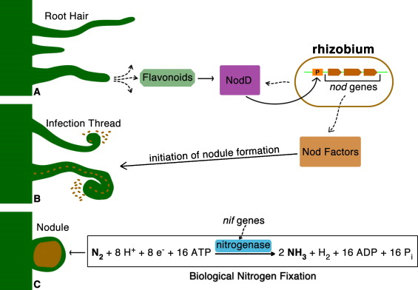
NITROGEN FIXATION BY RHIZOBACTERIA

Slide 12
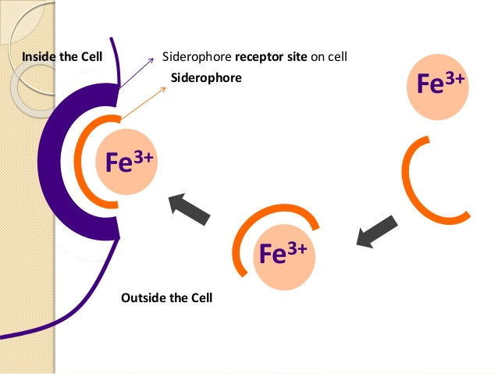
SIDEROPHORE PRODUCTION
Siderophores are water-soluble and low molecular mass iron chelators
Iron is often insoluble(oxides and hydroxides)
Cell produces siderophore
Iron binds to siderophore complex on bacterial cell wall
Siderophore binds to recognition sites on cell
Iron is reduced to Fe³⁺ to Fe²⁺ and taken by the cell

Slide 13
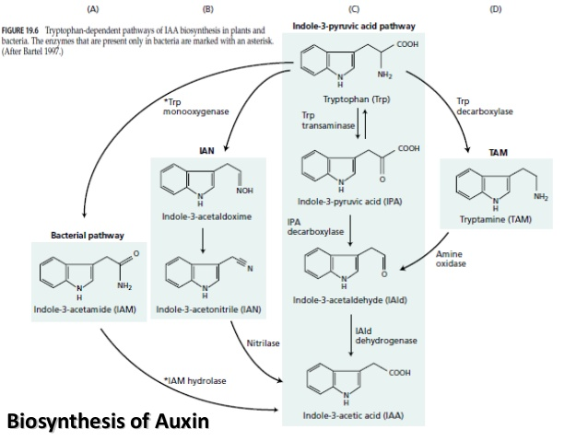

Slide 14
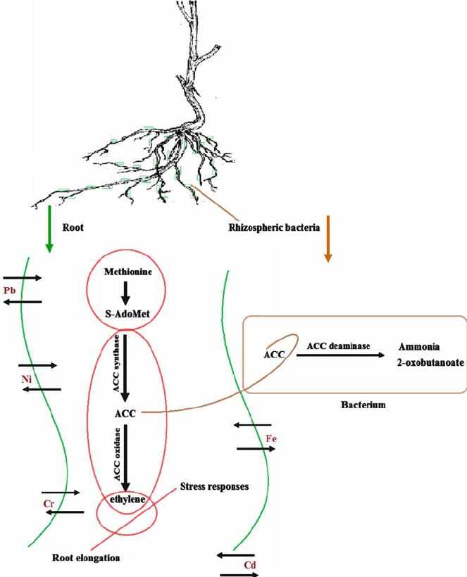
REGULATION OF ETHYLENE LEVEL BY PGPR
PGPR possess 1-aminocyclopropane-1-carboxylate (ACC) deaminase decreasing ethylene levels.
Induce salt tolerance and promoted plant growth by lowering the synthesis of salt-induced ethylene (Cheng et al., 2007).
ACC deaminase identified in genera - Acinetobacter, Enterobacter, Ralstonia, Agrobacterium, Alcaligenes, Azospirillum, Bacillus, Burkholderia, Pseudomonas,
Serratia and Rhizobium etc.

Slide 15
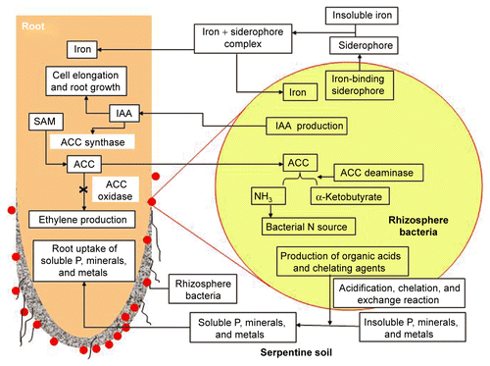

Slide 16
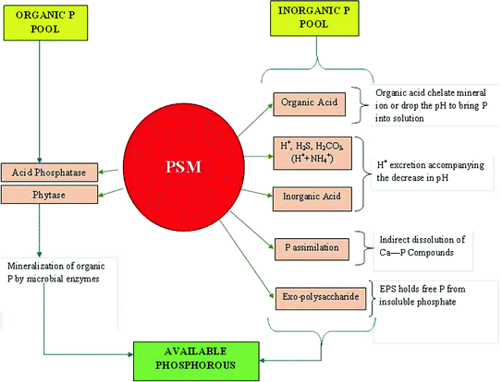
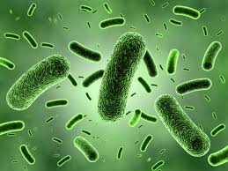
PHOSPHATE SOLUBILIZATION BY PGPR

Slide 17
Research Findings

Slide 18
Isolation of plant growth promoting rhizobacteria
Soil sampling/ analysis
Serial dilution 10⁻¹-10⁻⁸
0.1 ml of solution were spread serially and simultaneously on culture plates (10⁻¹-10⁻⁸) of NA, Pikoskava & King’s Media
Incubated at 37⁰C for 48 hrs
The plates were showing well isolated without any contamination colonies were subculture
Isolated colonies were checked for PGP Mechanism
IAA Production by
Bric et al., 1991
HCN Production by
Picric acid method
NH₃ Production by
Bakker & Schippers, 1987
Antifungal activity

Slide 19
After being checked for PGP Mechanism
MORPHOLOGICAL CHARACTERIZATION
BIOCHEMICAL
CHARACTERIZATION
CARBOHYDRATE
FERMENTATION
MOLECULAR CHARACTERIZATION
SHAPE
LACTOSE
DNA ISOLATION
TSI, SIM
SIZE
NUTRIENT GELATIN
DEXTROSE
DNA QUANTIFICATION
COLOUR
CITRATE
MANNITOL
DNA AMPLIFICATION
GRAM STAINING
STARCH
SUCROSE
Primer > 27F aga gtt tga tcc tgg ctc ag > 1492 tac ggt tac ctt gtt acg act
NITRATE
MR-VP
INOSITOL
CHOOSE PCR PRODUCT
CATALASE, OXIDASE
MALTOSE
SEQUENCING
GALACTOSE
ANALYSIS OF FORWARD & REVERSE SEQUENCE
SORBITOL
SUBMITTED TO NCBI GENEBANK BY SEQUIN

Slide 20
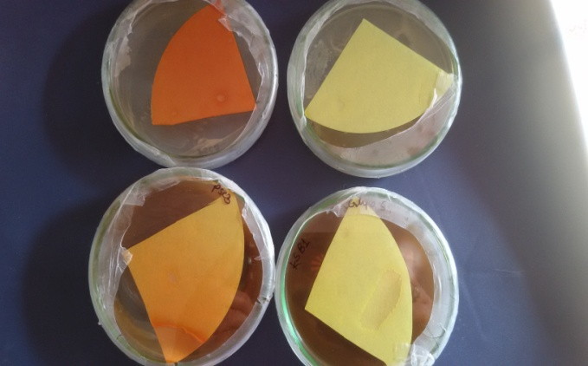
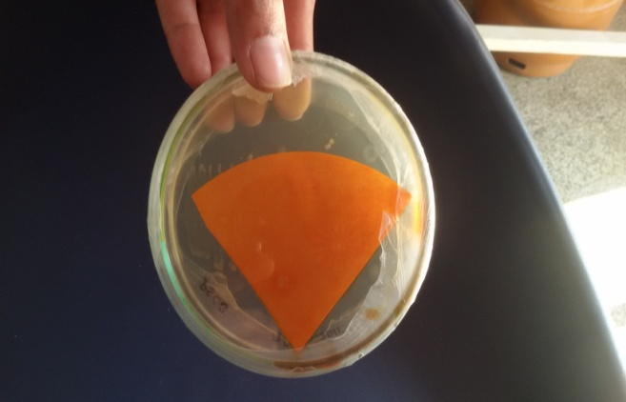
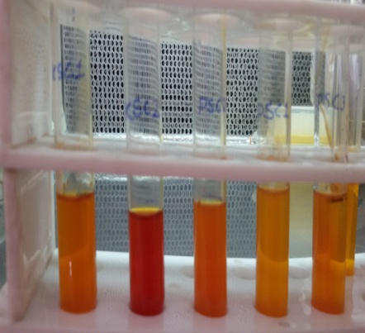
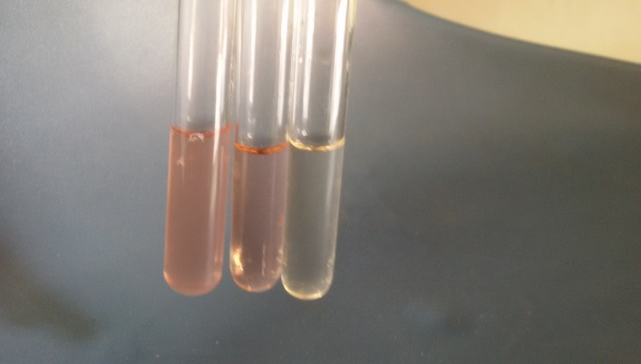
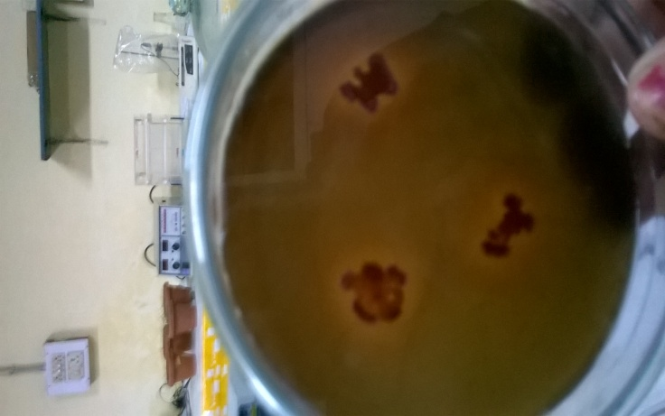
Plant growth promoting mechanism
PGP MECHANISM | PSC1 | PSC3 | KSC1 | P13 | P35
NH₃ PRODUCTION | ++ | +++ | ++ | - | +
HCN PRODUCTION | + | +++ | + | +++ | +
IAA PRODUCTION | ++ | ++ | + | + | +
SIDEROPHORE | + | ++ | + | - | -
HCN PRODUCTION
NH₃
IAA
SIDEROPHORE

Slide 21
BIOCHEMICAL
TEST | PSC1 | PSC3 | KSC1 | P13 | P35
COLOUR | Creamy white | Yellow | Yellowish | Creamy white | Creamy white
SHAPE | Rod | Rod | Rod | Rod | Rod
SIM (MOTALITY) | - | + | + | - | -
OXIDASE | + | - | + | + | +
CATALASE | + | + | - | - | +
TSI | R/Y | R/R | R/R | R/R | R/R
CITRATE | - | + | +
NITRATE | - | + | + | + | -
GELATIN | + | + | + | + | -
STARCH | + | - | - | + | -
MR | + | + | - | - | +
VP | + | - | + | - | +
SUCROSE | - | - | - | - | +
LACTOSE | + | - | + | - | -
MANNITOL | + | - | + | - | -
SORBITOL | + | + | - | + | -
INNOSITOL | - | - | + | - | -
MALTOSE | + | - | - | + | -
DEXTROSE | - | - | - | + | -
GALCTOSE | + | - | - | - | -
IDENTIFIED | Bacillus sp. | Enterobacter sp. | Bacillus sp. | Bacillus sp. | Bacillus sp.

Slide 22
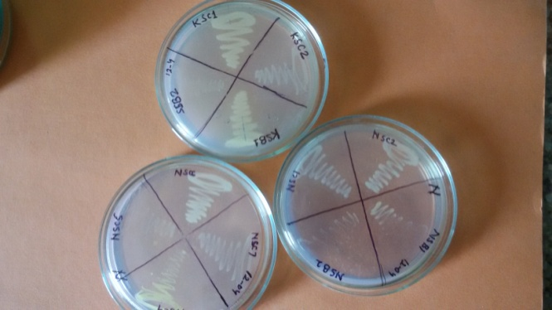
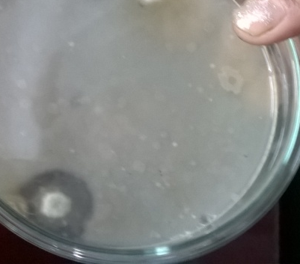
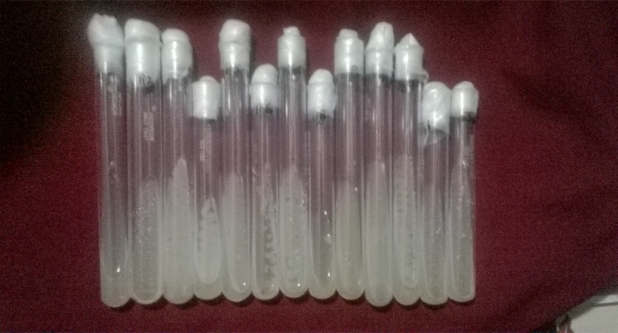
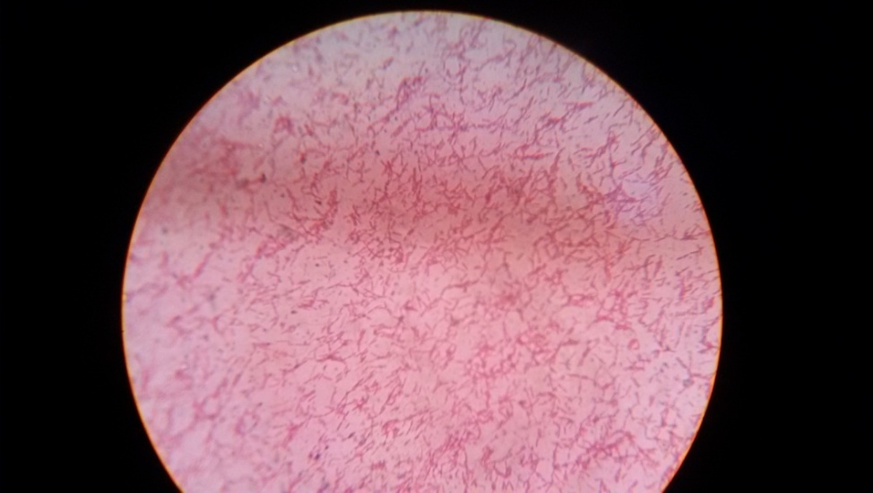
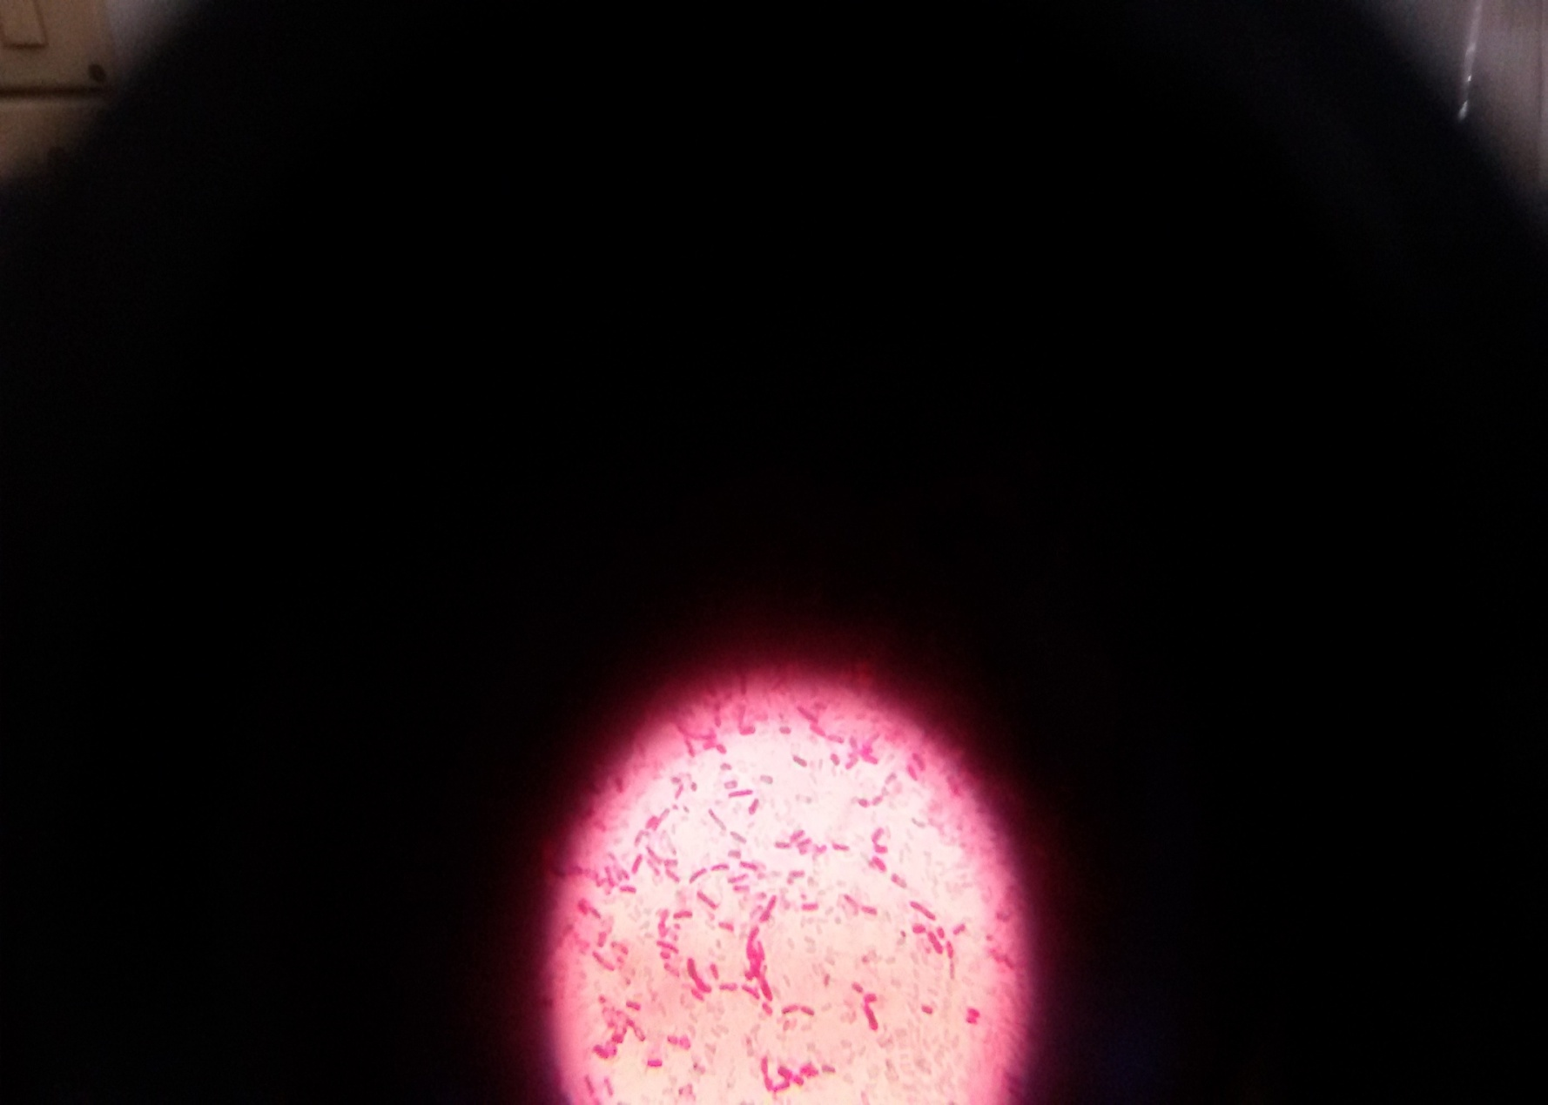
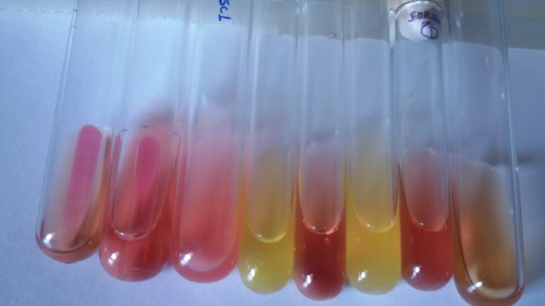
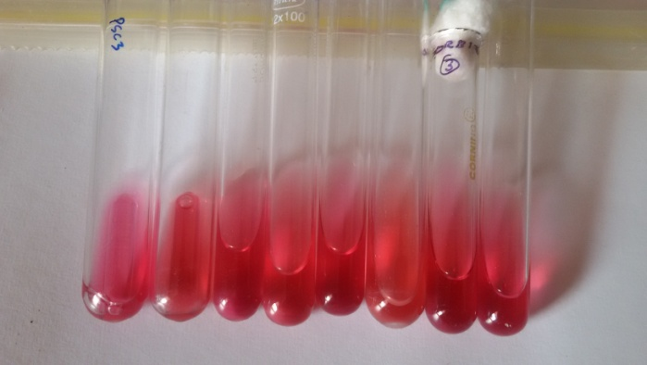
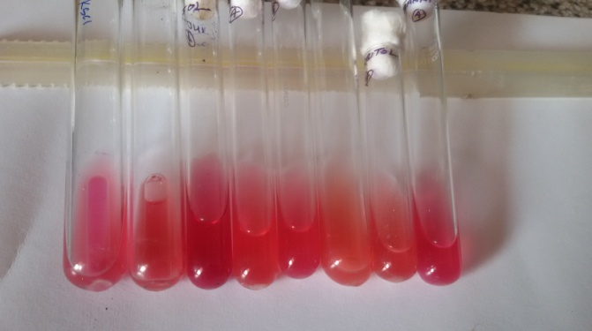
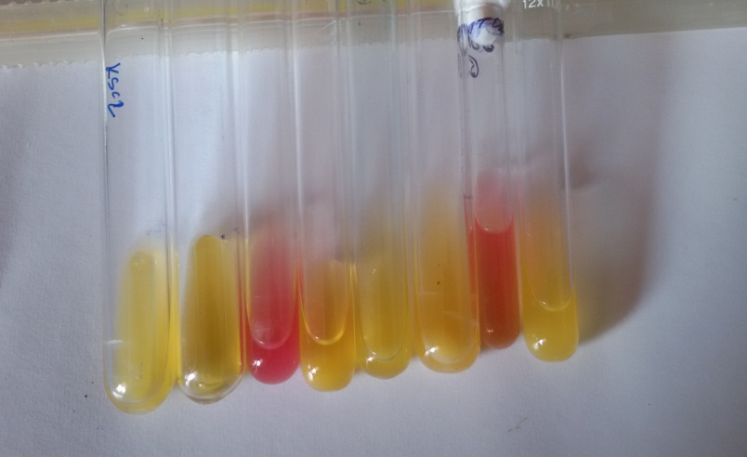
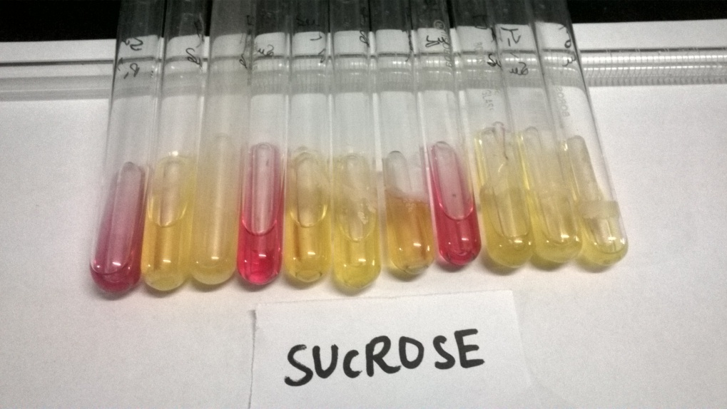
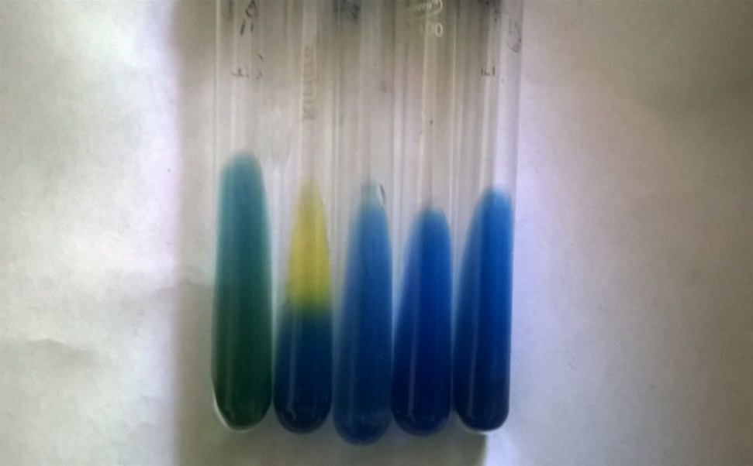
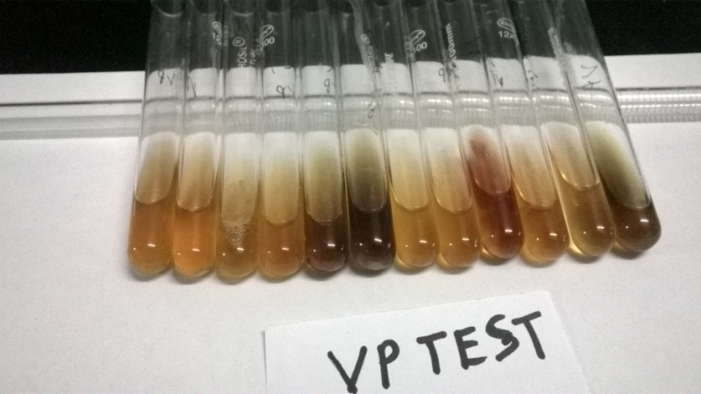
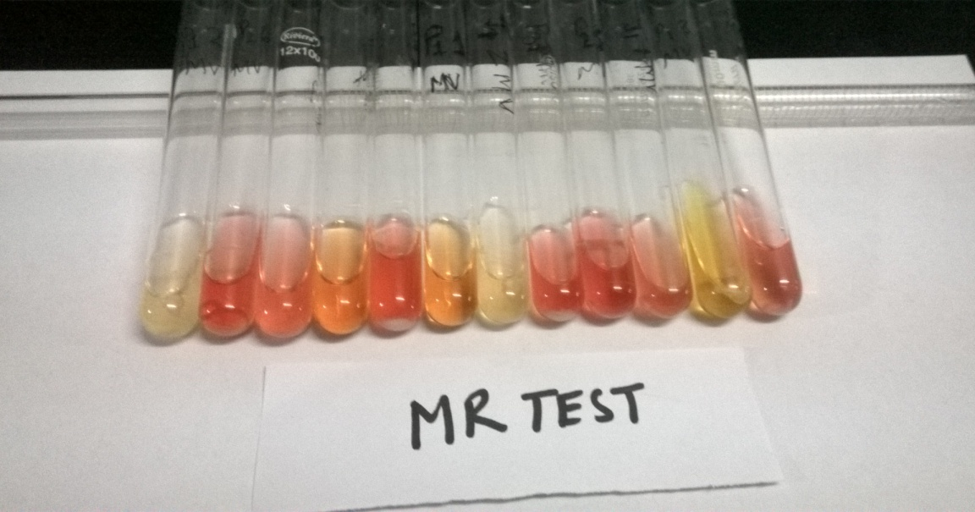
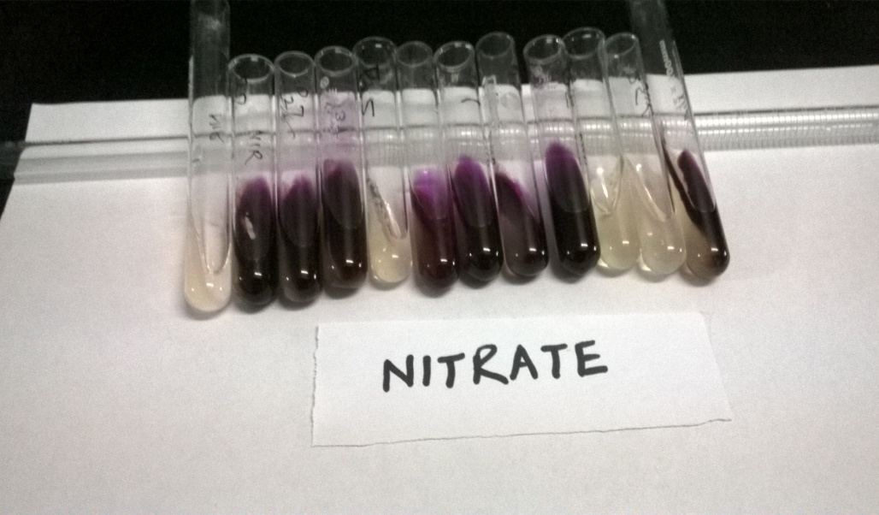
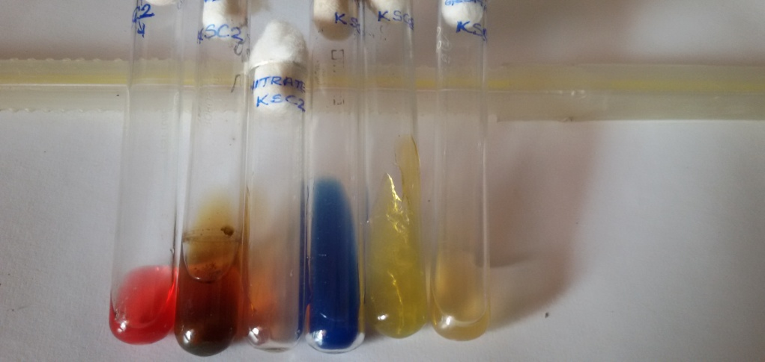
Isolated strain & Phosphate solubilization
Gram Stain
PSC1
PSC3
KSC1
P13
P35
Carbohydrates fermentation
Citrate
VP Test
MR Test
Nitrate Test
PSC3
Biochemical Test

Slide 23
IAA production rate in presence of tryptophan
Quantification of Phosphorus solubility by different strains

Slide 24
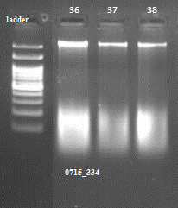
Lane 1
Lane 1
Lane 1
Lane 1
Fig. : Agarose gel electrophoresis of the 16S rDNA PCR products of bacterial isolate. Lane 1: 1kb DNA ladder; Lane 2: bacterial isolate PSC3; Lane 3: PSC1; Lane 4: P13.

Slide 25
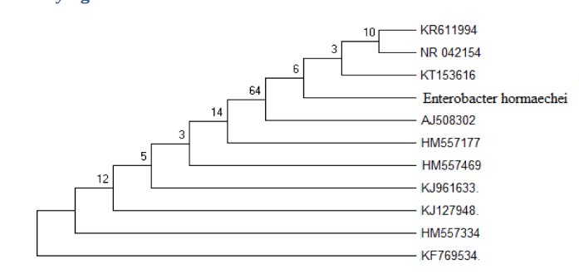
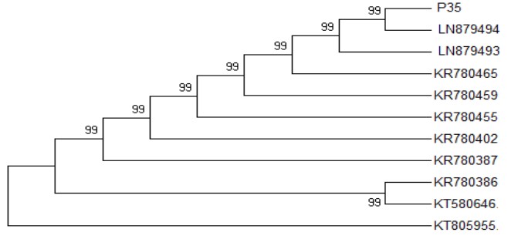
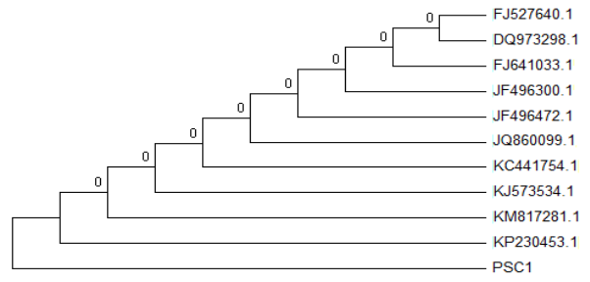
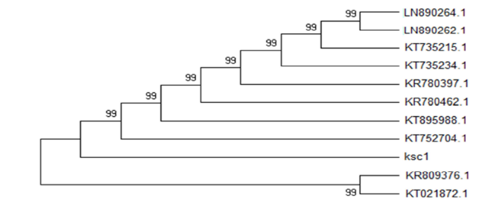
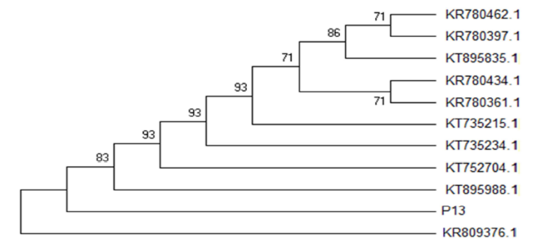
MOLECULAR CHARACTERIZATION
Phylogenetic dendrogram
Enterobacter hormaechei
Bacillus pumilus
Bacillus megaterium
Bacillus cereus
Bacillus thuringiensis
SN | ISOLATES | IDENTIFICATION | CLUSTAL W | ACCESSION NO
1 | PSC1 | Bacillus megaterium | 100 % | KU196781
2 | PSC3 | Enterobacter hormaechei | 99 % | KT852562
3 | KSC1 | Bacillus cereus | 100 % | KU196778
4 | P13 | Bacillus thuringiensis | 100 % | KU196779
5 | P35 | Bacillus pumilus | 100 % | KU196780

Slide 26
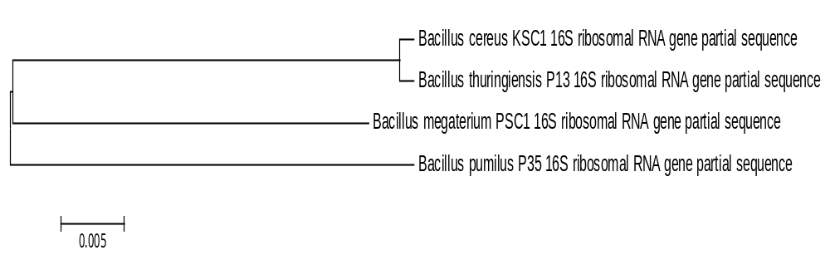
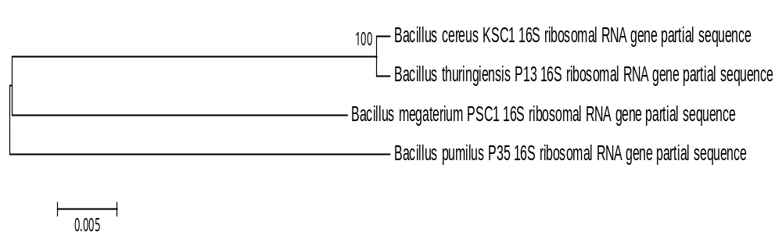
Fig 6: Neighbor-joining phylogenetic dendrogram based on a comparison of the 16S rRNA gene within sequences of isolated phylogenetic taxa. (A) Without bootstrap (B) With bootstrap.

Slide 27
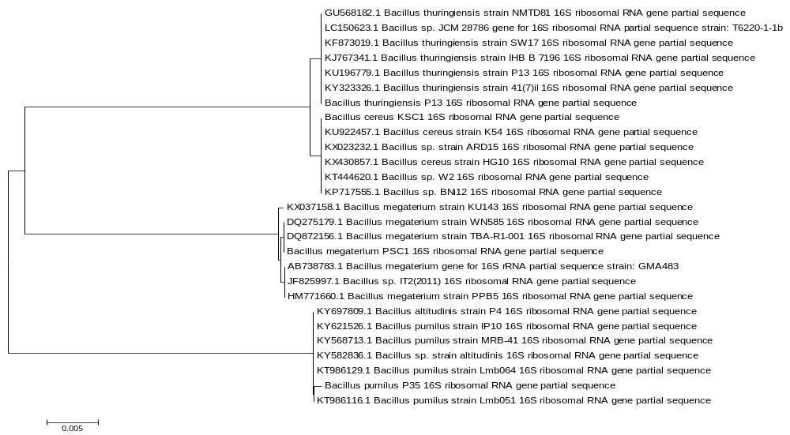
Fig.7: Neighbor joining phylogenetic tree based on partial 16S rRNA gene sequences. Sugarcane isolates (PSC1, KSC1, P13 and P35) were analysed with other bacterial species from the database between the sequences without or without bootstrap. The database accession numbers are indicated after the bacterial names. The scalebar represents 0.005 substitutions per site (A) Without bootstrap

Slide 28
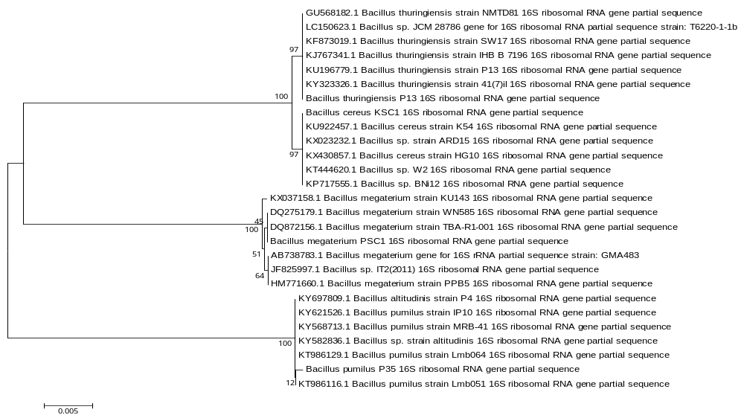
Fig.7: Neighbor joining phylogenetic tree based on partial 16S rRNA gene sequences. Sugarcane isolates (PSC1, KSC1, P13 and P35) were analysed with other bacterial species from the database between the sequences without or without bootstrap. The database accession numbers are indicated after the bacterial names. The scalebar represents 0.005 substitutions per site With bootstrap.

Slide 29
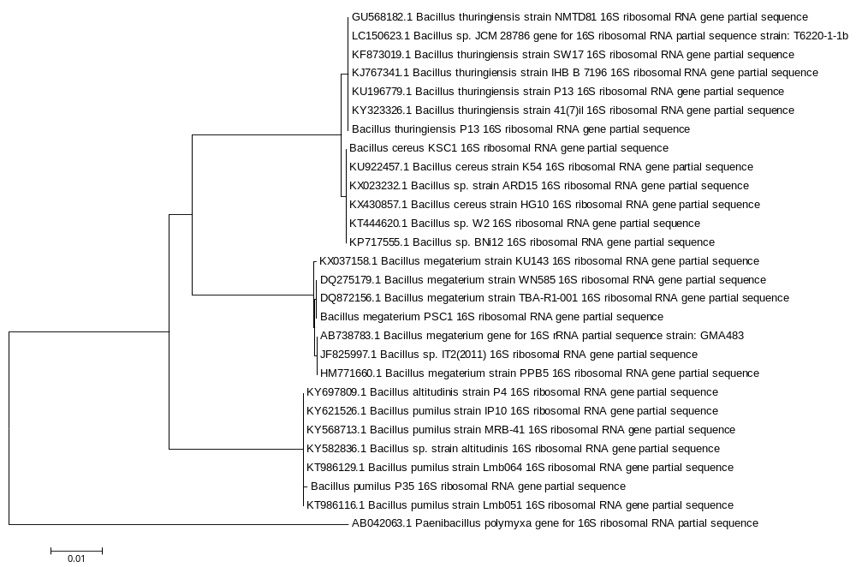

Slide 30
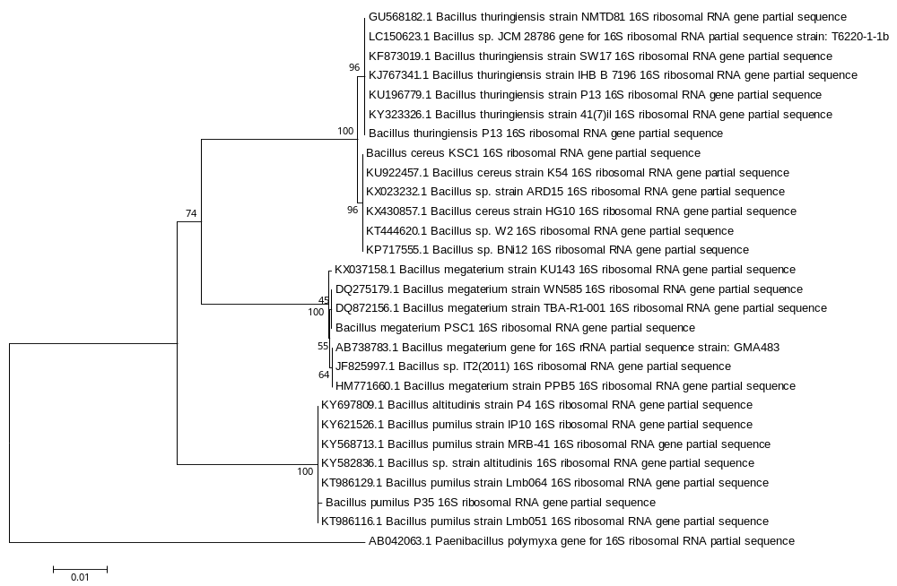
Fig.8: Neighbor joining phylogenetic tree based on partial 16S rRNA gene sequences. sugarcane isolates (PSC1, KSC1, P13 and P35) were analysed with other bacterial species from the database with outgroup and between the sequences. The database accession numbers are indicated after the bacterial names. The scalebar represents 0.01 substitutions per site. The bootstrap values are presented above the nodes. (A) Without bootstrap (B) With bootstrap

Slide 31
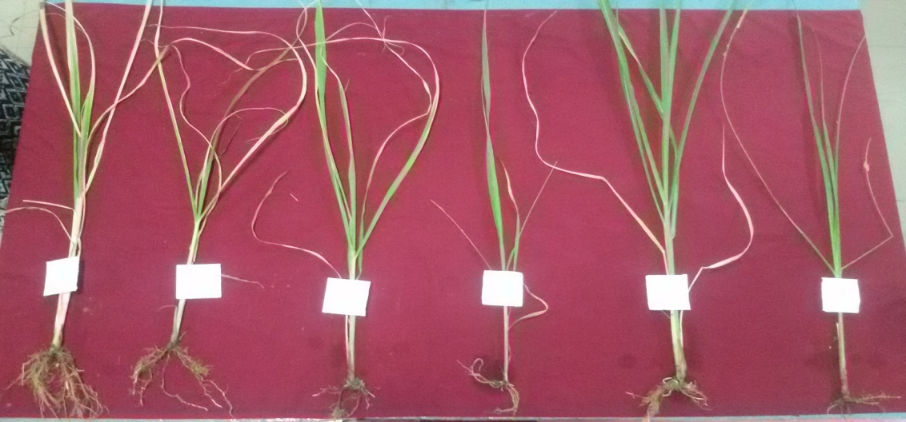
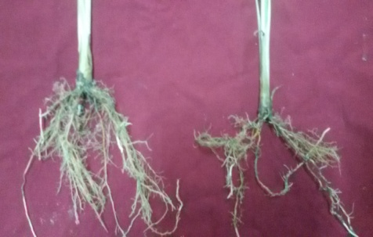
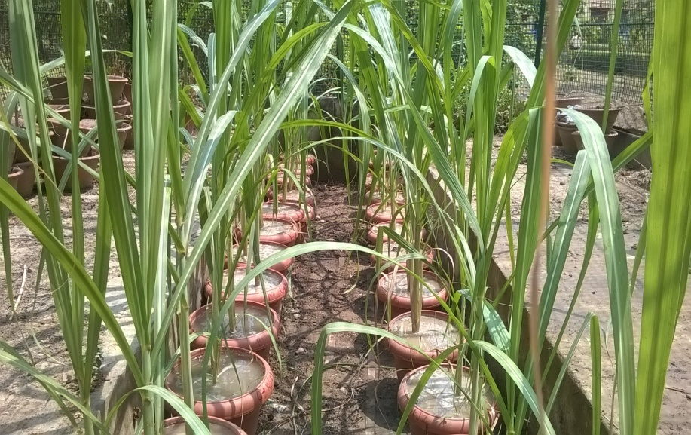
Screening of Isolates
PSC3
PSC1
PSC3
KSC1
P13
PSC1
P35
Ctrl
Variety- Co -239, 60 day plants
Strains
PSC1 Bacillus megaterium
PSC3 Enterobacter hormaechei
KSC1 Bacillus cereus
P13 Bacillus thuringiensis
P35 Bacillus pumilus

Slide 35
Synergistic effect of PRPR and chitosan Under salinity stress

Slide 36
T1 | = | Control (without treatment)
T2 | = | 150 mM NaCl
T3 | = | PSC3 (Enterobacter hormaechei) +150 mM NaCl
T4 | = | P35 (Bacillus pumilus) +150 mM NaCl
T5 | = | J2 (Bacillus paralicheniformis)+ 150 mM NaCl
T6 | = | PSC3 (Enterobacter hormaechei) + 150 mM NaCl + 0.5% Chitosan
T7 | = | P35 (Bacillus pumilus) + 150 mM NaCl + 0.5% Chitosan
T8 | = | J2 (Bacillus paralicheniformis) + 150 mM NaCl + 0.5% Chitosan

Slide 37
Treatments | Plant Height (cm) |  | Number of Leaves plant⁻¹ |  | Total Chlorophyll (mg g⁻¹ FW) |  | Proline content (µMol g⁻¹ FW) |  | Protein content (mg g⁻¹ FW
 | 60 DAS | 120 DAS | 60 DAS | 120 DAS | 60 DAS | 120 DAS | 120 DAS | 60 DAS | 60 DAS | 120 DAS
T1 (Control) | 31.667 | 61.667 | 6.000 | 8.000 | 2.076 | 0.108 | 0.218 | 2.076 | 10.657 | 79.508
T2 (150mM NaCl) | 28.333 | 58.333 | 6.000 | 10.000 | 2.348 | 0.081 | 0.163 | 2.348 | 9.481 | 69.101
T3 (150 mM NaCl +PSC3) | 34.333 | 64.333 | 7.000 | 10.00 | 1.940 | 0.094 | 0.192 | 1.940 | 11.764 | 71.261
T4 (150 mM NaCl +P35) | 35.667 | 65.667 | 6.00 | 8.000 | 1.775 | 0.134 | 0.267 | 1.775 | 12.955 | 82.117
T5 (150 mM NaCl+J2) | 38.667 | 68.667 | 6.00 | 10.00 | 1.534 | 0.160 | 0.320 | 1.534 | 10.061 | 85.229
T6 (150 mM NaCl + PSC3+0.5% Chitosan) | 42.333 | 72.333 | 7.00 | 11.00 | 1.241 | 0.199 | 0.398 | 1.241 | 14.531 | 87.066
T7 (150 mM NaCl + P35+0.5% Chitosan) | 37.333 | 67.333 | 5.000 | 10.00 | 1.385 | 0.232 | 0.467 | 1.385 | 16.785 | 99.821
T8 (150 mM NaCl +J2+0.5% Chitosan) | 40.667 | 70.667 | 6.00 | 10.00 | 1.449 | 0.164 | 0.330 | 1.449 | 11.955 | 117.280
SEm± | 0.391 | 0.391 | 0.312 | 0.441 | 0.004 | 0.001 | 0.003 | 0.004 | 0.504 | 1.892
CD at 5% | 1.182 | 1.182 | 0.943 | 1.333 | 0.013 | 0.003 | 0.008 | 0.013 | 1.523 | 5.722

Slide 38
Treatments | Nitrate Reductase activity (µg g⁻¹ FW) |  | Polyphenol Oxidase content (Enzyme unit g⁻¹ FW |  | Hydrogen Peroxide content (µg g⁻¹ FW) |  | Starch content (mg g⁻¹ FW) |  | Total Sugar content (mg g⁻¹ FW)
 | 60 DAS | 120 DAS | 60 DAS | 120 DAS | 60 DAS | 120 DAS | 60 DAS | 120 DAS | 60 DAS | 120 DAS
T1 (Control) | 65.149 | 132.385 | 88.817 | 133.283 | 235.197 | 487.665 | 1.961 | 13.162 | 10.657 | 79.508
T2 (150mM NaCl) | 41.682 | 76.787 | 112.625 | 168.958 | 369.755 | 543.596 | 1.837 | 11.305 | 9.481 | 69.101
T3 (150 mM NaCl +PSC3) | 82.954 | 104.364 | 85.158 | 127.750 | 194.231 | 478.063 | 2.331 | 13.904 | 11.764 | 71.261
T4 (150 mM NaCl +P35) | 99.304 | 141.935 | 81.905 | 123.042 | 179.266 | 391.704 | 2.178 | 13.166 | 12.955 | 82.117
T5 (150 mM NaCl+J2) | 85.895 | 117.710 | 76.175 | 114.267 | 158.190 | 381.602 | 1.768 | 15.580 | 10.061 | 85.229
T6 (150 mM NaCl + PSC3+0.5% Chitosan) | 116.445 | 152.751 | 70.475 | 105.792 | 146.842 | 264.378 | 4.727 | 18.467 | 14.531 | 87.066
T7 (150 mM NaCl + P35+0.5% Chitosan) | 93.422 | 120.430 | 77.308 | 115.975 | 121.901 | 226.717 | 3.190 | 16.170 | 16.785 | 99.821
T8(150 mM NaCl +J2+0.5% Chitosan) | 134.029 | 134.238 | 78.375 | 117.567 | 150.770 | 268.805 | 3.714 | 17.488 | 11.955 | 117.280
SEm± | 0.598 | 0.439 | 0.345 | 0.573 | 0.818 | 0.329 | 0.338 | 1.168 | 0.504 | 1.892
CD at 5% | 1.808 | 1.329 | 1.045 | 1.731 | 2.473 | 0.994 | 1.021 | 3.533 | 1.523 | 5.722

Slide 39
Bio-control Activity of PGPR

Slide 40
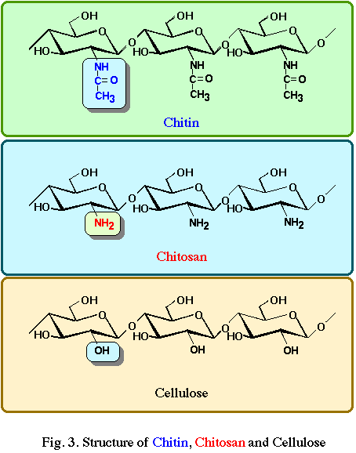
Chitin and Chitosan
Chitin is a 2nd abundant natural polysaccharide on earth.
Structure similar to cellulose with hydroxyl group replaced
by acetamido group N-acetyl-glucosamine units in β-(1→4)
Chitosan is the N-deacetylated derivative of chitin N-
glucosamine units in β-(1→4) linkage.
Unique characteristics of chitin and chitosan:
Biocompatible
Biodegradable
Non-toxic
Remarkable affinity to proteins
Ability to be functionalized

Slide 41
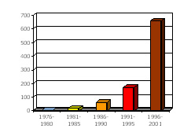
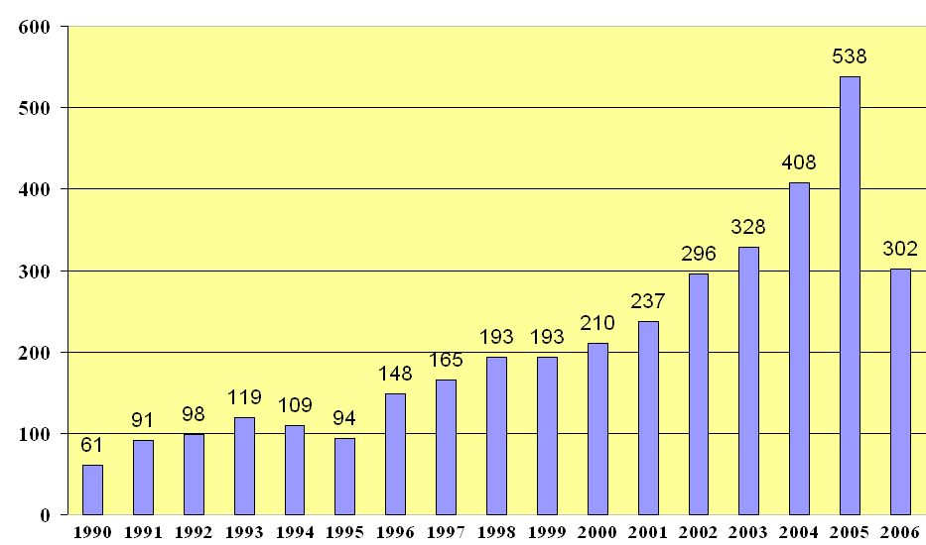
21st Century: New era for chitin?
Number of US patents
Survey of the scientific literature
Source: www.carmeda.com/eng/businessarea/
International conferences
International Conference on Chitin and Chitosan (ICCC)
International Conference of the European Chitin Society (EUCHIS)
International Conference “New achievements in study of chitin and chitosan”
Asia-Pacific Chitin Chitosan Symposium (APCCS)
The number of chitin scientific reports since 1990 as obtained from ScienceDirect®
The number of reports of 2006 is through April, 15th
Source: www.sciencedirect.com/

Slide 42
For the preparation of Chitosan , Chitin was treated with NaOH at a concentration of 40% w/v at high temperature (80⁰C) for 1 hr.
Chitosan was treated with papain to obtain Chitoligosaccharides (COS)
Characterization by FTIR , UV spectroscopy Chitosan Chitoligosaccharides (COS)
Preparation of chitooligosaccharides (Hong et al., 2002)
Chitin
Methods of Characterization
Determination of Chitosan and chitooligomers content- The chitooligomers content was determined by 3, 5-DNS (Miller, 1959).
Fourior transform infrared Spectroscopy- FTIR were performed with a PERKIN ELMER FTIR instrument. FTIR spectra are usually recorded in the middle infrared (4000 cm⁻¹ to 400 cm⁻¹) with a resolution of 4 cm⁻¹ (Thanpitcha et al., 2008).
UV vis spectroscopy of COS- UV-Vis spectra of chitosan derivatives are usually recorded in aqueous acid (acetic acid) solutions in a 1.0 cm quartz cell at ambient temperature.

Slide 43
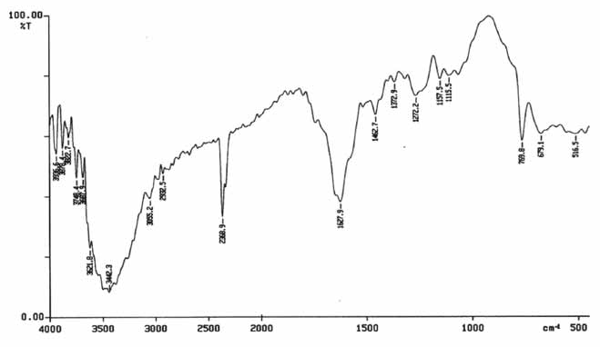

FTIR spectrum and UV vis spectrum of chitologigosacchrides (COS)

Slide 44



1H NMR spectrum of chitologigosacchrides (COS)

Slide 45



Antifungal activity of Chitosan, COS and E. hormaechei against C. falcatum
0.1%
0.5%
1.0%
Ctr

Slide 46





Percentage growth inhibition of Colletotricum falcatum by of different treatments
Concentration of / COS Chitosan | Growth Inhibition % by Chitosan | Growth Inhibition % by COS | Growth Inhibition % by Chitosan E. hormaechei
0.2 % Chitosan/COS | 72.3% | 2.85% | 83.5%
0.4% Chitosan/COS | 76.3% | 1.0% | 84.99%
0.6% Chitosan/COS | 79.6% | 3.0% | 86.85%
Ctr
0.2%
0.6%
Ctrl
Chitosan
0.6%
Trt
Ctrl
0.2%
Chitosan + E. hormaechei
Fungal mycelia stained with LPB

Slide 47
Antifungal Activity of different concentration of chitosan and E. hormaechei against C. falcatum
ab*
C^{NS}
C^{NS}
C^{NS}
b*
a*
b*
b*
a*
Values are statistically significant at *p<.05. Significance determined by ANOVA was compared within the treatments as follows: ª Control vs 0.6% chitosan and chitosan + E hormaechei; ^{b} 0.2%, 0.4%, 0.6% Chitosan vs. Control and ^{CNS} Not significant

Slide 48
1
Out of these 59 isolates seven isolates PSC1, PSC3, KSC1, P13, P35, J2 and SC7 were selected for further studies. PSC3 strain was for efficient P solubilizes among the seven isolates.
2
The selected isolates were Bacillus megaterium Enterobacter hormaechei, Bacillus cereus, Bacillus thuringiensis Bacillus pumilus, Bacillus paralicheniformis and Panaebacillus mucilaginous.
3
All the isolates were positive for IAA, HCN, NH₃ and some showed siderophore production. Enterobacter hormaechei (KT852562) showed highest plant growth promoting activities among five rhizobacteria.
4
Enterobacter hormaechei showed good plant growth as well as significant antifungal activity against red rot causing fungus C. falcatum combination with chitosan.

Slide 49
5
6
The combination of chitosan 0.6% and PGPR E. hormaechei showing potential antifungal activity. The percentage of growth inhibition was 86.8% compared to chitosan (79.6%)
8
Chitosan and PGPRs seems promising for the development of a new combination for plant growth promotion.That may be eco-friendly in nature compared to chemical fertilizers and fungicides.
The Chitosan COS and PGPR were showing antifungal activity. The 0.6% of Chitosan was showing significant concentration compared other concentration 0.2%, 0.4%.
This study is also helpful for developing new combination from PGPR and chitosan for managing red rot Colletotrichum falcatum Co-007 disease in sugarcane.
7

Slide 50




