Slide 1

An insight into the secondary metabolite profile of Bergenia ligulata rhizome showed bergenin as the most potent antilithiatic agent
Deepika
Department of Biochemistry
Panjab University, Chandigarh

Slide 2
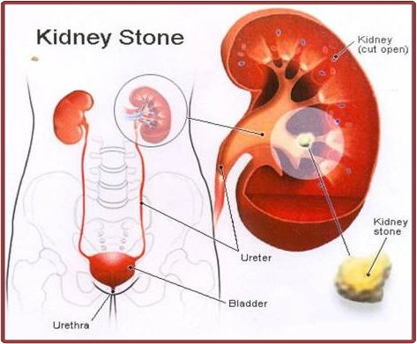
Urolithiasis

Slide 3
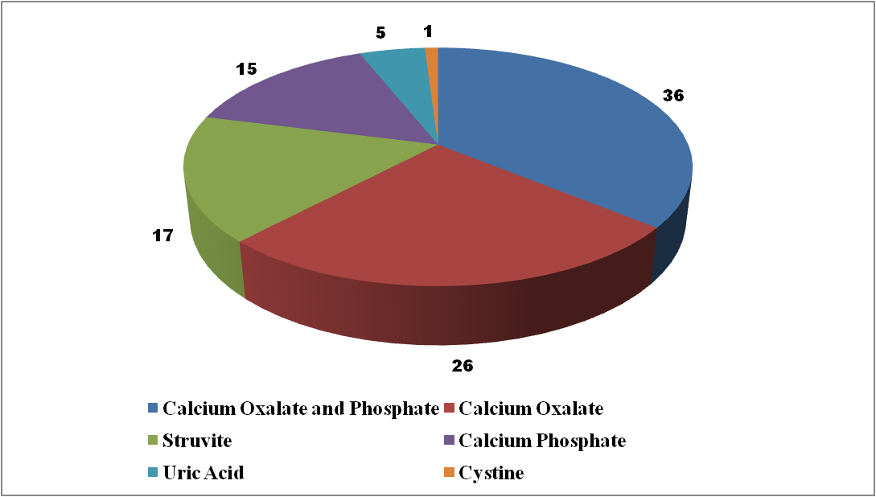
STONE TYPES

Slide 4
Oxalate mediated Stone Formation

Slide 5
management
Non-Invasive Shock wave Lithotripsy
Surgical procedures (PCNL)
Allopathic
Herbal Therapy
Non-Specific
Recurrence
Costly
High rate of Recurrence
No drug is available for dissolution or displacement
Side-effects
Less Side-effects
Non-Invasive
No standard Formulation
Batch to Batch Variation
Limited clinical studies

Slide 6
Herbal Therapy
Composite antiurolithiatic herbal formulations:
Cystone (Himalaya Herbal Healthcare, India)
Calcury (Charak Pharma Pvt. Ltd., India)
Neeri (Aimil Pharmaceuticals, India)
Uriflow (BioNeutrix Healthcare of Brooklyn, New York)
Pasanabheda (Bergenia ligulata)
is one of the main constituents of these available compositions

Slide 7
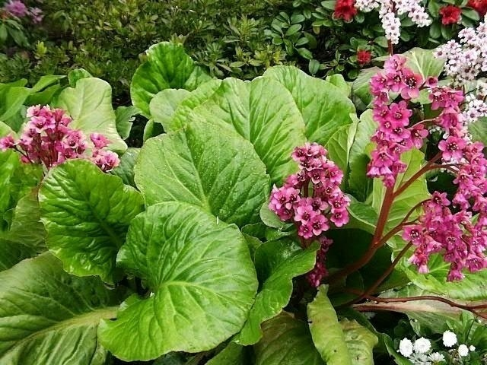
Bergenia Ligulata

Slide 8
AIM
To isolate the potential metabolite(s) responsible for antiurolithiatic activity of Bergenia ligulata

Slide 9
Study Design
IN VITRO
Effects of B. ligulata
Isolation of Active Metabolite(s)
Characterization
IN VIVO
Establishment of Urolithiatic Rat Model
Validation of effective metabolite(s)

Slide 10
In Vitro Experiments
Antilithiatic Activity
Calcium oxalate crystal growth
Antioxidant Activity
FRAP Assay
Effects of B. ligulata
Isolation of Active Metabolite(s)
Characterization
Activity guided fractionation
  Soxhlet extraction
  Column chromatography
TLC
LC-MS
FTIR
NMR

Slide 11
Purification Strategy

Slide 12
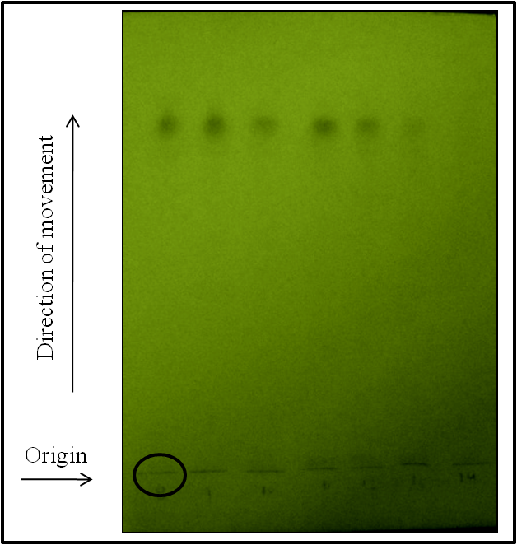
TLC (SFR1)

Slide 13
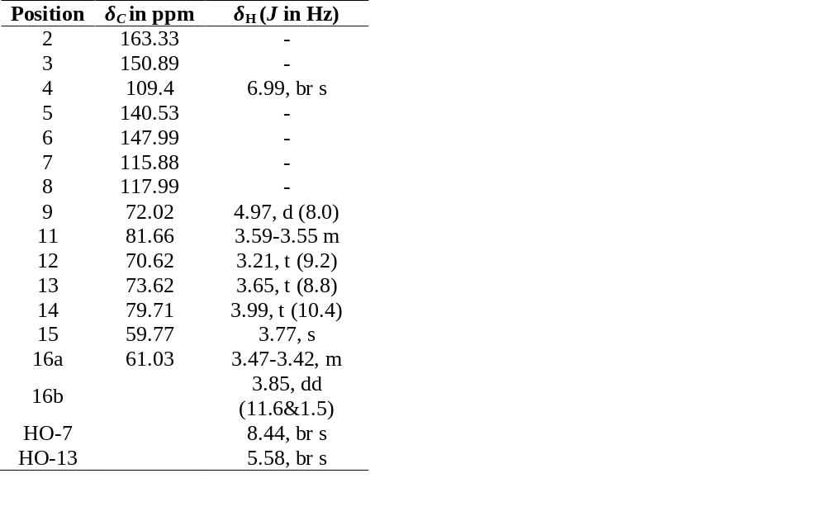
Characterization of SFR1
a)
NMR
b)
FTIR
ν_{max}3450–3200, 2943, 2894, 2724, 1703, 1612, 1528, 1463, 1374, 1092, 1071,859, 819, 594, and 540 cm⁻¹
LC-MS (EI, 70 eV)
m/z 351[M Na⁺], 329 [MH⁺], 275, 263, 209 (base peak), 181, 177 and 141
UV-VIS Spectra
λmax at 220 and 275 nm
c)
d)
e)

Slide 14
In Vitro Activity
Notes:
20µl of 0.5% solution of BRG, BLE and Cystone in 10% DMSO. BRG

Slide 15
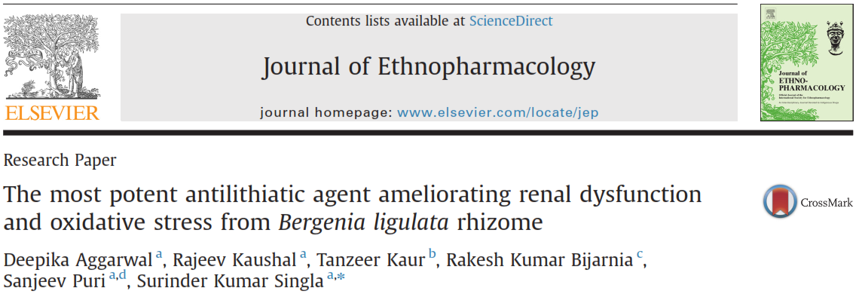
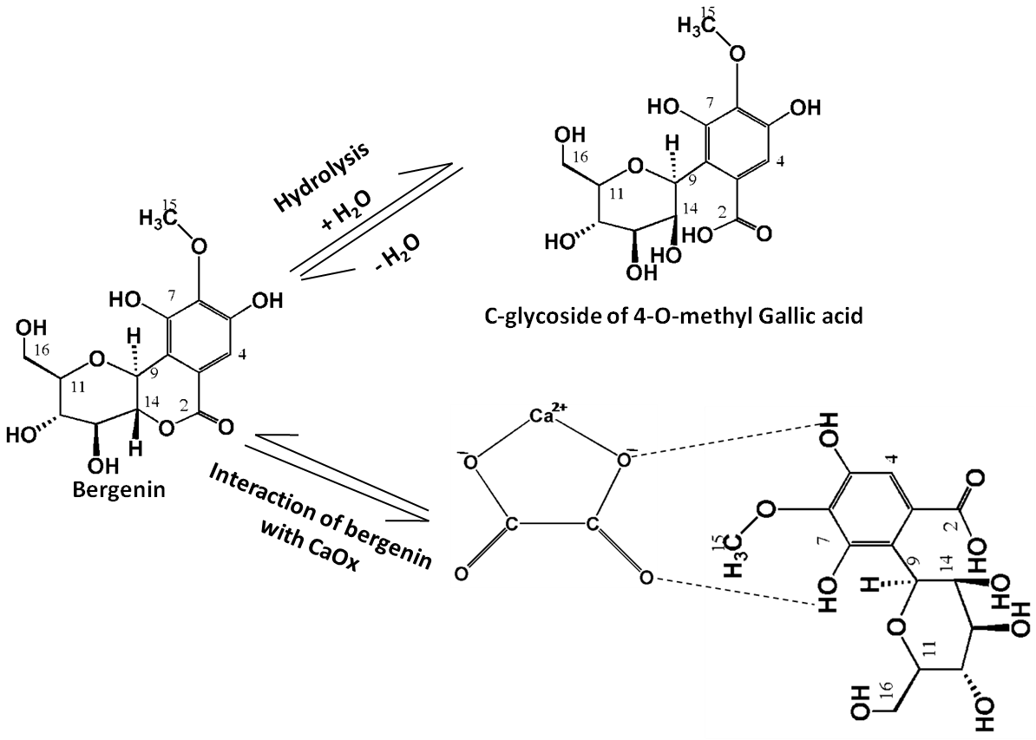
Notes:
Possible way of hydrolysis of bergenin into C-glycoside of 4-O-methyl Gallic acid and interaction of bergenin with calcium oxalate crystal

Slide 16
In Vivo Experiments
Urolithiatic Rat Model
Validation of effective metabolite(s)
0.4% ethylene glycol (EG) and 1% NH₄Cl in drinking water
0.4% EG and 1% NH₄Cl + 10mg/kg body wt of BRG
0.4% EG and 1% NH₄Cl + 10mg/kg body wt of BLE

Slide 17
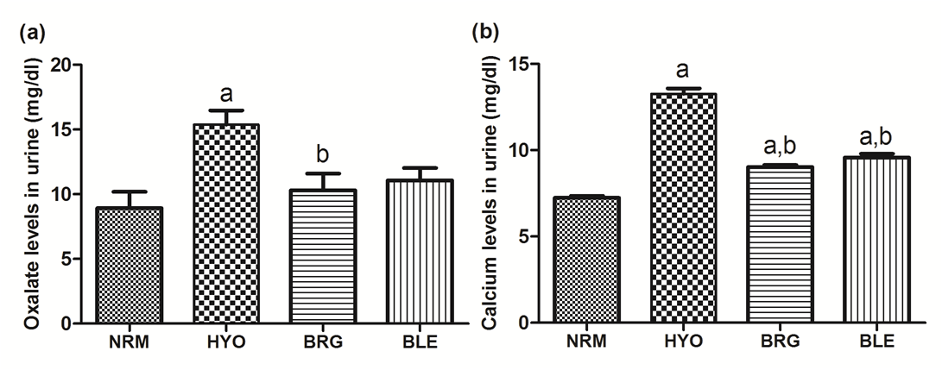
Urine Parameters

Slide 18
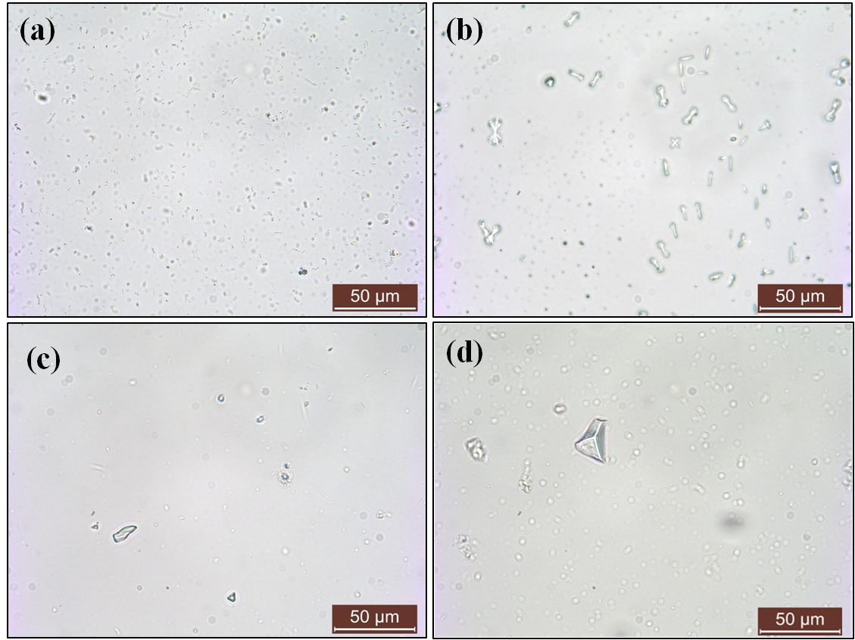
Crystalluria
NRM
HYO
BRG
BLE
Notes:
Original magnifications of 100X.

Slide 19
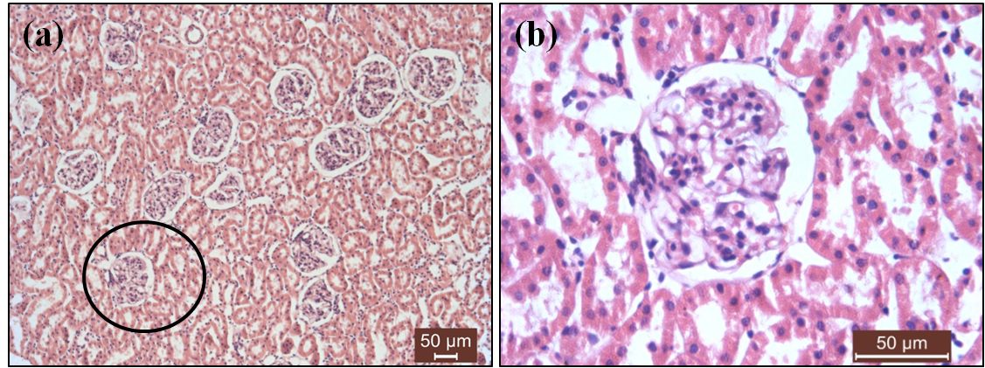
Histopathology
GROUP 1 - NRM
Histopathology
100X
400X

Slide 20
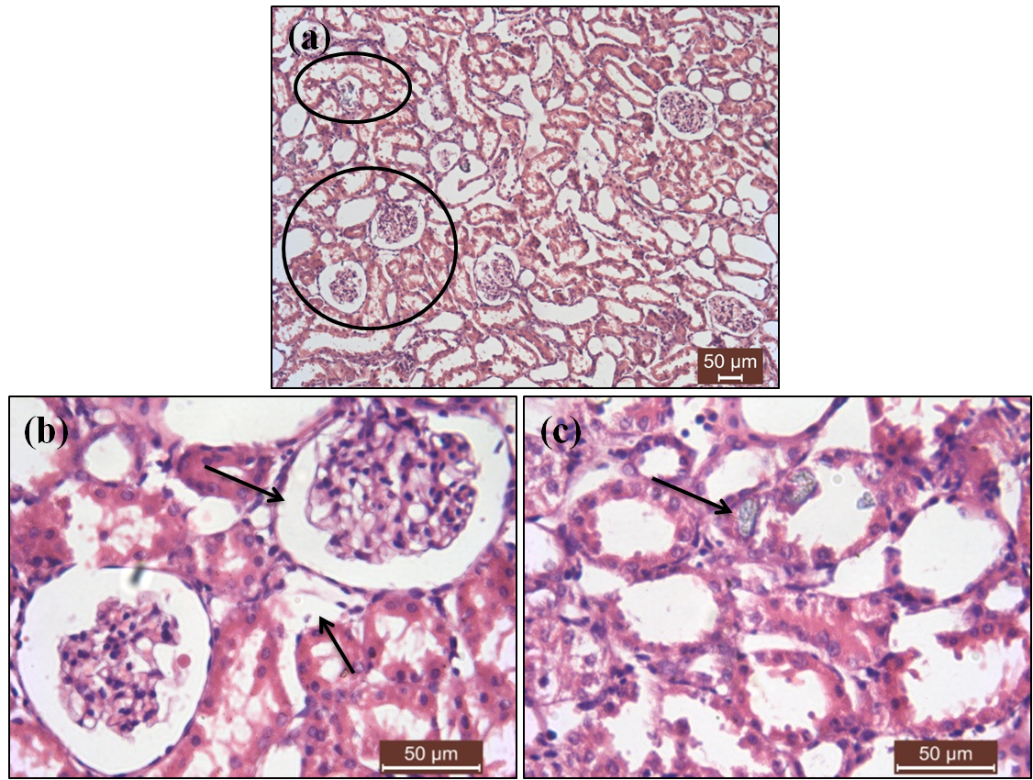
GROUP 2 - HYO
100X
400X
400X

Slide 21
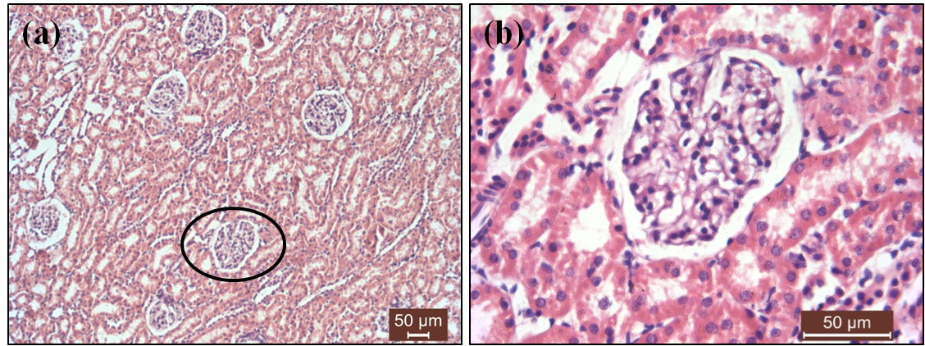
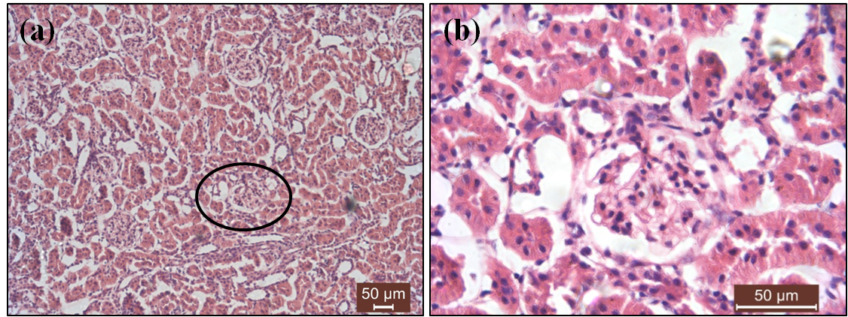
GROUP 3 - BRG
100X
400X
GROUP 4 - BLE
100X
400X

Slide 22
Antioxidant Profile-Kidney Tissue

Slide 23
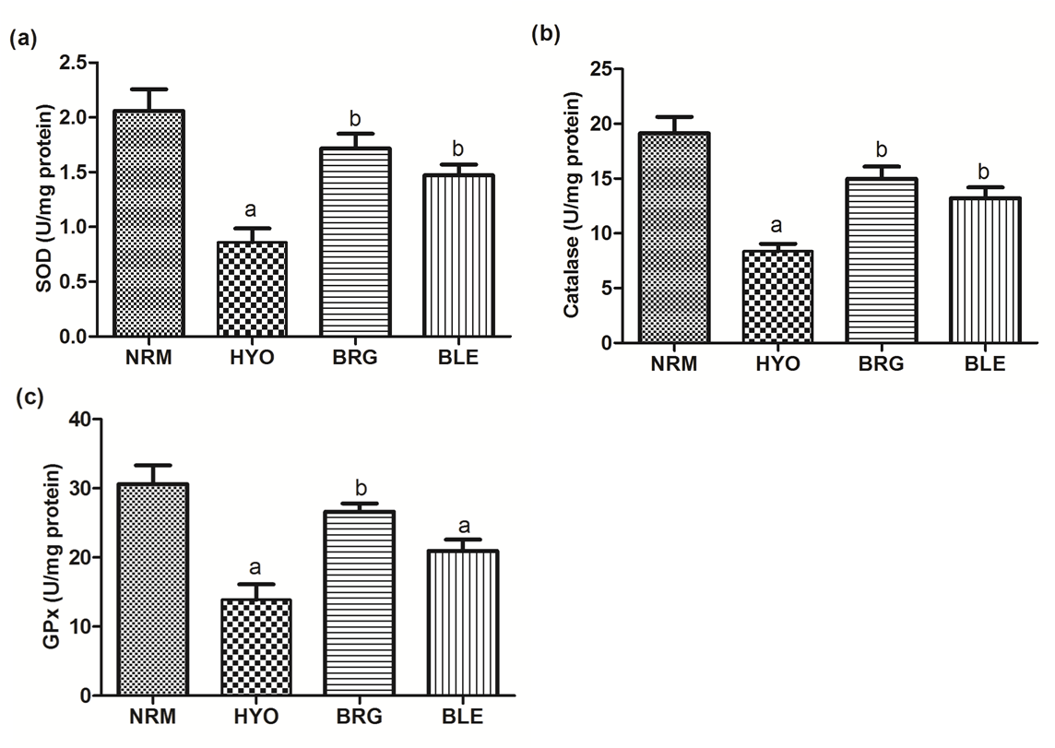
Antioxidant Profile-Kidney Tissue

Slide 24
Target Sites of BRG - Hyperoxaluria

Slide 25
Acknowledgements
Prof. S.K. Singla
Department of Biochemistry,
Panjab University Chandigarh
Department of Science and Technology, GoI
Indian Council of Medical Research, GoI

Slide 26

?

