Slide 1



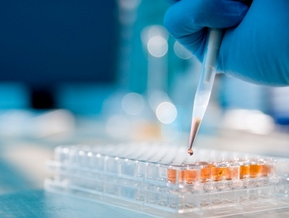
Towards a novel FRET immunosensor using biocompatible Graphene Quantum Dot for early diagnosis of Myocardial Infarction
Deepika Bhatnagar, Ashok Kumar, Inderpreet Kaur
Dr Inderpreet Kaur Prof. Ashok Kumar
Supervisor Co-Supervisor
CSIO-CSIR, Chandigarh IGIB-CSIR, New Delhi
Presented By:
Ms DEEPIKA BHATNAGAR

Slide 2
Contents
Introduction
  Myocardial damages
  Current Global scenario
  Myocardial Infarction (MI)
  Cardiac Troponin I (cTnI)
Carbon forms in biomolecular detection
Graphene Quantum dots
Design of work
Results & Discussion
References

Slide 3
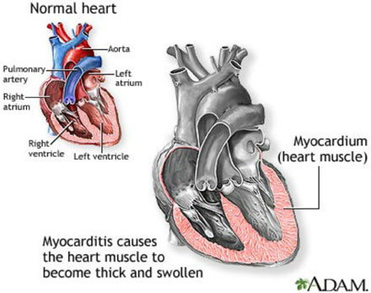
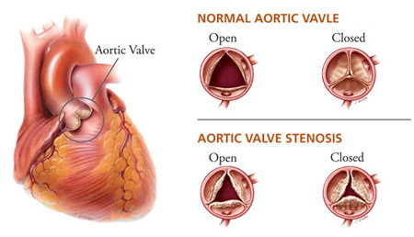
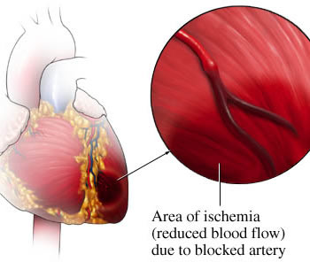
Myocardial damages
Myocardial pertaining to the muscular tissue of the heart.
Any disease causing loss of muscular or nervous function of the heart.
Includes myocarditis, ischemia, degeneration.
Muscle degeneration
Myocarditis
Ischemia

Slide 4
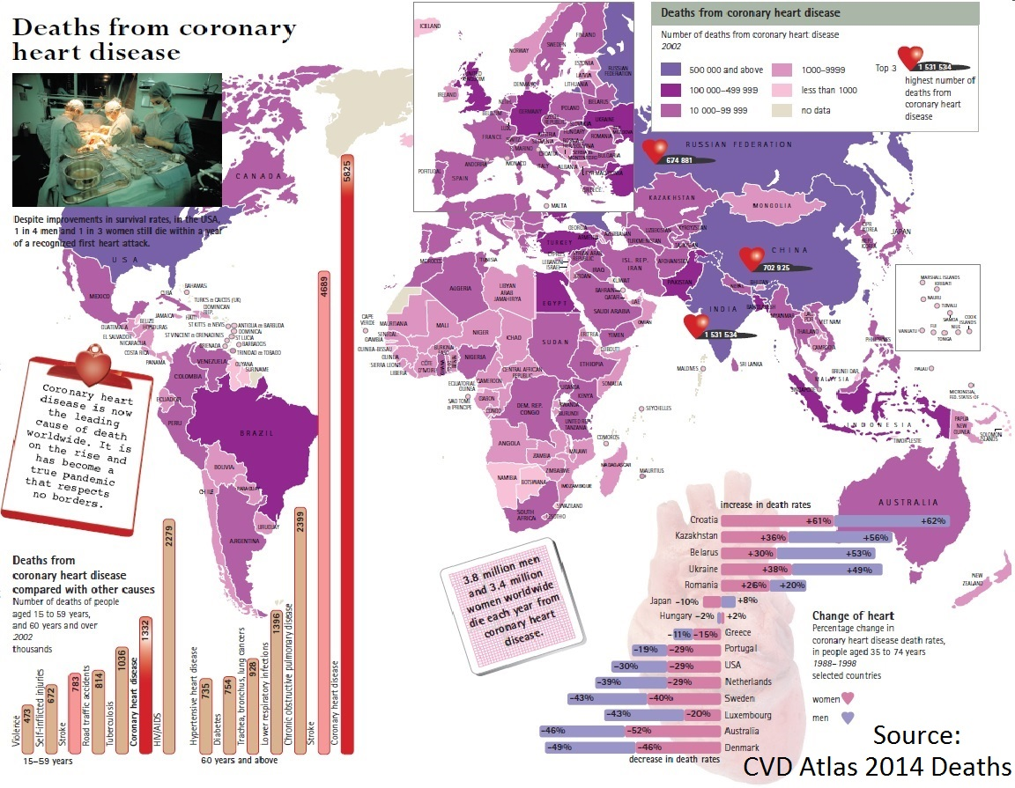
Current worldwide scenario

Slide 5
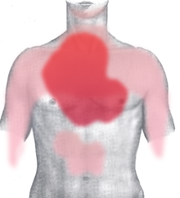
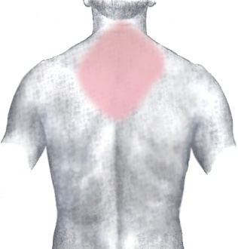
Myocardial infarction
(heart attack)
Necrosis of the cells of an area of the heart muscle (myocardium) occurring as a result of oxygen deprivation, which in turn is caused by obstruction to the blood supply.
Blockage in coronary arteries due to an unstable buildup of cholesterol and Fat.
Symptoms;
  Chest Pain or discomfort
  Upper body pain in arms, neck & jaw
  Shortness of breath
  Nausea
  Lightheadedness or cold sweats

Slide 6
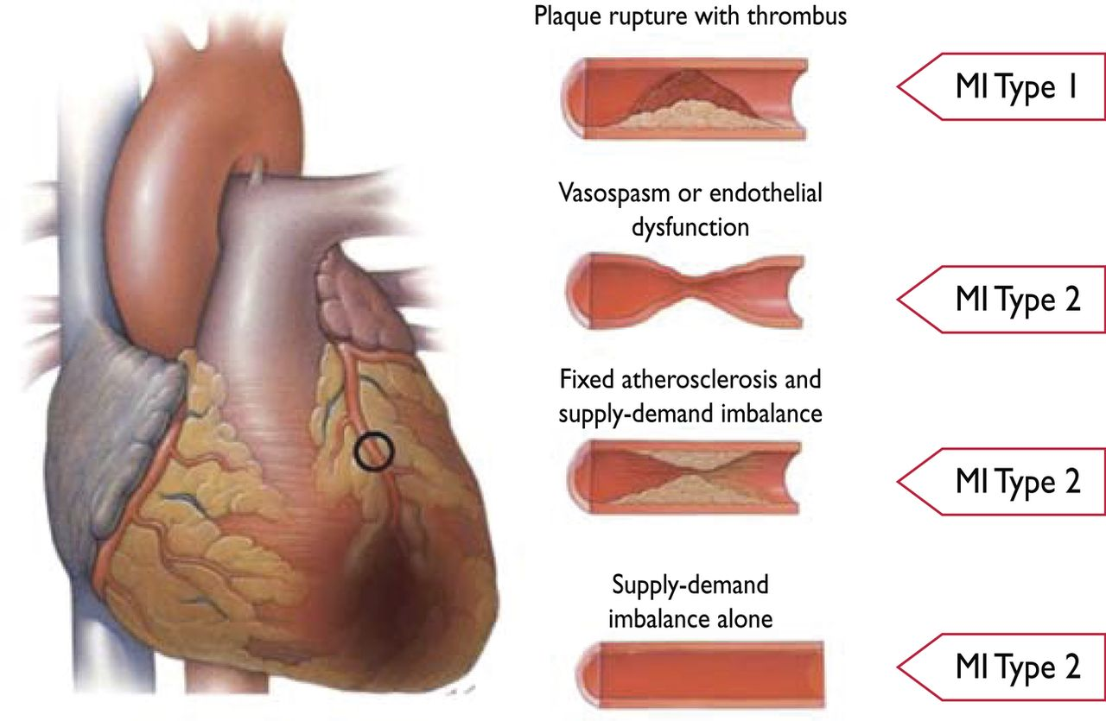
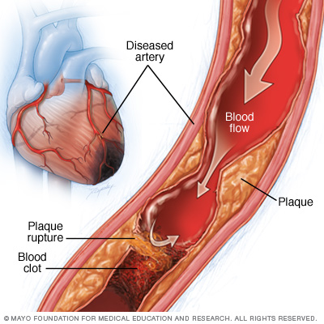
Factors responsible for MI
Myocardial infarction (MI) types 1 and 2 according to the condition of the coronary arteries.
Notes:
Differentiation between myocardial infarction (MI) types 1 and 2 according to the condition of the coronary arteries.

Slide 7
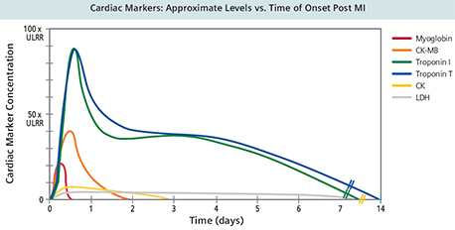
Biomarkers in MI
CK (CPK)
CK-MB
Troponin-I/T
Myoglobin
LD (LDH)
ALT/AST
Others
TEST | ONSET (hours) | PEAK (hours) | DURATION
CK/CK-MB | 3-12 | 18-24 | 36-48 hours
Troponins | 3-12 | 18-24 | Up to 10 days
Myoglobin | 1-4 | 6-7 | 24 hours
LDH | 6-12 | 24-48 | 6-8 days

Slide 8
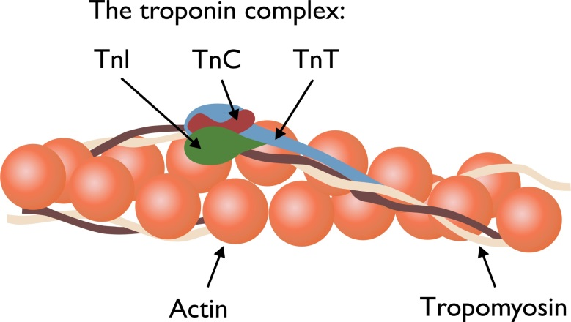

Troponin I
Laboratory range:
Since troponin I levels are virtually undetectable in normal subjects, the cut-off value is <0.04 ngmL⁻¹
Increases drastically to 0.7-1.4 ngmL⁻¹ within 3-12 h

Slide 9
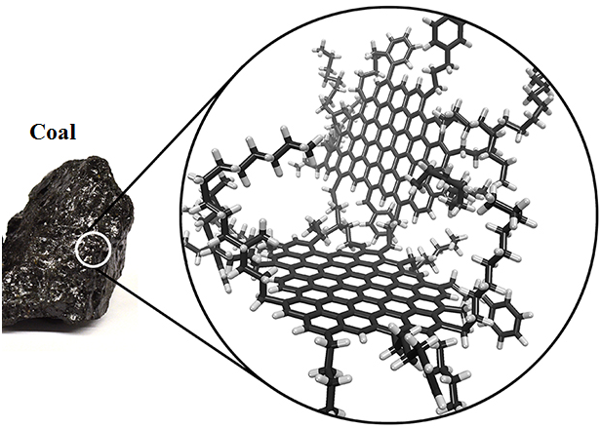
Carbon forms in biomolecular detection
Carbon based nanoplatforms are comparably more stable
Graphene
Carbon nanotubes
Carbon dots
Graphene quantum dots
Nanodiamonds
Carbon nanocones
Biocompatibility
Easy functionalization
Incredibly large surface area
Comparatively cost effective

Slide 10
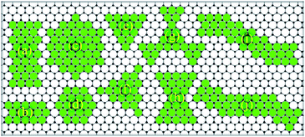
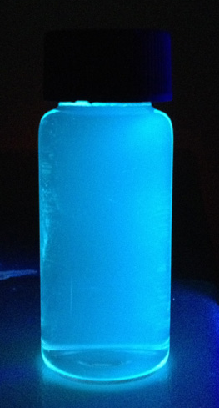
Graphene quantum dots
A 0D, unique sp² and sp³ hybridized carbon structure with size range of 3-20nm derived from 2D graphene
Characteristics derived from both graphene and Carbon Dots (CDs)
Strong Fluorescence
Excellent Biocompatibility (Non-toxic)
High surface area
Photostable emission
Possibility for bioconjugation
Under UV illumination

Slide 11
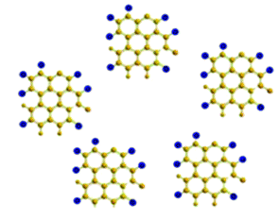
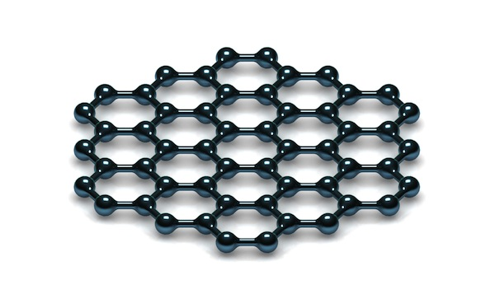
Graphene forms selected for FRET
Graphene Quantum Dots (GQDs)
(as Donor)
Graphene
(as Acceptor)
Notes:
http://www.nanowerk.com/spotlight/spotid=9857.php
http://www.rsc.org/chemistryworld/News/2005/September/19090501.asp

Slide 12
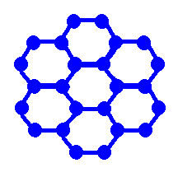

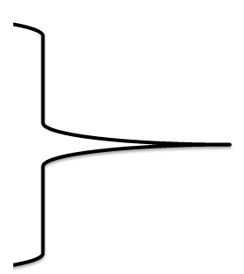
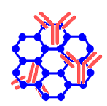
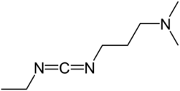

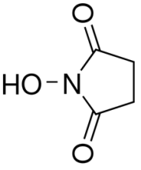
Design of work
C-H
H₂N
NH₂
(a)
H-O
Ammonia
H₂N
COOH
N-H
NH₂
O=C–
_
O=C-R
H₂N-C=O
O=C-NH₂
H-N
GQDs
afGQDs
EDC
anti-cTnI/afGQDs
conjugate
–C-OH
NHS
–C-O
=
=
O
O
anti-cTnI
NHS ester
Scheme 1. (a) Bioconjugation of monoclonal anti-cTnI with afGQDs using EDC-NHS chemistry.

Slide 13
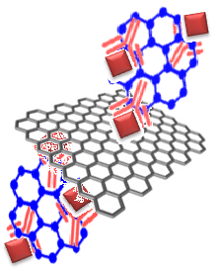
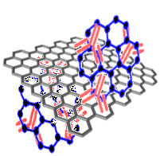
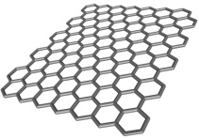
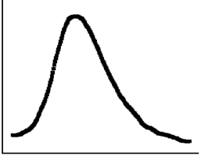
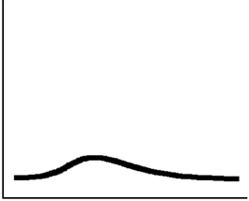


(b)
360 nm
457 nm
FRET
No FRET
Graphene
Antigen
anti-cTnI/afGQDs
anti-cTnI/afGQDs/Gr
anti-cTnI/afGQDs/Gr/cTnI
PL Intensity
PL Intensity
PL Intensity
Wavelength (nm)
Wavelength (nm)
Wavelength (nm)
afGQDs (Fluorophore)
cTnI antigen
Excitation
anti-cTnI antibody
Graphene (Quencher)
Emission
(b) Schematic mechanism of immunosensing based on specific interaction of anti-cTnI/afGQDs with graphene.

Slide 14
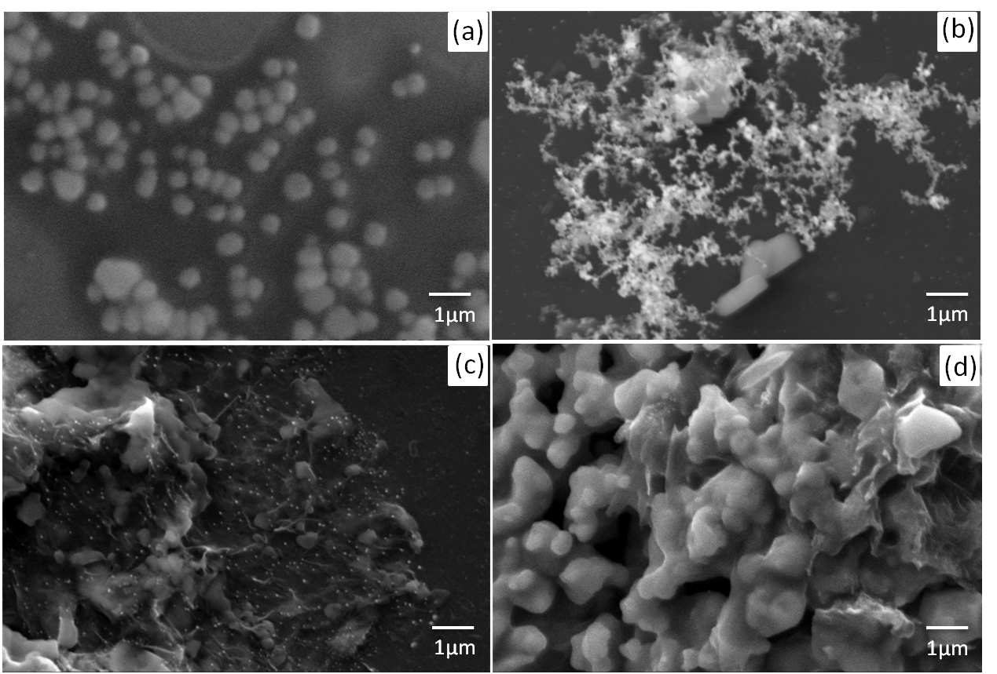
Results
Field emission scanning electron microscopy (FESEM)
Figure 1. FESEM images of (a) amine functionalized GQDs, (b) anti-cTnI/afGQDs conjugate, (c) anti-cTnI/afGQDs/Gr and (d) anti-cTnI/ afGQDs/Gr/cTnI.

Slide 15
Zeta Potential & UV-Vis spectra
Figure 2. (a) Zeta-potential studies of the GQDs (control) and synthesized anti-cTnI/afGQD conjugate.
(b) Positive shift in the value of zeta potentials
(c) UV-Vis Spectra of GQDs, afGQDs, anti-cTnI and anti-cTnI/afGQD conjugate.

Slide 16
Photoluminescence studies
Figure 3. Photoluminescence studies of (a) various precursors at the nano-platform, (b) The fluorescence quenching spectra of anti-cTnI/afGQDs with increasing concentrations of graphene 0, 1.0, 1.5, 2.0, 2.5, 3.0, 3.5, 4.0 µg mL⁻¹ from top to bottom, (Inset) Fluorescence quenching efficiency at varying concentrations of graphene and (c) Immunosensing behaviour and (d) Specificity check against specific (cTnI) and non-specific antigen BSA and Avidin.

Slide 17
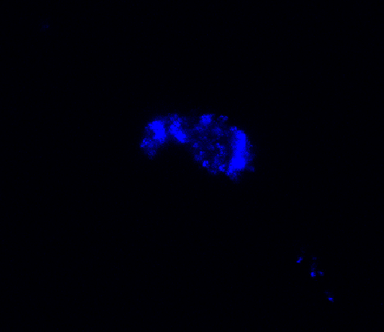
FRET observations through Confocal microscopy
(a)
(b)
(c)
(d)
(e)
(f)
(g)
Figure 4. CLSM images at 405 nm excitation of (a) afGQDs as control, (b) anti-cTnI/afGQDs nanoprobe, (c) anti-cTnI/afGQDs/cTnI, (d) anti-cTnI/afGQDs/Gr and (f) anti-cTnI/afGQDs/Gr/cTnI. CLSM images without excitation of (e) anti-cTnI/afGQDs/Gr and (g) anti-cTnI/afGQDs/ Gr/cTnI. Scale bar 10 µm.

Slide 18
TABLE I Comparative studies of photo count from confocal laser scanning microscopy (CLSM) and PL intensity at different fluorescent nanoplatforms
S. No. | Samples | Confocal Photon Count (Mean S/N=3) | PL Intensity
1 | afGQDs | 118.34 | 35.1
2 | anti-cTnI/afGQDs | 160.03 | 37.7
3 | anti-cTnI/afGQDs/cTnI | 145.31 | 33.4
4 | anti-cTnI/afGQDs/Gr | 4.45 | 6.7
5 | anti-cTnI/afGQDs/Gr/cTnI | 11.72 | 20.5
Validation of the sensor
Figure 5. (a) The fluorescence recovery spectra of anti-cTnI/afGQDs/Gr system with increasing concentrations of cTnI antigen 0, 0.001, 0.01, 0.1, 1.0, 10, 100, 1000 ng mL⁻¹ from bottom to top. (b) The linear relationship between the PL intensity of anti-cTnI/afGQDs/Gr system with increasing log concentrations of cTnI from picomolar to nanomolar.

Slide 19
Conclusion
GQDs based developed sensor have high sensitivity of 0.192 pg mL⁻¹.
Specific for cTnI; no cross reactivity.
Rapid method of detection.
Early diagnosis in MI.

Slide 20
References
1 T. Reichlin, W. Hochholzer, S. Bassetti, S. Steuer, C. Stelzig, S. Hartwiger, S. Biedert, N. Schaub, C. Buerge, M. Potocki, M. Noveanu, T. Breidthardt, R. Twerenbold, K. Winkler, R. Bingisser, and C. Mueller, New Engl. J. Med. 361, 858 (2009).
2 A. S. Jaffe, C. Ritter, V. Meltzer, H. Harter and H. Roberts, J. Lab Clin. Med. 104, 193 (1984).
3 K. W. Ma, D. C. Brown, B. W. Steele and H. L. Arthur, Arch. Intern. Med. 141, 164 (1981).
4 G. S. Bodor, S. Porter, S. Landt and Y. J. H. Ladenson, Clin. Chem. 38, 2203 (1992).
5 J. E. Adams, K. B. Schechtman, Y. Landt, J. H. Ladenson and A. S. Jaffe, Clin. Chem. 40, 1291 (1994).
6 P.A. Anderson, N. N. Malouf, A. E. Oakeley, E. D. Pagani and P. D. Allen, Circ. Res. 69, 1226 (1991).
7 V. S. Mahajan and P. Jarolim, Circulation 124, 2350 (2011).
8 K. Vichairuangthum, W. Leowattana, L. O. Ajyooth and S. Pokum, J Med. Assoc. Thai. 89, 714 (2006).
9 J. R. Tate, Clin. Chem. Lab. Med. 48, 1489 (2008).
10 S. Lee, D. Kwon, C. Yim and S. Jeon, Anal. Chem. 87, 5004 (2015).
11 Z. Xu, Y. Dong, J. Li and R. Yuan, Chem. Comm. 51, 14369 (2015).
12 P. Kar, A. Pandey, J. J. Greer and K. Shankar, Lab Chip 12, 821 (2012).
13 A. Periyakeruppan, R. P. Gandhiraman, M. Meyappan and J. E. Koehne, Anal. Chem. 85, 3858 (2013).
14 H. Guo, J. Zhang, P. Xiao, L. Nie, D. Yang and N. He, J. Nanosci. Nanotechnol. 5, 1240 (2005).
15 Rajesh, V.Sharma, N. K. Puri, R. K. Singh, A. M. Biradar and A. Mulchanadani, Appl. Phys. Lett. 103, 203703 (2013).
16 J. Peng, W. Gao, B. K. Gupta, Z. Liu, R. Romero-Aburto, L. Ge, L. Song, L. B. Alemany, X. Zhan, G. Gao, S. A. Vithayathil, B. A. Kaipparettu, A. A. Marti, T. Hayashi, J. J. Zhu and P. M. Ajayan, Nano Lett. 12, 844 (2012).
17 L. Tang L, R. Ji, X. Cao, J. Lin, H. Jiang, X. Li, K. S. Teng, C. M. Luk, S. Zeng, J. Hao and S. P. Lau, ACS Nano 6, 5102 (2012).
18 S. Kim, S. W. Hwang, M. K. Kim, D. Y. Shin, D. H. Shin, C. O.Kim, S. B. Yang, J. H. Park, E. Hwang, S. H. Choi, G. Ko, S, Sim, C. Sone, H. J. Choi, S. Bae and B. H. Hong, ACS Nano 6, 8203 (2012).

Slide 21
19 S. Park and R. S. Ruoﬀ, Nat. Nanotechnol. 4, 217 (2009).
20 G. Eda and M. Chhowalla, Adv. Mater. 22, 2392 (2010).
21 K. P. Loh, Q. Bao, P. K. Ang and J. Yang, Mater. Chem. 20, 2277 (2010).
22 S. Zhu, J. Zhang, C. Qiao, S. Tang, Y. Li, W. Yuan, B. Li, L. Tian, F. Liu, R. Hu, H. Gao, H. Wei, H. Zhang, H. Sun and B. Yang, Chem. Comm. 47, 6858 (2011).
23 X. Li, S. Zhu, B. Xu, K. Ma, J. Zhang, B. Yang and W. Tian. Nanoscale 5, 7776 (2013).
24 Q. Lu, W. Wei, Z. Zhou, Z. Zhou, Y. Zhang and S. Liu, Analyst 139, 2404 (2014).
25S. N. Baker and G. A. Baker, Angew. Chem. Int. Ed. 49, 6726 (2010).
26 M. Li, W. Ni, B. Kan, X. Wan, L. Zhang, Q. Zhang, G. Long, Y. Zuo and Y. Chen, Phys. Chem. Chem. Phys. 15, 18973 (2013).
27 P. Gao, K. Ding, Y. Wang, K. Ruan, S. Diao, Q. Zhang, B. Sun and J. Jie, J. Phys. Chem. C 118, 5164 (2014).
28 I. A. Ogaidi, H. Gou, Z. P. Aguilar, S. Guo, A. K. Melconian, A. K. A. Al-kazaz, F. Meng and N. Wu, Chem. Comm. 50, 1344 (2014).
29 H. Zhao, Y. Chang, M. Liu, S. Ghao, H. Yu and X. Quan, Chem. Comm. 49, 234 (2013).
30 M. J. E. Fischer, Methods Mol. Biol. 627, 55 (2010).
31 S. Saini, H. Singh and B. Bagchi, J. Chem. Sci. 118, 23 (2006).
32 B. Zhang, A. W. Morales, R. Peterson, L. Tang and J. Y. Ye, Biosens. Bioelectron. 58, 107 (2014).
33 T. Kong, R. Su, B. Zhang, Q. Zhang and G. Cheng, Biosens. Bioelectron.34,267(2012).

Slide 22


