Slide 1
Grim Reaping the Benefits of Venetoclax (Venclexta®), a BCL-2 Selective Antagonist, for the Treatment of Hematological Malignancies
Deepak Sampath, Ph.D.
Principal Scientist
Department of Translational Oncology
Genentech
November 28th, 2016
Translational Medicine Conference

Slide 2
Presentation Outline
BCL-2 family as regulators of intrinsic apoptotic pathways
BH3 mimetics as a cancer therapeutic:
  Venetoclax (ABT-199/GDC-0199):
    Preclinical Pharmacology
    Predictive Biomarkers
    Clinical data from pivotal/registration trial in relapsed/refractory CLL
Mechanisms of intrinsic drug resistance to venetoclax
Identification of drug combination partners to support clinical development in additional hematological malignancies (i.e. multiple myeloma)
Summary

Slide 3
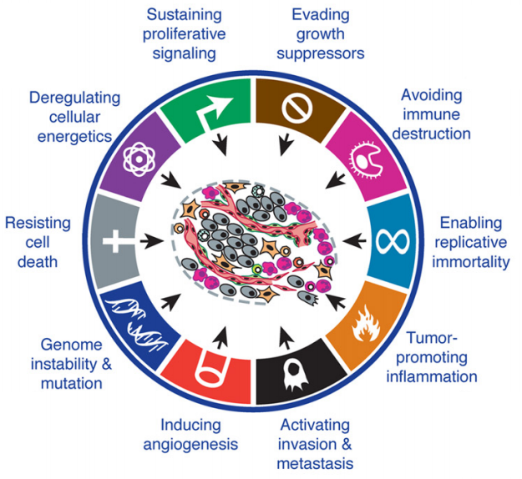
Resistance to Apoptosis is a Hallmark of Cancer
Apoptosis (programmed cell death) is the natural mechanism to eliminate damaged cells
Cancer cells induce mechanisms to survive stresses that kill normal healthy cells
Defects in apoptosis regulation contribute to tumorigenic phenotypes
  Accumulation of oncogenic mutations that result in more aggressive tumors
  Resistance to chemotherapy or cytotoxins
Impaired apoptosis is a key step in tumor initiaiton and progression
Hanahan, D., Weinberg, R.A. (2011) The Hallmarks of Cancer: The Next Generation Cell, 144, 646-674.
Notes:
Cancer cells must survive stresses that kill normal cells: hypoxia, growth factor deprivation, inappropriate substratum attachment, abnormal cell cycle progression, chemotherapeutics

Slide 4
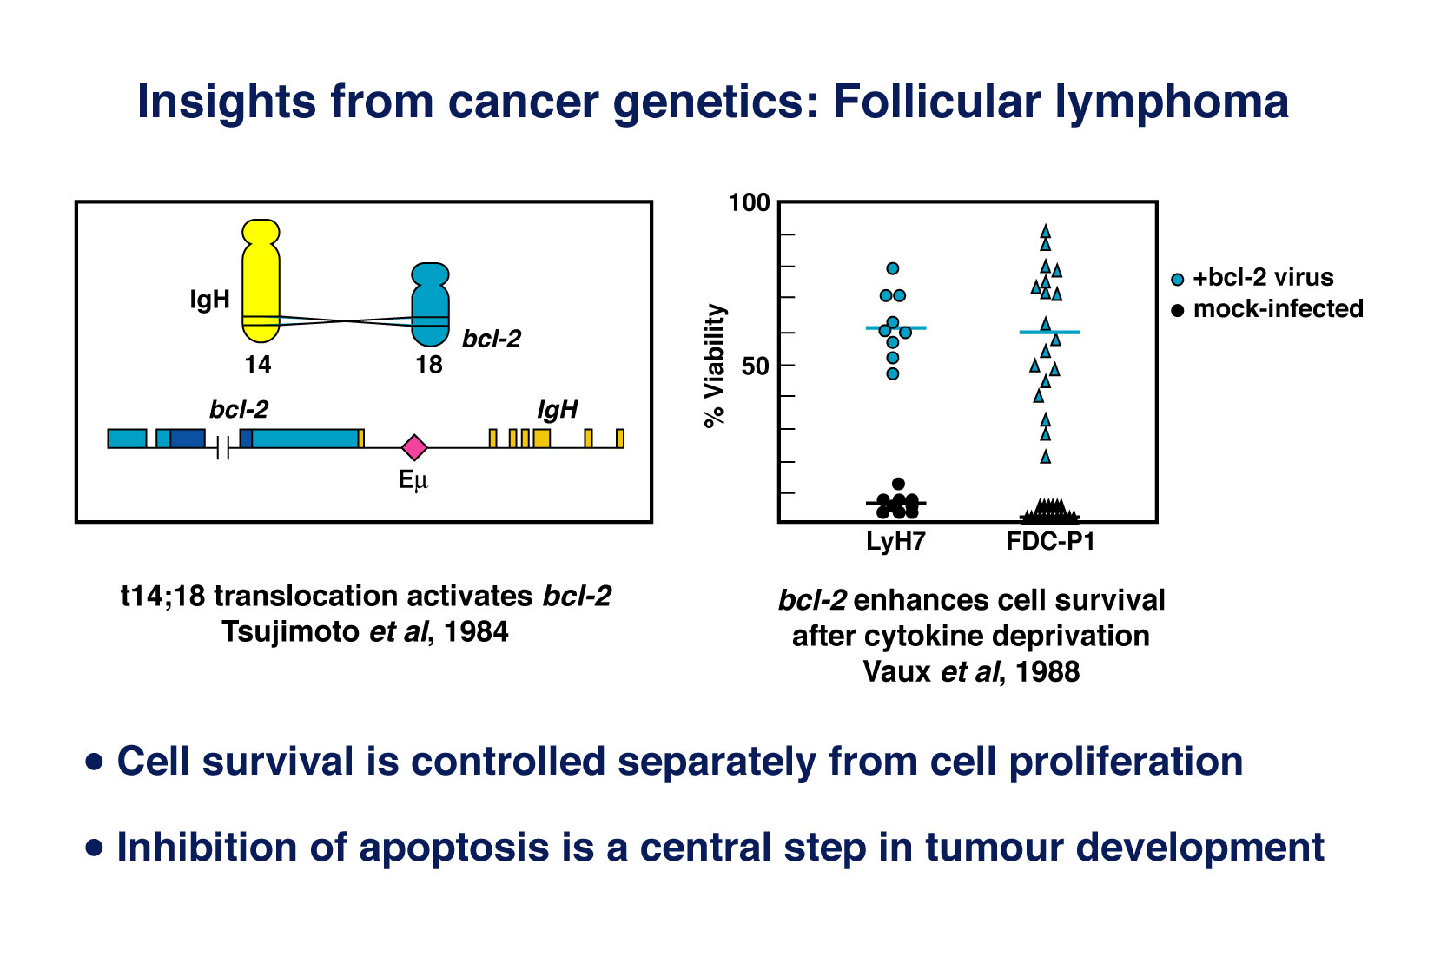
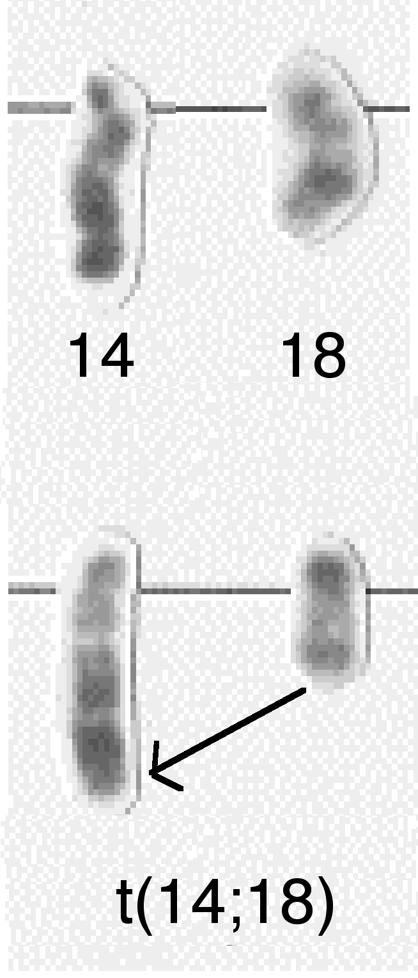
BCL-2: The First Identified Regulator of Apoptosis
Tsujimoto et al. (1984): BCL2 gene identified at the site of the t(14;18) chromosomal translocation characteristic of follicular lymphoma
Vaux et al. (1988): Unlike all previously identified oncogenes, overexpression of BCL-2 promoted cellular survival rather than proliferation
Cellular survival and cellular proliferation are independent processes under separate genetic control
Normal
Follicular lymphoma

Slide 5
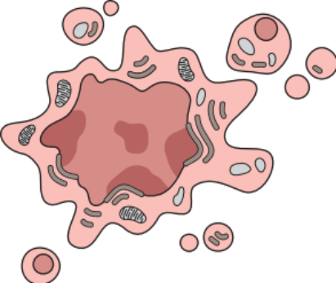
BCL-2 family proteins are central regulators of
intrinsic apoptosis and arbitrate life or death decisions
Pro-Apoptotic
Pro-Survival
BIM, PUMA, BAD, BID, BIK, NOXA, HRK, BMF
  BCL-2, BCL-X_{L}, BCL-W,
  MCL-1, A1
BCL-2 pro-survival proteins prevents apoptosis by sequestering pro-apoptotic effectors BAX/BAK through interactions with BH3 motifs
BH3
Only
BCL-2
Like
Effectors
BAX
X
BAX
BAX
BAX
BAK
Oligomerization
BAK
BAK
BAK
MOMP
X
Caspase
activation
X
Cytochrome C
SMAC
Apoptosis

Slide 6
BCL-2 family proteins are central regulators of
intrinsic apoptosis and arbitrate life or death decisions
Pro-Apoptotic
Pro-Survival
BIM, PUMA, BAD, BID, BIK, NOXA, HRK, BMF
  BCL-2, BCL-X_{L}, BCL-W,
  MCL-1, A1
BH3 only pro-apoptotic proteins induce apoptosis by blocking BCL-2 protein interactions with BAX/BAK
Death
Signals
BH3
Only
BCL-2
Like
Effectors
Effectors
BAX
BAX
BAX
BAX
BAX
BAK
Conformational
change
BAK
Oligomerization
BAK
BAK
BAK
MOMP
Caspase
activation
Cytochrome C
SMAC
Apoptosis
Notes:
Resistance to apoptosis is a major hallmark of cancer. A cells decision to undergo apoptosis is governed by a balance of pro-death and pro-survival factors that are often dysregulated in cancer. Therefore, the ability to induce apoptosis in cancer cells by targeting the central cell death machinery would offer a powerful therapeutic strategy.
Bcl-2 family proteins regulate Intrinsic apoptosis. They share up to 4 common, highly-conserved, Bcl-2 homology or BH domains and individual family members can be grouped into three factions base on the distinct mechanisms in which they regulate cell death. Cells undergo apoptosis when stress signals are generated and activate BH3 only proteins by post-translational or transcriptional mechanisms. Activated BH3 disrupts the interaction between pro-survival Bcl-2 proteins and the effectors Bax and Bak which, untethered, oligomerizes to form pores on the outer mitochondrial membrane. This breach of the outer mitochondria results in release of a cadre of apotogenic factors such as cytochrome c which in turns triggers a cascade of events that leads to downstream activation of caspases culminating in proteolytic degradation and nuclear fragmentation that are salient features of apoptotic cell death. In cancer cells, overexpression of Bcl-2 acts a protein sink to sequester BH3-only proteins upon signals of stress thereby promoting tumor cell survival.
Anti-apoptotic Bcl-2 proteins prevent apoptosis by sequestering their pro-apoptotic counterparts
Death Signals: DNA Damage, Somatic mutations, Oncogene signaling, Cell cycle dysregulation, Hypoxia, Detachment to substratum, chemotherapeutics or targeted agents

Slide 7
Levels of BH3 only and BCL-2 pro-survival proteins
dictate balance between life and death in tumors
Binding of BH3 only to BCL-2 pro-survival proteins can be non-selective (i.e. BIM) or selective (i.e. BAD, PUMA, NOXA)
BH3 only proteins are regulated at a transcriptional and post-translational level
Bind to 14-3-3
scaffolding protein
BCL-2
BCL-X_{L}
X
BAD
P
PI3K/Akt
MEK/ERK
P
BIM
X
BCL-W
Increased mRNA
MCL-1
Degradation
NOXA
p53
A1
Oncogenic pathways negatively or positively regulate BH3 only proteins
X

Slide 8
Levels of BH3 only and BCL-2 pro-survival proteins
dictate balance between life and death in tumors
Binding of BH3 only to BCL-2 pro-survival proteins can be non-selective (i.e. BIM) or selective (i.e. BAD, PUMA, NOXA)
BH3 only proteins are regulated at a transcriptional and post-translational level
BCL-2
Taxanes
PI3K
Pathway
Inhibitors
BCL-X_{L}
BAD
P
X
PI3K/Akt
MEK/ERK
X
P
BIM
BCL-W
Increased mRNA
MAPK Pathway
Inhibitors
MCL-1
DNA
Damaging
Agents
NOXA
p53
A1
Therapeutics that upregulate BH3 only proteins induce cell death
X

Slide 9
Targeting BCL-2 proteins directly as a therapeutic
Strategy may provide greater outcomes
Pro-Apoptotic
Pro-Survival
BIM, PUMA, BAD, BID, BIK, NOXA, HRK, BMF
  BCL-2, BCL-X_{L}, BCL-W,
  MCL-1, A1
BH3
Only
BCL-2
Like
BH3 mimetics that directly antagonize BCL-2 proteins should induce apoptosis
Effectors
BAX
BAX
BAX
BAX
BAK
Oligomerization
BAK
BAK
BAK
MOMP
Caspase
activation
Cytochrome C
SMAC
Apoptosis
Notes:
Resistance to apoptosis is a major hallmark of cancer. A cells decision to undergo apoptosis is governed by a balance of pro-death and pro-survival factors that are often dysregulated in cancer. Therefore, the ability to induce apoptosis in cancer cells by targeting the central cell death machinery would offer a powerful therapeutic strategy.
Bcl-2 family proteins regulate Intrinsic apoptosis. They share up to 4 common, highly-conserved, Bcl-2 homology or BH domains and individual family members can be grouped into three factions base on the distinct mechanisms in which they regulate cell death. Cells undergo apoptosis when stress signals are generated and activate BH3 only proteins by post-translational or transcriptional mechanisms. Activated BH3 disrupts the interaction between pro-survival Bcl-2 proteins and the effectors Bax and Bak which, untethered, oligomerizes to form pores on the outer mitochondrial membrane. This breach of the outer mitochondria results in release of a cadre of apotogenic factors such as cytochrome c which in turns triggers a cascade of events that leads to downstream activation of caspases culminating in proteolytic degradation and nuclear fragmentation that are salient features of apoptotic cell death. In cancer cells, overexpression of Bcl-2 acts a protein sink to sequester BH3-only proteins upon signals of stress thereby promoting tumor cell survival.
Anti-apoptotic Bcl-2 proteins prevent apoptosis by sequestering their pro-apoptotic counterparts
Death Signals: DNA Damage, Somatic mutations, Oncogene signaling, Cell cycle dysregulation, Hypoxia, Detachment to substratum, chemotherapeutics or targeted agents

Slide 10
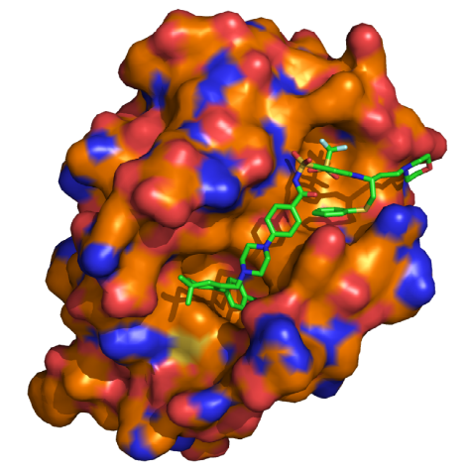
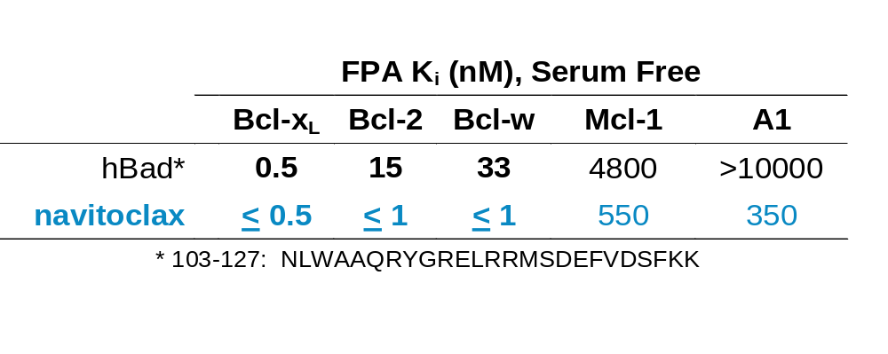
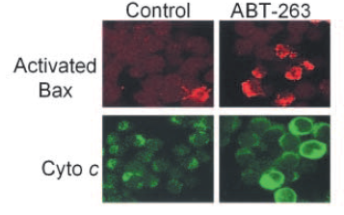
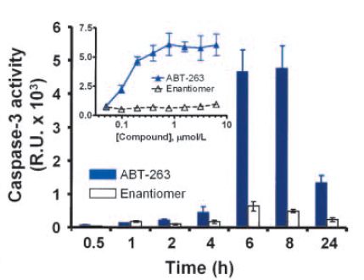
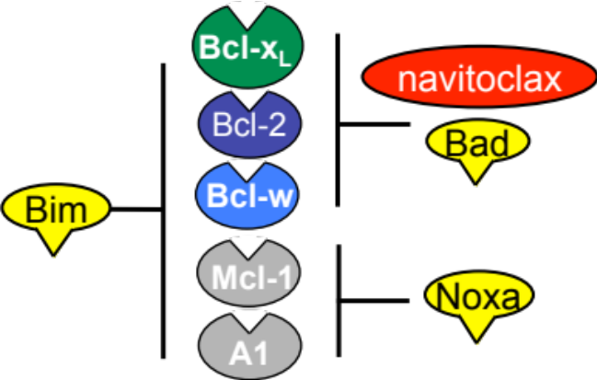
ABT-263 (navitoclax) is a small molecule BH3 mimetic
of BAD that induces apoptosis
BCL-2:navitoclax crystal structure
P4
P2
Tse C et al. Cancer Research 2008; 68: 3421

Slide 11
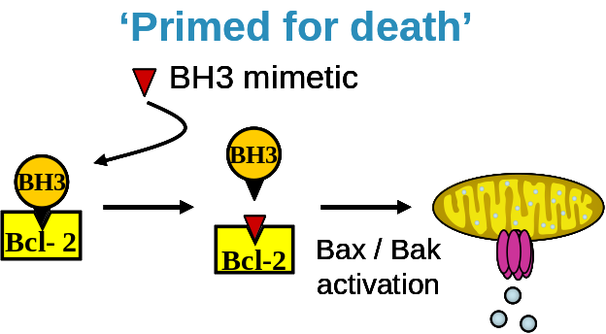
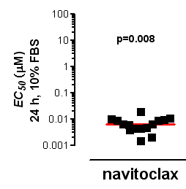
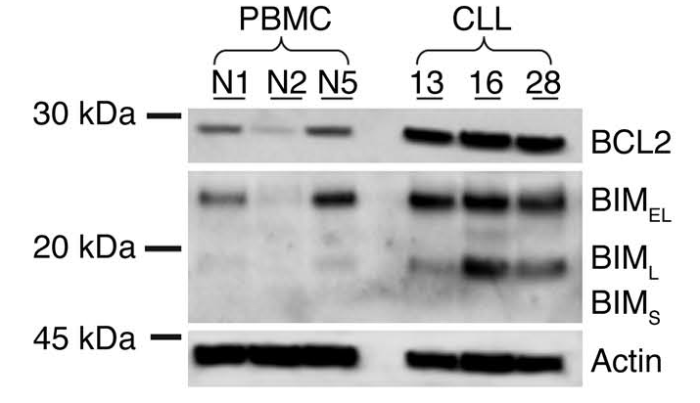
CLL cells overexpress BCL-2 and are “primed for death”
Uniformly high BCL-2 and BIM expression “primes” or sensitizes cells for death
BCL-2:BIM complexes form at outer mitochondrial membranes
Navitoclax potently kills CLL patient samples ex vivo
CLL Patient Samples
EC₅₀ = 0.006 μM
Del Gaizo Moore V et.al. J. Clin. Invest. 2007;117

Slide 12
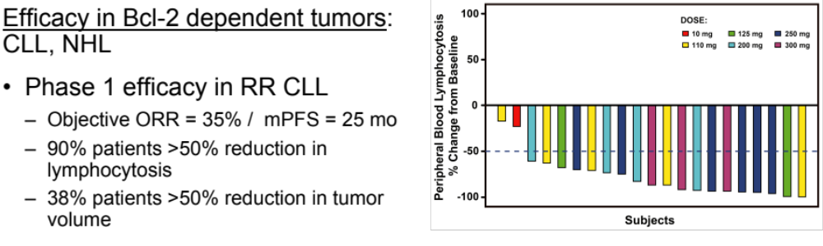
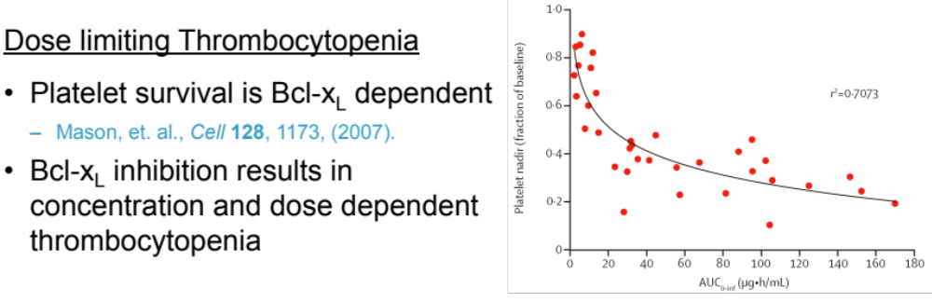
BCL-2 is a clinically validated drug target
navitoclax Phase 1a Trial
Inhibition profile of navitoclax dictates therapeutic index
Roberts, et al. J Clin Oncol 30, 488 (2012)
Wilson et al., Lancet Oncol 11, 1149, (2010)
Notes:
Efficacy in Bcl-2 dependent tumors: CLL, NHL
Phase 1 efficacy in RR CLL
Objective ORR = 35% / mPFS = 25 mo
90% patients >50% reduction in lymphocytosis
38% patients >50% reduction in tumor volume

Slide 13
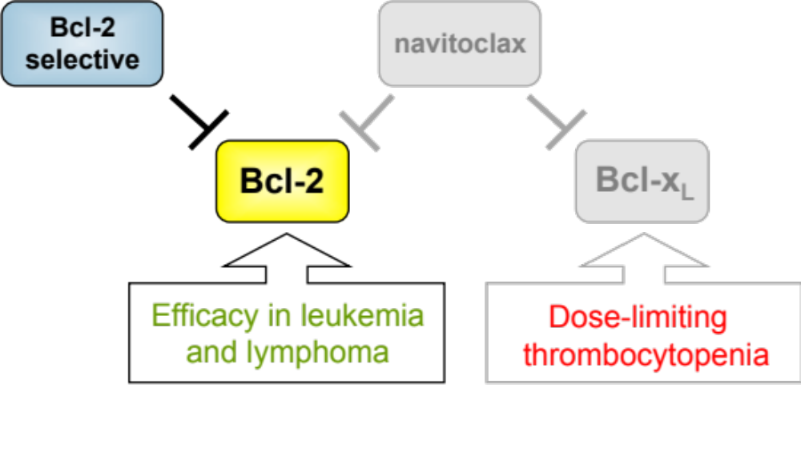
Strong clinical rationale for a BCL-2 selective inhibitor
Hypothesis:
  BCL-2 selective inhibitors will maintain efficacy in lymphoid malignancies
  BCL-2 selective (BCL-X_{L} sparing) inhibitors will not induce thrombocytopenia
  Greater therapeutic window will enable greater efficacy

Slide 14
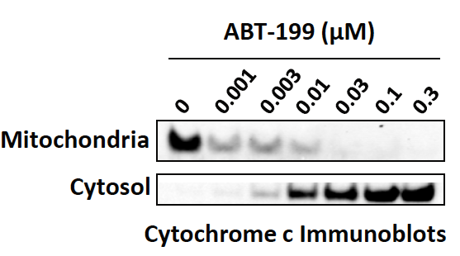
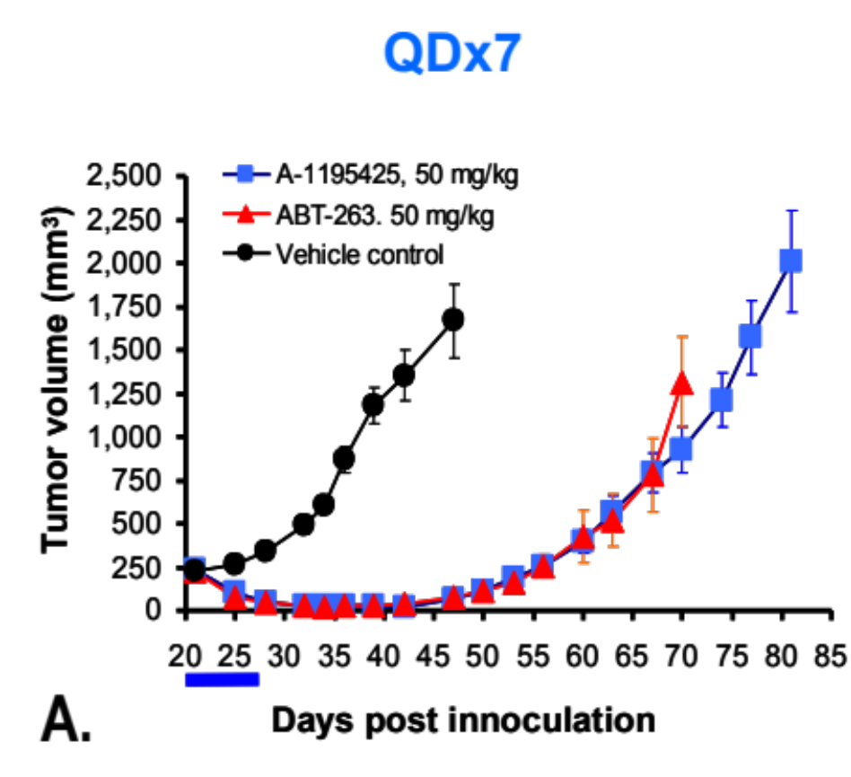
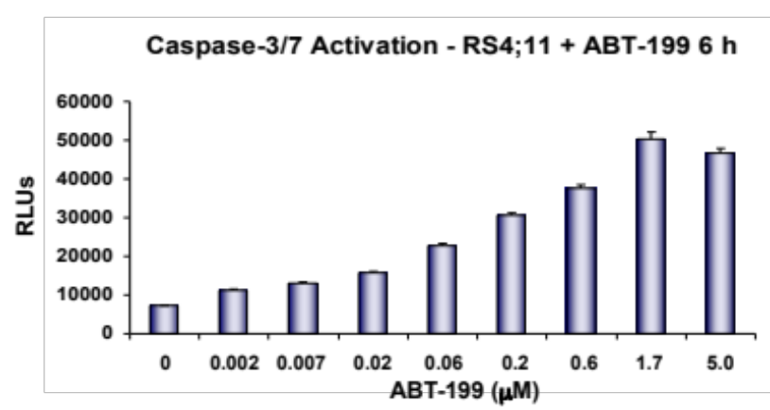
Venetoclax is a potent and selective BCL-2 inhibitor
 | TR FRET K_{i} (nM) |  |  |  | Cellular Potency EC₅₀ (nM)
 | BCL-2 | BCL-X_{L} | BCL-W | MCL-1 | RS4;11 (BCL-2) | H146 (BCL-X_{L})
navitoclax (ABT-263) | 0.04 | 0.05 | 7 | >440 | 110 | 75
venetoclax (ABT-199) | < 0.01 | 48 | 21 | >440 | 12 | 3600
RS4;11 (QD x 7)
ABT-199
ABT-263
Souers AJ et al. Nature Medicine 2013;19:202-208

Slide 15
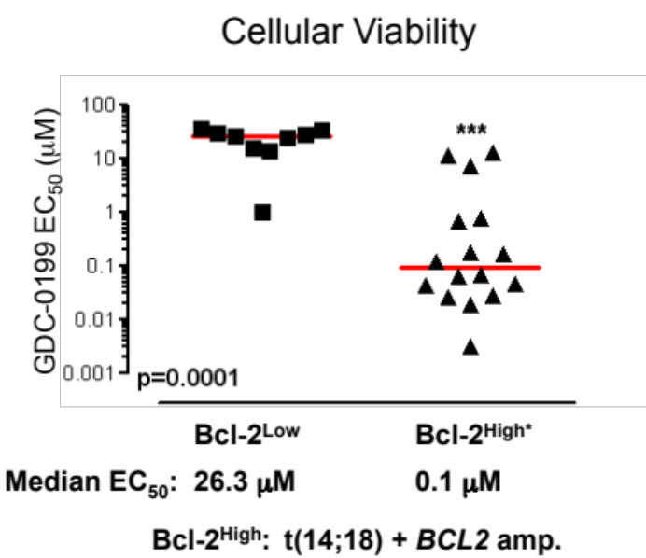
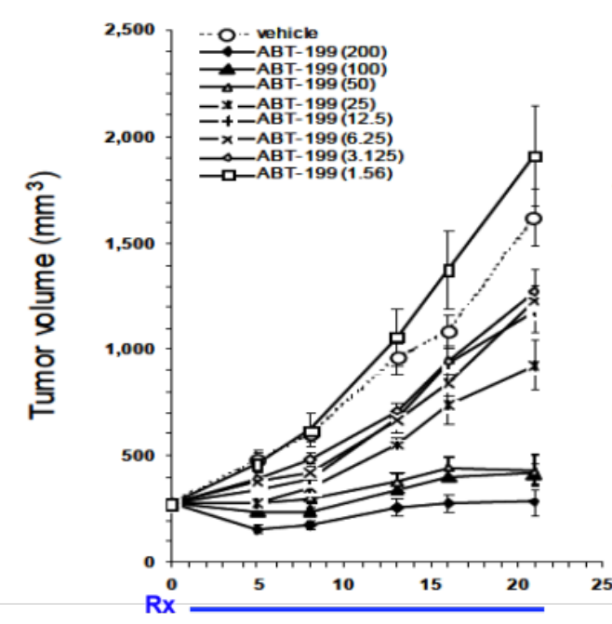
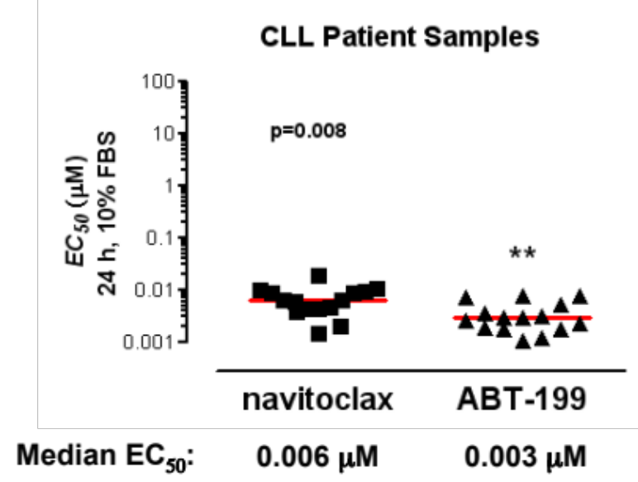
BCL-2 overexpression is a predictive biomarker of
venetoclax sensitivity
Cellular Viability
(CLL Patient Samples)
Cellular Viability
(NHL Lines)
Toledo NHL (t14;18)
t(14;18) and BCL-2 amplification correlates with greater sensitivity to venetoclax in vitro and in vivo
Souers AJ et al. Nature Medicine 2013;19: 202-208

Slide 16
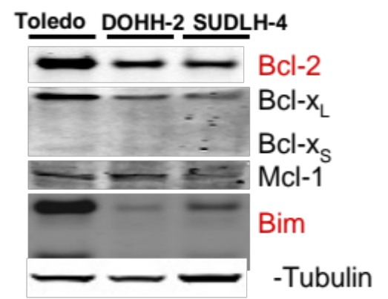
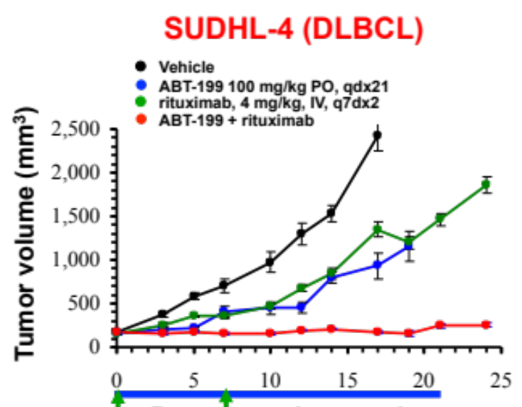
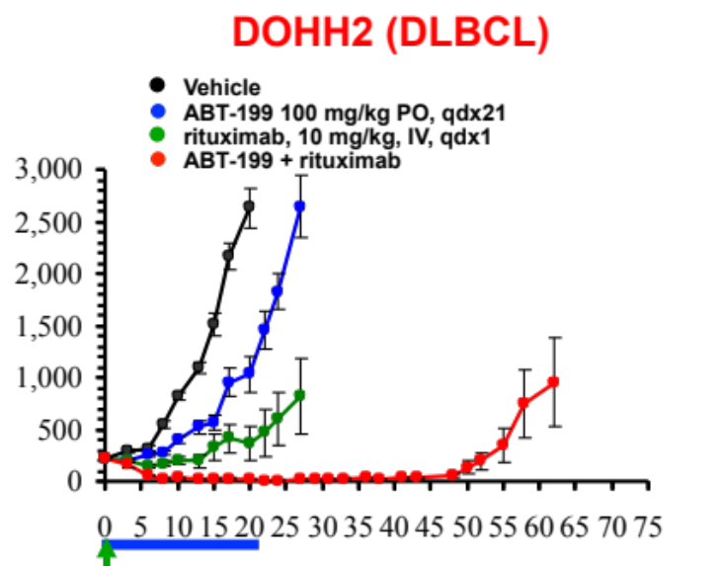
Venetoclax enhances efficacy of rituximab in NHL
xenograft models
  SUDHL4 and DOHH2 cell lines (DLBCL) harbor t(14;18)
    High BCL-2 / Low BIM levels
  venetoclax + rituximab improves tumor growth inhibition, tumor growth delay and complete response (CR) rates
    Similar observations made with venetoclax in combination with bendamustine + rituximab or R-CHOP
Souers AJ et al. Nature Medicine 2013;19:202-208

Slide 17

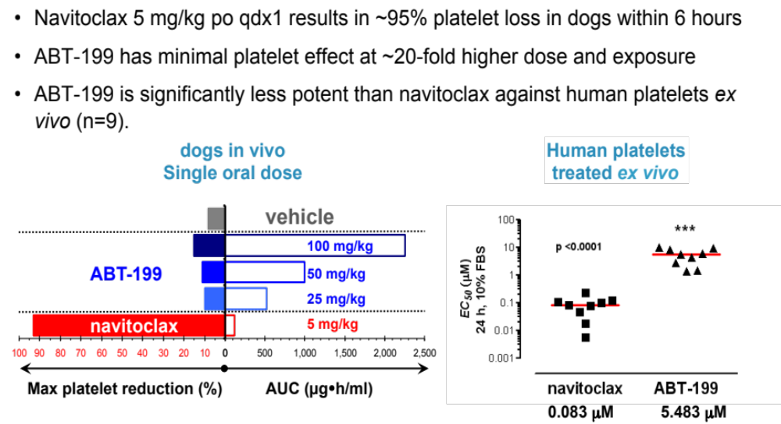
Venetoclax is platelet sparing
Dogs (single PO dose)
Human Platelets
CLL Patient Samples
Souers AJ et al. Nature Medicine 2013;19: 202-208
Notes:
Navitoclax 5 mg/kg po qdx1 results in ~95% platelet loss in dogs within 6 hours
ABT-199 has minimal platelet effect at ~20-fold higher dose and exposure
ABT-199 is significantly less potent than navitoclax against human platelets ex vivo (n=9).

Slide 18
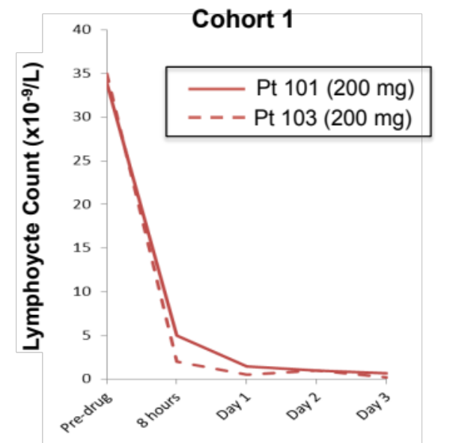
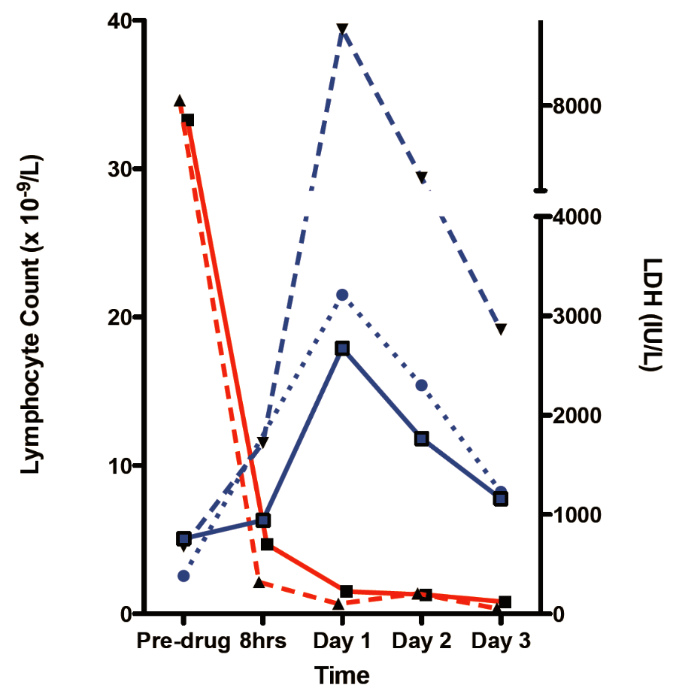
A Single Dose of venetoclax achieves rapid reduction
of CLL Burden in patients with refractory disease
  Phase 1 study in relapsed/refractory CLL
    Cohort 1 (n=3) 200 mg, 200 mg, 100 mg, single oral dose.
    >95% reduction in lymphocytosis within 24 hours after a single oral dose
    Rapid reduction in palpable lymphadenopathy
  Laboratory signs of rapid tumor lysis (TLS)
  TLS mitigated through appropriate dose management
Souers AJ et al. Nature Medicine 2013;19:202-208

Slide 19
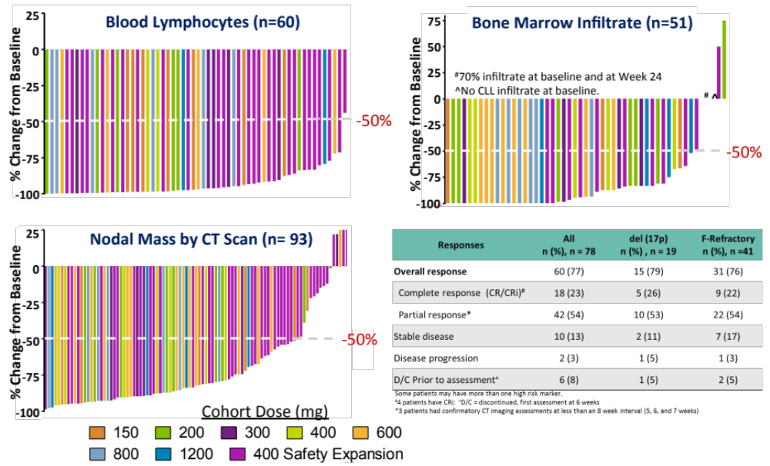
Venetoclax mono-therapy is efficacious in all disease
compartments of aggressive CLL [del(17p)]
Breakthrough designation received on May 7th, 2015
NDA filed on October 29th, 2015
Approved on April 11th, 2016
Roberts AW et al. New England Journal of Medicine 2016;374:311-22

Slide 20
Are there additional indications for venetoclax in hematological malignancies beyond CLL and NHL?
Key Questions:
Does BCL-2 play a pro-survival role in other hematological malignancies that have high unmet medical needs (i.e multiple myeloma and acute myeloid leukemia)?
Is single activity observed in preclinical models?
What are the predictive biomarkers of sensitivity and resistance?
What are the ideal combination therapy partners?

Slide 21
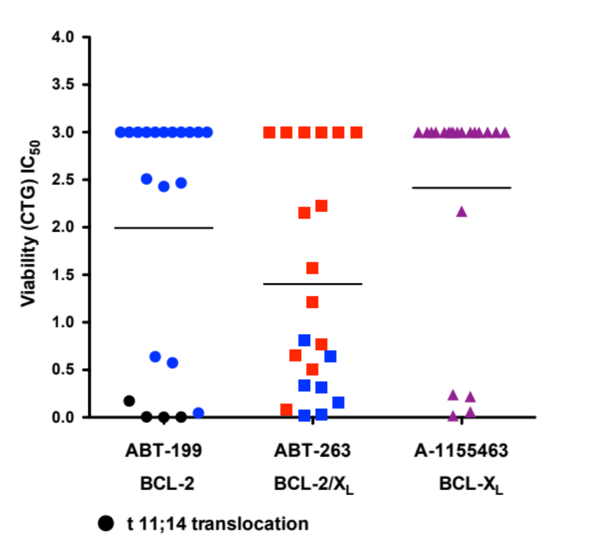
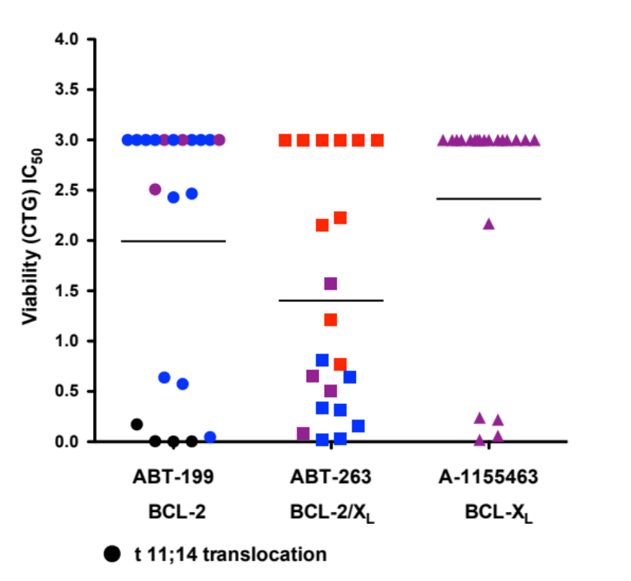
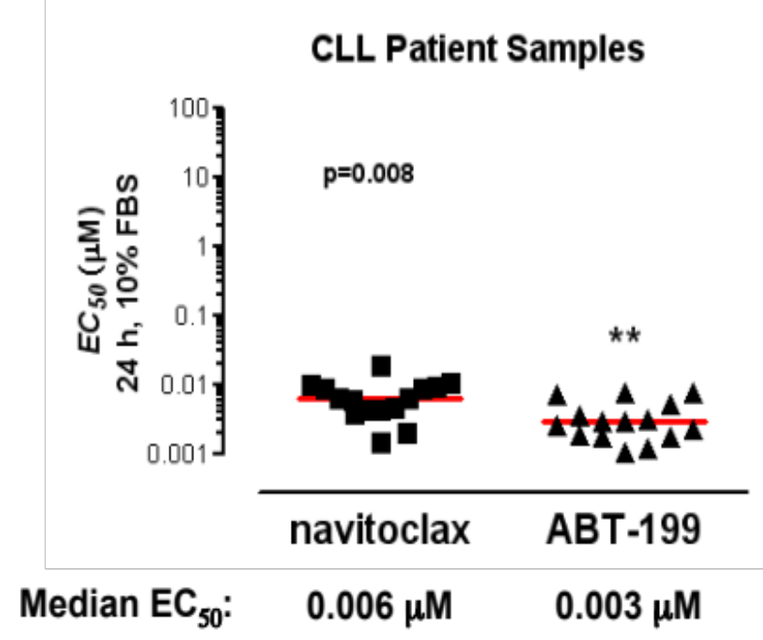
A subset of human multiple myeloma cell lines
(HMCLs) are sensitive to venetoclax in vitro
HMCLs
Heterogenous sensitivity of HMCLs to venetoclax in vitro (n=21 lines)
4 out of 7 venetoclax sensitive lines harbor t(11;14) translocation (approx. 25% prevalence in MM)
4 lines are resistant to venetoclax but sensitive to a BCL-X_{L} selective inhibitor (A-1155463) and navitoclax
Punnoose E et al. Molecular Cancer Therapeutics.
2016;15:1132-1144.

Slide 22
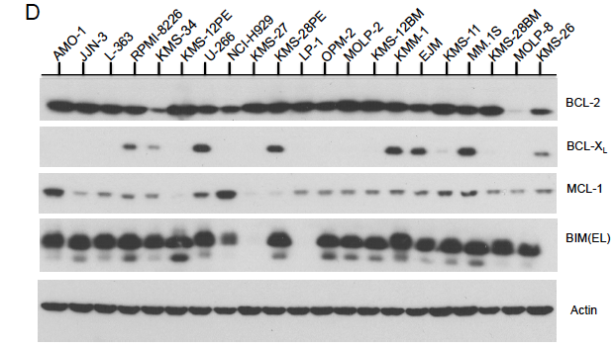
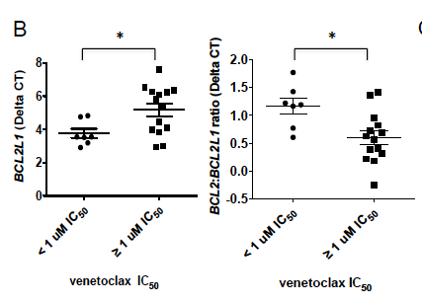
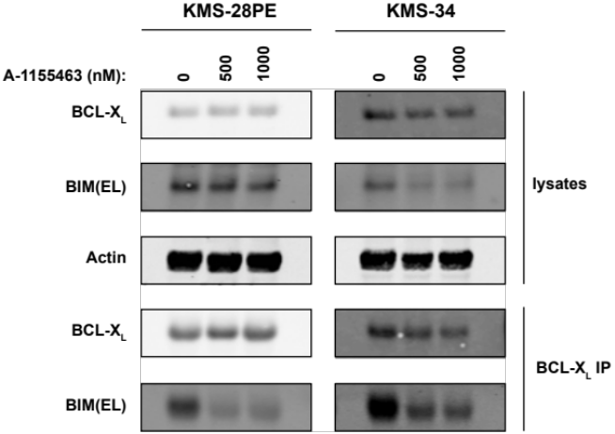
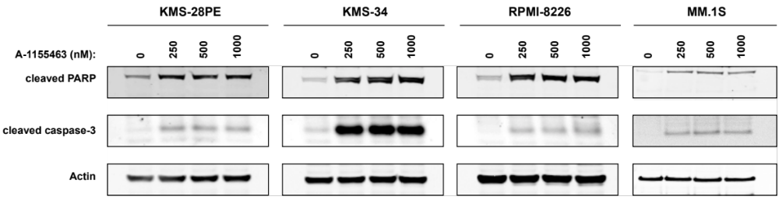
Increased BCL-X_{L} expression correlates with decreased
sensitivity to venetoclax in myeloma cell lines
*
*
*
*
BCL-X_{L}
BCL-2:BCL-X_{L}
* A-1155463 (BCL-X_{L} selective) IC₅₀ < 1.0 uM
Punnoose E et al. Molecular Cancer Therapeutics
2016;15:1132-1144.

Slide 23
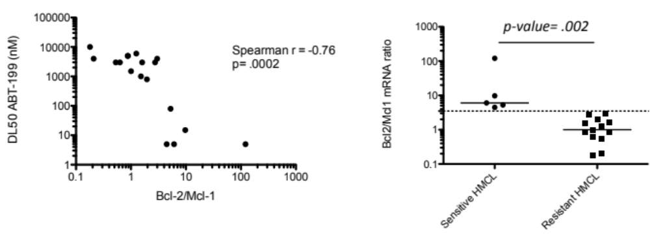
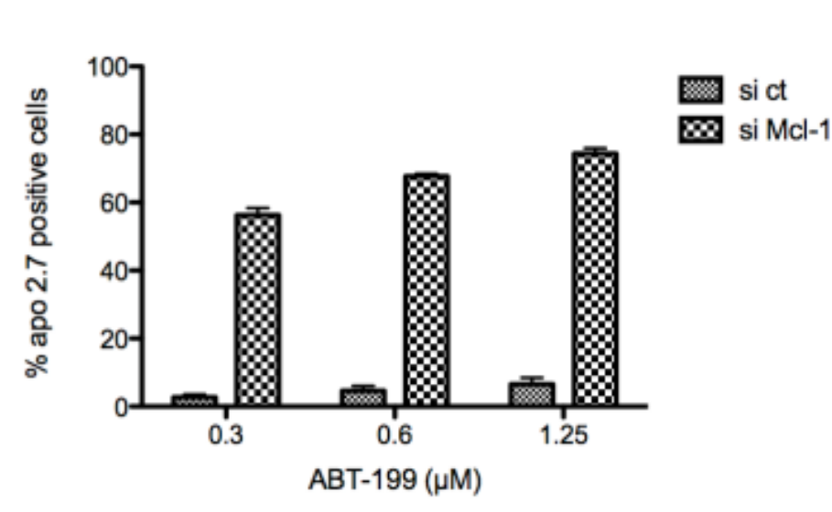
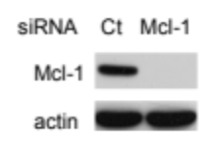
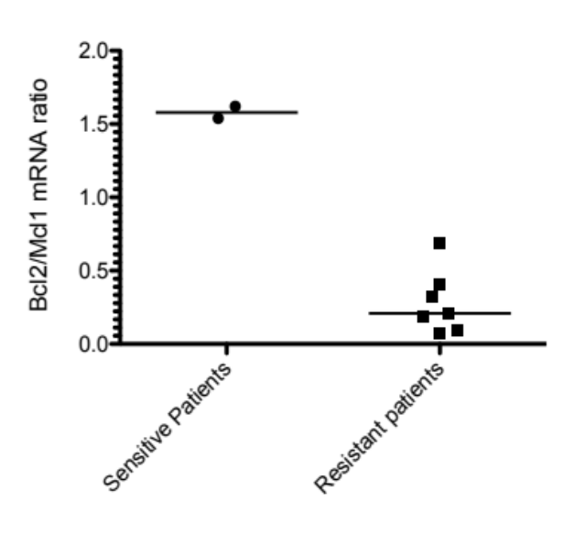
Ratio of BCL-2/MCL-1 predicts sensitivity to venetoclax
in myeloma cells
LP-1
p-value= .05*
Touzeau C et al. Leukemia 2013;17

Slide 24
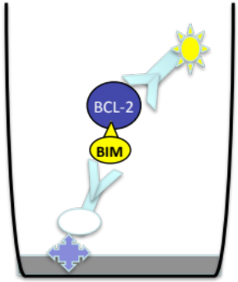
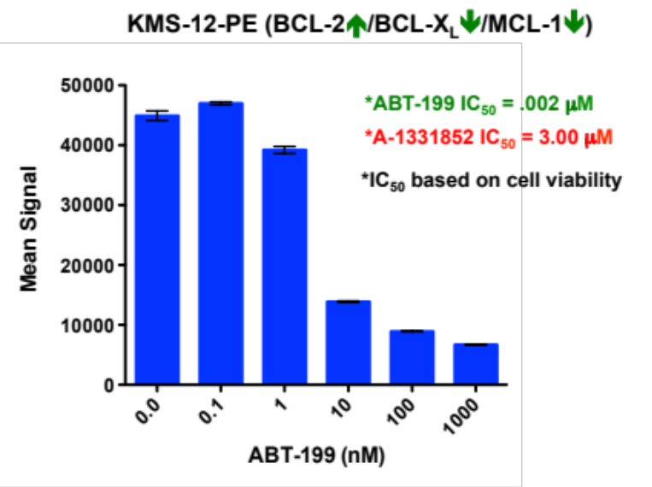
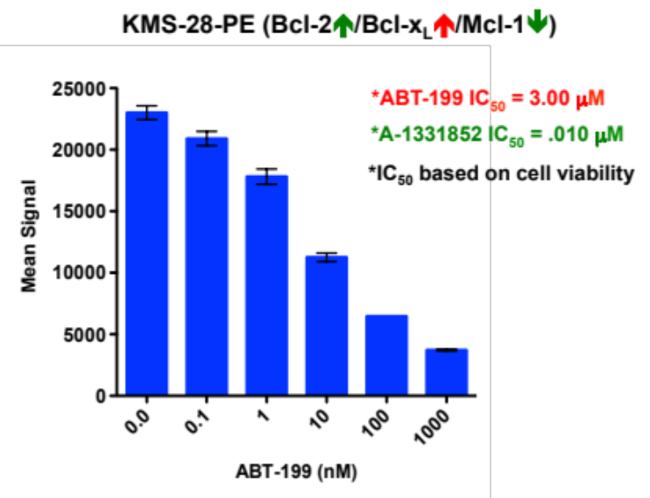
Myeloma cell lines that express high levels of BCL-X_{L} are resistant to venetoclax
BCL-2:BIM PD Immunoassay
Resistance to venetoclax in BCL-X_{L}^{high} HMCLs is not due to ineffective drug binding to BCL-2
Punnoose E et al. Molecular Cancer Therapeutics
2016;15:1132-1144.

Slide 25
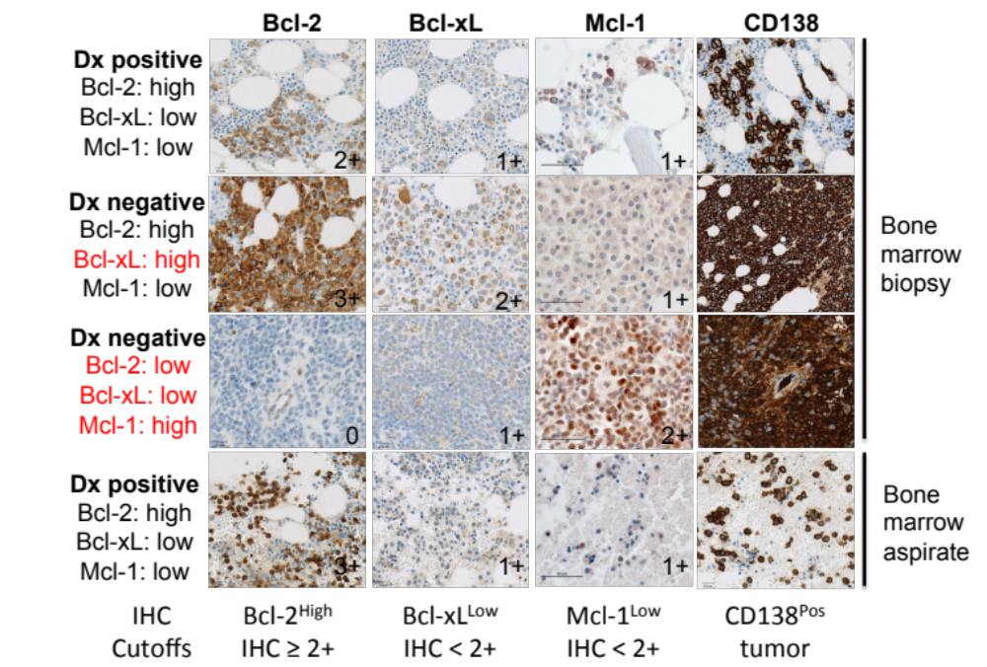
Prevalence of BCL-2, BCL-X_{L} and MCL-1 in MM
patient tumor samples
Bone
Marrow
biopsy
81% of MM samples (n=95) are BCL-2 high based on IHC (score > 2+); typically MCL-1 low
57% of MM are BCL-X_{L} low, IHC score < 2+
43% show favorable combination of high BCL-2, low BCL-X_{L,} low MCL-1
Punnoose E et al. Molecular Cancer Therapeutics.
2016;15:1132-1144.
Notes:
In samples evaluable for MCL-1 tumor staining (n=77), 81% (62/77) scored 1+ or weaker.

Slide 26
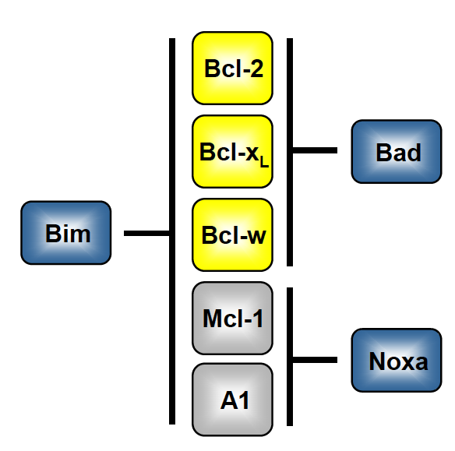
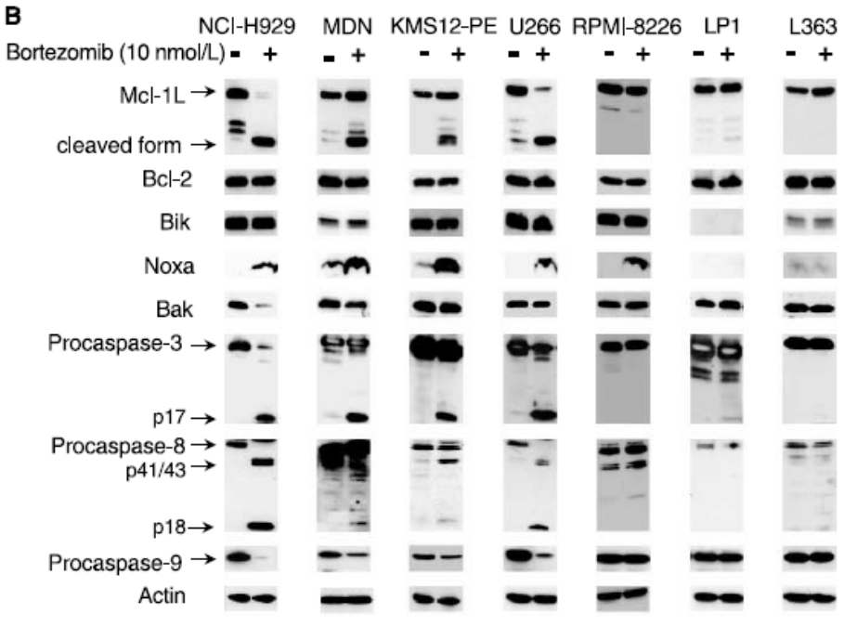
Targeting MCL-1 with therapeutic agents as a
strategy to overcome resistance to venetoclax in MM
MCL-1 is a resistance factor to venetoclax in myeloma cell lines
venetoclax
bortezomib
Gomez-Bougie et al. Cancer Research 2007;67:5418-5424.
Does the combination of bortezomib and venetoclax result in increased cell death and efficacy?

Slide 27
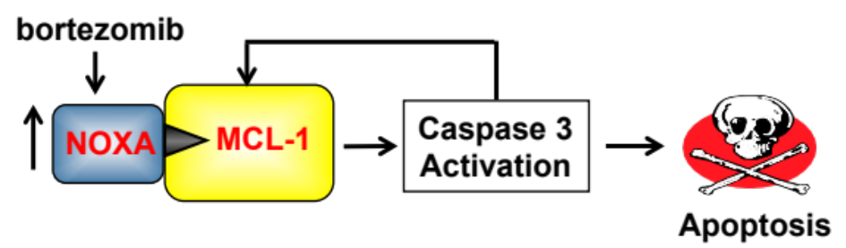
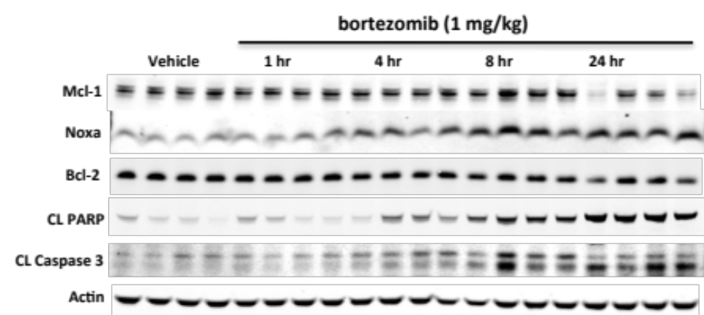
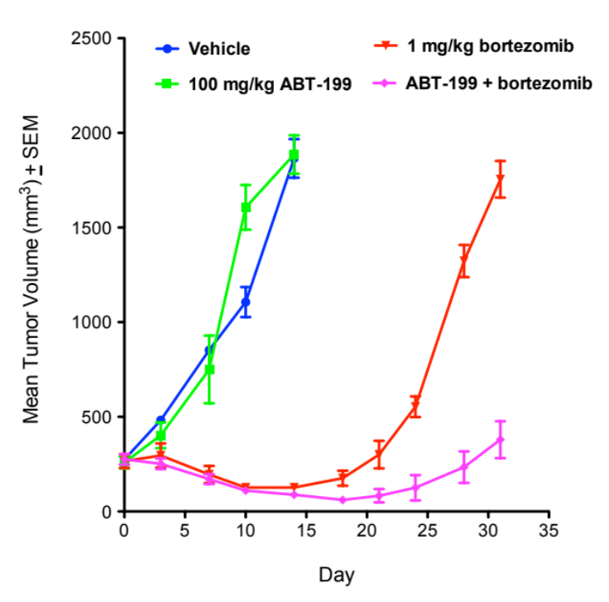
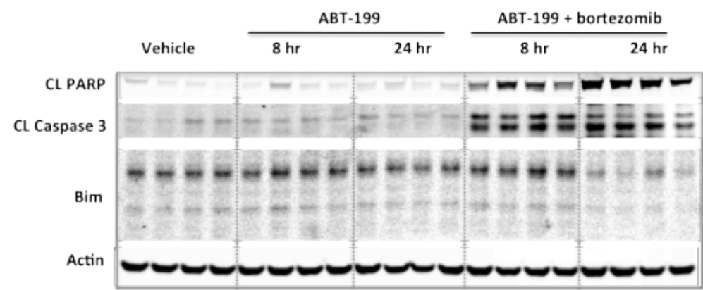
Bortezomib in combination with venetoclax increases
apoptosis in vivo
NCI-H929 Xenografts (BCL-2⬆/Mcl-1⬆)
Rx
Punnoose E et al. Molecular Cancer Therapeutics
2016;15:1132-1144.

Slide 28
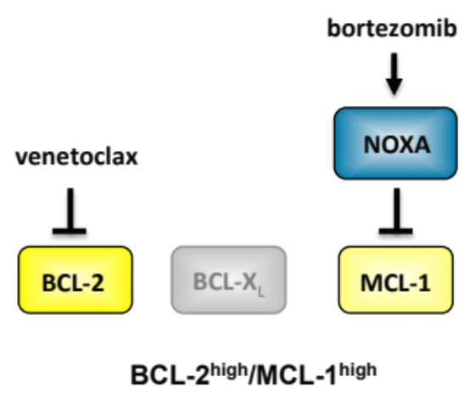




Venetoclax does not enhance efficacy of bortezomib
in MM xenografts that co-express BCL-X_{L}
OPM-2 (BCL-2⬆/MCL-1⬆)
MM.1S (BCL-2⬆/BCL-X_{L}⬆/MCL-1⬆)
Punnoose E et al. Molecular Cancer Therapeutics
2016;15:1132-1144.

Slide 29


BCL-2 is a clinically validated target in MM
Phase Ia: Venetoclax clinical response rate vs. t(11;14) status
Phase Ib: BCL-2 gene expression vs. clinical
response in combination with Velcad/ dexamethasone
t(11;14) prevalence in MM is 25%
  4 out of 7 MM cell lines sensitive to venetoclax harbored t(11;14) translocation
t(11;14) subgroup from venetoclax phase I monotherapy trial is enriched for BCL-2^{High}, BCL-X_{L}^{Low} tumors
Phase 3 clinical trial evaluating venetoclax in combination with Velcade/dexamethasone initiated
(FPI on July 19^{th,} 2016)
Kumar S et al. J Clin Oncol 2015;33 (A8576)
Touzeau C et al. J Clin Oncol 2015;33 (A8580)
Notes:
67% if patients in phase IA trial experienced grade 3/4 SAEs: anemia, thrombocytopenia.
70% of patients in phase 1B trial experience grade ¾ SAEs: anemia thrombocytopenia and decreased neutrophil count.

Slide 30
Working model: identification of drug combinations
with venetoclax based on mechanistic rationale
Venetoclax is efficacious as mono-therapy in BCL-2 high or dependent hematological malignancies (i.e. CLL and NHL)
CLL
NHL
venetoclax
⬆BCL-2

Slide 31
Working model: identification of drug combinations
with venetoclax based on mechanism of action
MCL-1 is an established resistance factor for venetoclax in preclinical NHL, AML, MM and BCL-X_{L} is emerging
CLL
NHL
venetoclax
⬆BCL-2
⬆BCL-X_{L}
MM
MM
NHL
AML
⬆MCL-1

Slide 32
Working model: identification of drug combinations
with venetoclax based on mechanism of action
Strategy: Combine venetoclax with SOC drugs or NMEs that upregulate BH3 only proteins to antagonize MCL-1 and/or BCL-X_{L} and maximize efficacy in hematological malignancies
CLL
NHL
venetoclax
⬆BCL-2
GDC-0032
GDC-0068
PI3K/Akt
BAD
⬆BCL-X_{L}
MM
X
X
PUMA
Anti-tubulin ADCs
FLT3i
CDK9i
DNA Damaging
Agents (HMAs)
p53
X
NOXA
X
MM
NHL
AML
idasanutlin
MDM2
⬆MCL-1
bortezomib
X
GDC-0973
MEK/ERK
X
BIM

Slide 33
Summary
  Venetoclax is a potent, orally bioavailable BCL-2 selective inhibitor that is platelet sparing
  Venetoclax is highly active as a single agent and achieves rapid and durable reduction of CLL tumor burden in all disease compartments in “hard to treat”/unfit patients
  Preclinical predictive biomarkers:
    t(14;18), BCL2 amplification and BCL-2/BIM levels (NHL and CLL)
    t(11;14) translocation (approx. 25% prevalence in MM)
    Bcl-2^{high}/Bcl-x_{L}^{low}/Mcl-1^{low} expression profile (NHL and MM)
  Mechanistic rationale supports combination therapies (standard of care or new molecular entities) with venetoclax that antagonize MCL-1 (i.e. bortezomib, MEKi, MDM2i, anti-tubulin ADCs) and BCL-X_{L} (i.e. anti-tubulin ADCs, MDM2i)
  Venetoclax clinical development has expanded beyond treatment for CLL, DLBCL, FL into AML and MM
  BCL-2, BCL-X_{L} and MCL-1 selective inhibitors can be utilized to pharmacologically dissect dependency on these specific pro-survival proteins in vitro and in vivo

Slide 34

Acknowledgements: Sampath Lab
Venetoclax Project
Jason Oeh
Ellen Ingalla
Amy Young
Elisabeth Lasater
Raghuveer Mali
Ritu Malla

Slide 35
Acknowledgements
TO/IVP
IVCC
Lori Friedman
Stephen Gould
Genentech Venetoclax
Translational Research and Biomarker Teams
Elizabeth Punnoose
Frank Peale
Monique Dail
Lisa Belmont
Ingrid Wertz
Wayne Fairbrother
Abbvie Venetoclax
Translational Research Team
Joel D. Leverson
Darren Phillips
Erwin Boghaert
Andrew J. Souers
Genentech Collaborators
Gail Phillips
Andrew Polson
Mark Merchant
Academic Collaborators
Martine Amiot (University of Nantes, France)
Marina Konopleva (MD Anderson)
Joan Brugge (Harvard Medical School)
Kevin Shannon (UCSF)

Slide 36
Appendix

