Slide 1

Pervaporative removal of polyaromatic hydrocarbons from model diesel composition using a fabricated polyimide membrane and process optimization.
Presented by
Dr. Debarati Mitra
ASSISTANT PROFESSOR
DEPARTMENT OF CHEMICAL TECHNOLOGY
UNIVERSITY OF CALCUTTA
INDIA

Slide 2
What is a membrane?
Membrane can be defined essentially as a barrier which separates two phases and restricts the transport of various components in a selective manner.

Slide 3
What is Pervaporation?
Pervaporation is a unique membrane separation process combining membrane permeation and evaporation. Here, the chemical potential gradient across the membrane is the driving force for mass transfer.

Slide 4
POLY-AROMATIC HYDROCARBONS (PAHs)
Polycyclic aromatic hydrocarbons, also known as poly-aromatic hydrocarbons (PAHs), are hydrocarbons with multiple aromatic rings. PAHs occur in petroleum, coal & tar deposits, and are produced as by-products of fuel burning in the presence of insufficient oxygen. They are potent atmospheric pollutants.

Slide 5
World-wide Fuel Charter Specifications
According to Worldwide Fuel Charter Category, the maximum allowable concentration of PAHs in diesel oil to be used as automotive fuel should be limited to 2 vol% (max.)

Slide 6
Objective
The main objective of the proposed investigation is separation of PAHs from a model diesel composition via pervaporation using a suitable polymeric membrane.

Slide 7
Why pervaporation?
The process pervaporation has numerous advantages.
The quality of products generated is generally high,
It generally avoids product degradation and produces no wastes,
Easy scale-up and scale down,
Simple and economic.

Slide 8
Membrane Preparation
Cast
Casting temp 308 K
Evaporation periods
318K
10 minutes
Casting solution
Polyamic acid(75 wt%)
Phenanthrene (5 wt%)
N,N-Dimethylacetamide
(20 wt%)
Gelation
24 hrs in toluene
24 hrs in Dioctyl Sebacate
Imidization
373K- 1 hr
473K - 1 hr
573 K -1 hr
Immersion
24 hrs in Methanol
Vacuum drying
Temp – 303K
12 hrs at 5 mm Hg
Fig. 1. Block diagram of membrane preparation

Slide 9
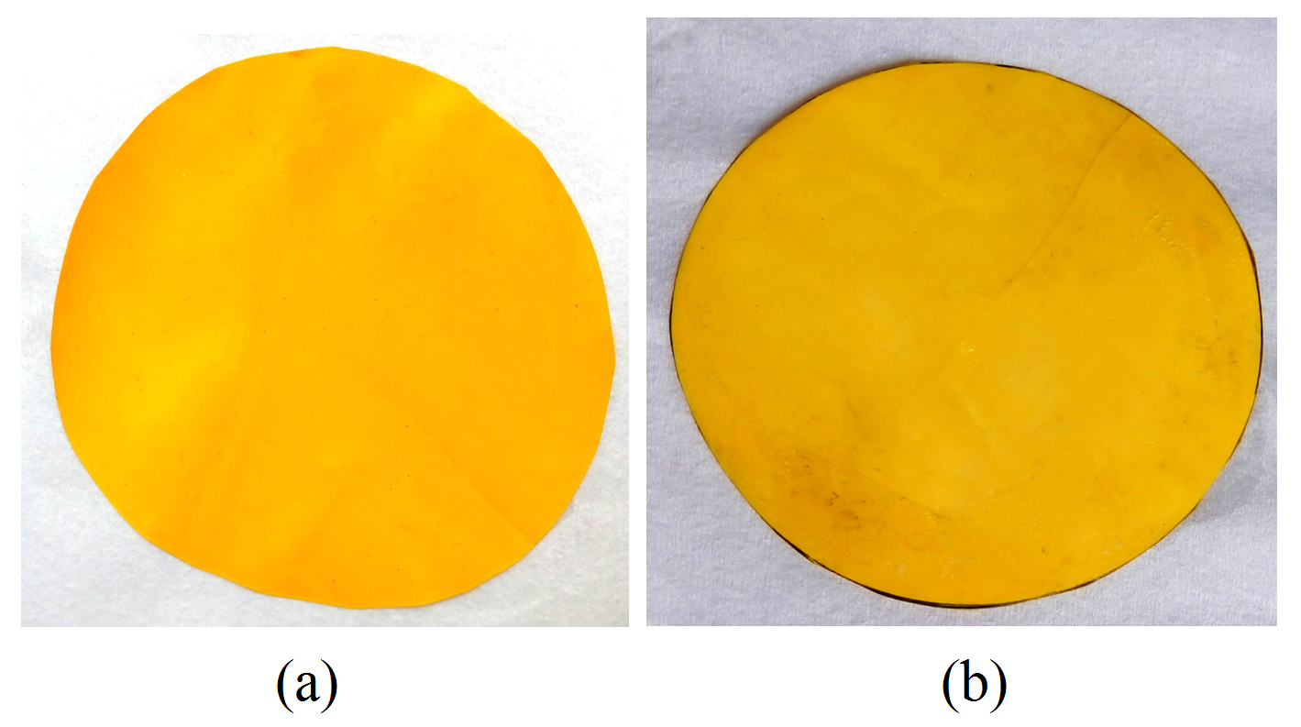
Photograph of the membrane
Fig. 2. Physical appearance of the prepared aromatic polyimide membrane.

Slide 10
MEMBRANE CHARACTERIZATION
SCANNING ELECTRON MICROSCOPY
Fig. 3. The virgin membrane and cross sectional view were analyzed in SEM by using Zeiss EVO18, Germany Scanning Electron Microscope equipped with Ion Sputter E1010.

Slide 11
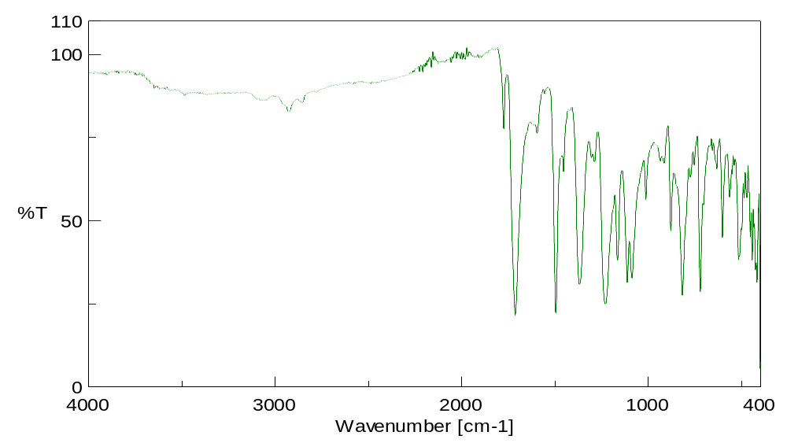
FTIR
Fourier Transform Infra-Red Spectrometry
Fig. 4. FTIR analysis of aromatic polyimide membrane

Slide 12
PERVAPORATION SETUP
Fig. 5. Schematic diagram of the experimental set up.

Slide 13
PERVAPORATION EXPERIMENTS
The effective membrane area in contact with the feed was 37.39 ×10⁻⁴ m².
The feed temperatures were varied from 413-493K.
The downstream pressure was also varied from 0.05 to 0.15 mm Hg.
The membrane thickness was about 25.5 µm.
Three feed composition are chosen for pervaporation study
Table 1. Different Feed Compositions
 | Feed 1 (F 1) | Feed 2 (F 2) | Feed 3 (F 3)
PAHs wt% (wt ratio of 2-Methyl napthalene: Acenapthene = 3:1) | 3 | 4 | 5
Toluene wt% | 10 | 10 | 10
n-tetradecane wt% | 87 | 86 | 85

Slide 14
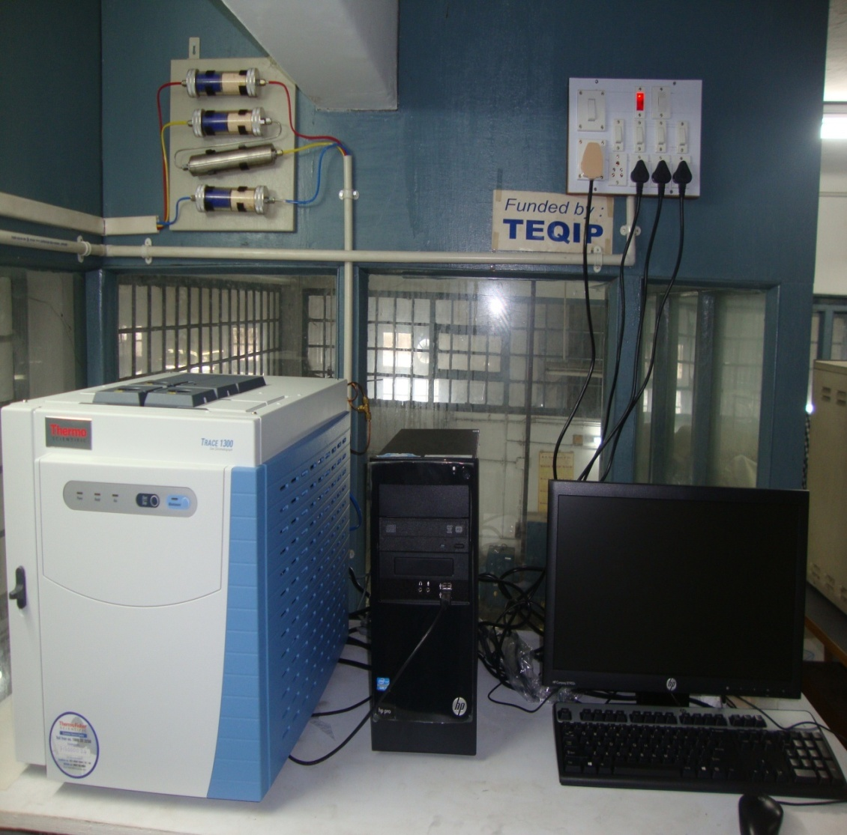
ANALYSIS
Chromatographic analysis of the retentates and permeates were performed using a Trace 1300, (Thermo Fischer SCIENTIFIC) GC equipped with a FID detector and a capillary column, TR-1 column 30m×0.3 mm id.

Slide 15

Separation Performance
The separation performance of the membrane was evaluated in terms of combined flux of PAHs, i.e, J_{i} = (J_{2MN}+ J_{Ace}), (J_{2MN} = individual flux of 2-methyl naphthalene and J_{Ace} = individual flux of Acenaphthene)as :
J_{i} (kg/m²h) =
where, Q in kg is the total mass of PAHs in the permeate collected per unit area of the membrane (A, m²).

Slide 16
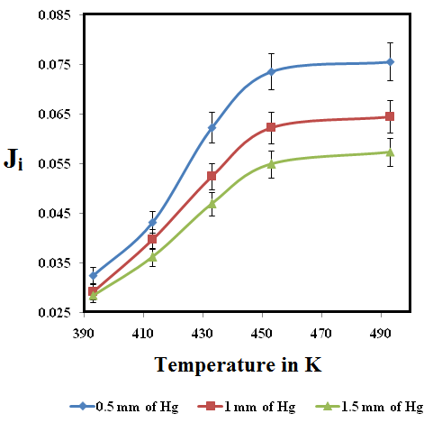
Variation of combined permeation flux as a function of temperature at different downstream pressure
Fig. 6. Effect of combined flux with Temperature at different Downstream pressure

Slide 17
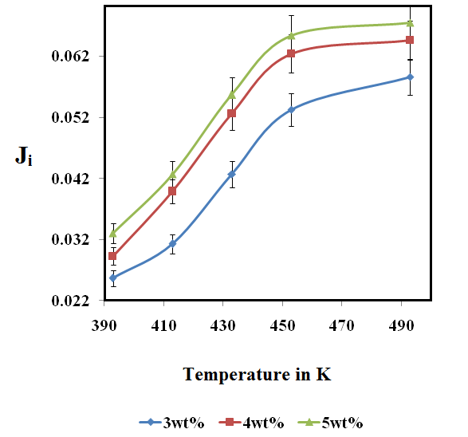
Variation of combined permeation flux as a function of temperature at different feed compositions
Fig. 7. Effect of combined flux with Temperature at different feed composition

Slide 18
ARRHENIUS’ PLOT
Fig.8. Arrhenius’ plot of permeation flux vs. 1/T

Slide 19
EXPERIMENTAL DESIGN
Table 2. Process factors and their levels
Factor | experimental Factor | Units | Levels
 |  |  | - α | -1 | 0 | +1 | + α
T | Temperature | K | 399.36 | 413 | 433 | 453 | 466.64
C | Feed Composition | Wt% | 2.32 | 3 | 4 | 5 | 5.68
P | Downstream pressure | mm of Hg | 0.16 | 0.5 | 1.0 | 1.5 | 1.84

Slide 20
ANOVA values of response surface quadratic model to PSI.
Source | Sum of squares | df | Mean square | F value | p-value | Prob>F
Model | 0.002522 | 9 | 0.0002802 | 70.77 | < 0.0001 | Significant
T | 0.0007571 | 1 | 0.0007571 | 191.21 | < 0.0001
C | 0.0004814 | 1 | 0.0004814 | 121.57 | < 0.0001
P | 0.0006196 | 1 | 0.0006196 | 156.48 | < 0.0001
TC | 0.0000099 | 1 | 0.0000099 | 2.52 | 0.1433
TP | 0.0001778 | 1 | 0.0001778 | 44.92 | < 0.0001
CP | 0.00003192 | 1 | 0.00003192 | 8.06 | 0.0176
T² | 0.0002921 | 1 | 0.0002921 | 73.77 | < 0.0001
C² | 0.00002586 | 1 | 0.00002586 | 6.53 | 0.0286
P² | 0.000189 | 1 | 0.000189 | 47.74 | < 0.0001
Residual | 0.0000396 | 10 | 0.00000396
Lack of Fit | 0.0000396 | 5 | 0.000007919
Pure Error | 0.000 | 5 | 0.000
R² | 0.9845
Adj R² | 0.9706

Slide 21
The final empirical model is as follows:
J_{i} = -2.38841+ 0.010368T+ 0.003544C+ 0.23564P- 0.00005587TC- 0.0004715TP- 0.003995CP-0.000011255T²-0.00133967C²-0.014487P²

Slide 22
Surface plot and 3D contour plot showing effect of temperature and feed concentration on J_{i}
Fig. 9. Surface plot (a) and 3D contour plot (b) showing effect of temperature and feed composition on J_{i}.

Slide 23
Surface plot and 3D contour plot showing effect of temperature and downstream pressure on J_{i}
Fig. 10. Surface plot (a) and 3D contour plot (b) showing effect of temperature and downstream pressure on J_{i}.

Slide 24
Surface plot and 3D contour plot showing effect of feed concentration and downstream pressure on J_{i}
Fig. 11. Surface plot (a) and 3D contour plot (b) showing effect of downstream pressure and feed composition on J_{i}.

Slide 25
CONCLUSION
Removal of polyaromatic hydrocarbons from diesel is an important challenge to today’s refiner in order to meet fuel emission specifications. We have chosen a model diesel composition and studied the separation of PAHs using Pervaporation technique. A dense aromatic polyimide membrane was prepared using a simple and relatively inexpensive method. The effect of different operating variables on the combined permeation flux was investigated. The regression equations between the three physico-chemical parameters viz. temperature, downstream pressure and feed composition and the response J_{i} were obtained. The optimum operating condition was established using RSM at a temperature of 452.59K, downstream pressure 0.50 mm of Hg, PAH in feed 4.92 wt% for the maximum value of J_{i} (0.0705214 kg m⁻² h⁻¹). The percent removal of PAHs was about 50% in this study.

Slide 26
REFERENCES
1. Katarzynski, D., and Staudt, C. (2010). Temperature-dependent separation of naphthalene/n-decane mixtures using 6FDA-DABA-copolyimide membranes, J. Membr. Sci., 348, 84-90.
2. Salehian, P., Chua, M. L., Askari, M., Shi, G. M., and Chung, T. -S. (2015). In situ regulation of micro-pore to design high performance polyimide membranes for pervaporation dehydration of isopropanol, J. Membr. Sci., 493, 299-310.
3. Roychowdhury, S., and Mitra, D. (2016). Separation of phenanthrene/n-tetradecane mixtures (model diesel) via pervaporation using an aromatic polyimide membrane, Polym. Eng. Sci., d.o.i. 10.1002.
4. Kononova, S. V., Kremnev, R. V., Suvorova, E. I., Baklagina, Y. G., Volcheck, B. Z., Uchytil, P., Shabsels, B. M., Romashkova, K. A., Setnickova, K., and Reznickova, J. (2015). Pervaporation membranes with poly(γ-benzyl-L-glutamate) selective layers for separation of toluene-n-heptane mixtures, J. Membr. Sci., 477, 14-24.
5. Katarzynski, D., Pithan, F., and Staudt, C. (2008). Pervaporation of Multi Component Aromatic/Aliphatic Mixtures through Copolyimide Membrane, Sep. Sci. Technol., 43, 59-70.
6. Mitra, D. (2012). Desulfurization of Gasoline by Pervaporation, SEP PURIF REV., 41, 97-125.
7. Kim, K., Yoo, T., Kim. J., Ha, H., and Han, H. (2015). Effects of Dianhydrides on the Thermal Behavior of Linear and Crosslinked Polyimides, J. Appl. Polym. Sci., 132, 41412 (1-9).
8. Kuang, G., Jiang, L. Y., Wang, Y., and Chung, T. S. (2010). Asymmetric hollow fibers by polyimide and polybenzimidazole blends for toluene/iso-octane separation, J. Membr. Sci., 360, 303-314.

Slide 27
ACKNOWLEDGEMENT
I would like to express my heartiest gratitude to Department of Science and Technology (DST FAST TRACK, Sanction No. SERB/F/0796/2012-2013 dated 15/05/2012), Government of India for providing the financial support and University of Calcutta for infrastructural support.

Slide 28

Thank you

