Slide 1

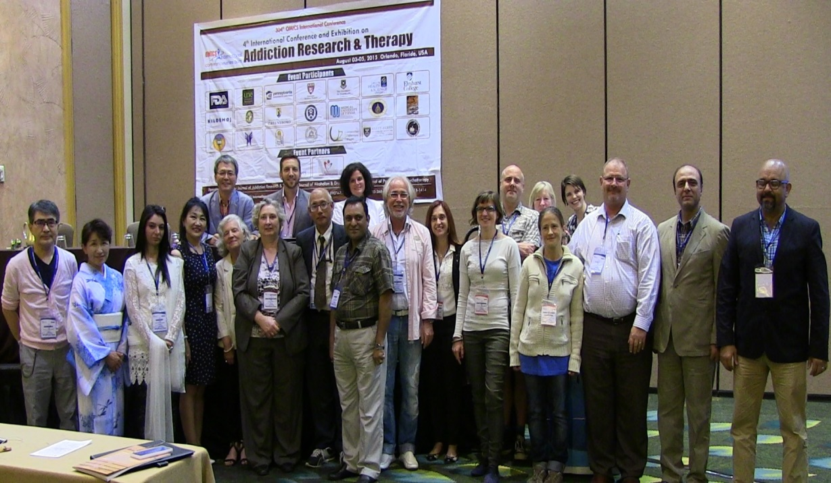
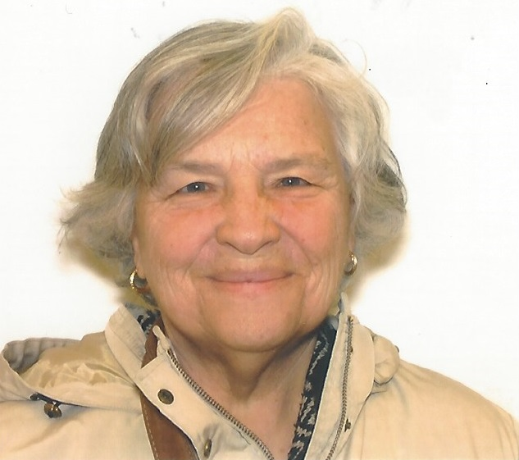
Addiction Therapy 2015
Florida, USA
August 03-08, 2015
Deanna Mulvihill

Slide 2
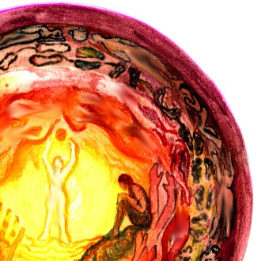

The Application of Rebonding of the Body to a Women’s Substance Abuse Program
Deanna L Mulvihill RN PhD
Cogenz International

Slide 3
Why a women’s substance abuse program?
Women who have experienced IPV are at greater risk of physical and mental health problems, including PTSD and alcohol dependence (Campbell, 2002; Ziberman, Tavares, Blume & el-Guebaly, 2003)
The incidence of alcohol dependence and substance abuse is higher in people with a history of trauma than in those without such a history and this risk is intensified for those with PTSD (Diaz, Simatov & Ricker, 2000)

Slide 4
2/3 of women with substance abuse have mental health problems that include PTSD and many are survivors of IPV (Ziberman, et al., 2003., Mulvihill, et al,2009).
Women with IPV and AD who seek treatment have difficulty benefiting from present treatment programs (Miller et al 2000, Chase et al 2003)
Alcohol and other substances used to cope with the symptoms of PTSD (Brady et al., 2005).
Both trauma and substance abuse make neurohormal changes in our body.

Slide 5
During a 4 month intersubjective ethnographic study using hermeneutic dialogue and participant observation of women and staff in a substance abuse treatment center, it was documented that all the women had a history of trauma including the staff, the trauma of the clients was documented and discussed during the admission assessment but was not considered as part of the treatment plan (Mulvihill et al. 2009)

Slide 6
Both the staff and the clients were asked if they knew what PTSD was and if they knew what to do if a person showed symptoms.
Few knew a definition but many gave personal experiences.

Slide 7
Many of the interventions that were part of the regular therapeutic groups were triggering the clients PTSD (Mulvihill et al. 2009). None of the staff knew what to do when a client was triggered.

Slide 8
Rebonding of the Body
Rebonding of the Body is a multimodality structured program which consists of 8 three hour sessions.
It was originally developed for children who had been sexually abused and has been altered to serve persons of all ages and genders who have experienced a wide variety of trauma

Slide 9
Rebonding of the Body"
based on the assumption that in order to survive traumatic incidents in our life we may disassociate or disown certain parts of our body or personalities. No real healing can take place until these disassociated parts are revealed and reintegrated into the person’s whole being.
The technique utilizes memories as pathways to healing.

Slide 10
Objective: "rebond”, or reintegrate the disassociated personality or body parts.
The program is:
Structured and consistent
From least vulnerable to the more vulnerable
Maintain nurturing position
Uses art, movement, and creative visualization
Open for abreaction to occur in a safe manner,
The element of "play", must be present.
Details of the trauma need not be disclosed to others for integration to occur.

Slide 11
Session content
Session One: (Introduction) Body History
Obtaining a Body Map
Session Two: The Feet
Grounding
Session Three: The Legs
Standing Up Standing Firm
Session Four: The Hands and Arms
Creativity
Taking In /Pushing Out

Slide 12
Sessions content cont’d
Session Five: Head
The Masks
What Can I See, Say and Do
Session Six: Trunk
History
Healing Ways
Session Seven: Integration
Session Eight: Self-Forgiveness
The New Body/ The New Way

Slide 13
Structure of sessions
Verbal Sharing , Play and Storytelling
Drawing an Outline of the Body or Body Part
Physical Exercise and or Games involving a particular body part.
Relaxation
Visualization and Memory Recall
Painting and Drawing/Journal Writing
Verbal Sharing and Story telling
Closing
Journal & Dream Writing (during and between groups)

Slide 14
Recommendations
Longer rehabilitation
Education the staff on trauma informed and trauma specific techniques
Introduce Rebonding of the Body program into substance abuse treatment programs

Slide 15
Rebonding of the Body introduced into the Program
All groups were audited for trauma informed techniques
This substance abuse programs was only 24 days long, so one Rebonding session was offered every third day beginning with day one.
This programs offered yoga, movement programs, mediation groups ,art and journaling groups: Rebonding of the Body was offer in place and two staff were trained during the program, so they could continue to offer the program.

Slide 16
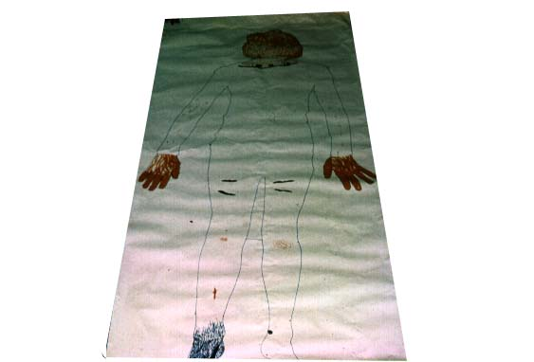
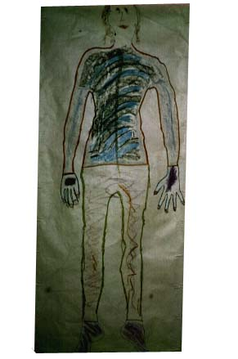
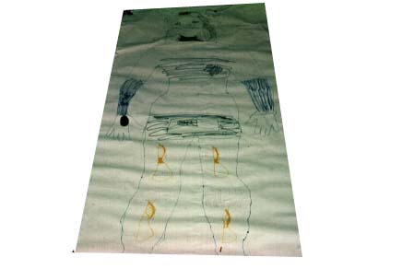

Slide 17
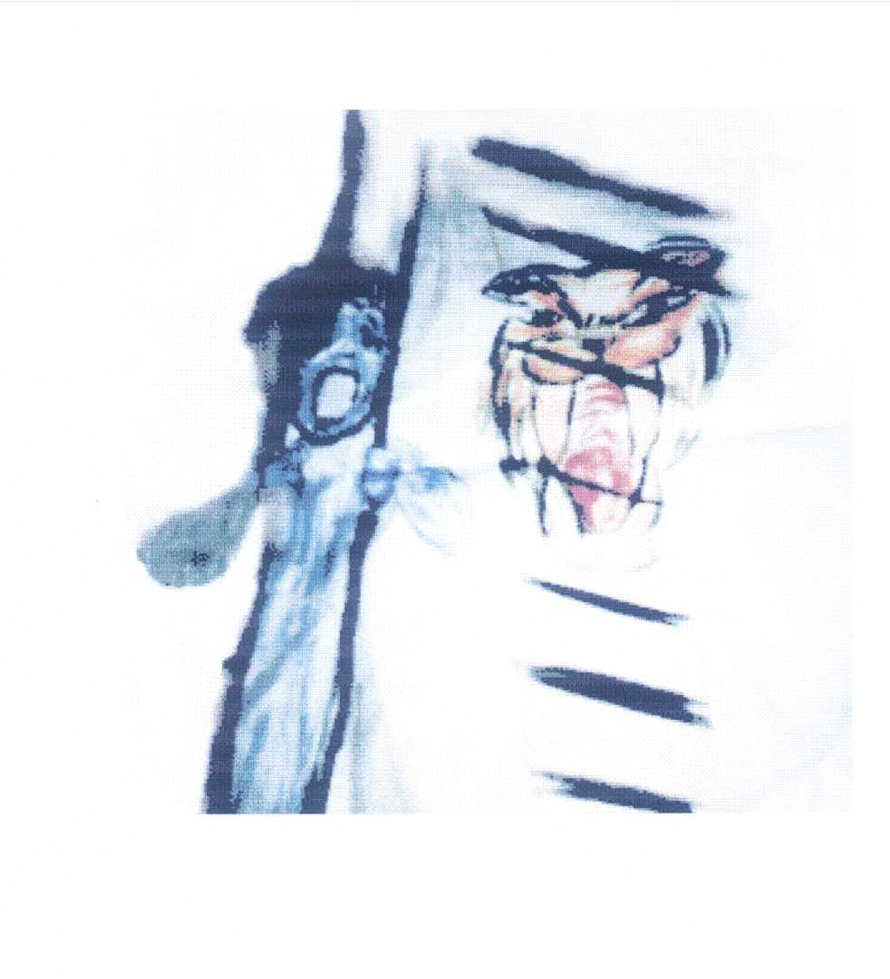
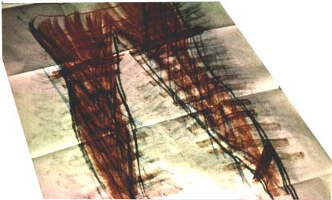

Slide 18
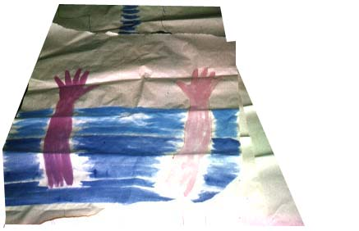
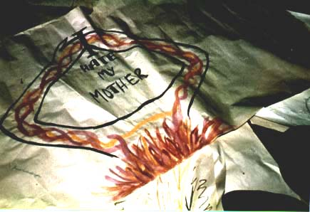

Slide 19
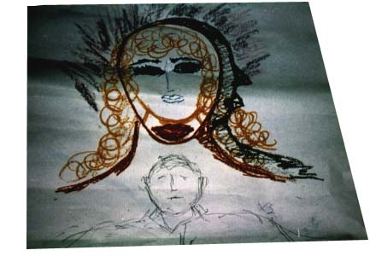
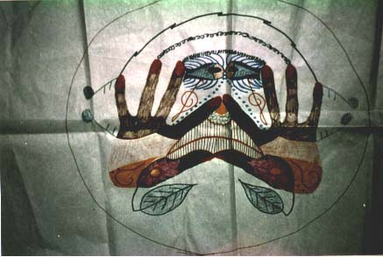

Slide 20
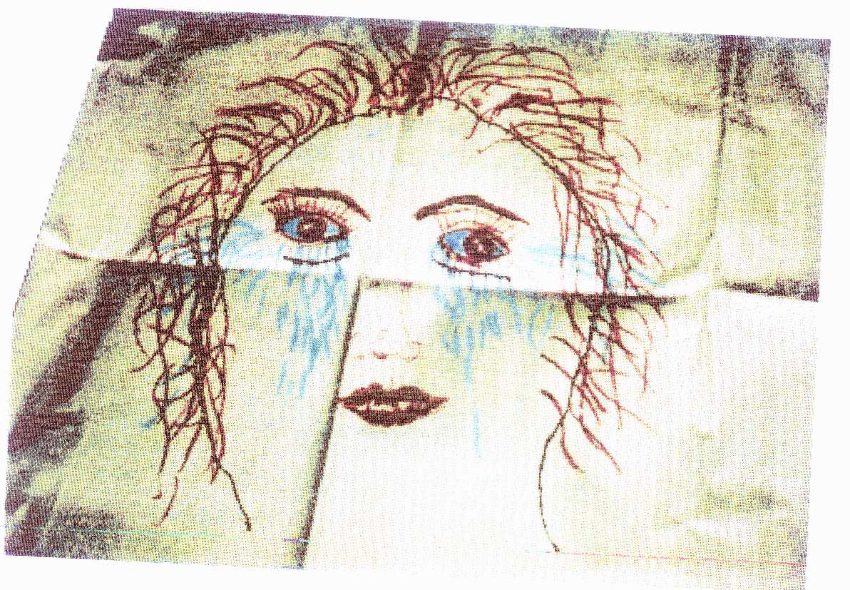
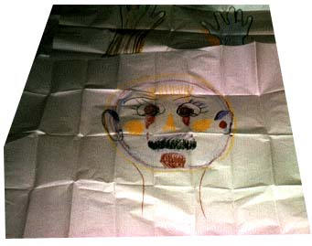

Slide 21
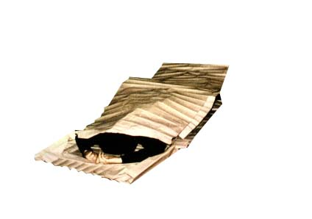

Slide 22
Comments and Critiques
Deanna L Mulvihill RN PhD deannalifestyle@hotmail.com

Slide 23

Meet the eminent gathering once again at
Addiction Therapy 2016
Miami, USA
October 06-08, 2016
Addiction Therapy 2016
Website: addictiontherapy.conferenceseries.com

