Slide 1
Innate-adaptive immunity duo as a regimen for conferring rapid-sustained-broad protection against pathogens
De-chu Christopher Tang, PhD
VaxDome LLC
Dallas, Texas
September 29, 2015
Notes:
1

Slide 2
A litany of demands for better vaccines
Problem: Current vaccines confer protection in a slow motion.
Solution: Develop a drug-vaccine duo (DVD) by activating a protective innate-adaptive immunity duo.
Problem: Current vaccines do not confer broad protection.
Solution: Develop a universal vaccine component within a DVD context.
Problem: Current injectable vaccines are associated with pain; fear; medical license; syringe needle disposal; and systemic inflammation.
Solution: Develop noninvasive vaccines by delivering vaccines to the interface between the body and environment (e.g., oral vaccine; nasal vaccine; skin-patch vaccine).

Slide 3
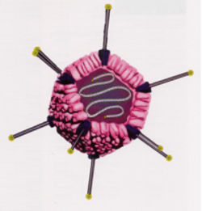
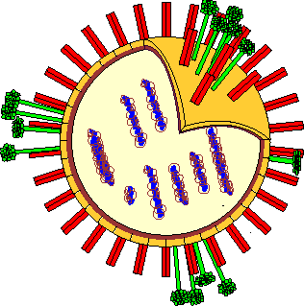
Ad5-vectored influenza vaccine
Clone HA
Influenza virus Ad5 vector encoding influenza HA
Growth varies from strain to strain More consistent growth rates
Some strains are lethal Benign vectors
Prone to reassortment/mutation events No reassortment events
Low-titer production in eggs High-titer production in cultured cells
A new RCA-free Ad5 can be generated by the AdHigh system within one month

Slide 4
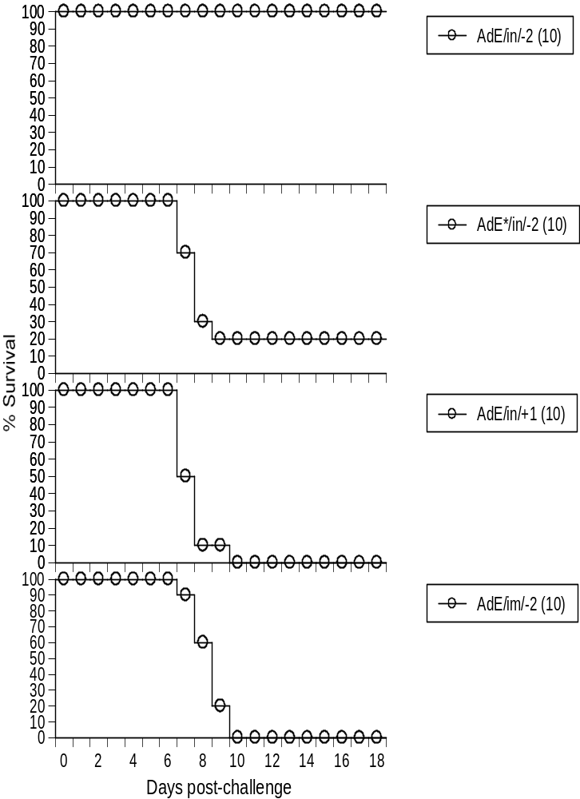
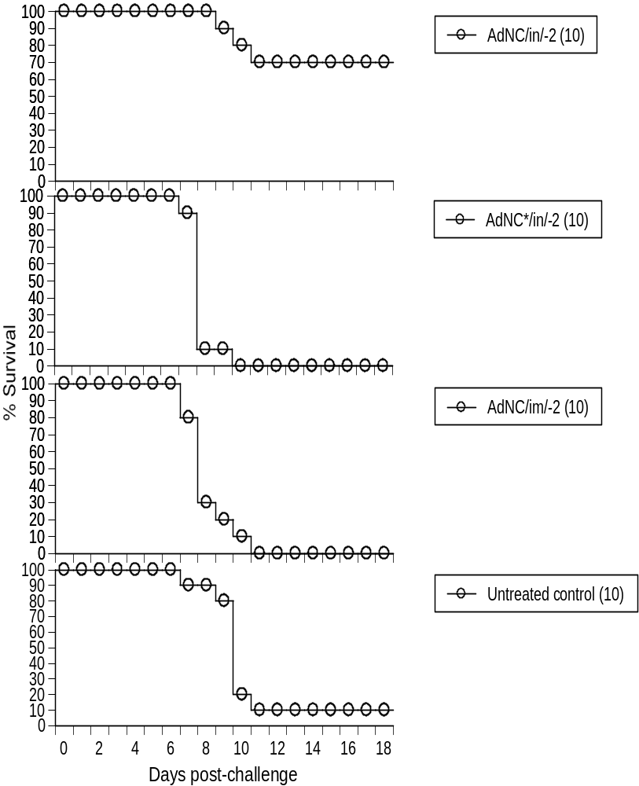
Prophylactic influenza therapy by Ad5-vectored drug-vaccine duo
4
-Zhang J et al. PLoS ONE 6: e22605, 2011

Slide 5
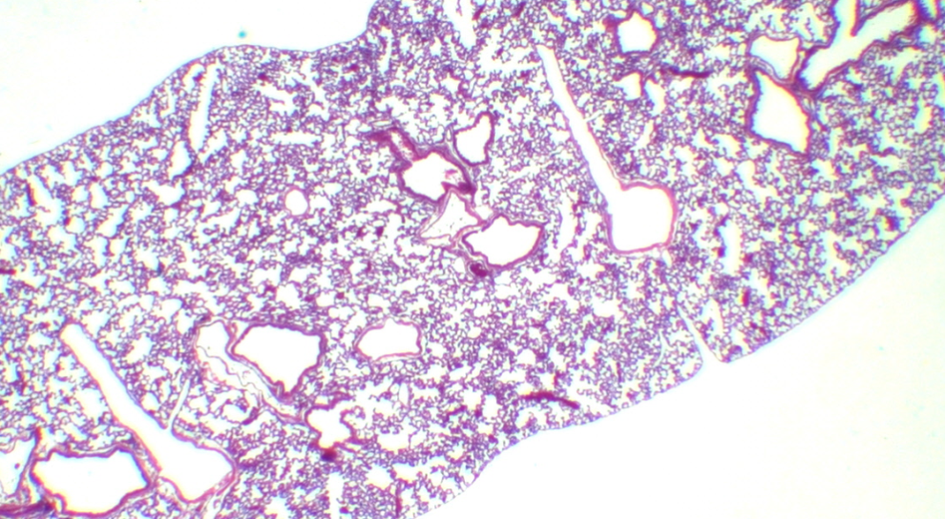
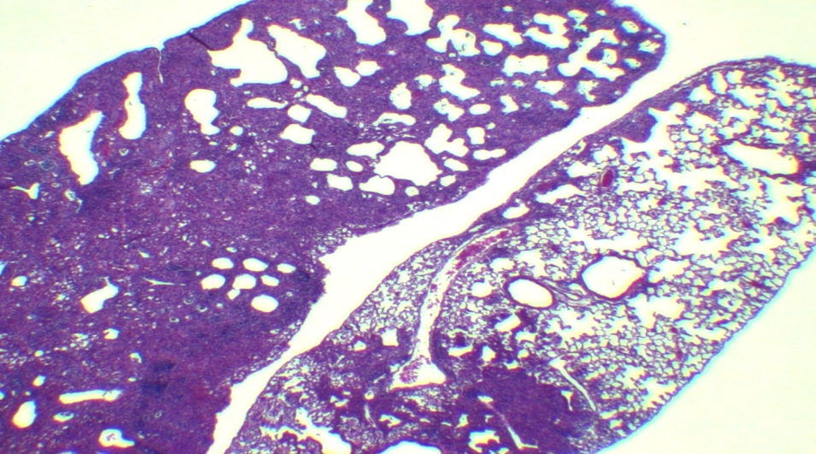
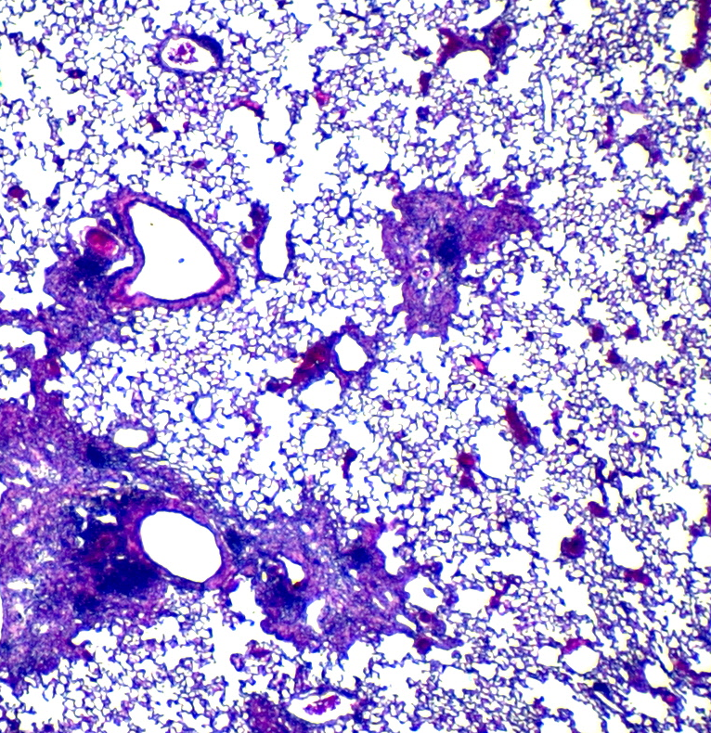
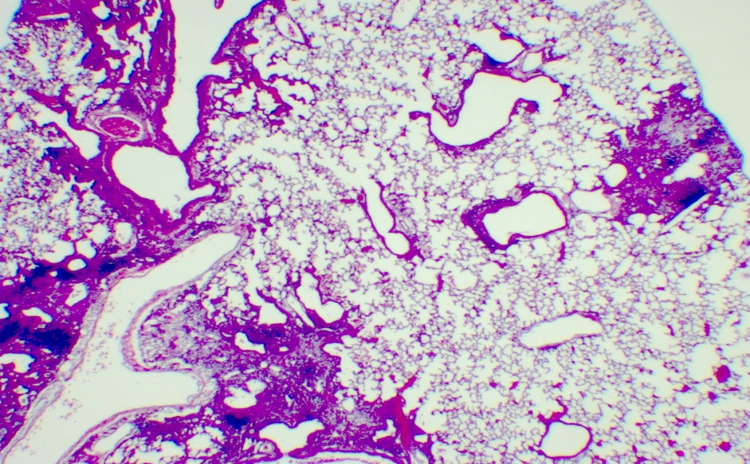
Lung histopathology 19 days post-influenza virus infection (2X)
Normal; no PR8 No Ad5 pre-exposure; PR8 challenge
Pre-exposure to AdE; PR8 challenge Pre-exposure to AdNC.H1.1; PR8 challenge
-Zhang J et al. PLoS ONE 6: e22605, 2011
5

Slide 6
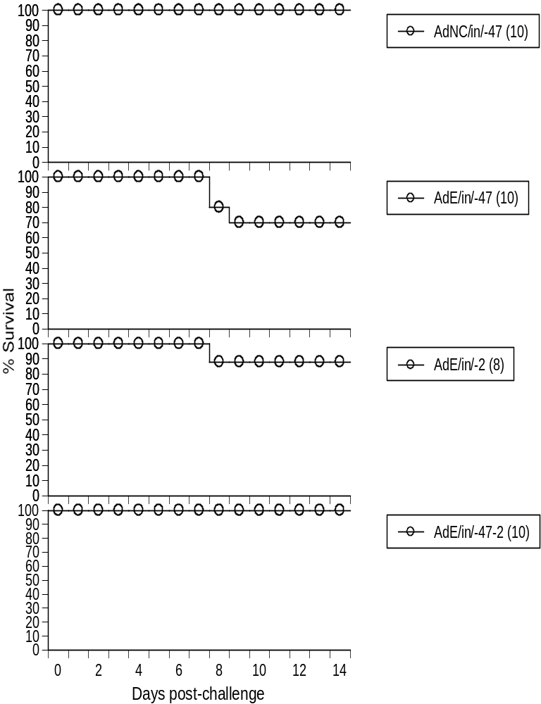
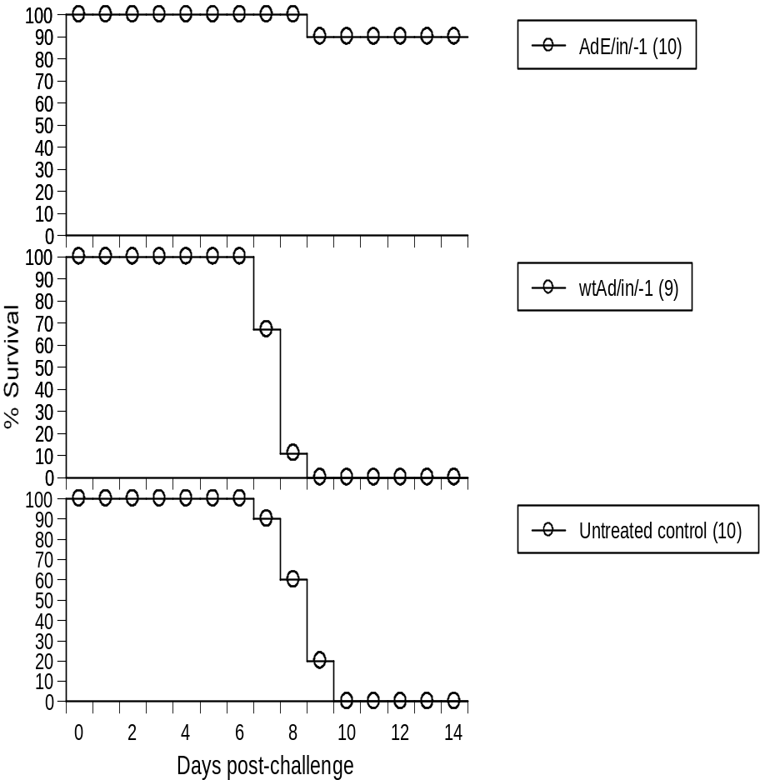
Ad5-vectored drug-vaccine duo induces rapid-sustained protection against influenza – a vaccine more than just a vaccine
-Zhang J et al. PLoS ONE 6: e22605, 2011
6

Slide 7
Influenza drugs
Class I: M2 ion channel blockers – impaired by drug resistance
Amantadine
Rimantadine
Class II: Neuraminidase inhibitors – impaired or to be impaired by drug resistance
Oseltamivir (Tamiflu)
Zanamivir (Relenza)
Peramivir
To bypass drug resistance: Taking the way a licensed drug as we know how it works, then doing the exact opposite.
Class III: Induction of an anti-influenza state – may not induce drug resistance
Adenovirus-vectored drug-vaccine duo (DVD)

Slide 8
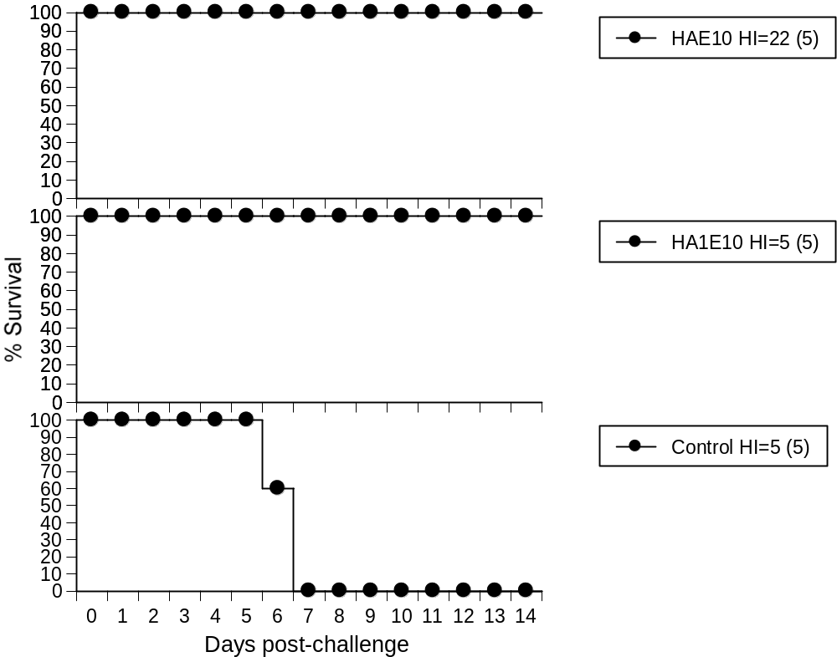
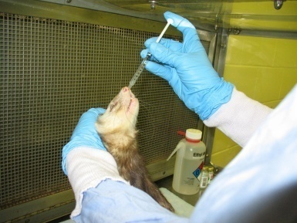
Ad5-vectored nasal influenza vaccine protected ferrets against the A/VN/1203/04 (H5N1) avian influenza virus
Ferrets were immunized i.n. on Day 0; and challenged with A/VN/1203/04 at a dose of 10 FLD₅₀ (10² EID₅₀) at SRI on Day 56. HA, Ad encoding HA1+HA2; HA1, Ad encoding HA1; E10, 10¹⁰ vp; HI, GMT of serum HI titers on Day 51.

Slide 9
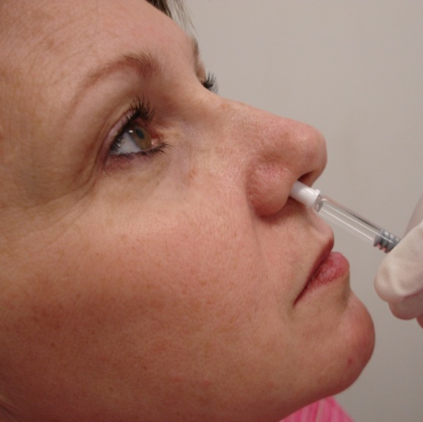
Human Phase I clinical trial of an Ad5-vectored nasal avian influenza vaccine
Study design
Ad_{h}VN1203/04.H5 vector encodes HA1+HA2 of the A/VN/1203/04 (H5N1) avian influenza virus
Randomized, double-blind, placebo-controlled, single-site study
Three cohorts at an escalating dose of 10⁸, 10⁹, and 10¹⁰ vp
Administered by nasal spray
Two doses on Days 0 and 28
Total of 48 healthy volunteers, aged 19 – 49
Sixteen human subjects per dose cohort, including 4 placebo controls per cohort
RCA free, cell culture based manufacturing in PER.C6 suspension cells in serum-free medium at SAFC
Human clinical trial was performed by Dr. Scott Parker at UAB
Notes:
9

Slide 10
Rationale to develop an Ad5-vectored nasal influenza vaccine
 | Licensed TIV | Licensed LAIV (FluMist) | Ad5-vectored nasal influenza vaccine
IFV required | Yes | Yes | No
Egg required | Yes | Yes | No
Mode of administration | Intramuscular injection | Nasal spray | Nasal spray
Replication postvaccination | No | Yes | No
Reassortment | No | Yes | No
Antiviral co-administration | Yes | No | Yes
Nearly-immediate protection | No | Yes (animal model) | Yes (animal model)
Systemic inflammation | Yes | No | No (conceivably)

Slide 11
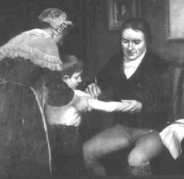
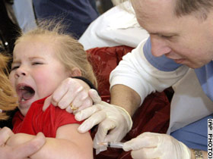
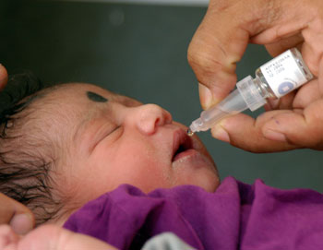
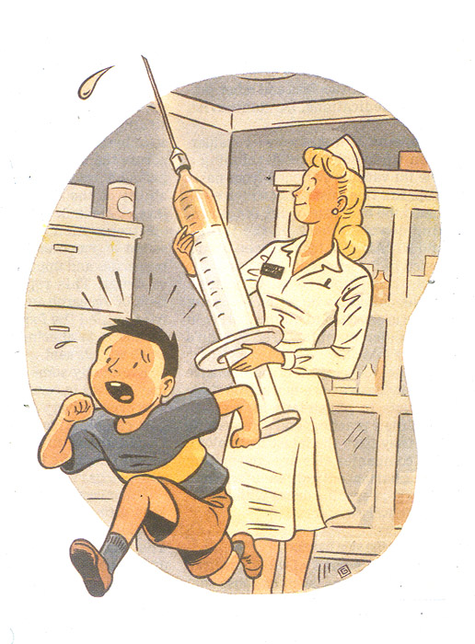

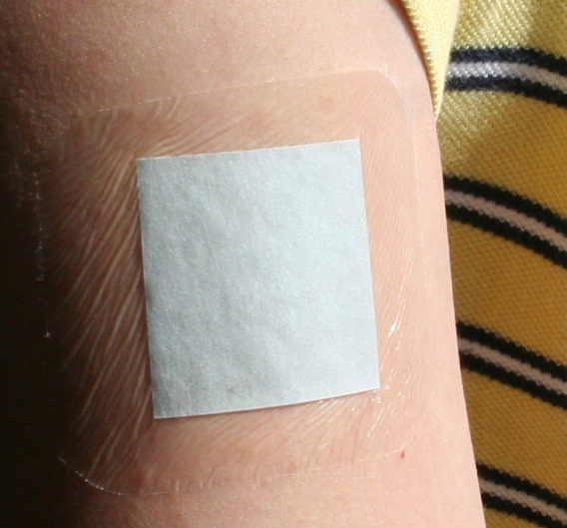
Inflammation induced by noninvasive vaccination tends to be benign

Slide 12
Vaxin Inc. Kent R. Van Kampen Zhongkai Shi Jianfeng Zhang De-chu C. Tang VaxDome LLC De-chu C. Tang | IVI (Korea) Huan Huu Nguyen Hoewon Jeong De-chu C. Tang | Collaborators University of Alabama at Birmingham Utah State University Battelle Biomedical Research Center Southern Research Institute Southern Drug Research Crucell Holland BV SAFC | Support NIH Korean Brain Pool Program BARDA U.S. Navy Transgovernmental Enterprise for Pandemic Influenza in Korea National Research Foundation (Korea) Kolmar Korea Co., Ltd. AnC Bio Inc. Paradigm Venture Partners I, L.L.C. Wallace H. Coulter Foundation

