Slide 1

CO₂-Prophet model based evaluation of
CO₂-EOR and storage potential
in mature oil reservoirs
( Based on Journal of Petroleum Science and Engineering, Vol. 134 (2015), pp. 79–86)
By
Dayanand Saini, Ph.D.
Assistant Professor of Petroleum Engineering
3rd World Congress on
Petrochemistry and Chemical Engineering
November 30, 2015, Atlanta,

Slide 2
Slide 2
Outline
  Motivation
  CO₂-Prophet Model Based EOR and Storage Potential Estimation Methodology
  Model Calibration for Candidate Reservoirs
  Calibration Results (Reservoir X, Reservoir Y)
  Prediction Results (Reservoir X, Reservoir Y)
  Summary

Slide 3
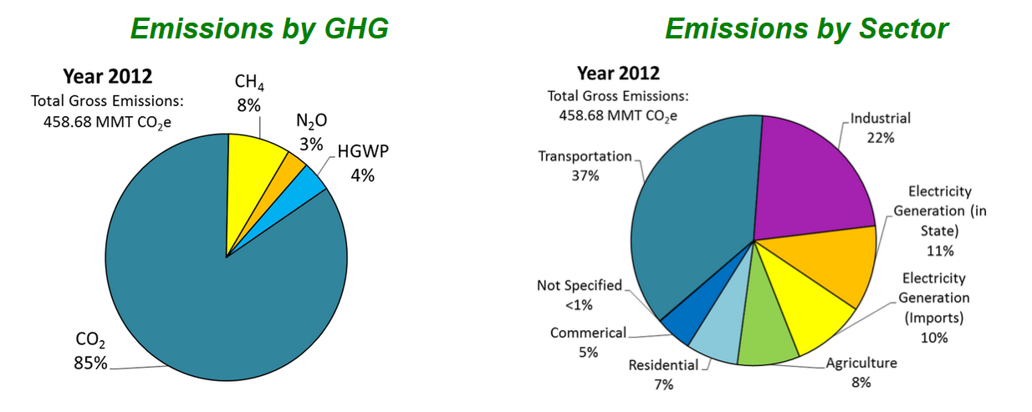
Slide 3
Motivation
33% of the total GHG emissions from stationary sources
Reference: California Air Resources Board

Slide 4
Slide 4
Motivation
California’s greenhouse gas (GHG) emission reduction goals:
        By 2020- at 1990 levels
        (~ 427 MMTCO₂e)
        By 2050- 80% below 1990 levels
        By 2030- 40% below 1990 levels
Executive Order B-30-15 (2015)
Carbon Capture and Storage (CCS) is an important option
References: California Air Resources Board Report, 2007
California Carbon Capture and Storage Review Panel Report, 2010

Slide 5
Slide 5
US CO₂ EOR and Geologic CO₂ Storage
113 CO₂-EOR projects in the USA
Use of 60 million metric tons (MMT) of natural and industrial CO₂ per year for EOR
Stored nearly 10 MMT of CO₂ from natural gas processing and industrial sources in underground formations in 2013
Reference: Wallace and Kuuskraa, 2014

Slide 6
Slide 6
CO₂-EOR in California
Basin | Field/Area | CO₂ EOR Type | Period | Net mcf CO₂ Injected
Los Angeles | East Coyote/Hualde Dome | WAG | 1982-84 | 143,080
Los Angeles | Huntington Beach/A-37 | Cyclic | 1981-82 | 183,892
Los Angeles | Wilmington (Fault Block I, III, V) | WAG | 1981-87 | 14,283,496
Ventura | Ventura/D-6(C) | Pilot | 1988 | 216,159
San Joaquin | North Coles Levee/Stevens | Flood | 1981-84 | 1,706,355
San Joaquin | Lost Hills/Belridge Diatomite | Pilot | 2000-01 | 216,514
San Joaquin | Elk Hills/Stevens | WAG | Active | -
California CO₂ Injection Projects
(Winslow, 2012; Jeschke et. al, 2000)

Slide 7
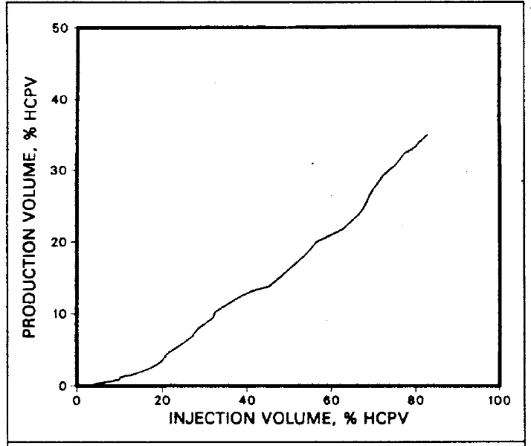
Slide 7
Incident CO₂Storage in CO₂-EOR Operations
North Coles Levee CO₂ Pilot, Injection/production material balance (MacAllister,1989)

Slide 8
Slide 8
CO₂-EOR Potential in California
Basin | No. of Reservoirs | OOIP (Billion Bbls) | Cumulative Recover/Reserves (Billion Bbls) | ROIP (Billion Bbls)
San Joaquin | 29 | 11.9 | 3.8 | 8.1
Los Angeles | 36 | 14.1 | 4.2 | 9.9
Coastal | 23 | 5.9 | 1.8 | 4.1
Total | 88 | 31.9 | 9.8 | 22.1
California’s “Stranded Oil” amenable to CO₂-EOR
(Advanced Resources International (ARI) Inc. 2005)

Slide 9
Slide 9
CO₂-EOR and Storage Candidate Reservoirs in the San Joaquin Valley
Field | Formation(s)
Asphalto | Stevens, 64 Zone
Buena Vista | Stevens, B27, Antelope
Coalinga | Nose Area
Coals Levee North | Richfield
Coals Levee South | Stevens
Cuyama South | Homan
Cymric | Oceanic, Phacoides
Edision | Vedder-Freeman, West Area Chanac
Elk Hills | Stevens, Upper
Fruitvale | Etchegoin-Chanac
Greeley | Stevens, Vedder
Field | Formation(s)
Guikarral Hills | Main Area
Kettleman Dome North | Temblor
McKittrick | Phacoides, Point of Rocks
Paloma | Paloma Sands
Raisin City | Zilch Sand
Russell Ranch | Dibblee Sands
Tejon Grapevine | Central Area
Ten Section | Stevens
Wheeler Ridge | L-36 Reserve
Yowlumne | Yowlumne (Stevens)
Kettleman Hills (N. Dome) | Vaqueros
Stevens Sand
Asphalto, Buena Vista, Coles Levee South, Elk Hills, Greeley, Ten Section, Yowlumne
(Source: Advanced Resources International (ARI) Inc. 2005, Gillespie, 2010)

Slide 10
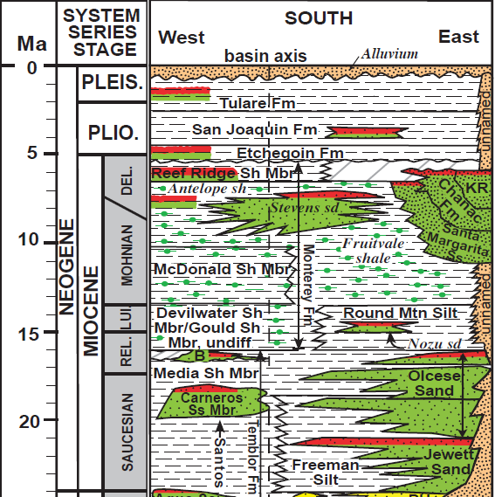
Slide 10
CO₂-EOR and Storage Candidate Reservoirs in the San Joaquin Valley
Stevens Sand
Asphalto,
Buena Vista,
Coles Levee South,
Elk Hills,
Greeley,
Ten Section,
Yowlumne
Image modified from Scheirer and Magoon, 2007 USGS Professional Paper 1713

Slide 11
Slide 11
CO₂-Prophet Model Based EOR and Storage Potential Estimation Methodology
CO₂-Prophet model is a screening tool that falls between crude empirical correlations and sophisticated numerical simulators
Can assist in estimating incidental CO₂ storage potential associated with future CO₂-EOR operations
(amount of CO₂ injected-amount of CO₂ produced)

Slide 12
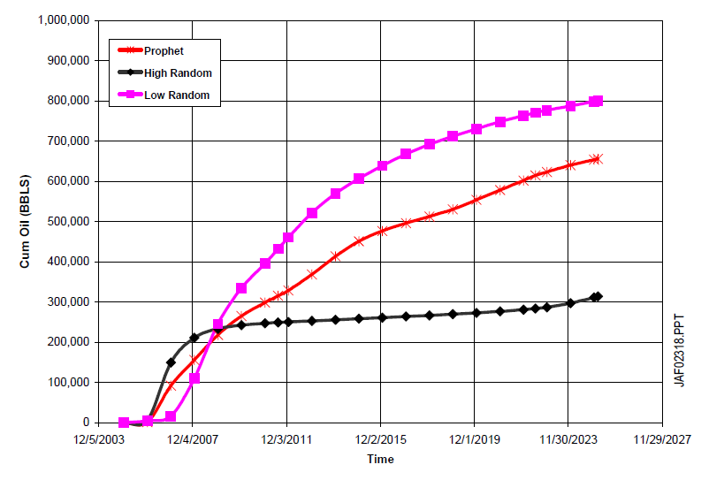
Slide 12
CO₂-Prophet and CMG GEM® Comparison
(Source: Advanced Resources International (ARI) Inc. 2005)

Slide 13
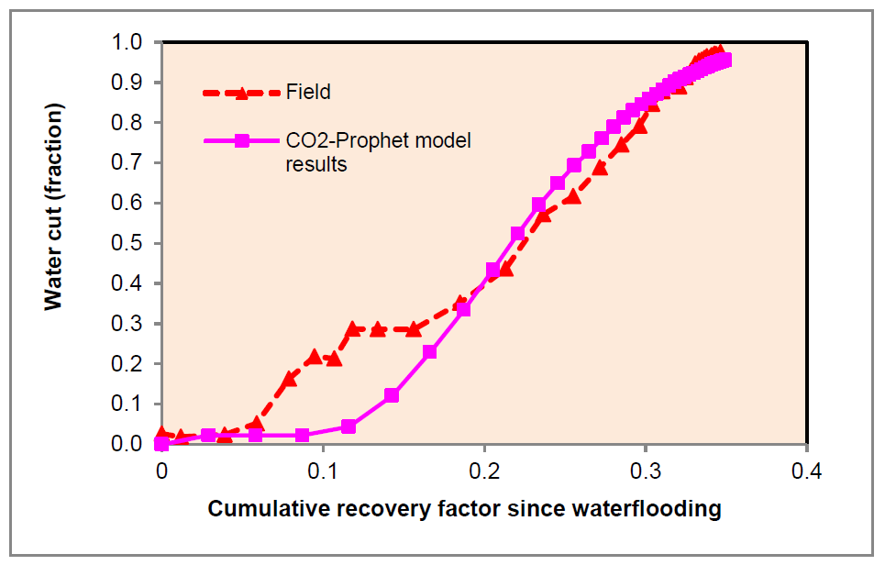
Slide 13
CO₂-Prophet Model Calibration
Involves a match between simulated and actual field water cut versus cumulative oil recovery history since waterflooding

Slide 14
Slide 14
Model Calibration for the Reservoirs Evaluated (Reservoir X and Reservoir Y)
Reservoirs evaluated in this study were already been found amenable for CO₂-EOR and CO₂ storage (ARI, 2005 and Gillespie, 2010)
Both the Reservoirs produce from the Stevens Sand
Relied on the data available in public domain
      Original oil in place (OOIP)
      Water saturation at the beginning of waterflooding
      Dykstra-Parsons coefficient
      Minimum miscibility pressure (MMP)
      Average reservoir pressure (waterflooding)

Slide 15
Slide 15
Calibration Results (Reservoir X)
Field water cut versus cumulative oil recovery history
(80-acre-line drive)

Slide 16
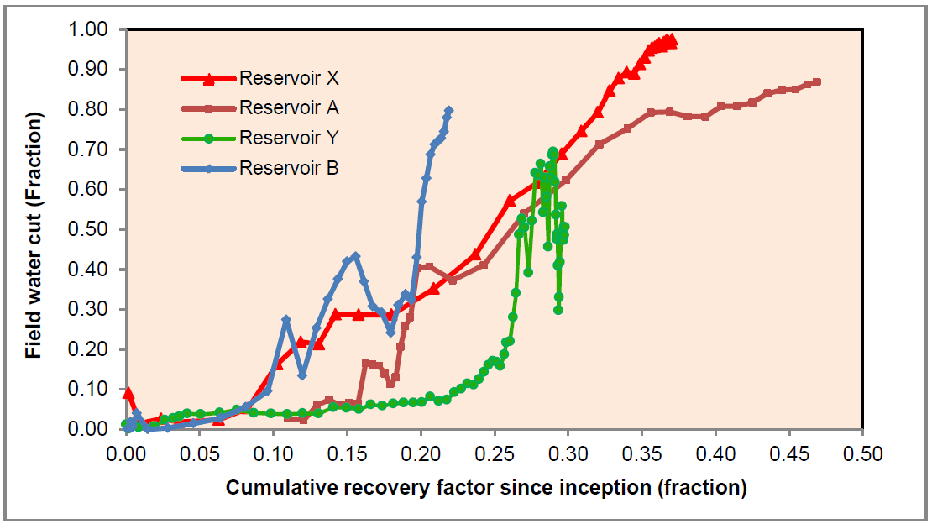
Slide 16
Calibration Results (Reservoir Y)
line drive
5-spot
Field water cut versus field cumulative oil recovery since inception curves
(Reservoirs X (line drive), A (line drive), B (5-spot), and Y (5-spot??))

Slide 17
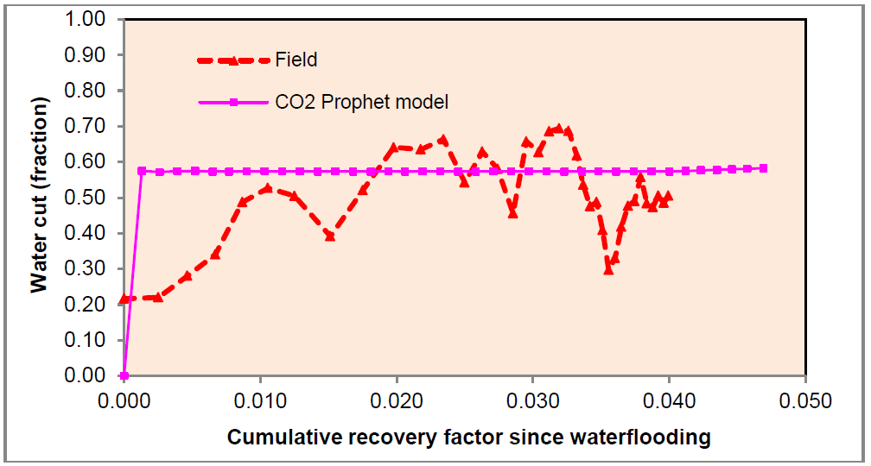
Slide 17
Calibration Results (Reservoir Y)
Field water cut versus cumulative oil recovery history (40-acre-5-spot)

Slide 18
Slide 18
Prediction Results (Reservoir X and Reservoir Y)
Continuous miscible CO₂ and 1:1 WAG injection scenarios
1 Hydrocarbon pore volume (HCPV) fluid injection
Single pattern (line drive or 5-spot) results were converted to field level results using representative no. of flooding patterns
Incidental CO₂ storage:
amount of CO₂ injected-amount of CO₂ produced
A simple MS Excel® macro was written to read and refresh (as and when required) modal output file stored in text format

Slide 19
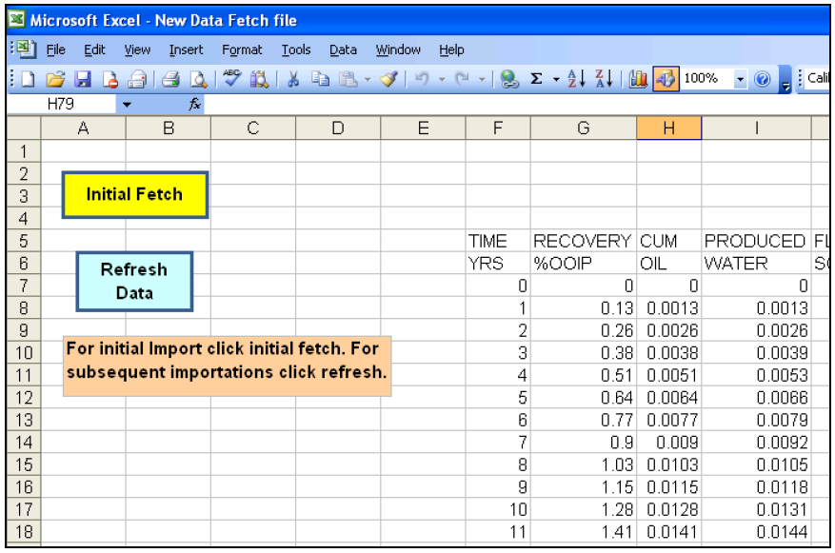
Slide 19
Prediction Results (Reservoir X and Reservoir Y)
Screen shot of MS Excel® spreadsheet used for reading modal output file stored in text format

Slide 20
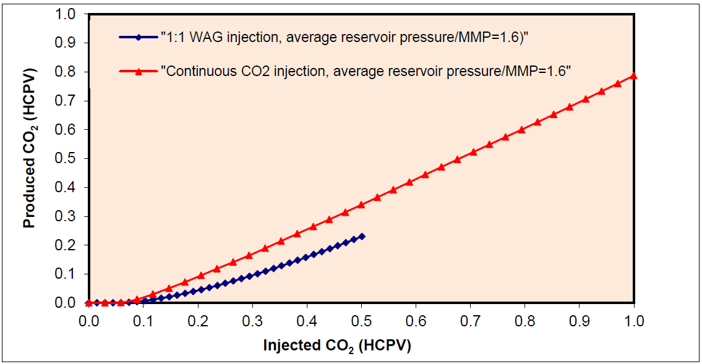
Slide 20
Prediction Results (Reservoir X, ~1 MMT CO₂ injection/year)
Amount of injected and produced CO₂ in different injection modes @1 HCPV fluid Injection (equivalent to a project life of 34 years)
80 acre-line drive pattern

Slide 21
Slide 21
Prediction Results (Reservoir X, ~1 MMT CO₂ injection/year)
Field wide CO₂-EOR and storage potential predication results @1 HCPV fluid Injection
(equivalent to a project life of 34 years)

Slide 22
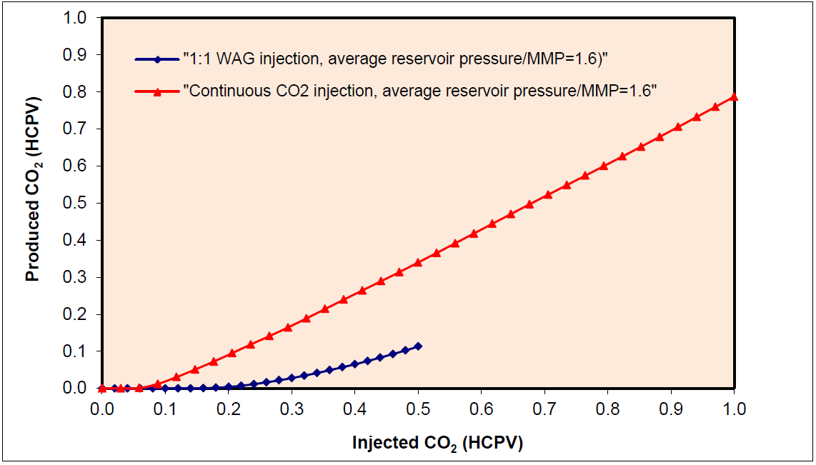
Slide 22
Prediction Results (Reservoir Y, ~1 MMT CO₂ injection/year)
Amount of injected and produced CO₂ in different injection modes
@1 HCPV fluid Injection (equivalent to a project life of 25 years)
40-acre-5-spot pattern

Slide 23
Slide 23
Prediction Results (Reservoir Y, ~1 MMT CO₂ injection/year)
Field wide CO₂-EOR and storage potential predication results
@1 HCPV fluid Injection
(equivalent to a project life of 25 years)

Slide 24
Slide 24
Summary
  Both of the reservoirs investigated in the study have potential for a large scale (injection of more than 1 MMT CO₂ per year) CO₂-EOR and storage project.
  Compared to continuous miscible CO₂ injection, 1:1 WAG injection looks to be more promising recovery process in terms of both the incremental recovery and the amount of CO₂ stored incidentally in the reservoir.
  The analysis presented in the study can be potentially used to identify candidate reservoirs beyond initial screening and simple estimations.

Slide 25
Slide 25
Thank You
Dayanand Saini
dsaini@csub.edu
661-654-2845

