Slide 1
About OMICS Group
OMICS Group International is an amalgamation of Open Access publications and worldwide international science conferences and events. Established in the year 2007 with the sole aim of making the information on Sciences and technology ‘Open Access’, OMICS Group publishes 400 online open access scholarly journals in all aspects of Science, Engineering, Management and Technology journals. OMICS Group has been instrumental in taking the knowledge on Science & technology to the doorsteps of ordinary men and women. Research Scholars, Students, Libraries, Educational Institutions, Research centers and the industry are main stakeholders that benefitted greatly from this knowledge dissemination. OMICS Group also organizes 300 International conferences annually across the globe, where knowledge transfer takes place through debates, round table discussions, poster presentations, workshops, symposia and exhibitions.

Slide 2
About OMICS Group Conferences
OMICS Group International is a pioneer and leading science event organizer, which publishes around 400 open access journals and conducts over 300 Medical, Clinical, Engineering, Life Sciences, Pharma scientific conferences all over the globe annually with the support of more than 1000 scientific associations, 30,000 editorial board members and 3.5 million followers to its credit.
OMICS Group has organized 500 conferences, workshops and national symposiums across the major cities including San Francisco, Las Vegas, San Antonio, Omaha, Orlando, Raleigh, Santa Clara, Chicago, Philadelphia, Baltimore, United Kingdom, Valencia, Dubai, Beijing, Hyderabad, Bengaluru and Mumbai.

Slide 3


Magnetic Nanoparticles-based Microfludic Sensing System for Genotyping, CTC Measurement and Therapeutic Monitoring
Daxiang Cui
Institute of Nano Biomedicine and Engineering
Research lnstitute forTranslational Medicine
2014-8-15

Slide 4
Outline
Current status and scientific problem of gastric cancer
Biomarkers associated with gastric cancer
Nano devices for ultrasenstive detection of
gastric cancer biomarkers
Multifunctional nanoprobes for Targeted Imaging
and simultaneous therapy of Gastric Cancer
Biosafety of nanoprobes
Summary and Acknowledgement

Slide 5
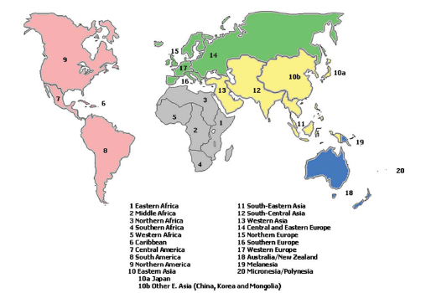

World Cancer Distribution
In 2008, cancer patients reached to 1.27 million
In 2020, cancer number will be 1.500 million

Slide 6
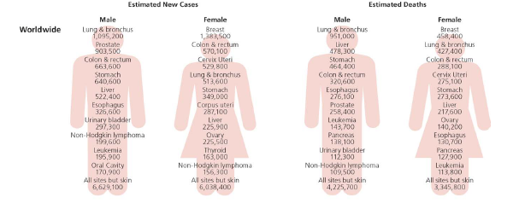
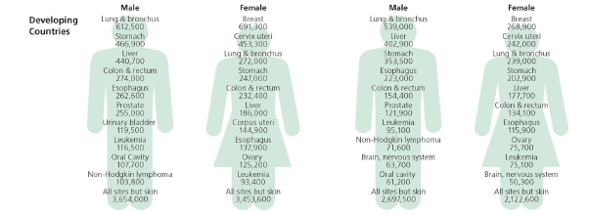
In China, incidence and mortality rates of gastric cancer are respectively second (16.7‰), third (10.4‰)
Gastric Cancer statistics
CA CANCER J CLIN 2011;61:69–90.

Slide 7
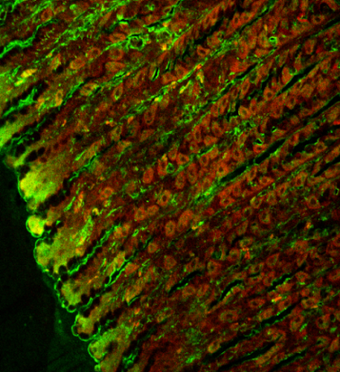
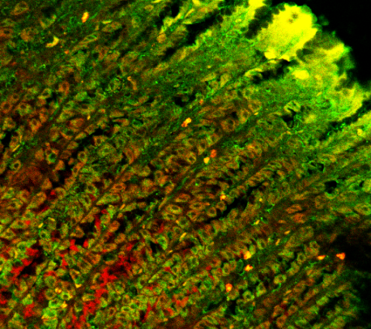
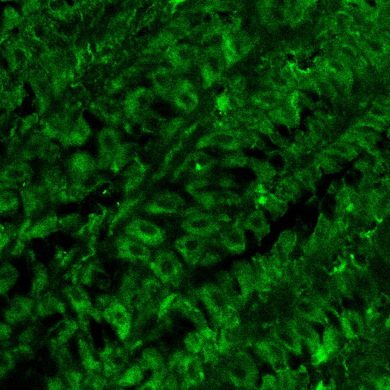
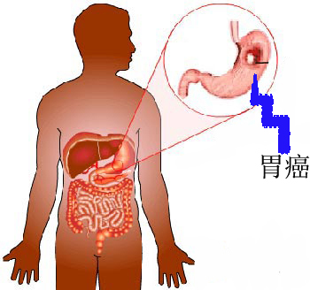
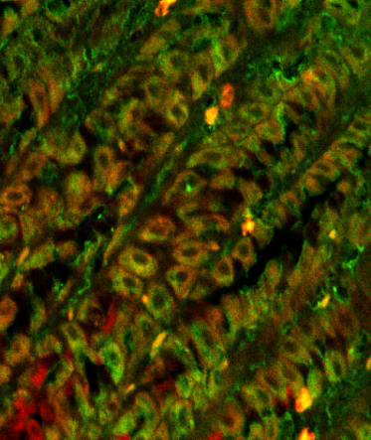
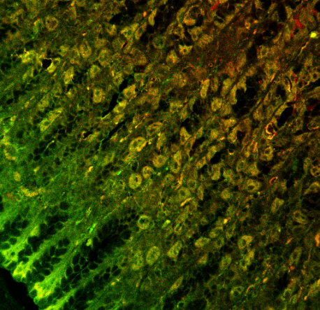
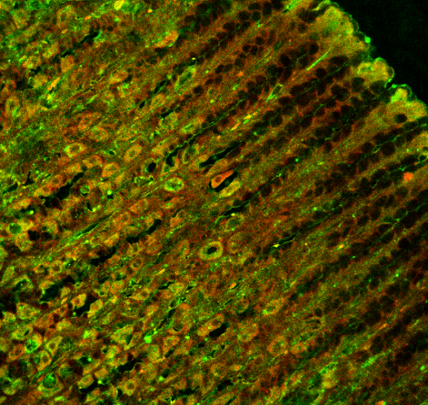
From Precancerous Lesions to Gastric Cancer
Gastric Cancer
precancerous lesions
Ho w to find early gastric cancer ?
QDs-labeled MUC1 antibody
Qds-labeled HAI-178

Slide 8
How to find early gastric cancer
1. Controlled preparation
of nanomaterials
2.Gastric cancer
biomarkers Screening
Prewarning and theranostics for gastric cancer
4. Nanoprobes for
gastric cancer imaging
3. Devices for gastric
cancer biomarkers detection
5. Biosafety of nanoprobes
8

Slide 9
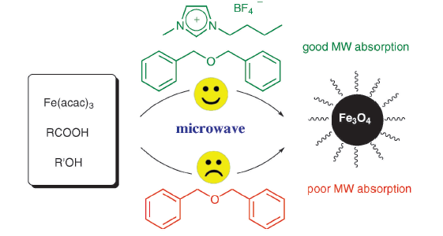
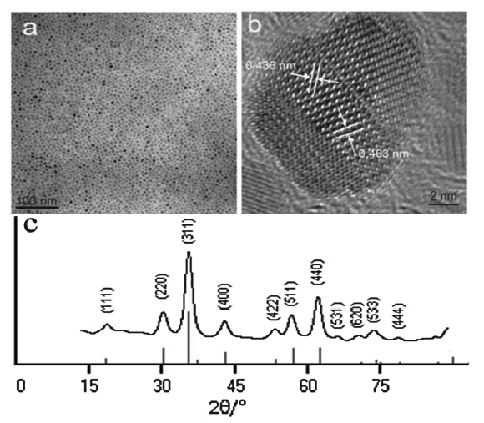
Controlled Preparation of Nanoparticles
Magnetic nanoparticles preparation
Hu, et al. Chem. Comm. 2010; 46:3866-3868.

Slide 10
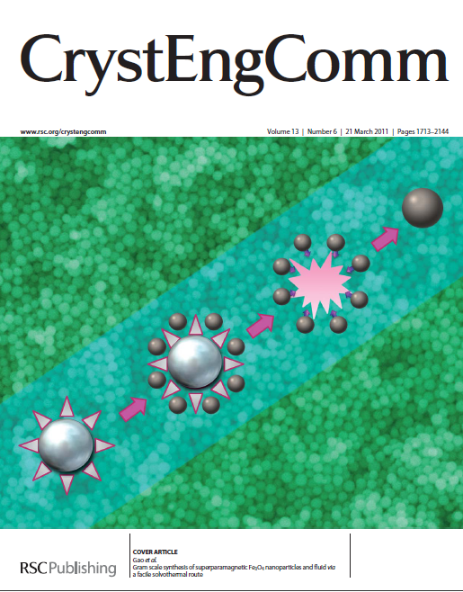
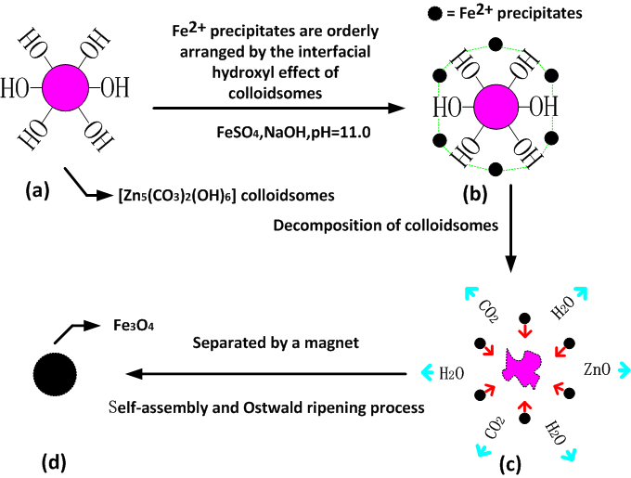
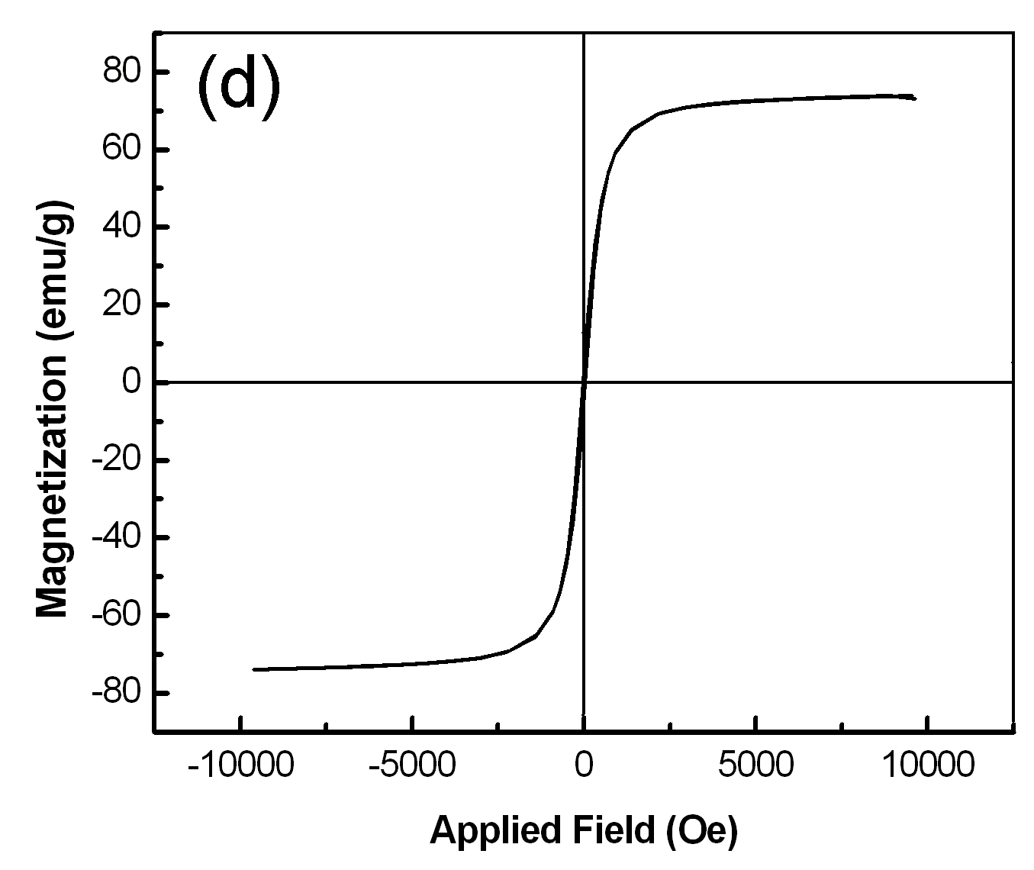
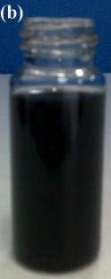
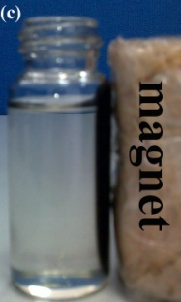
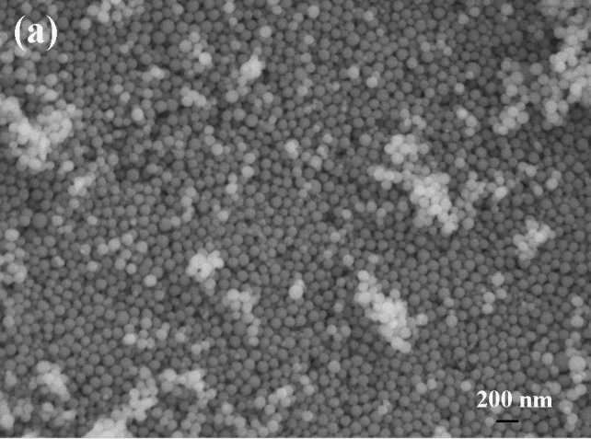
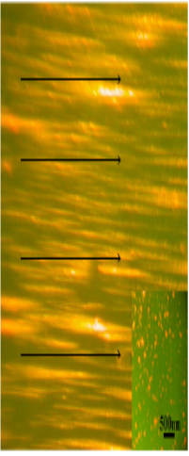
Scale preparation of magnetic nanoparticles
Gao, et al. Gram scale synthesis of superparamagnetic Fe₃O₄ nanoparticles and fluid via a facile solvothermal route. Cryst. Eng. Com. 2011;13:1782-1785.

Slide 11
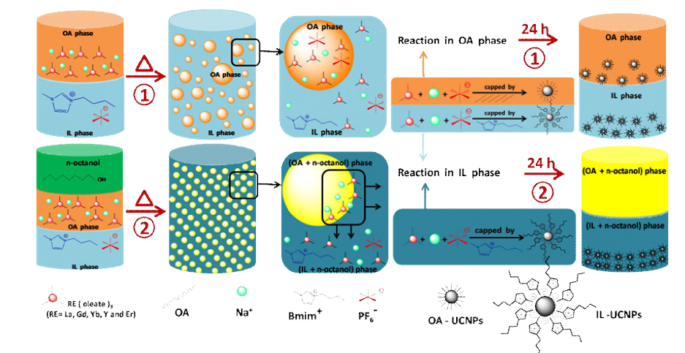
Dual Phase-Controlled Synthesis of Uniform Lanthanide-Doped Upconversion Nanocrystals Via an OA/Ionic Liquid Two-Phase System
NaGdF4: Yb, Er
He, et al. Chem. Comm. 2011;47：9510-9517.
He, et al. Advanced Functional Materials 2011; 21:4470-4477.
He, et al. Chem. A Europ. Journal 2012: 18:5954-5960.

Slide 12
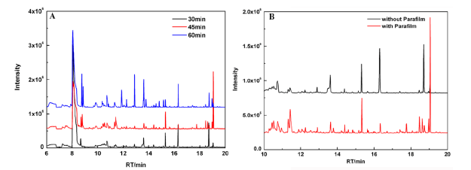
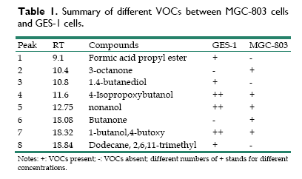
Gastric Cancer Biomarkers Screening
VOC biomarkers

Slide 13
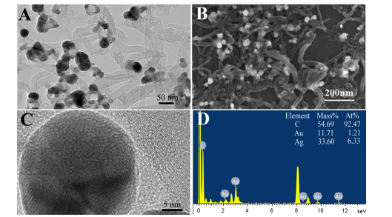
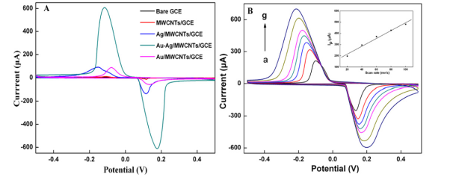

Slide 14
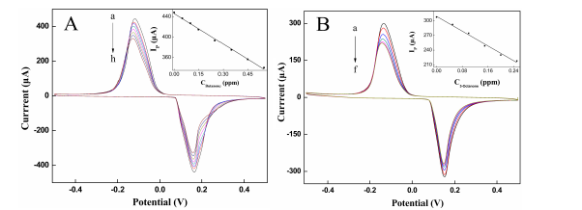
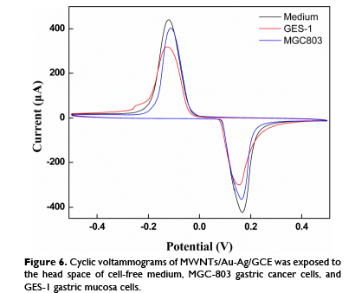
Zhang, et al. Theranostics 2012; 4:152-164.

Slide 15
VOC difference between healthy people and patients with gastric cancer

Slide 16
Zhang, et al. Theranostics 2012; 4:152-164.

Slide 17
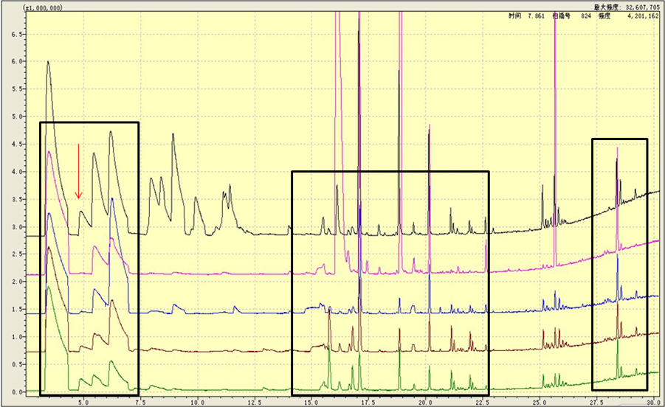
VOC difference between healthy people and patients with gastric cancer
I I I
I I I
Three area at RT ：2-7min，15-22min，24-30min

Slide 18
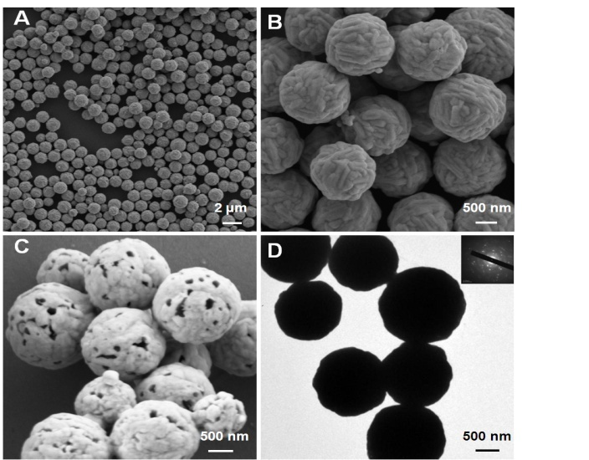
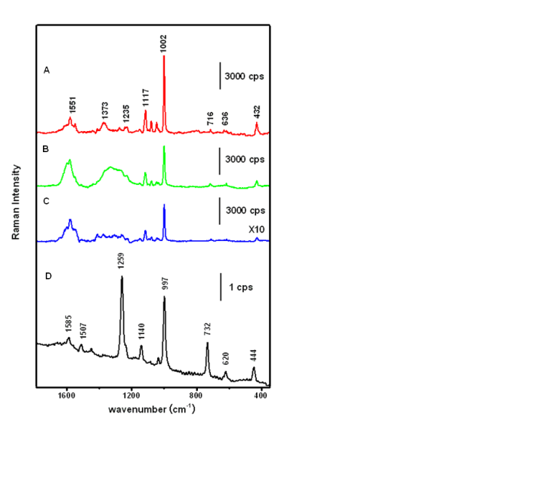
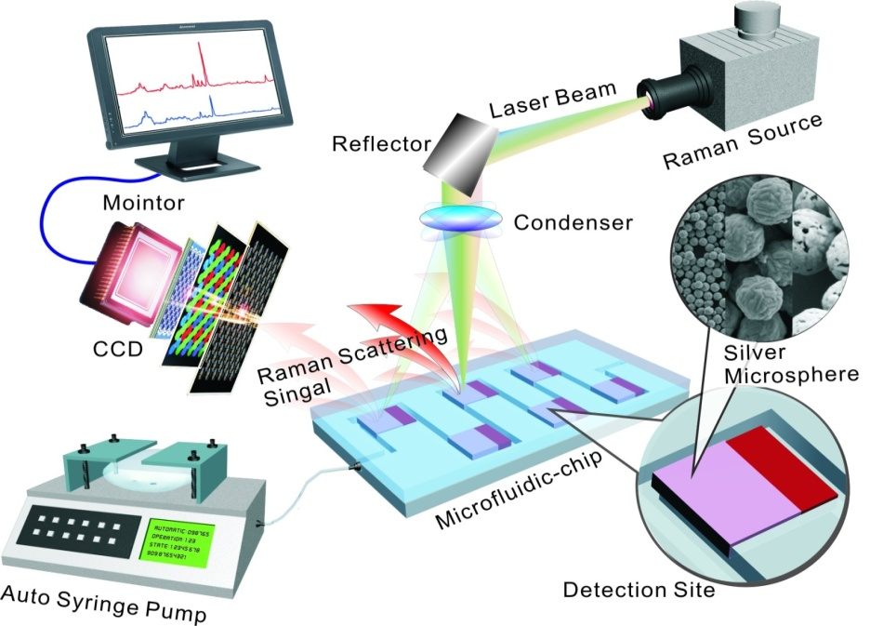
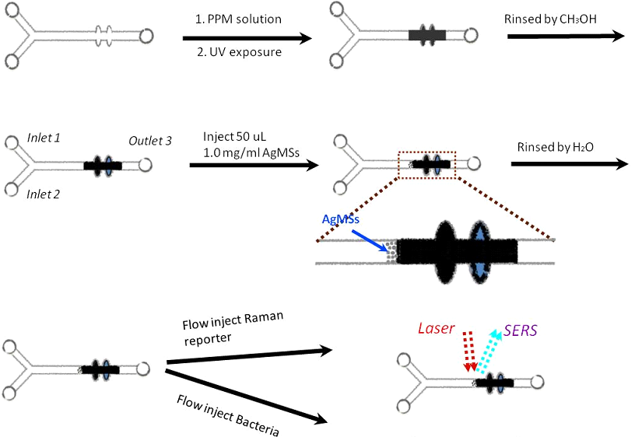
以乳酸菌作模板，首次可控制备空心银微球
灵敏度：10⁻¹⁵ M 拉曼分子, 增强系数：10¹¹倍
Yang, et al. Green Chem. 2010;12:2038-2042.
发明专利授权：ZL201010257653.X
制备含有空心银微球的整体柱
将气体分子富集于检测区域
18

Slide 19

阿尔贝·费尔 与彼得·格林贝格尔
Obtain 2007 Nobel Physcis Prize for finding Giant MagnetoResistance (GMR)

Slide 20
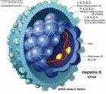
病毒基因快速分型的微流控GMR传感器
HBV epidemiol characterization ：
Liver cancer:
20 billion
3.5 billion with HBV virus
China：
7.18% population with HBsAg
Gene types：
A to I
In china, A,B,C,D four types
B type：41%；C type：53%
HBV virus structure

Slide 21
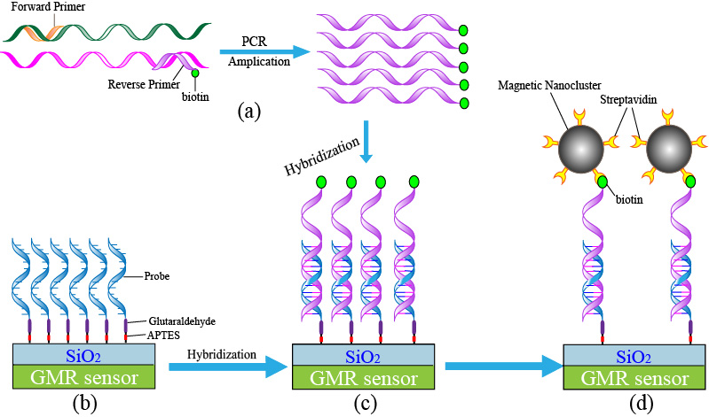
Schematic of detection principle
amplication of target DNA by PCR;
immobilization of the probe DNA;
hybridization of the analyte DNA;
binding of the magnetic microspheres.

Slide 22
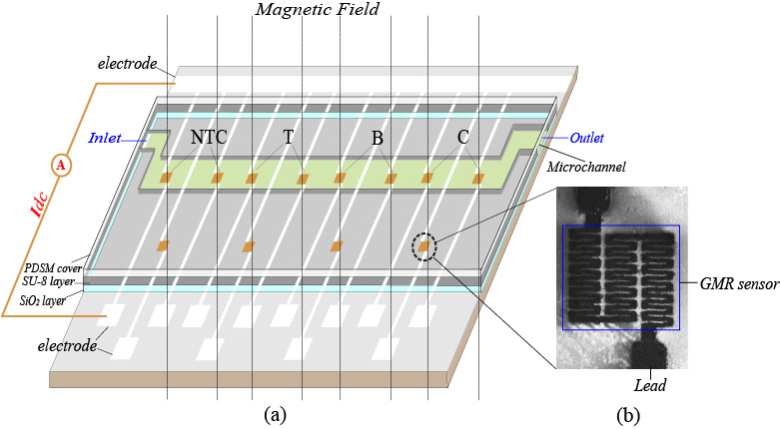
GMR sensing chip
B or C
T
△ R = detection value –reference value
Conformation of the magnetoresistive biochip:
(a) fabrication of the biochip; (b) pattern of the GMR sensor

Slide 23
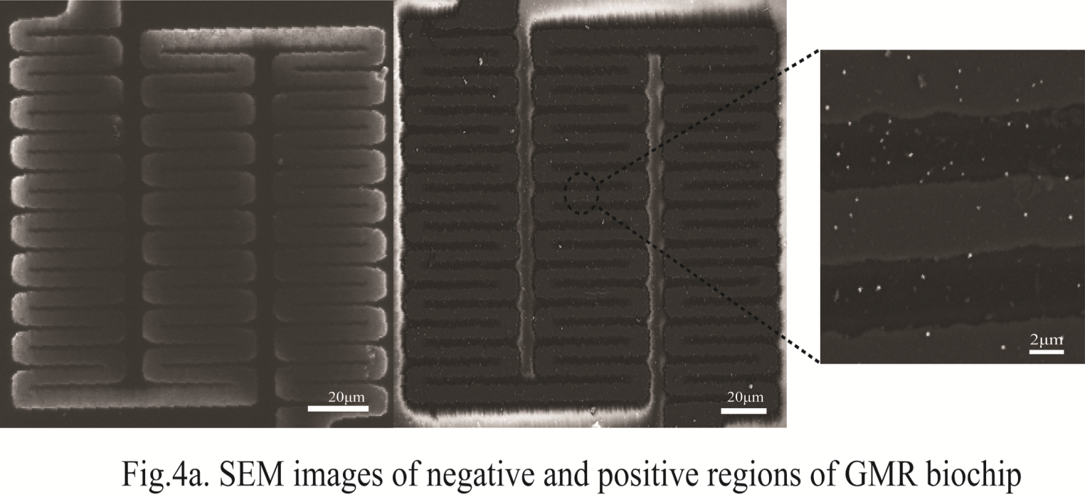

Slide 24
GMR changes of different genotypes （n =4, X ±SE）
Genotype samples |  | Signal change, in mΩ(positive signals in bold)
 |  | NTC region | T region | B region | C region
Genotype B | Reference | 32.50±5.90
 | Detection | 42.50±8.54 | 262.50±27.80 | 262.50±14.93 | 47.50±8.54
 | Net value | 10.00±2.64 | 230.00±21.90 | 230.00±9.03 | 15.00±2.64
Genotype C | Reference | 28.75±3.50
 | Detection | 42.50±11.08 | 272.50±27.80 | 52.50±4.79 | 203.75±15.19
 | Net value | 13.75±7.58 | 243.75±24.30 | 23.75±1.29 | 175.00±11.69
sensitivity：HBV DNA
real time PCR level
Xiao Zhi, et al. Quick genotyping detection and line probe ofHBV by giant magnetoresistive biochip combined with PCR and line probe assay. Lab-on a chip 2012; 12:741-745.

Slide 25
microfluidic chip
loop-mediated isothermal amplification
GMR sensor

Slide 26
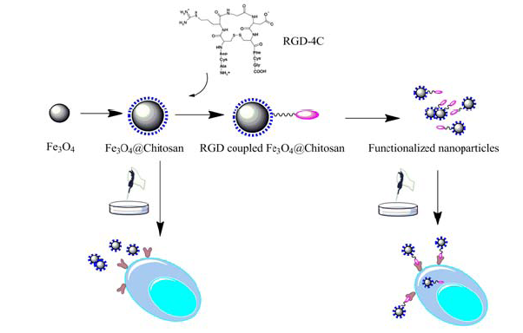
GMI Sensing System for Gastric Cancer Cells Capturing and Quantifying
biomarker：RGD-4C
Chitosan modified magnetic nanoparticles
RGD peptide conjugated with magnetic nanoparticles
Capture cancer cells
Chen, et al. Biosensors and Bioelectronics 2011:6:2435-2442.

Slide 27
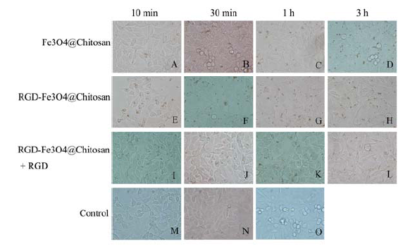
Endocytosis of functionalized magnetic nanoparticles， E,F,G,H: functionalized NPs enhanced absorption， (A,B,C,D),L ,I,J,K,L : competing inhibition，Control o: MGC803 cells

Slide 28
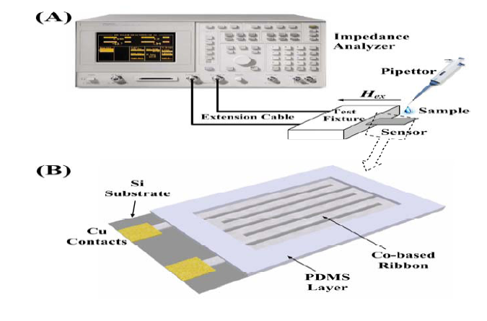
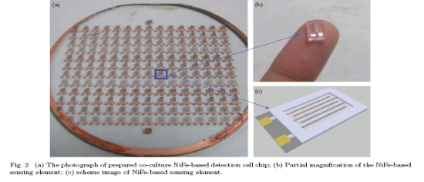
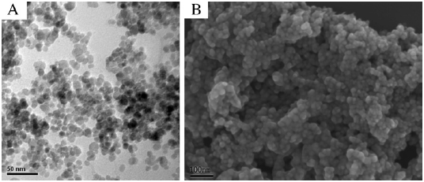
GMI sensor detection system:
（A) sensing system；（B)GMI sensing element
Functionalized magnetic nanoparticles: (A)TEM;(B) SEM

Slide 29
血液中胃癌细胞的快速捕获
可用于疗效监测
检测时间20分钟
特异性100%

Slide 30
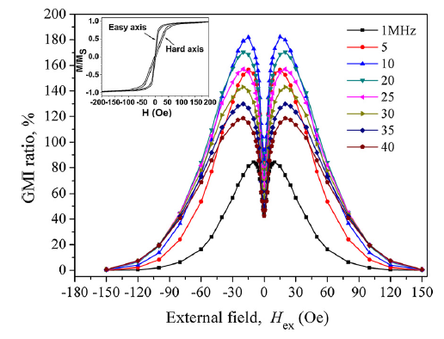
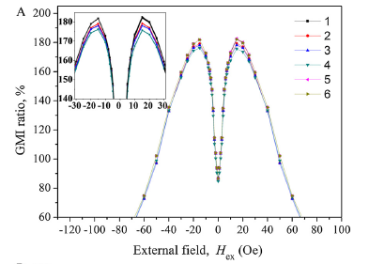
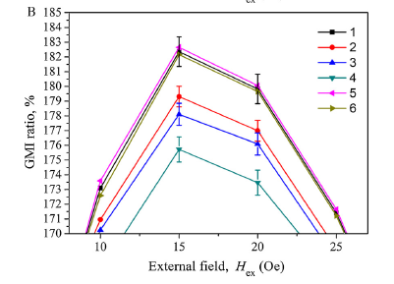
Chen, et al. Biosensors and Bioelectronics 2011：6：2435-2442.

Slide 31
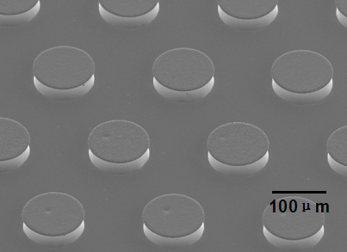
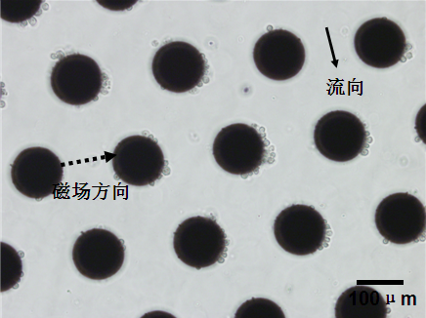
MEMS Capturing Chip based on Magnetic column
SEM picture of magnetic column
Cancer cell capturing picture

Slide 32
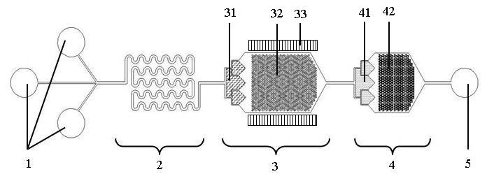
One rapid isolation and capturing chip for CTC cancer
Mixture lysis white cell capturing cancer cell capturing
ZL 201110224663.8

Slide 33

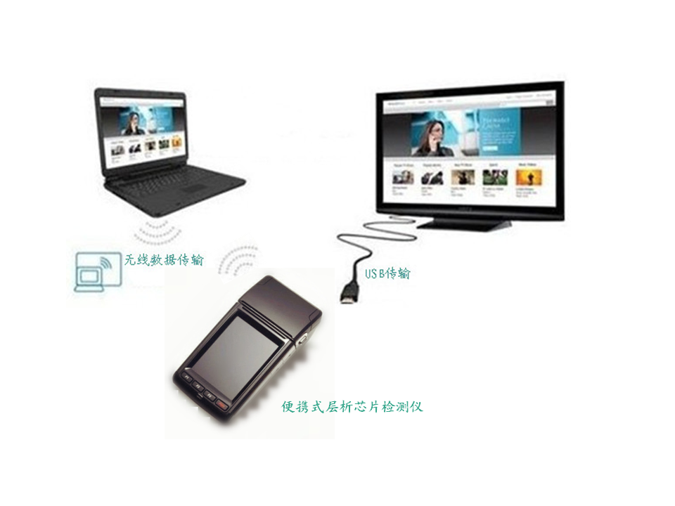
Next Generation of POCT
SEM picture for chip surface

Slide 34
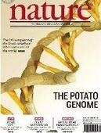

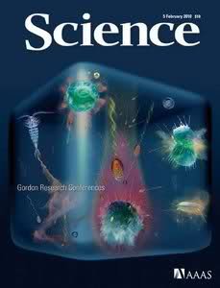
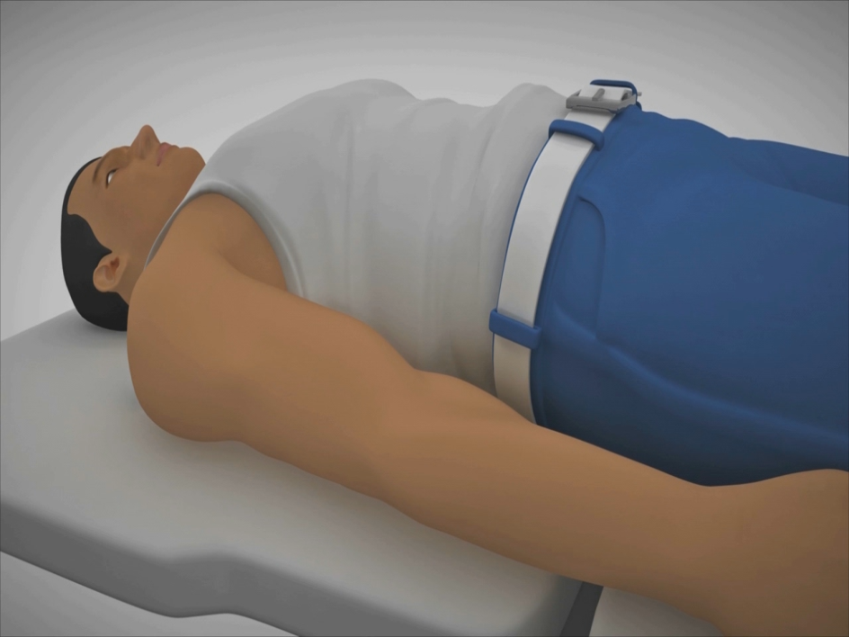


Advances of molecular imaging
Molecular imaging provides one new pathway for new generation of tumor theranostic Technology

Slide 35

Molecular Imaging
Multimode molecular imaging
Theranostics, Theragnosis

Slide 36
How to realize the targeted imaging and therapy of gastric cancer
Selectivity
＋
Target Biomolecules
＋
Biosafety
？
recepter or ligand
？
Successful development of safe and effective nanoprobes for tumor targeting imaging and selective therapy is a great challenge

Slide 37
BRCAA1-antibody-conjugated Fluorescent Magnetic Nanoprobes for in vivo targeted imaging of gastric cancer

Slide 38



BRCAA1 Structure and Function
1q42.1-q43. (AF208045)
Cui, et al. Characterization of BRCAA1 and Its Novel Antigen Epitope Recognization. Cancer Epidemiology Biomarkers and Prevention 2004; 13(7), 1136-1145.

Slide 39
Titers of BRCAA1 Monoclonal Antibodies in Ascites Fluid Induced by Hybridoma Clone Cells by ELISA
Clone | Antibody titer*
 | BRCAA1 (C)-OVA ** | BRCAA1 (C)-BSA ** |  | BSA ** | OVA **
S-200-5 | 1,024,000 | 1,024,000 |  | <1,000 | <1,000
S-335-5 | 128,000 | 512,000 | <1,000 |  | <1,000
*The reciprocal of ascites fluid dilution, the first dilution of ascites fluid was 1:1,000. **The antigens were coated on ELISA plate.

Slide 40

65% gastric cancer tissues with BRCAA1 over-expression

Slide 41



Characterization of Fluorescent Magnetic Nanoparticles (FMNPs)

Slide 42

Characterization of BRCAA1-Monoclonal Antibody-conjugated FMNPs [ BRCAA1-MNPs]

Slide 43
Coupling rate of FMNPs-BRCAA1 antibody
 | Total concentration of the anti-BRCAA1 antibody (ng/μL) | The concentration of BRCAA1 antibody in residual reaction mixture (ng/μL) | Coupling rate (%)
1 | 1000.0 | 197.3 | 80.27
2 | 1000.0 | 191.2 | 80.88
3 | 1000.0 | 203.0 | 79.70

Slide 44

Nanoprobes for Targeted In Vitro Gastric Cancer Cells

Slide 45


Slide 46



Slide 47



MRI imaging of gastric cancer
mice model of in situ gastric cancer

Slide 48
FMNPs-labeled MSCs for Targeted Imaging and Therapy of Gastric Cancer

Slide 49

Morphology and immunophenotypic characterization of MSCs. (A) The fibroblastic morphology of passage 3 MSCs (Magnification= ×100); (B) MSCs stained with FITC conjugated CD29 antibody (200×); (C) MSCs stained with PE conjugated CD90 antibody (200×); (D), (E), (F): MSCs analyzed by FACS for the positive expression of CD29 (D), CD90 (E) and negative expression of CD45 (F); (G) Differentiated osteoblasts tested with alkaline phosphatase staining (Magnification= ×100); (H) Differentiated adipocytes characterized by oil red O staining (Magnification= ×100); (I) Differentiated chondrocytes verified by toluidine blue staining (Magnification= ×100).

Slide 50

44.8meu/g
Characterization of FMNPs. (A) TEM image of amino-modified FMNPs; (B) PL intensity of amino-modified FMNPs; (C) Magnetic intensity curve of amino-modified FMNPs; (D) Zeta-potential of FMNPs with amino group and Si-O group.

Slide 51

Evaluation of FMNPs-labeled MSCs. (A) Cell nucleuses and FMNPs were visible in the MSCs by fluorescent microscope observation (200×); (B) FMNPs-labeled MSCs were detected by using Prussian blue staining(100×); (C) non-labeled MSCs were detected by using Prussian blue staining (100×); (D) The TEM image of non-labeled MSCs; (E) The TEM image of FMNPs-labeled MSCs illustrate that amino-modified FMNPs were randomly distributed in the cytoplasm of MSCs (6000×); (F) The magnification image of FMNPs distributed in the cytoplasm of MSCs (12000×).

Slide 52

Labeled stability of the FMMPs-labeled MSCs. (A) MR imaging of MSCs after being labeled FMNPs 7 and 14 days. (B) Fluorescent microscope images of MSCs after being labeled FMNPs 7 and 14 days (200×).

Slide 53

Effects of amino-modified FMNPs on MSCs. The survival rates of MSCs after being labeled with FMNPs keep increasing from day 1 to day 7. Mean values ± standard deviation (SD) of independent experiments are shown. Asterisk represents P < 0.05.

Slide 54

Fluorescent imaging of FMNPs-labeled MSCs targeting gastric cancer cells in vivo. (A) The in vivo fluorescent images show that tumor sites of the mice in test group had fluorescent signals after post-injection FMNPs-labeled MSCs 7 and 14 days (right), and tumor sites of the mice in control group had no fluorescent signal after post-injection FMNPs 7 and 14 days (left)

Slide 55

MR imaging of FMNPs-labeled MSCs targeting gastric cancer cells. The coronal and transected images of MRI show that MSCs firstly presented in the tumor tissue at 7 days post-injection, and then gradually accumulated in the tumor tissue and reached peak value at 14 days post-injection.

Slide 56


D
Ex vivo analysis of major tissues. (A) Immunofluorescence staining analysis show that the tumor tissue slices in test group had obvious fluorescent signals, and that in control group had no fluorescent signal; (B) Prussian blue staining results show that the tumor tissue slices in test group had blue iron particles, and that in control group had no iron particle; (C) The ICP-MS results show that FMNPs mainly distributed in the tumor tissues of the test group. (D) distribution of labeled MSCs

Slide 57

Effects of alternating magnetic field on the gastric tumor size. (A) Time-temperature curve of FMNPs-labeled MSCs under an alternating magnetic field with 63 kHz and 7kA/m；(B) The growth of tumors was inhibited under hyperthermia Therapy.

Slide 58

Potential Mechanism of MSCs Targeted Tumor
Analysis of chemokine receptors and chemotaxis
The expressions of CXCR4 and CCR7 on MSCs were determined by FACs
The migration of MSCs to different concentrations of CXCL12 and CCL19 was evaluated by chemotaxis assay. [13.2±1.8 ng/mL, 5.5±0.7 ng/mL, ]
CCL19/CCR7 and CXCL12/CXCR4 axis loops may involve in MSCs motion.

Slide 59












Strip for quick detection of biomarkers
Magnetic or QDs labeling based Strips
Qualtive, quantitative detection ；sensitivity: 5pg/ml；
Specificity : 98%
Hu, et al. Chem. Commun. 2010; 46: 3866-3868.:[IF5.787]
Gao, et al. J. Mater. Chem. 2011; 2011, 13, 1782-1785
Zhang, et al. J. Biomed. Nanotechnol. 2011; 7; 776-781.
Yang, et al. Nanoscale Res. Lett. 2009; 4: 1469-1474.
Yang, et al. Nanoscale Res. Lett. 2010; 5: 875-881.
59

Slide 60
Acknowledgement
This work was supported by National 973 project (2010CB933900), 863 Project (No.2007AA022004), National Natural Scientific Fund (No. 81225010 and 20771075), and Shanghai Nano-Project (1052nm041000), and International Cooperation Budget of Waseda university .

Slide 61

Thanks for your attention!

Slide 62
Let Us Meet Again
We welcome you all to our future conferences of OMICS Group International
Please Visit:
www.omicsgroup.com
www.conferenceseries.com
www.pharmaceuticalconferences.com

