Slide 1
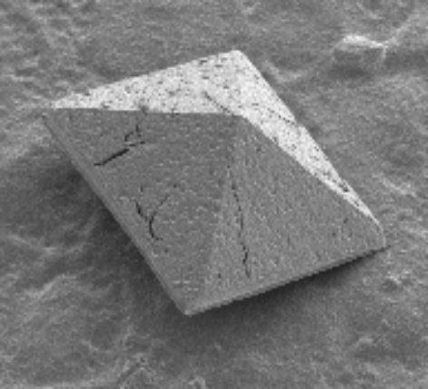
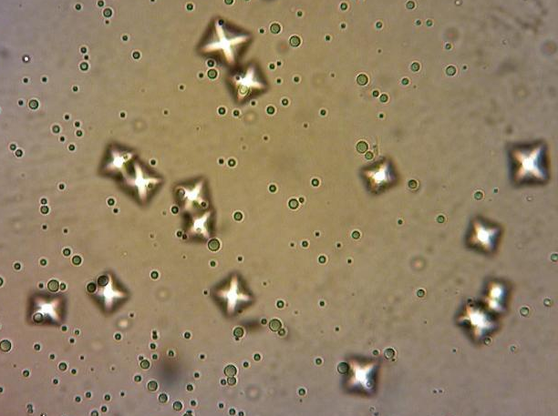
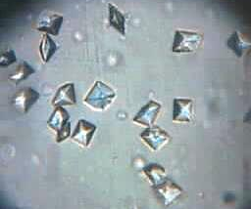
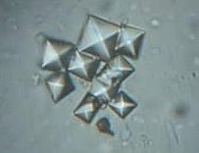
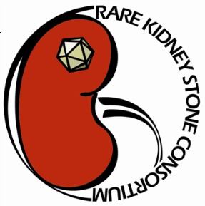
Hyperoxaluria
Underappreciated Cause of Kidney Stones and CKD
Valencia, Spain
April 1, 2016
Dawn S. Milliner, M.D.
Mayo Clinic Hyperoxaluria Center
Rare Kidney Stone Consortium

Slide 2
54 y.o. woman with CKD stage 4
In good general health aside from marked obesity
48 yrs of age gastric bypass followed by excellent weight loss over 2 years.
51 y.o. seen for diarrhea. BMI 25.6. Stool fat 68 gm/24 hrs (< 7 gm normal). Serum creatinine 1.6 mg/dl (< 1.1 normal). Bypass revised.
54 y.o. routine care for osteoporosis.
S creatinine 3.9 mg/dl. Kidney size
normal. Renal ultrasound increased
echogenicity.
Renal biopsy performed.

Slide 3
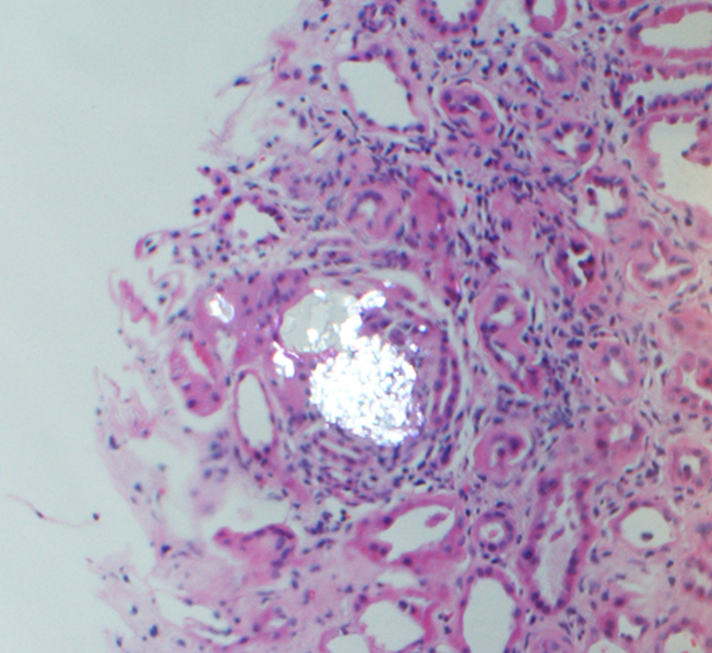
54 y.o. woman with CKD stage 4
48 yrs of age marked obesity, gastric bypass followed by excellent weight loss over 2 years.
51 y.o. seen for diarrhea. BMI 25.6. Stool fat 68 gm/24 hrs (< 7 gm normal). Serum creatinine 1.6 mg/dl (<1.1 normal). Bypass revised.
54 y.o. routine care for osteoporosis.
S creatinine 3.9 mg/dl. Kidney size
normal. Renal ultrasound increased
echogenicity.
Renal biopsy performed.

Slide 4
54 y.o. woman with CKD stage 4
55 y.o. preemptive LUD kidney transplant. Acute rejection treated with methylprednisolone. Creatinine remained 3.3 mg/dl, eGFR 15.
CT showed 3 stones in allograft. Urine oxalate 0.92 mmol/24 hours (<0.46 normal).
Low oxalate diet, calcium supplementation but CKD progressed. Second transplant planned.

Slide 5
Oxalate: Significance for the Kidney
Small organic compound (C₂O₄)
Produced by the liver and ingested in the diet
Cannot be metabolized in humans, must be eliminated by kidney excretion
When complexed with calcium is poorly soluble. Calcium oxalate crystals and kidney stones form in the urine.
Calcium oxalate crystals incite inflammation and tissue damage
CKD and renal failure may result

Slide 6
Oxalate balance on a typical western diet
Diet
100 mg
Glyoxylate
Ascorbic Acid
10%
Absorbed
10 mg
Endogenous Production
24 mg (1 mg/hr)
30%
Stool
90 mg
Renal Excretion
34 mg

Slide 7
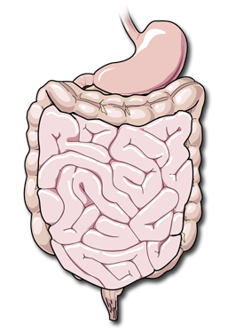
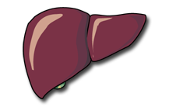
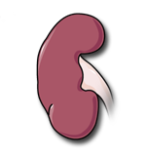
Oxalate Homeostasis
Ingested oxalate
Normal
Intestinal
absorption
Hepatic
production
Plasma
oxalate
Intestinal
secretion
Fecal oxalate
Urine oxalate
Aronson: KI, 2006
CP1285192-18

Slide 8
Hyperoxaluria
Idiopathic Stone Formers
Enteric Hyperabsorption
Crohn’s disease
Chronic pancreatitis
Cystic fibrosis
Surgical resection of small bowel
Malabsorptive bariatric surgery procedures
Medications (orlistat)
Primary Hyperoxaluria

Slide 9
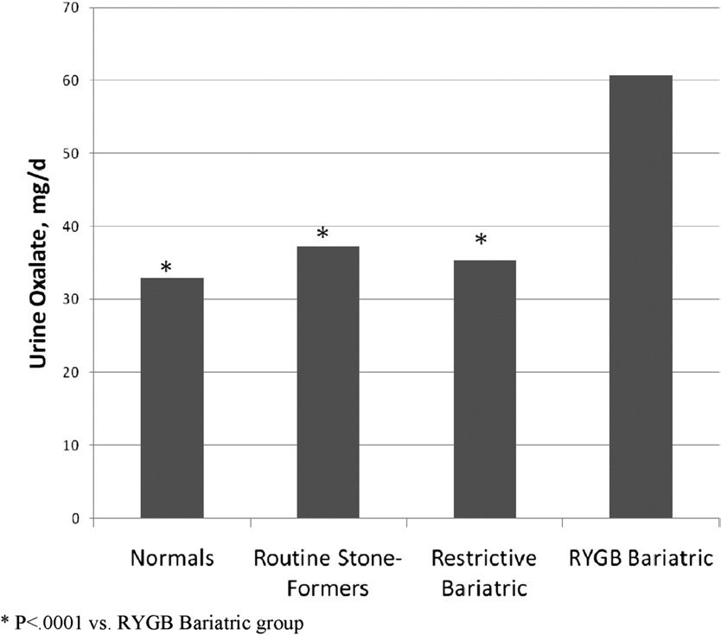
Hyperoxaluria in Various Conditions
Urinary oxalate excretion in nonstone formers, routine stone formers, restrictive bariatric surgery subjects, and RYGB bariatric surgery subjects. Semins MJ et al, J Urol 2010

Slide 10
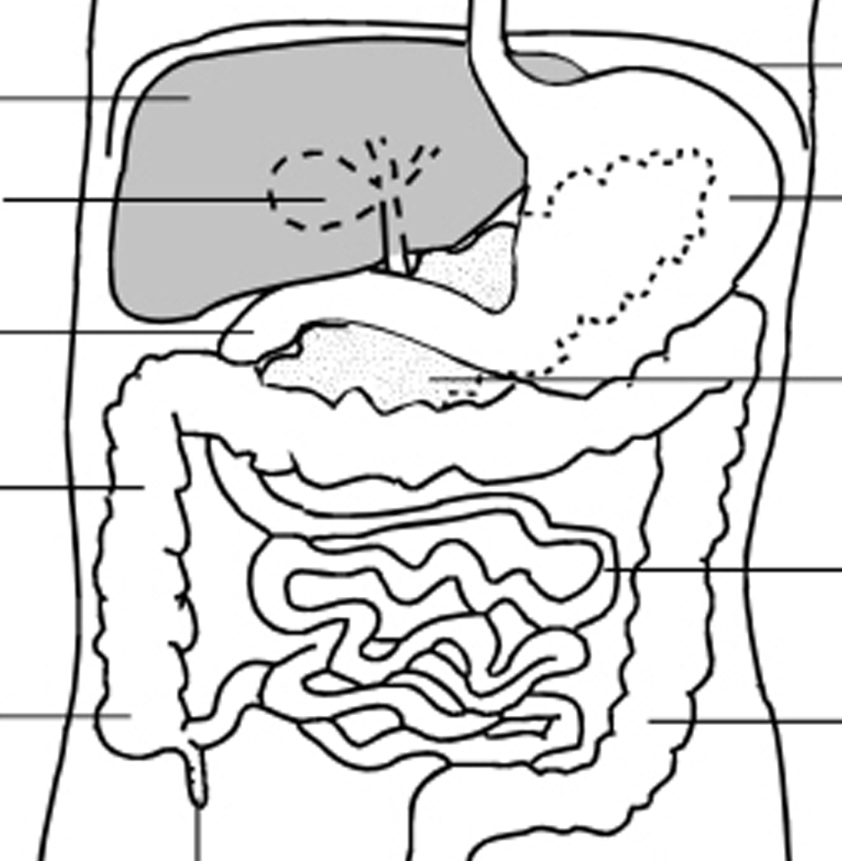
Enteric hyperoxaluria is caused by fat malabsorption
Ox⁻⁻
BA
Ox⁻⁻
Ca⁺⁺
FA

Slide 11
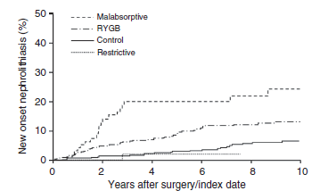
Nephrolithiasis after Bariatric Surgery
Risk of new-onset nephrolithiasis after bariatric surgery. The risk of incident stones was greater after Roux-en-Y gastric bypass (RYGB) or malabsorptive bariatric procedures, compared with that in matched obese controls (P<0.001 overall). Patients with restrictive procedures were not at increased risk.
Lieske J: Kidney Int 2015

Slide 12
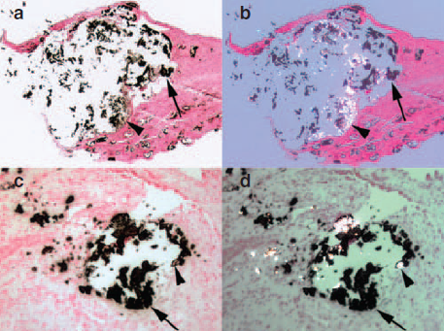
Renal Histopathology in patients with small bowel
resection and calcium oxalate stone disease
Inner medullary collecting duct (IMCD) deposits are mixture of apatite and calcium oxalate (CaOx). Two different large IMCD plugs from separate patients are seen under polarizing optics. These deposits show birefringent (arrowheads) and nonbirefringent (single arrows) crystals forming the same deposit.
Evan AP et al: Kidney Int 2010

Slide 13
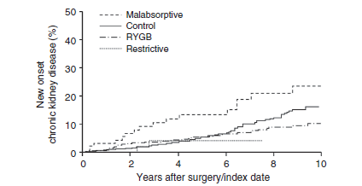
CKD after Bariatric Surgery
Risk of new-onset chronic kidney disease (CKD) after bariatric surgery. The risk of incident CKD was greater after malabsorptive bariatric procedures compared with that in matched obese controls (P=0.004 overall).
Lieske J: Kidney Int 2015

Slide 14
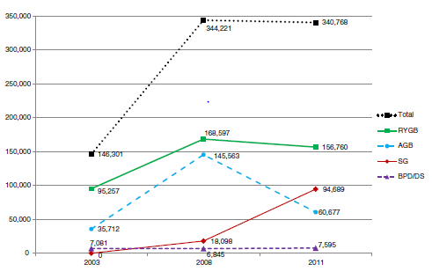
Trends in the Numbers of Bariatric Surgery Procedures Worldwide: 2003 to 2011
Buchwald H, Obes Surg 2013

Slide 15
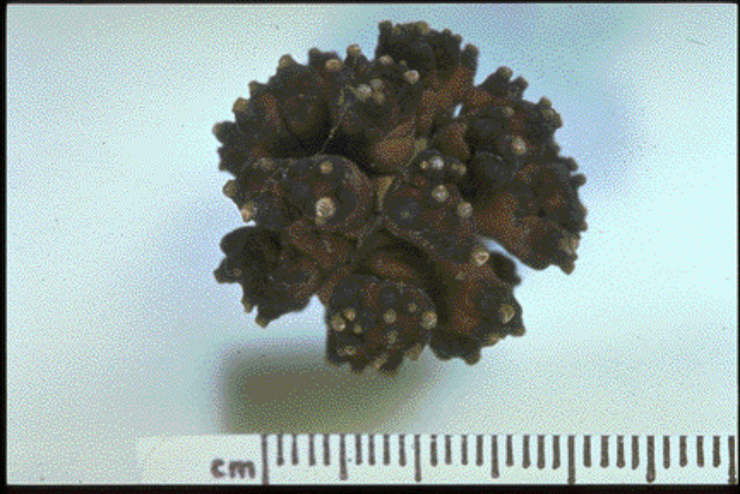
Idiopathic stone disease
Frequency 8-12% of population
CaOx stones 75-80%
Hyperoxaluria 15-20%
Urolithiasis and the Risk of ESRD
Conclusions: Symptomatic stone formers are at increased risk for ESRD
independent of several cardiovascular risk factors. Other urological
disease is relatively common among stone formers who develop ESRD.
Clin J Am Soc Nephrol 7:1409-1415, 2012.

Slide 16
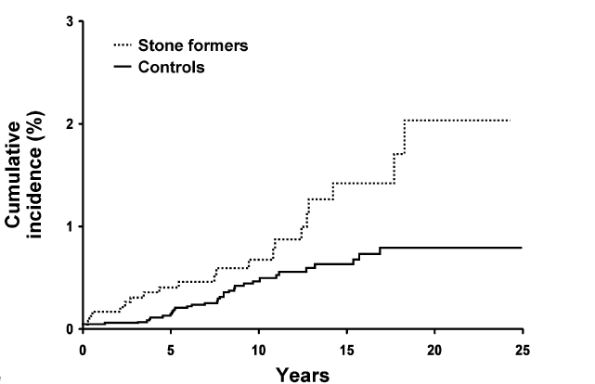
Incidence of Renal Failure in Stone Formers
versus Age-matched Controls
p = 0.01
El-Zoghby Z: CJASN 2012

Slide 17
Primary Hyperoxaluria
A Model for Oxalate Nephropathy
Inherited inborn error of metabolism with marked hepatic overproduction of oxalate
3 types described due to deficiencies of hepatic AGT (PH1), GRPHR (PH2), or HOGA (PH3)
Urine oxalate 2-8 x normal from birth
Stones, nephrocalcinosis, and loss of kidney function over time are characteristic
Among patients with PH1 75% have ESKD by 50 yrs of age

Slide 18
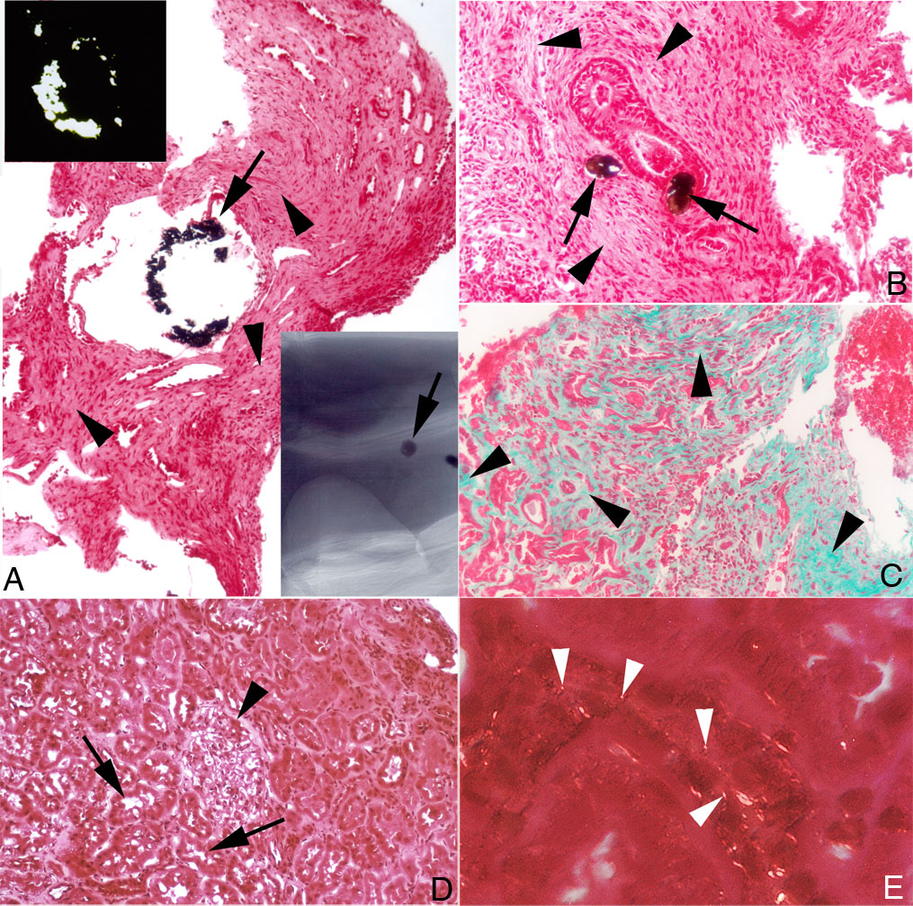
Primary Hyperoxaluria
Histopathologic Examination of Kidney Tissue
Calcium oxalate crystals in proximal proximal tubule cells of PH type 1 patients with preserved kidney function
Worcester et al, AJP 2013
Oxalate concentration highest in S3 segment of proximal tubule
Proximal tubule fluid is supersaturated for CaOx in PH1

Slide 19

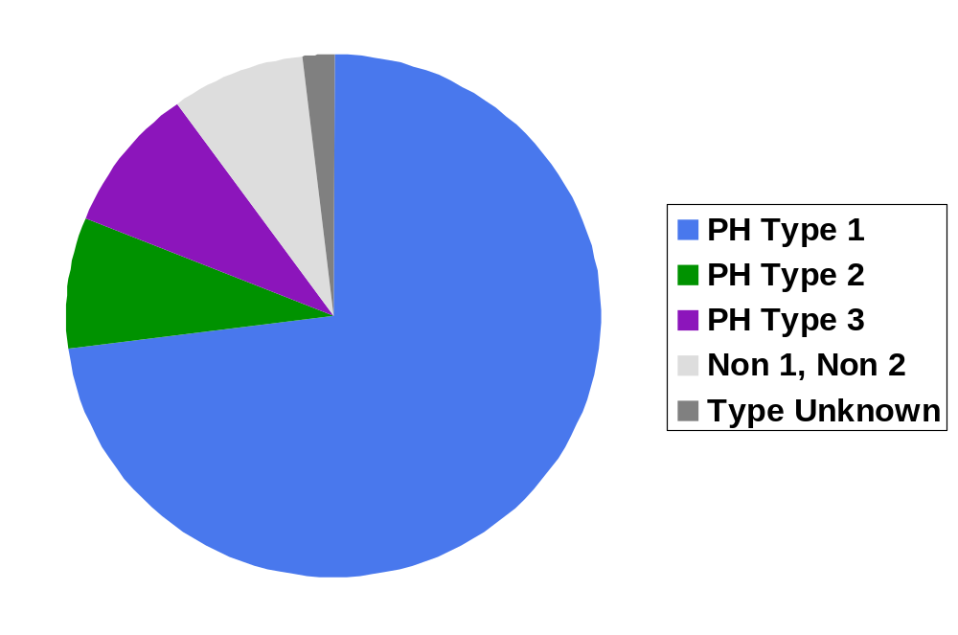
Rare Kidney Stone Consortium
Primary Hyperoxaluria Registry, 387 Patients
7%
9%
9%
73%
Notes:
Add AGXT, GRHPR, and HOGA1 to this slide

Slide 20
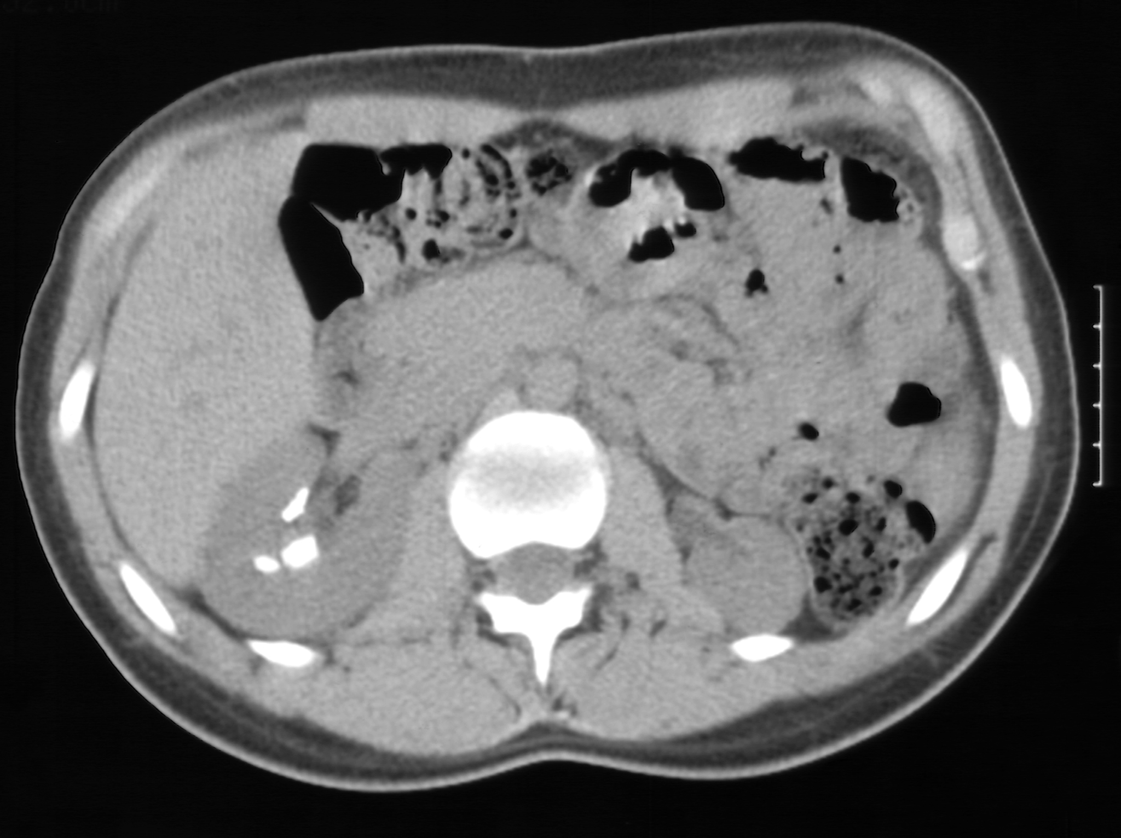
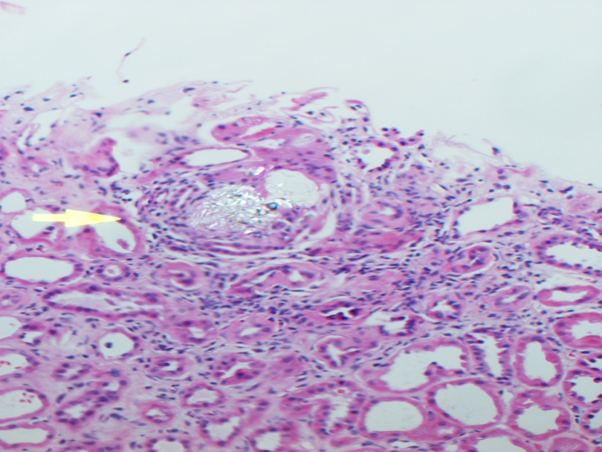
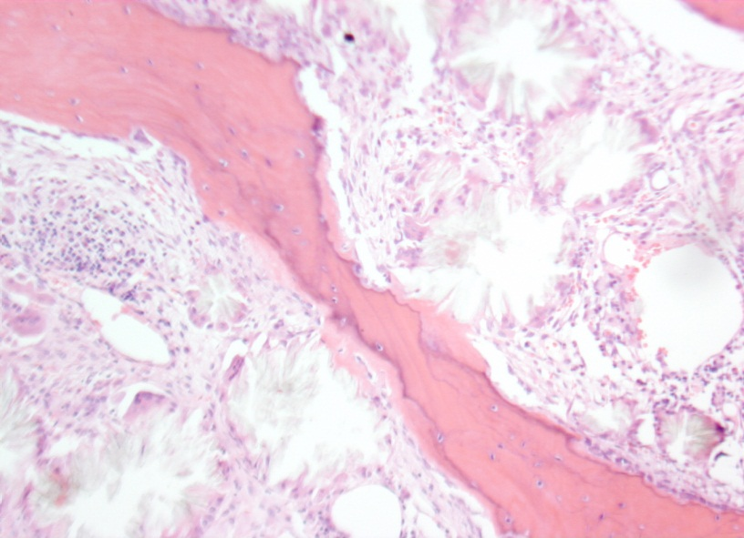
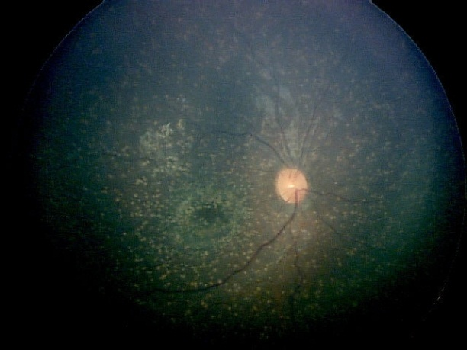
The Primary Hyperoxalurias
Notes:
These inborn errors of metabolism are characterized by marked over production of oxalate. The excess oxalate, which is excreted by the kidneys, causes renal stones, and also deposits in the kidney parenchyma to cause nephrocalcinosis and fibrosis, leading to kidney failure. After renal failure ensues, high concentratons of oxalate in the blood lead to calcium oxalate deposition in multiple organ systems such as the bone marrow and trabecular bone (causing anemia refractory to erythropoeitin and fracturing bone disease), the retina of eye. Many other organ systems are affected. Systemic oxalosis causes death.

Slide 21

Primary Hyperoxaluria Kidney Status at Diagnosis
Preserved renal function
End stage renal failure
Patients (no.)
0-4
5-9
10-14
15-19
20-24
25-29
30-34
35-39
40-44
45-49
50-54
55+
Age

Slide 22
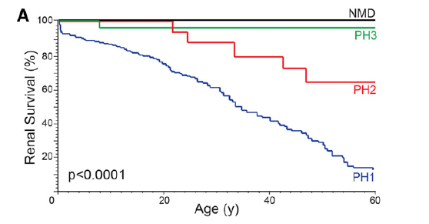
Renal Survival in Primary Hyperoxaluria
Renal Survival plots showing poorer renal survival for PH1 patients followed by PH2. Kaplan-Meier renal survival plot of the PH1, PH2, PH3, and NMD cohorts. Tables below Kaplan-Meier plots show survival estimates with number of patients at risk in parentheses.
at risk in parentheses.

Slide 23
Primary Hyperoxaluria
15 y.o. boy with his second kidney stone
28 y.o. with ESKD and dense kidneys on imaging
14 m.o. with failure to thrive found to have stage 4 CKD
61 y.o. undergoing transplant evaluation for ESKD of unknown etiology (single stone on imaging)
43 y.o. for stone evaluation with normal kidney function
Notes:
For this slide, when you do the ‘slide show’ you just click in slide to set the animation in motion and then click each time you want a new line to scroll in.

Slide 24
Diagnosis of the Primary Hyperoxalurias
Normal renal function
  Caox stones or nephrocalcinosis in childhood
  Recurrent CaOx stones/ hyperoxaluria in adults
  Hyperoxaluria with family hx of PH
Renal insufficiency
  Ca oxalate stones
  Nephrocalcinosis
  Ca oxalate tissue deposits
or
Uox >0.7 mmol/1.73 m²/24 hr
or
Uox/ucreat > normal for age
Uox >0.5 mmol/1.73 m²/24 hr
and/or
Plasma ox > 20 μmol/L
Evaluate
Yes
Secondary cause?
No
DNA testing
CP1304636-1

Slide 25
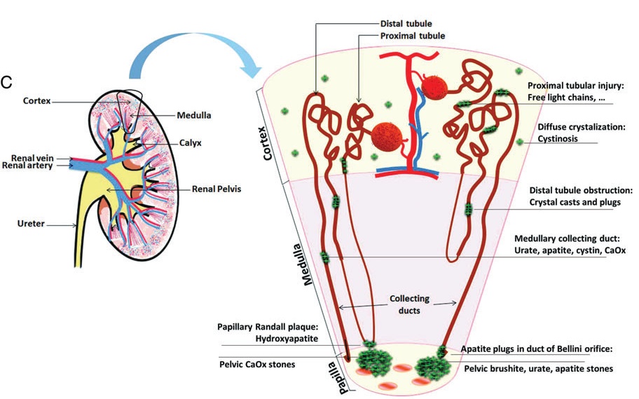
Routes and Sites of Crystal Deposition in the Kidney
Mulay SR. Nephrol Dial Transplant 2013

Slide 26
Hyperoxaluria: Mechanisms of injury
Caox crystals can trigger injury when deposited within the kidney. Mechanisms largely unknown.
Intracellular NLRP3 inflammasome discovered: a pattern recognition platform that translates crystal uptake into immune activation through secretin of IL-1B and IL-18.
Proof of concept in animal models of oxalate nephropathy (Knauf KI 2013).
Crystal-induced Inflammatory infiltrate, multinucleated giant cells in patients with hyperoxaluria.
Scarring, nephrocalcinosis

Slide 27
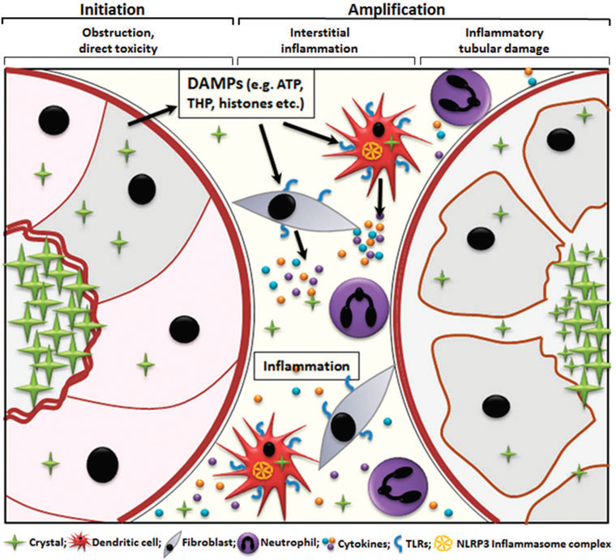
Mechanisms of Crystal-Induced Renal Inflammation
Mulay SR. Nephrol Dial Transplant 2013

Slide 28
Oxalate Nephropathy
Awareness with early and specific diagnosis
Targeted intervention for primary or secondary cause, as indicated.
Reduce oxalate produced (e.g. pyridoxine in PH) or absorbed (enteric hyperoxaluria)
Reduce calcium oxalate crystal formation, deposition
Future directions anti-inflammatory strategies
Particular attention to renal replacement therapies.

Slide 29


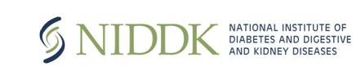
Acknowledgements
Rare Kidney Stone Consortium Staff
RKSC Coordinating Centers
The many contributors to the PH Registry

