Slide 1

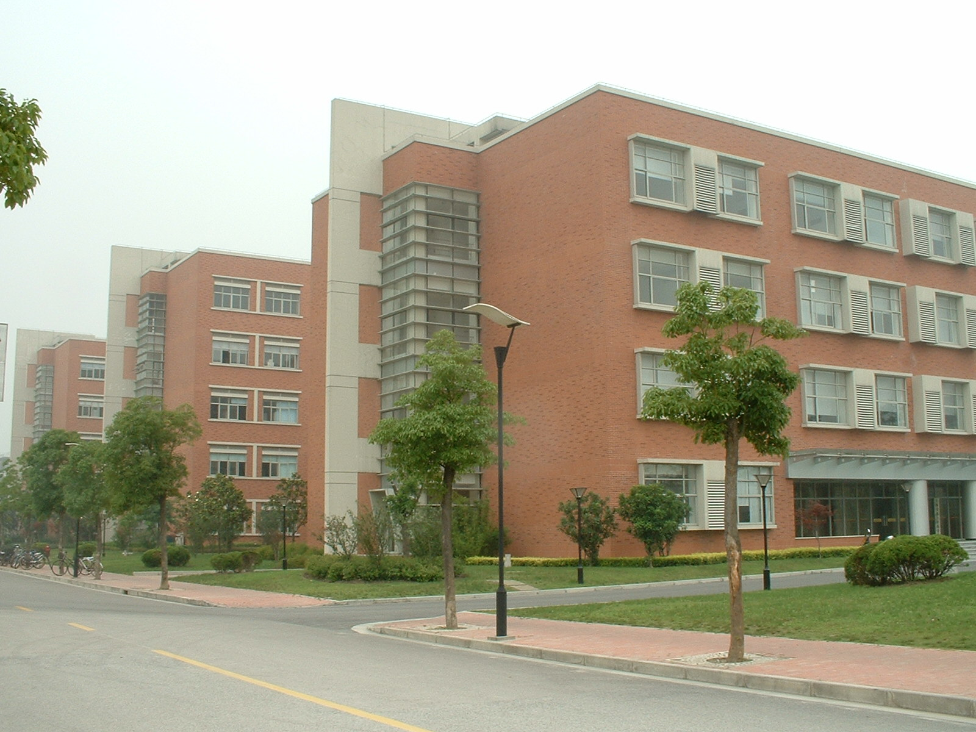
SJTU-School of Pharmacy
Secreted AGR2 Helps Tumor Cells to Establish Its Microenvironment
Dawei Li, Prof.
Center For Cell Engineering And Antibody Medicine
Shanghai Jiao Tong University

Slide 2
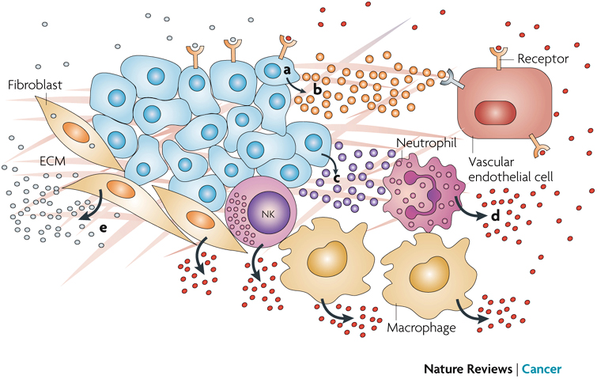
Tumor Microenvironment:
Multiple Cell Types , Factors, Receptors
Growth Factors
VEGF
bFGF
EGF
etc
Immuno Regulation
Proteases
Morphogens

Slide 3
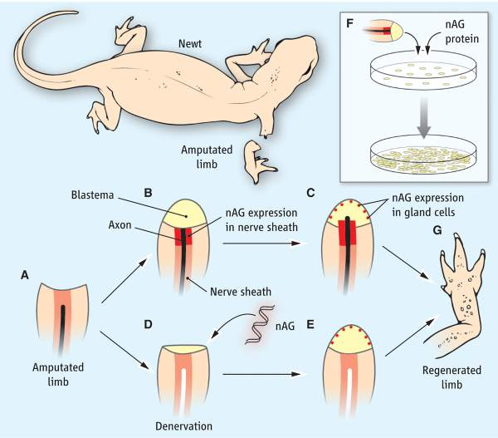
AGR2 Is a Key Factor in Tissue Remodeling
AGR2 is critical in regeneration and promotes cancer formation
Science (2007) Kumar et al

Slide 4
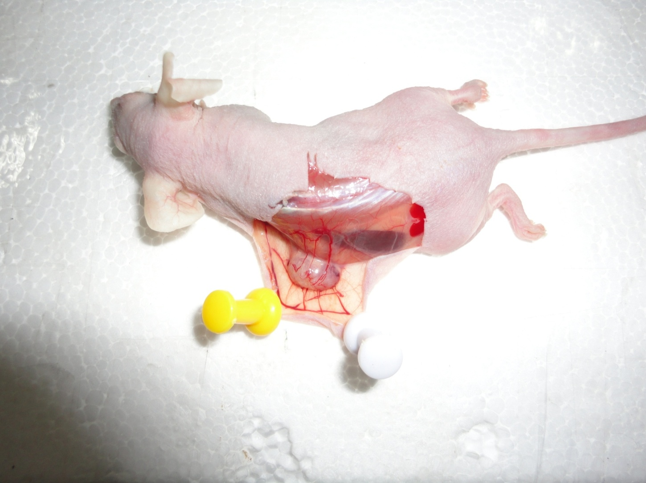
Targeting Cancer Microenvironment:
Beyond Angiogenesis ?
Tumor Remodels Its Microenvironment
With Multiple Secreted Factors
Non-tumor Cells:
Migration
Cell Cycle
Vascularization

Slide 5
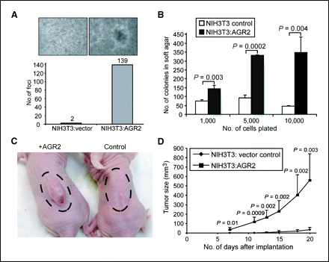
AGR2 Is a Drug Target Against Cancer
AGR2 Overexpression increases tumorigenic potential
Cancer Research (2008) Wang Zheng et al

Slide 6
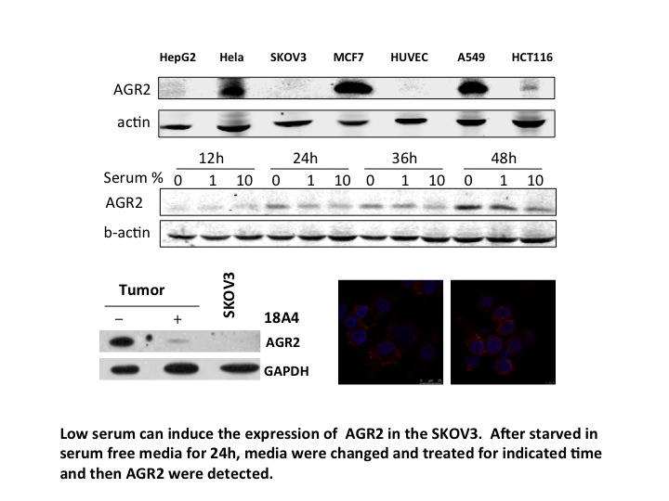
AGR2 Is Expressed Through Low Serum Induction
Surface AGR2
Internal AGR2

Slide 7
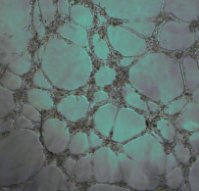
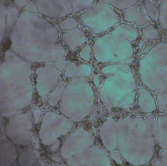
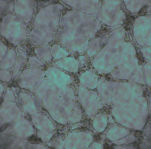
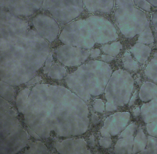
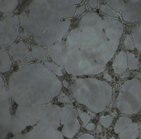
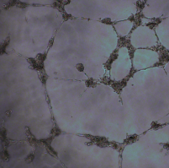
Angiostatic Effect of 18A4
18A4 Reduce HUVE Cell Tube Formation
Degree of HUVC tube formation
Anti-VEGF
Anti-AGR2
Control
Anti VEGF
Anti AGR2

Slide 8
AGR2 Is A Multi-Functional Proliferation Enhancer
Control AGR2 FGF FGF+AGR2

Slide 9
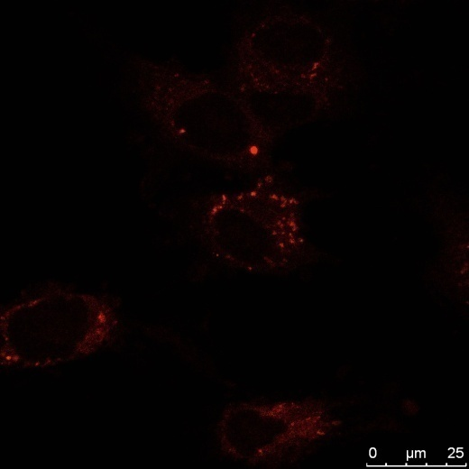
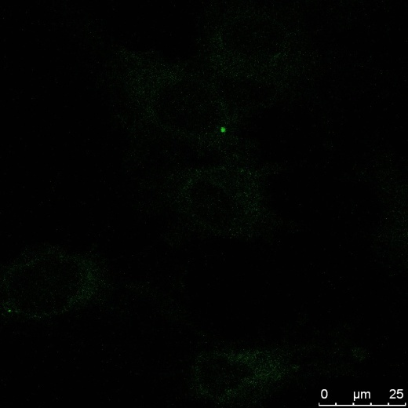
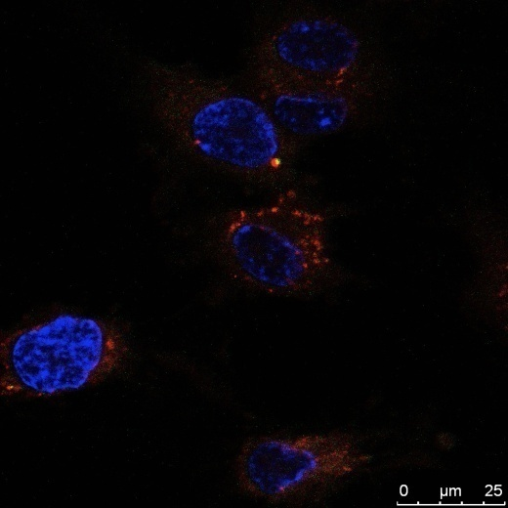
荧光Confocal共定位-AGR2和bFGF相互作用
Binding with bFGF, then binding to the membrane of HUVEC.

Slide 10
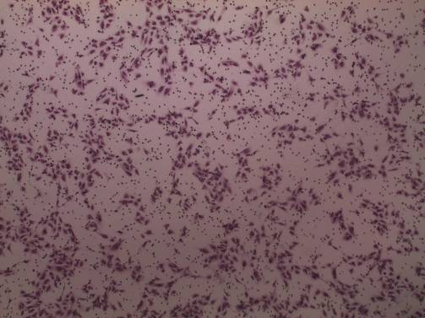
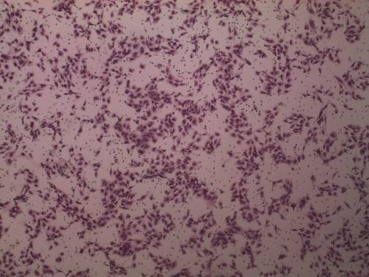
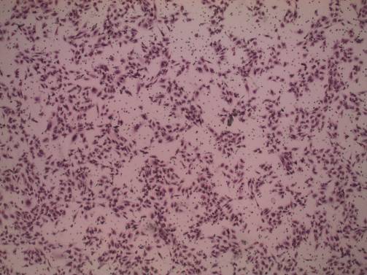
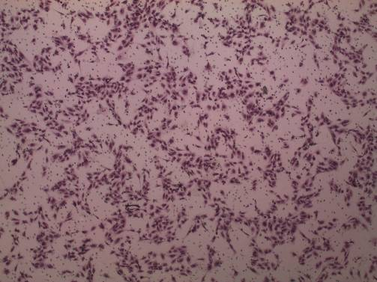
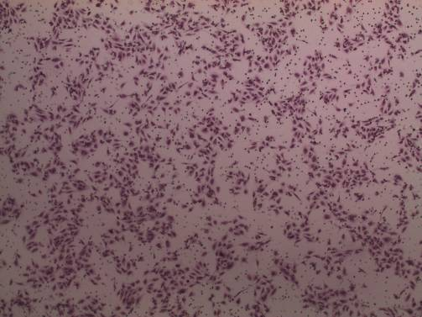
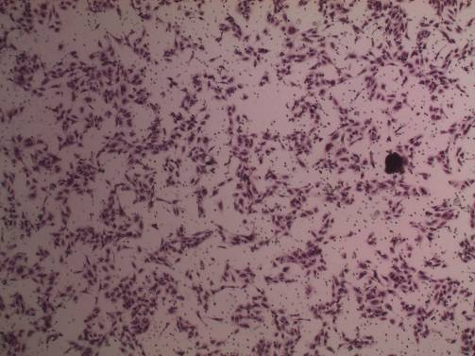
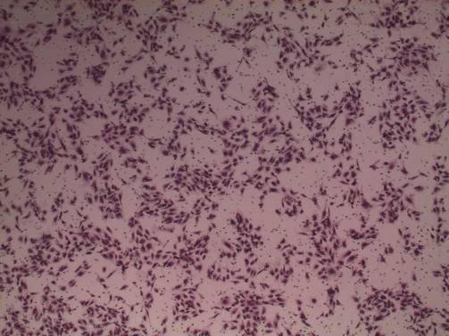
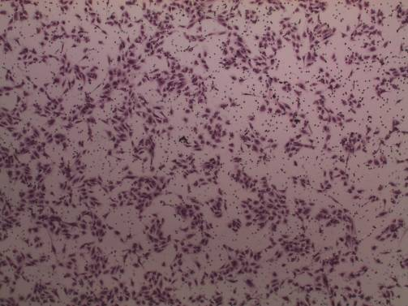
CAGR2 Has No Effect on Ang-1/PLGF/PDGF
Induced Migration
0.5% serum
AGR2 50ng/ml
Ang-1 50ng/ml
PLGF 50ng/ml
PDGF 25ng/ml
Ang-1 50ng/ml
AGR2 50ng/ml
PLGF 50ng/ml
AGR2 50ng/ml
PDGF 50ng/ml
AGR2 50ng/ml

Slide 11
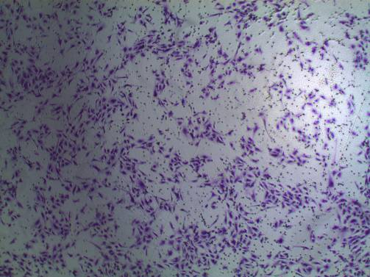
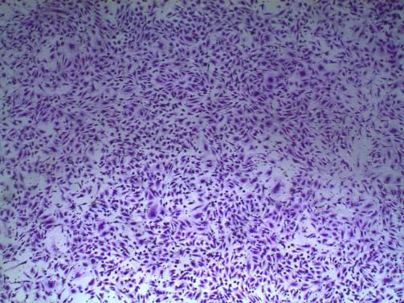
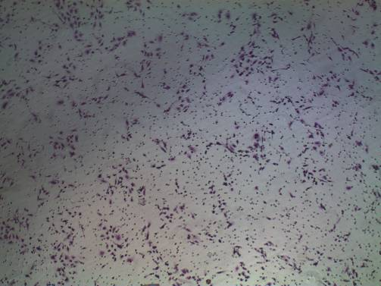
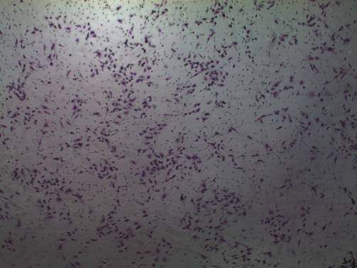
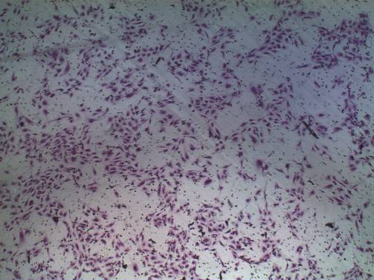
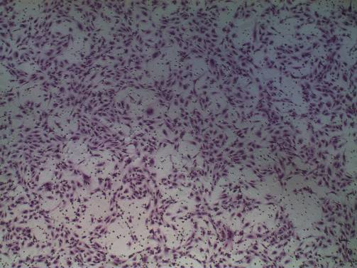
AGR2 增强 bFGF / VEGF在细胞转移实验中的作用
对照
AGR2
VEGF
VEGF+AGR2
对照
AGR2
bFGF
AGR2+bFGF

Slide 12
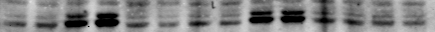
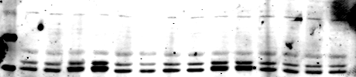
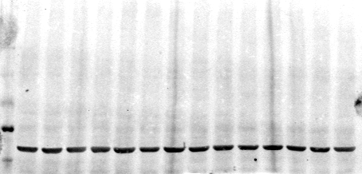
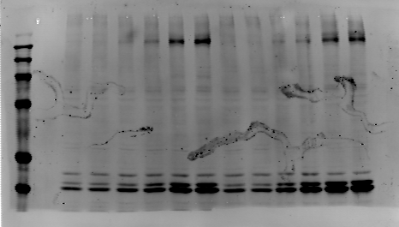
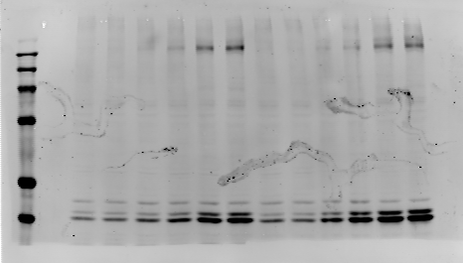
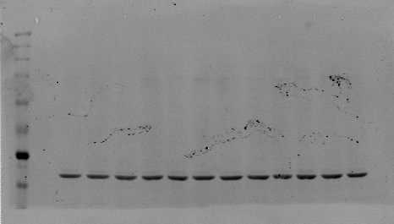
AGR2 can enhance the phosphorylation of ERK and VEGFR caused by VEGF and this effection can be disturbed by VEGFR inhibitor or VEGF antibody
Axitinib 2nM PD 173074 20nM Avastin
0 AGR2 VEGF AGR2 VEGF AGR2 VEGF AGR2 VEGF AGR2 AGR2
VEGF VEGF VEGF VEGF
pERK
ERK
actin
0 AGR2 VEGF 3ng/ml VEGF 20ng/ml
AGR2 AGR2
pVEGFR
(1175)
pERK
actin

Slide 13
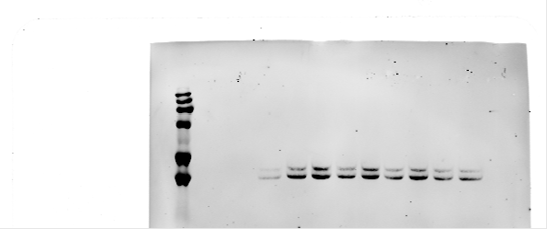
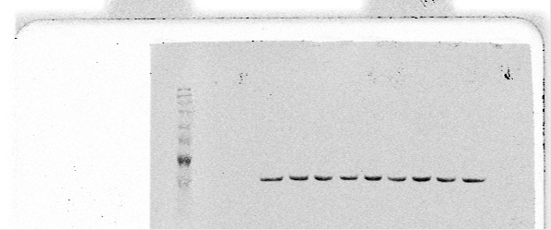


DTT can disturb the AGR2 signaling activities
DTT
250nM 250nM 5uM 5uM 100uM 100uM
0 VEGF AGR2 VEGF AGR2 VEGF AGR2 VEGF AGR2
VEGF VEGF VEGF VEGF
pERK
ACTIN
AGR2抗体阻断VEGF对ERK1/2的促进作用
0 AGR2 VEGF AGR2 18A4 清除AGR2 18A4 中和AGR2
VEGF AGR2 VEGF AGR2 AGR2 AGR2 VEGF AGR2
VEGF VEGF
pERK
actin

Slide 14
Generation of Agtuzumab Against AGR2
18A4 Hybridoma: Patent #ZL200910045963.2
18A4 Sequence and Target: Patent Pending 201110186469.5
Agtuzumab: International Patent -PCT and Countries
AGR2 is an early marker for ovarian
cancer
Agtuzumab from A18A4 specifically
binds AGR2 in its denatured or native form
Agtuzumab specifically
inhibits AGR2’s growth enhancing function

Slide 15
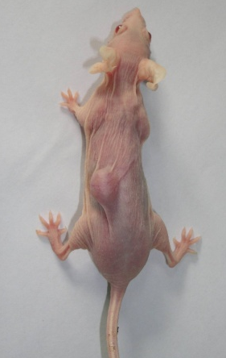
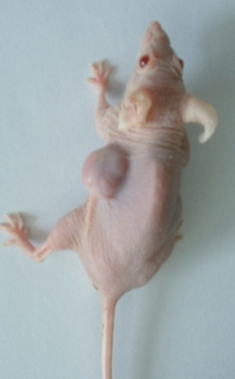
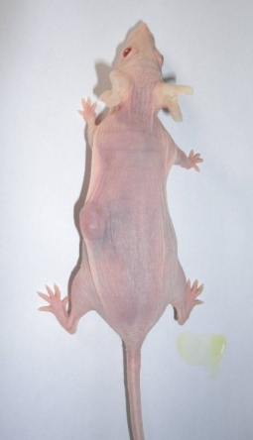
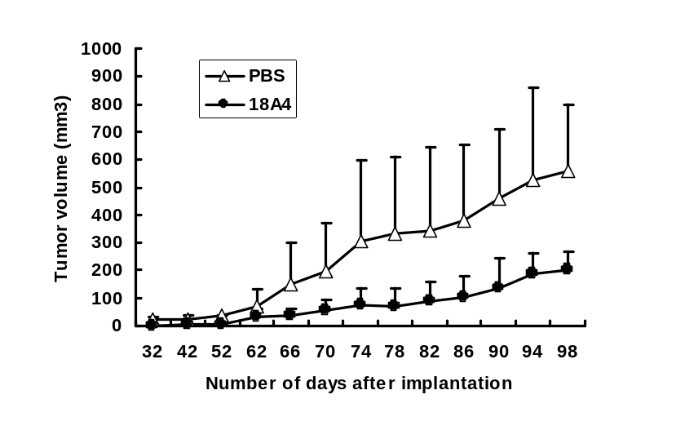
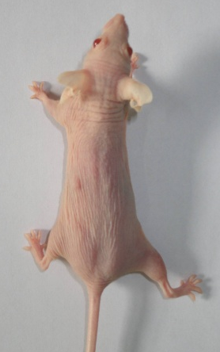
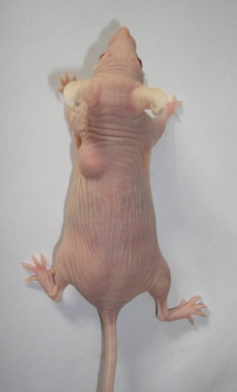
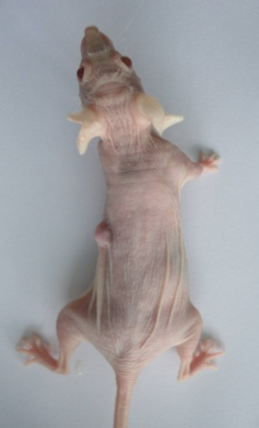
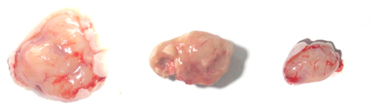

AGR2 mAb Inhibits Cancer Cell Growth
A
B
PBS
18A4
D
*
C
PBS
18A4
A. mAb 18A4 inhibit the growth of SKOV3 Xenograft model of nude mice. Comparison of tumor size between control group and 18A4 treatment group. B. Growth curve of the SKOV3 allograft tumors of nude mice. C and D, Comparison of tumor size and weight.

Slide 16
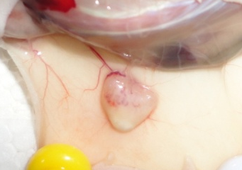
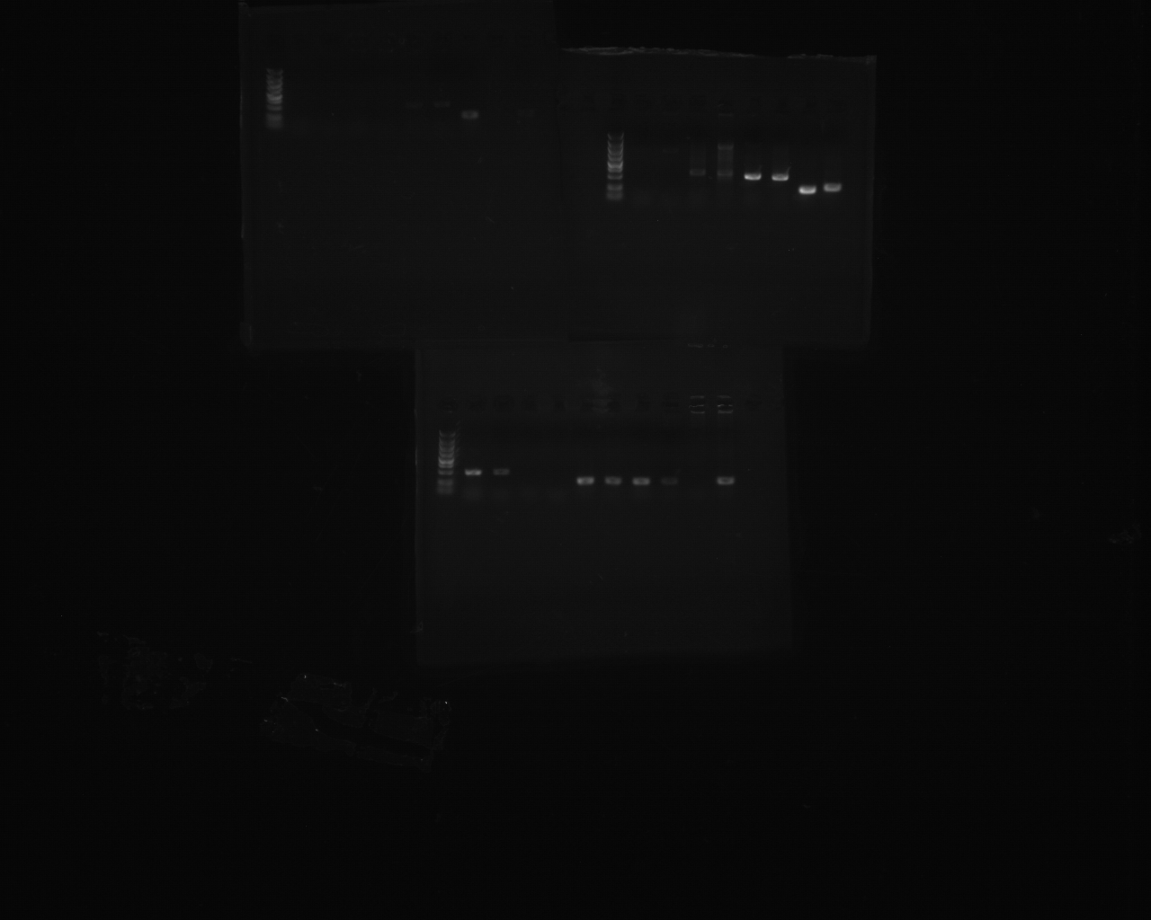
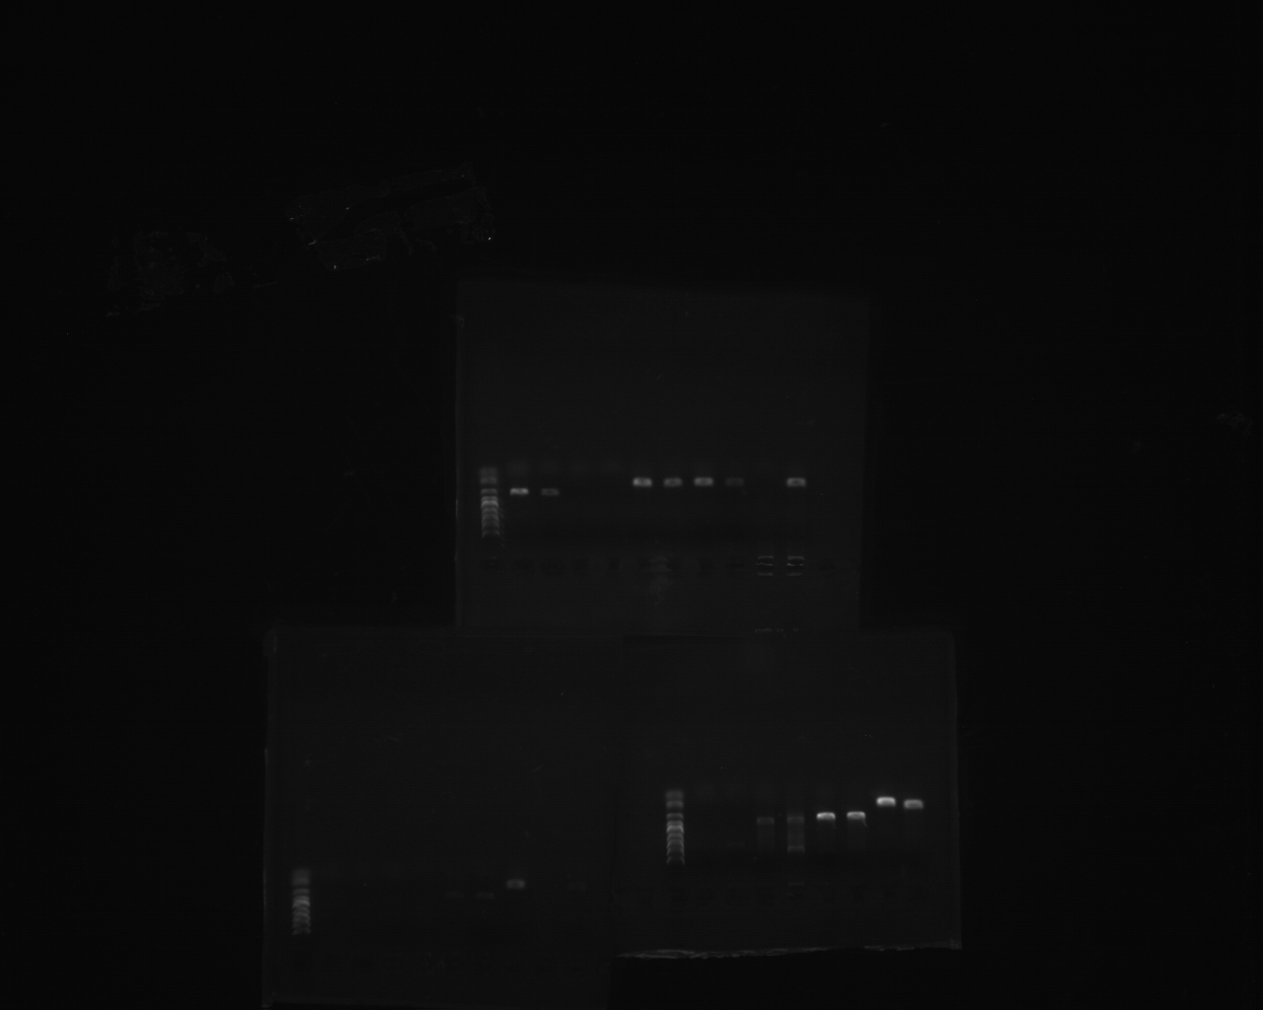
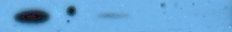
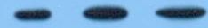
The Angiostatic Effect 8A4 Inhibits cancer cell growth in vivo
SKOV3 Tumor
A
B
Human-AGR2
Human-GAPDH
Control
18A4
Detection of AGR2 expression by semi-quantitative RT-PCR
2.0
Tumor
SKOV3
1.5
- +
18A4
C
1.0
AGR2
AGR2/GAPDH
0.5
GAPDH
0.0
E
SKOV3 cell
SKOV3
D
culture
Xenograft tumor
A. B, PCR of the cDNA of 0.5ml tumor tissue with 25 cycles shows that human AGR2 is expressed in tumors, but SKOV3 doesn’t express AGR2. AGR2 decrease in tumor tissue of treatment group. C, expression of AGR2 in SKOV3 cell and SKOV3 xenograft tumor. D E, Figure 6. Comparison of the expression of mouse and humon growth factors in tumor by realtime PCR.

Slide 17




Angiostatic Effect
Reduced Angiogenesis in Tumor Tissue After 18A4 Treatment
Control
18A4
Tumor Section Stained with CD31, a Blood vessel marker
Control
18A4

Slide 18
AGR2 Enhances Growth Factor Effect
Cancer Cells
AGR2
AGR2 Gradient
EGF/EGFR
VEGF/VEGFR
FGF/FGFR
Chemotactic effect
Stroma cells
Blood vessels
Other cells

Slide 19


Acknowledgement
Lab members:
Zhenghua Wu
Qi Zhu
Hao Guo
Hao Chen
Weiguo Xu
Guangwei Gao
Dhairi Mashuasi
Haochuan Lou
Collaborators
Dr. Chuanhua He (Yale/Int. Med)
Dr. Ronny Drapkin (Harvard/DFCI)
Dr. Steven Skates (Harvard/MGH)

