Slide 1

TELEPSYCHIATRY
IN GENERAL HEALTH CARE PRACTICE
IN DENMARK
Davor Mucic, MD, psychiatrist
The Little Prince Psychiatric Centre
Copenhagen, Denmark
www.denlilleprins.org
Notes:
1

Slide 2
There are two principal dimensions of quality of care for individual patients:
1. Access
2.Effectiveness

Slide 3

In essence,
do users get the care they need
and is the care effective
when they get it?

Slide 4
Telepsychiatry
refers to the use of telecommunication technologies
with the aim of providing psychiatric services
from a distance.
Most often used is videoconferencing in real time.
Notes:
4

Slide 5
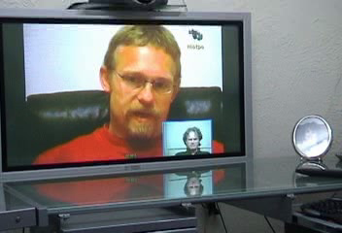

Slide 6


Shared care project connected via videoconference GP clinics in outskirts area of Denmark with
Little Prince Treatment Centre in Copenhagen

Slide 7

Project period 2011-2014

Slide 8
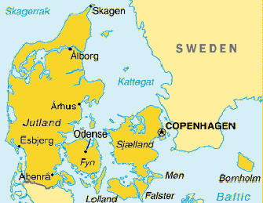
GP
Brande
LITTLE
PRINCE
Malmö
GP
Grindsted
GP
Nakskov
Notes:
8

Slide 9
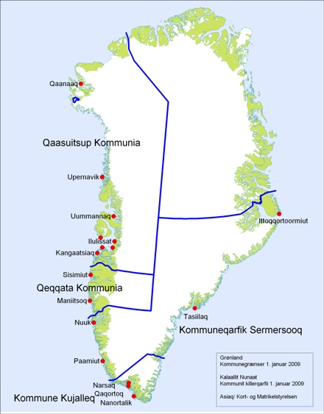
GP Frederikshavn
GREENLAND
LITTLE
PRINCE
Malmö
Jobcenter
Holbæk
GP
Haderslev
Psych.dpt..
Rønne
Jobcentret Åbenrå
GP
Nakskov
Notes:
9

Slide 10
Participants
66 patients referred by general practitioners received the consultation via the Telepsychiatry service.
The general practitioner had the initial responsibility of identifying those patients in need of mental health intervention.
Identification of such patients was typically based on patients themselves presenting symptoms or problems that were of a psychological nature.
All patients were given the choice between face-to-face consultation, usually with a long waiting list, or Telepsychiatry, waiting max 2 week.

Slide 11
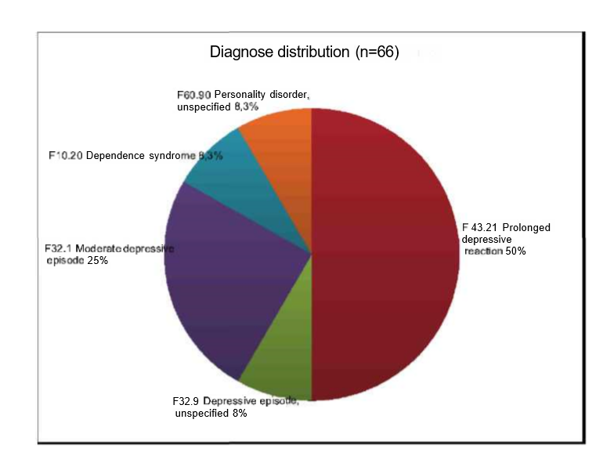

Slide 12
Patients’ satisfaction with Telepsychology
The patients that were offered sessions with psychologists have been pleased with the way the technology functioned (i.e. picture, sound).
They felt secure even though they had never tried Telepsychology treatment before.
Some of them had been attending treatment face to face before.
Participants indicated that the treatment improved their ability to cope in general and better understand the ir problems, but the outcome varied regarding improvement within family life, mental state and interest in different activities.

Slide 13
GP’s satisfaction with the Service
GP’s reported high level of satisfaction with the Shared Care Service
Noteworthy on the replies from the general practitioners is that all answers were positive, either excellent or good, and that specifically the idea of continuing working with telepsychiatry received 100% support.
General practitioners were satisfied with the practical issues regarded the collaboration, such as introduction to the project and equipment and coordination of the project. They also reported that they benefited from shared care cooperation.

Slide 14
The project has shown to be a time and money saver both for patients and health care service.
Lack of access to psychiatric help on the outskirts of Denmark and the expensive alternatives are problems that can be successfully solved by using the Telepsychiatry service.
This would mean a more efficient use of scarce resources and related cost efficiencies.

Slide 15
General benefits of such an approach
Antistigma
Reaching more potential patients via contact with clinics around
Reaching specific group of patients e.g. autism spectrum, ADHD, young population used on online communication, physically impaired individuals with difficulties to be transported; inmates
Liaison psychiatry : assessment and/or treatment of patients hospitalized cause of infarct, stroke etc (depression most common)
Supervision of General Practitioners
Patient is saving time on transportation
Medical tourism (patients from whole Middle East would come for initial assessment and treatment suggestion. Follow up via video)
Telepsychiatry

Slide 16

Conclusion
Collaboration via use of videoconferencing across levels of health care sectors can be a useful alternative that offers learning, leads to continuity, reduces costs and improves the quality of care.
Telepsychiatry, supplemental to existing mental health system, can improve the quality of care.
Notes:
16
16

Slide 17


Thank you for your attention!

