Slide 1

Early stage work in raising awareness about vascular dementia in African Caribbean communities in london
David Truswell B.Sc., M.Sc.(Econ.), MBA

Slide 2
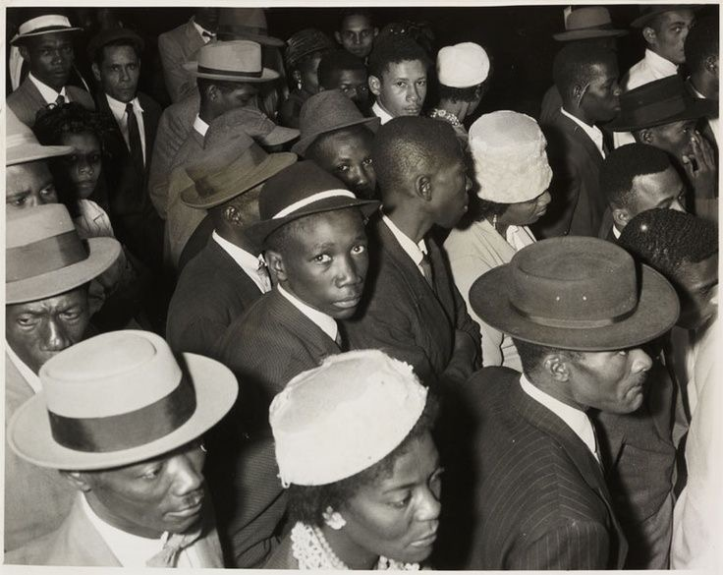
Significant numbers of working adults from the Caribbean migrated to the UK in the late 1950s and the 1960s.

Slide 3
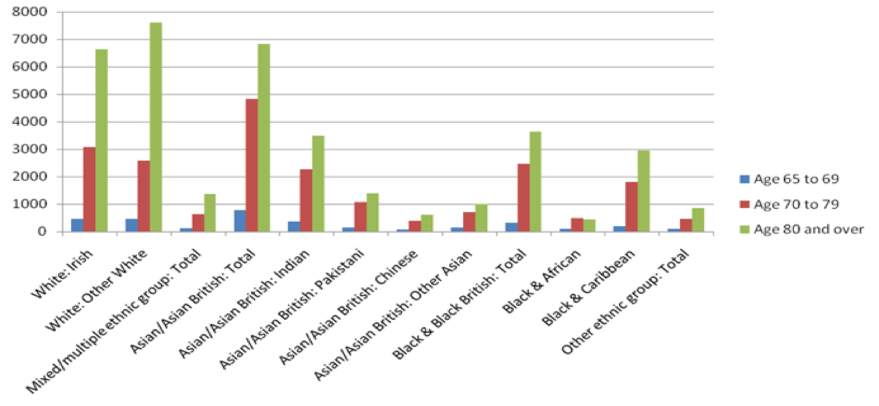

Slide 4
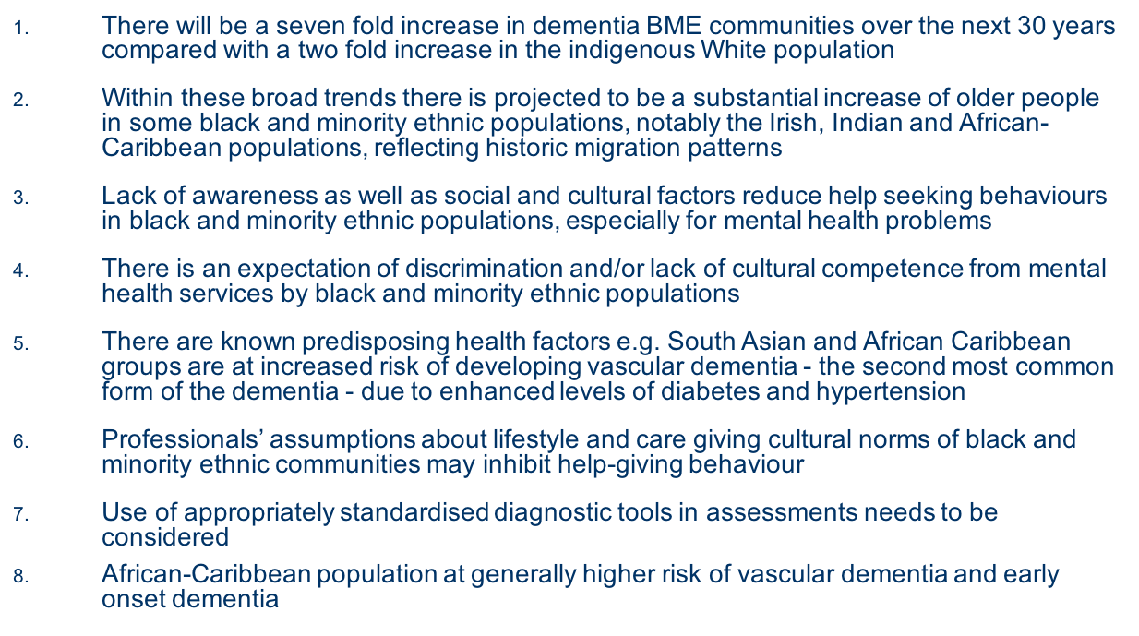

Slide 5
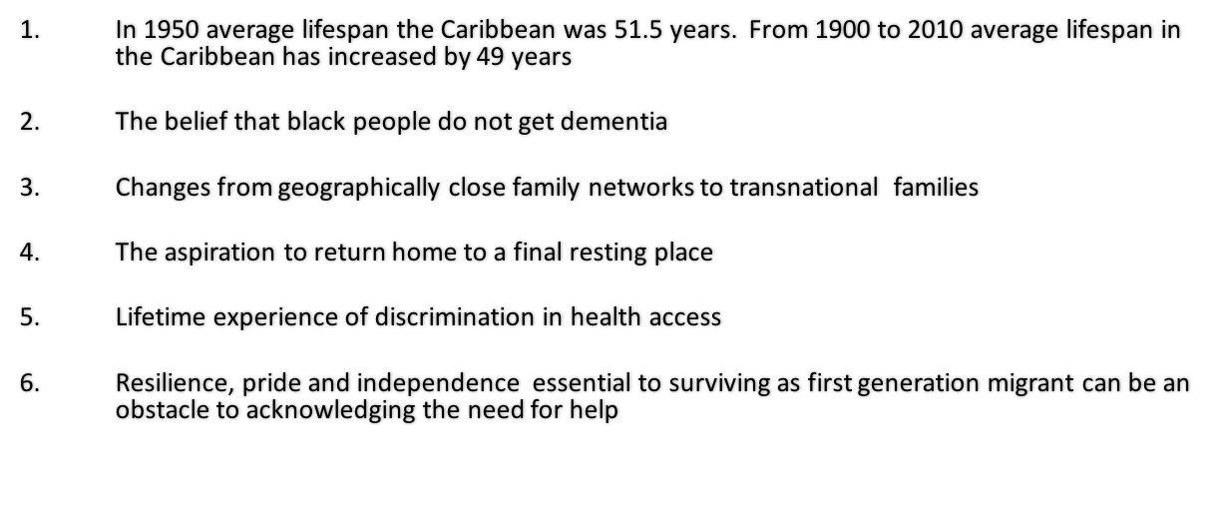

Slide 6







CRISIS
Stigma & lack of information
Family member with increasing cognitive & behaviour problems
Increasing isolation for person with dementia & carer
Health crisis for person with dementia
Health crisis for carer
Hospital admission
Admission to residential care
No suitable home based care alternative
Carer cannot continue to provide care

Slide 7
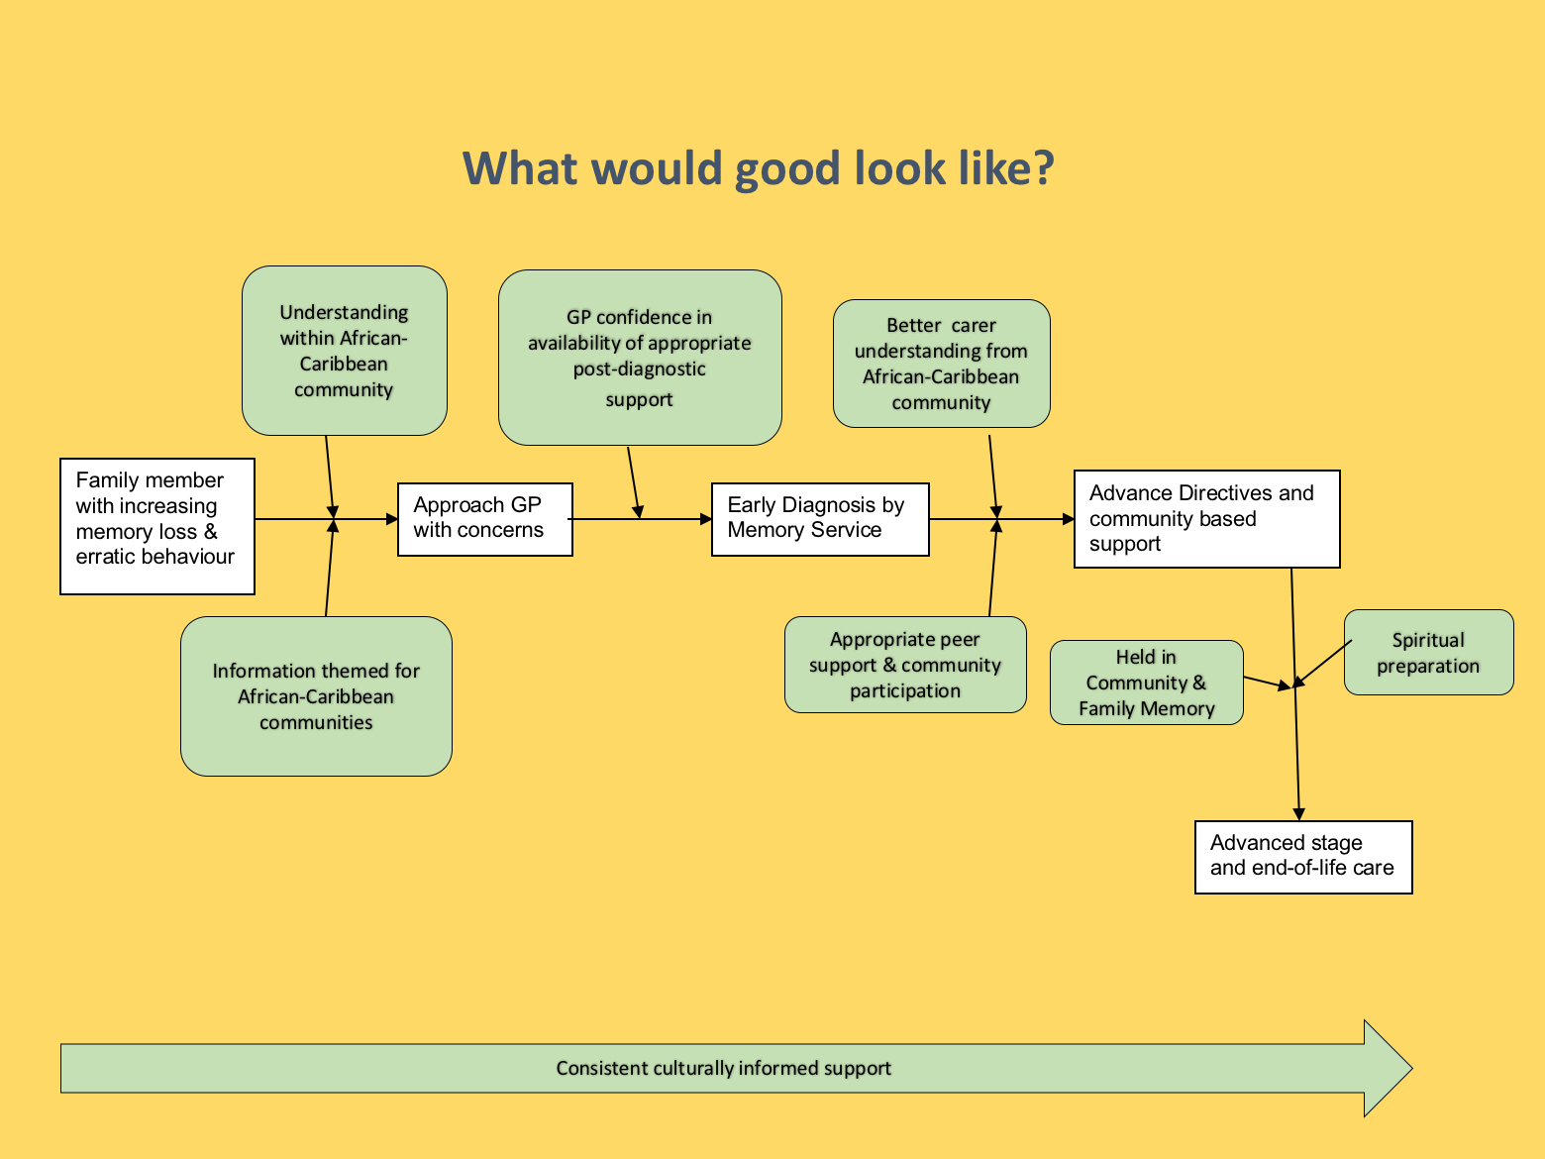
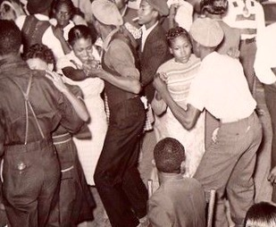

Slide 8
Culture Dementia UK
examples of raising awareness using a culturally appropriate approach
Community radio broadcasts
Local conferences
People living with dementia from the community speak out
Working with churches
Fundraising events
Supplementary school teachers and parents
Promotion of minority issues in mainstream
Health Education England

Slide 9
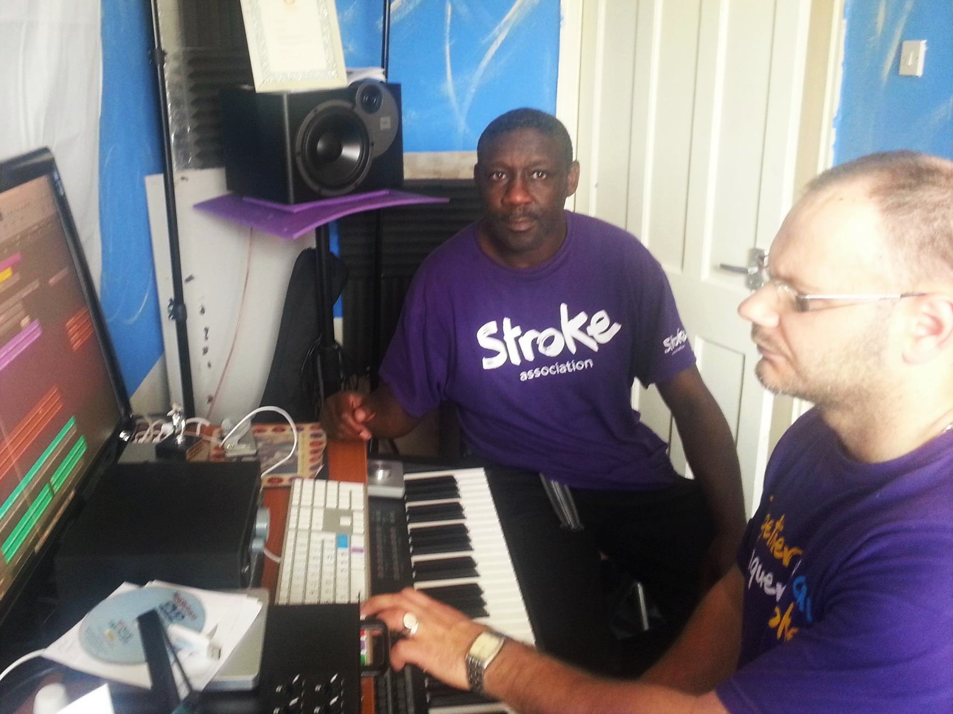
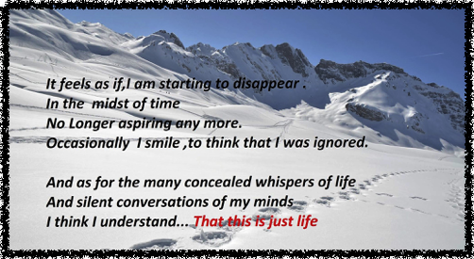
RONALD'S STORY

Slide 10
For the African-Caribbean community in the uk the experience of dementia is routinely complex for carers, professionals and the person living with dementia

Slide 11
www.culturedementiauk.org
david@somefreshthinking.com

