Slide 1

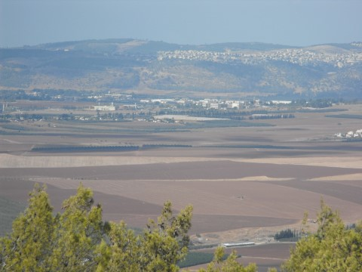


Correcting Acidosis during Hemodialysis:
Current limitations
& Potential Solutions
כנס שנתי של החוג
4.9.2015
David Tovbin MD
Department of Nephrology,
Emek Medical Center, Afula, Israel

Slide 2




Back to Rome after 40 years

Slide 3




Slide 4
What is the Appropriate
Dialysate Bicarbonate Concentration?

Slide 5
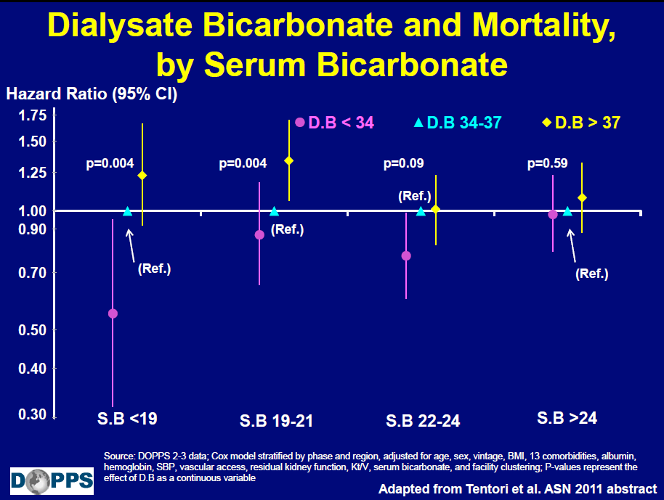
Notes:
We can see that lower dialysate bicarbonate especially in more acidotic patients is associate with better survival
Is associate with

Slide 6
Correcting Acidosis in Hemodialysis- Outline
Introduction- Dialysate Bicarbonate?
1. Significance
2. Mechanisms, Current Limitations & Complications
3. Potential Solutions
Questions
Take Hemodialysis Message

Slide 7
Correcting Acidosis in Hemodialysis- Outline
Introduction- Dialysate Bicarbonate?
1. Significance
2. Mechanisms, Current Limitations & Complications
3. Potential Solutions
Questions
Take Hemodialysis Message

Slide 8
Why to correct acidosis in hemodialysis patient?

Slide 9
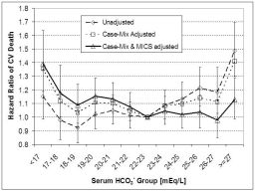
Kalantar-Zadeh K, McAllister CH, Wu DY, et al
baseline (1st 3-month averaged) pre-HD serum bicarbonate
and CV mortality in 56,376 HD patients- DaVita
bicarbonate >22 mEq/L associated with improved CV survival
Reverse Epidemiology
Healthy HD patients eat better and more proteins and thus are more acidotic
However, Acidosis is associated with worse outcome after adjustment
23

Slide 10
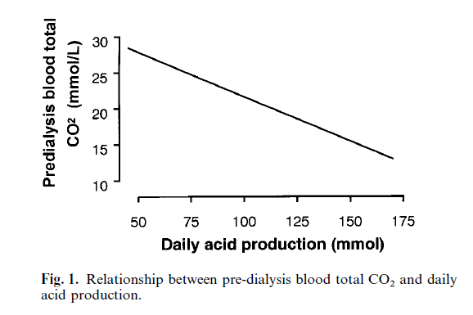
100 g
130 g

Slide 11
Nutritional / Metabolic Inter-relations of Bicarbonate & HD
Bicarbonate
Bones Proteins Inflammation BP Ca K glucose
Respiration
Adjusting
other dialysate components
according to patient state

Slide 12
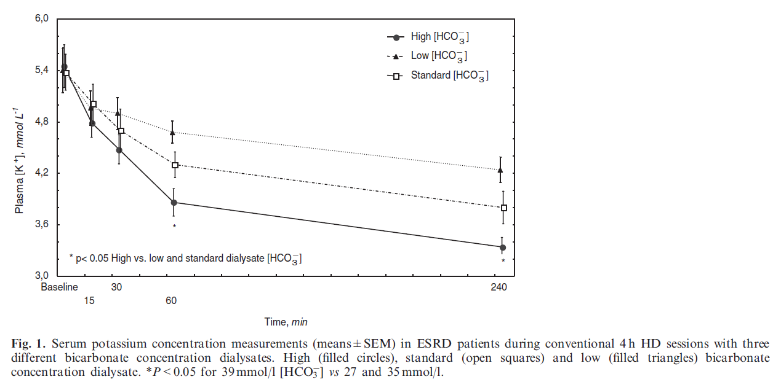
27 mEq /L
35 mEq /L
39 mEq /L
3.4

Slide 13
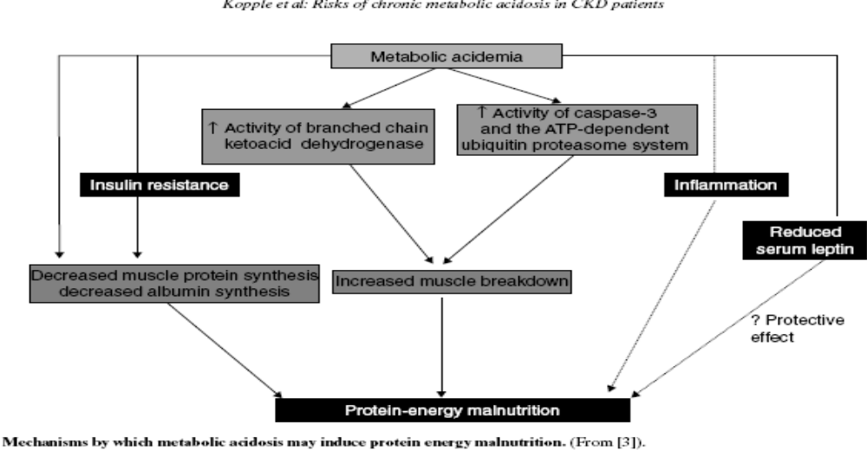

Slide 14
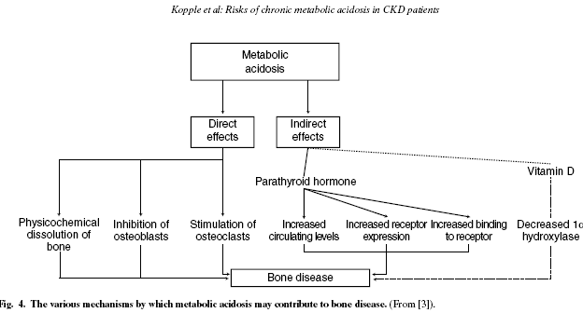

Slide 15
Correcting Acidosis in Hemodialysis- Outline
Introduction- Dialysate Bicarbonate?
1. Significance
2. Mechanisms, Current Limitations & Complications
3. Potential Solutions
Questions
Take Hemodialysis Message

Slide 16
Suggested limiting Principals in HD
1st limitation- Intermittent Therapy- Not a uniform steady state
2. 2nd limitation- Discrepancy in duration between
Accumulation vs Removal by Dialysis
duration-hours 44-68 vs 4
3. 3rd limitation - Discrepancy between
Accumulation vs Removal by Dialysis
Compartments and their size
Volume- large interstitial vs small plasma
K, Acids- large Intracellular vs small plasma

Slide 17
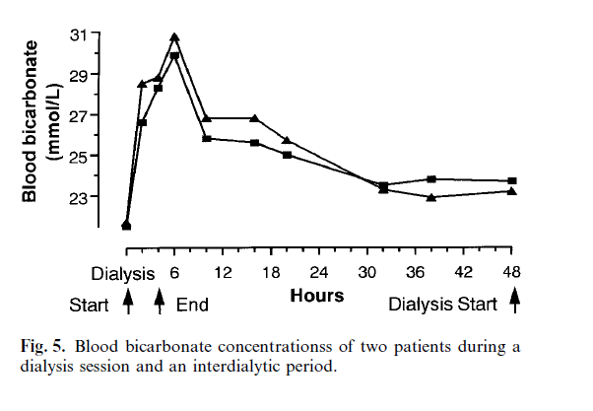
limitations of intermittent therapy
Alkalosis Acidosis
35 mEQ/L

Slide 18
Hypothesis
In acidotic pts (pre-HD PBIC<22 mEq/L) on SDBIC-33.5-34 mEq/L
high DBIC (HDBIC) - 40 mEq/L
will correct inter-dialytic acidosis & pre-HD PBIC
with limited intra-dialytic PBIC increase & alkalosis
Methods
Δ3 weeks on SDBIC and afterwards HDBIC
Results
8 Acidotic (<22mEq/L) patients
on SDBIC - 34 mEq/L D-P grdient Δ
Pre-HD PBIC - 19.3 (1.5) mEq/L 15 6.7
Mid-HD PBIC - 26 (2) mEq/L 8 2
End-HD PBIC - 28 (2.9) mEq/L 6
on HDBIC - 40 mEq/L D-P grdient Δ
Pre-HD PBIC - 24 (2.6) mEq/L16 8.2
Mid-HD PBIC - 33.2 (2.4) mEq/L 6.8 1.7
End-HD PBIC -34.9 (3.2) mEq/L 5

Slide 19
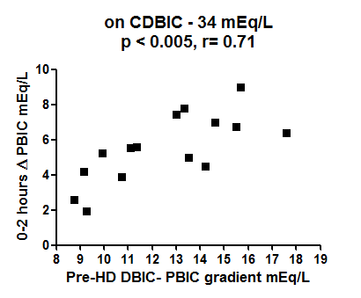
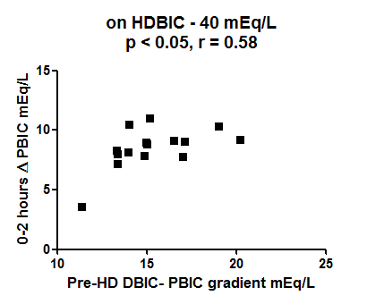
HDBIC corrects acidosis in acidotic patients on SDBIC
However
Acidotic patients are not protected from Intra-dialytic alkalosis since PBIC increase correlates with D-P BIC gradient

Slide 20
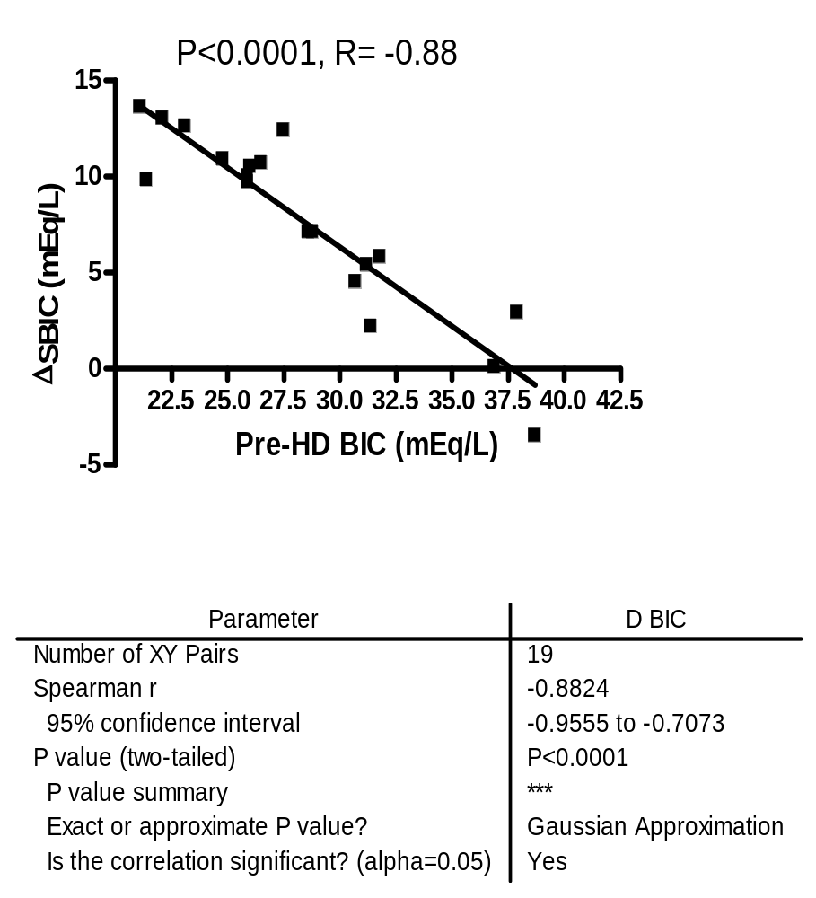
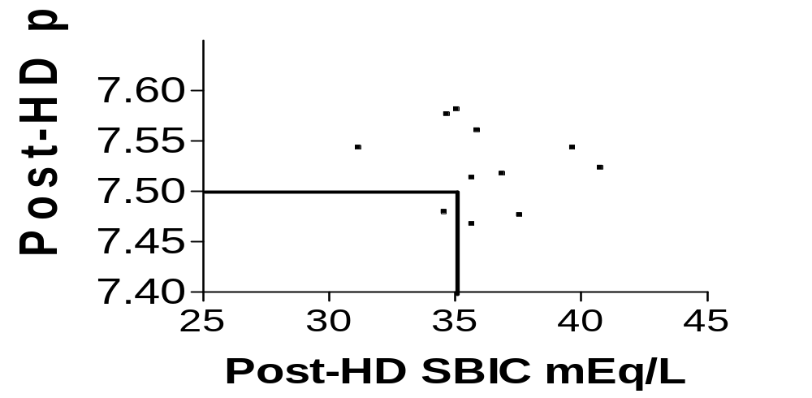
Post-HD alkalemia with attenuated increase in pCO₂
In Acidotic patients
HDBIC induced intra-dialytic metabolic alkalosis /alkalemia resembling the non-acidotic who don’t need HDBIC
Acidotic patients not protected from alkalemia development
Increase in SBIC inversely correlated with pre-HD SBIC
7.52 A 35.3
7.51 NA
37

Slide 21
35
33
intra-dialtic
alkalosis
30
Post-HD
post-dialtic
alkalosis
28
26
inter-dialytic alkalosis
24
22
inter-dialytic acidosis
2 h
Pre-HD
21
End-HD
19
Pre-HD
DBIC- constant 34 mEq/L
DBIC- constant 40 mEq/L
DBIC- early 40 mEq/L and afterward reduction- suggested exponential drop from 40 to 34 mEq/L
Notes:
21
fluid, bicarbonate

Slide 22
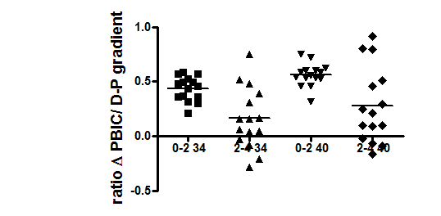
0.44 (0.11) 0.16 (0.28)
p<0.05
0.56 (0.11) 0.28 (0.35)
p<0.05
Late HD decrease in
ratio PBIC increase/ D-P BIC gradient & probably D-P BIC transfer
may be explained by larger later P-EP BIC transfer

Slide 23
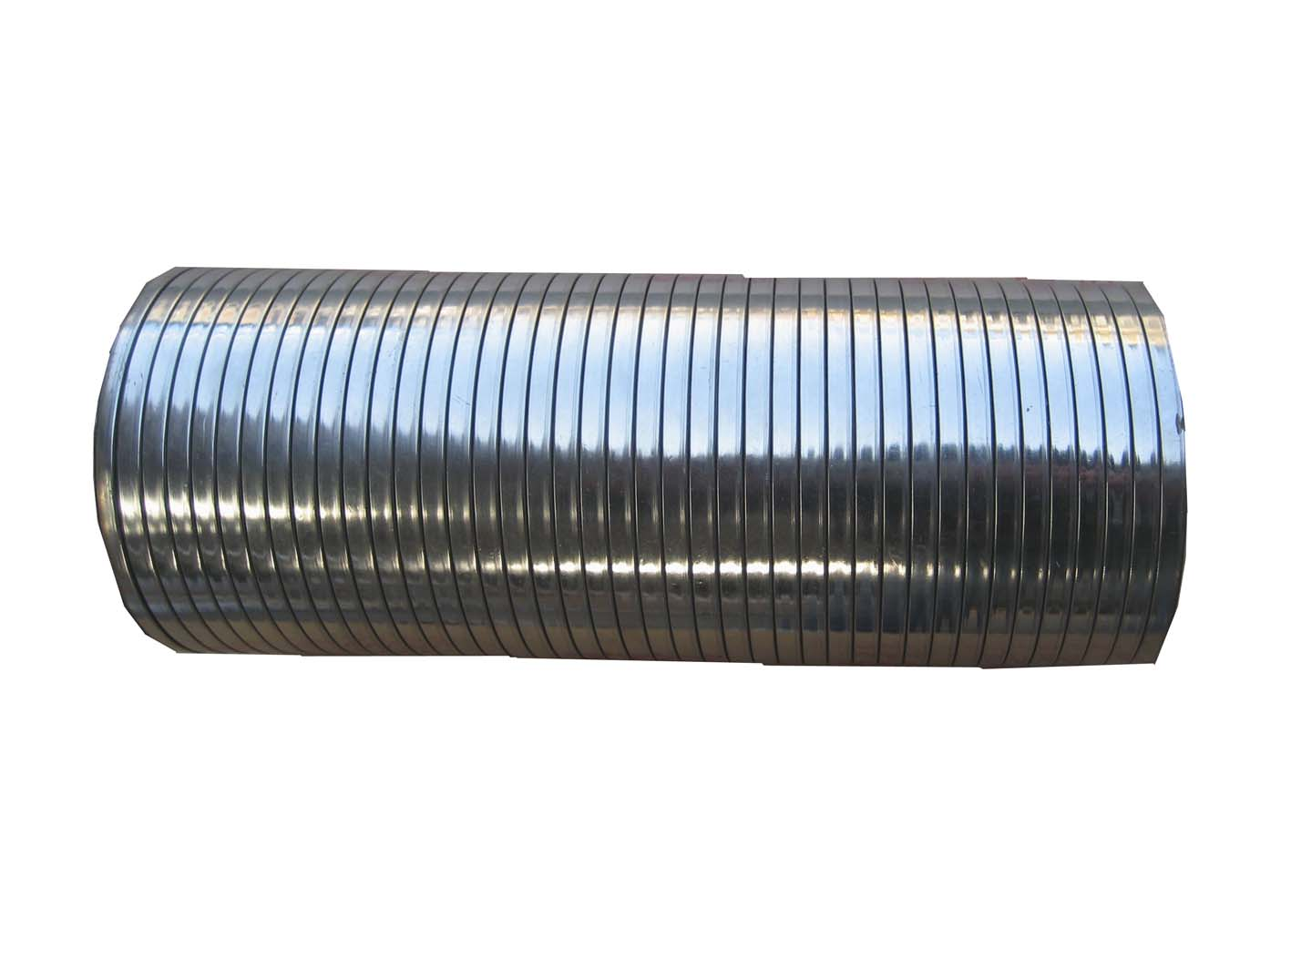
CURRENT OPTIONS –FIEXFIED DBIC
Dialysate(D)
P-EP BIC transfer
D-P BIC transfer
35
4h
Plasma (P)
PBIC
32
2h
40
26
gradient16
24
D-EP BIC transfer
Large Extra Plasma compartments (EP)
Dialysate(D)
P-EP BIC transfer
D-P BIC transfer
28
4h
26
2h
Plasma(P)
PBIC
35
gradient16
19
BIC transfer from dialysate (D) to expanded extra-plasma (EP) through narrow plasma (P). PBIC increase, reach alkalotic range & counteracts D-P BIC gradient & transfer limiting acidosis correction

Slide 24
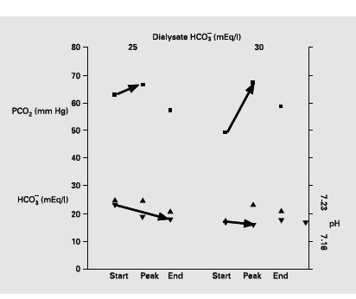
Clinical Study. Intra-dialytic Hypercapnic Respiratory Failure Managed by Noninvasive Assisted Ventilation Am J Nephrol 2001; 21:383–385
4. 4th limitation - Hypercapnia
44 male, HD 4 y, Morbidly obese-dry Wt 139 kg, med ICU-respiratory failure,
BIPAP 12/min, Exp & Insp positive airway pressure : 3–4 & 8–9 cm H2O, respectively
T 39°C, RR 32/m Lung congestion, Bil pleural effusion Lt > Rt (transudate) LLL infiltrate
HTN. LVH, CHF, CIHD, PVD, no smoking, COPD? OSA?, PFT: restrictive, FVC 62%, FEV1/FVC 0.84
Pre-HD 1 :
pCO₂ 63 mm Hg
HCO₃ 25 mEq/l ,
pH 7.23
DBIC 25 mEq/l: end HD:
pCO₂ 57 mm Hg
HCO₃ 21 mEq/l,
pH 7.19
peak pCO₂ 67 mm Hg
Pre-HD 2 (2 d) :
pCO₂ 49.3 mm Hg
HCO₃ 17.5 mEq/l
pH 7.175
DBIC 30 mEq/l :
end HD:
pCO₂ 57 mm Hg
HCO₃ 21.2 mEq/l
pH ~
peak pCO₂ 67 mm Hg
Notes:
מטופל עם מחלת לב קשה ללא מחלת ריאות ידועה שבהחייאה בדיאליזה התגלתה היפרקפניה
בהמשך ריכוז ביקרבונט בדיאליזט של 25 מא"ק/ל וBIPAP
ב2011 פרסום מ Mayo Clinic בחולה כרוני עם השמנת יתר קיצונית שהונשם עקב דלקת ריאות והחמרת היפרקפניה, הפסקת נשימה והחייאה בדיאליזה השנייה לאחר גמילה מהנשמה
פרסום (יפנית) של החמרת היפרקפניה בהמודיאליזה עקב הפרעה נשימתית בשל תת תזונה קשה
עברו יותר מ10 שנים ללא שנתקלתי שוב בבעיה זו עד השנה וחצי האחרונות (3 מטופלים)

Slide 25
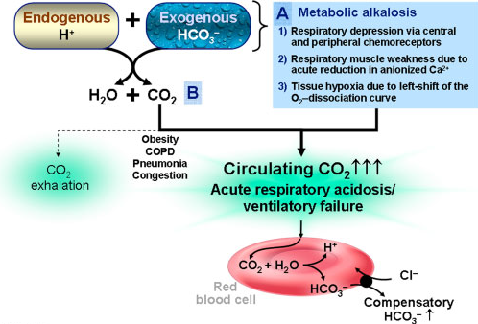
Acute hypercapnic respiratory failure associated with hemodialysis (Mayo clinic) Dialysis & Transplantation Vol 40, Issue 2; 83–85, Feb 2011
55 M, 140 kg, COPD pCO₂ 48 mm HG,
Pnoumonia-mechanical ventilation
intra-dialytic hypercapnia and resuscitation post extubation

Slide 26
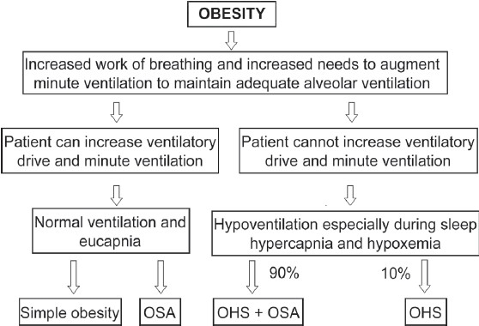
Respiratory System Compliance Weak Respiratory Muscles
Work of Breathing
Need to Increase Ventilation
Ventilation
Severe Upper Airway Resistance

Slide 27
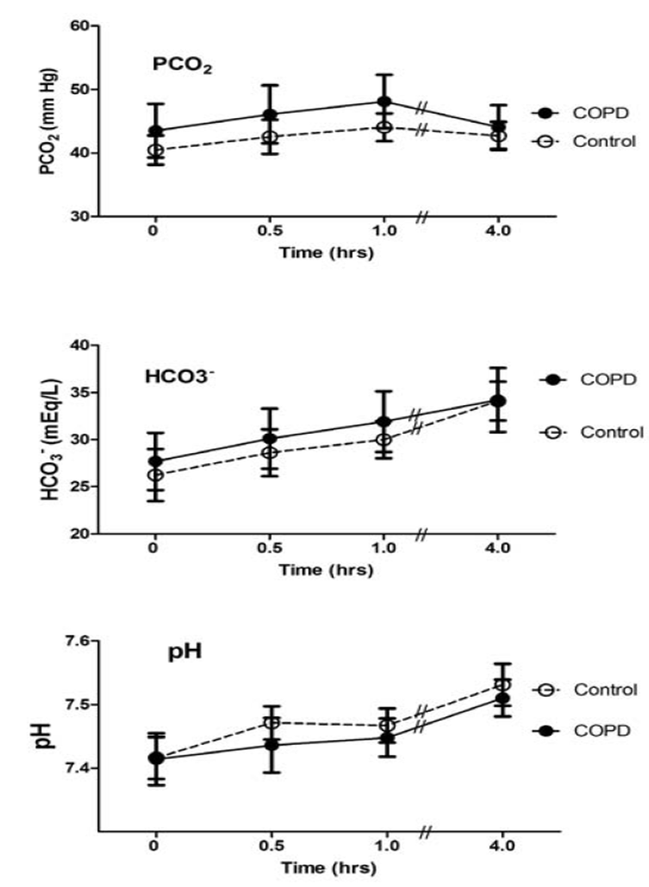
Pulmonary Gas Exchange During Hemodialysis: A Comparison of Subjects with and without COPD on Bicarbonate Hemodialysis Annals of Clinical & Laboratory Science, vol. 41, no. 4, 2011

Slide 28
Correcting Acidosis in Hemodialysis- Outline
Introduction- Dialysate Bicarbonate?
1. Significance
2. Mechanisms, Current Limitations & Complications
3. Potential Solutions
Questions
Take Hemodialysis Message

Slide 29
Inter-dialytic oral bicarbonate
Obligatory in hypercapnic HD patients
Warranted in non hypercapnic HD patients

Slide 30
35
33
intra-dialytic
alkalosis
30
Post-HD
post-dialytic
alkalosis
28
26
inter-dialytic alkalosis
24
22
inter-dialytic acidosis
2 h
Pre-HD
21
End-HD
19
Pre-HD
DBIC- constant 34 mEq/L
DBIC- constant 40 mEq/L
DBIC- early 40 mEq/L and afterward reduction- suggested exponential drop from 40 to 34 mEq/L
Notes:
30
fluid, bicarbonate

Slide 31
Large Extra Plasma compartments (EP)
CURRENT OPTIONS –FIEXFIED DBIC
Dialysate(D)
P-EP BIC transfer
D-P BIC transfer
35
4h
Plasma (P)
PBIC
32
2h
40
26
gradient16
24
D-EP BIC transfer
Dialysate(D)
P-EP BIC transfer
D-P BIC transfer
28
4h
26
2h
Plasma(P)
PBIC
35
gradient16
19
BIC transfer from dialysate (D) to expanded extra-plasma (EP)(D-EP transfer) through narrow plasma (P). Intra-dialytic PBIC increase reach alkalotic range & counteracts D-P BIC gradient & transfer limiting acidosis correction

Slide 32
0.44 (0.11) 0.16 (0.28)
p<0.05
0.56 (0.11) 0.28 (0.35)
p<0.05
Late HD decrease in
ratio PBIC increase/ D-P BIC gradient & probably D-P BIC transfer
may be explained by larger later P-EP BIC transfer

Slide 33
Extra Plasma compartments (EP)
CURRENT OPTIONS –FIEXFIED DBIC
Dialysate(D)
Plasma(P)
PBIC
D-P BIC transfer
40
P-EP BIC transfer
gr16
26
4h
26?
21
34
D-EP BIC transfer
Plasma(P)
PBIC
D-P BIC transfer
24
34
P-EP BIC transfer
gr15
24
28 4 h
26 2h
7+
19
initial HDBIC with subsequent exponential DBIC reduction

Slide 34
Extra Plasma compartments (EP)
CURRENT OPTIONS –FIEXFIED DBIC
Dialysate(D)
Plasma(P)
PBIC
D-P BIC transfer
40
P-EP BIC transfer
gr16
26
4h
26?
24
34
D-EP BIC transfer
Plasma(P)
PBIC
D-P BIC transfer
24
35
P-EP BIC transfer
gr16
24
28 4 h
26 2h
7+
19
initial HDBIC with subsequent exponential DBIC reduction

Slide 35
Correcting Acidosis in Hemodialysis- Outline
Introduction- Dialysate Bicarbonate?
1. Significance
2. Mechanisms, Current Limitations & Complications
3. Potential Solutions
Questions
Take Hemodialysis Message

Slide 36
Correcting Acidosis in Hemodialysis- Outline
Introduction- Dialysate Bicarbonate?
1. Significance
2. Mechanisms, Current Limitations & Complications
3. Potential Solutions
Questions
Take Hemodialysis Message

Slide 37
Take Hemodialysis Message
1. Acidosis correction in HD is essential but frequently not achieved
2. HDBIC corrects pre-HD acidosis
3. However, as PBIC increase is correlated with D-P BIC gradient even the acidotic patients
develop mid-HD & end-HD alkalosis even on SDBIC and more on HDBIC
4. Fixed DBIC does not achieve acidosis correction with limited Intra-dialytic & post-HD
alkalosis
5. Thus A new approach is probably required and we suggest to evaluate initial HDBIC with
subsequent exponential DBIC reduction

Slide 38
Take Hemodialysis Message
6. There is increase in prevalence of HD patients with morbid obesity and severe
hypercapnia from case reports to a mini “epidemic”?
7. HD patients with hypercapnia, intra-dialtytic exacerbation especially during acute
events such as respiratory infection, sepsis and/or pulmonary congestion could induce
hypercapnic encephalopathy and respiratory arrest
8. Management includes reduced dialysate bicarbonate concentration of 25-30 mEq/L,
inter-dialytic intensive oral bicarbonate therapy & NIPPV -BiPAP during HD and at night

Slide 39


THANKS

