Slide 1
Modulation of cerebral blood-flow, brain metabolism and cognitive function by nutritional interventions
Prof. David Kennedy
david.kennedy@northumbria.ac.uk
www.nutrition-neuroscience.org

Slide 2
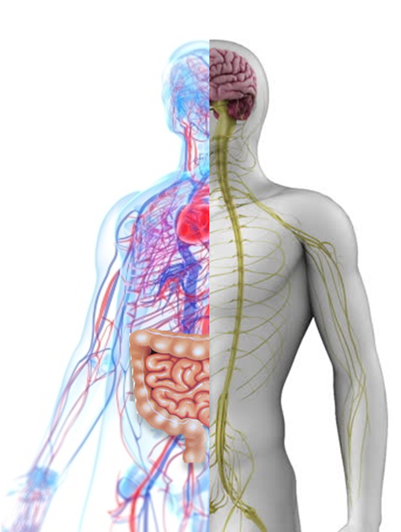
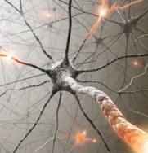
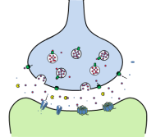
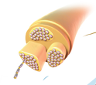
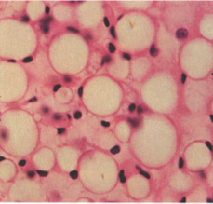
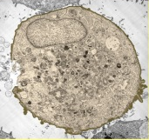
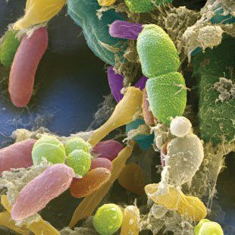
Cardiovascular system
Nervous system
Pituitary, Pineal, Hypothalamus
Thyroid
Thymus
Adrenals glands Pancreas, Intestines
Testes, Ovaries
Adipose (fat) cells

Slide 3



Neuro-inflammation
Cardiovascular dysfunction
OXIDATIVE STRESS
Obesity
adipokines
fat leakage
Inflammatory cytokines
SYSTEMIC INFLAMMATION
IMMUNE FUNCTION
Diet dysbiosis leaky gut
inflammatory
cytokines

Slide 4
The Tyranny of Ageing
Brain volume
Ventricles
Cerebral blood-flow
Glucose metabolism
Haemodynamic responses
Cognitive function
Dementia/neuropathologies
Cardiovascular function
Insulin resistance
Gluco-regulation
OXIDATIVE STRESS
Blood pressure
Endothelial function
Obesity
SYSTEMIC INFLAMMATION
IMMUNE FUNCTION
Sarcopenia
Oxidative stress
DNA damage
Telomeres
Mitochondrial damage
Microbiota diversity
Leaky gut
e.g. Amin-Hanjani 2015,;Pase et al 2014; Zonneveld 2015; Cevenini et al 2013; Lemaitre et al 2012; Volkow et al 2013

Slide 5


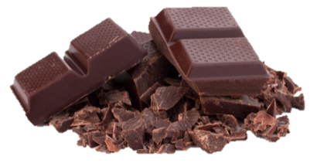



Western diet
Mediterranean diet
Polyphenols

Slide 6
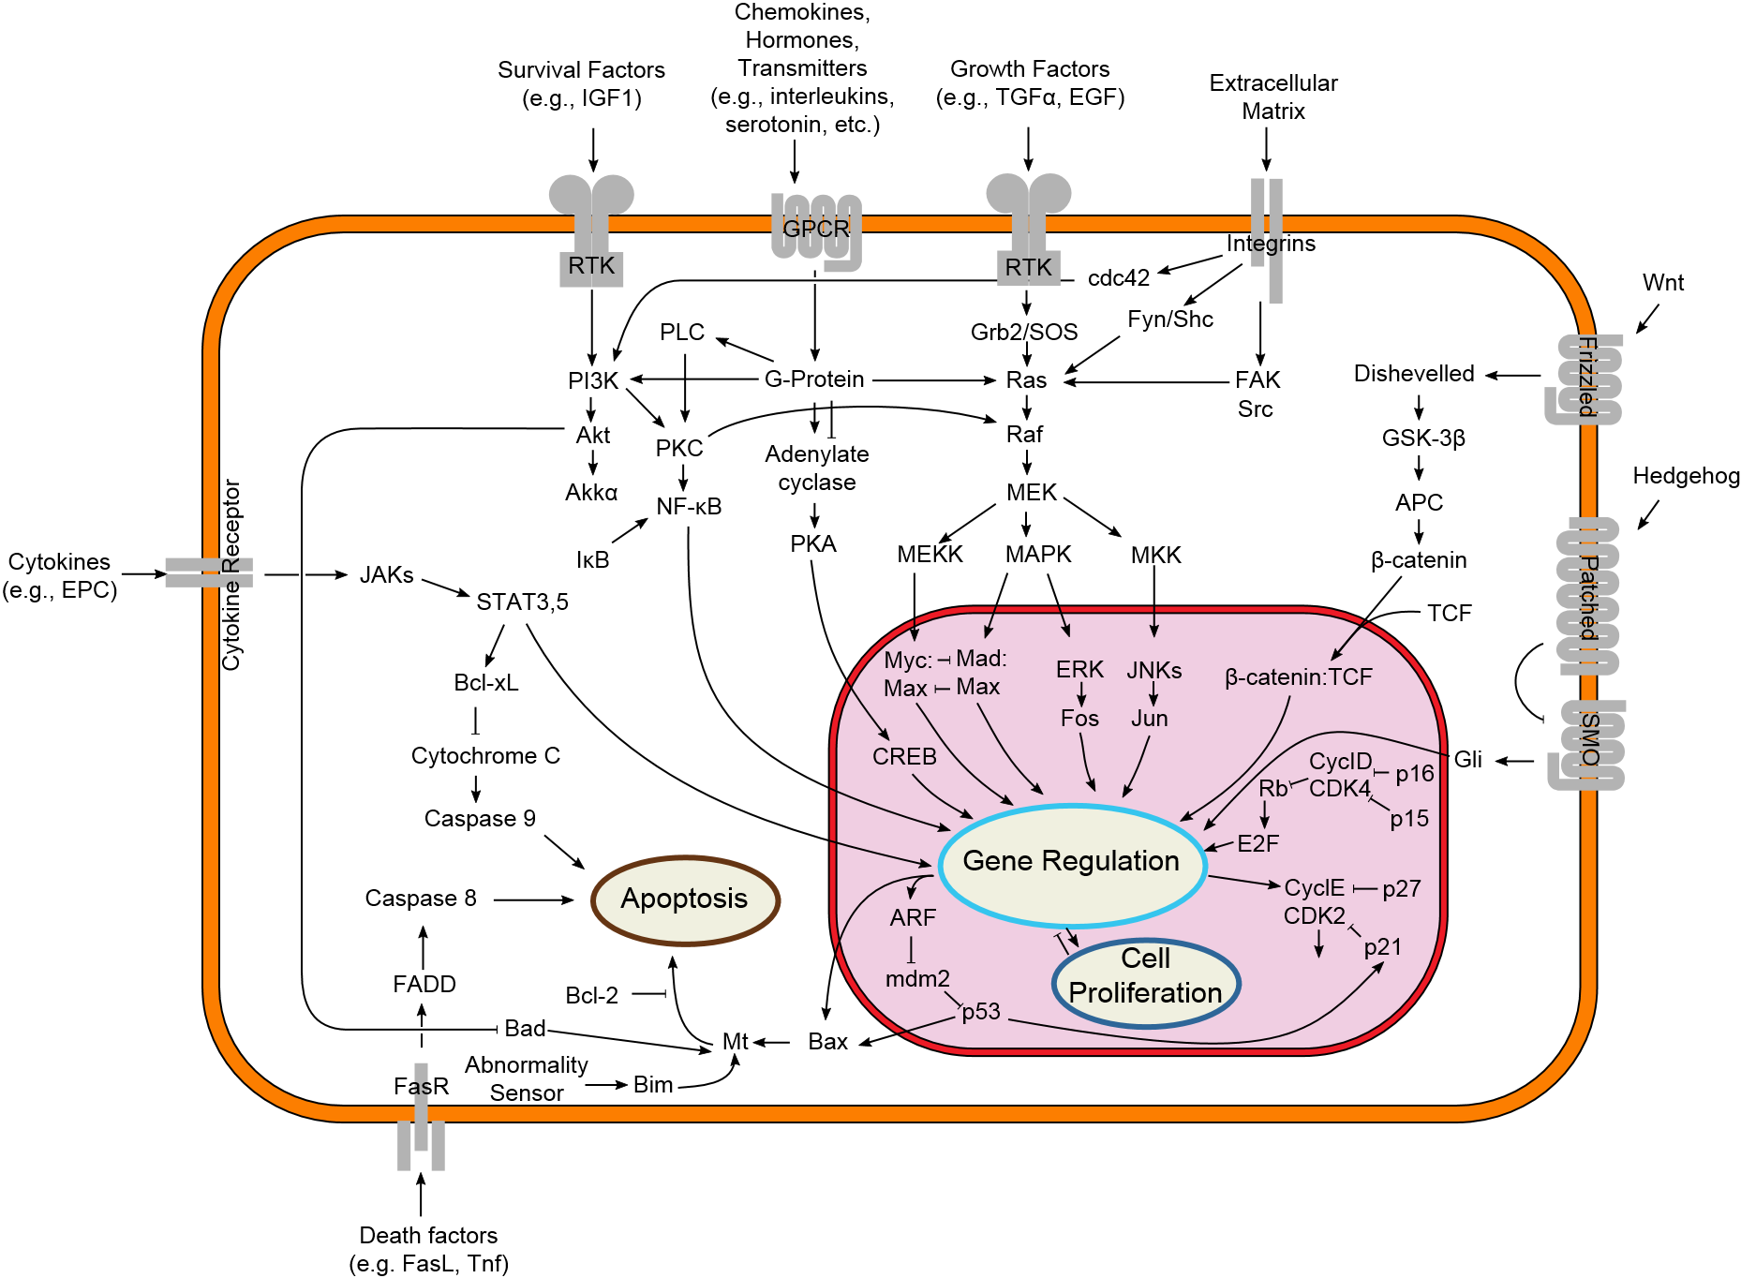
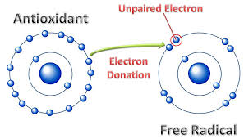

Polyphenols - Mechanisms of action
By cybertory http://en.wikipedia.org/wiki/File:Signal_transduction_v1.png

Slide 7
Epidemiological research
Flavonoid or flavonoid rich foods (fruit/veg, tea, chocolate, wine) related to benefits in:
Cardiovascular
Brain
Endothelial function
Blood pressure
Cardiovascular disease (CVD)
CVD mortality
AND
Inflammatory biomarkers
Incidence/progression of cerebrovascular disease and dementias
cognitive function in the elderly
(e.g. McCullough et al 2012; Kesse-Guyot et al 2011; Kay et al; Mink et al 2007; Nanri et al 2011; Calder et al 2011; Anderson et al 2012; Root et al 2012)
(e.g. Kuryama et al 2006; Arab et al 2009; Commenges et al 2000; Ng et al 2008; Hollman et al 2010; Nurk et al 2009; Moreira et al 2016)

Slide 8

Randomised Controlled Trials
Cardiovascular
Brain
Meta-analyses
Single dose studies
Cocoa flavanols
inflammatory biomarkers
insulin resistance
lipid profiles
blood pressure
Vasodilation/endothelial function
Optimal dose 500 mg/d flavanols - Effects within 2 hours
Cocoa flavanols
Scholey et al (2009) (N = 30 X)
Field et al (2011) (N = 30 X)
Wirtz et al (2014) (N = 65)
Pase et al (2013) (N = 72)
Watson et al (2015) (N = 36 X)
Bondonno (2014) (N = 30 X)
Alharbi et al (2015) (N = 24 X)
White and Williams (2015) (N = 14 X)
White et al (2015) (N = 21 X)
Fruit polyphenols
Fruit Polyphenols
Acute and chronic attenuation of inflammatory biomarkers
(e.g. Bauer et al 2011; Monagas et al 2009; Shrime et al 2011; Hooper et al 2012; Joseph et al 2016)

Slide 9
Chronic Studies
Desideri et al (2012) and Mastroiacovo et al (2015) investigated the cognitive and cardiovascular effects of 8 weeks administration of high (990 mg), medium (520 mg) and low (45 mg) cocoa-flavanol treatments in 90 sufferers from mild cognitive impairment and 90 cognitively intact elderly participants respectively.
 | Cardiovascular | Cognitive
Desideri et al (2012) | Insulin resistance Blood pressure Lipid peroxidation | High/Medium - Trail Making Test High - Verbal Fluency n.s. MMSE
Mastroiacovo et al (2015) | Insulin resistance Blood pressure Lipid peroxidation | High/Medium - Trail Making Test High - Verbal Fluency n.s. MMSE
Changes in insulin resistance explained 40% and 17% of changes in cognitive function respectively

Slide 10
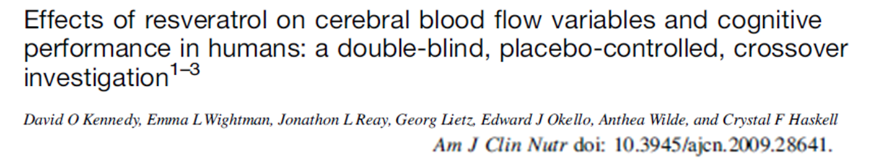
Design: Placebo-controlled, double-blind, balanced cross-over
Participants: 24 healthy young adults
Treatments: 250 mg, 500 mg and 0 mg pure (99.8%)
Tasks: Serial Subtractions and Rapid Visual Information Processing (all of which activate the frontal cortex)

Slide 11
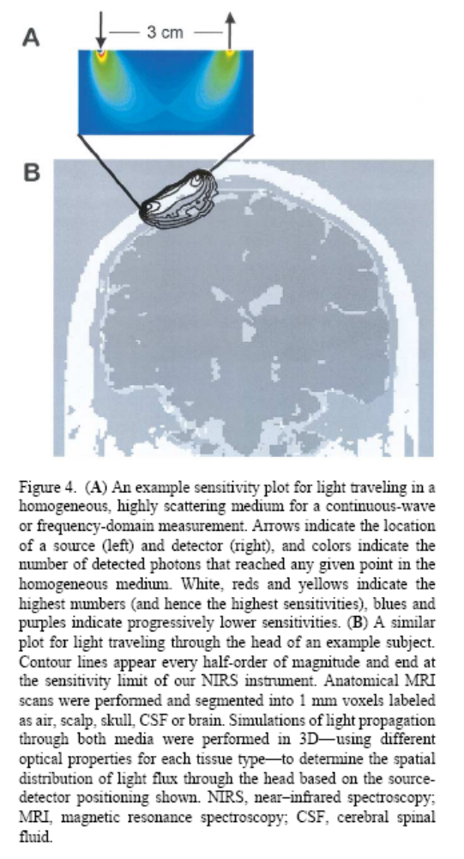
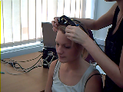
Near Infrared Spectroscopy
Oxygenated haemoglobin and deoxygenated haemoglobin absorb near infrared light wavelengths differentially
Light has a predictable pattern of diffusion and scatter in neural tissue.
Introducing differentially absorbed wavelengths (765 nm and 855 nm) allows the quantification of concentration changes in oxygenated and deoxygenated haemoglobin, and therefore increases in cerebral blood flow and oxygen utilisation.
NIRS parameters correlate strongly with the fMRI BOLD signal.

Slide 12
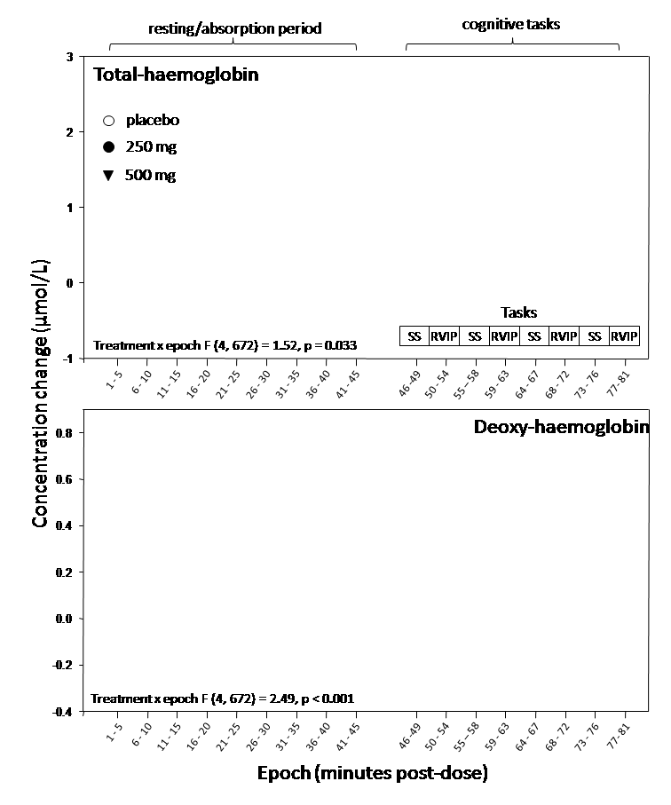
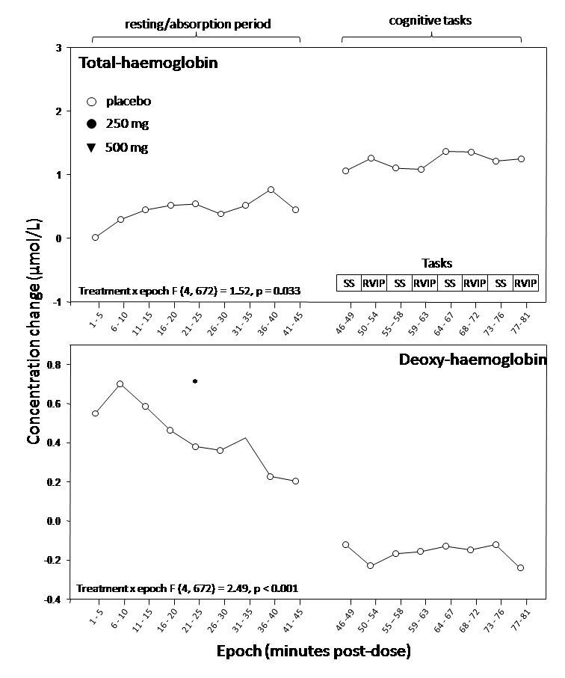
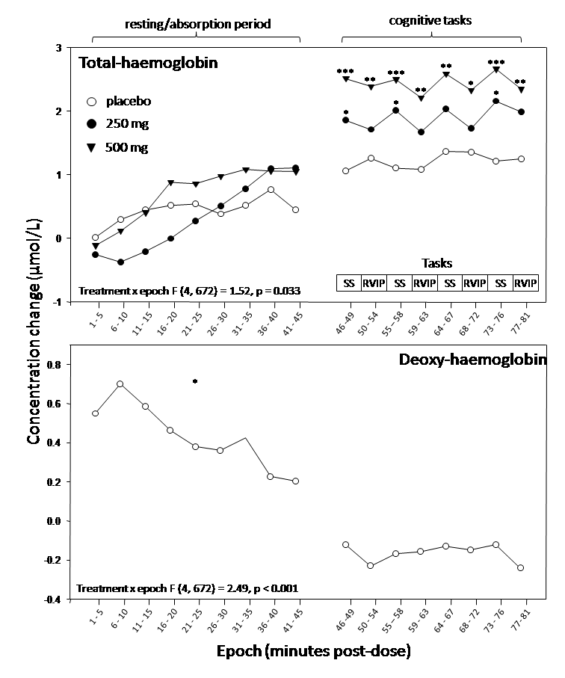
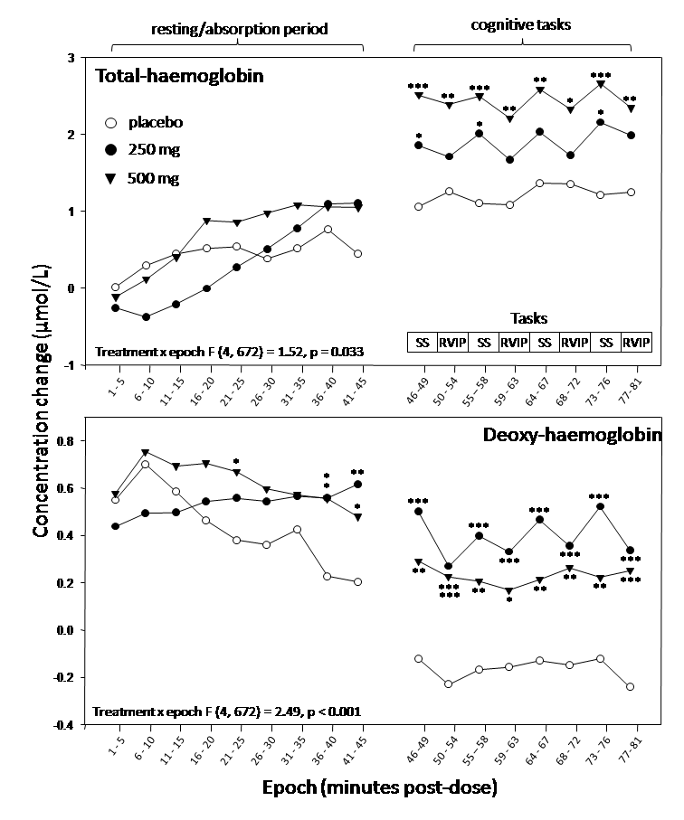
Local cerebral
blood flow
Oxygen
extraction
Treatment

Slide 13
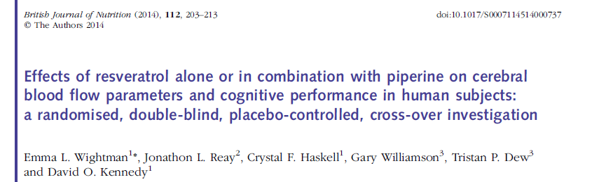
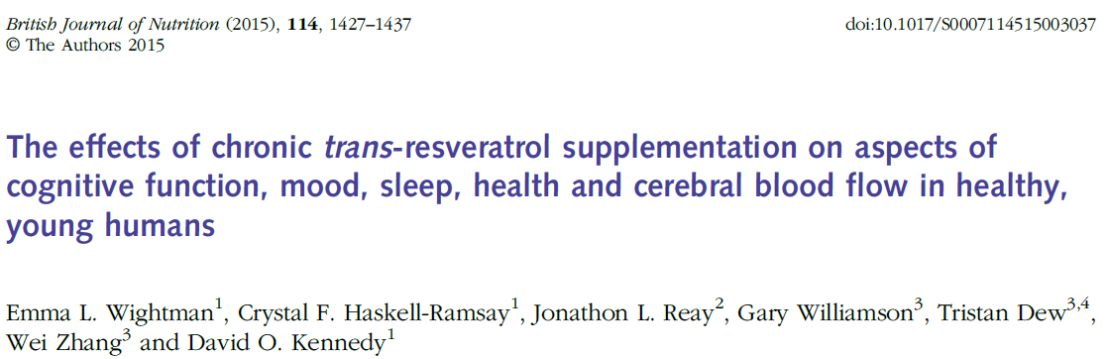
Increased cerebral blood-flow following cocoa-flavanols for 5 day and 2 weeks using transcranial Doppler (Sorond 2008) and fMRI (Francis 2006).
Increased perfusion following a single dose of cocoa-flavanols (fMRI - arterial spin labelling) (Lamport et al 2015)

Slide 14
The Tyranny of Ageing
Brain volume
Ventricles
Cerebral blood-flow
Glucose metabolism
Haemodynamic responses
Cognitive function
Dementia/neuropathologies
Cardiovascular function
Insulin resistance
Gluco-regulation
OXIDATIVE STRESS
Blood pressure
Endothelial function
Obesity
SYSTEMIC INFLAMMATION
IMMUNE FUNCTION
Sarcopenia
Oxidative stress
DNA damage
Telomeres
Mitochondrial damage
Microbiota diversity
Leaky gut

Slide 15
The Tyranny of Ageing – polyphenols
Brain volume
Ventricles
Cerebral blood-flow
Glucose metabolism
Haemodynamic responses
Cognitive function
Dementia/neuropathologies
Cardiovascular function
Insulin resistance
Gluco-regulation
OXIDATIVE STRESS
Blood pressure
Endothelial function
Obesity
SYSTEMIC INFLAMMATION
IMMUNE FUNCTION
Sarcopenia
Oxidative stress
DNA damage
Telomeres
Mitochondrial damage
Microbiota diversity
Leaky gut

Slide 16
Vitamins, CEREBRAL BLOOD-FLOW and METABOLISM

Slide 17


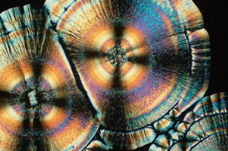

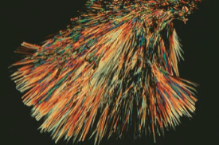




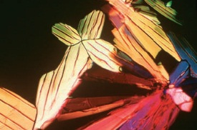
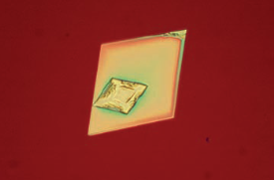



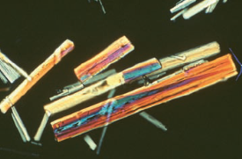
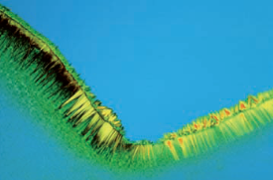
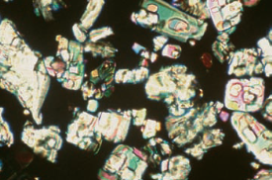
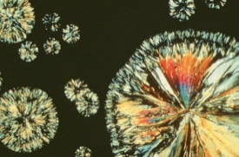

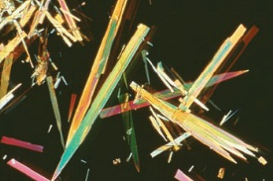
Water soluble vitamins
Generally safe at much higher doses than the recommended daily allowance – only 4 have a any upper tolerable limit, ranging from 2 to 70 times the RDA
Vitamin E
Vitamin K
Vitamin C
Niacin
Vitamin D
Cellular growth
Vitamin B12
Vitamin A
Hormone regulation
Body’s
Energy
ATP
Biotin
Vitamin B2
Antioxidants
Enzyme-Cofactors
Vitamin B1
Vitamin B6
Folic acid
Pantothenate
Notes:
17

Slide 18
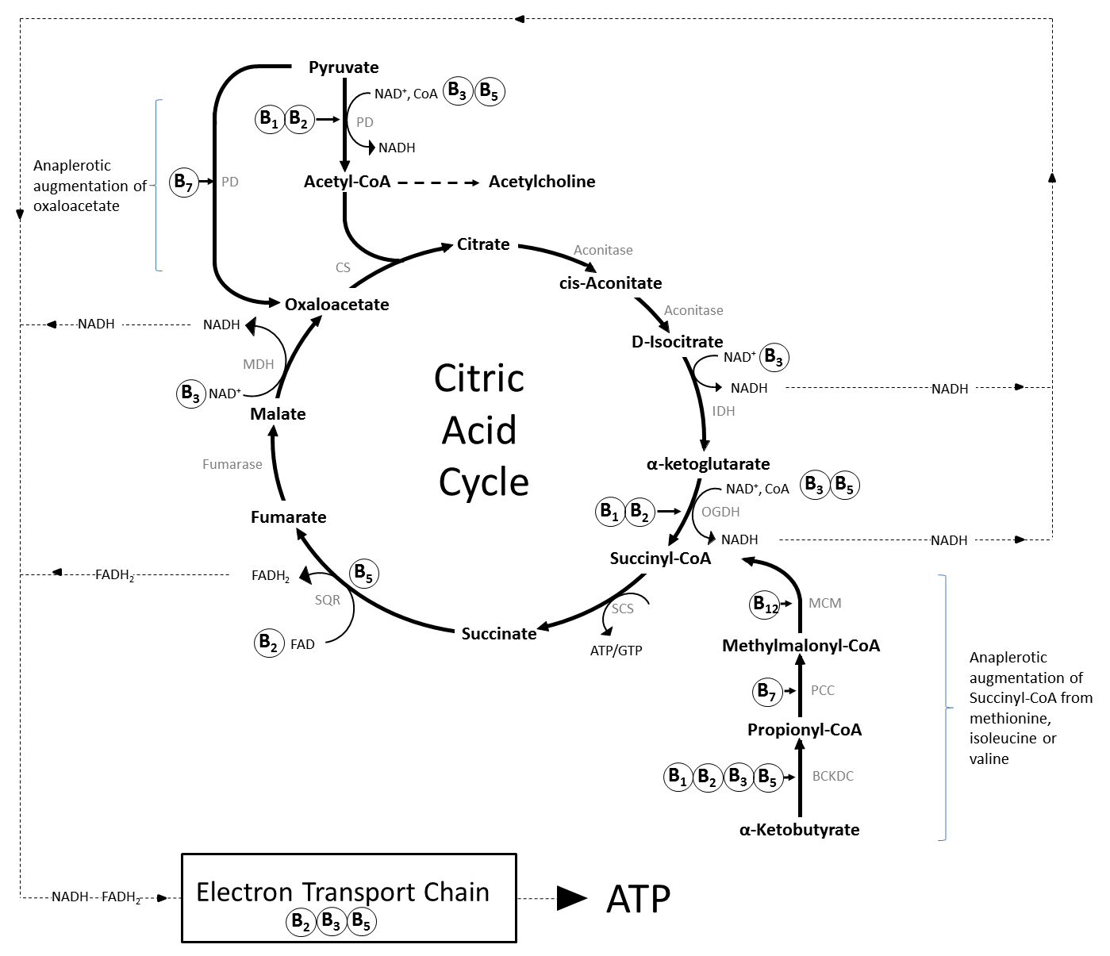

B VITAMINS
Cellular Energy
Production
Superoxide
Superoxide
Superoxide
= ENERGY
Notes:
Ubiquitous co-enzymes. e.g. :
Pyridoxal 5'-phosphate (B6) cofactor - >140 amino acids enzymes
CoA (pantothenic acid - B5) co-factor for ~ 4% of all mammalian enzymes [16].
The citric acid cycle (tricarboxylic/Krebs cycle) is a series of chemical reactions that generate energy, in the form of ATP, in the mitochondria of eukaryotes. Carbohydrates, fats and proteins are first converted to acetyl-CoA, most often via pyruvate, and then undergo eight enzymatic reactions that result in the production of NADH and FADH2, which transfer the energy generated by the citric acid cycle to the electron transport chain. This in turn leads to the synthesis of ATP, the energy currency of cells. B vitamins contribute (as shown) to this process as co-factors/enzymes such as FAD (B2), NAD (B3) and as a component of CoA (B5), or Co-enzyme Q10 (B5). The intermediate compounds of the cycle are also sequestered as substrates for the synthesis of other compounds, including amino acids and fatty acids, and several subsequently have to be replenished by anaplerotic synthesis, taking place outside of the cycle. The most prevalent examples are the augmentation of succinyl-CoA from α-ketobutyrate generated from methionine within the methionine cycle (see Figure 2.), and synthesis of oxaloacetate direct from pyruvate.

Slide 19

BH3
Glutathione
Notes:
The interlinked folate and methionine cycles. Dietary folate enters the folate cycle and rotates through several enzymatic modifications which generate the one-carbon units required for the synthesis of DNA/RNA and the methyl groups required to regenerate methionine from homocysteine. The “methionine cycle” provides the methyl groups required for all genomic and non-genomic methylation reactions in the form of S-adenosyl methionine (SAM). These two enzymatic cycles are essential to cellular function, including via interactions with other pathways. As an example of the latter, the re-salvaging from dihydrobiopterin of tetrahydrobiopterin, an essential cofactor in trace amine and catecholamine neurotransmitter synthesis and nitric oxide production, is rate limited by provision of the enzyme dihydrofolate reductase produced by the folate cycle.

Slide 20
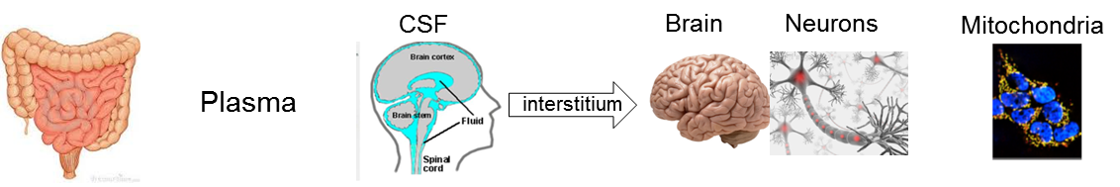
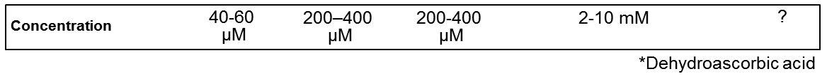
Water soluble vitamins and the brain
B Vitamins
Actively transported into the brain by dedicated transport mechanisms
Concentrated at between 4 and 100 times the levels seen in the blood.
High turnovers ranging from 8% to 100% per day in the brain
Vitamin C
CONCENTRATION

Slide 21




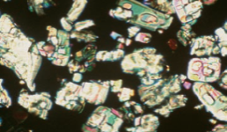



Vitamin deficiency
Fatigue
Tiredness
Vitamin B1
Mood
disorders
Vitamin B2
Deficiency in each of the individual B vitamins is associated with brain dysfunction
Deficiency in vitamin B₆ and, for a large percentage, vitamins B₁₂ or B₉ are primarily associated with neurological symptoms.
Niacin
Cognitive
Personality
Irritability
Pantothenate
Vitamin B6
Psychosis
Biotin
Folic acid
Physiological brain damage
Vitamin B12
Seizures
Convulsions
Notes:
21

Slide 22


Vitamin deficiency
Vitamin B₆
CDC (2012)
10.5% of all US
adults biochemically
deficient
Morris (2008)
23% to 27% of all US
adults deficient when supplement users excluded
CDC (2012) – “In addition, recent findings have determined that less than optimal biochemical concentrations (representing suboptimal status) have been associated with risks of adverse health effects”.

Slide 23
Vitamin B₁₂
Tucker et al (2000)
9% of all US
adults deficient
[rising to 30%+ of elderly and vegetarians (Morris et al 2008, Pawlak et al 2013)]
Marginal deficiency between 20% and 38% (Qi et al 2014 – Tucker et al 2000 – NHANES data)

Slide 24
Vitamin deficiency
B2
66% of UK population [NDNS 20045]
B1
Over 16% of elderly and obese [Kerns et al 2015]
8.4% of all US adults (<11.4 µM)
14% - non-supplement users (58% of the population)(Schleicher et al 2009)*
25%m/16%f lower economic status in UK (NDNS 2004)
(Schleicher et al 2009)*
C
Additional factors (beyond lack of consumption): age, inherited malabsorption, genetic polymorphisms, ethnicity, vegetarianism, obesity, alcohol, smoking, contraceptives and other medications.
Notes:
This may well be due to an age-related impairment in the absorption of the protein-bound vitamin B12 found in food [Tucker et al 2000],
(i.e. enough to satisfy the requirements of 50% of the population)

Slide 25
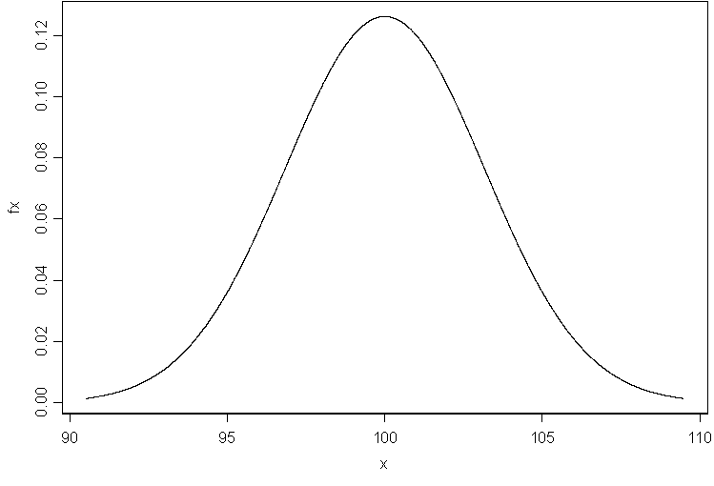
Optimum level ?
Deficient
Marginal
deficiency
Number in
population
a
Low
Blood level of vitamin
High

Slide 26
B vitamins and brain function
epidemiology versus controlled trials
Over 100 studies and multiple meta-analyses show that increasing biochemical levels of vitamin B₉ ± B₁₂ and/or B₆ and decreasing levels of homocysteine are related to better cognitive function and reduced incidence of dementia (e.g. Smith 2008, Ho et al 2011, Wald et al 2011, Nie et al 2014).
BUT:
Equivocal evidence from dozens of controlled trials that supplementation with vitamin B₉ ± B₁₂ and/or B₆ improves brain function (e.g. Dangour et al 2010, Malouf and Grimley Evans 2008, Clark et al 2014)
No consideration of the other five B vitamins
or supplementation with all eight B vitamins

Slide 27
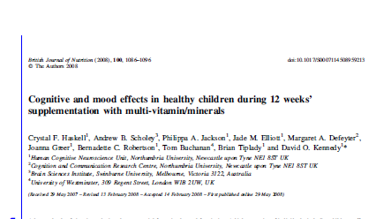
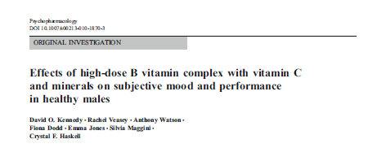
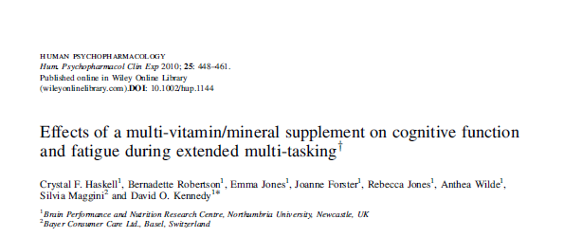
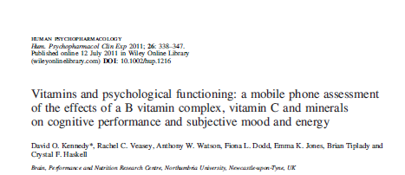
Efficacy
Meta-analysis of data from 8 studies – benefits to psychological state, including fatigue, across studies, with benefits related to level of B vitamins (Long and Benton 2013)

Slide 28
Multi-vitamins/minerals in cognitively intact cohorts of adults
Reference | Sample | Psychological state/mental health | Cognitive function
Benton, et al. (1995a, 1995b) | 127/118 m/f 17–27 y
Carroll et al. (2000) | 80 m 18–42 y
Cockle et al. (2000) | 127 m/f 60–83 y
Haskell et al. 2010 | 220 f 25 - 50 y
Kang et al (2008) | 2009 f ≥65 y
Kennedy et al (2010, 2011) | 210/198 m 30–55 y
McNeill et al. (2007) | 910 m/f ≥65 years
Schlebusch et al. ^{[89]} | 300 m/f 18–65 y
Wolters et al. ^{[97]} | 220 f ≥60 y
Long and Benton (2013) | 173 m >18
Harris et al (2011) | 50 m 50-69 y
+
(females)
+
(females)
+
mixed
+
+
+
(poorer
nutrient status)
+
+
+
(older and poorer
nutrient status)
+
+
+
Meta-analysis - dose response with regards B vitamins (and vitamin C) for mood and stress. Four out of five of the studies administered Berocca (Long and Benton 2015)

Slide 29
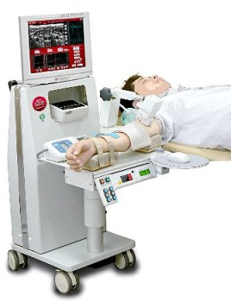
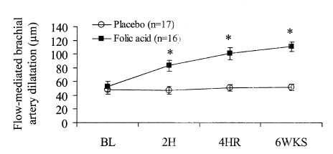
Acute effects of B vitamins
Meta-analysis - Liu et al 2014: Vitamin B₉, at doses as low as 400µg, and co-administered with B6, administered for 4 weeks+ has consistent beneficial effects on blood flow (endothelial function).
These effects are evident after a single dose of B9 (e.g. Moat et al 2004)

Slide 30
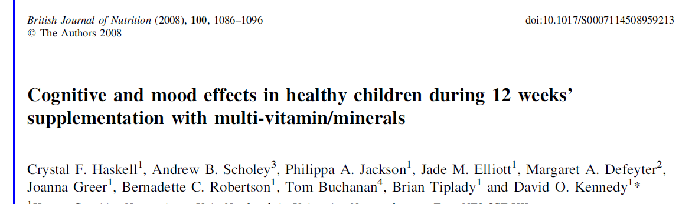
Acute effects of B vitamins
A single dose of vitamin B₆ has also been shown to:
Elicit increased serotonin synthesis in the primate brain (Hartvig et al 1995).
Engender an increase in dream salience (vividness, bizarreness, emotionality, and color) commensurate with serotonin synthesis, in humans (placebo controlled, double blind, cross-over) (Ebben et al 2002).

Slide 31
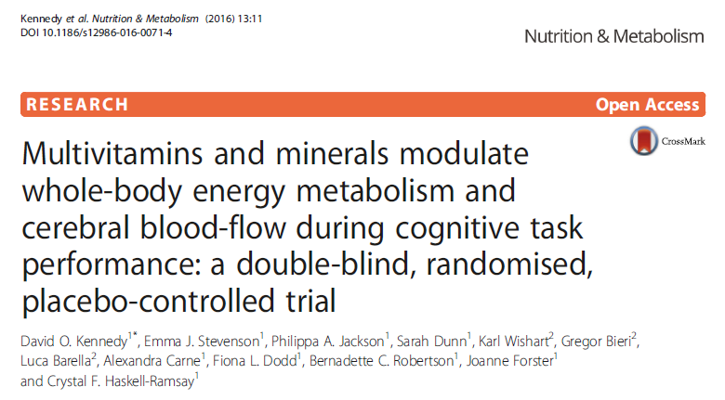

Slide 32

Methodology
Randomised, double blind, placebo controlled, parallel groups study involving 97 healthy females (25–49y)
Assessed the effects of two doses of vitamins/minerals, on whole body metabolism, cerebral blood-flow and psychological functioning during 5 cognitive tasks of differing difficulty
Assessments after a single dose and after 8 weeks administration.
Indirect
Calorimetry
(Ica)
Near-infrared
Spectroscopy
(NIRS)

Slide 33
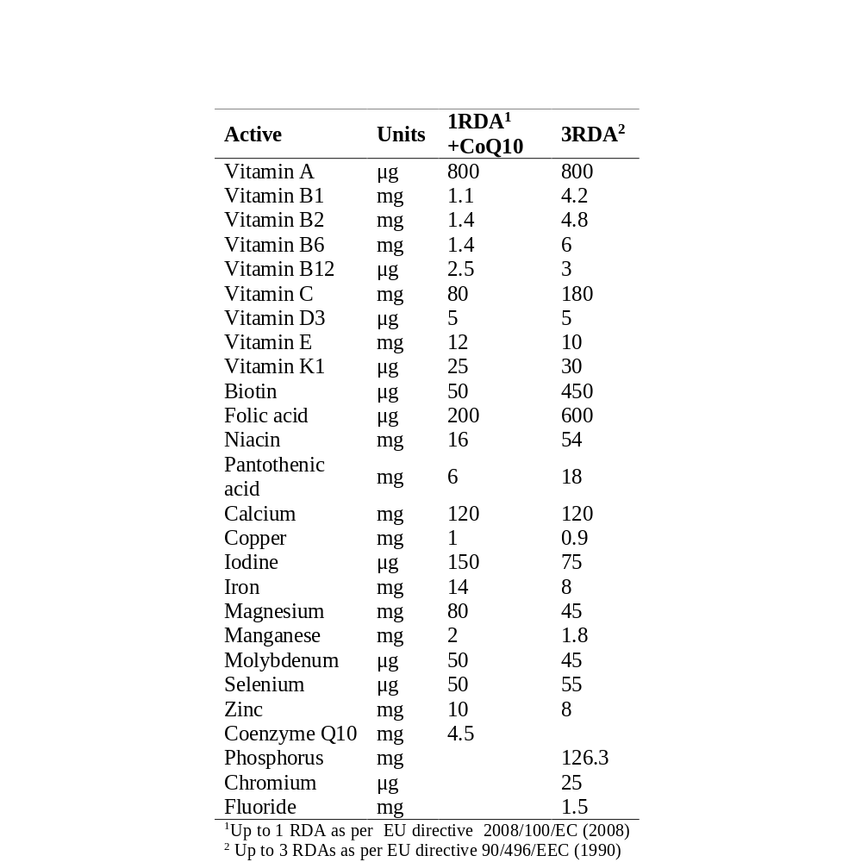
Treatments
Two separate Supradyn® multi-vitamin/mineral supplements
Water soluble vitamins!

Slide 34
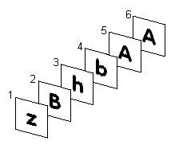

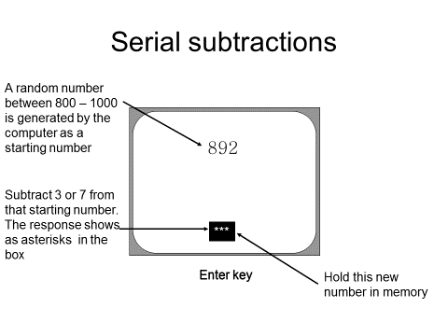
Tasks (COMPASS)
6 x 5 minute tasks:
3-Back
Stroop task
Serial 3s
Serial 7s
Serial 17s
Control task (key tapping)

Slide 35
Assessment
Resting
Measure
Gas analysis
Baseline
Measure
NIRS recording
Task order counterbalanced across participants
Serial 3s
Serial 17s
Control task
Serial 7s
3-back
2 minutes rest
2 minutes rest
2 minutes rest
Stroop
2 minutes rest
2 minutes rest
0
10
60
110
Treatment
Mood/Energy Visual Analogue Scales
Minutes post-treatment
Full practice session, then assessments on the 1st (i.e. single dose) and 56th day of treatment.

Slide 36
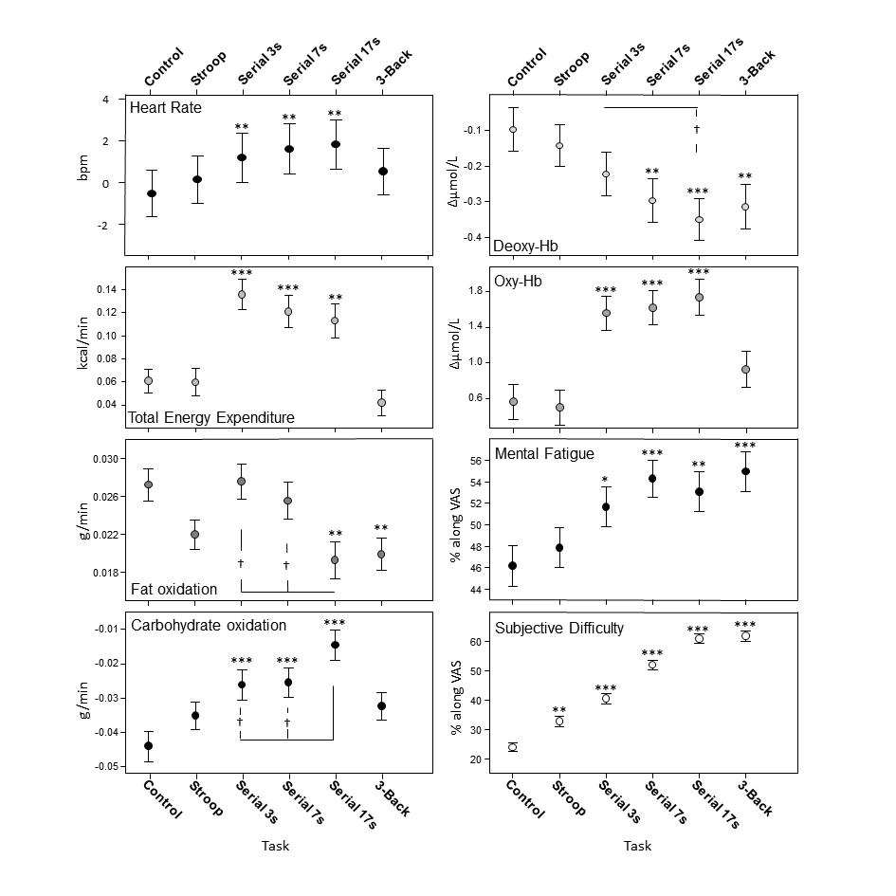
Results:
Effects of task

Slide 37
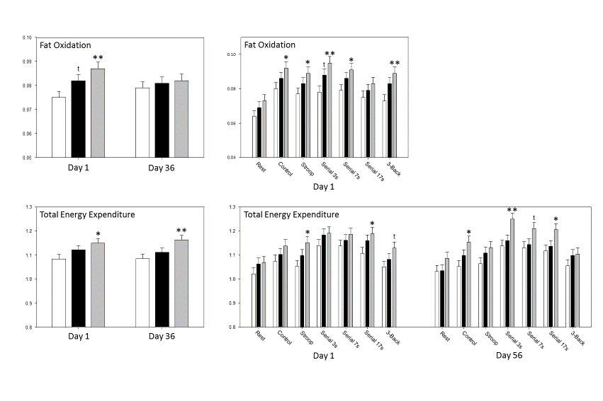

Metabolism (Ica)
Placebo
1RDA+CoQ10
3RDA

Slide 38
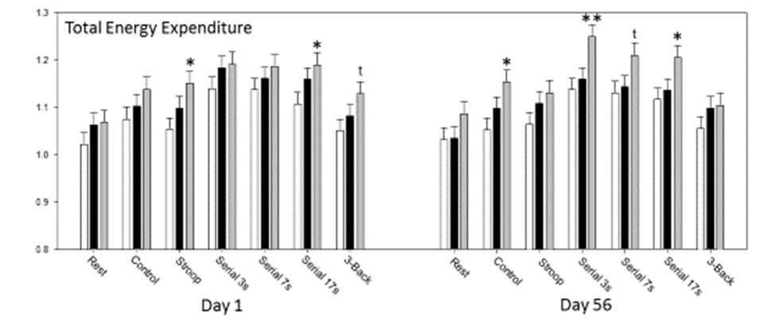
Metabolism (Ica)

Slide 39
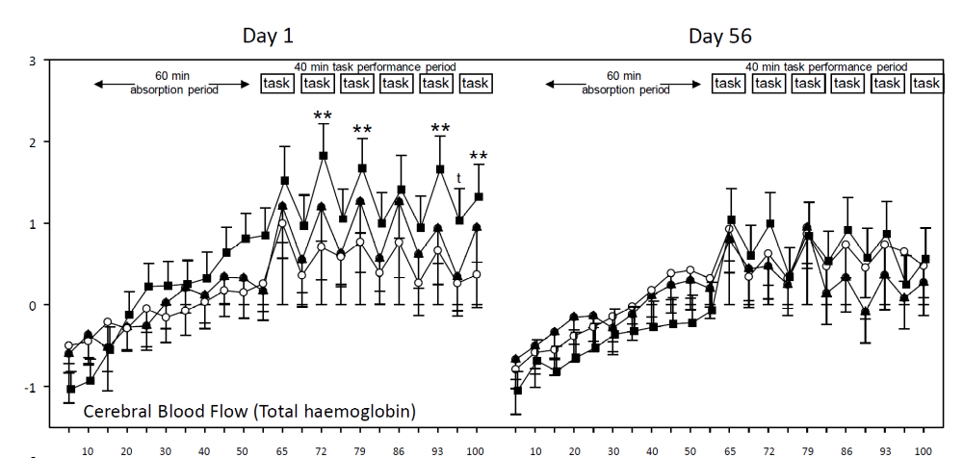

NIRS

Slide 40
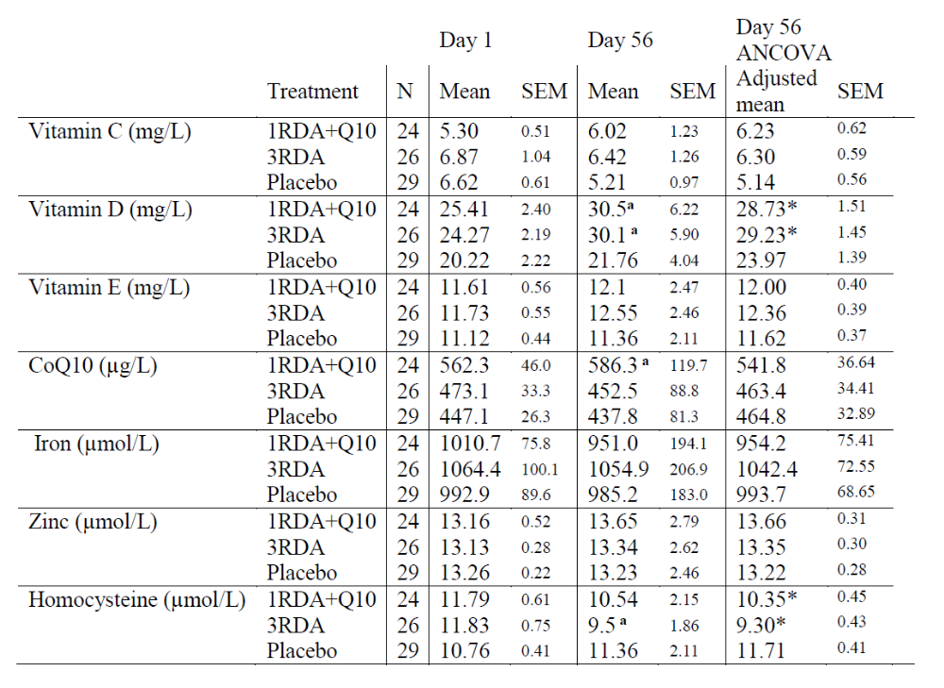

Slide 41
Conclusions and future research
Multivitamins containing a full range of water soluble vitamins can beneficially modulate cognitive function and/or mood/psychological state and metabolic parameters in healthy adults.
Evidence suggests a dose response with regards vitamin C and the B vitamins
There is a need for research that elucidates the individual and combined effects of the B vitamins and vitamin C.
Research should not be concentrated on elderly samples
The acute effects of micronutrients deserve greater research attention.

Slide 42
Conclusions

