Slide 1
Five Steps to Social Responsibility in Chronic Pain Management
David Nagel, MD

Slide 2
“Loneliness and the feeling of being unwanted is the most terrible poverty.”
Mother Teresa
“The world is not capable of making man happy. It is not capable of saving him from every evil in all of its types and forms—illness epidemics, cataclysms, catastrophes and the like…The world is not free to make man free from suffering…”
Pope John Paul II

Slide 3
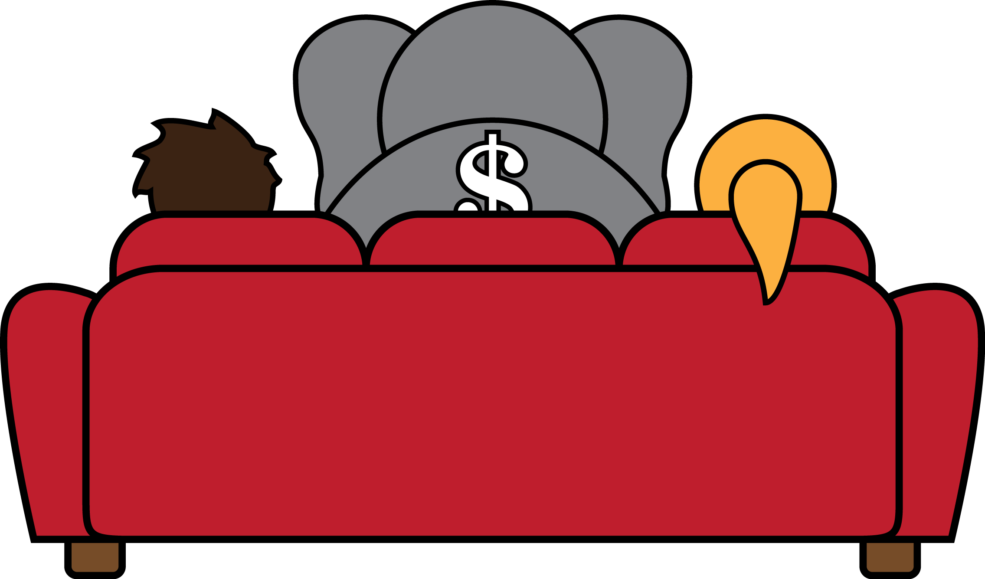
Who am I?

Slide 4
Needless Suffering;
A Critical Look at Pain Management In America
by David Nagel, MD
Forthcoming in Spring, 2016 from University Press of New England

Slide 5
Five Steps, in no order of importance
Define what we mean by pain management
Pain management is a team sport. So…who is on the team?
Follow the Golden Rule when planning interventions
Understand Evidence Based Medicine and keep it in its proper perspective
Keep the bottom line in its proper perspective

Slide 6
Let me introduce you to my teachers

Slide 7
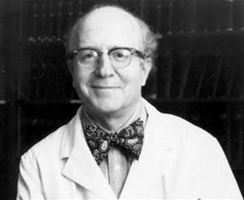
George Engel, MD (1913-1999)
Father of the biopsychosocial model

Slide 8
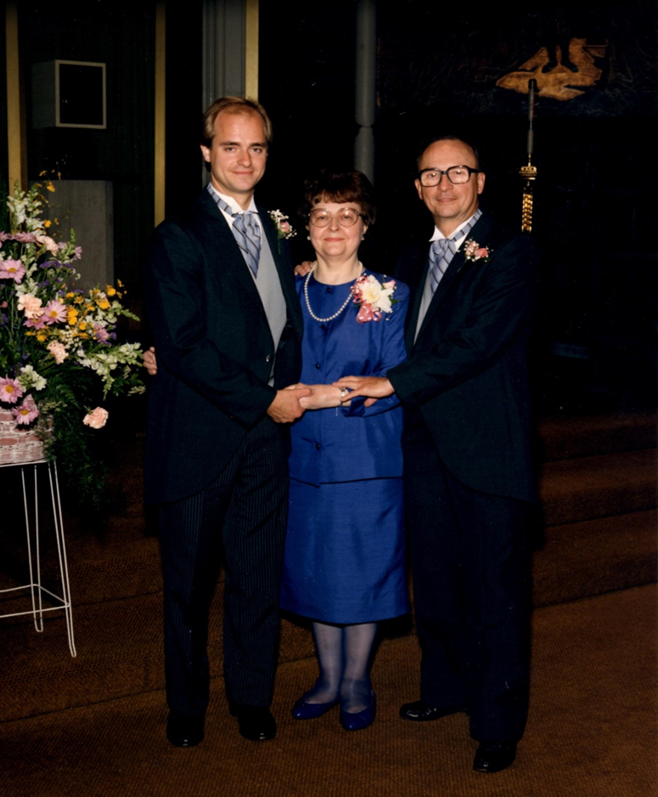
Mom and Dad:
5 Lessons
Smile
Devotion
Continuity
Ignorance
Cooperation

Slide 9
Jane

Slide 10
1. So, What it is chronic pain management?

Slide 11
Facts About
Chronic Pain Management
(what I have learn about pain management
in 28 years…)

Slide 12
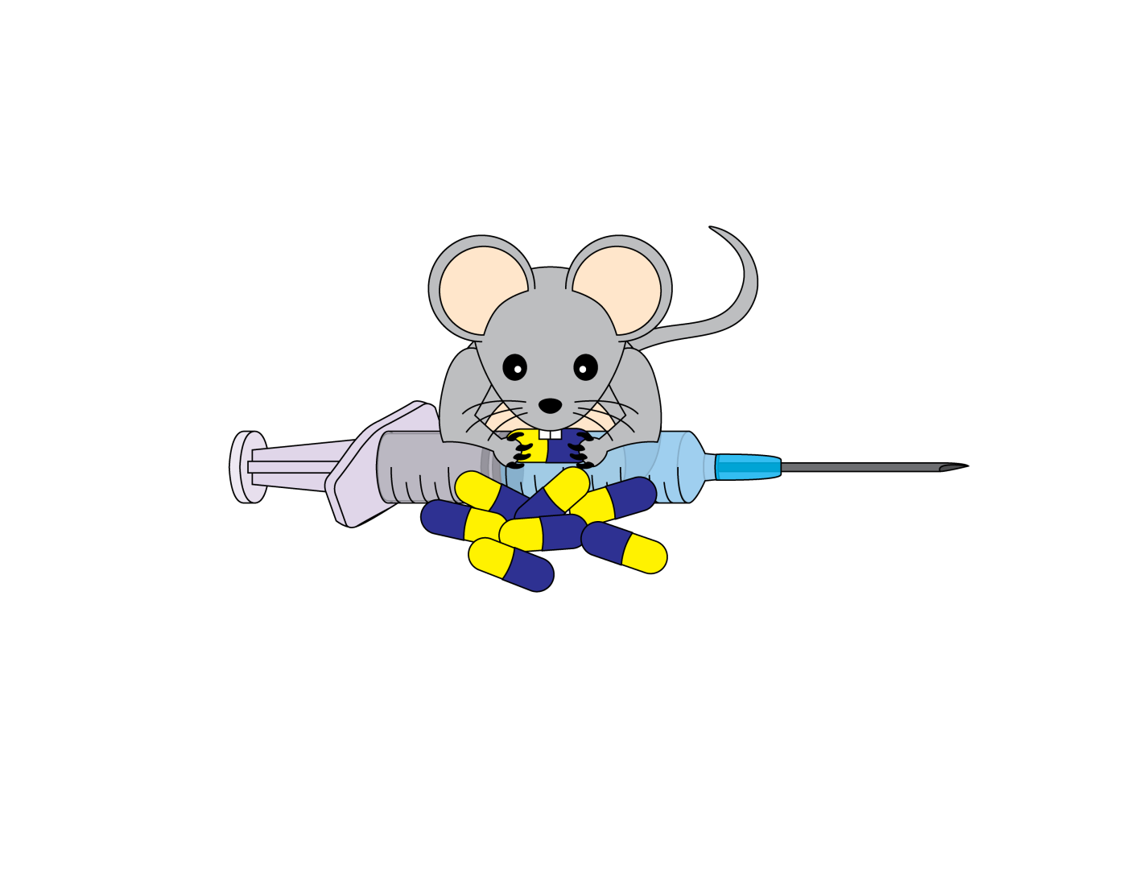

Slide 13
No Universal Understanding
No Universal Solution
NO CURE!
Every patient’s experience is unique

Slide 14
“The greater the ignorance, the greater the dogmatism.”
Sir William Osler, MD

Slide 15
Most of our interventions do
very little in the long run

Slide 16
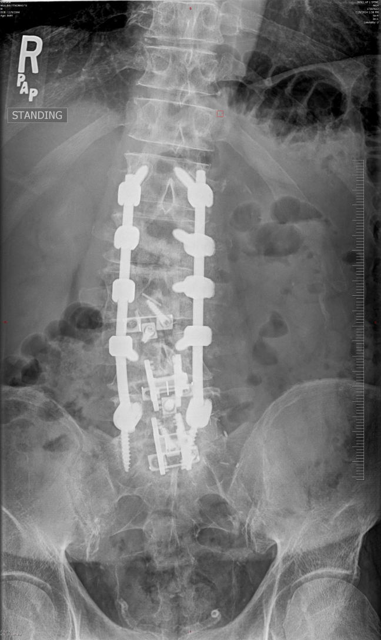
Bill

Slide 17
Moving Target
  Neuroplasticity
  Psychosocial Factors

Slide 18
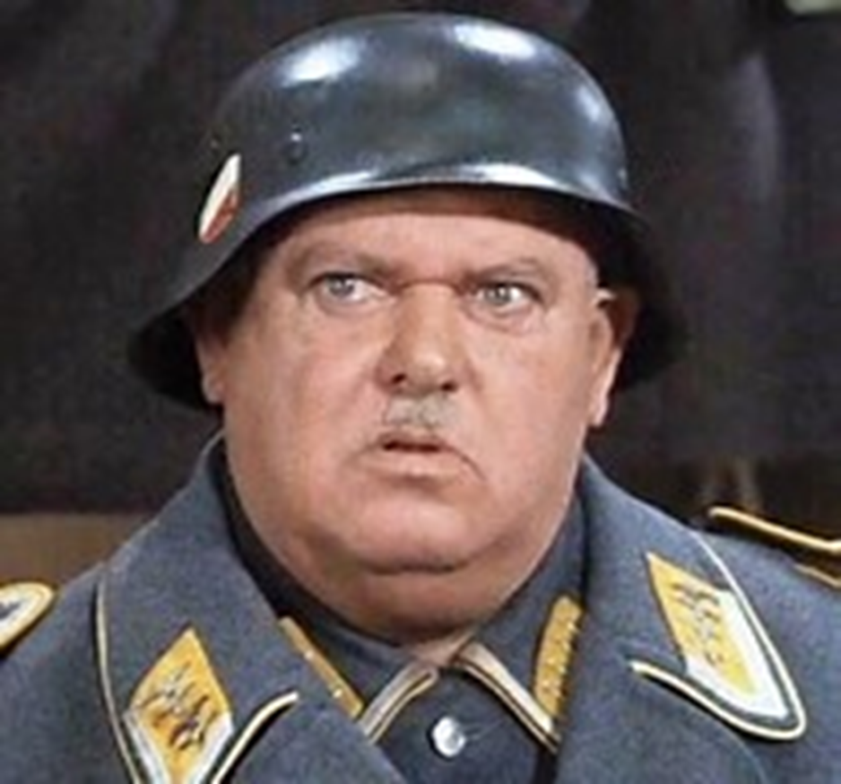
Linda

Slide 19
Chronic Pain Sucks!!!
“Pain is the most terrible of all the lords of mankind.”
Albert Schweitzer

Slide 20
Grieving: Kubler-Ross Model
Denial
Anger
Bargaining
Depression
Acceptance

Slide 21
So what is chronic pain management?
Helping a suffering, fellow human adapt to a permanently altered, unpleasant, and new reality.

Slide 22
Need To:
Take a chance to believe. Belief is empowering
Start with honesty about what we can and cannot do.
Set reasonable goals:
  Palliation, not cure
  maximize function despite pain
  Minimize adverse effects

Slide 23
Focus is bio-psycho-spiritual-social-functional
Teamwork is essential
  Importance of communication: crucial conversations
  Notion of Staff Splitting
  Put needs of patient first
  Role of tough love

Slide 24
Do No Harm!
  Do not add unnecessarily to the person’s suffering

Slide 25
2. Who is on the team?
The micro picture:
Patient
Family
Primary Doctor/para-professional
Specialists
Therapists: physical, occupational, vocational
Counselor/psychologist/psychiatrist/spiritual
Social Worker
Complementary providers: massage, acupunturist, chiropractor, trainer, etc

Slide 26
There are others;
The Macro Picture:
Medical Business: management, corporization
Medical Business: product development
Non-medical Business

Slide 27
Employer
Attorney
Judge
Medical Expert, legal
Medical Expert, academic
Insurer: health, life, disability, worker’s comp

Slide 28
Neighbors
Passers-by
Police and other law enforcement
Criminals
Pseudo-criminals

Slide 29
Groups
Regulatory Agencies: Medical Board, DEA, FDA
Political Bodies: legislative, executive, judicial
Medical groups

Slide 30
Entities
Entitlement System: SSDI, SSI, Medicare, Medicaid, welfare, others
Internet
Computer

Slide 31
Public Policy
Drug Policy: Opioids, Cannabinoids, others
Health Care Reform

Slide 32
Social Media
News Media
Facebook, twitter, etc
Internet
Angie’s List

Slide 33
Public Perception

Slide 34
Inter vs Multi-disciplinary Teamwork
All players, through their actions, have the ability to help or harm those we care for
How do you bring them all together as a team?

Slide 35
So, What’s a pain professional to do?
Focus should always be on the needs of the patient. Don’t forget the Golden Rule
Micro: patient management: Do your best!

Slide 36
Macro: role of social advocacy:
  Casual Conversation
  Testimony: legal, academic, political
  Education: professional, public
  Change perception: de-stigmatize the stigmatized
    Pain Action Initiative to implement a National Strategy (PAINS)
    IOM Report: Relieving Pain in America
    National Pain Strategy
    Goal: Transform the way pain is perceived, judged, and treated by establishing chronic pain as a public health priority through professional education and training, public policy advocacy, public education and communication, health service delivery and reimbursement, and prevention!

Slide 37
3. So many options, so little evidence long term or short term
“East and West are at cross purposes only because the West is determined, at once resolved and economically ‘determined,’ to keep on going it knows not where, and it calls the rudderless voyage ‘Progress’.” Ananda Coomaraswamy

Slide 38
It comes down to the Golden Rule…
The role of tough love
The “Yo Mama” Rule

Slide 39
4. Undestand Evidence Based Medicine and Keep it in its proper perspective

Slide 40
What is EBM?
“Evidenced-based medicine requires the integration of the best research evidence with our clinical expertise and our patient’s unique values and circumstances.
Glasziou, P, Strauss, S, Evidence-based medicine: how to practice and teach EBM, Elsevier/Churchill Livingstone, 2005.

Slide 41
Why does this matter?
The macro team players use EBM to judge the micro team players
Ex: U.S. Agency for Health Care Policy published Clinical Practice Guideline #14: Acute Low Back Problems in Adults. (1994)

Slide 42
There are four types of questions in the medical literature:
Those which have been answered beyond a reasonable doubt. Assessment of the Cochrane data suggests these are rare.
Those which have been addressed, but require further study, and for which there are no firm guidelines.
Those which have never been studied for whatever reason and lacking guidelines.
Those, because of their complexity, that will never be studied satisfactorily.

Slide 43
What is a pain doc to do?
Understand the evidence base, its strengths and its weaknesses
Put the needs of the patient first, always…
Advocate for the patient at the macro and micro levels.

Slide 44
5. Keep the bottom line in its proper perspective

Slide 45
Challenges
Separating bottom line decisions from clinical decisions
Understanding cost/benefit ramifications of all clinical decisions
Understanding the patient’s unique financial status

Slide 46
More Challenges
Corporization
Health Care Reform
Specialization
Fragmentation

Slide 47
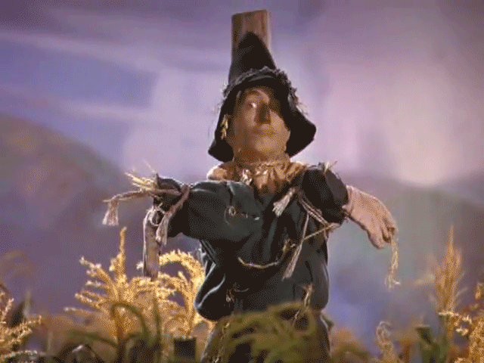
Abandonment

Slide 48
What’s a pain doc to do?
“Integrity is doing the right thing, even when no one is watching.”
C.S. Lewis

Slide 49
What I learned from Hillary Clinton…
It is ok to make a living, but…
Do what is reasonable and charge a reasonable fee for what you do
Take the lead in public policy planning. The current system is not sustainable. If we don’t take the lead, someone else will…

Slide 50
What I learned from Mother Teresa
When asked about how best to deal with the overwhelming problem of homelessness in Washington, she replied:
“Help the people one by one, and start with the person nearest to you.”

Slide 51
In Summary…
Pain management is helping a suffering, fellow human adapt to a permanently altered, unpleasant, and new reality.
Pain management is a team sport made up of a disparate group of individuals with their own individual interests, too often at odds with those of the patient.
Follow the Golden Rule when planning interventions

Slide 52
Understand Evidence Based Medicine and keep it in its proper perspective
Keep the bottom line in its proper perspective

