Slide 1
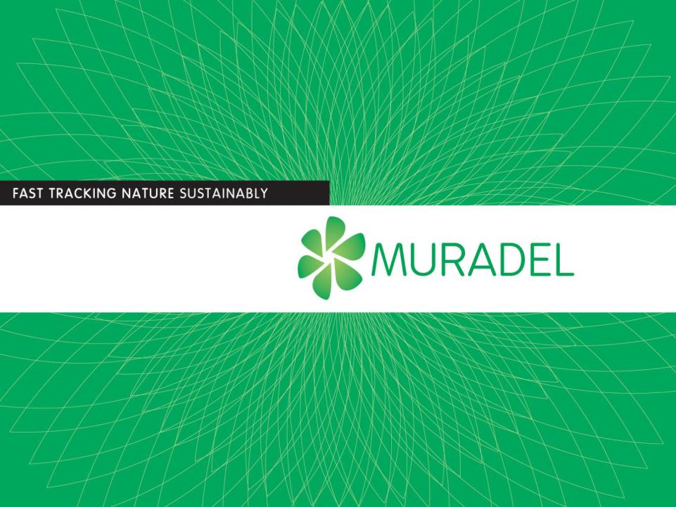
FROM FEEDSTOCK TO OIL Green2Black™
Sustainable and renewable oils
Notes:
Muradel is developing technologies to produce commodity products with reduced carbon footprint such a renewable crude oil and lipids

Slide 2
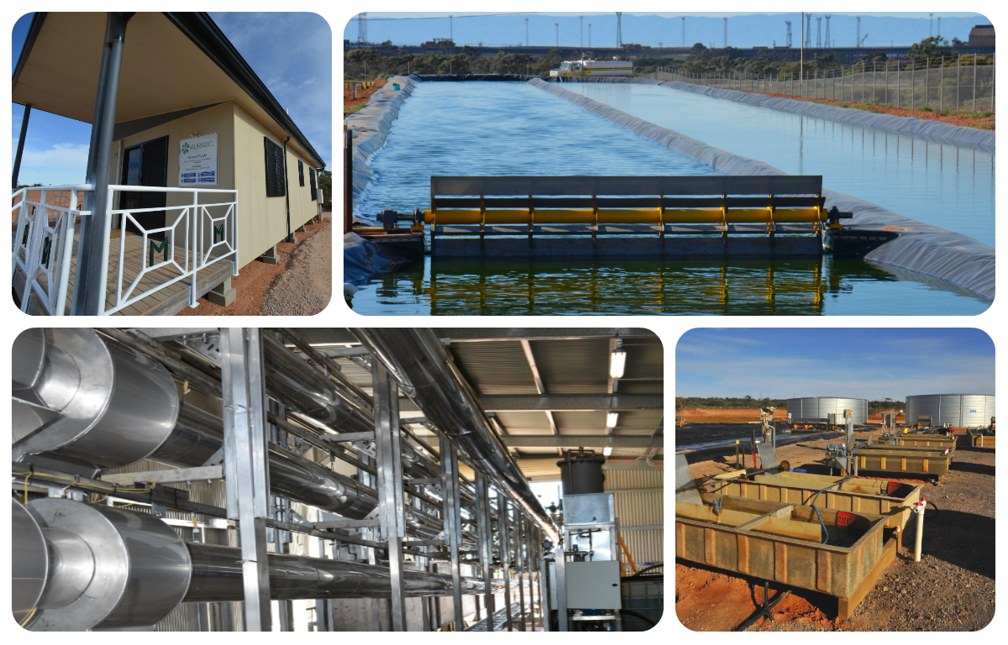
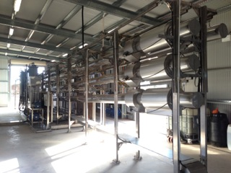

Overview
Company established in 2010 (R&D program started 2008)
Developed the Green2BlackTM technology platform
Commercialisation pathways:
  Organic feedstocks for sustainable oils
  Microalgae for lipids
Designed, built and commissioned the
Muradel Demonstration Plant in Whyalla
(Australian Renewable Energy Agency,
Advanced Biofuels Investment Readiness
Program, Funding Agreement number Q00150)
Notes:
Discuss reactor and patents – licensing 4 but with scale-up will only require 2

Slide 3
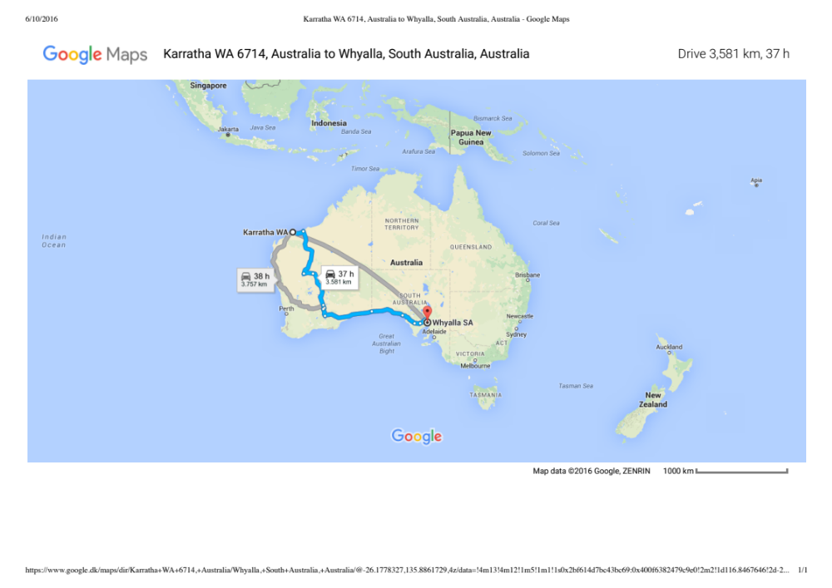
Site locations

Slide 4
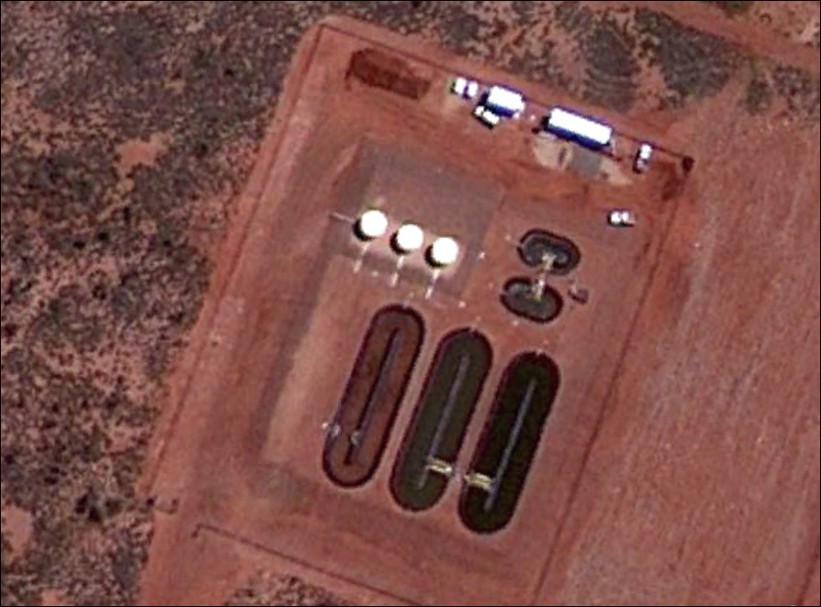
Scale 2009 - 2012

Slide 5
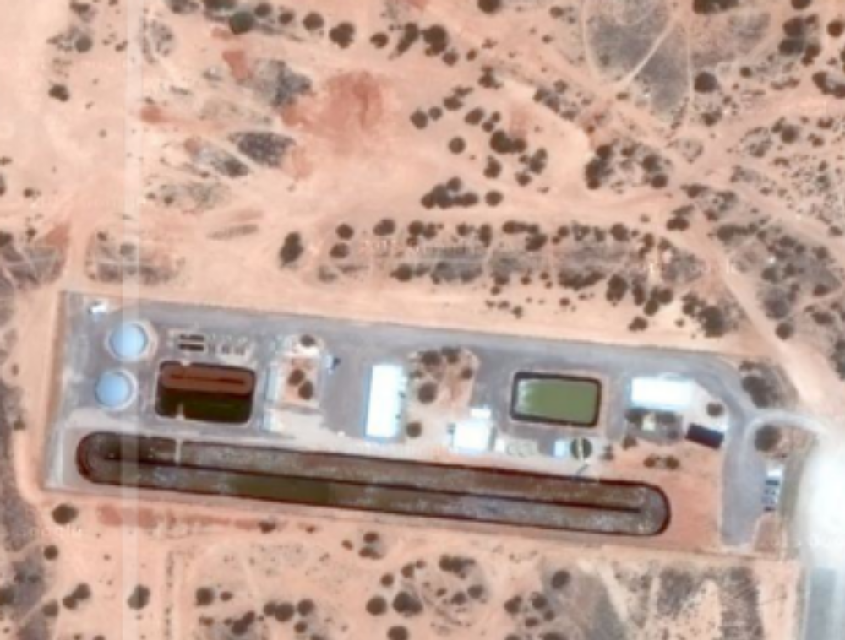
Scale 2014

Slide 6
Scale 2011 & 2014

Slide 7
End 2014 (Crude oil price plummets)
Energy balance – biofuels must be energy positive ✔
Carbon footprint – biofuel footprint must be less than a fossil oil derived equivalent fuel ✔
Cost – consumer cost for biofuels must be parity with a fossil oil derived equivalent fuel ✗
Economic reality – 100% microalgae biomass for biofuels not currently feasible – need zero/negative cost feedstock e.g. sludge’s, biosolids and car and/or trucktyres

Slide 8
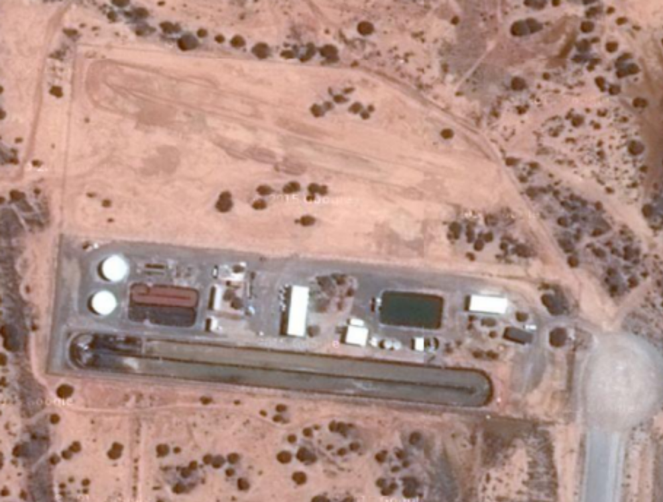
2016
New 4000m² pond, to be commissioned Q1 2016.
Area for biosolids to green crude process, to be commissioned Q3 2016.

Slide 9
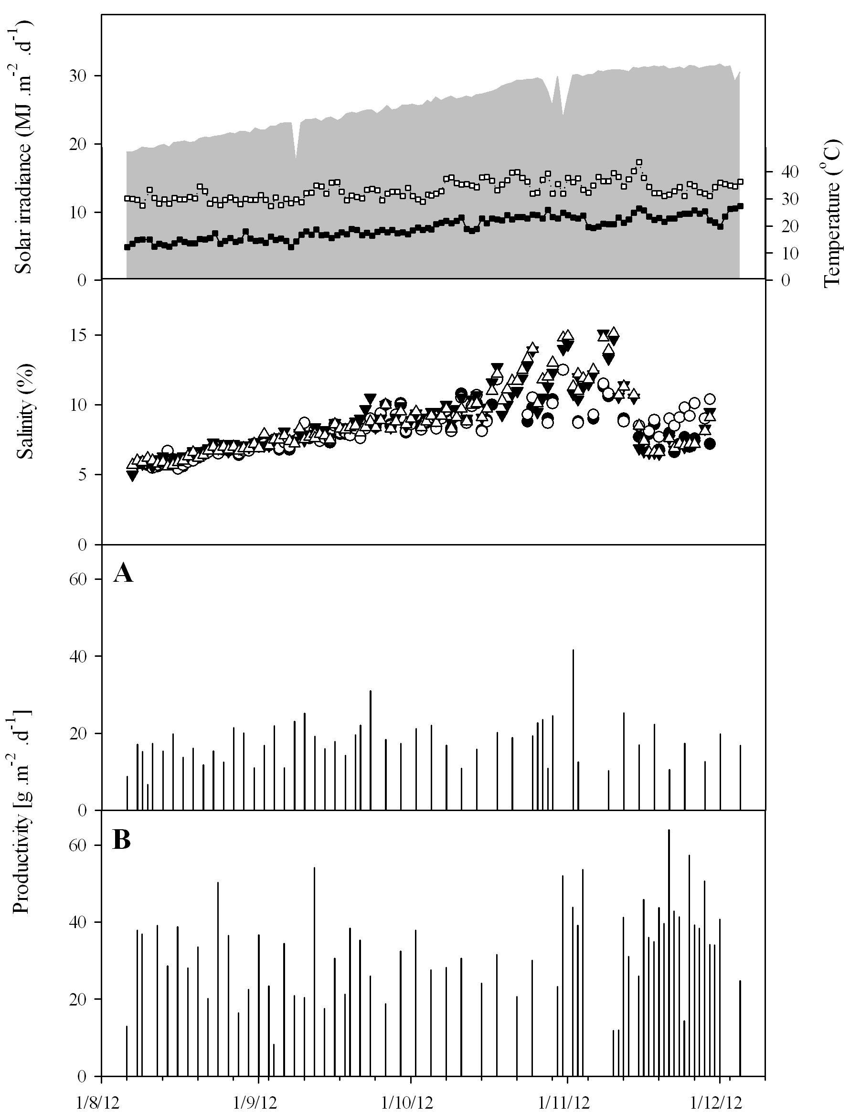
Production
Solar irradiance (area plot), air temperature (☐=maximum, =minimum), Salinity trend (○M1,●M2)=2m² pond; (qP4, rP5)=25m² pond over the time in relation to microalgae productivity for Tetraselmis sp. grown in the 2m² raceway ponds without recycled medium (A) and 25m² raceway ponds with recycled medium (B).
Fon Sing, A. Isdepsky, M.A. Borowitzka and Lewis, D.M. (2014) Bioresource Technology, 161, 47-54

Slide 10
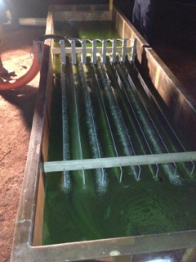
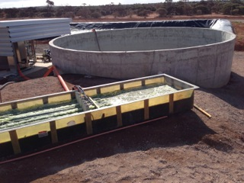
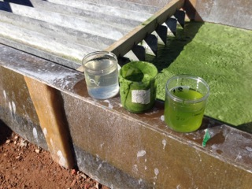
Harvesting
By incorporating mixing and settling into an electro- flocculation process, a lower energy consumption of $0.30 MJ m⁻³ has been achieved
This combination can readily concentrate the biomass from <0.1% solids w/w to >5% solids w/w and enables recycle of >99% of the culture media.
Australian Provisional Patent Application 2014902412 Title: Methods and systems for continuously separating particulates from a liquid medium
K. Lee, D.M. Lewis and P.J. Ashman (2013) Applied Energy, 108, 45-53
Klein-Marcuschamer D., Chisti Y., Benemann J.R., and D.M. Lewis (2013)
Biotechnology and Bioengineering 110(9), 2317–2322

Slide 11
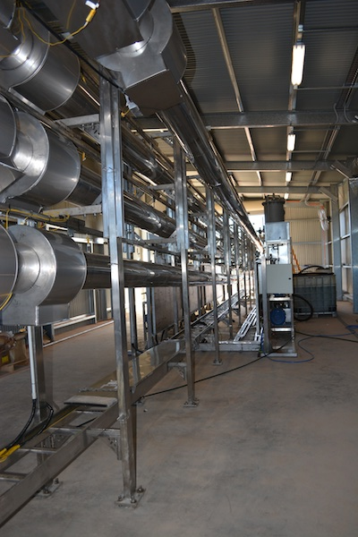
Subcritical water reactor
Fully automated continuous SCWR
Max operating temperature 400ºC
Max operating pressure 282 bar_{g}
Typical operating conditions
  T = 350ºC
  P = 200 bar_{g}
  tr = 5 minutes
  Q = 720 kg/d/tube (20% solids w/w)
  EROI >>1
Patent Portfolio
  PCT/NZ2011/000067
  PCT/NZ2011/000066
  PCT/NZ2011/000065
  PCT/NZ2008/000309
B.E. Eboibi, D.M. Lewis, P.J. Ashman, and Chinnasamy S. (2014) Bioresource Technology, 174, 212-221
B.E. Eboibi, D.M. Lewis, P.J. Ashman and Chinnasamy S. (2014) Bioresource Technology, 170, 20-29

Slide 12
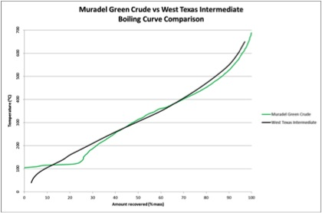
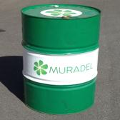
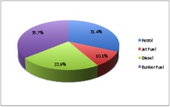
Kerogen products
Microalgae green crude: 20% w/v solids to kerogen type I and II: Conversion energy 8MJ/kg _{green crude}

Slide 13


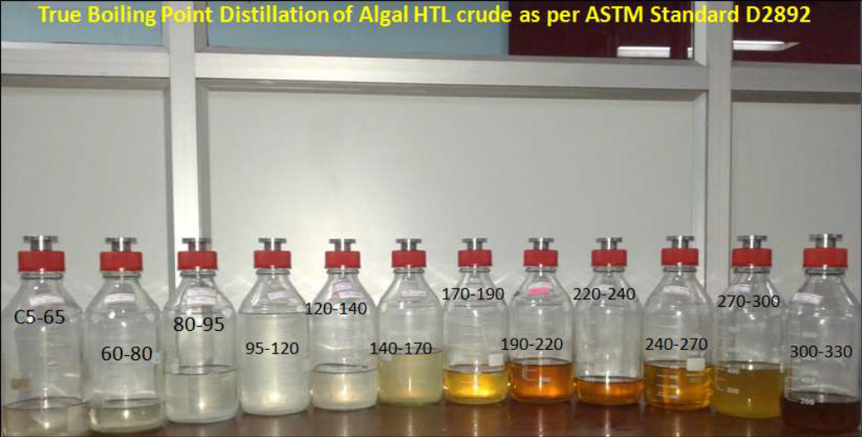
Kerogen products
Green crude:
Muradel microalgae green crude was blended at 10% with fossil crude by Aban Biotechnology and Chennai Petroleum Corp Ltd., and fractionated
to individual products - all fractions were close to specification
Notes:
Capitalised title
Broke up single paragraph into several blocks

Slide 14
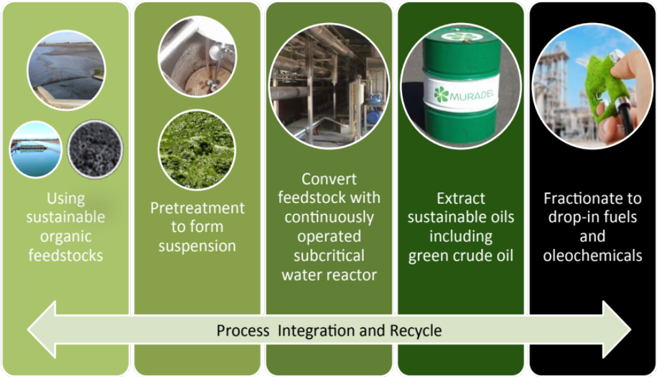
The Green2Black™ Platform
Integrated Green2Black™ technology produces the whole barrel and is protected by a suite of provisional, PCT and national phase patent applications

Slide 15
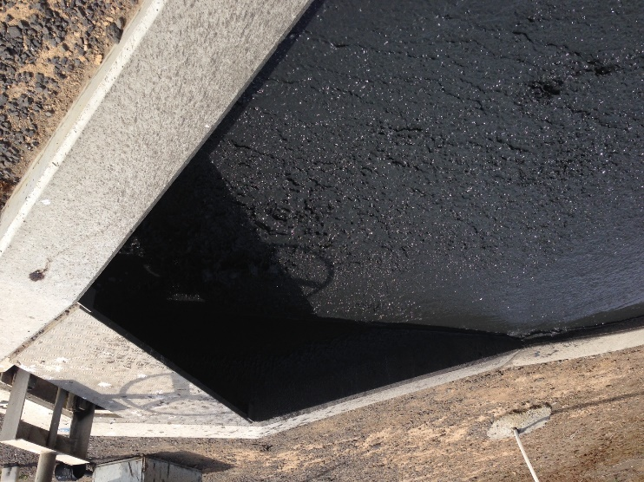
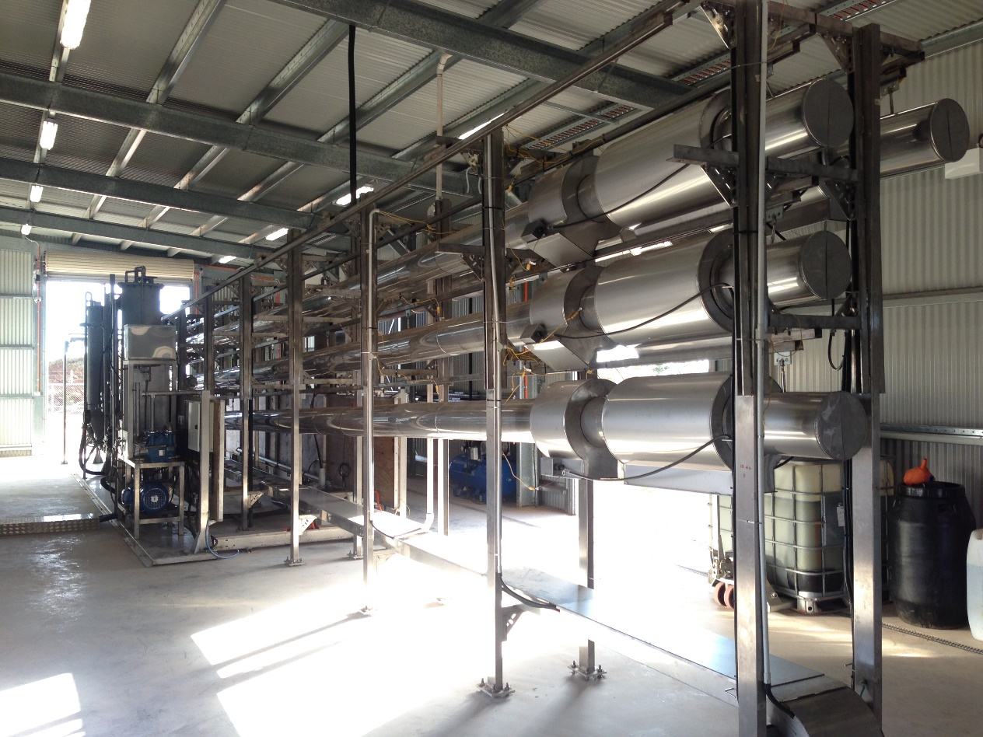
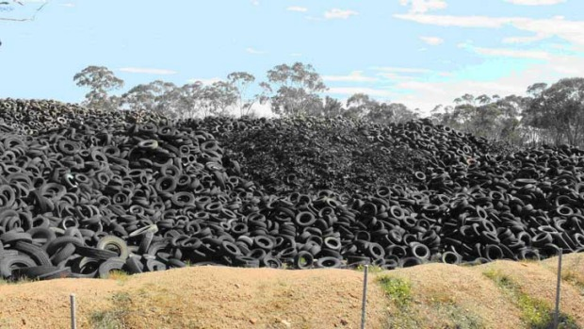
Hydrothermal Liquefaction
BIOSOLIDS
SUB CRITICAL WATER REACTOR
(350⁰ C, 200 bar)
RUBBER TYRES

Slide 16
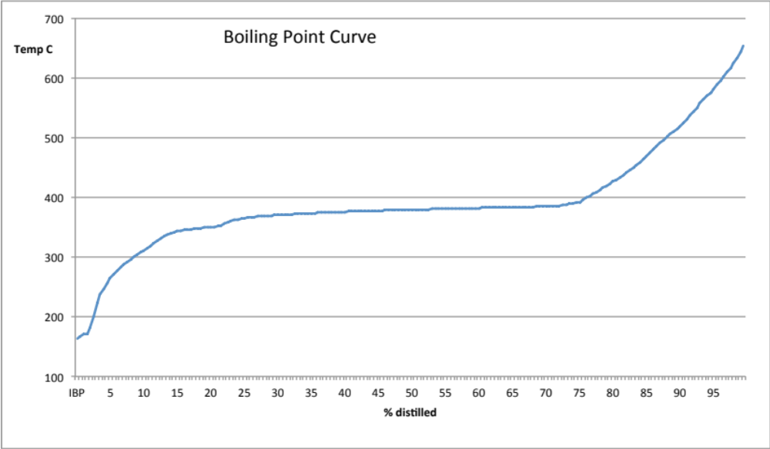
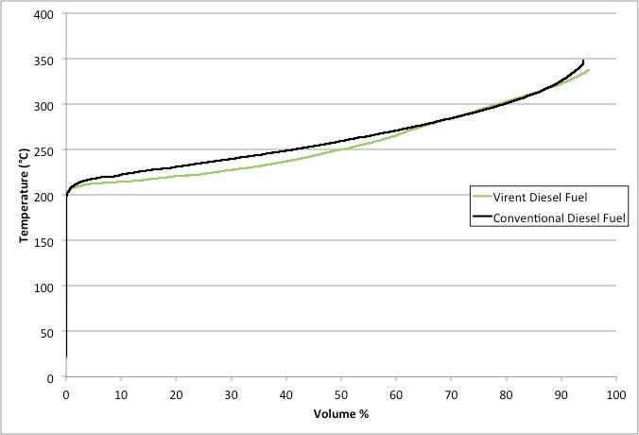
Tyre crumb trial

Slide 17
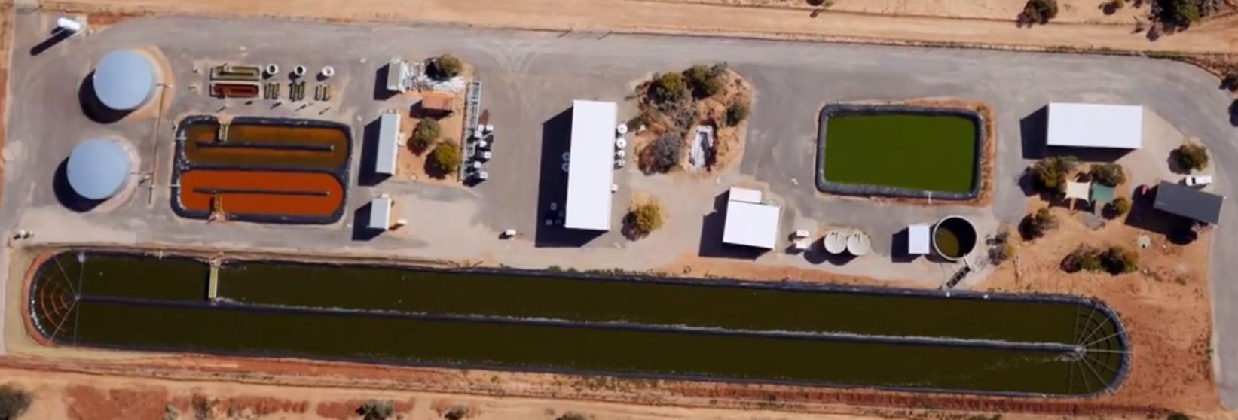
ARENA Advanced Renewables Program
Expand Green2BlackTM to incorporate pre/post processing unit operations
  Quantify product quality and quantity under continuous operation
  Demonstrate robustness of Green2BlackTM technology
Validate financial model assumptions
Provide competitively-priced renewable crude oil for Australia

Slide 18
Advanced Renewables Program
Upgrade MDP infrastructure to integrate biosolids feedstock storage, pre-treatment and extraction capabilities and increase production capacity
Reach long-term steady-state operations at pre-commercial scale
Product development and certification of the biofuel products with Southern Oil Refinery from renewable biosolids provided by Melbourne Water Corporation
Production of a commercially relevant volume of green crude for supply as a feedstock to Southern Oil Refinery for supply of renewable military diesel fuel or to a large end user
Finalise capital requirements and construction plans for a single ~25 million L green crude production “bankable” project

Slide 19
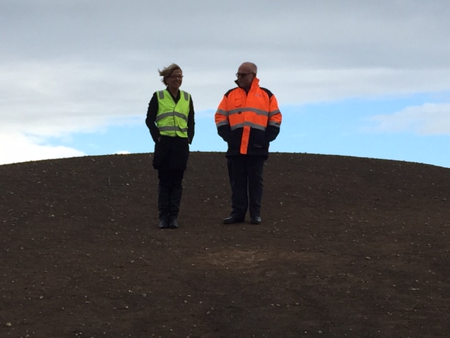
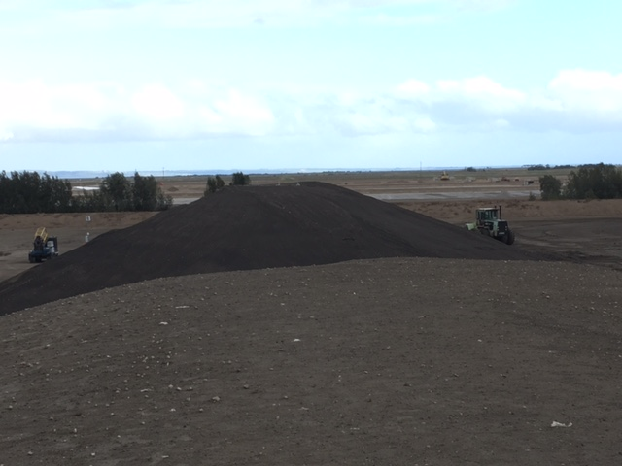
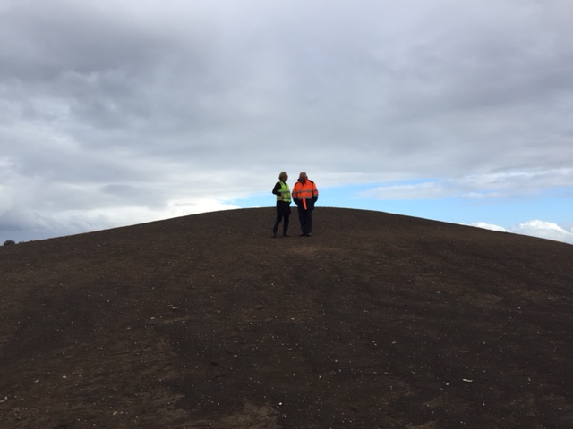
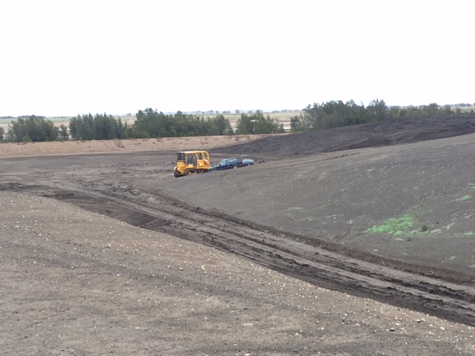
Biosolids - a sustainable feedstock available at scale
Notes:
Mention the holy grail of ‘mountain of biomass’, give story about 2008 Galway ISAP meeting.

Slide 20
Summary
The Muradel Green2BlackTM technology is fully operational at pre-commercial scale
EPA, SafeWork SA and PIRSA permits issued for full operation
Existing SCWR at the MDP is available to feasibility study trials
New SCWRs will be manufactured in Whyalla and located internationally
Southern Oil Refinery ready to receive green crudes and biocrudes
Continuous lipid production from marine microalgae
By 2020, Muradel aims to operate a commercial plant in Whyalla (non-biosolids feedstocks) and in Melbourne (World’s first biosolids to biocrude processing plant).

Slide 21






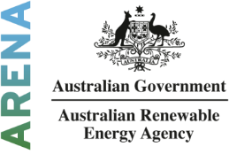


Partners

Slide 22
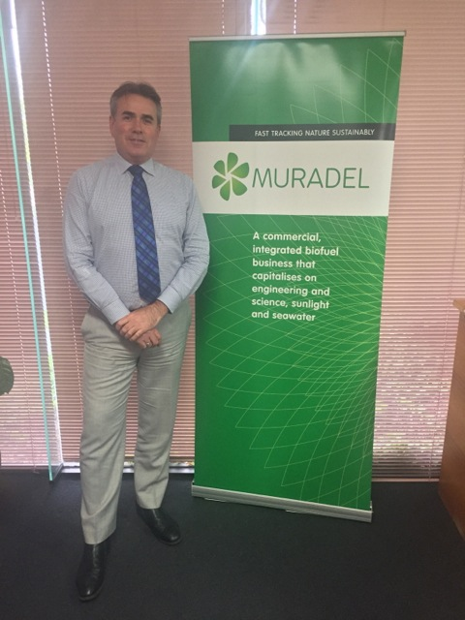
Contact
Please visit our website for further information about Muradel’s capabilities:
www.muradel.com.au
For financial and technical information please contact:
David Lewis PhD
Chief Executive Officer
Suite 1, 1401 Burke Road
Kew East, Victoria 3102
ph: +61 8 8645 5683
mb: +61 411 161 325
SKYPE: drdmlewis

