Slide 1
Catalytic deoxygenation
27. 8. 2015
David Kubička – VÚAnCH / UniCRE-RENTECH, david.kubicka@vuanch.cz

Slide 2
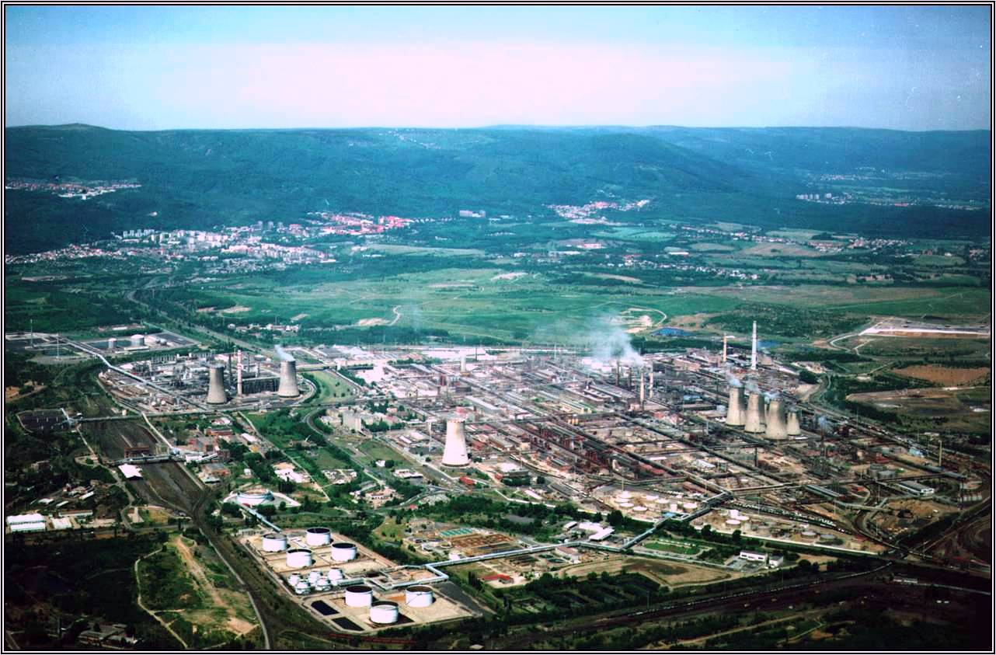
VÚAnCh - UniCRE
Czech Republic
Ústí nad Labem; HQ & inorganic technologies
Litvínov – Chempark; UniCRE
Ústí nad Labem
Litvínov
Prague

Slide 3
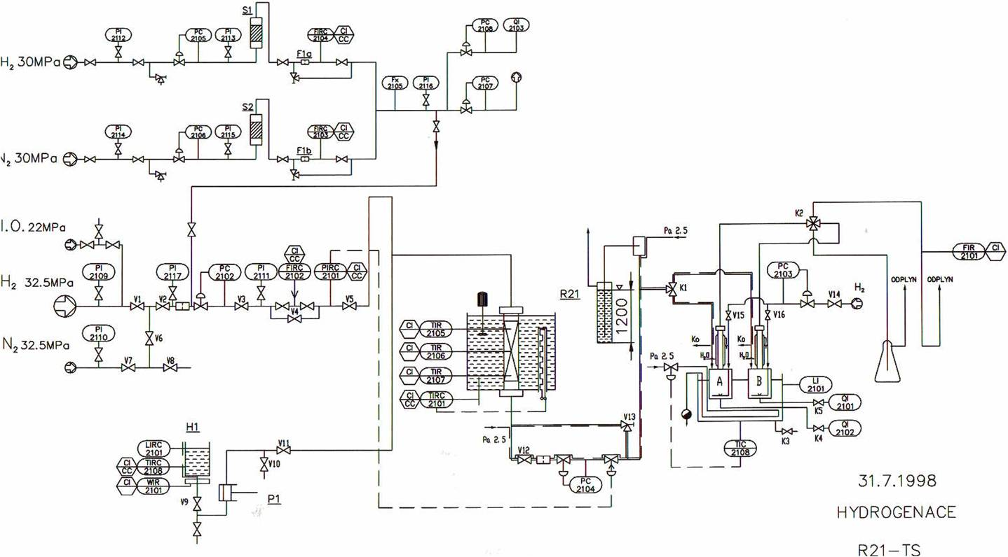
UniCRE – CATPRO infrastructure
  More than 20 units (plug-flow reactors…)
  Catalyst loading: 5-250 ml
  Testing conditions:
          up to 550° C
          20 MPa
          various technical gases
  Operation 24/7
  Catalyst synthesis, scale-up, shaping
  Detailed / advanced analytics
catpro@vuanch.cz

Slide 4
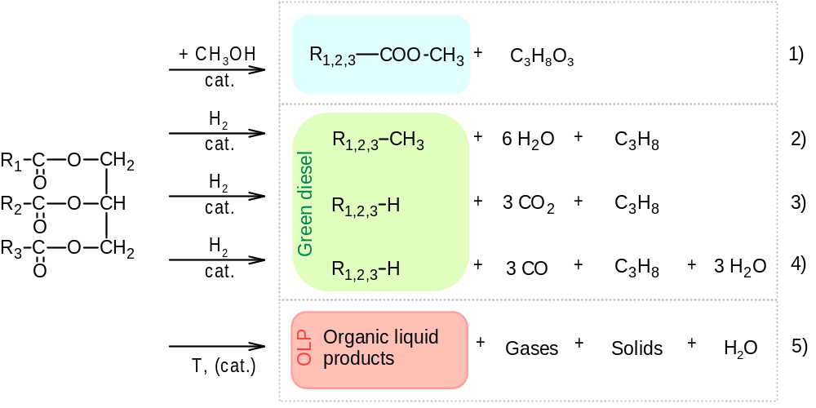
Triglycerides to Fuels
Kubičková, I.; Kubička, D. Waste Biomass. Valor. 2010, 1, 293-308.

Slide 5
Comparison of diesel fuels
 | ULSD | Biodiesel | Green Diesel
O, % | 0 | 11 | 0
Density, kg/m³ | 840 | 880 | 780
S, ppm | <10 | <5 | <1
LHV, MJ/kg | 43 | 38 | 44
Cloud point, °C | -5 | -5 - +10 | -20 - +20
Cetane number | 51 | 50-65 | 70-90
Stability | good | poor | good
Energy & GHG Savings
Fossil CED, GJ/t | 0 | 26.3 – 35.5 | 40.3 – 42.9
GHG, t CO₂eq./t | 0 | 1.2 - 2.4 | 1.8 – 3.2
UOP, 1st Alternative Fuels Technology Conference, 18.2.2008, Prague

Slide 6
Biodiesel (FAME) - transesterification Selected issues

Slide 7
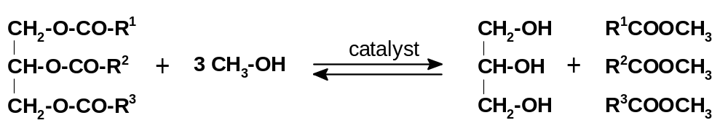
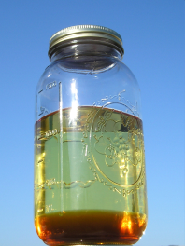

Basics of triglycerides to FAME
Reaction conditions
  T: 60°C
  P: 1 atm
  MeOH/oil: 5-6 mol/mol
  catalyst: NaOH, CH₃ONa
  cat_{NaOH}/oil: 0.007 g/g
pictures from the Internet

Slide 8
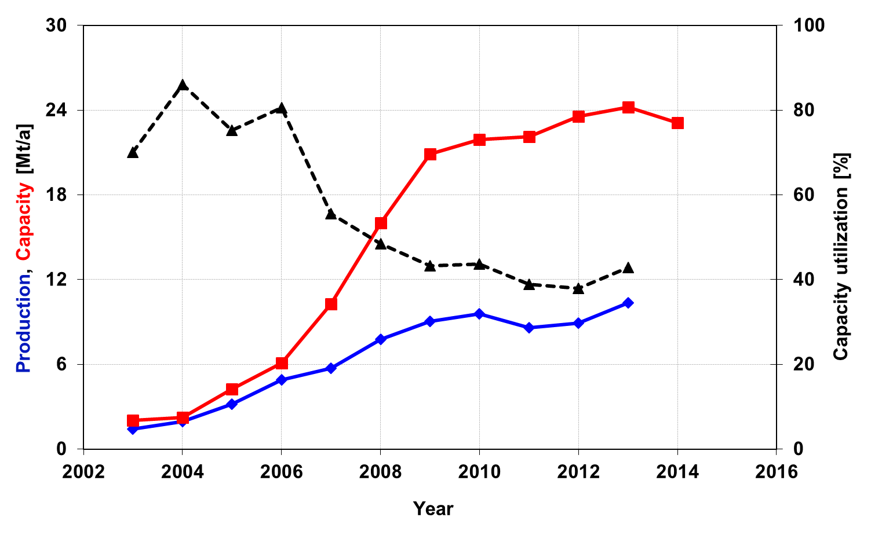
FAME – European situation
2009-28-EC:
GHG savings
Now: 35%
2017: 50%
2018: 60%
GHG savings
RS-BD: 38%
RS-GD: 47%
SF-BD: 51%
SF-GD: 62%
data from www.ebb-eu.org (includes green diesel capacity and production), EU Directive 2009 28EC

Slide 9
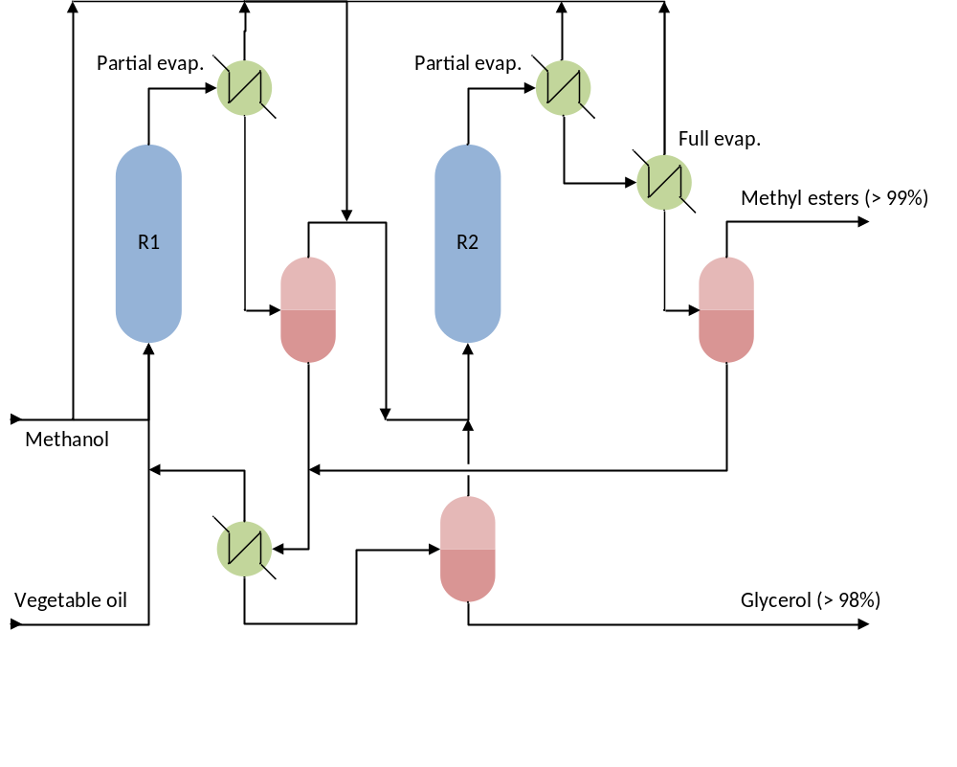
Alternative to the traditional process
Esterfip-H
160-250 kt/y
1.5 Mt/y
Conditions
Zn-Al catalyst
200 – 250°C
Bournay, L.; Casanave, D.; Delfort, B.; Hillion, G.; Chodorge, J. Catal. Today 2005, 106, 190–192.

Slide 10
Green diesel - deoxygenation Industrial processes

Slide 11
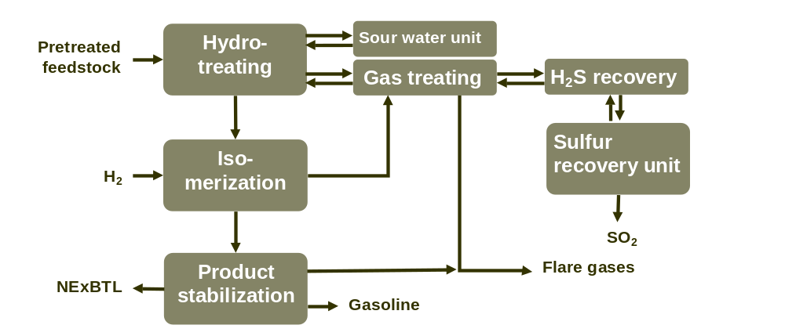
Commercial applications
NexBTL
  Neste Oil, stand-alone units
NexBTL process (Hodge, 2006)

Slide 12
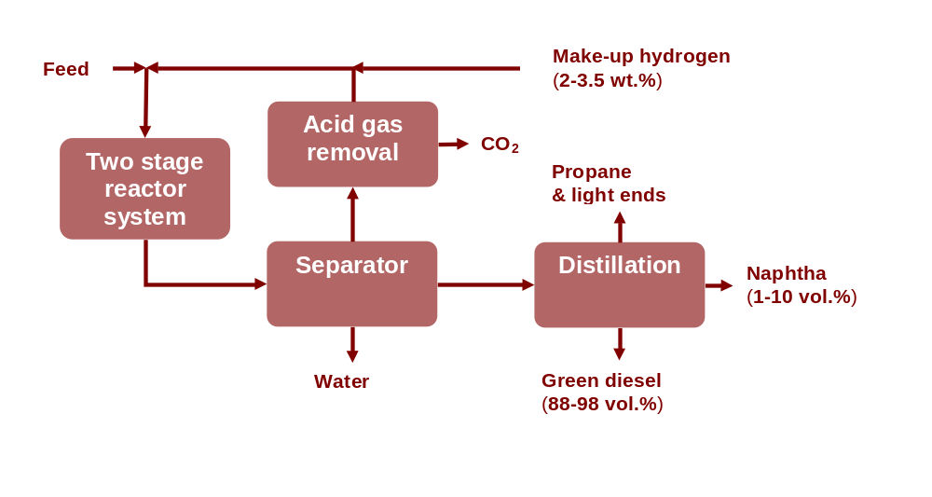
Commercial applications
Ecofining
  UOP / ENI, stand-alone
Ecofining process (Frey, 2011, UOP, 2012)

Slide 13
Commercial units
Name | Technology developer | Location | Company | Capacity, kt/a | Status
NexBTL | NesteOil | Finland Finland Singapore Netherlands | NesteOil NesteOil | 190 190 800 800 | 2007 2009 2010 2011
Ecofining | UOP/Eni | USA Italy, Venice | Diamond Green Diesel | 400 300 (500) | 2013 2014 (2015)
(Neste Oil, 2012, C. Perego, Liblice, 2014)

Slide 14
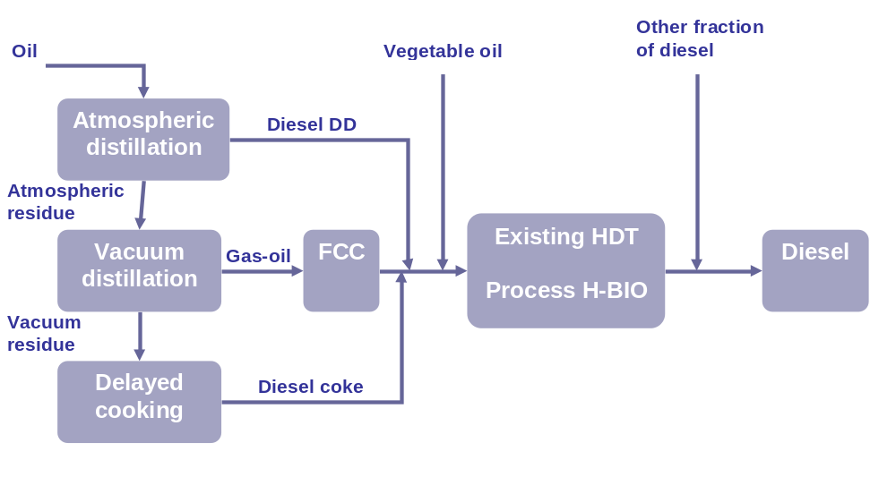
Commercial applications
H-Bio
  Petrobras, co-processing units
H-Bio process (Costa, 2007)

Slide 15
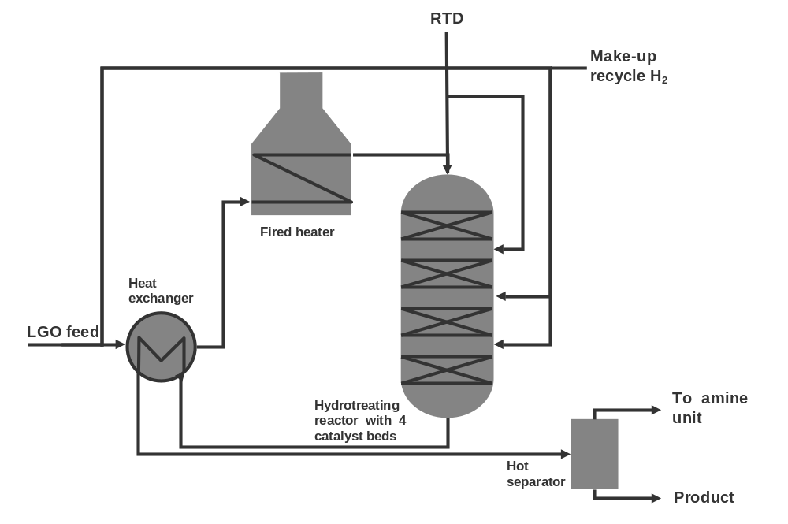
Commercial applications
Preem refinery
  Haldor Topsoe, co-processing units
Co-processing of tall oil with LGO in Preem refinery (Egeberg et al., 2011)

Slide 16
Stand-alone vs. co-processing & challenges
Stand-alone
  Investment intensive
  Flexible
    Premium products (green diesel x green jet)
Co-processing
  Directly or revamp
  Low flexibility
    EN590 constraints
      Low temperature properties (CFPP)
      Sulfur
    By-products (CO, CO₂, CH₄, C₃H₈, H₂O)
    Catalyst deactivation

Slide 17
Deoxygenation of triglycerides Fundamental aspects

Slide 18
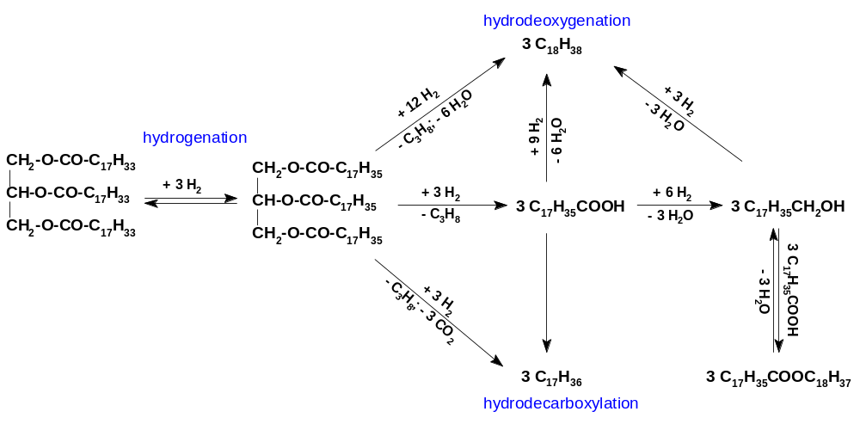
Reaction pathways in deoxygenation
X
Initial hydrogenation of double bonds
HDO (H₂O), HDC (CO₂) accompanied by CO₂ hydrogenation
Mechanism determines H₂ consumption
Collect Czech Chem Commun 2008, 73 1015

Slide 19
Key aspects
Reaction pathways
  Product selectivity
  Hydrogen consumption
Raw materials quality
  Cost
  Deactivation

Slide 20
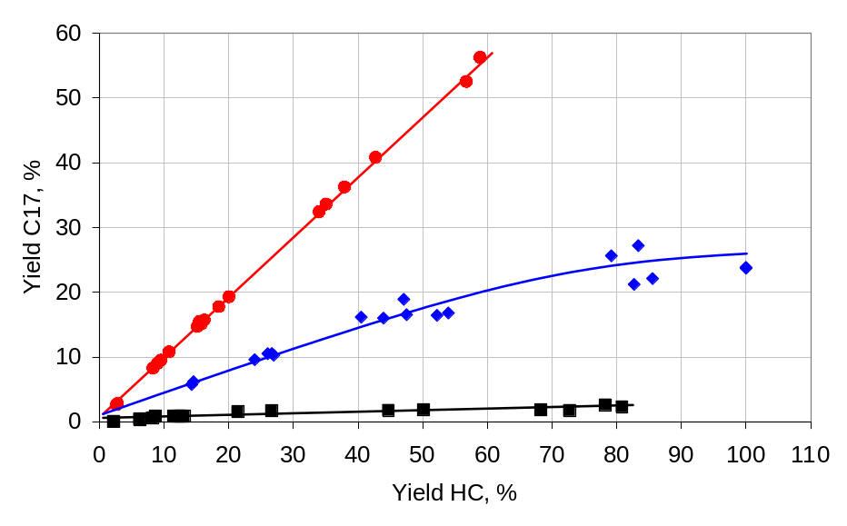
Dealing with H₂ consumption
Active phase selection
  Noble metals catalysts – decarboxylation
  Sulfided (hydrotreating) catalysts – HDO and HDC
Ni
NiMo
Mo
Appl. Cat A: Gen. 372 (2010) 199–208

Slide 21
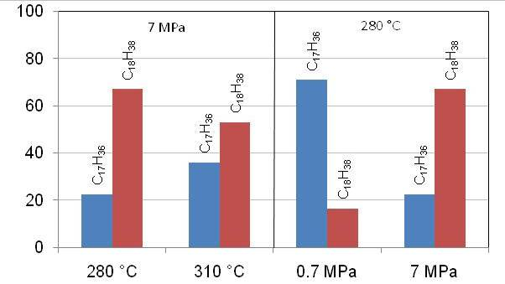
CS II – Triglycerides – Green diesel
Kubička, D. Collect. Czech. Chem. Commun. 2008, 73, 1015–1044

Slide 22
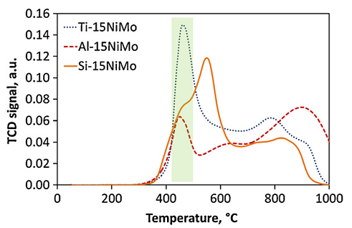
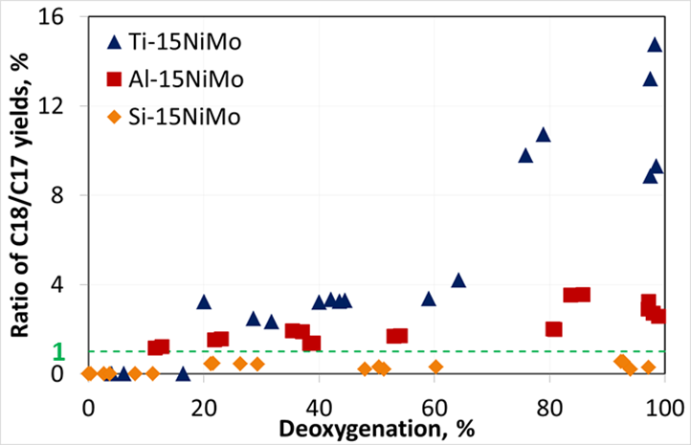
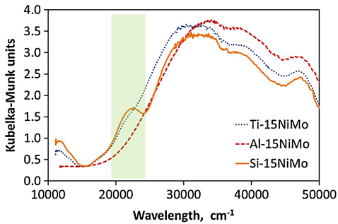
Dealing with H₂ consumption
Support influence
  Active phase
  Modifying active phase properties
Appl. Cat. B: Environ. 145 (2014) 101-107

Slide 23
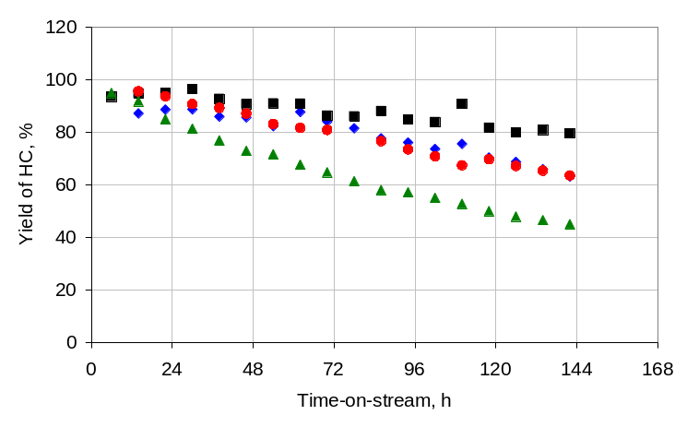
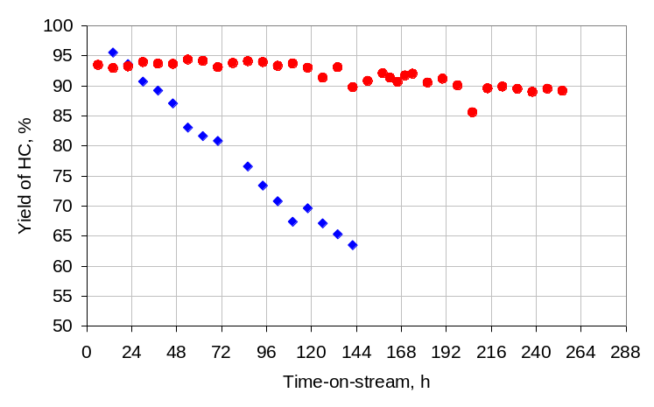
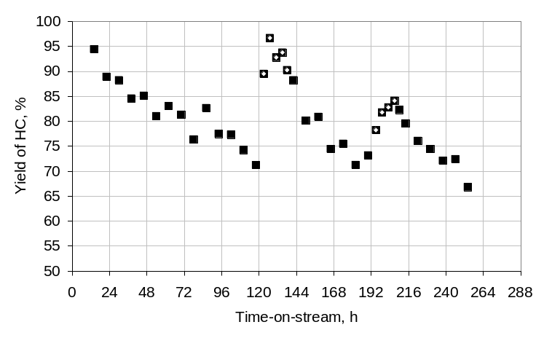
Deactivation of sulfided catalysts
Sulfur depletion
Feedstock impurities
DMDS pulse
RRO-II
RRO-I
RO-S
NRO
WRO
RO
RO
mmol/kg | M eq. | P
NRO | 6.003 | 6.070
RRO-I | 0.237 | <0.016
RRO-II | 0.197 | 0.023
WRO | 2.035 | 1.224
Appl. Cat A: Gen. 394 (2011) 9–17

Slide 24
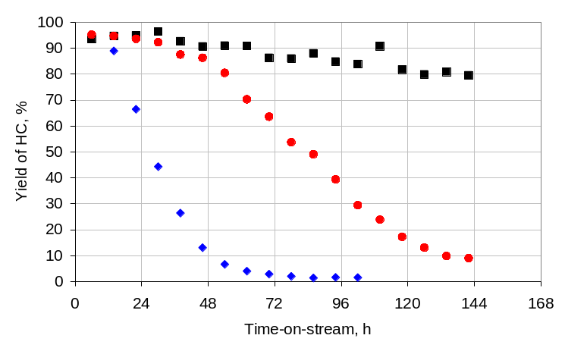
Deactivation of sulfided catalysts
Sulfur depletion
Feedstock impurities
DMDS pulse
RO
RO-S
TG
ROG
RO
RO
mmol/kg | M eq. | P
RO | 0.197 | 0.023
ROG* | 0.279 | 3.351
TG | 0.444 | 10.009
Appl. Cat A: Gen. 394 (2011) 9–17

Slide 25
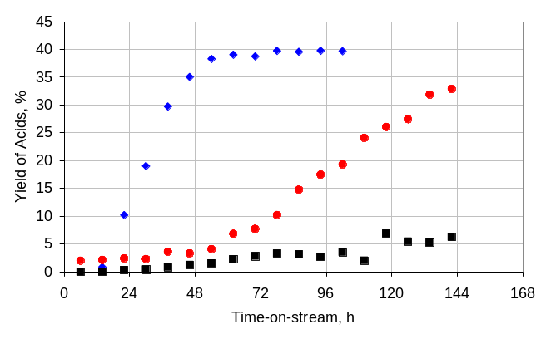
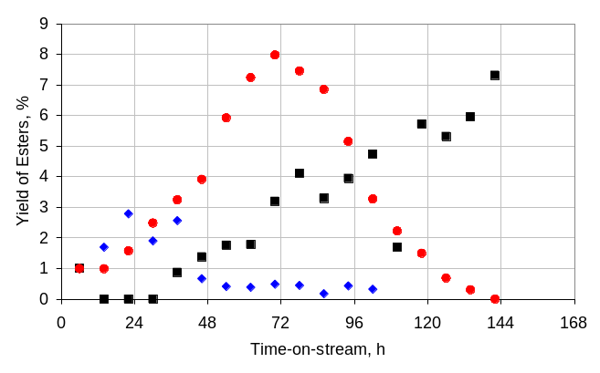
Deactivation of sulfided catalysts
Sulfur depletion
Feedstock impurities
TG
DMDS pulse
ROG
RO-S
RO
RO
RO
ROG
RO
TG
Appl. Cat A: Gen. 394 (2011) 9–17

Slide 26
Challenges
Feedstock – price / quality / availability
Hydrogen consumption – HDO / HDC
Single step hydrogenation / isomerization
Full refinery integration
Robust non-sulfided catalysts

Slide 27
Acknowledgements
  N. Žilková, J. Vlk – mesoporous materials
  L. Kaluža – NiMo, Ni, Mo catalysts
  P. Priecel, L. Čapek – NiMo catalysts with different Ni coordination
  P. Šimáček, J. Chudoba – GC-MS identification
  J. Horáček, F. Homola – deoxygenation experiments
  R. Bulánek, M. Setnička – active-phase–support interactions
  FT-TA3/074, P106/12/G015, CZ.1.05/2.1.00/03.0071
  THANK YOU!

Slide 28

Contacts
Areál Chempark, Záluží 1, Litvínov, Postal Code 436 70
UniCRE is a part of
Research Institute of Inorganic Chemistry
Revoluční 1521/84, Ústí nad Labem, Postal Code 400 01
Reg. No.: 62243136, TAX ID No.: CZ62243136
Phone: +420 475 309 211, +420 475 309 222
e-mail: vuanch@vuanch.cz, www.vuanch.cz
Registered in the Commercial Register at the Regional Court
in Ústí n. L., Part B, File 664
Banking information: 7009 411/0100, KB Ústí n. L.
the presentation was part of the project
UniCRE – Unipetrol Centre for Research and Education
Supported under the Operational Programme of Research
and Development for Innovation
No. CZ.1.05/2.1.00/03.0071
From EU and the Ministry of Education, Youth and Sports funds

