Slide 1
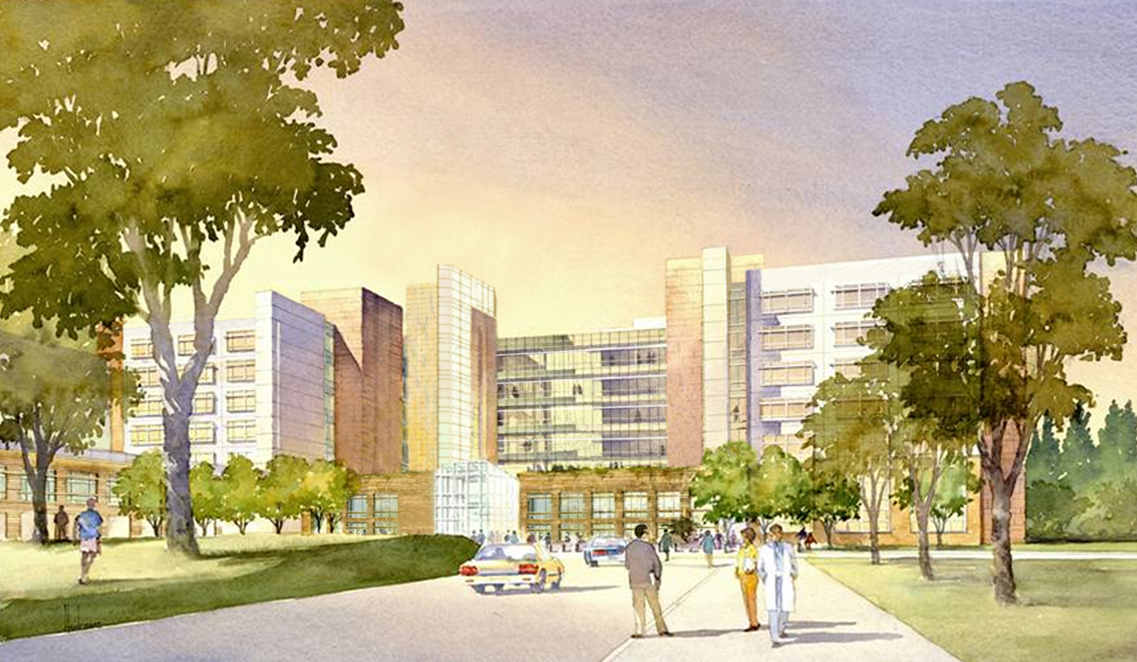
Pilot study comparing the Pharmacokinetics of Sorafenib in the Asian-American population vs. Non-Asian Population in the Treatment of Hepatocellular Carcinoma
David K. Imagawa MD, PhD, FACS
Professor of Clinical Surgery and Pathology
Suzanne Dykema Chair in Pancreatic Cancer
Division of Hepatobiliary and Pancreas Surgery, Islet Cell Transplantation
University of California Irvine Medical Center

Slide 2
Disclosures
Bayer Pharmaceutical: Speaker’s bureau, consultant, research support
Daiichi Pharmaceutical: Clinical trial research support
Onyx Pharmaceutical: Clinical trial research support
Sillajen Pharmaceutical: Clinical trial research support

Slide 3

HCC: Epidemiology and Etiology
Fifth most common malignancy in the world.
Endemic in Africa and Asia
areas with high prevalence of Hep B
Congenital transmission
Mean age of diagnosis: 50 – 60 years
Annual incidence has doubled in the past 30 years in the United States due to Hep C infections

Slide 4
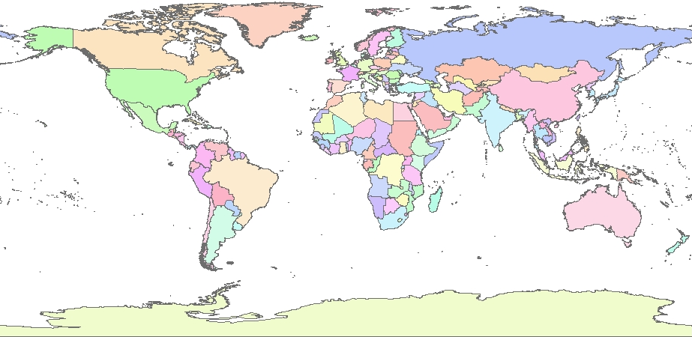
HCC Is a Global Problem
NORTH
AMERICA
EUROPE
ASIA
MIDDLE
EAST
AFRICA
SOUTH
AMERICA
OCEANIA
ANTARCTICA
INCIDENCE:
10-120/100,000
5-10/100,000
<5/100,000
Adapted from data of McGlynn KA et al. Int J Cancer. 2001;94:290-296.
Notes:
HCC Is a Global Problem
Hepatocellular carcinoma (HCC) is becoming a global issue with incidence rates increasing worldwide:
The lowest incidence rate (green) is in North America and Northern Europe with
<5 per 100,000 people
The intermediate range is indicated by yellow with 5-10 per 100,000 people
The highest incidence range (red) occurs in sub-Saharan Africa and Southeast Asia with a rate of 10-120 per 100,000 people
Reference
McGlynn KA, Tsao L, Hsing AW, Devesa SS, Fraumeni JF Jr. International trends and patterns of primary liver cancer. Int J Cancer. 2001;94:290-296.

Slide 5
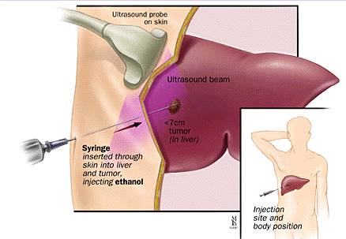

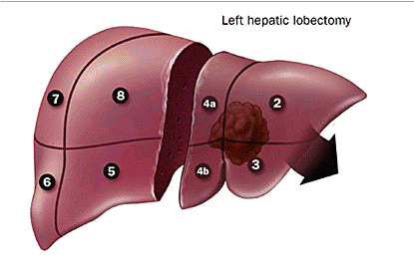
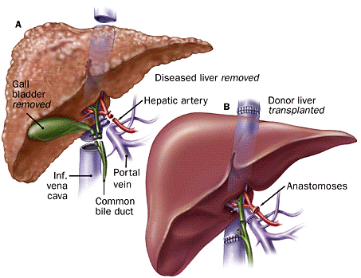
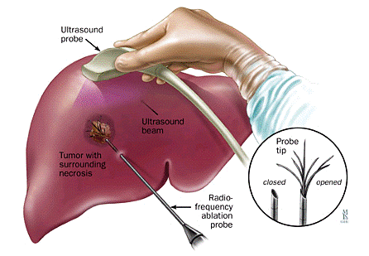
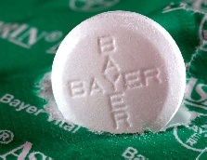
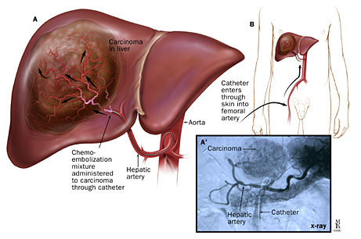
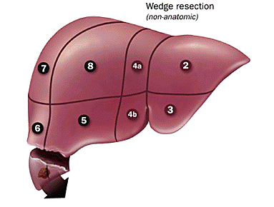
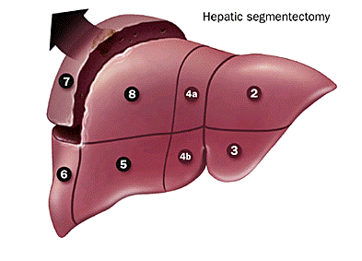
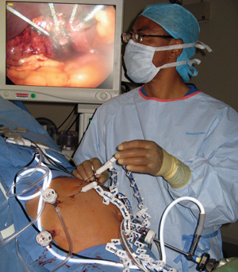
Treatment of Liver Tumors
Surgical Resection
  Lobectomy
  Segmentectomy
  Non Anatomic wedge resection
Orthotopic Liver Transplantation
  only for selected cases of hepatoma, hepatoblastoma, neuoroendocrine tumors
Radiofrequency ablation
Microwave
Chemoembolization
Therasphere \ Sirtex
Systemic chemotherapy
Ethanol injection
Notes:
7/18/2015
5

Slide 6
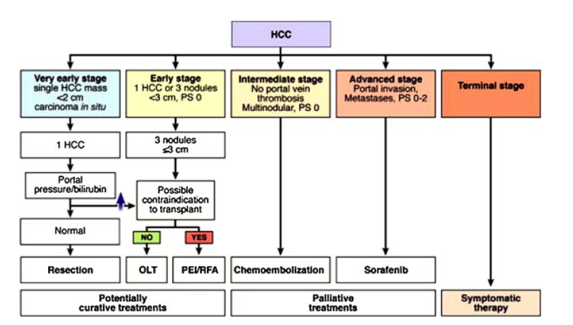
Barcelona Liver Clinics: Staging and Treatment
Padma et al. Liver Tumor Ablation: Percutaneous and Open Approaches. Journal of Surgical Oncology 2009;100:619–634

Slide 7
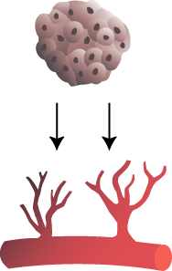
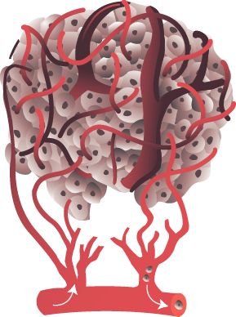


Angiogenesis Role in Tumor Growth
7
Initiation
Proliferation
Maturation
Somatic
mutation
Small
avascular
tumor
Tumor secretion of angiogenic factors stimulates angiogenesis
Rapid tumor growth and metastasis
Angiogenic switch
Carmeliet J and Jain RK. Nature. 2000;407(6801):249-257; Bergers B and Benjamin LE. Nat Rev Cancer. 2003;3(6):401-410.
Notes:
7
Before vascularization, tumors cannot grow beyond 3 mm and are considered dormant.
Tumors secrete pro-angiogenic factors resulting in the formation of new tumor vasculature; this is known as the angiogenic switch.
Establishing tumor vasculature allows tumor cells to grow rapidly and divide by supplying a means to deliver oxygen and other nutrients, as well as a means to remove cellular waste products.
Tumor vascularization facilitates metastasis by connecting the tumor to the systemic vasculature.

Slide 8
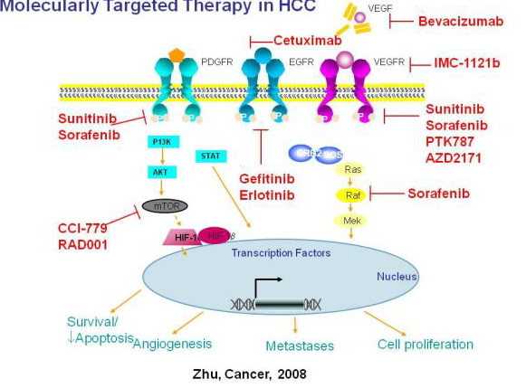

Slide 9

Molecular Signaling Pathways in HCC
Sorafenib
Growth
and
survival
factors
(eg, VEGF,
PDGF)
Autocrine loop
EGF/HGF
Apoptosis
RAS
Tumor Blood Vessels
RAF
MEK
Mitochondria
ERK
HIF-2
EGF/HGF
PDGF
Tumor Cell
Nucleus
VEGF
Proliferation
Survival
Wilhelm S et al. Cancer Res. 2004;64:7099-7109.
Notes:
Molecular Signaling Pathways in HCC
In HCC, RAF kinase is over-expressed and activated
RAF/MEK/ERK signaling pathway has been implicated in liver tumorigenesis
Sorafenib is a multikinase inhibitor of RAF and other kinases and growth factors involved in angiogenesis (eg, VEGF, PDGF)
Sorafenib induces apoptosis in HCC xenograft models
Sorafenib was active in a phase 2 trial of patients with advanced HCC and with a Child-Pugh class A and B liver function status (98 patients = Child-Pugh class A and 38 patients = Child-Pugh class B)
Reference
Wilhelm SM, Carter C, Tang L, et al. BAY 43-9006 exhibits broad spectrum oral antitumor activity and targets the RAF/MEK/ERK pathway and receptor tyrosine kinases involved in tumor progression and angiogenesis. Cancer Res. 2004;64:7099-7109.

Slide 10
Introduction
Sorafenib is the only FDA approved agent that has been shown to prolong survival in unresectable hepatocellular carcinoma (HCC).
The recommended dose is 400mg BID.

Slide 11
Sorafenib in HCC:
Phase 2 Study Design
Primary end point: RR by modified WHO criteria
Secondary end points: TTP, OS
Eligibility
Measurable, histologically proven, unresectable HCC
No prior systemic therapies
ECOG PS 0 or 1
Child-Pugh score A or B
Sorafenib 400 mg bid until disease progression or
drug-related toxicity
N=137
OS=overall survival; PS=performance status; TTP=time to progression.
Abou-Alfa GK et al. J Clin Oncol. 2006;24:4293-4300.
Notes:
Sorafenib in HCC: Phase 2 Study Design
The phase 2 study of sorafenib assessed efficacy, toxicity, pharmacokinetics and biomarkers in advanced HCC patients
The primary end point was to evaluate tumor response rate using WHO criteria in patients with advanced inoperable biopsy-proven HCC
This was a multicenter, international, uncontrolled study with 137 patients
Sorafenib was given as a continuous dosing of 400 mg twice daily in a 28-day cycle
The phase 2 inclusion criteria were the following:
At least 1 bi-dimensionally measurable lesion by CT-scan or MRI according to WHO criteria
Eastern Cooperative Oncology Group (ECOG) performance status of 0 or 1
Child-Pugh score A or B
No prior systemic therapies
If previous local therapy, target lesion must have progressed >25%
No recent gastrointestinal bleeding
Reference
Abou-Alfa GK, Schwartz L, Ricci S, et al. Phase II study of sorafenib in patients with advanced hepatocellular carcinoma. J Clin Oncol. 2006;24:4293-4300.

Slide 12
Sorafenib in HCC:
Phase 2 Overall Survival (N=137)
1.00
Median OS: 9.2 months
0.75
Product-limit estimate curve
Censored observations
0.50
Survival distribution function
0.25
0
0
3
6
9
12
15
18
Time from start of study treatment (months)
Overall survival is defined as the time from start of treatment to death due to any cause (uncensored observation) or to last follow-up date if the patient did not die (censored observation).
Abou-Alfa GK et al. J Clin Oncol. 2006;24:4293-4300.
Notes:
Sorafenib in HCC: Phase 2 Overall Survival (N=137)
One of the secondary end points of the study was OS, with the median OS of 9.2 months
Reference
Abou-Alfa GK, Schwartz L, Ricci S, et al. Phase II study of sorafenib in patients with advanced hepatocellular carcinoma. J Clin Oncol. 2006;24:4293-4300.

Slide 13
Phase III SHARP Trial
Study Design
Multi-center, Phase III study
Inclusion criteria
  Histology proven HCC
  Advanced, unresectable HCC
  At least one measurable untreated lesion
  ECOG ≤ 2
  Child-Pugh class A
  No prior systemic treatment
Randomization
  Double-blind placebo controlled trial (1:1)
  Accrual: March 2005-April 2006
Llovet JM, et al. Sorafenib in advanced hepatocellular carcinoma. N Eng J Med 2008; 359(4):378-90.

Slide 14
Phase 3 SHARP Study Design
(Sorafenib HCC Assessment Randomized Protocol)
Primary end points: OS, quality of life assessment (FHSI8-TSP)
Secondary end point: TTP (independent review)
Sorafenib
400 mg bid
Stratification
Macroscopic vascular invasion and/or extrahepatic spread
ECOG PS
Geographical region
Discontinue therapy
Radiologic progression
AND
FHSI8-TSP worsening
(n=299)
Placebo
400 mg bid
(n=303)
FHSI8-TSP: A composite defined by patient-reported symptoms, deterioration
to ECOG PS 4, or death.
Adapted from Llovet J et al. Presented at: ASCO Annual Meeting; June 1-5, 2007; Chicago, IL.
Notes:
Phase 3 SHARP Study Design (Sorafenib HCC Assessment Randomized Protocol)
This was a large, multicenter, randomized, placebo-controlled phase 3 trial that evaluated the efficacy and safety of sorafenib versus placebo in patients with HCC
Patients with advanced measurable HCC, no prior systemic treatment, ECOG PS 0-2 and Child-Pugh status A received sorafenib 400 mg bid (n=299) or placebo (n=303)
Primary efficacy end points of the trial were OS and time to symptomatic progression. TTP was a secondary end point
Reference
Llovet J, Ricci S, Mazzaferro V, et al. Randomized phase III trial of sorafenib versus placebo in patients with advanced hepatocellular carcinoma (HCC). Presented at: American Society of Clinical Oncology Annual Meeting; June 1-5, 2007; Chicago, IL. Abstract LBA1.

Slide 15
Phase III SHARP Trial
Patient Characteristics
Characteristics | Sorafenib (n=299) | Placebo (n=303)
Age (yr, median) | 65 | 66
Male/Female (%) | 87/13 | 87/13
Region (Europe/N America/others, %) | 88/9/3 | 87/10/3
Etiology (%)
Viral Hepatitis (HCV/HBV) | 29/19 | 27/18
Alcohol/Other | 26/26 | 26/29
Child-Pugh (A/B, %) | 95/5 | 98/2
Prior Therapies (%)
Surgical Resection | 19 | 21
Loco-regional Therapies | 39 | 41
Llovet JM, et al. Sorafenib in advanced hepatocellular carcinoma. N Eng J Med 2008; 359(4):378-90.

Slide 16
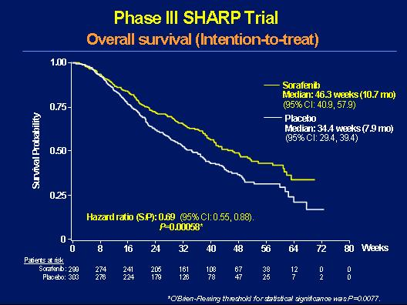
Phase III SHARP Trial
Overall Survival (Intention to Treat)
Llovet JM, et al. Sorafenib in advanced hepatocellular carcinoma. N Eng J Med 2008; 359(4):378-90.

Slide 17
Phase III SHARP Trial:
Time to Tumor Progression
(Independent Review)
1.00
Nexavar
Median: 24.0 weeks (5.5 months)
(95% CI, 18.0-30.0)
0.75
Placebo
Median: 12.3 weeks (2.8 months)
(95% CI, 11.7-17.1)
Progression-Free Probability
0.50
0.25
Hazard ratio (Nex/Pbo): 0.58
(95% CI, 0.45-0.74)
P=0.000007
0
0
6
12
18
24
30
36
42
48
54
Time (weeks)
Patients at risk
Nexavar:
299
196
126
80
50
28
14
8
2
Placebo:
303
192
101
57
31
12
8
2
1
Llovet JM, et al. Sorafenib in advanced hepatocellular carcinoma. N Eng J Med 2008; 359(4):378-90.
.

Slide 18
Phase III SHARP Trial:
Maximum Percent Reduction in TumorMeasurement
Change in Target Lesion From Baseline to Smallest Tumor Size Post-Baseline
Based on Independent Radiological Assessment
100
80
Nexavar
Placebo
60
40
20
Change in Target Lesion
From Baseline (%)
0
-20
-40
-60
27.1%
-80
-100
51.1%
Data on file. Bayer HealthCare.

Slide 19
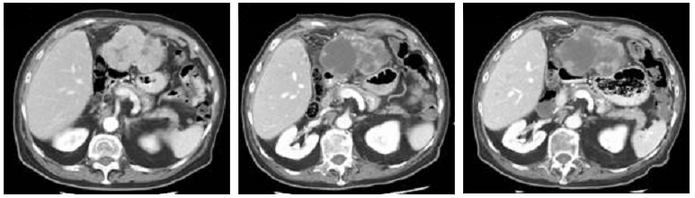
Nexavar in HCC:
Tumor Necrosis
Central tumor necrosis was evident in many patients’ scans, despite
the appearance of tumor growth
Tumor necrosis was assessed rigorously in 11 patients
Baseline
Follow-up 1
(2 months)
Follow-up 2
(4 months)
Volume (cm³)
295
341
285
Necrosis (%)
2.1
53.1
51.0
Representative sample of baseline and serial follow-up scans demonstrating tumor necrosis
in a patient with HCC.
Abou-Alfa GK et al. J Clin Oncol. 2006;24:4293-4300.

Slide 20
SHARP: All-Grade Treatment-Emergent Adverse Events Reported in ≥10% of Patients
Adverse Event NCI-CTC v3.0 | Nexavar n=297 (%) |  |  | Placebo n=302 (%)
 | All Grades | Grade 3 | Grade 4 | All Grades | Grade 3 | Grade 4
Any adverse event | 98 | 39 | 6 | 96 | 24 | 8
Diarrhea | 55 | 10 | <1 | 25 | 2 | 0
Fatigue | 45 | 9 | 1 | 45 | 12 | 2
Pain (abdomen) | 31 | 9 | 0 | 26 | 5 | 1
Weight loss | 30 | 2 | 0 | 10 | 1 | 0
Anorexia* | 29 | 3 | 0 | 18 | 3 | <1
Nausea | 24 | 1 | 0 | 20 | 3 | 0
Hand-foot skin reaction | 21 | 8 | 0 | 3 | <1 | 0
Rash/desquamation | 19 | 1 | 0 | 14 | 0 | 0
Hemorrhage/bleeding | 18 | 3 | 2 | 20 | 5 | 4
Vomiting | 15 | 2 | 0 | 11 | 2 | 0
*Grade 5 events — 2 (<1%) in the Nexavar treatment arm.
NCI-CTC v3.0=National Cancer Institute–Common Toxicity Criteria version 3.0.
Nexavar Package Insert.
Notes:
Hypertension:
Treatment-emergent hypertension was reported in 9.4% of Nexavar-treated patients vs. 4.3% of placebo-treated patients. The majority of these events were Grade 1 or 2. There were 3.7% Grade 3 events in the Nexavar group versus 1% in the placebo group. Drug-related hypertension was reported in 5.1% of Nexavar patients versus 2% of placebo patients. Hypertension was reported as serious in 0.3% of both Nexavar and placebo-treated patients. None of the serious hypertensive events was assessed as drug-related.
Hemorrhage:
At least 1 hemorrhage/bleeding event occurred in 18.2% of Nexavar patients versus 19.9% of placebo-treated patients. Grade 3 or 4 events in this category were reported more frequently with placebo, 8.9%, than with Nexavar, 5.8%. Hemorrhage events assessed as related to study drug, occurred in 3.6% of placebo-treated patients and 7.1% of Nexavar-treated patients. The majority of these events in the Nexavar group were grade 1 or 2 (5.7%). Serious hemorrhage events were reported in 12.6% of placebo-treated patients and 8.8% of Nexavar-treated patients. Of these, a positive relationship to study drug was assessed in 1.7% of placebo-treated patients and 2% of Nexavar-treated patients. Variceal bleeding occurred in 7 (2.4%) Nexaver-treated patients and in 12 (4%) placebo-treated patients.

Slide 21
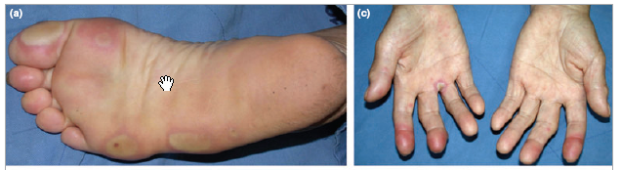
Toxicity
Hand-Foot Skin Reaction
More than 90% of patients experience skin reactions on multi-targeted TKI therapy
  Hand-foot reaction reported as high as 60%
Yang CH, et al. Br J of Dermatology. 2008:158(3):592-596.
Notes:
The mechanism by with hand-foot syndrome occurs is unknown.
Figures in detail:
Erythematous swelling of the finger tips with blisters on the finger webs.
Erythematous patches with central blisters on the pressure areas of the sole.
21

Slide 22
Phase III: Sorafenib vs Placebo in Asian Patients with Advanced HCC
Primary endpoint: Not specified
Overall endpoints: OS, TTP time to symptomatic progression, disease control rate, and safety
Advanced HCC
ECOG PS 0 - 2
Child-Pugh Class A
No prior to systemic therapy
Life expectancy > 12 weeks
Randomization N = 226
Sorafenib 400 mg PO BID n = 150
Placebo PO BID n = 76
Cheng A, et al. Lancet Oncol. 2009:10(1):25-34
Notes:
To further define the role of sorafenib in the Asian population, the Phase III Asia-Pacific trial was conducted.

Slide 23
Asian Patients with Advanced HCC
Overall Survival
1.00
Sorafenib
Median: 6.5 weeks
(95% CI; 5.6-7.6)
0.75
Placebo
Median: 4.2 weeks
Survival Probability
(95% CI; 3.7-5.5)
0.50
Cheng A, et al. Lancet Oncol. 2009:10(1):25-34
0.25
HR (S/P): 0.68
95% CI: 0.50-0.93
P = 0.014
0
Patients at risk
0
2
4
6
8
10
12
14
16
18
20
22
Sorafenib:
150
134
103
78
53
32
21
15
13
4
1
0
Placebo:
76
62
41
26
23
15
9
5
4
1
0
0

Slide 24
Asian Patients with Advanced HCC
TTP
1.00
Sorafenib
Median: 2.8 months
(95% CI; 2.6-3.6)
0.75
Placebo
Median: 1.4 months
Progression-free Probability
(95% CI; 1.3-1.5)
0.50
HR (S/P): 0.57
95% CI: 0.42-0.79
P <0.001
0.25
Cheng A, et al. Lancet Oncol. 2009:10(1):25-34
0
Patients at risk
0
2
4
6
8
10
12
14
16
18
20
22
Sorafenib:
150
80
38
19
1
1
8
5
2
1
0
0
0
Placebo:
76
19
10
8
3
0
0
0
0
0
0
0

Slide 25
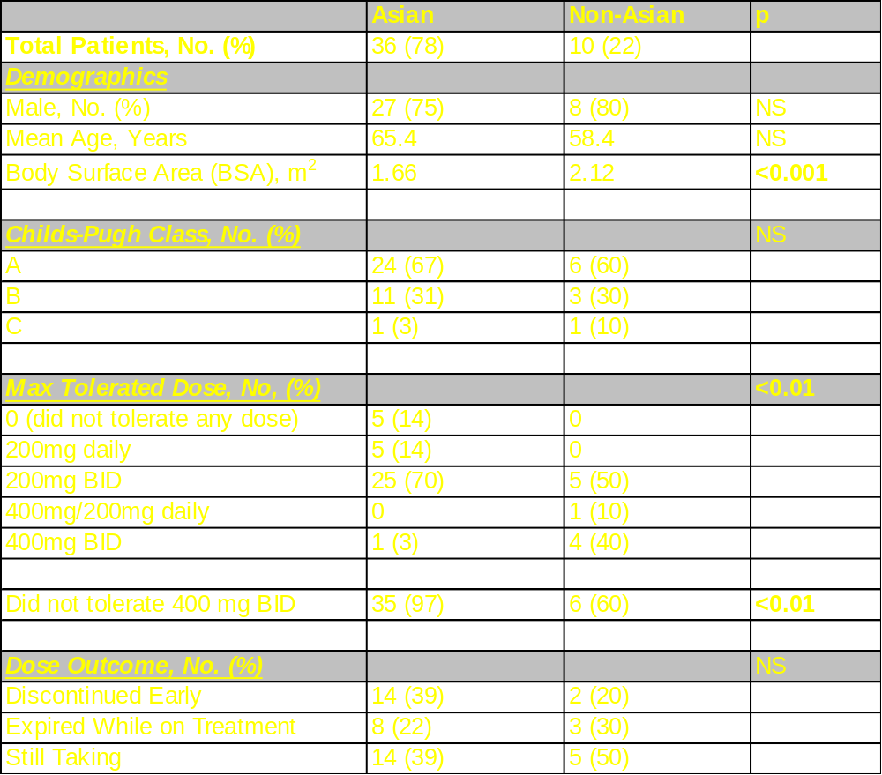
Sorafenib in Asian v non Asian Patients: UCIMC

Slide 26
Hypothesis
Our experience has shown that the majority of our Asian-American patient population are unable to tolerate this recommendation.
This is a pilot study aimed at evaluating a potential difference in pharmacokinetics (PK) of Sorafenib metabolism between the Asian-American (AA) and Non-Asian (NA) patient population.

Slide 27
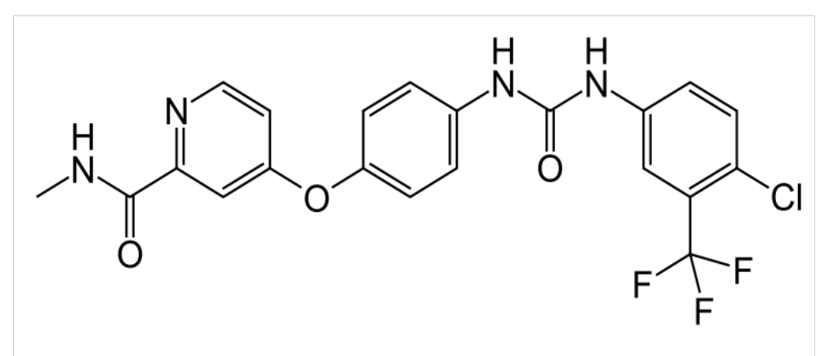
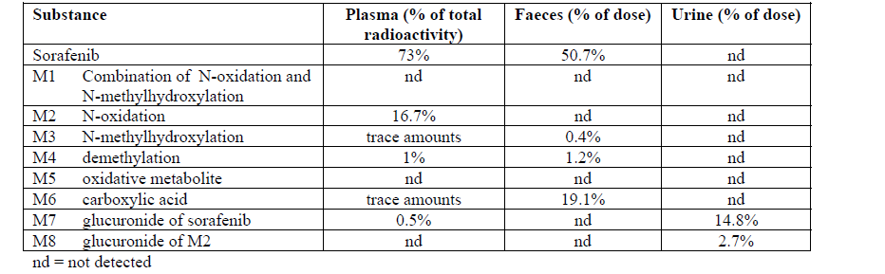
Sorafenib and Metabolites

Slide 28
Methods
A cohort of 23 patients completed the study. The PK of Sorafenib and its main metabolite M-2 were analyzed at 0, 1, 2, 4, 9 and 12 hours respectively.
A subset analysis comparing
  high dose (>400mg daily) vs. low dose (≤400mg daily)
  high body surface area (BSA>1.9) vs. low body surface area (BSA≤1.9)
  AA vs. NA patients was preformed.

Slide 29
Recruitment
27
Patients Recruited
4
Dropped Out
10
Asian-Americans
13
Non-Asians
4
High Dose
9
Low Dose
1
High Dose
9
Low Dose

Slide 30
Results
High Dose
5 patients
No deaths
Low Dose
18 patients
2 mortalities (749 and 283 days)
1 patient achieving complete response (201 days)

Slide 31
Results
 | Asian-American (N = 10) | Non-Asians (N = 13)
Sex
Male | 8 | 10
Female | 2 | 3
BMI | 22.65 | 27.72
BSA | 1.708 | 1.928
Median Dose Tolerated (mg) | 300 | 400
Sorafenib AUC | 28442.545 | 37913.72692
M-2 Metabolite AUC | 4012.361 | 7960.961923

Slide 32
Low vs. High Dose

Slide 33
Low vs. High BSA

Slide 34
Asian vs. Non-Asian

Slide 35
Results
Cohort | Sorafenib AUC (mg*h/L) | Mean Difference (mg*h/L) | P-value
High Dose | 42,729 | 11,415 | >0.05
Low Dose | 31,314
High BSA | 41,477 | 9,815 | >0.05
Low BSA | 31,662
Non-Asian | 37,914 | 9,471 | >0.05
Asian-American | 28,443

Slide 36
Complete Response

Slide 37
6 months

Slide 38
12 months

Slide 39
2 years

Slide 40
PK Graph

Slide 41
Limitations
Small Sample
Hard to Recruit
Most patients unable to tolerate high dose range

Slide 42
Conclusions
Our analysis reveals a trend towards comparable PK of Sorafenib and M-2 metabolite despite lower doses and lower BSA.
These findings suggest that a lower, more tolerable dose of Sorafenib in AA patients may not compromise drug efficacy.
Large, population based studies are needed to validate these findings.

