Slide 1

Zika Virus (ZIKV), Diagnosis, Treatment and Prevention
David I. Watkins
Dept. Pathology, Miller School of Medicine, University of Miami

Slide 2
Outline
ZIKV in Miami-A special problem
Diagnostics for ZIKV
Macaque model for ZIKV-induce fetal demise
Monoclonal antibodies for prevention of ZIKV infection

Slide 3
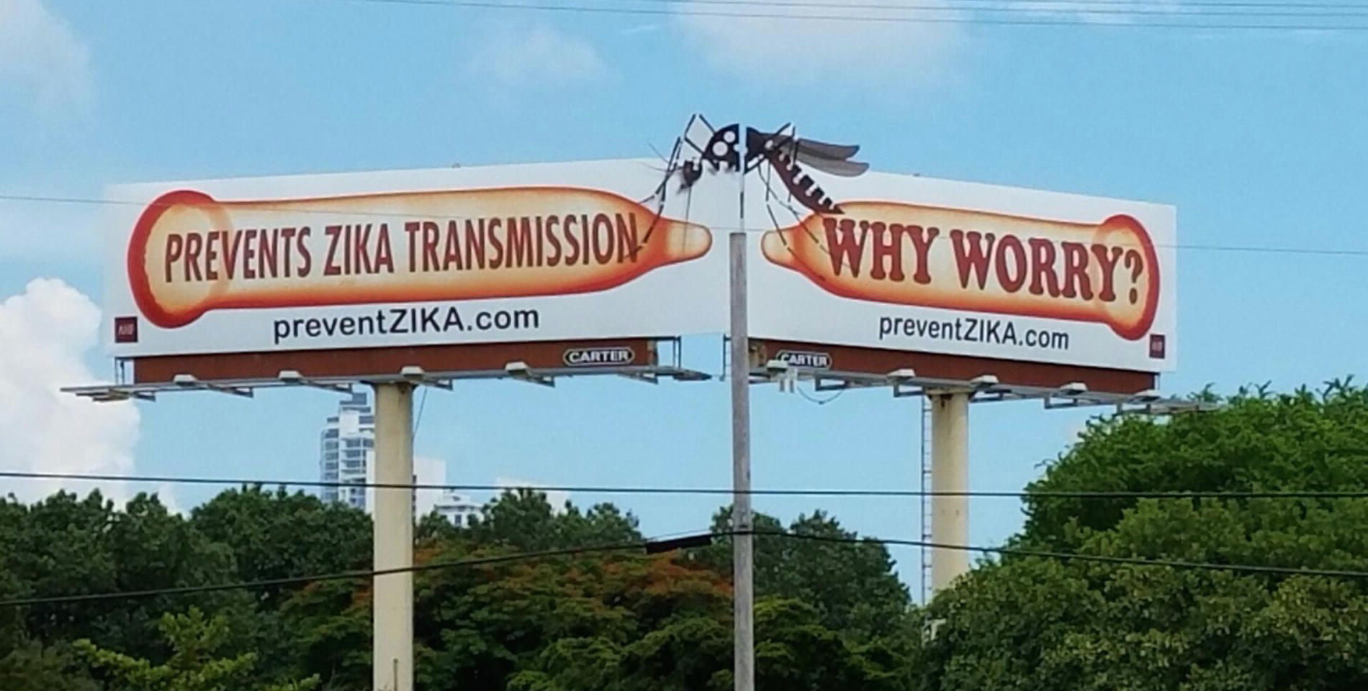
ZIKV in Miami

Slide 4
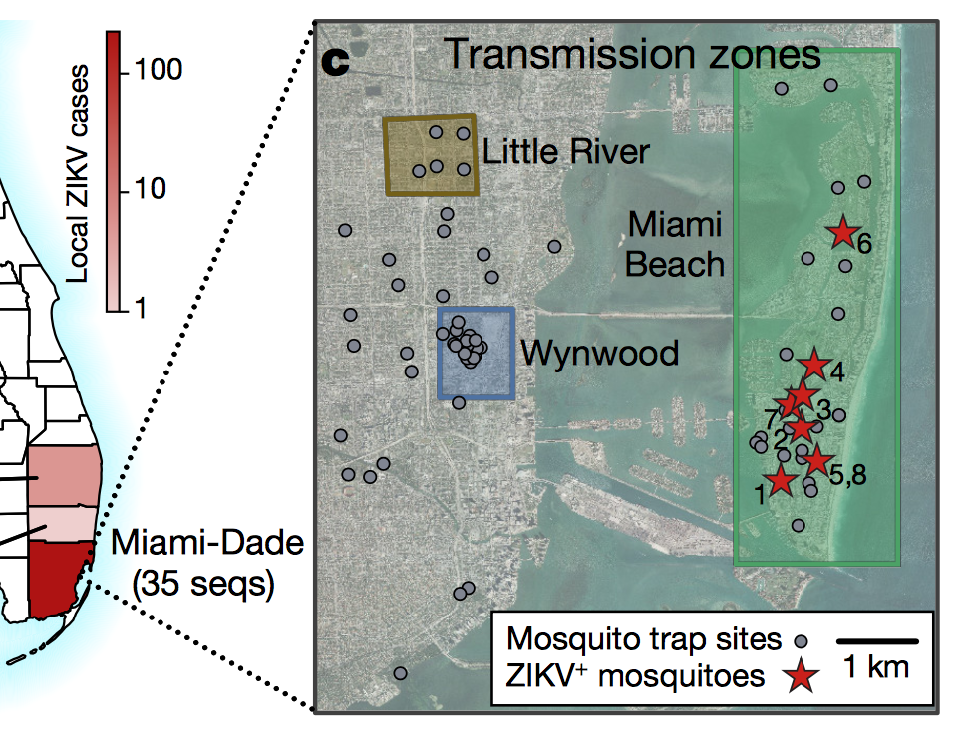
Miami remains susceptible to multiple ZIKV reintroductions
Lab!
Grubaugh N.D, et al. (2017). Nature

Slide 5
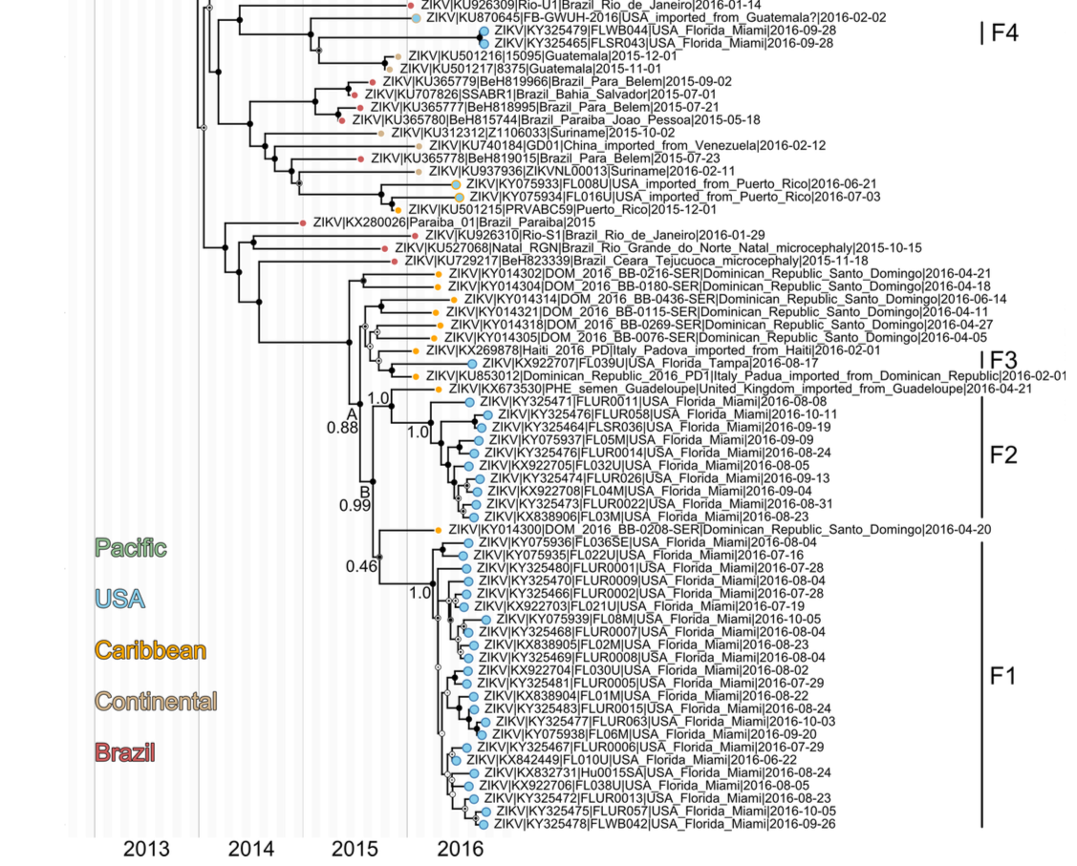
Four distinct ZIKV introductions in FL

Slide 6
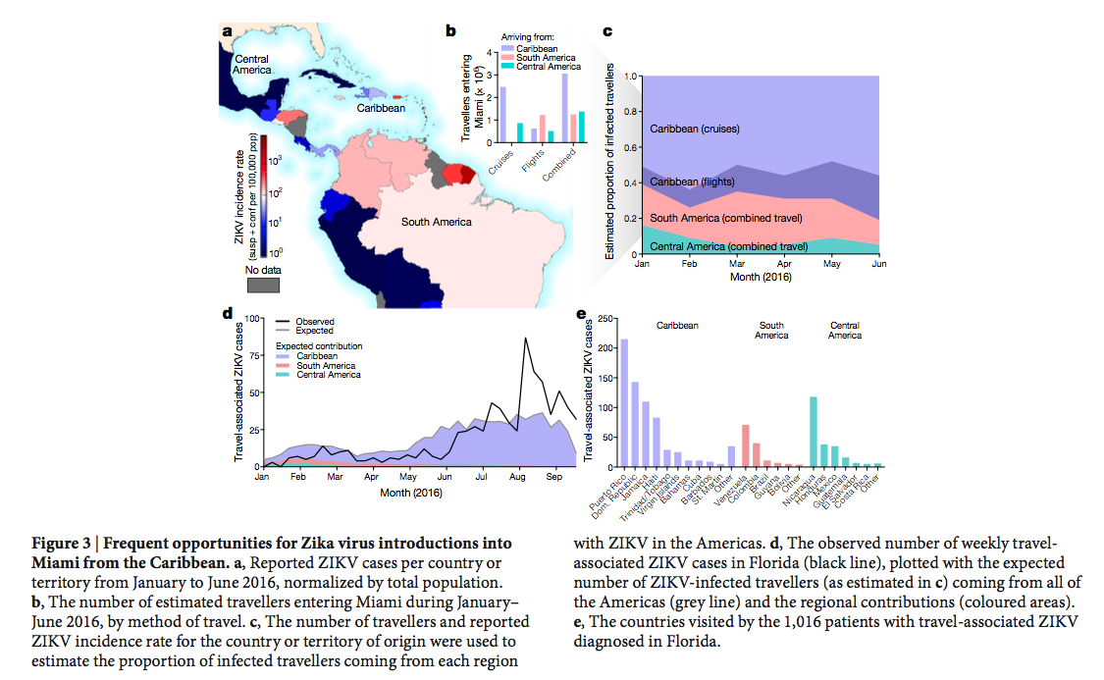
Frequent opportunities for Zika virus introductions into Miami from the Caribbean

Slide 7
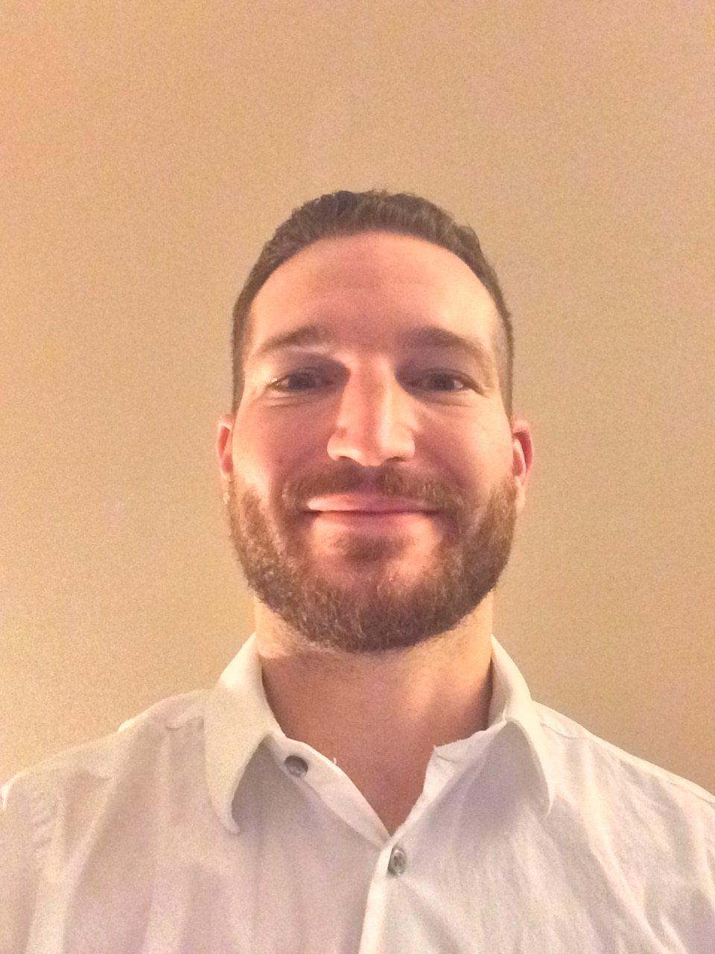
Diagnostics: The Z-Quick Test
Michael Ricciardi

Slide 8
Summary
We have isolated several hundred mAbs from ZIKV-infected patients in São Paulo
One of these mAbs seems particularly effective in diagnosis of prior ZIKV exposure

Slide 9
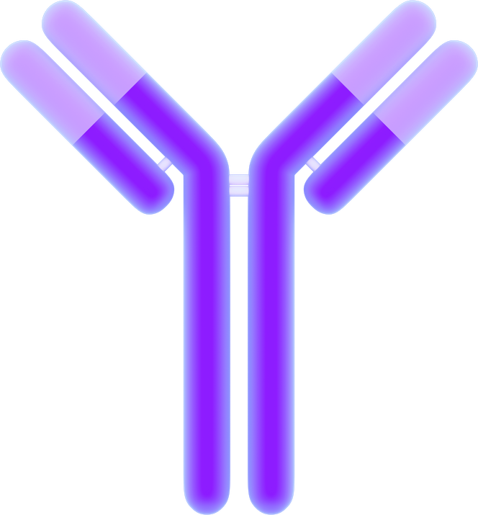
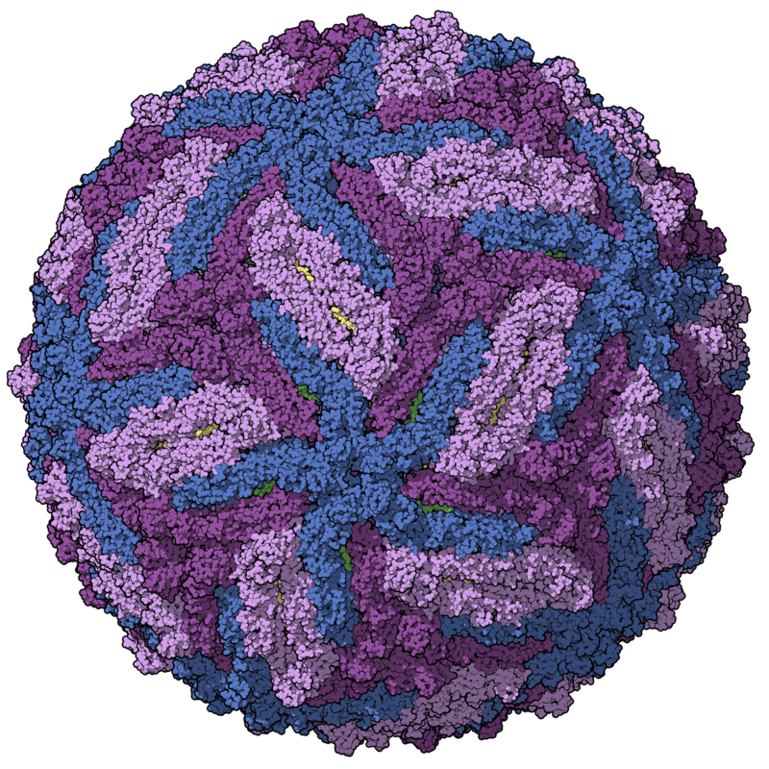
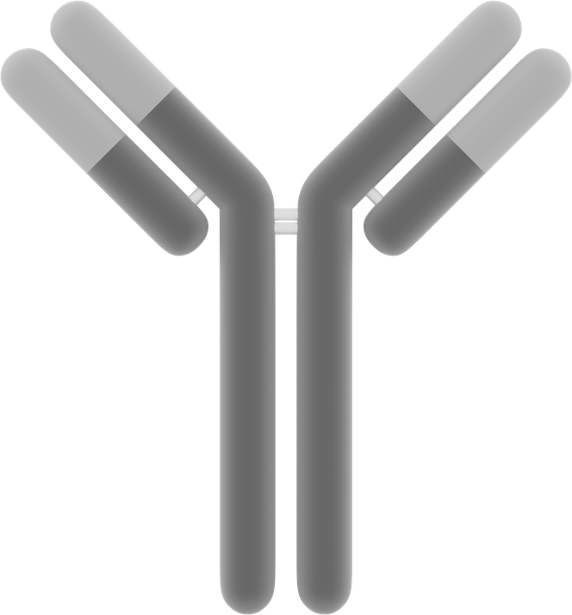
ZIKV- Plasma will react and turn blue
ZIKV+ Plasma will not react or change color
HRP
ZIKV-specific
P1F12 mAb
w/ rhesus Fc
anti-rhesus Fc mAb
P1F12 Binding Site
Human polyclonal
Abs in plasma
bind many sites
Human polyclonal
Abs in plasma
bind many sites
ZIKV
ZIKV
Broad flavivirus epitope
Broad flavivirus epitope
Anti-flavivirus mAb
Anti-flavivirus mAb

Slide 10
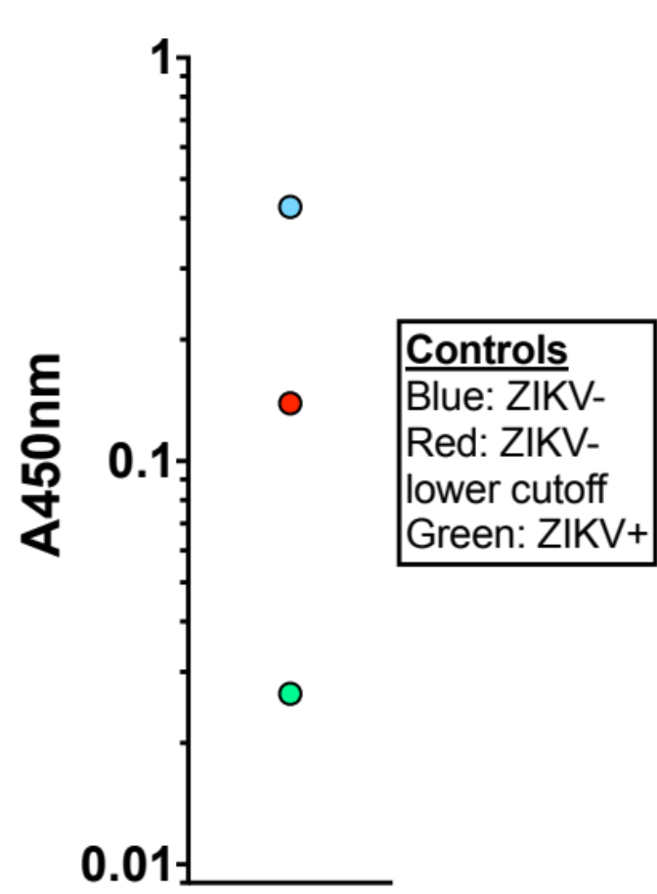
Human Plasma Controls
Hu0002 – blue
  DENV- and ZIKV-
  Local Miami resident
Hu0016 – red
  DENV neutralization activity
  Low ZIKV neutralization activity
Hu0004 – green
  Confirmed ZIKV infection, with previous DENV exposure
    Neutralizes DENV ~60% at 1:1,000
    Neutralizes ZIKV ~90% at 1:1,000

Slide 11
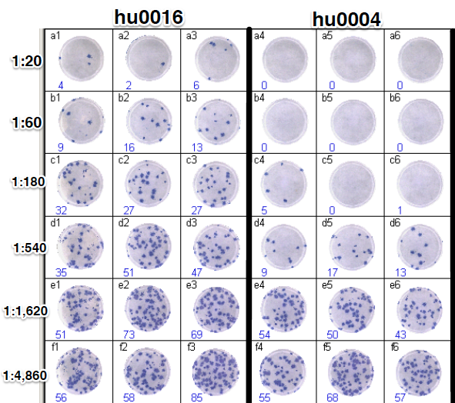

Human Plasma Controls
FRNT against ZIKV
Hu0002
  FRNT
    ZIKV < 1:20
    DENV2 < 1:20
Hu0016
  FRNT
    ZIKV ~ 1:100
    DENV2 ~ 1:500
Hu0004
  FRNT
    ZIKV ~ 1:500
    DENV2 ~ 1:500
hu0002

Slide 12
NIH VRC 51 blinded sera samples

Slide 13
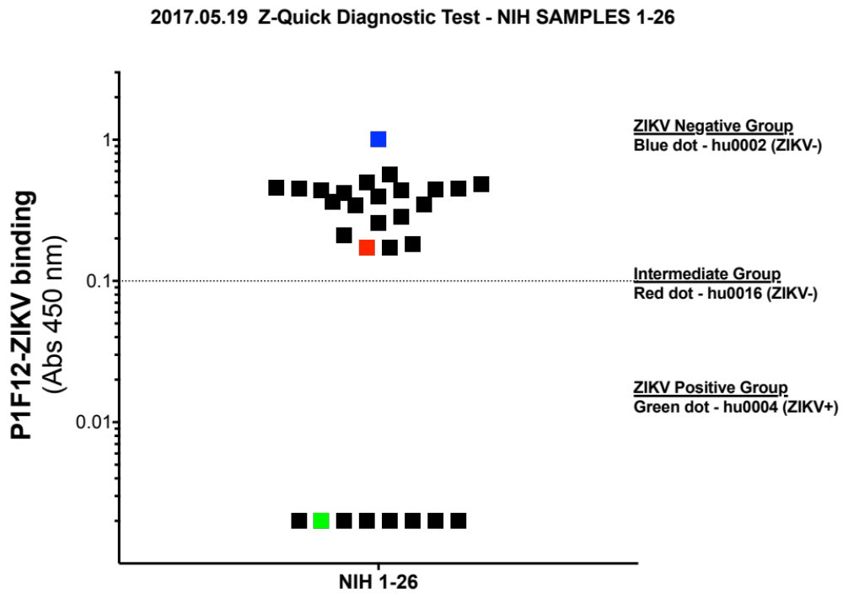
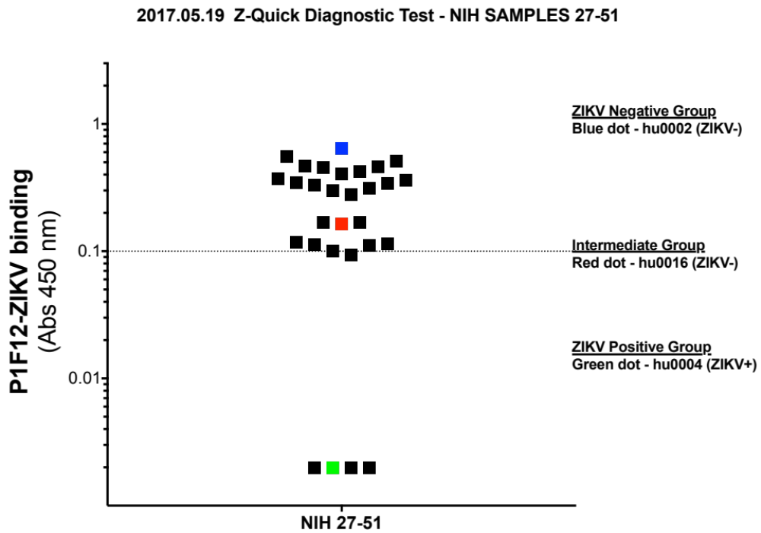
Z-Quick Results

Slide 14
Summary of NIH samples
Correctly predicted the 9 ZIKV+ samples out of the group
  9 samples were PCR+ confirmed
  As early as D24, as late as D138 POS
  9 had prior confirmed DENV infection
  2/9 samples had YF vaccination
All P1F12 positive samples were confirmed with FRNT against DENV and ZIKV
  1 sample was P1F12 positive and the FRNT for ZIKV was negative and therefore removed
  This sample previously had DENV and WNV
42 negative samples:
6 samples were WNV+
8 samples were DENV+
4 samples had YFV vaccination
3 samples had JEV vaccination
1 sample had a DENV vaccine
16 samples were vaccinated with a ZIKV-DNA vaccine

Slide 15
Seroprevalence study in Miami
265 samples tested so far from downtown Miami area (near CDC defined outbreak zone)

Slide 16
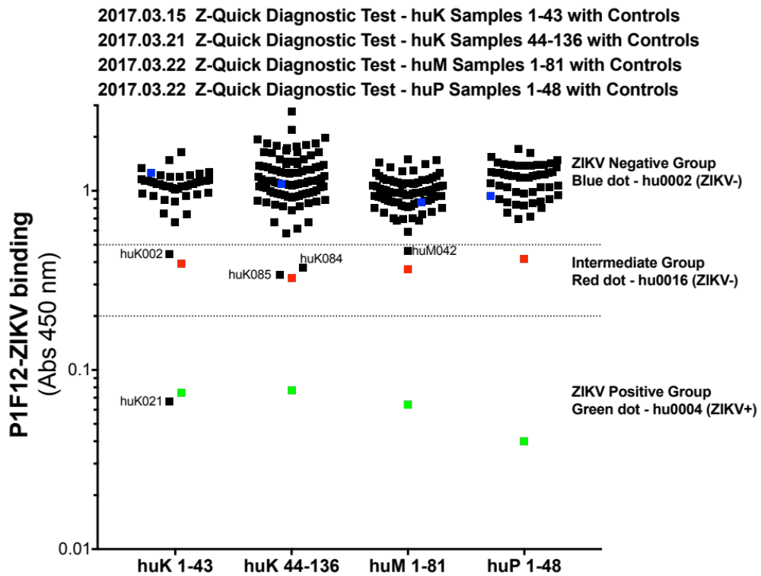

Slide 17
Summary of Miami Seroprevalence Data
265 plasma samples from people in downtown Miami
Run in duplicate in the P1F12 test
The single positive P1F12 sample (huk021) neutralized ZIKV
  had traveled to ZIKV endemic areas in Brazil during the 2015 outbreak but was never diagnosed with ZIKV
  had symptoms that were consistent with Zika
All intermediate P1F12 samples (huK002, huK084, huK085, and huM042) did not neutralize ZIKV in an FRNT at titers greater than 1:180
Several selected negative P1F12 samples also did not neutralize ZIKV in an FRNT

Slide 18
Blinded samples from Brazil

Slide 19
Sample List - Brazil
48 Zika PCR+ samples
  15/48 previously reported DENV infection
  5/48 previously reported YF vaccine
14 DENV PCR+ samples
4 DENV / ZIKV PCR- samples
4 Yellow Fever vaccinee samples, collected 1yr+ before Zika outbreak

Slide 20
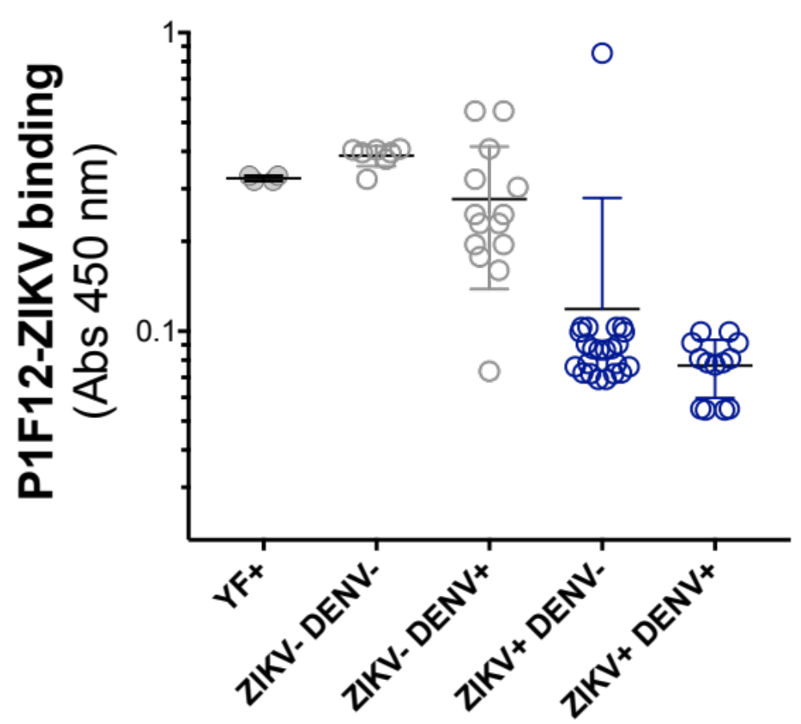

Slide 21
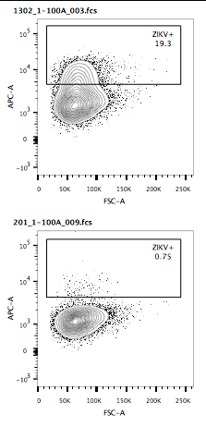
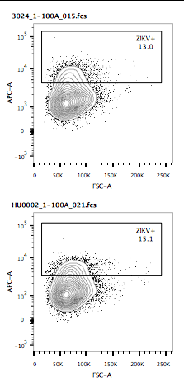
2 Anomalous Samples
Confirmation of P1F12 results with neutralization assay using hu0002 plasma as a control for Zika infection
Sample 1302
    Supposed ZIKV+ based on PCR in Brazil, no history of DENV
    Negative twice for Zika abs in P1F12 assay
    No neutralization of Zika at 1:100 dilution of plasma
Sample 201
  Supposed ZIKV- DENV- sample
  Positive twice for Zika abs in P1F12 Assay
  Neutralized Zika at 1:100

Slide 22
Summary of Data
Out of 69 plasma samples from Brazil, run in duplicate in the P1F12 test, we have only had 2 anomalous samples according to the Brazilian key
Upon testing the plasma of the 2 anomalous samples for neutralization capability against ZIKV, the neut data supports the claims made by the P1F12 test
  Sample 201 was DENV1 positive with symptoms, ZIKV PCR will be re-run
  Sample 1302 will have PCR re-run on acute phase for both DENV and ZIKV
Need to re-test the neuts using dilutions of the anomalous sera and investigate the original PCR data performed in Brazil

Slide 23
Establishing a timeline of P1F12 blocking

Slide 24
Miami Zika Cohort
IRB approved study to investigate the immune response to Zika
Currently 49 enrolled
Approved to collect blood, saliva, urine, and seminal fluid from study subjects
We can collect samples up to 24 times from each subject
Uses:
  Isolation of virus
  Study the B and T cell responses to Zika
  Isolation of antibodies for use in diagnostics and treatment
  Better understand the clinical symptoms associated with Zika
Currently enrolling:
  If volunteers are found, please contact Mike at: mricciardi@med.miami.edu

Slide 25
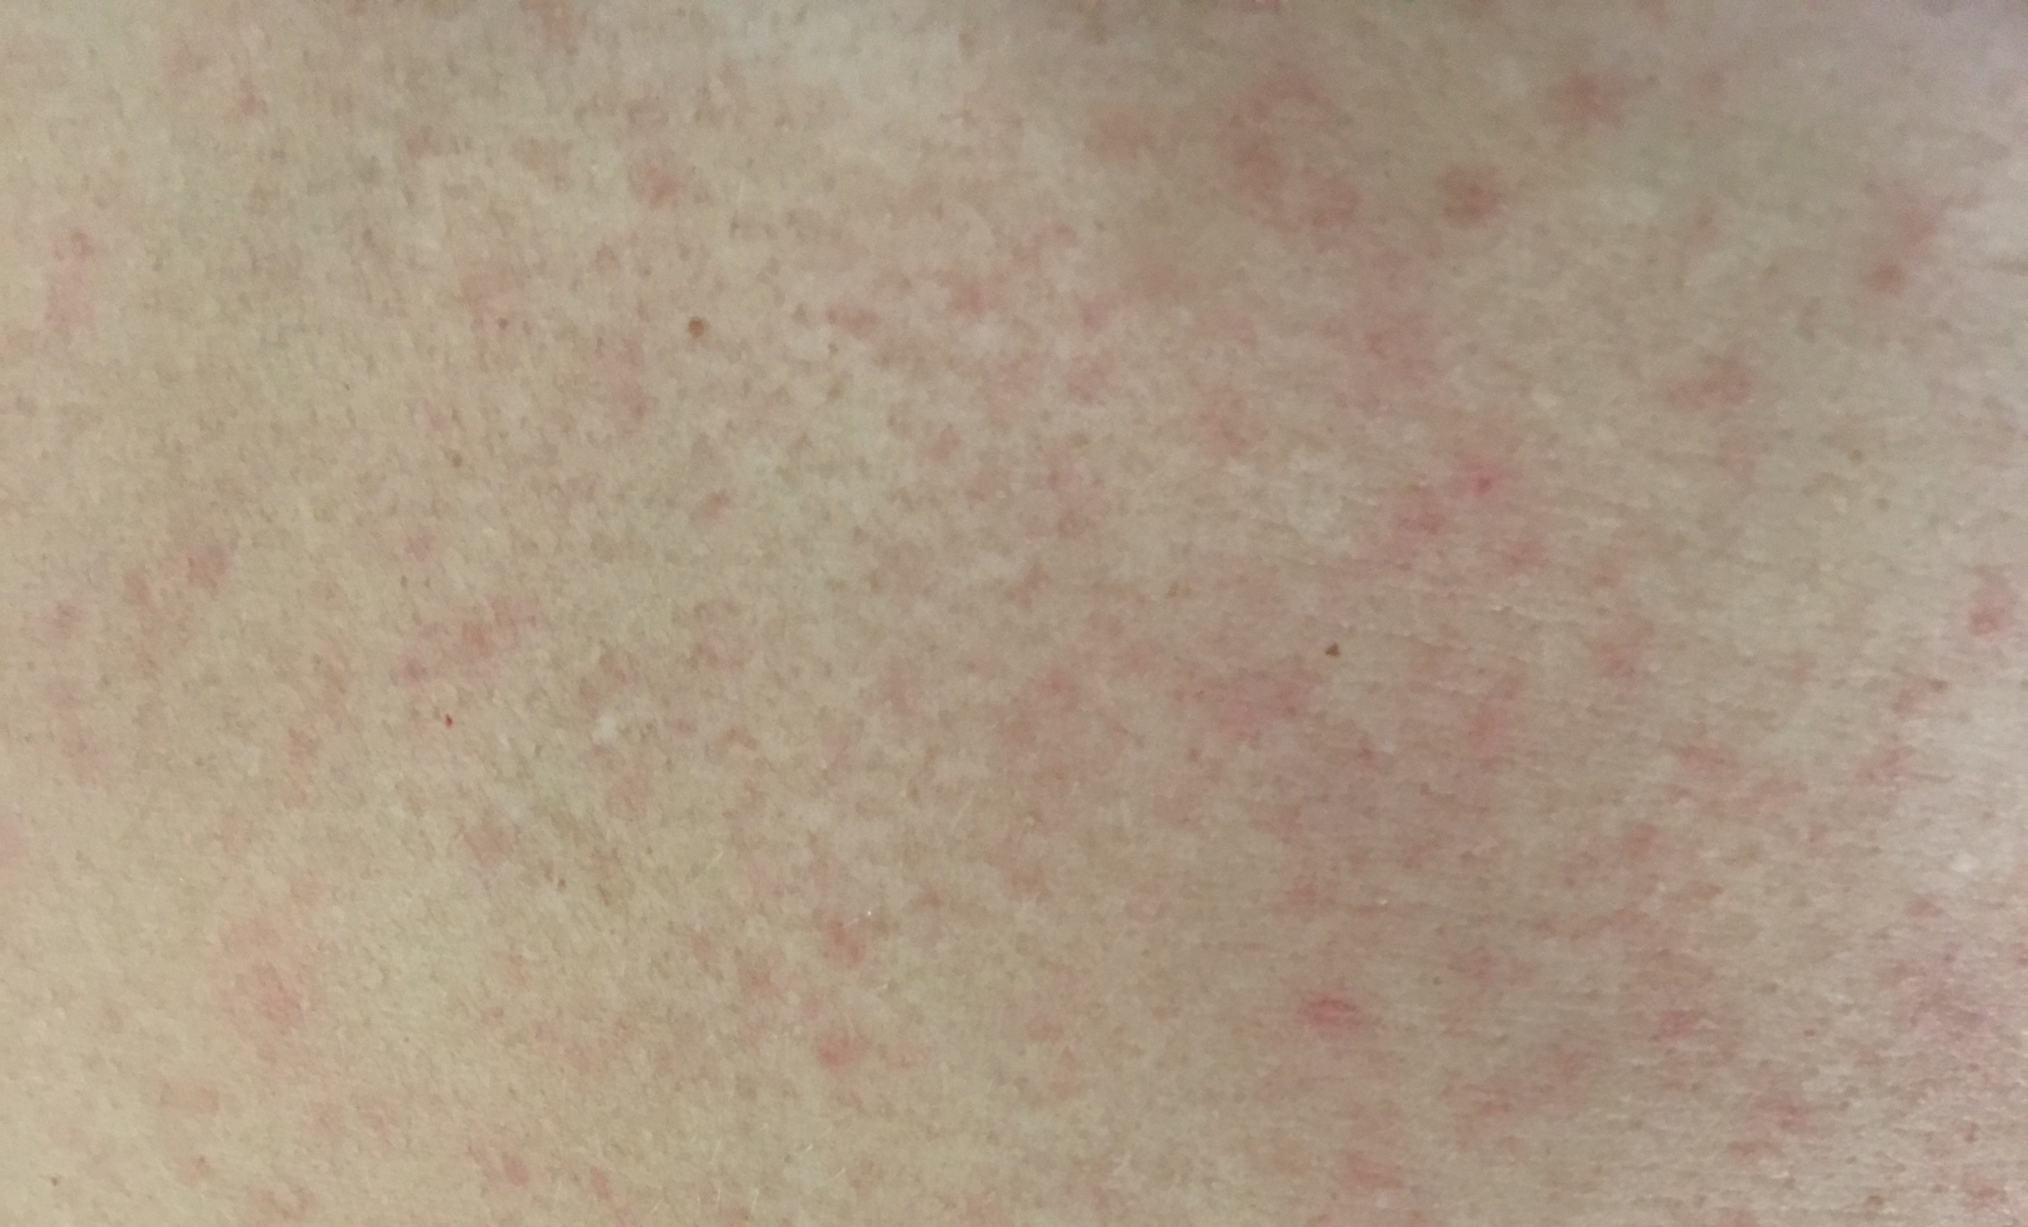
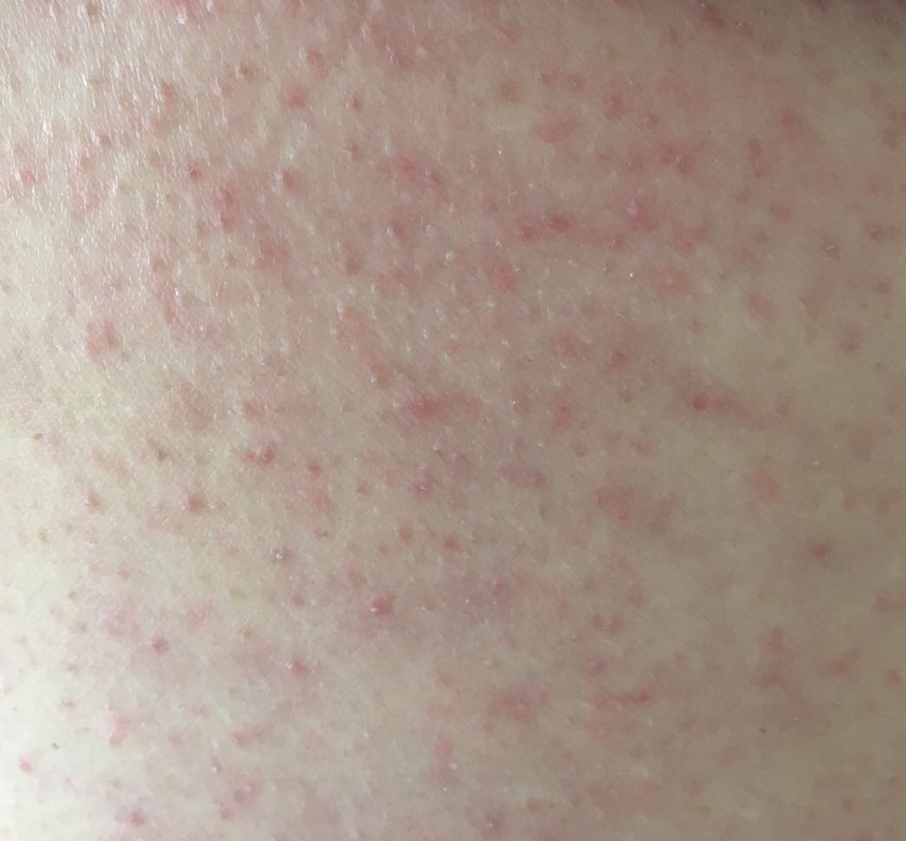
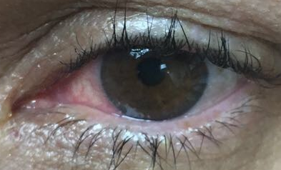
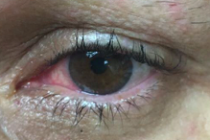
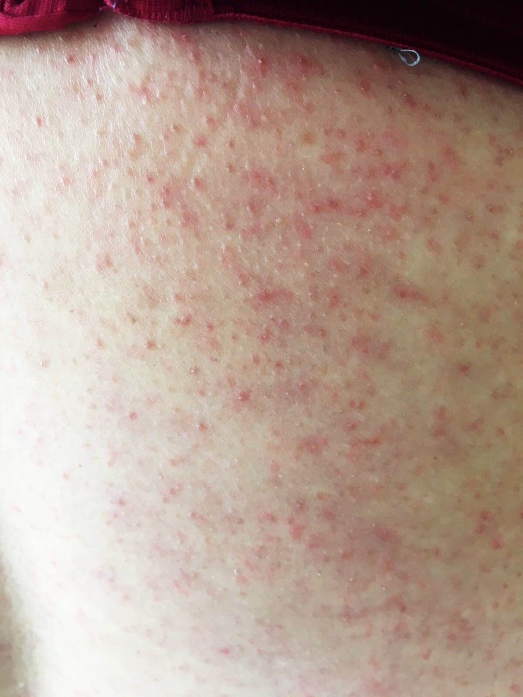
Miami Acute Phase Zika Patients hu0015 & 46
Hu0015 Rash of the torso
Hu0015 Case Details:
  32 year old female, living in the Brickell neighborhood of Miami
  No history of travel outside the US in the past 6 months
  No history of prior dengue infection or yellow fever vaccination
  August 18th 2016, patient woke up with a mild febrile illness including joint pain
    Day 0 of symptoms
  Sampled weekly for 5 months
Hu0046 Case Details:
  64 year old female, living in the downtown neighborhood of Miami
  No history of prior dengue infection or yellow fever vaccination
  April 16th 2017, patient returned from Cuba while on vacation
  April 18th, woke up with a mild febrile illness including severe joint pain, maculopapular rash, and unilateral conjunctivitis
    Day 0 of symptoms
  Sampled throughout acute phase
Hu0046 Conjunctivitis and rash of the torso

Slide 26
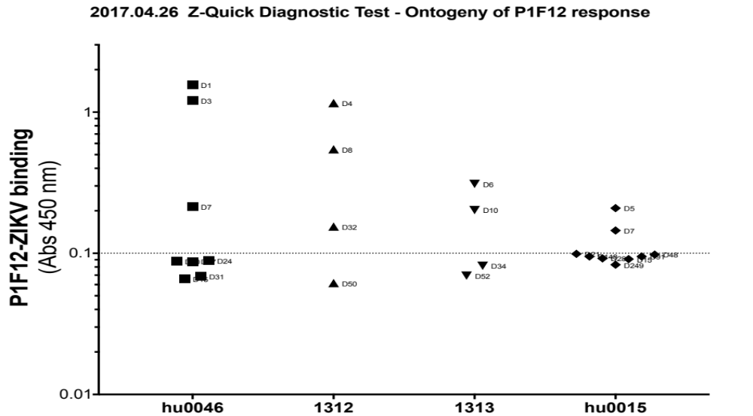



P1F12 Blocking Present after Day 14 POS

Slide 27

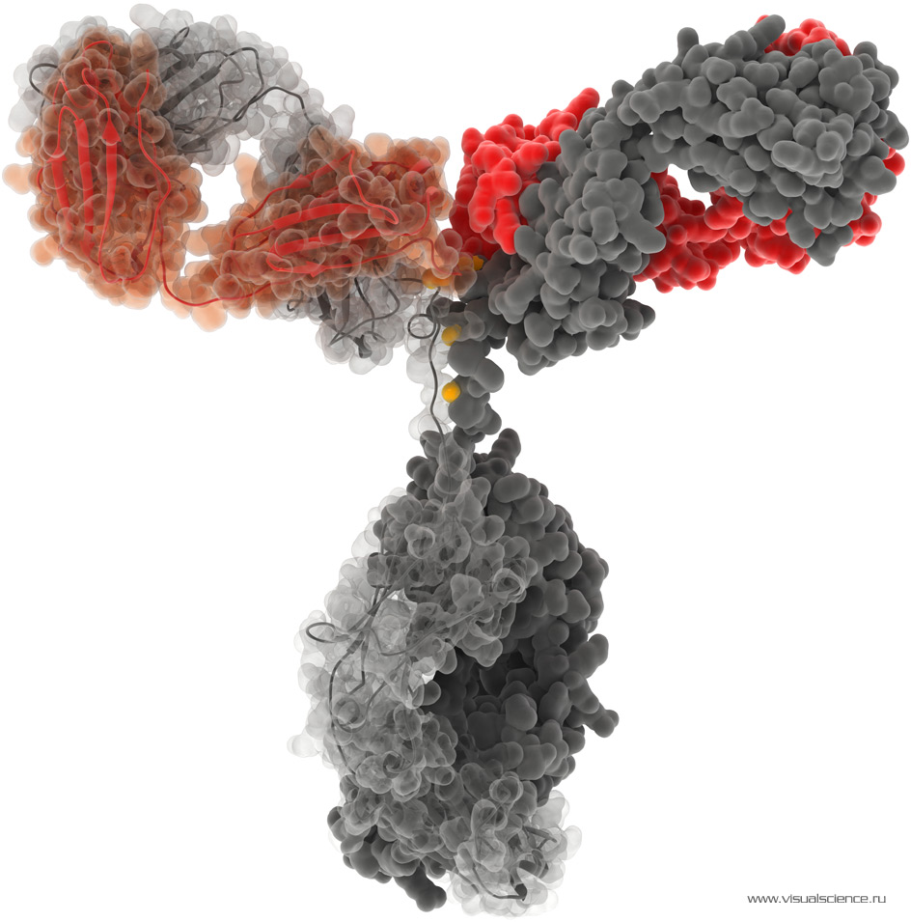
Nonhuman primate models for
ZIKV
Diogo Magnani, PhD
Assistant Scientist
Notes:
-
http://3.bp.blogspot.com/_Pxj7c3m549I/TKYrO9b3PUI/AAAAAAAAAR8/fZS4NGfSlNE/s1600/immunoglobulin-IgG-molecula.jpg

Slide 28

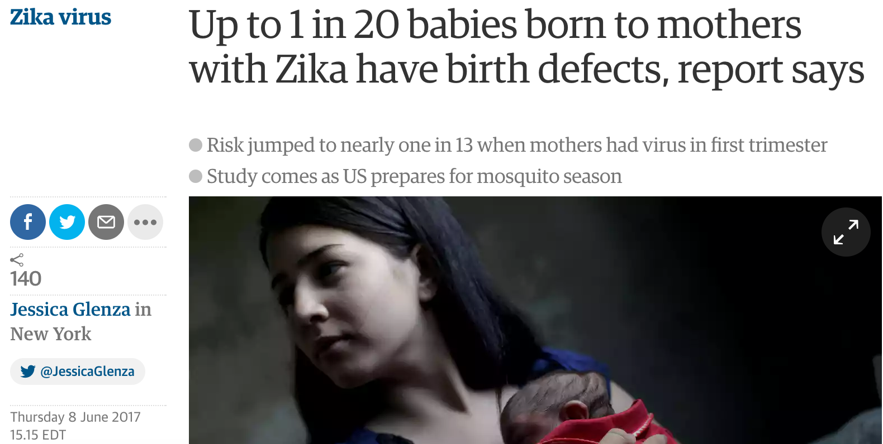

Slide 29
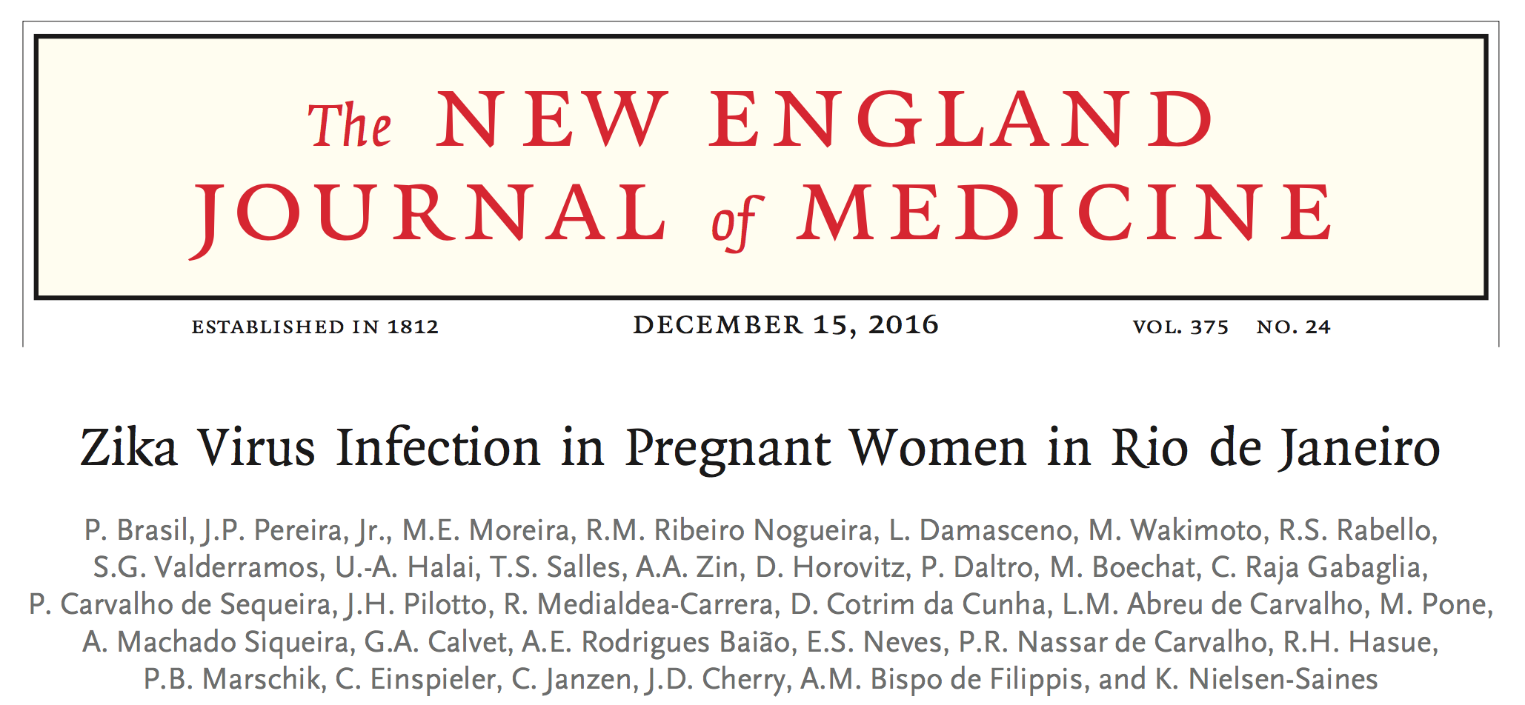

Slide 30
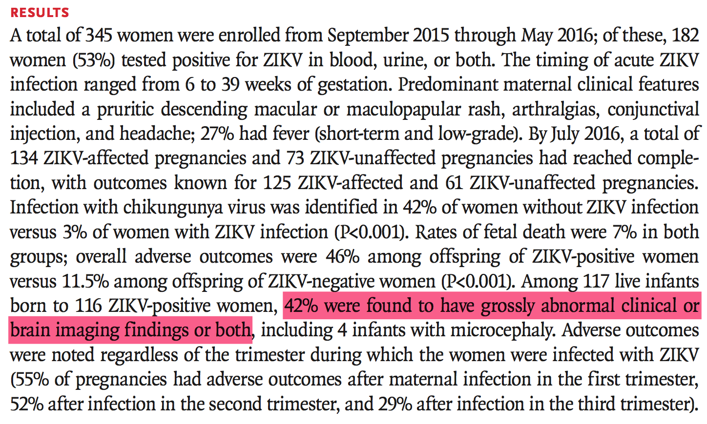

Slide 31
ZIKV Rio U-1 / 2016
Bonaldo, M. C., et al. (2016). Isolation of Infective Zika Virus from Urine and Saliva of Patients in Brazil. PLoS Neglected Tropical Diseases
Urine from nine patients (collection from January 14th to February 2nd 2016) from Rio de Janeiro presenting rash and other typical Zika acute phase symptoms were inoculated in Vero cell cultures.
The urine sample of patient 1 (pregnant, in the 18th week of gestation) had cytopathic effect detected at 4th day of post-inoculation (1 out of 9 patients tested); Viral load of 2.68 x 10³ RNA copies per ml of urine.
’We communicated our data before the Carnival in Brazil (from February 6th to 10th), because we were very concerned about the risk of pregnant women to be exposed to ZIKV in an event involving crowds.’

Slide 32
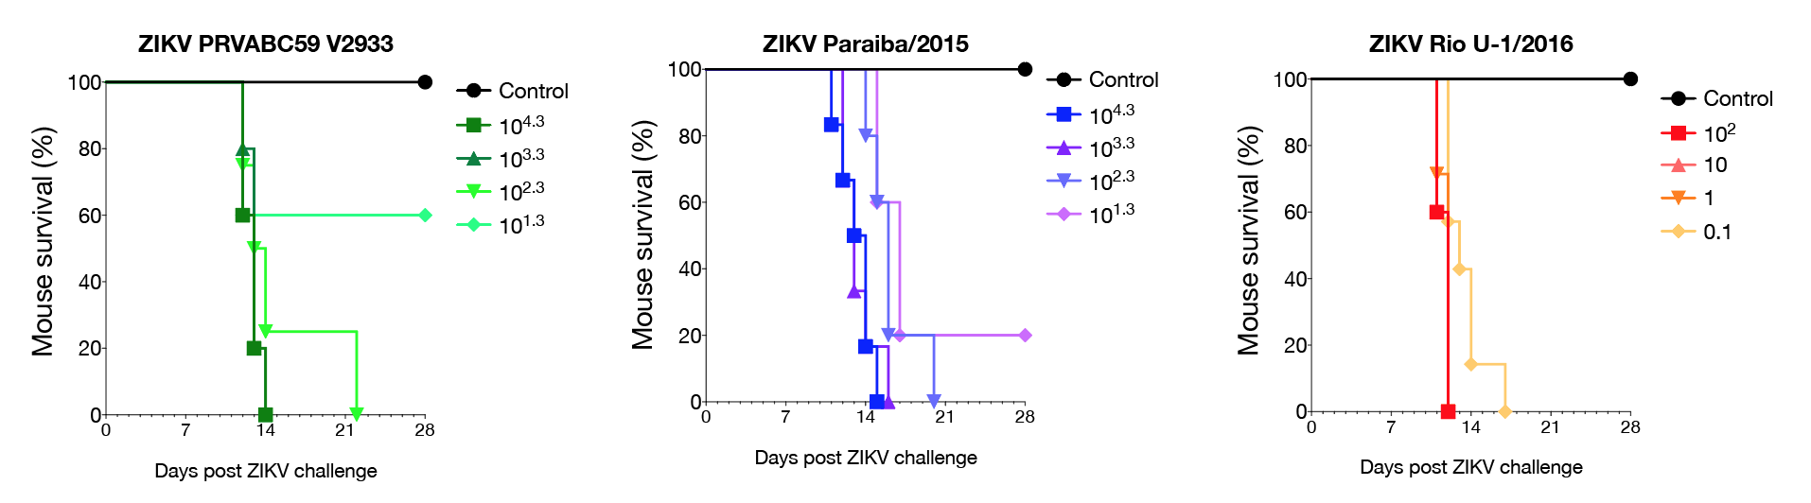
ZIKV Rio U-1 / 2016 is lethal to mice at low challenge doses
Justin Julander (manuscript submitted)

Slide 33
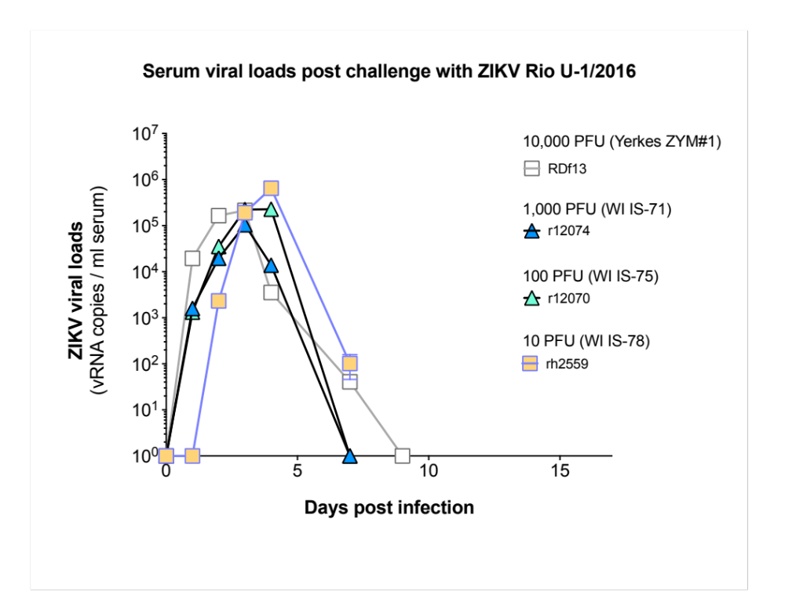
Serum viral loads post challenge with ZIKV Rio U-1/2016

Slide 34
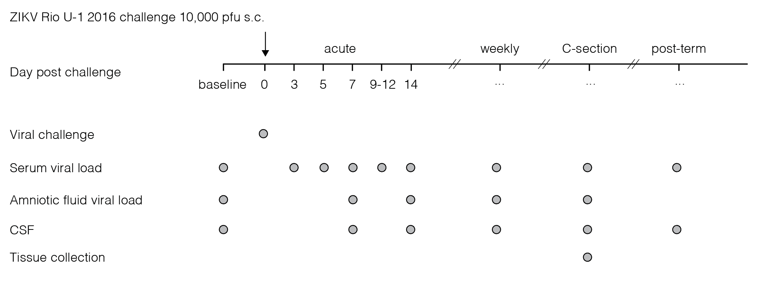
ZIKV infection of pregnant macaques

Slide 35
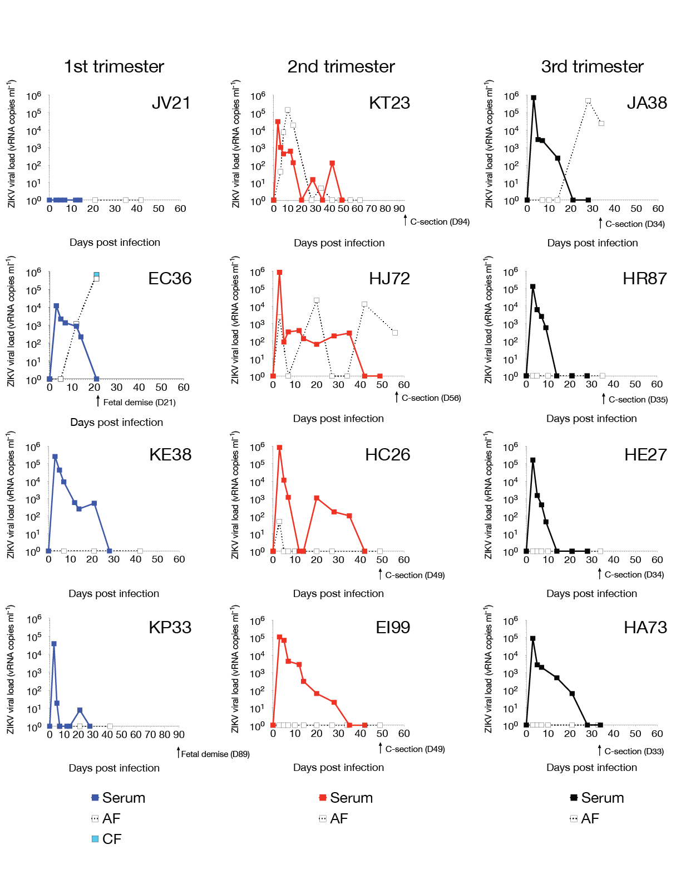
ZIKV infection of pregnant macaques
Third trimester pregnant rhesus macaques

Slide 36
ZIKV infection of pregnant macaques
Second trimester pregnant rhesus macaques

Slide 37
ZIKV infection of pregnant macaques
First trimester pregnant rhesus macaques

Slide 38
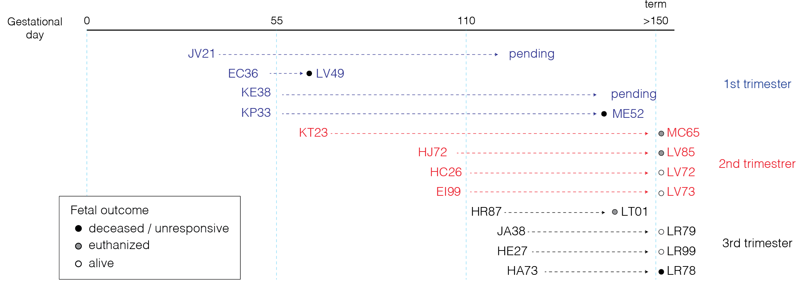
ZIKV infection of pregnant macaques

Slide 39
LR78 neonate rhesus macaque from ZIKV+ mother
The First C-section (HA73 D34 post infection)
The infant (LR78) was not responsive immediately after delivery.
The CSF and urine were slightly cloudy, suggested bacterial cultures to rule out any secondary issues. Preliminary results were negative for bacteria.
The meninges of the temporal cortex, cerebellum, and upper pons were extremely hemorrhagic. The choroid plexus was dark red with old clotted blood and appeared to have been present for several days or even weeks. 10 sections of brain plus cerebellum, brainstem, and spinal cord will have histopathology performed along with a complete set of tissues.
All other organs appeared grossly normal.
ZIKV was undetectable by qPCR in Brain, CSF, Urine, Cord-blood, Umbilical cord, Placental tissues.
The second C-section (JA38 D35 post infection)
The infant (LR79) was responsive. This infant was re-challenged with ZIKV infection around 6 months after birth.

Slide 40
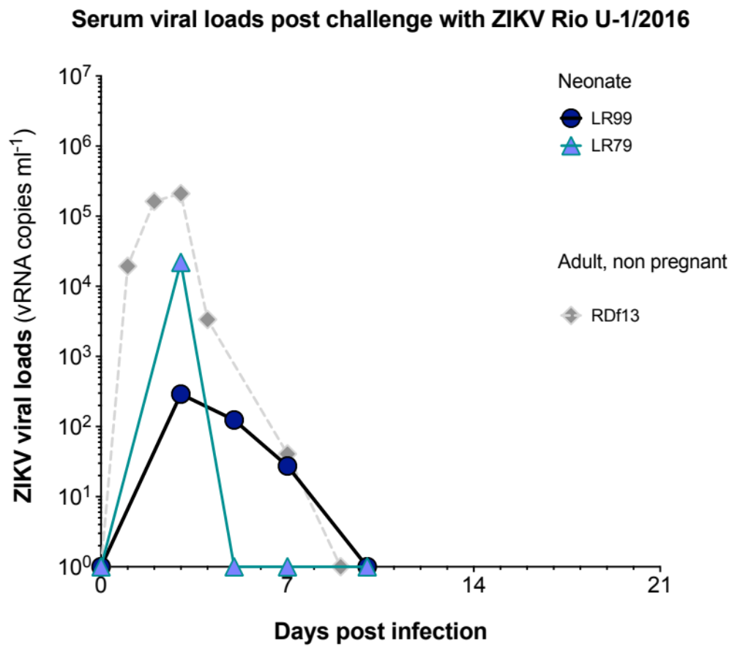
Infant macaques (from ZIKV+ mothers) have low viral loads

Slide 41
Two of three first-trimester infected mothers with ZIKV replication experienced fetal demise
At the time of LV49 demise (21 days post infection), ZIKV was present in the AF and chorionic fluid (CF) (>10⁵ copies ml⁻¹).
ME52 was aborted at day 89 post challenge, on gestation day 138.

Slide 42
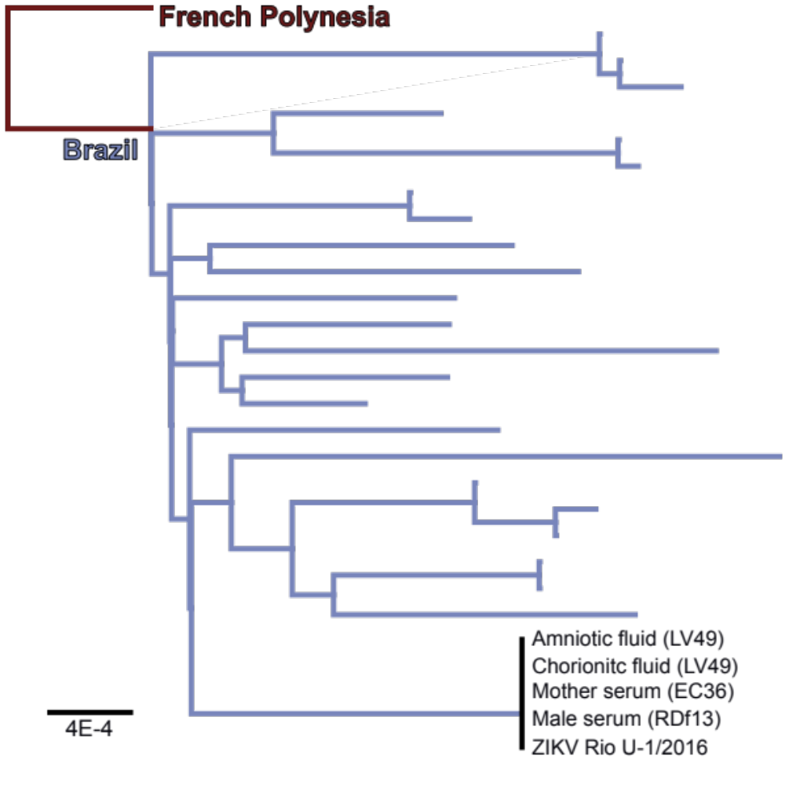
De novo mutations are not required for fetal transmission and demise
A maximum likelihood phyologenetic tree was constructed with ZIKV genomes from Brazil to demonstrate that the consensus sequence of ZIKV strain Rio-U1/2016 remained unchanged during acute infection of a male (RDf13) and pregnant female (EC36) rhesus macaque and vertical transmission the dam (EC36) to her fetus (LV49, deceased at time of delivery).

Slide 43
Summary
Four first trimester pregnant animals challenged with our highly pathogenic Rio-1 primary ZIKV isolate, three showed viral replication in the sera of the dam.
Of the three first trimester dams infected with ZIKV, one fetus is still in utero and TWO dams have lost their fetuses.
Sequences of our primary isolate stock, the dam’s replicating virus and the virus found in the fetus that died in utero appeared to be identical. This suggests that the virus does not need to change to cause fetal demise.
KP21 resisted infection-we are investigating.
Our results from this macaque cohort study are very similar to those from the human study carried out in Rio de Janeiro where 42% of ZIKV-infected pregnant women experienced fetal complications (Brasil et al., NEJM, 2016).

Slide 44
Anti-ZIKV antibody therapies
Diogo Magnani, PhD
Assistant Scientist
Notes:
-
http://3.bp.blogspot.com/_Pxj7c3m549I/TKYrO9b3PUI/AAAAAAAAAR8/fZS4NGfSlNE/s1600/immunoglobulin-IgG-molecula.jpg

Slide 45
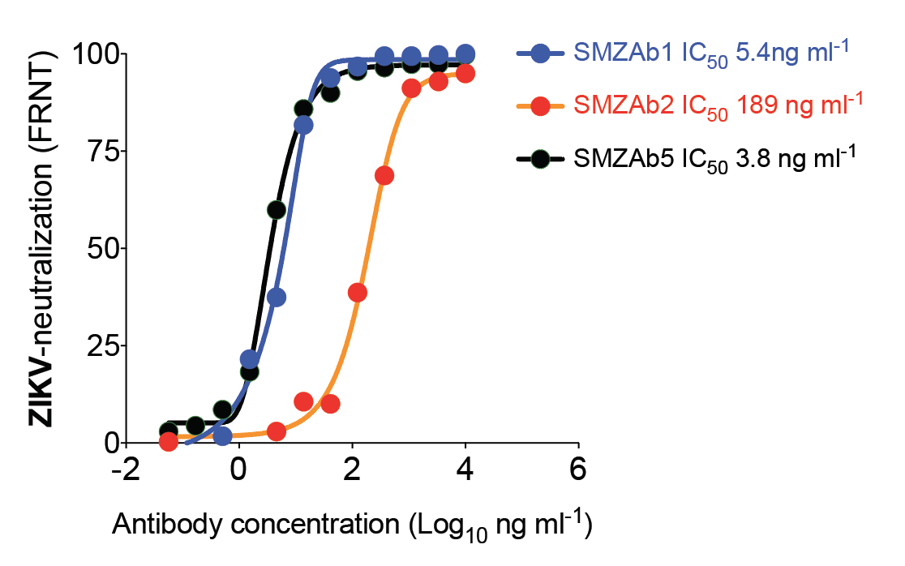
SMZAbs neutralize ZIKV at nanogram concentrations
Thomas Rogers (manuscript submitted)

Slide 46
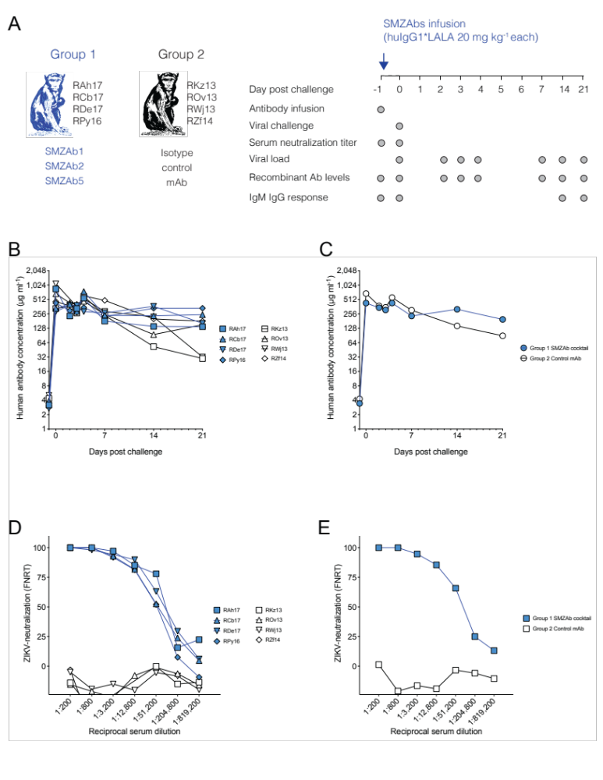
Can passively transferred SMZAbs prevent ZIKV infection?

Slide 47
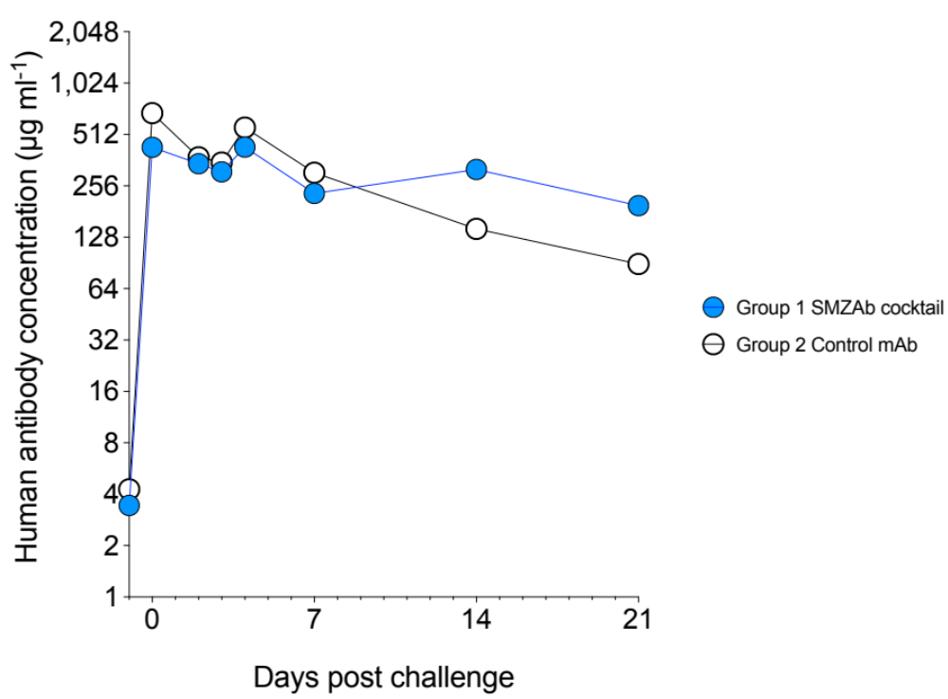
Can passively transferred SMZAbs prevent ZIKV infection?
Antibody concentrations in serum
ZIKV-neutralizing activity in serum at day of challenge

Slide 48
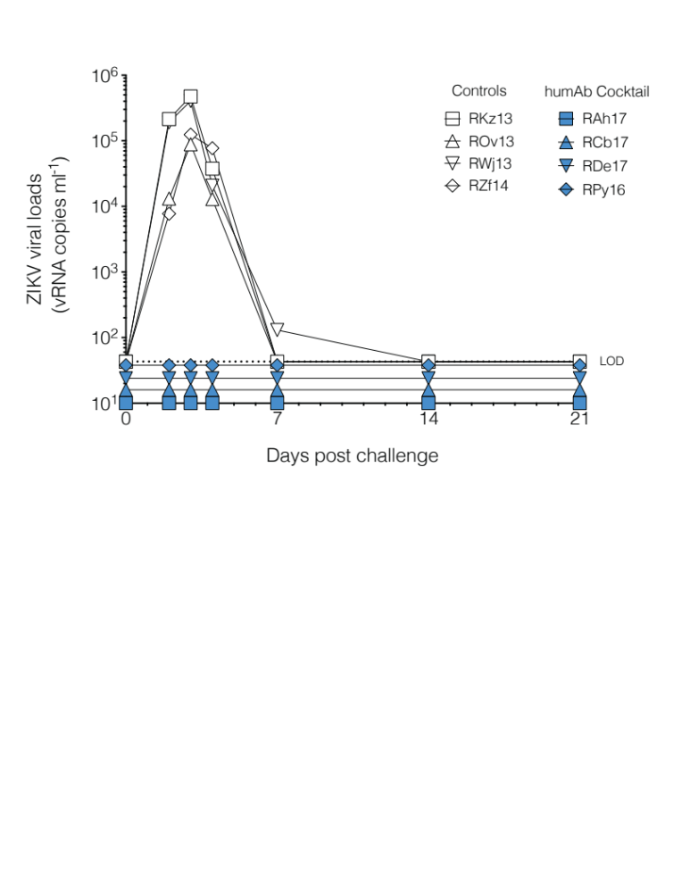
Viral loads post ZIKV Rio U-1 / 2016 challenge

Slide 49
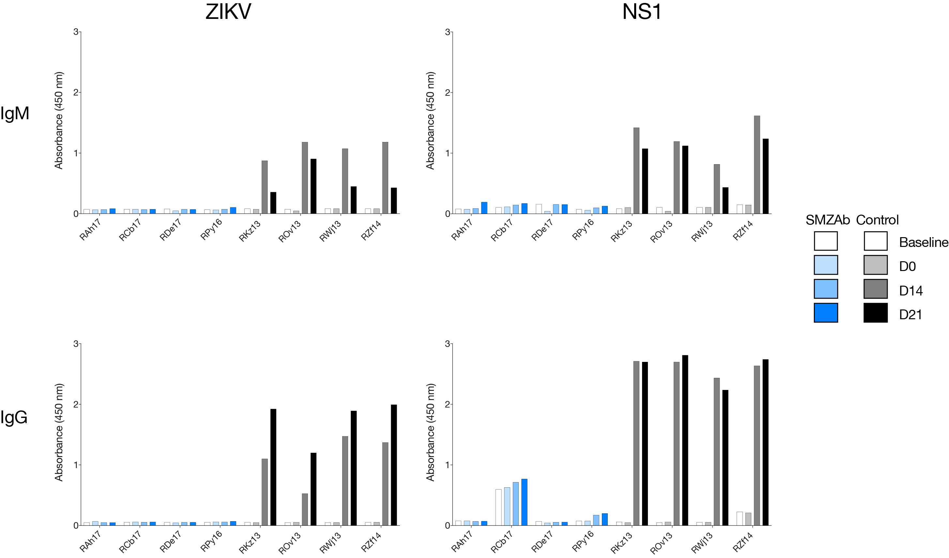
Rhesus humoral responses (IgG) against ZIKV only developed in the control group animals

Slide 50
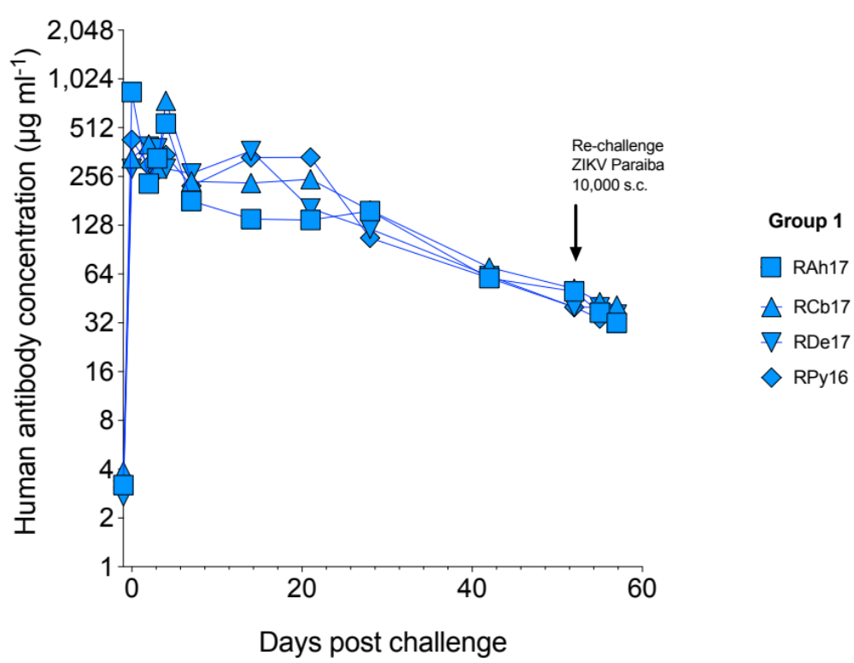
How long will the protection last?

Slide 51
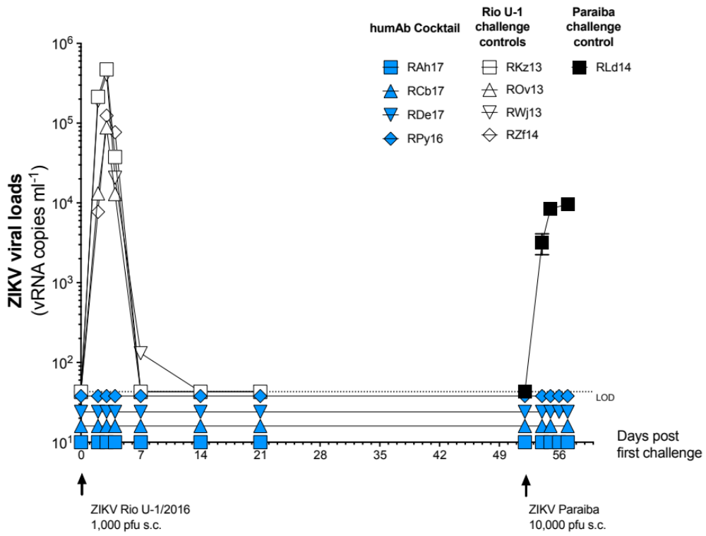
Re-challenge with 10,000 pfu of the ZIKV Paraiba strain

Slide 52
Summary
We treated four macaques with a cocktail of three potent nmAbs and then challenged them with ZIKV one day later.
All four animals showed no sign of ZIKV in their sera as measured by plaque assay or RT-PCR. By contrast, the four control animals treated with an irrelevant isotype control had normal levels of ZIKV replication.
The nmAb-treated macaques did not mount an antibody response against either NS1 or whole ZIKV, suggesting that the nmAb cocktail conferred sterile protection.
We re-challenge with a higher ZIKV dose (10,000 pfu Paraiba strain) at day 53 post antibody administration, and the animals remain uninfected.

Slide 53



Acknowledgements
Scripps
Dennis Burton
Thomas Rogers
Kristian Anderson
Nathan Grubaugh
Tulane
Antonito Panganiban
Nick Maness
Faith Schiro
Ronald Veazey
Pyone Aye
Myrna Bonaldo Fiocruz
Esper Kallas USP
Steve Whitehead NIH
Eva Rakasz UW Madison / WNPRC
Thomas Vanderford Yerkes
Nick Maness Tulane
Ron Desrosiers UM
Paola Lichtenberger UM / ID
Justin Julander USU
NIH 4 P01 AI094420 05
Bill and Melinda Gates Foundation
The Wallace H. Coulter Foundation
The Miami Clinical and Translational Science Institute (CTSI)
Watkins lab
Diogo Magnani
Mike Ricciardi
Varian Bailey
Nuria Pedreño
Lucas Gonzalez
Martin Gutman

